Slide 1

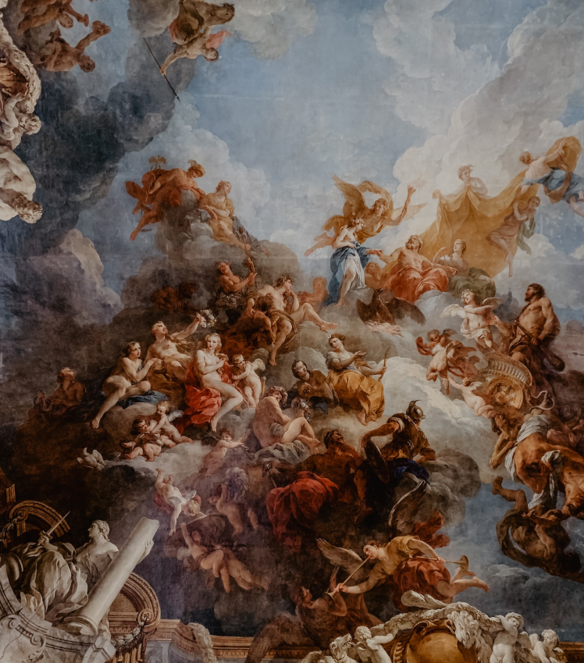
Company Portfolio
FREE PRESENTATION TEMPLATE
May, 2023

Slide 2
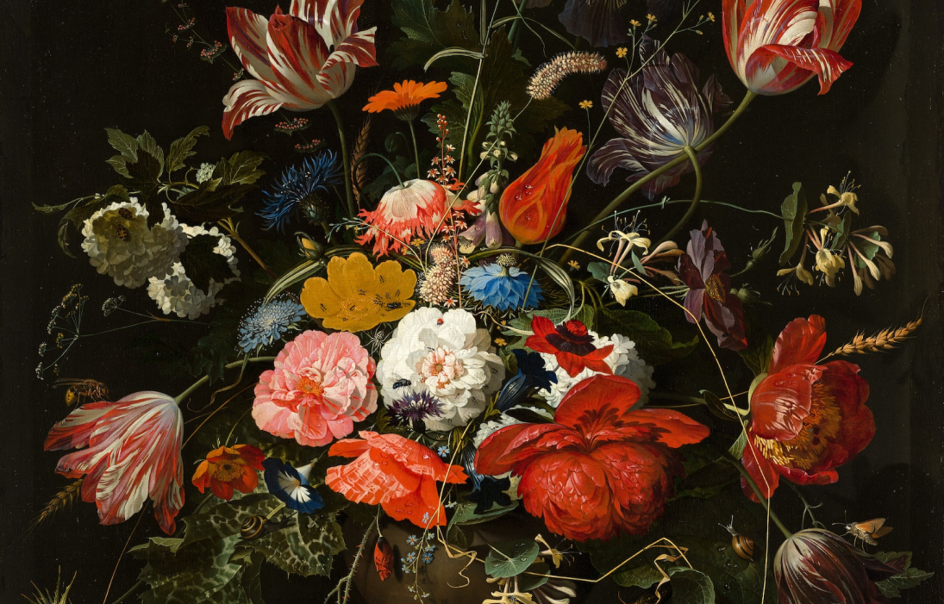
Welcome
Welcome to the world of fantasy! Join us on a journey to explore the mystical creatures, enchanted lands, and magical wonders that exist beyond our reality. Discover the wonders and secrets of this exciting realm and unlock the power of imagination.
May, 2023

Slide 3

Table of Contents
01
Introduction
Encounters
02
The Extraordinary Realm
Unicorn Sightings
03
Wonders
Magic
04
Wishes Granted
Spellcasting
05
Adventure
Conclusion
06
Happily Ever After
Embrace the Fantasy
May, 2023

Slide 4
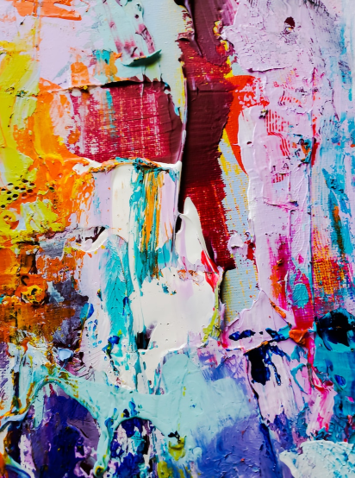
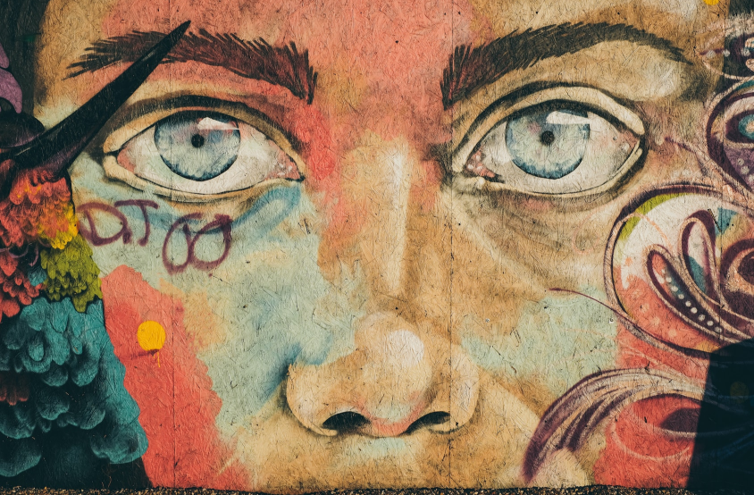
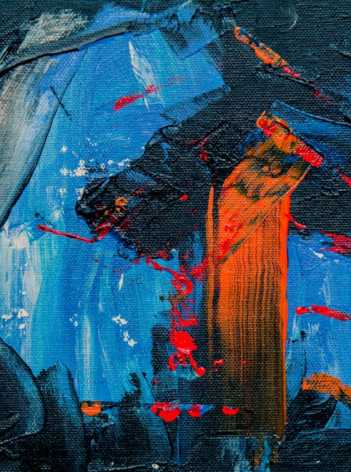
Introduction
The Fantasy Realm: Uncovering the Secrets of the Imagination and the Magic that Lies Within
May, 2023

Slide 5
The Realm of the Extraordinary
Welcome to the Fantasy World, a realm of wonder and enchantment where anything is possible. Here, dragons breathe fire, unicorns prance through meadows, and rainbows shine brightly. This world is a place where wishes come true, where potions can be cursed and spells are cast. It's a place of treasure and adventure, where the impossible becomes possible. But the greatest treasure of all is the one that lies within.
The world of fantasy is a reflection of our deepest desires, our fondest dreams, and our wildest imaginations. It's a place where we can let go of the constraints of reality and explore the boundless possibilities of the human mind. In this introduction, we will delve into the mysteries of this realm, uncovering the magic and wonder that lies within. So come with us and let's embark on a journey through the Fantasy World.
May, 2023

Slide 6
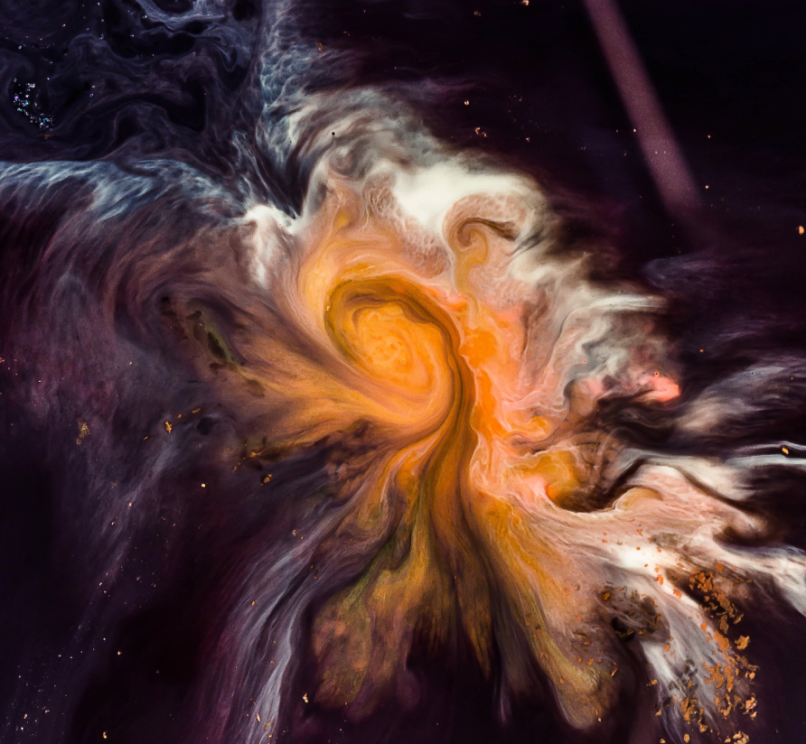



Unicorn Sightings
A record of the number of unicorns spotted in the fantasy realm and the beauty and mystery that surrounds these enchanting creatures.
Dragon Taming
A closer look at the art of taming dragons and the brave adventurers who dare to take on these fearsome creatures.
May, 2023

Slide 7
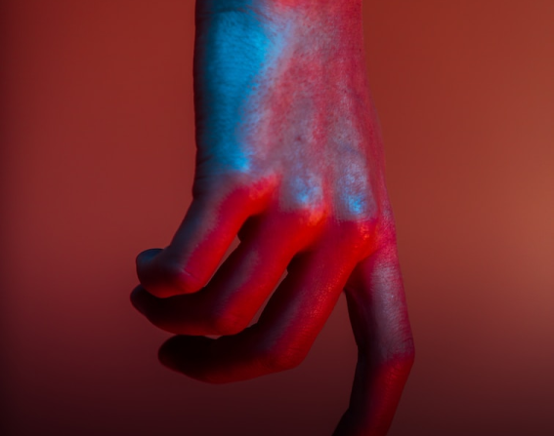
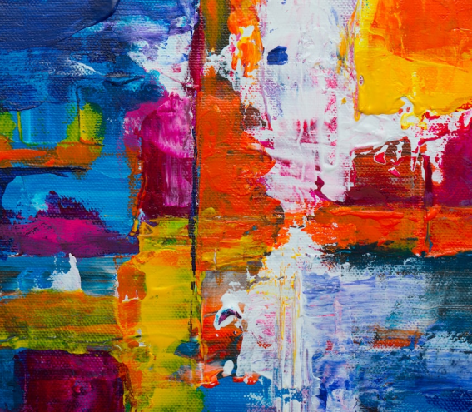
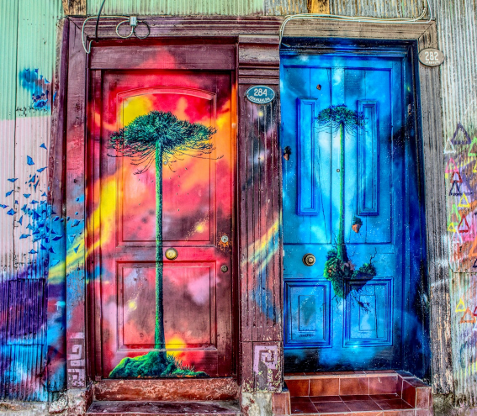
Unicorn Sightings
Unicorn Sightings
A record of the number of unicorns spotted in the fantasy realm and the beauty and mystery.
A record of the number of unicorns spotted in the fantasy realm and the beauty and mystery.
Dragon Taming
A closer look at the art of taming dragons and the brave adventurers who take on these creatures.
May, 2023

Slide 8

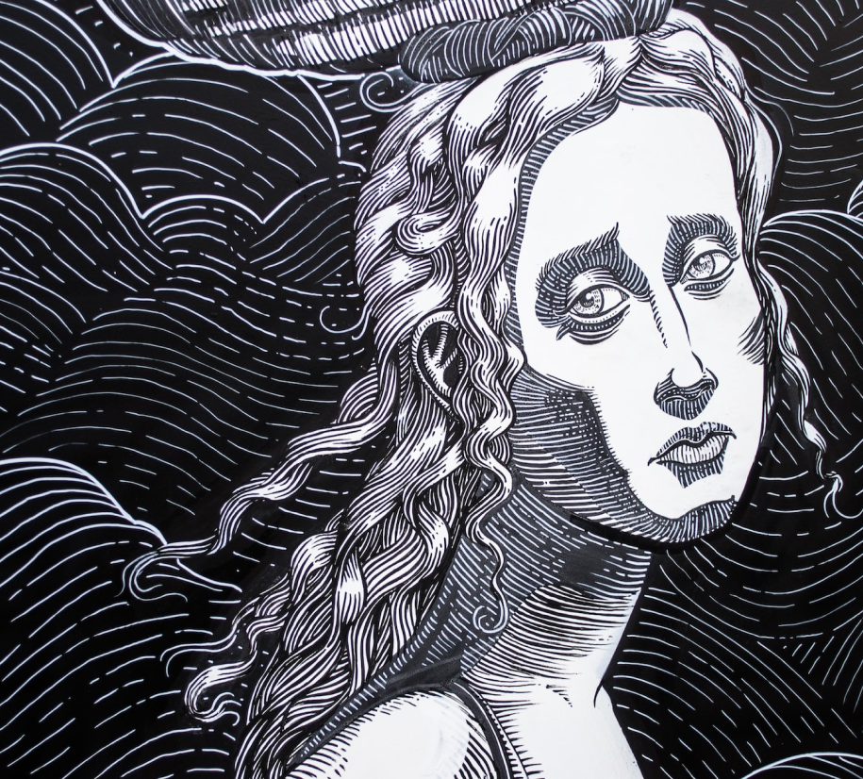
Fantasy is the gateway to the impossible, the land where the ordinary becomes extraordinary, and the impossible becomes possible. It is the realm of the imagination, where anything can happen and everything is possible.
The Dream Weaver
May, 2023

Slide 9
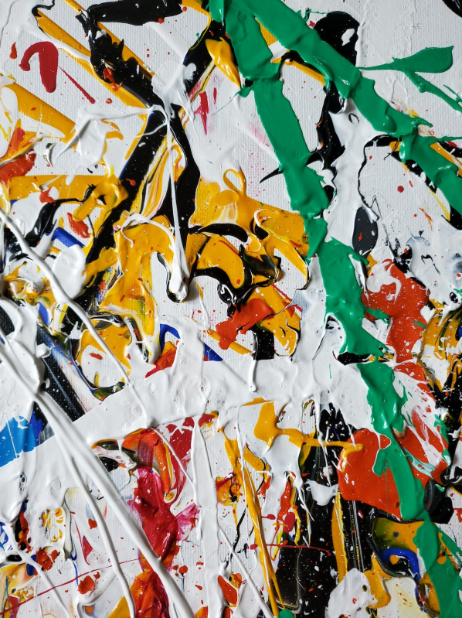
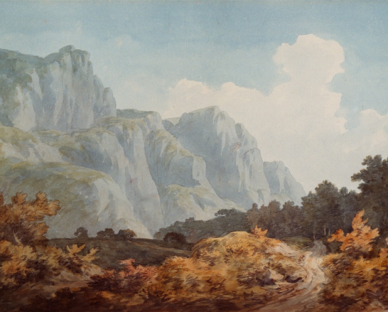
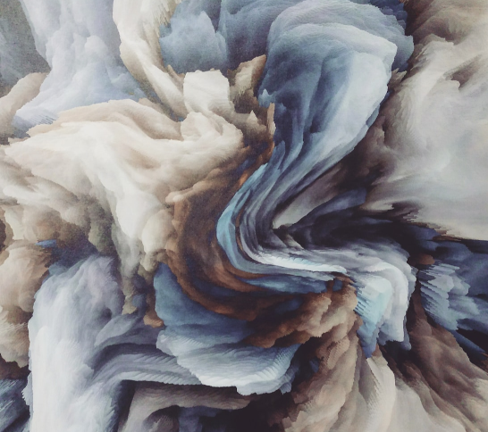
Dragon Taming Technique
A guide to taming and caring for dragons in the realm of magic.
The Art of Unicorn Sighting
Tips and tricks for spotting the elusive unicorns in their natural habitat.
May, 2023

Slide 10
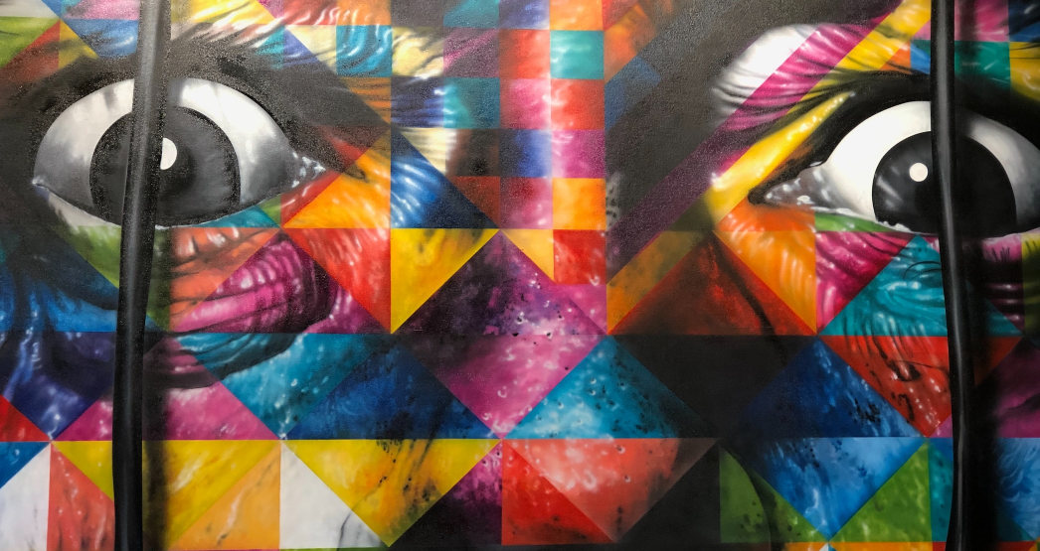
The Magic of Dragons:
A Research
6.7M
4.4M
2.3M
May, 2023

Slide 11
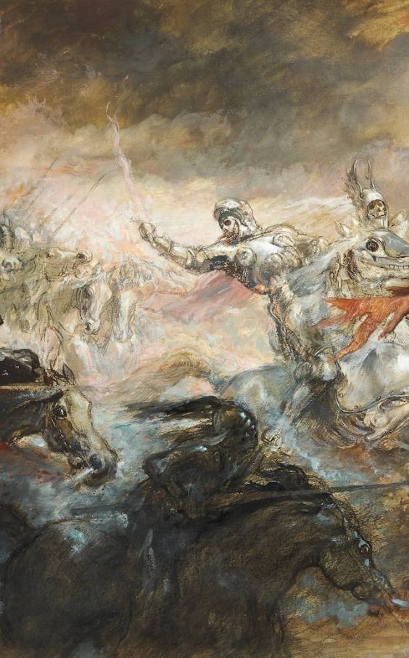
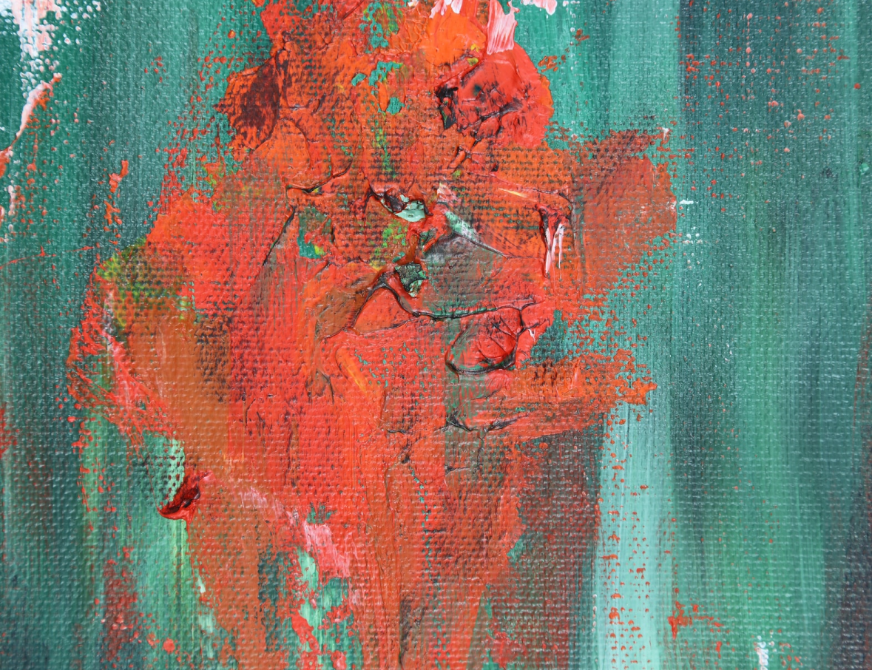
May, 2023

Slide 12
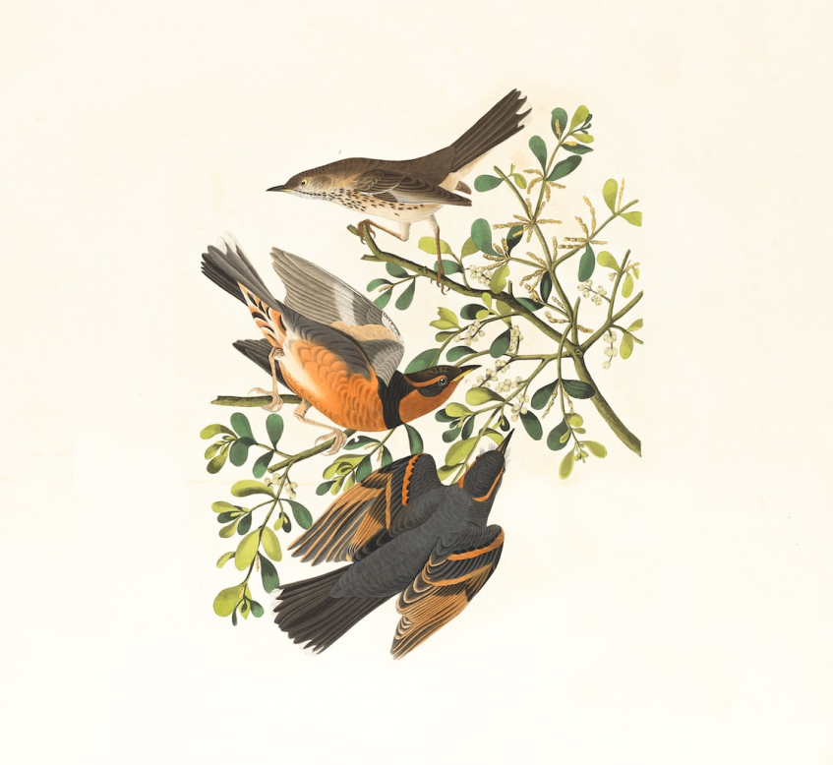
The journey of self-discovery and the exploration of the human imagination are just as important as the creatures and wonders that populate this realm. Here, you can reflect on your deepest desires and fulfill your fondest dreams. The realm is a place where you can let go of the constraints of reality and explore the boundless possibilities of the mind.
EaTemp.com
May, 2023

Slide 13
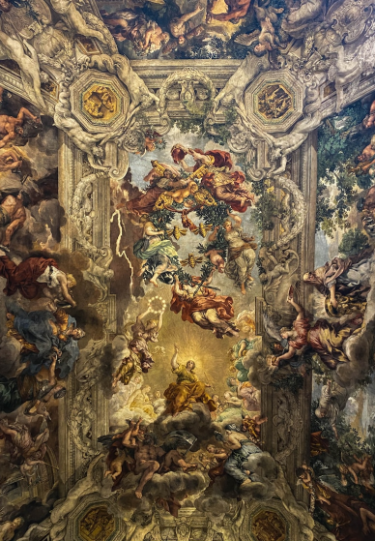
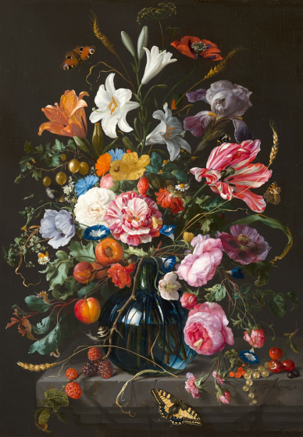
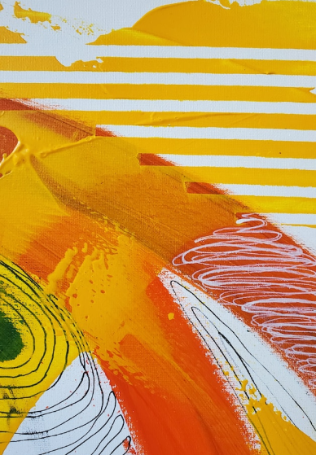
Exploration of the Inner Self: A Journey of Self-Discovery
May, 2023

Slide 14

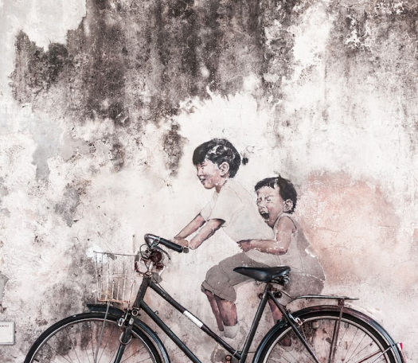
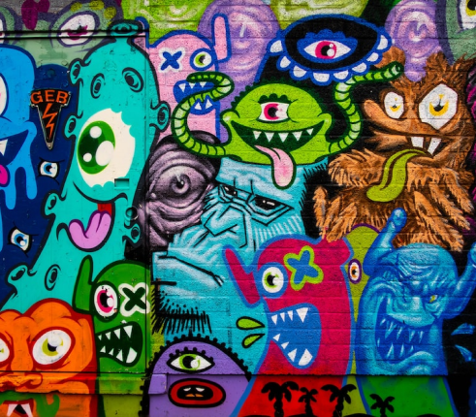
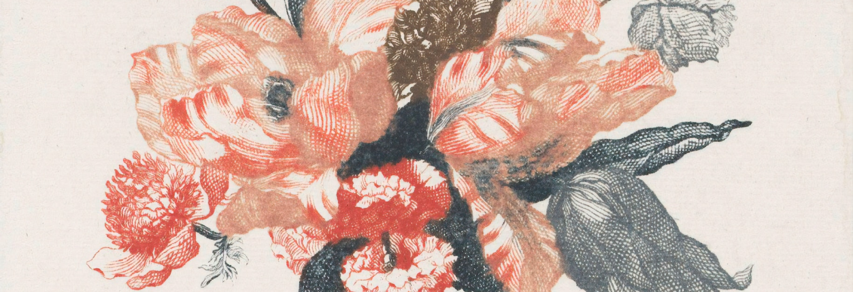
May, 2023

Slide 15

"The Evolution of the Unicorn" is a study exploring the historical, cultural, and mythical development of the iconic fantasy creature. From its ancient roots in Mediterranean mythology to its modern-day representation in popular culture, this research delves into the various interpretations and beliefs surrounding the mystical horse.
The Evolution of the Unicorn
May, 2023

Slide 16
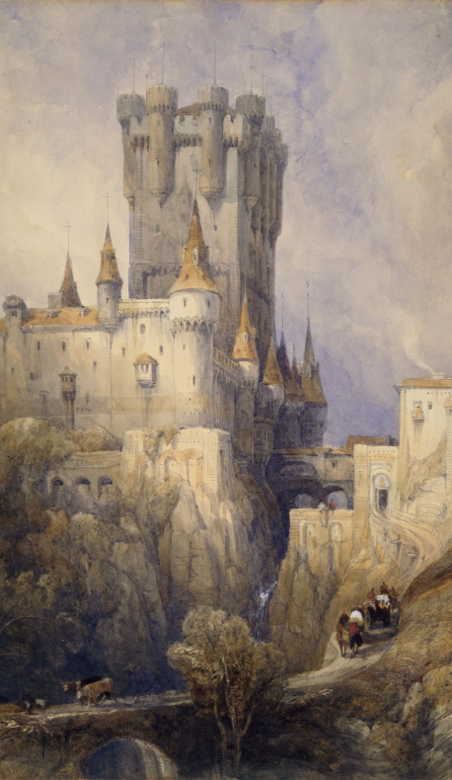
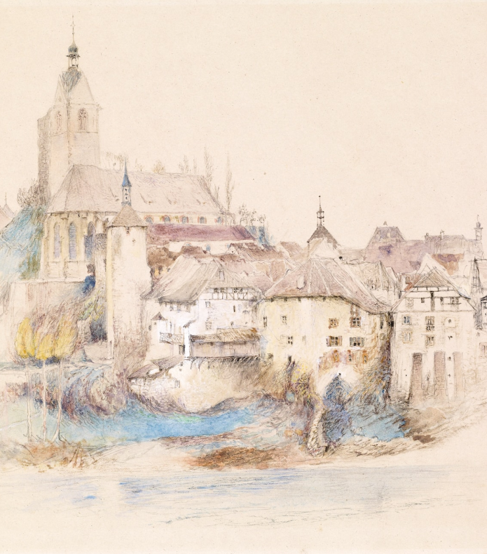
The Art of Enchantment
A magical being with the power to cast spells and create illusions, often sought for bringing wonder and magic into people's lives.
May, 2023

Slide 17


Portal to Adventure
A web application
A web application designed for discovering the world of fantasy
May, 2023

Slide 18

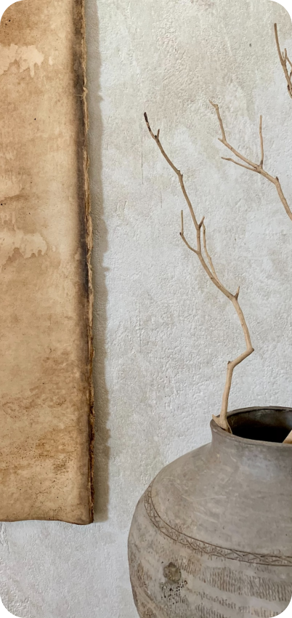
The Future of Fantasy
An mobile app
An app designed for exploring and experiencing the enchanting realm of fantasy
  Explore a magical world
  Experience fantasy firsthand
  Immerse in a realm of magic
  Discover untold wonders
  Live your fantasy dreams
May, 2023

Slide 19
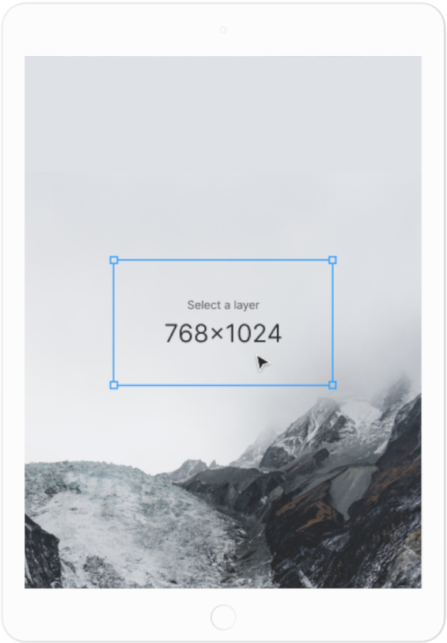
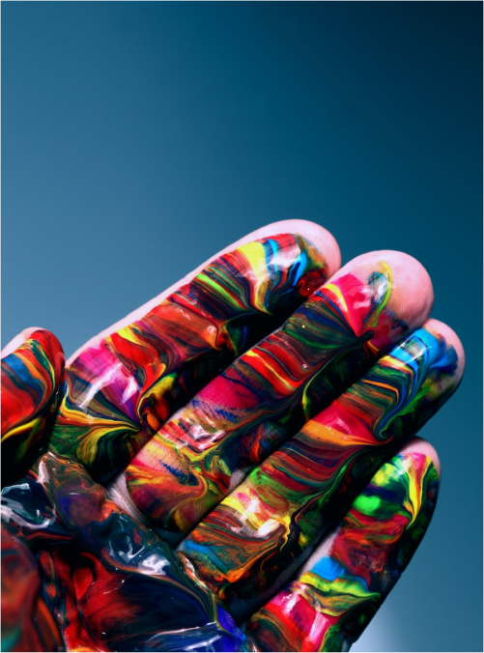
A Gateway to a World of Fantasy and Wonder
  Immerse yourself in the world of magic and mystery
  Explore uncharted territories and fantastical lands
  Meet mythical creatures and legendary beings
  Uncover hidden treasures and secret treasures
A web application
A web application designed for discovering the world of fantasy
May, 2023

Slide 20
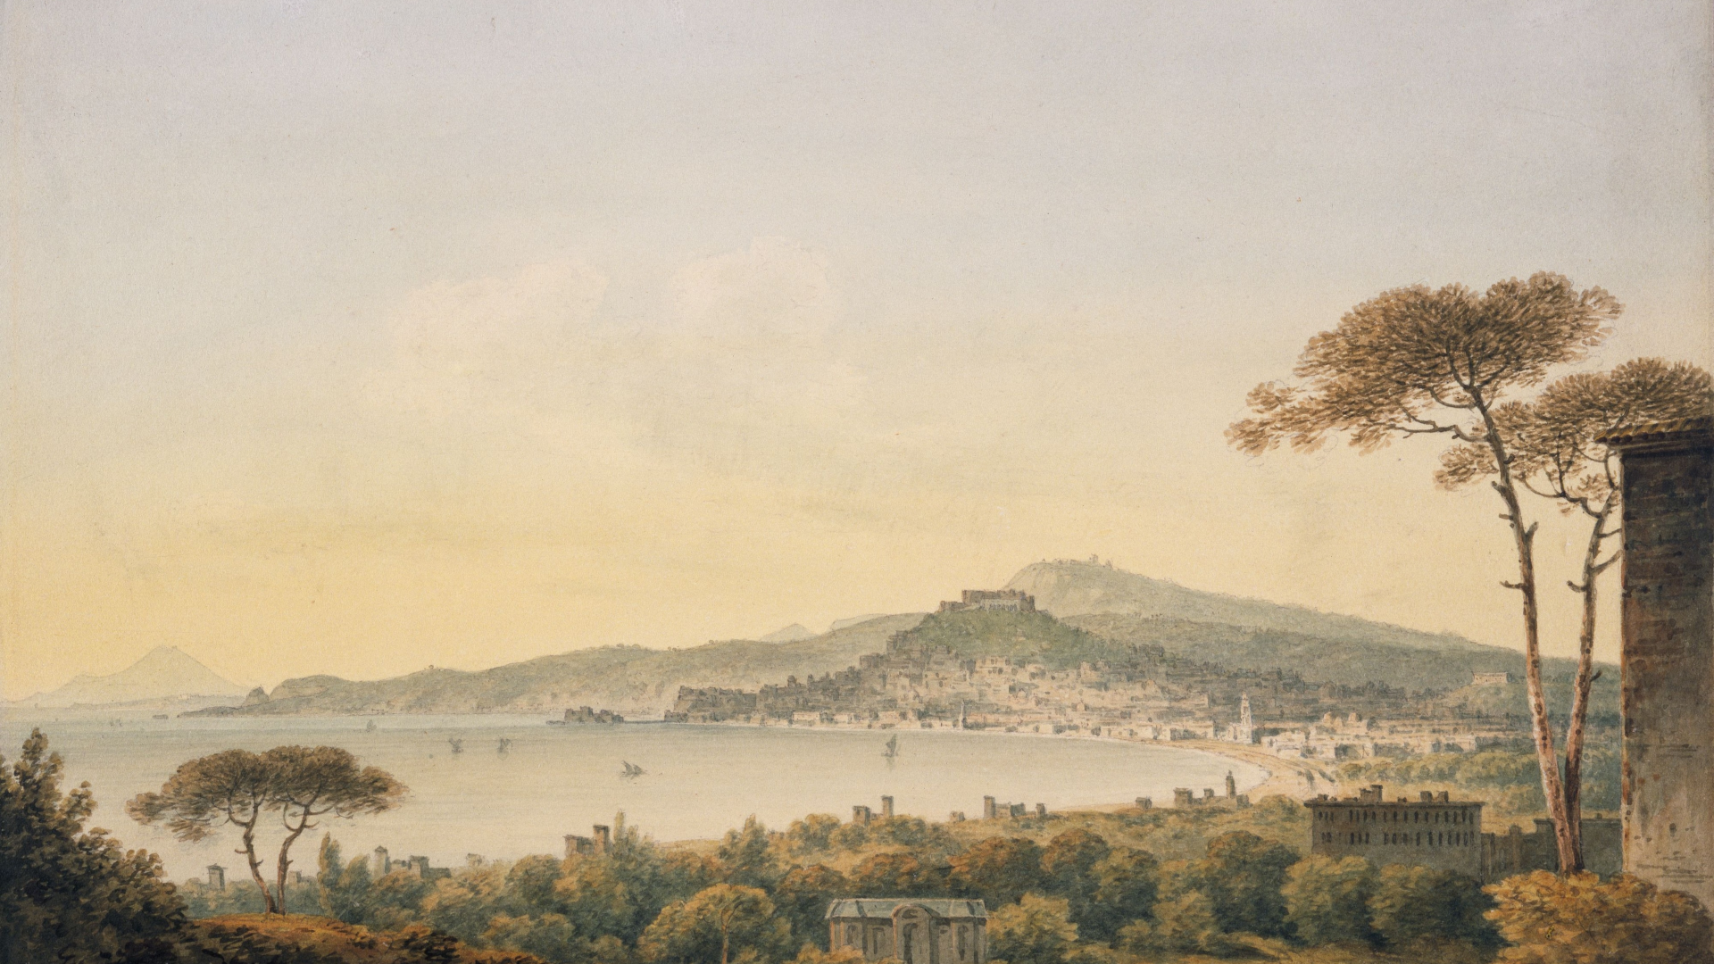
A Magic Picture
May, 2023

Slide 21

Discover the secrets
Find your own path
1
2
Explore the lush, vibrant forest and uncover the mysteries that lie within.
Choose your own path through the forest, and see where it takes you.
Meet the creatures
Uncover the magic
3
4
Encounter the mythical creatures that call the forest home, from talking animals to fairies.
Learn about the powerful magic that pervades the forest and how it affects all who enter.
May, 2023

Slide 22

Taming Dragons and Sighting Unicorns: A Guide to the Realm.
In the Realm of Magic and Adventure, dragons are no longer fearsome beasts to be feared. They can be tamed and even become loyal companions to those brave enough to venture into the unknown. Similarly, unicorns, long considered to be mythical creatures, can now be sighted in this fantastical realm.
May, 2023

Slide 23
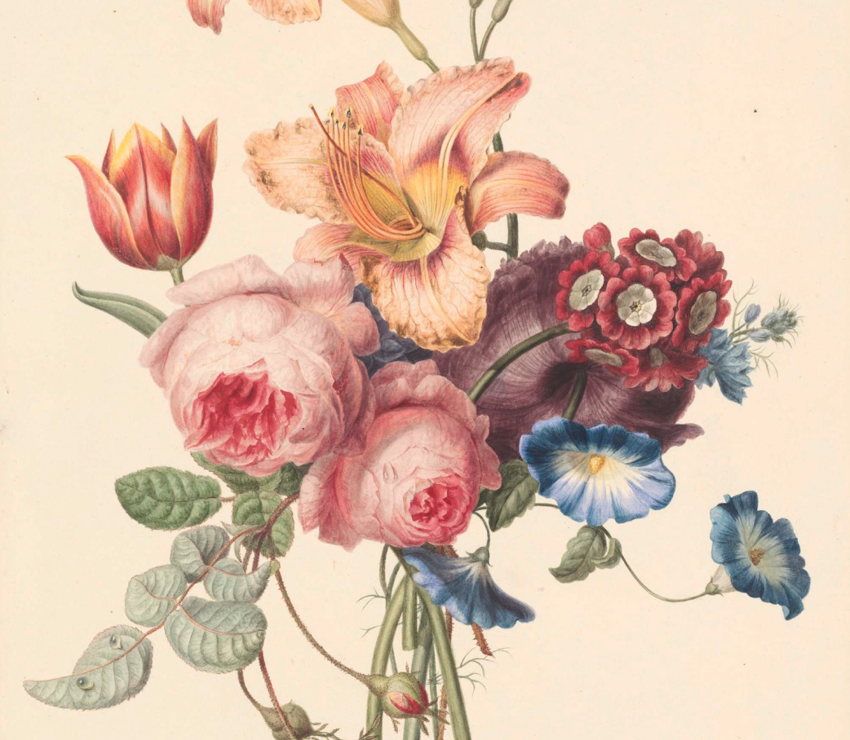
Thank you for choosing EaTemp
We offer free and high-quality slides templates for your presentations. We appreciate you choosing us and hope our templates have been helpful.
As a new website, we rely on your support to grow, so please help us by sharing our site with your friends and colleagues.
Credit | Image: Unsplash
May, 2023

