Slide 1


Anchor Layer Teacher Guide
A curriculum companion for Anchor Layer users
Grade 1
Day Patterns
Unit Web Link • Pacing Guides • Other Units

Slide 2
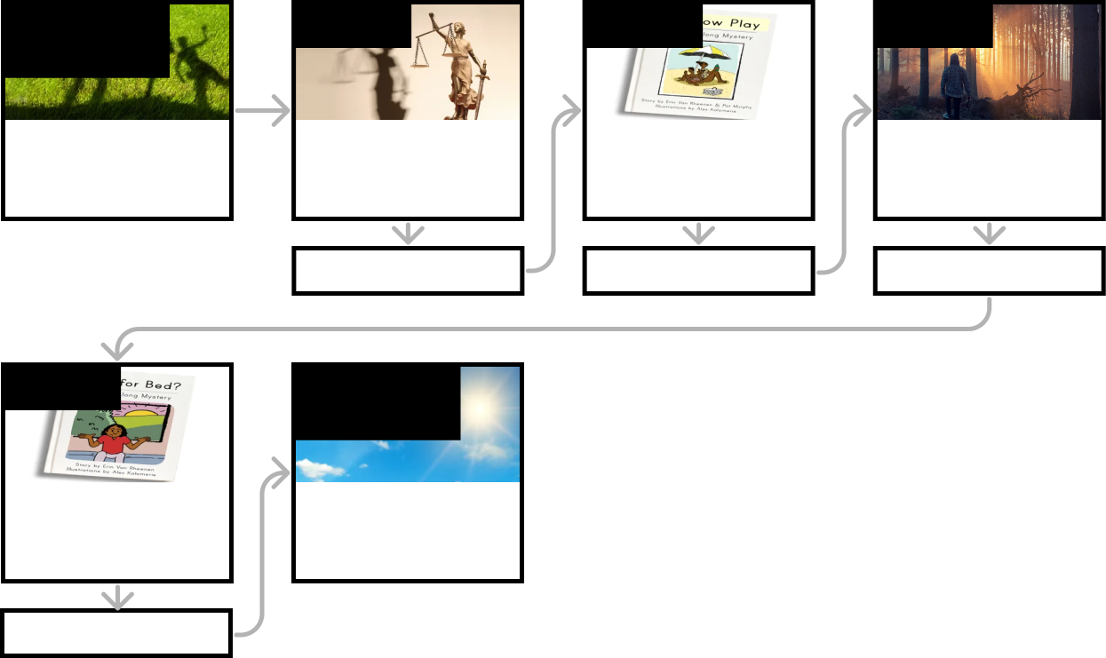
Day Patterns • Grade 1
Anchor Layer Teacher Guide
Unit Summary
In this unit, students make observations of the Sun and shadows throughout the day and across the seasons. They use their observations to understand patterns that occur throughout the day.
Performance Expectations | Science & Engineering Practices | Disciplinary Core Ideas | Crosscutting Concepts
• 1-ESS1-1. Use observations of the sun, moon, and stars to describe patterns that can be predicted. • 1-ESS1-2. Make observations at different times of year to relate the amount of daylight to the time of year. | • Analyzing and Interpreting Data • Planning and Carrying Out Investigations • Developing and Using Models • Engaging in Argument from Evidence • Obtaining, Evaluating, and Communicating Information | • ESS1.A: The Universe and its Stars • ESS1.B: Earth and the Solar System | • Patterns
Anchor Phenomenon
Lesson 1
Lesson 2
Lesson 3
Sun, Shadows, & Daily Patterns
Shadow Surprises
Sun, Shadows, & Daily Patterns
Could a statue’s shadow move?
Sun, Shadows, & Daily Patterns What does your shadow do when you’re not looking?
Sun & Daily Patterns
How can the Sun help you if you’re lost?
Anchor Connection
Anchor Connection
Anchor Connection
Lesson 4
Performance Task
Daylight & Seasonal Patterns
Why do you have to go to bed early in the summer?
Sun, Shadows, & Daily Patterns
Where will the Sun be tomorrow?
Anchor Connection
‹#›

Slide 3

Day Patterns • Grade 1
Anchor Layer Teacher Guide
Anchor Phenomenon Background
Why do shadows change so much over the course of every day?
On a daily basis, the sky above our heads goes through some of the most dramatic changes of anything in our world. Over the course of just a few hours, the sky can change from a jet black background speckled with thousands of stars, to a uniform bright blue with the Sun as the only visible object.
Early cave paintings show that our ancestors paid great attention to the objects that can be seen in our sky, and the ways in which those objects move. While the explanations for how and why these objects move has changed over time, the patterns that can be observed in their movement are predictable and consistent.
The brightest object that can be observed in our sky is the Sun. As long as you are not close to the extreme north and south poles of the Earth, the Sun can be observed to rise in the east every morning and set in the west every evening. (Close to the poles, there can be multiple days in a row in which the Sun doesn’t set, and multiple nights in a row in which the Sun doesn’t rise!)
During the late winter and throughout the spring, the days get longer and longer as the Sun rises earlier and sets later. Then, the reverse happens over the course of the remainder of the year. These daily, monthly, and yearly changes in the Sun lead to daily, monthly, and yearly changes in the shadows we see on the ground. By observing these patterns of light and shadow as they have happened in the past, we can make predictions about them far into the future.
While the Sun is only visible during the day, our Moon is an object that can be present in the sky during the day and the night. It follows a predictable pattern of rising and setting, just like the Sun, but the patterns are different. Its patterns repeat roughly each month. In fact, the word “month” is directly related to the word “moon.” By observing objects in the night sky, just as our ancestors did thousands of years ago, we can describe, explain, and predict the behavior of those objects as well.
‹#›

Slide 4
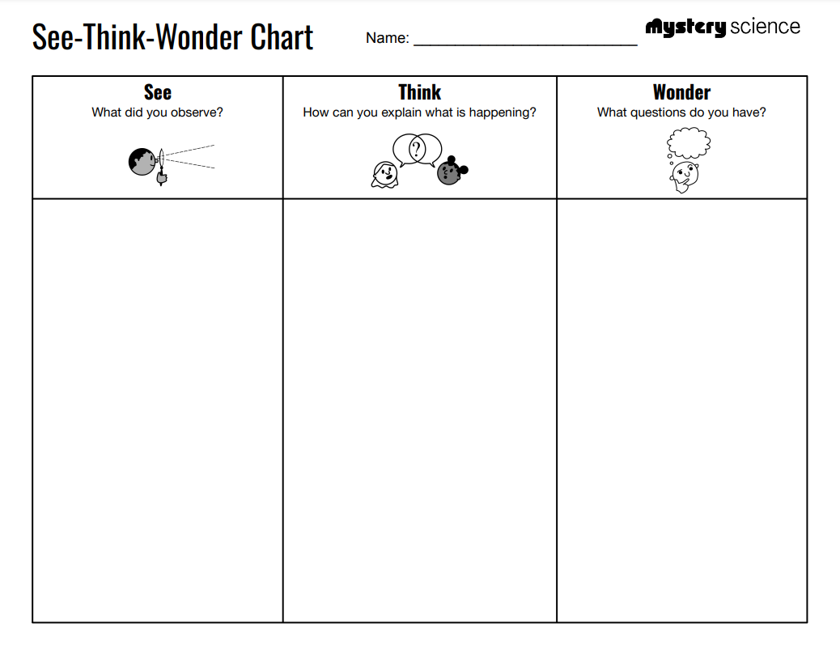
Day Patterns • Grade 1
Anchor Layer Teacher Guide
Anchor Phenomenon: Shadow Surprises
Sun, Shadows, & Daily Patterns
Anchor Phenomenon Overview
Note: This lesson is part of this unit’s Anchor Layer. If you have the Anchor Layer turned on, we recommend teaching lessons 1-4 in this unit in order.
The anchor phenomenon for this unit is a set of strange shadows that are moving in a mysterious way.
During the introduction, students generate observations and questions about the phenomenon and create a list of possible explanations for the phenomenon. Students will use these initial ideas to track how their understanding grows throughout the unit.
Anchor Phenomenon 10 mins
Guided Inquiry 15 mins
Student Work Samples & Notes
Students will gather clues during and after each lesson in this unit to help them improve their understanding and explanations. It is important to encourage students to recognize that even if they don't know the perfect answer yet, they are going to learn a lot throughout the unit and will have an opportunity to revisit the phenomenon over time.
Dark lines moving very slowly
People moving very fast
The sky is blue and it is bright out
It’s trees, and the trees are moving
The video is moving much faster than real life
It’s trees that are growing
Why are the trees moving?
Why are the trees moving so slowly?
Are the trees
growing?
‹#›

Slide 5

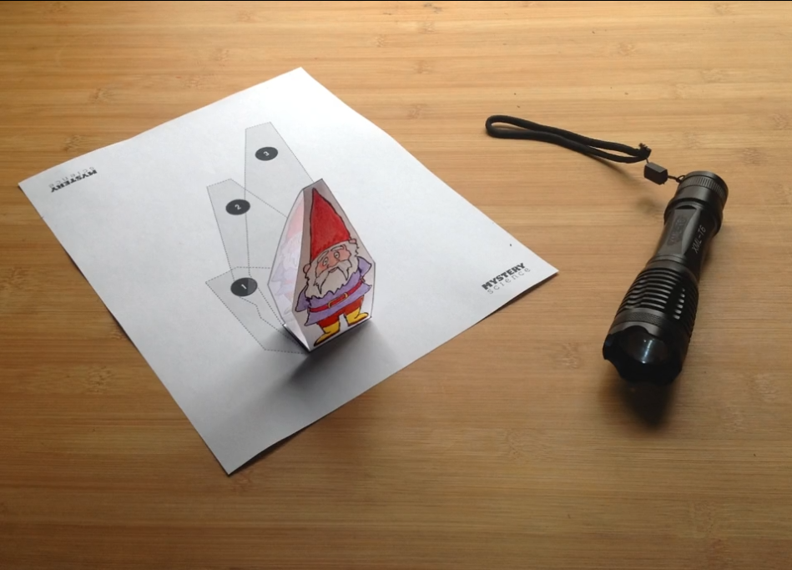
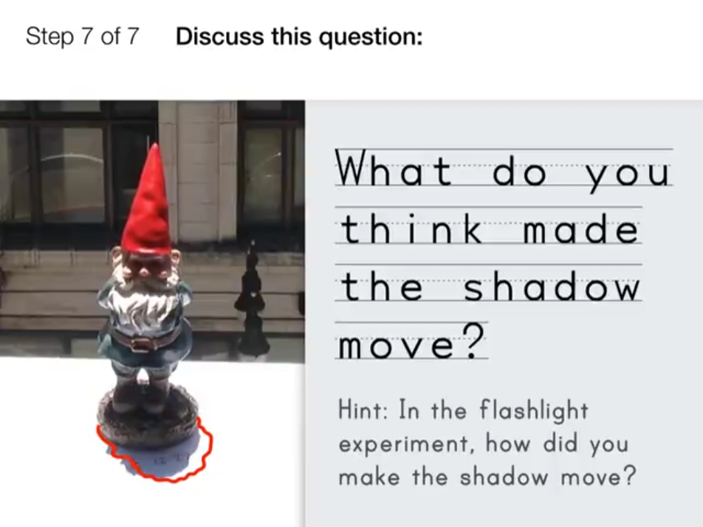
Day Patterns • Grade 1
Anchor Layer Teacher Guide
Lesson 1: Could a statue’s shadow move? (pg 1 of 2)
Sun, Shadows, & Daily Patterns
Overview
In this lesson, students investigate what it takes to make a stationary object’s shadow move.
In the activity, Moving Shadows, students use flashlights and paper gnomes to explore how moving the position of a light makes shadows move. Students relate these observations to shadows changing throughout the day and the Sun’s position moving across the sky.
Anchor Connection on Next Page
Exploration 7 mins
Hands-On Activity 30 mins
Wrap-Up 3 mins
Anchor Connection 10 mins
Assessment 20 mins
Activity Notes
You will need to do this activity in the dark with the lights off. We provide seven different Shadow Patterns, so we recommend setting up seven stations. You can choose to set up fewer stations depending on your space or the number of flashlights that you have available. See the lesson page for more detailed prep instructions.
‹#›

Slide 6
Day Patterns • Grade 1
Anchor Layer Teacher Guide
Lesson 1: Could a statue’s shadow move? (pg 2 of 2)
Sun, Shadows, & Daily Patterns
Anchor Connection
The object making a shadow can move, or the light source can move. Both of these situations can cause a shadow to move. The Sun appears to always be in motion in the sky, and this explains why shadows are constantly moving on Earth—even the shadows of stationary objects, like trees!
Students revisit the See-Think-Wonder chart that they worked on during the Anchor Phenomenon. They should understand that shadows can move when the object making the shadow moves, or when the light source moves. The Sun appears to continually move across the sky every day.
Students may revise their See-Think-Wonder chart by adding that the motion of the Sun is what causes the shadows of the trees to appear to move.
Connecting Storyline Question
Does the Sun always move in the same ways?
Exploration 7 mins
Hands-On Activity 30 mins
Wrap-Up 3 mins
Anchor Connection 10 mins
Assessment 20 mins
‹#›

Slide 7

Day Patterns • Grade 1
Anchor Layer Teacher Guide
Lesson 2: What does your shadow do when you’re not looking?
Sun, Shadows, & Daily Patterns
Overview
In this Read-Along lesson, Jada explores why her shadow changes over the course of a day at the beach.
The lesson includes a short exercise where students act out the movement of shadows with their bodies. You can extend the lesson with the optional activity, Trace Your Shadow, where students trace their shadows using colored chalk and track the shadow’s changes throughout the day.
Anchor Connection
The apparent motion of the Sun in the sky causes shadows to change in predictable ways over the course of each day. In the mornings, when the Sun is low in the sky, shadows are long. As the Sun appears to move up and across the sky, shadows get progressively shorter. Then, as the Sun appears to begin moving down in the afternoons, shadows become long again.
Students revisit the See-Think-Wonder chart that they worked on during the Anchor Phenomenon. They should understand that the height of the Sun in the sky affects the length of shadows. As the Sun rises throughout the morning, shadows get shorter. As the Sun lowers in the afternoon, shadows get longer.
Students may revise their See-Think-Wonder chart by adding that the shadows are getting longer, which tells us that the Sun is moving lower in the sky.
Connecting Storyline Question
Does the Sun always rise and set in the same directions?
Exploration 25 mins
Hands-On Activity 20 mins
Anchor Connection 15 mins
Assessment 20 mins
Activity Notes
We suggest students work in pairs. You will need access to a playground or other area with a blacktop. This activity works best on a sunny day when students can clearly see their shadows.
‹#›

Slide 8



Day Patterns • Grade 1
Anchor Layer Teacher Guide
Lesson 3: How can the Sun help you if you’re lost? (pg 1 of 2)
Sun & Daily Patterns
Overview
In this lesson, students develop a model of the sun’s daily path across the sky, then use this model to help someone who’s lost.
In the activity, Sun Finder, students create a mobile paper model of the sun and earth to illustrate the position of the sun throughout the day.
Anchor Connection on Next Page
Exploration 12 mins
Hands-On Activity 20 mins
Anchor Connection 15 mins
Assessment 20 mins
Activity Notes
Each student will make their own Sun Finder.
Fold the Sun Finder template in half, lengthwise. You can fold 5 at a time, if you like.
Put the folded edge in a 3-hole punch and punch the templates. You can work with multiple copies at a time — depending on what your 3-hole punch will accommodate.
It's okay if the hole in the rectangle with the sun on it doesn't quite match the circle printed on the page.
‹#›

Slide 9
Day Patterns • Grade 1
Anchor Layer Teacher Guide
Lesson 3: How can the Sun help you if you’re lost? (pg 2 of 2)
Sun & Daily Patterns
Anchor Connection
The apparent motion of the Sun in the sky causes shadows to change in predictable ways over the course of each day. In the mornings, when the Sun is low in the sky, shadows are long. As the Sun appears to move up and across the sky, shadows get progressively shorter. Then, as the Sun appears to begin moving down in the afternoons, shadows become long again.
Students revisit the See-Think-Wonder chart that they worked on during the Anchor Phenomenon. They should understand that the height of the Sun in the sky affects the length of shadows. As the Sun rises throughout the morning, shadows get shorter. As the Sun lowers in the afternoon, shadows get longer.
Students may revise their See-Think-Wonder chart by adding that the Sun must be in the western part of the sky because it is moving downward.
Connecting Storyline Question
Does the Sun always rise and set in the same directions?
Exploration 12 mins
Hands-On Activity 20 mins
Anchor Connection 15 mins
Assessment 20 mins
‹#›

Slide 10


Day Patterns • Grade 1
Anchor Layer Teacher Guide
Lesson 4: Why do you have to go to bed early in the summer?
Daylight & Seasonal Patterns (pg 1 of 2)
Overview
In this Read-Along lesson, Arushi wonders why she has to go to bed while the sun is still up, and learns that the sun stays up longer on some days than others.
The lesson includes a short exercise where students get moving by acting out a bedtime routine. If you want to extend the lesson, we provide a printable Summer Sunshine Reader that your students can color and use to practice their reading skills.
Anchor Connection on Next Page
Digital Book (W/Audio) 25 mins
Hands-On Activity 20 mins
Anchor Connection 10 mins
Assessment 20 mins
Activity Notes
Print a reader for each student to read and staple at the corner. You can choose to print the black and white version for students to color or a version that's already in color.
‹#›

Slide 11
Day Patterns • Grade 1
Anchor Layer Teacher Guide
Lesson 4: Why do you have to go to bed early in the summer?
Daylight & Seasonal Patterns (pg 2 of 2)
Anchor Connection
The apparent motion of the Sun follows predictable patterns, and these patterns can be used to determine the time of day. If the Sun is appearing to move upward in the sky, it is morning. When the Sun begins to appear to move downward, it is afternoon or evening. This repeated pattern allows us to determine the approximate time of day based on how the Sun is appearing to move at any given moment.
Students revisit the See-Think-Wonder chart that they worked on during the Anchor Phenomenon. They should understand that days get longer and shorter throughout the year, but the Sun is in consistent directions at different times of day. This means we can use the location of the Sun to tell the time of day.
Students may revise their See-Think-Wonder chart by adding that it must be the afternoon in the video because the Sun is moving downward. At this point, the students will have used the motion of shadows to determine cardinal directions, time of day, and the apparent motion of the Sun—all while not being able to actually see the Sun.
Connecting Storyline Question
Can we predict how things in the sky will move?
Digital Book (W/Audio) 25 mins
Hands-On Activity 20 mins
Anchor Connection 10 mins
Assessment 20 mins
‹#›

Slide 12

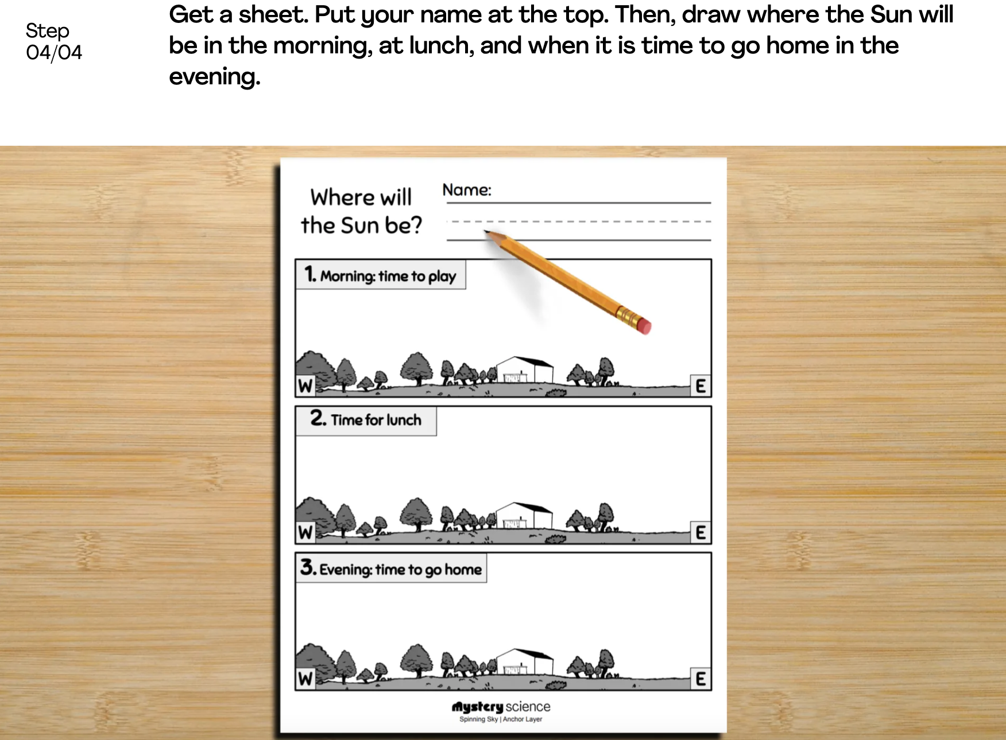
Day Patterns • Grade 1
Anchor Layer Teacher Guide
Performance Task: Where will the Sun be tomorrow?
Sun, Shadows, & Daily Patterns
Overview
In this performance task, students will observe and predict the apparent location of the Sun in the sky at different times of day.
After a review of the unit, students will gather observations of the Sun from a single location. They will see that the Sun follows a repeating pattern in its apparent motion, and then use that pattern to predict the location of the Sun at various times of day in the future.
Unit Review 10 mins
Hands-On Activity 35 mins
Performance Task Notes
Students can work individually, in pairs, or you may choose to work with small groups. Print as many copies of the Where Will the Sun Be? worksheet as you will need for your students. One copy will be needed for each individual, each pair, or each small group.
Crosscutting Concepts
Patterns: The Sun appears to move in the sky in a variety of predictable patterns. The most easily observable pattern is daily.
The Sun appears to rise in the east at the beginning of every day, it progresses up and across the sky over the course of the day, and it sets in the west at the end of each day. By identifying patterns in this apparent motion, we can use them to track the flow of time
‹#›

