Slide 1
Kinder
Design Theory-Visualization and Application

Slide 2
Table of Contents
01
03
Kinder company background
The new Kinder card
Design Brief
02
Kinder card
Kinder Card Lunch
Kinder Card ingredients
Kinder card design
Brand Model
Business Model
04
Visual Identity
Concept

Slide 3

Kinder
Company

Slide 4
Ferrero’s Company to Kinder division
Kinder, the world's second largest chocolate brand, offers a wide variety of chocolate products, from chocolate bars to surprise-filled treats such as Kinder Joy, Kinder Bueno, and Kinder Seasonal. The brand is known for its dedication to delighting families around the world through innovative products and commemorating memorable milestones. Kinder is a brand owned by the Italian multinational confectionery company Ferrero, and its products are sold in over 125 countries around the world.
Ferrero, which was founded in 1946 and opened the kinder division in 1968, is a private company that employs 123 people. While it is best known for its chocolate, it also produces seasoning and sauce products to enhance the flavor of home-cooked foods. This diverse product line demonstrates Kinder's adaptability in the food industry.
Kinder™ USA. (n.d.). Kinder Brand: History, Offerings & Chocolate Products. Available at: https://www.kinder.com/us/en/.
PitchBook. (n.d.). Kinder's Company Profile: Valuation, Funding & Investors. Available at: https://pitchbook.com/profiles/company/160800-12 .
Kinder™ USA. (n.d.). Kinder Brand Mission & Commitment. Available at: https://www.kinder.com/us/en/about-us.

Slide 5
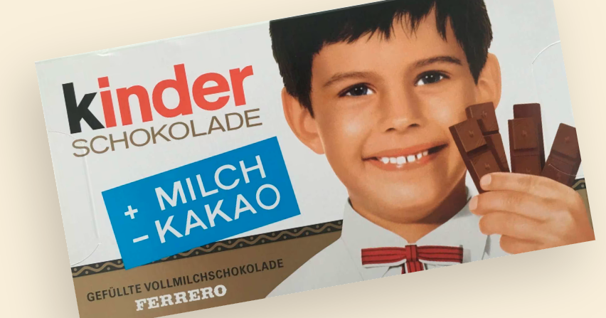
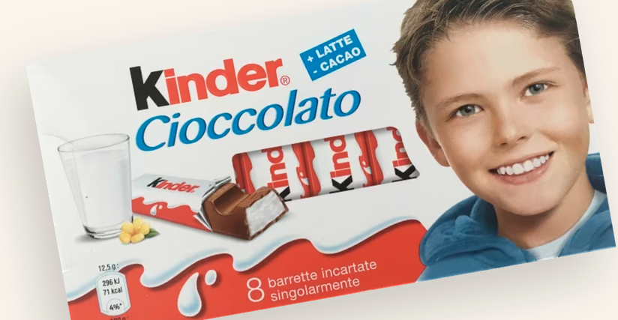
Kinder 1968 \ Kinder 2012
Color Change from dark Gold based on Home company Ferrero’s to Warm red Color for kinder division
*Both version holds a young boy to attract and identify the target audience straightforward
*Both Packages style looks alike in term of shape
Holding the product for accurate scaling \ to adding the pictures of ingredients with nutrition measures such as Kcal
Kinder™ Australia. (n.d.). The Kinder Story. Available at: https://www.kinder.com/au/en/the-kinder-story/02

Slide 6

Kinder Card Launch
Kinder Cards, a Ferrero group biscuit brand, was launched in August 2021.
Kinder Cards were introduced to the UK market in the summer of 2021, following their successful launch in Europe. To promote this new product, Ferrero launched a £1.82 million television advertising campaign highlighting the product's introduction and initial positive consumer response.
Why Kinder Launch the Kinder card?
Based on the video objectives and the message
Kinder wanted to add a “thin yet creamy” product to their line, basing kinder card is the lightest kinder product with only 66kcal per serving and 516 per 100 gram
A light thin crunchy snack that could be enjoyed anytime
To address the issue raised in M, Emilie (2013). KinderCommunication Plan that kinder products are not associated with being healthy.
Better Retailing. (2021). Ferrero launches TV ad campaign for Kinder Cards. Available at: https://www.betterretailing.com/sponsored/advertorial/ferrero-launches-tv-ad-campaign-for-kinder-cards/.
Manchester Evening News. (2021). I tried the new Kinder Cards. Available at: https://www.manchestereveningnews.co.uk/whats-on/food-drink-news/tried-new-kinder-cards-heres-21749525.
Talking Retail. (2021). Kinder Cards launches television advertising campaign. Available at: https://www.talkingretail.com/news/industry-news/kinder-cards-launches-television-advertising-campaign-01-04-2021/
wFatSecret. (n.d.). Calories in Kinder Cards and Nutrition Facts. Available at: https://www.fatsecret.com/calories-nutrition/kinder/cards FatSecret. (n.d.). Kinde. Products, Calories and Nutritional Information. Available at: https://www.fatsecret.com/calories-nutrition/kinder.

Slide 7
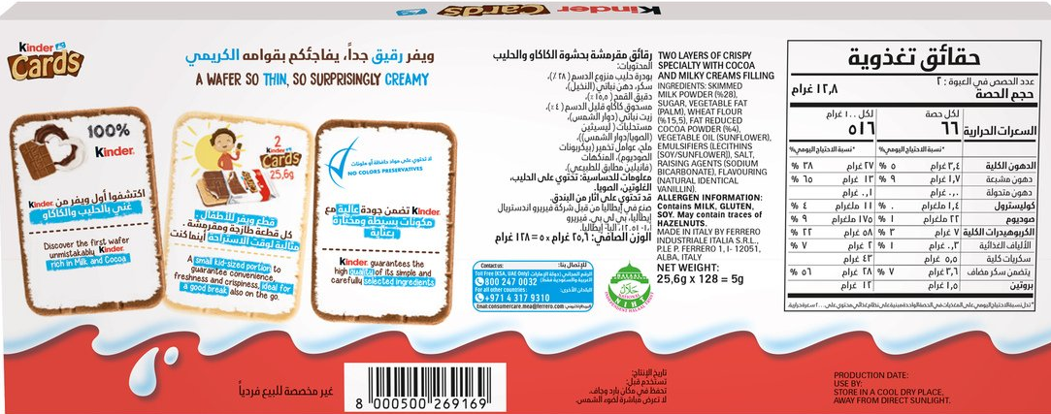
Kinder Card Launch supporting figure
An introduction to waver
A light snack that could be enjoyed anytime

Slide 8
Kinder Card ingredients
Skimmed MILK powder (28%)
Sugar
Palm oil
WHEAT flour (15.5%)
Fat-reduced cocoa (4%)
Emulsifier: lecithins (SOYA)
Salt
Raising agent (sodium bicarbonate)
Vanillin
An implementation to introduce waver for the first time in kinder family
Ferrero UK. (n.d.). Kinder Cards. Available at: https://www.ferrero.co.uk/products/kinder/kinder-cards [Accessed 20 Nov. 2023].

Slide 9
Kinder
Design

Slide 10
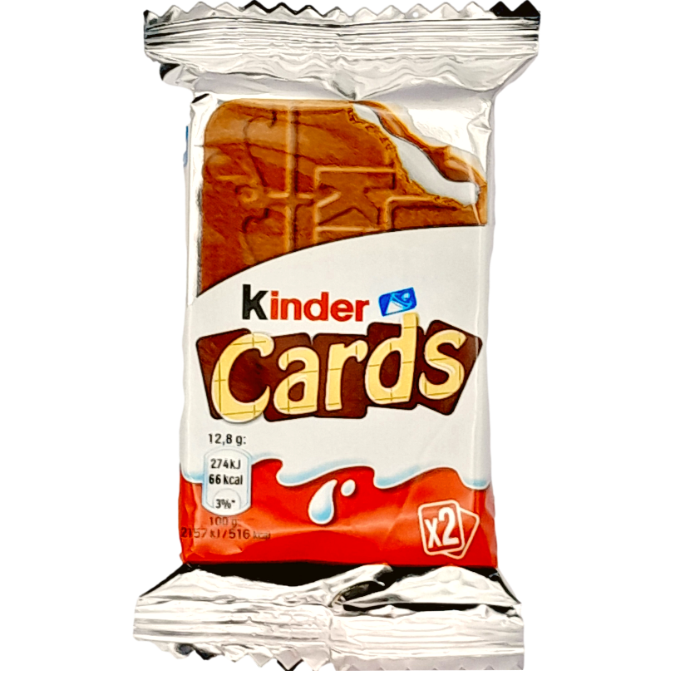
Kinder Card Design
Kinder
Two colored sides (white chocolate \chocolate) representing the two flavours in the card
Aluminium Silver foil Plastic Pouche
kinder's original design (kinder Milk drop)
The square pattern symbolling the chocolate bar
An accurate scaling and presentation for the inside product drawn in right measurement
An Icon of Milk Cup suggestion a different ways to enjoy kinder card
Kinder Card Unqiue logo with 5 Kinder cards resmbling the 5 letters new product
The fact of nutrition emphasizes the lightness of the kinder cards product
A rectangle thin shape to represent the card
The number indicate the number of cards included in the packaging

Slide 11
Kinder Card Design
Theories
Princples
Kinder
The real scale of the card is drawn in the package to Identify the size of the product
Using curvy Line for milk drop to represent a smooth creamy texture for the prodcut
Using rectangle shape and pattern for the balance of the waver
The use of the dark side of the card to emphases the logo on white background for the contrast
The Use of two shade of colors for the flavor represent in the product
The Golden Ratio

Slide 12
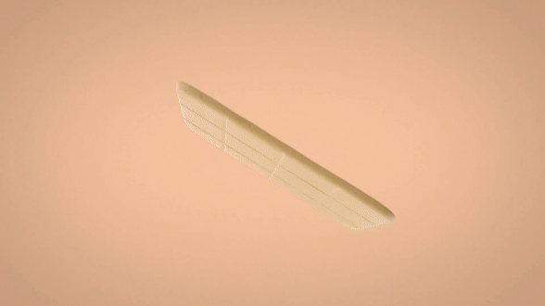
Kinder Card Design

Slide 13
SWOT Analysis
S
W
O
T
Strength
Weakness
Opportunity
Threat
Histroic Brand, Popular trusted brand, good quality ingredients, orignal
Unhealthy Image, Never been present on the low calorie market
Growing concern about eating habits and health, grown market
competiton and well-known brands
M, Emilie (2013). KinderCommunication Plan

Slide 14
Kinder
Design Brief

Slide 15
Kinder Card Design Brief

Slide 16
Kinder Card
PRESENTED BY :
Dana alshiddi
PRESENTED TO :
Kinder
Introducing a healthy Kinder card development
DESIGN
BRIEF
This presentation has live captioning.

Slide 17
Kinder card
PRESENTED BY :
Dana alshiddi
PRESENTED TO :
Kinder
Overview | 3
Objectives and Goals | 4
Target Audience | 5
Competition | 6
Timeline | 7
Stakeholders | 8
AGENDA

Slide 18

kinder
PRESENTED BY :
Dana alshiddi
PRESENTED TO :
Kinder Design department
OVERVIEW
Kinder Cards are noteworthy for their particular light and crunchy feel, which is the consequence of the product's revolutionary usage of wafers. This was the first time Kinder offered a wafer-based product, broadening its chocolate options. Kinder Cards stand apart from other Kinder goods, which are generally recognized for their creamy textures and chocolate coatings.
Introduce the project.
03

Slide 19



OBJECTIVES AND GOALS
Clarify the project's main overall objectives and goals.
GOAL #2
The ability to share the Kinder card with friends and families
GOAL #1
GOAL #3
Introducing healthy snack that could be enjoyed by teenages in anytime
Expand the varieties for taste and flavors for teenager to enjoy

Slide 20
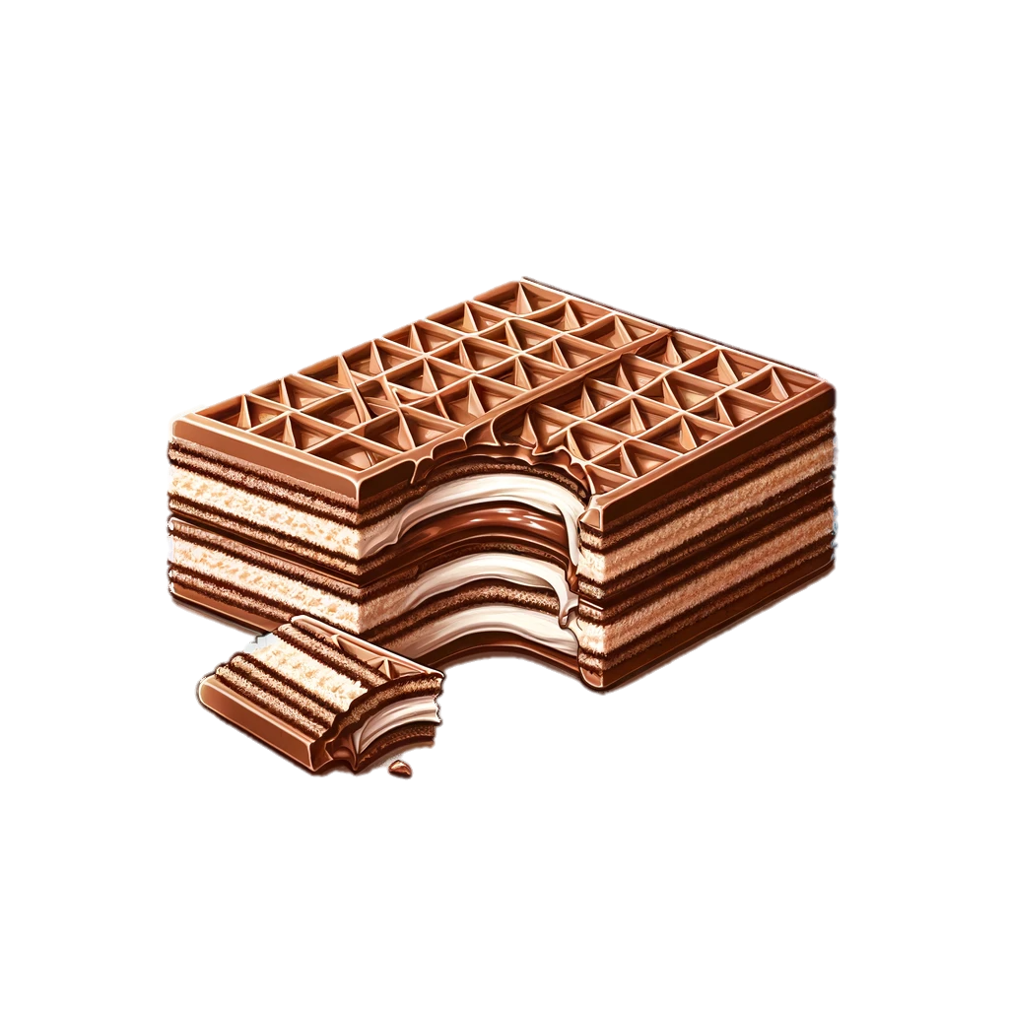

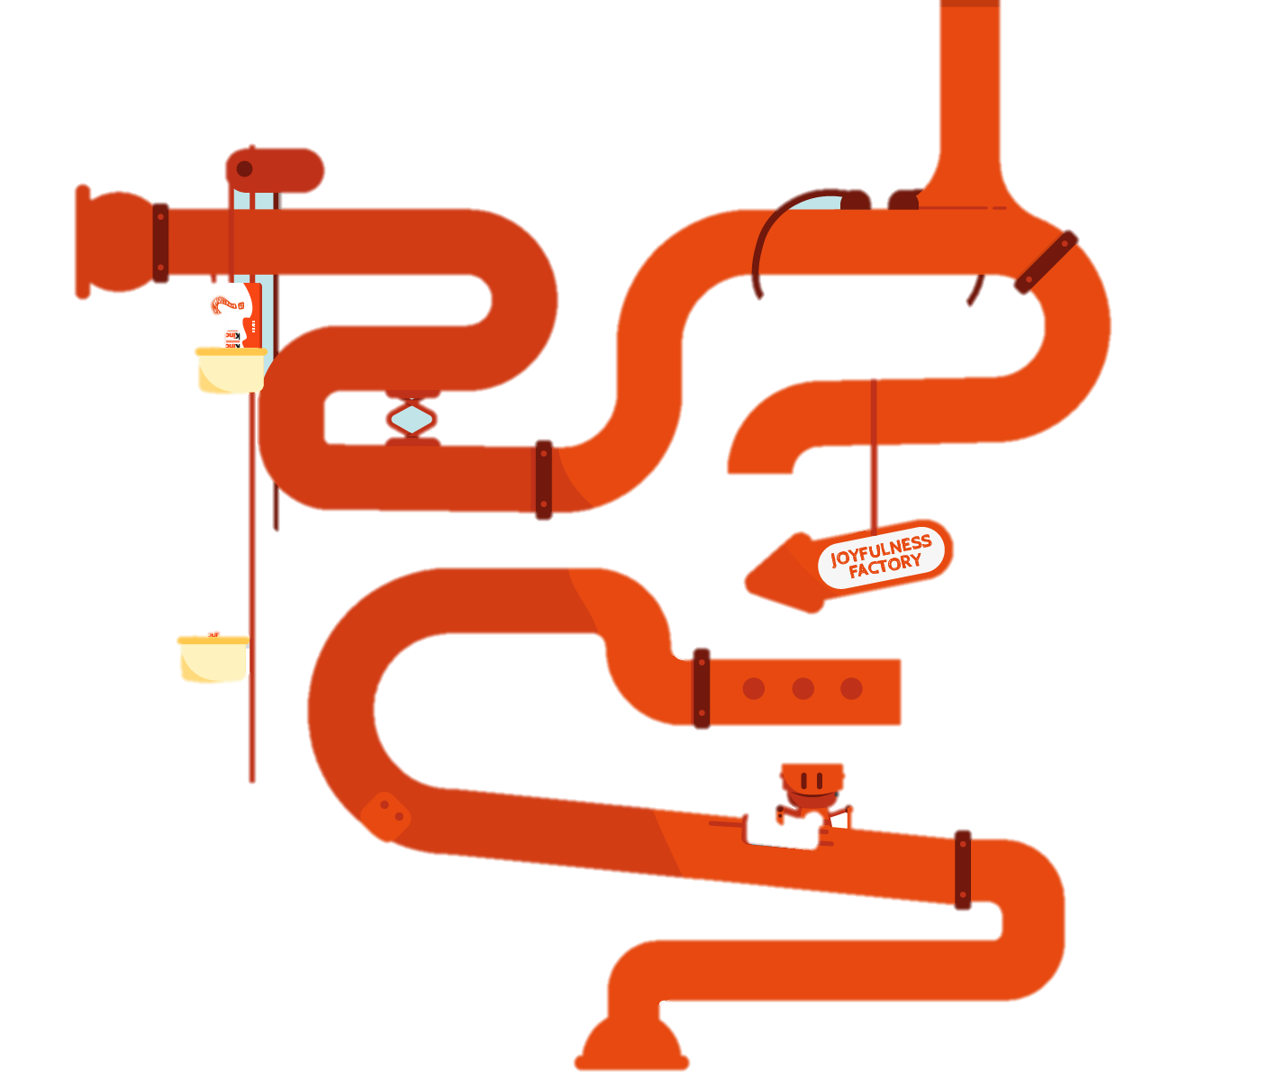
TARGET AUDIENCE
Kinder Card is the perfect snack for Teenagers due to it’s lightness and creamy taste that could be enjoyed during their between meals time, school, trips.
Teenagers
New Family
List their key details.

Slide 21
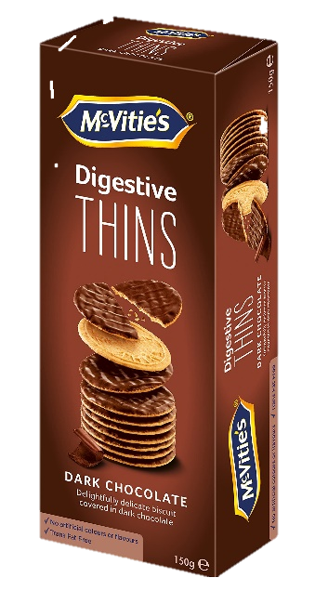
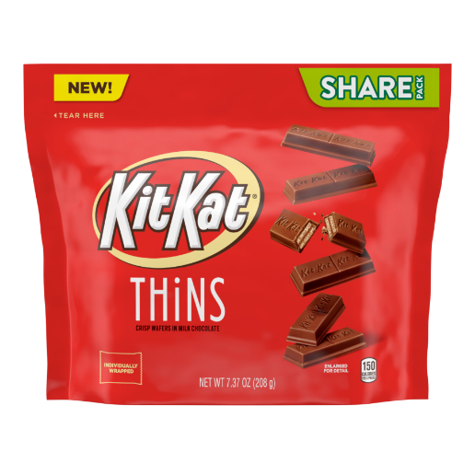
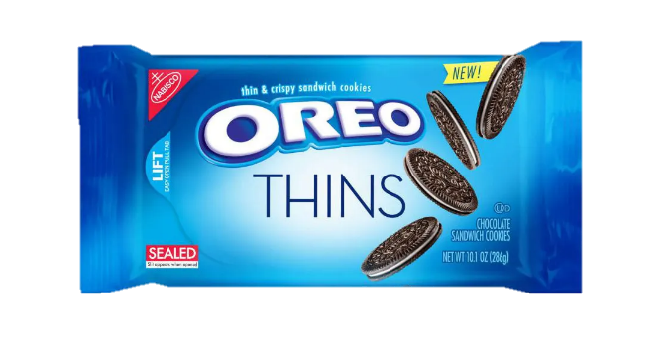
COMPETITOR #2
This presentation has live captioning.
COMPETITOR #1
A Chocolate brand based on the lightness of their product release even a thinner version for the maximum enjoyment
A Healthy thin snack well known for their light and crunchy texture is the perfect competitor.
A thin chocolate biscuit product from well known company some are considered a healthy light snack
COMPETITOR #4
Well known product for their signature biscuit releasing a thin version
COMPETITION
Introduce the company's main competitors for launching a healthy light snack

Slide 22
Briefly discuss the key dates for the project.
1st Quarter
2nd Quarter
3rd Quarter
4th Quarter
an Technical sketch of the new Thin card using The dark chocolate recipes from kinder bueno planning the new ingredient and thinning the waver layer
Testing – Prototype for the New chocolate
Packaging Design and soft launching
A promotion of the Launch for the New kinder card
TIMELINE

Slide 23
THANKS
for participating our meeting.

Slide 24
Kinder
Visual Identity

Slide 25
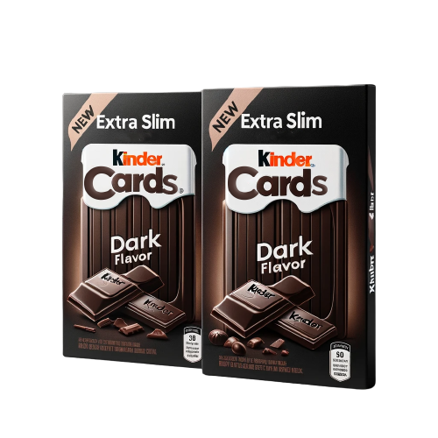
Kinder Extra slim
Cards
Dark chocolate

Slide 26
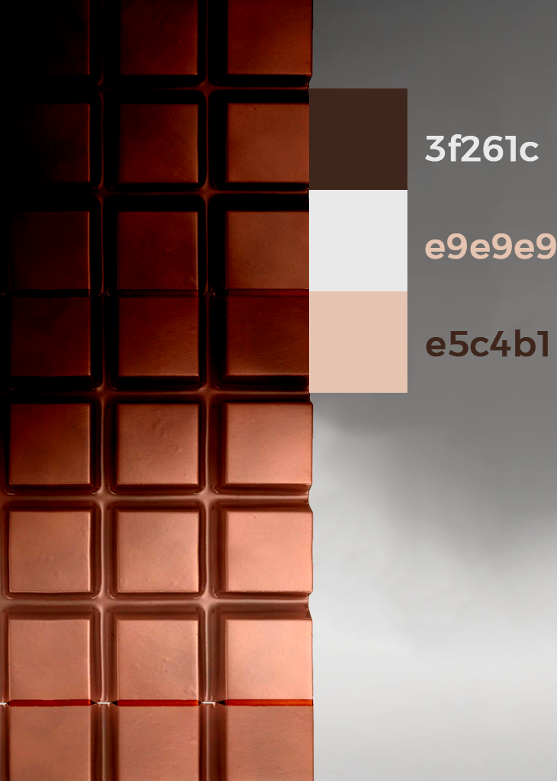

Slide 27

Kinder Card Design
Kinder
One Color side
Cardboard packaging
Crunchy even lighter snack
A shape of the type of chocolate it’s been used
A thin layer of dark chocolate Kinder card
50 Kcal which was cut in half introducing new healthy snack with kinder
Sticking with same engraved shape

Slide 28
kinder

