Slide 1


Why Science
Has Not Had A Greater Impact On Education
Jack States
Notes:
This is specially frustrating when we see so many pockets of excellence, . a robust and growing knowledge base of effective practice, but despite this progress these practices are not taken to scale.

Slide 2
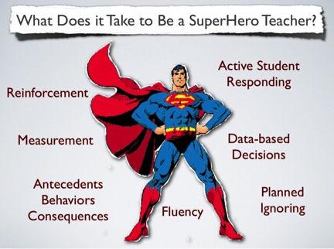
Janet Twyman, 2014
Notes:
- What we know is Teachers and how they teach are the #1 factor in improving student achievement. We understand that there are four important skills areas that define effective teaching.

Slide 3
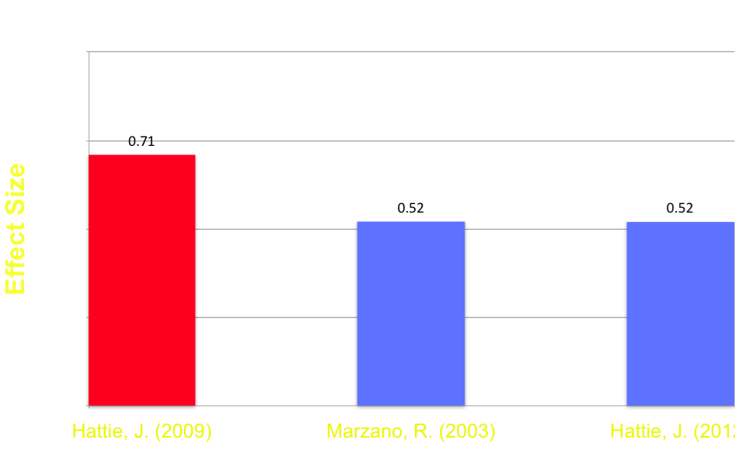
Classroom Management
Appropriate
Behavior
Classroom Management

Slide 4
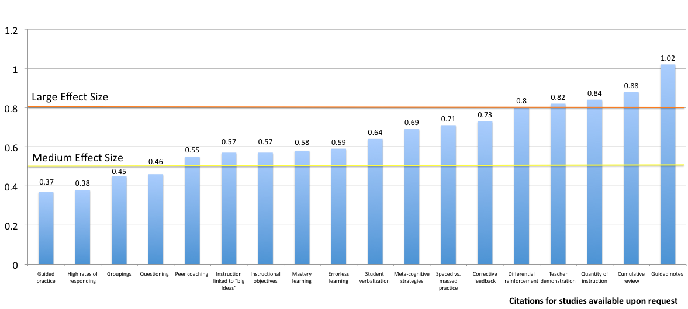
Instructional Delivery

Slide 5
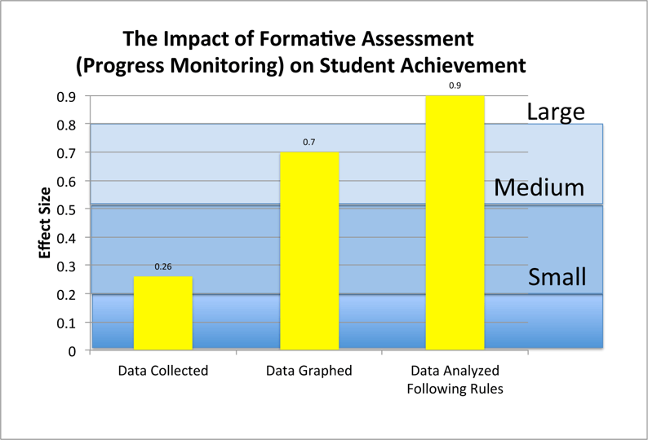
Formative Assessment
Fuchs and Fuchs, 1986

Slide 6
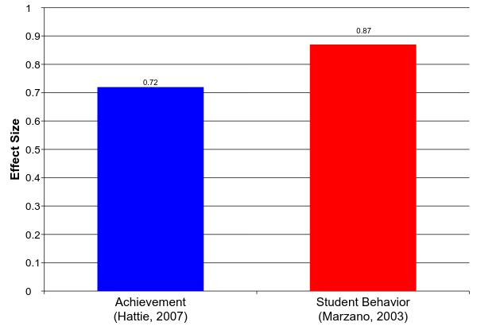
Soft Skills
Teacher – Student Relations
Notes:
Ability to show empathy, warmth, encourage student learning, be adaptable to novel situations, exhibit cultural sensitivity and show respect for students

Slide 7
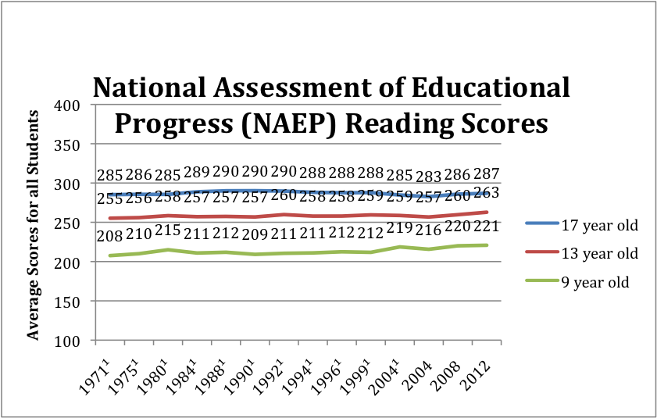

NAEP Scores
Notes:
No cohort of US students performs at or above the 38% of proficiency, the US PISA ranking is stagnant at around 15th, and this continues into adulthood, Despite deep knowledge base explicit practices are not being adopted or sustained

Slide 8
What is Culture?
“As a set of contingencies of reinforcement maintained by a group…
The group has…
a continuing existence beyond the
lives of members of the group,
a changing pattern as practices are
added, discarded, or modified…
A culture so defined controls the behavior of the members of the group that practice it.”

Slide 9
Why Culture Is Important to
Building An Evidence-Based Model?
Americans are ill informed and skeptical of science
To win the hearts and minds of policy makers, educators, and the public
To overcome advantages held by competing educational approaches
To overcome the limitations of large social change delivered one individual at a time
Notes:
“Being Right is Not Enough” - There are a number of reasons for this, but we believe Culture is a very powerful variable that is often overlook
5 minutes

Slide 10
Who Is Having The Greatest Impact In The Classroom?
Constructivists
Practitioners of explicit instruction
Notes:
Discovery learning and Direct Instruction – Policy makers looking for quick fixes accountability, class size, firing bad teachers

Slide 11
Comparing The Two Dominant Approaches to Teaching
Explicit Instruction | Constructivism
The teacher and student share responsibility for learning | The student is self directed and responsible for their own learning
The role of the teacher is to teach concepts, skills, and knowledge | The role of the teacher is to provide a context and process for students to discover concepts, master skills, and acquire knowledge on their own
The role of the teacher is to provide systematic instruction tied to standards and goals | Students create knowledge of the world through personal experiences not tied to external standards and goals
Teachers master evidence-based teaching skills | Teachers develop their own philosophy of education and personal style of teaching
Formative assessment is key to ensuring student progress | Assessment of student progress is subjective
Higher order thinking is systematically taught and dependent on student mastery of foundation skills | Higher order thinking and foundation skills are learned as required to solve problems
Notes:
Clear distinction between the belief systems 1. Systematic vs random acts of exploration 2. The world is objective vs. subjective 3. Skills need to be taught vs. knowledge is already within us

Slide 12
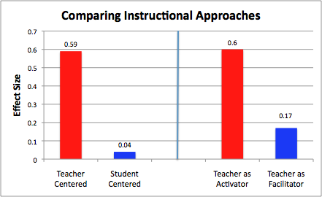
What is the Impact of Education Philosophy on Teaching?
Hattie, 2009
Notes:
Despite constructivist appeal the research supports explicit model

Slide 13
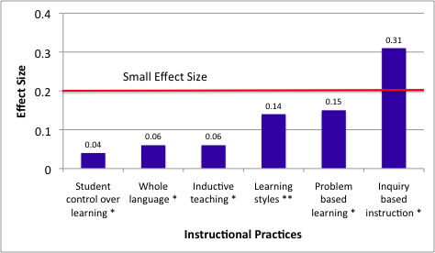
Less Effective
Instructional Practices
* Hattie, 2009 ** Kavale, 1987
Notes:
Practices associated with constructivism do not hold up under scrutiny

Slide 14
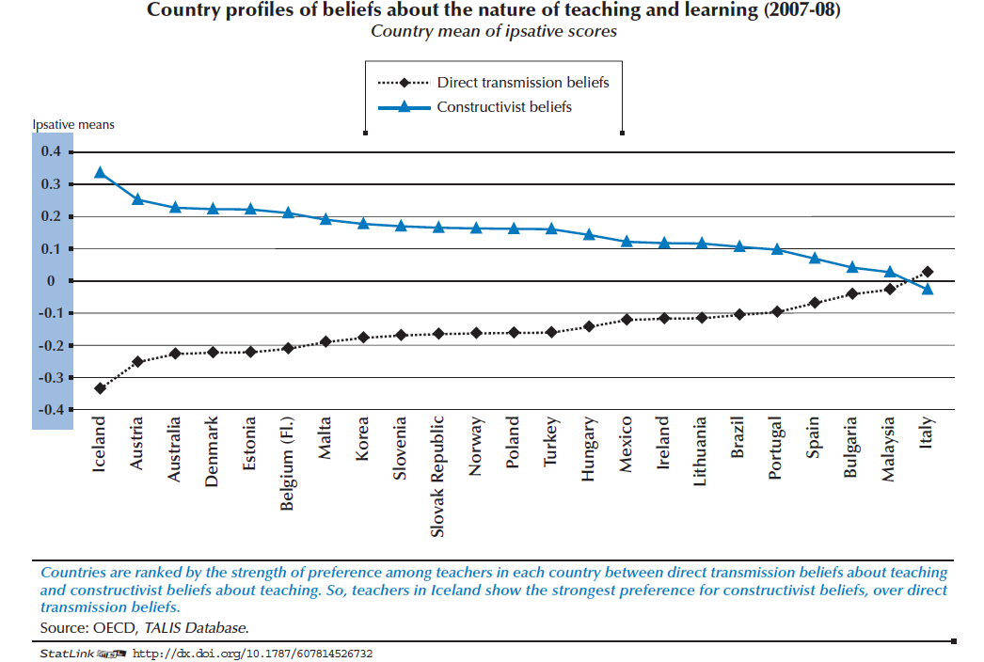
Notes:
Organization for Economic Co‑operation and Development – Teaching and Learning International Survey (TALIS)

Slide 15
What Do These Terms Describe?
Systematic skills building
Mastery learning
Component skills to composite
Behavioral cusp
Contingent praise
Errorless learning
Blooms taxonomy
The search for social justice
Authentic learning
Student centered
Learning occurs through discovery
Teaching students how to think, not what to think
Real world learning
Intrinsic motivation
Helping students become caring, responsible problem solvers
Notes:
The constructivist descriptors are warm, inviting, appealing to many of our human values. Explicit descriptors come off sounding cold and mechanistic
What does this suggest: Contructivists are doing very good job of selling their message and it appears that explicit practitioners are spending little effort in winning over converts

Slide 16
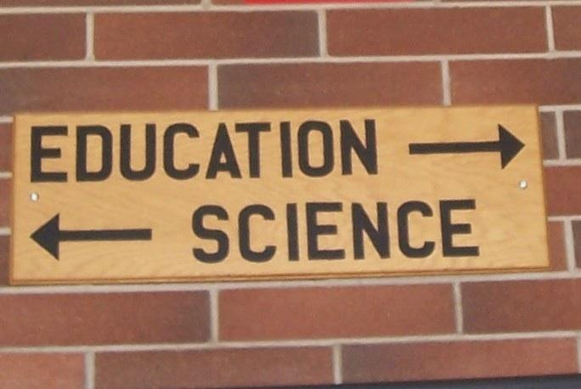
How Do Americans Feel About Science?
This picture was taken at a well known American university
Notes:
the National Science Foundation - 90 % of Americans think scientists are "helping to solve challenging problems"
26% of respondents said the sun revolves around the earth (44% for EU) and only 48% percent knew that human beings developed from earlier species of animals.

Slide 17
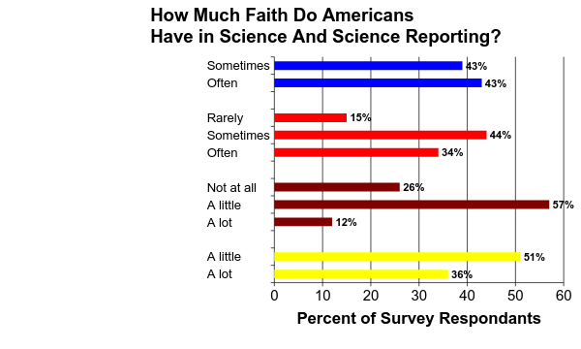
Findings influenced by
companies funding
Results influenced
by politics
Trust science journalists
Trust what scientists report
Huffington Post and YouGov, 2013
Notes:
Companies = 86% --- Politics = 78% ----- journalist 0ver 80% --------- what science reports = 51% #2 The American public is ill informed regarding science and are skeptical about what science is reporting

Slide 18
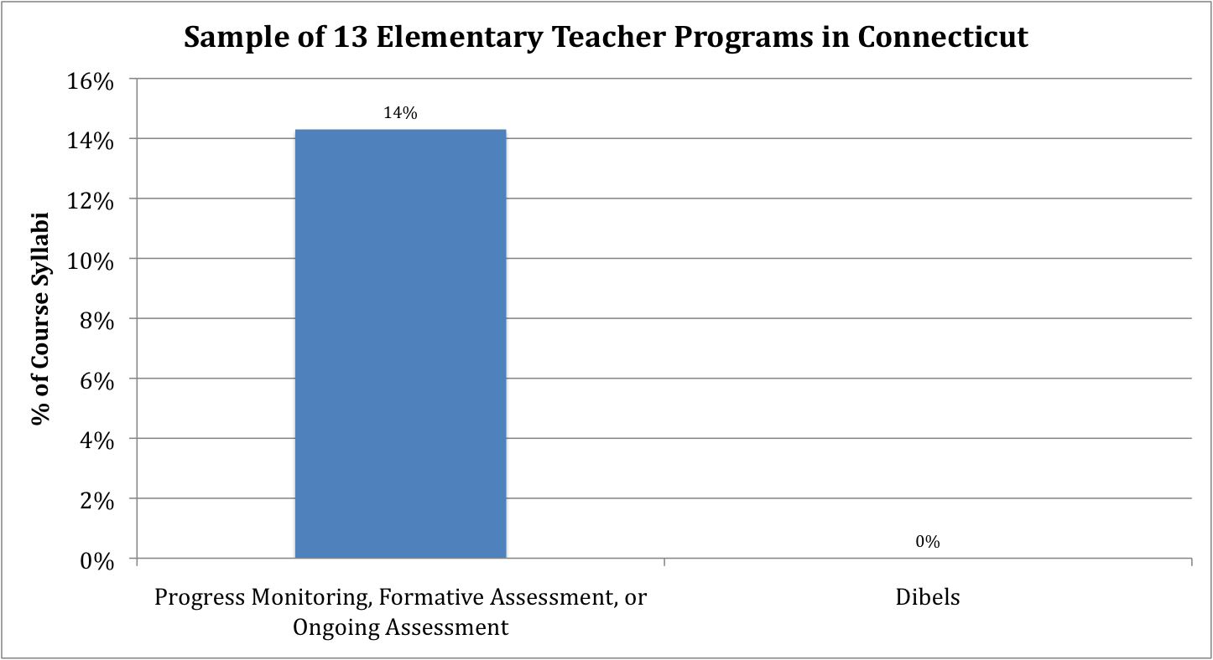
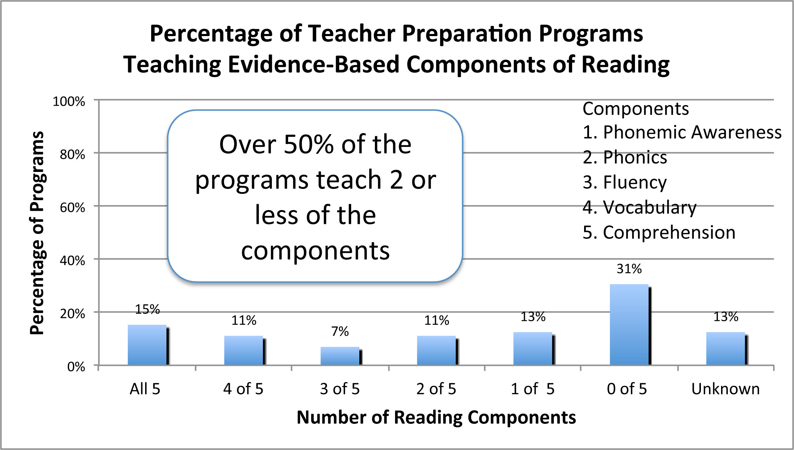
Impact of Teacher Preparation
Spear-Swerling (2008)
Walsh, Glaser, and Wilcox. (2006)
Notes:
Steiner, 2004 - 16 mostly well-regarded colleges of education all emphasized constructivism
National Reading Panel
#3 Constructivism predominates Teacher preparation

Slide 19

“How to Bridge the Divide”
The Culture Divide
Notes:
example: How many of you can repair the wiring in your own home? Why? Dangerous, Destroy the circuitry, it would take you weeks of trial and error to accomplish the job, despite great motivation on my part. Reading and mathematics are no different. Trial and error can be just as frustrating as drill and kill and using trial and error some children will never succeed without the teachers input. The key is to use the correct strategy when appropriate. Students need the fundamentals, before they can use these skills and lessons creatively but they need to be challenged with interesting lessons

Slide 20
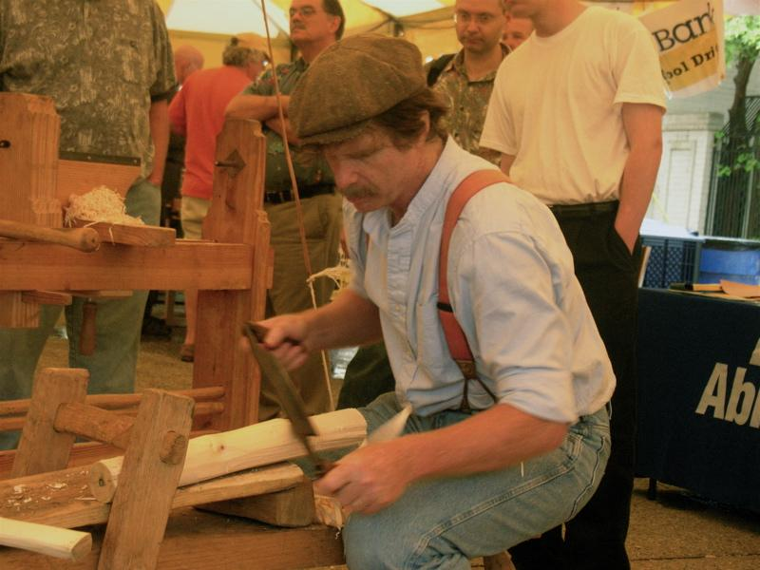
Are Teachers Artists or Scientists?
Notes:
Art vs. Science – it is more akin to being a craftsperson or an engineer. A scientist goal is to describe the world. Art is beyond analysis and it attempts to interpret the world through creative means. Education we are trying to change the world. We use science in a creative ways to change the world.
Classroom teacher will make more than 800 - 1,500 educational decisions every school day.
Explicit model teachers must master a set a skills – Trained and coached: This takes time, effort, and money.

Slide 21
Take Away Message?
We have a robust knowledge-base of practices supported by science that work and those that do not
Despite knowing what works, most teachers embrace constructivism
The constructivists are doing a better job of framing the debate
The foundation of explicit instruction, science, is misunderstood by the public
Constructivist control of a majority of teacher preparation programs
In a head to head match constructivism is winning the short term contingency vs the long term contingencies
Notes:
Take Away is Being right is not enough

