Slide 1
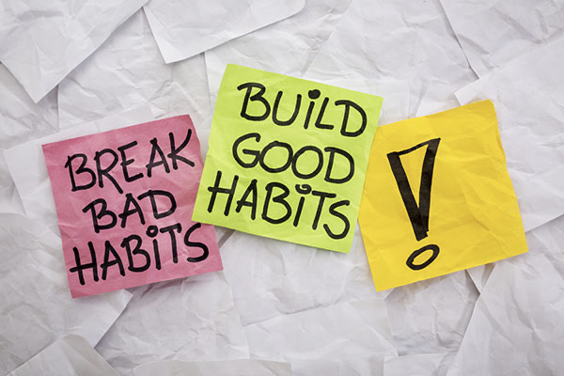
Personal Habits
Project Presented by
Md. Samin Yeasir Hasan
Notes:
Starting/Team Intro – Slide 1 , 2 - Shubhangi
Skit – Samin & Shubhangi
Central Problem – Slides 5,6, 7 - Samin
Persona, Target Audience, Early adaptors – 8, 9, 10 - Shubhangi
Product intro , Prototype evolution – 12, 13, 14 – Videep
Product – physical calendar + Figma screen – 15,16,17 – Smriti
Digital App Journey, show the screens , value proposition - 19,20,21 – Sakshi
Business model overview - go-to-market strategy, price model, sale distribution – 22, 23, 24 - Xingshu
Product USP – Success value - Samin
Next steps & wrap up - Shubhangi

Slide 2



Process to identify a “Central Problem”
Initial Interviews [Exploration]
  Gaining perceptions regarding Personal Habits.
  Understanding the overall process in shaping habits, decision makers and motivation behind it.
  Identifying major pain points in accomplishing a goal related to habits : namely - starting a new habit, breaking a bad habit or staying consistent.
More in-depth interviews [2nd round data-collection]
  Narrowing down on most-stated pain points that we can address.
  Identifying the different personas we discovered.
  Comparing the personas for overlapping insights & behaviors.
  Selecting one to proceed for solution ideation and concept.
Finalizing our persona & the key problem
  Our chosen persona - un organized student, big time procrastinator but highly motivated to make an active change and needs help & tool to succeed.
  Addressing the key reason leading to procatination i.e., high unorganized on his submission due dates , class schedules and other events of interest.
*Illustrations from Google images
Notes:
Add user quotes to prove the stated pain points

Slide 3




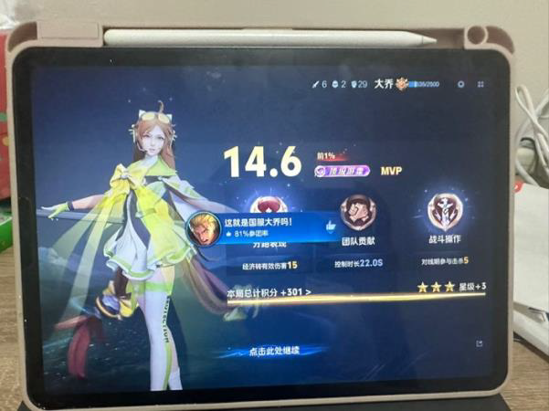

Observed Habits & Pain Points
Visual mapping of primary distractions and daily behavioral challenges
HABIT 01
Unorganized Space
A cluttered environment directly hinders focus, leading to cognitive fatigue and constant procrastination.
HABIT 02
Excessive Screen-Time
Late-night phone usage disrupts sleep cycles and drains mental energy required for next-day tasks.
HABIT 03
Social Media
Continuous notifications and doomscrolling create high distraction loops, breaking deep work focus.
HABIT 04
Mobile Gaming
Instant gratification mechanics in mobile games consume productive hours and replace healthy routines.
HABIT 05
Lack of Motivation
Without clear goals and visual progress tracking, procrastination easily takes over daily schedules.
*Some pictures are AI generated.Personal Habits Research • Group 3

Slide 4

Root Cause Analysis
Mapping the top 3 behavioral pain-points to our central problem
EFFECTS
INCONSISTENCY
Broken Habits
Habits tend to break easily after major life changes.
ATTENTION DEFICIT
Screen Addiction
Excessive screen time disrupts focus and daily routines.
DISORGANIZATION
Deadline Overwhelm
Poor planning leads to sudden stress as deadlines approach.
CENTRAL PROBLEM
Disorganized &
Procrastination
CAUSES
REINFORCEMENT
Context-dependent routines combined with shame-based systems.
DOPAMINE
Missing dopamine replacement, lack of community support, and absence of gradual transitions.
PHONE DEPENDENCY
Lack of an integrated physical-digital system to organize tasks.
*Illustration from Google images

Slide 5


User Persona
Comfortable Campie
DESCRIPTION
Campie is a 25-year-old student navigating life far from home. Her days begin with a comforting breakfast routine and a cup of coffee before a packed schedule of classes. In between, she connects with friends but often finds herself spending hours scrolling through social media until late at night.
MOTIVATION
Driven by immediate comfort, social interaction, and external deadlines. She wants to improve her habits for health and academics but often chooses present enjoyment. Her motivation spikes under deadline pressure but quickly fades once that pressure lifts.
“
I know it's bad, but I enjoy this life. I do want to change!
”
BEHAVIORAL PATTERNS
Her day begins with intentional routines, but resolve fades as stress builds. Even though she feels guilt and worry about excessive scrolling and missed goals, she rarely takes decisive action unless prompted by looming deadlines or external support.

Slide 6

Target Customers
Self-aware procrastinator and unorganized students and young professionals, in the age range of 18-35 years, who are highly motivated but struggling to change.
*Illustration from Google images
Notes:
Target customer:
Students at university at undergraduate and graduate levels.
Young professionals.
Age range of 18 – 35 years.
Samin - Students and young professionals self-aware procrastinators in the age range of 18-35 years. (in class)
Sakshi – Self-aware unorganised students and young professionals in the age range of 18-35 years who are highly motivated to change but struggling.

Slide 7

Early Adopters
Highly motivated tech-enthusiasts, students and young professionals.
*Illustration from Google images
Notes:
Note – Early adopters can be different from our prime target audience.
Target customer
Students at university at undergraduate and graduate levels.
Young professionals.
Age range of 18 – 35 years.

Slide 8
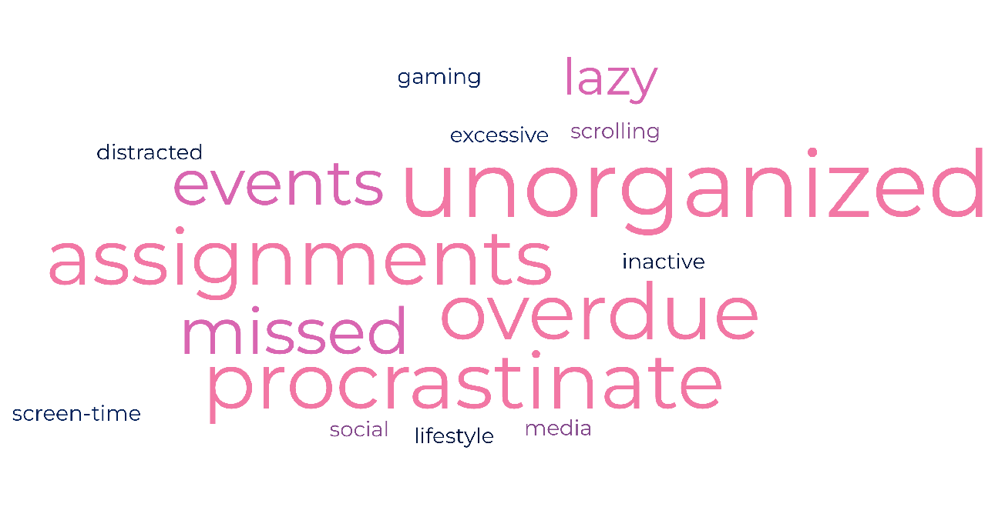
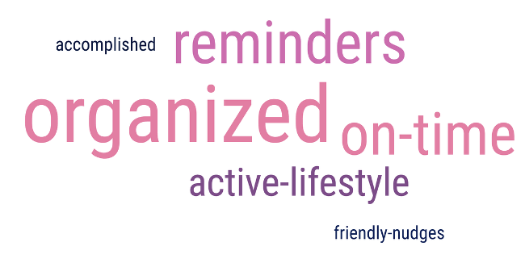
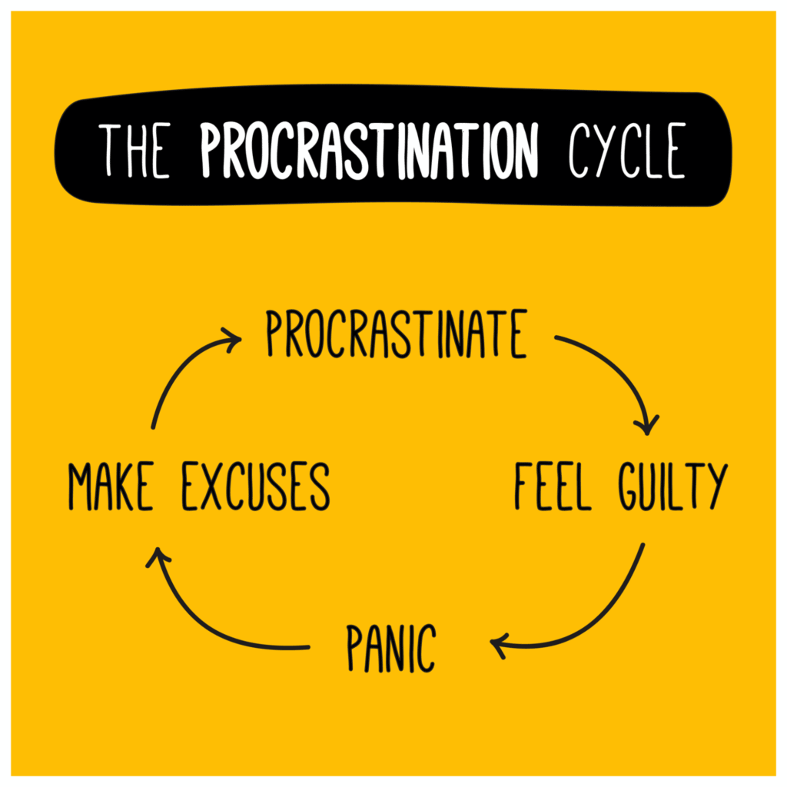
Solution Concept
Major Pain-points
Changing them to plus-points
Break the cycle!

Slide 9
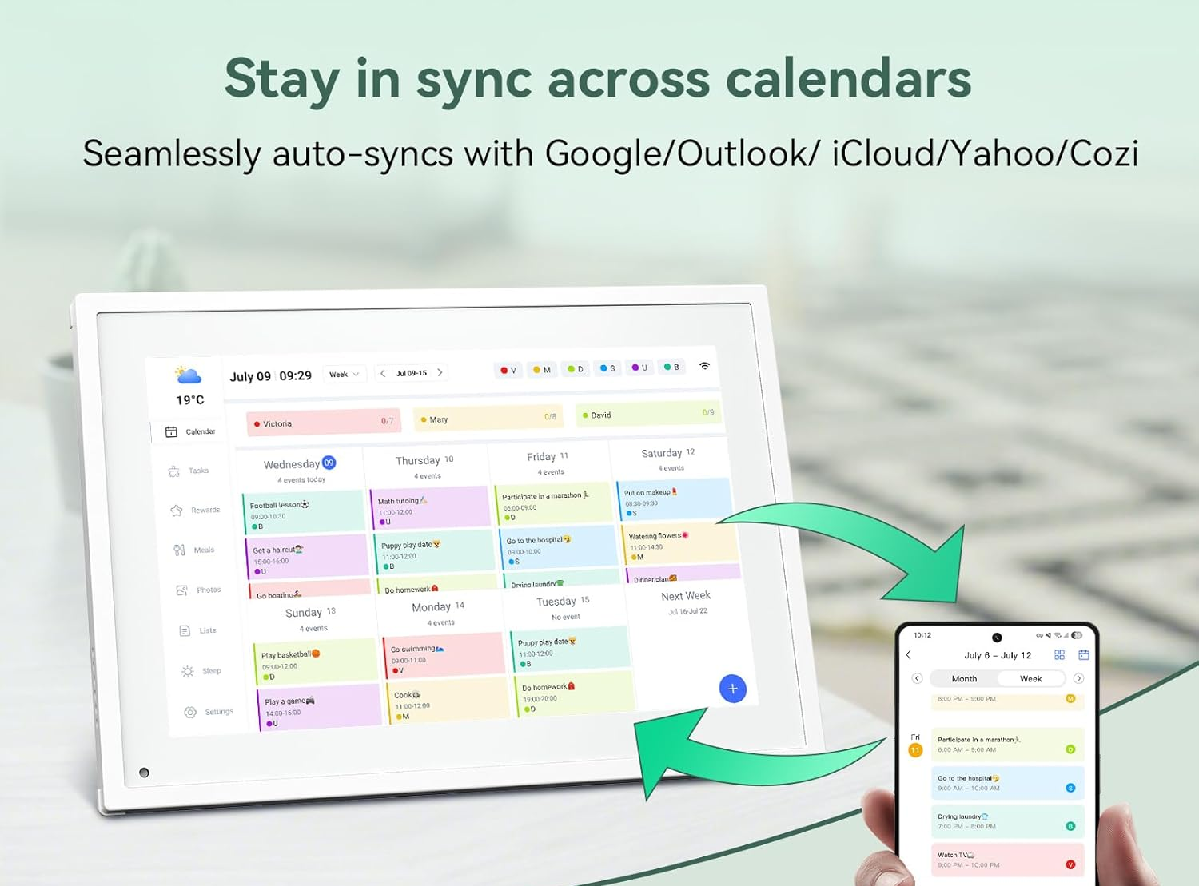
Introducing the Solution-
“FlowHabit”
Redefining the good-old calendar with the new-age digital features!
*AI generated image
Notes:
A physical-digital calendar
Keep on the desk or hang on a wall
AI-enabled to take voice notes
Customizable to one’s preference
Fun & Engaging
Easy setup & sync with all other calendars
One-stop for all events & schedules
Reminders, Alarms, to-do lists, chore charts,
and so much more…..

Slide 10

Prototype Fidelity Evolution But it wasn’t that easy...
01 / CONCEPT
Initial Solution
Started with a physical desk calendar.
Limited features (basic calendar, reminders, voice notes).
No digital app integration.
No reward or loyalty-points system.
02 / EVAL
Usability Test
Tested versatility with desk or wall mounting options.
Identified need for digital sync with other calendars & mobile.
Requested features: to-do lists, alarms, chores, & calendar sharing.
03 / UPDATE
Prototype Iteration
Engagement drivers: • Interactive character
• Motivational quotes
• Color visual aids
• Loyalty/streak points
Added "Mobile App" for integration & user flexibility.
04 / TEST 2
2nd Usability Test
Introduced AI-driven automatic event creation.
Observed significantly more positive feedback on the new version.
Improved product likeability & user acceptance.
Digital sync was validated as critical.
05 / FINAL
Prioritization
Wi-Fi connectivity & App sync.
Seamless calendar integrations.
Voice memo to event creation.
Enhanced visual cues & custom settings.
Procrastinator-friendly early deadlines (positive reinforcement).

Slide 11
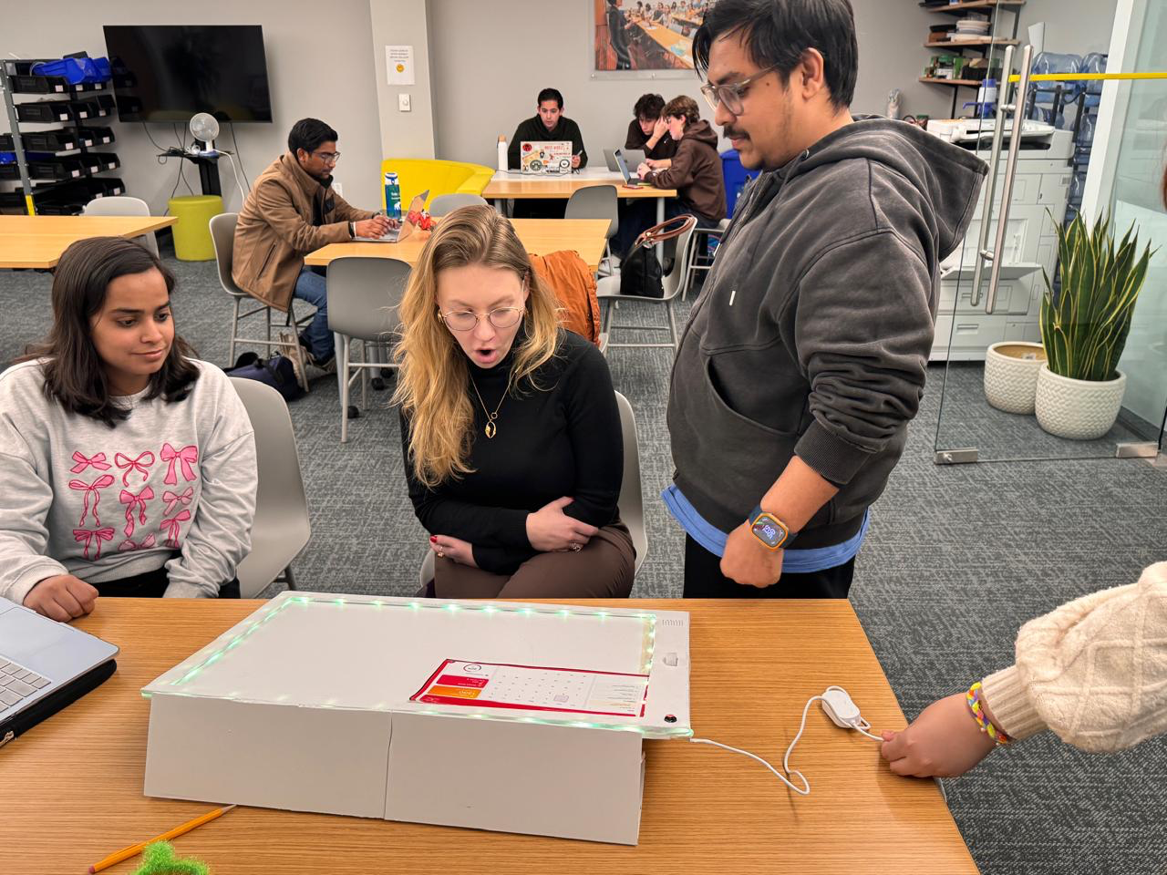
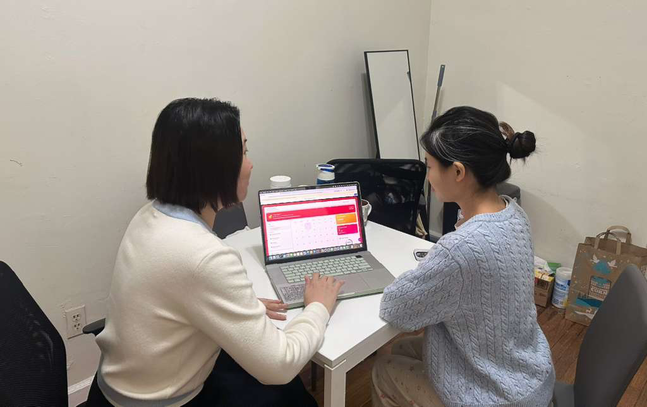
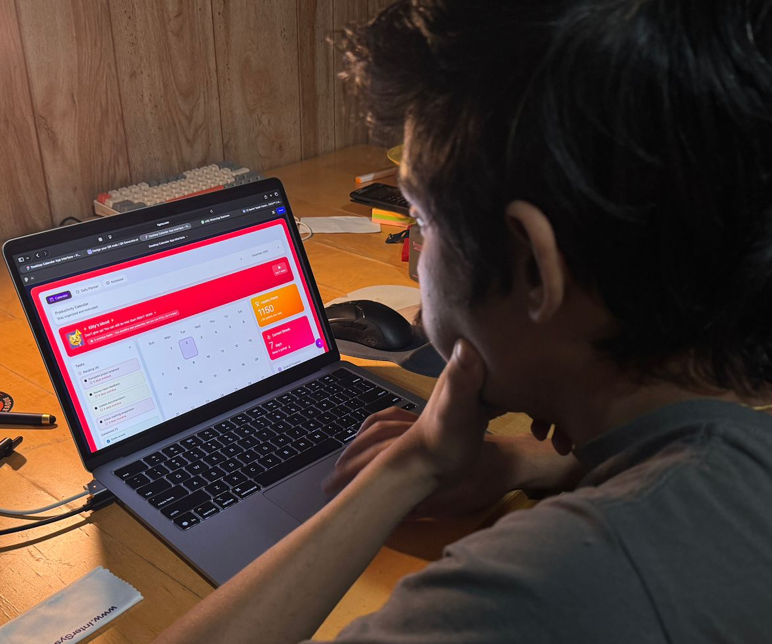
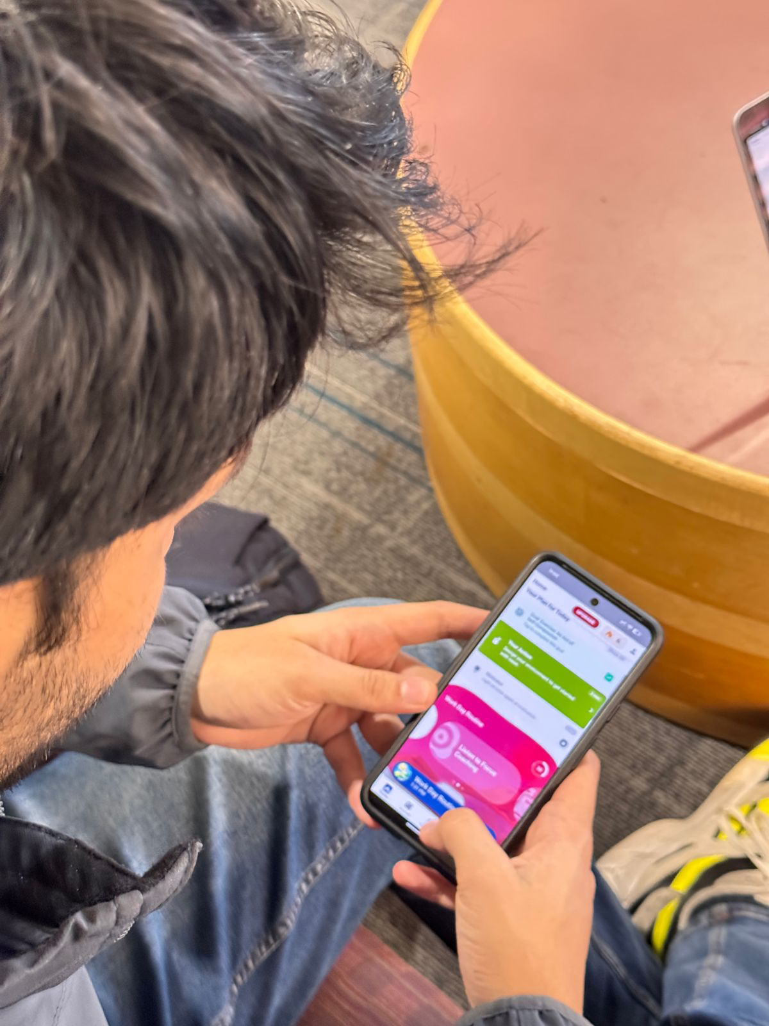
Usability test results
Category | Key Goal | Key Metric | Key Insight
Happiness | Supportive, motivating experience | Satisfaction score, sentiment | Tone of Kitty messages heavily impacts mood.
Engagement | Consistent task interaction | DAU, task count | Students engage more with visual feedback.
Adoption | Understand app in 3 minutes | Onboarding completion | Daily vs. Calendar confusion slows adoption.
Retention | Return even after missed days | Streak retention | Overdue overload decreases retention.
Task Success | Complete tasks easily | Task creation success | Add Task is smooth; task visibility needs clarity.

Slide 12
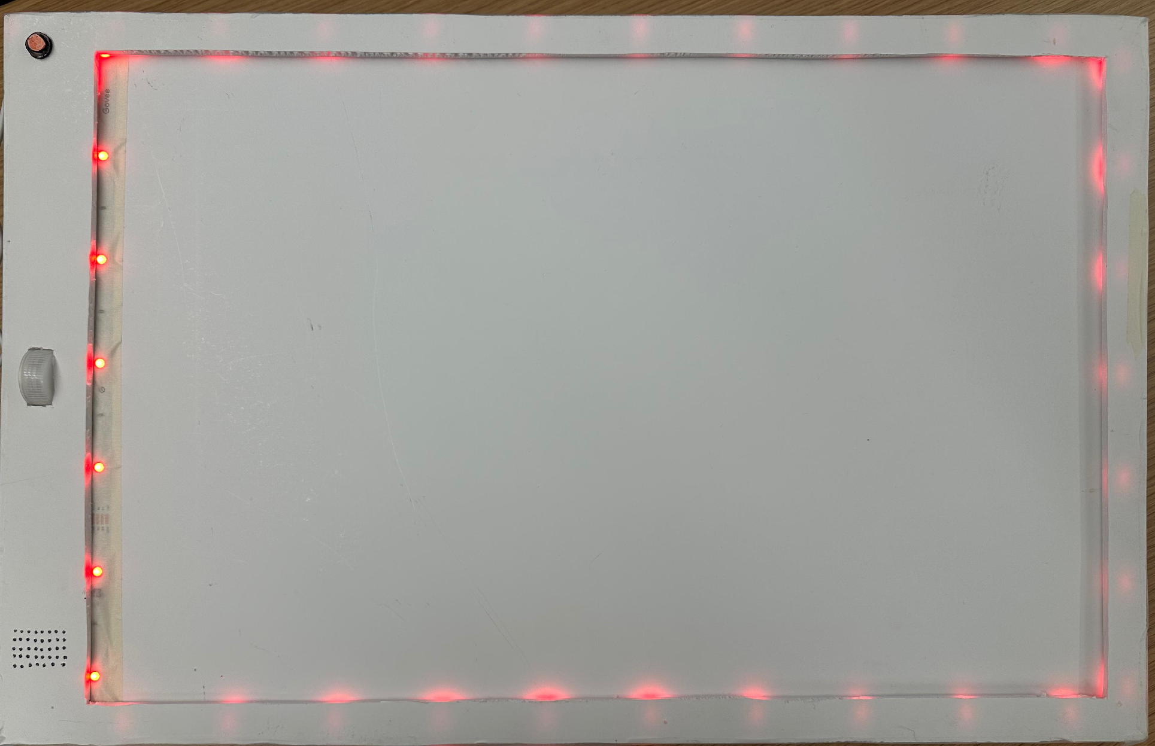
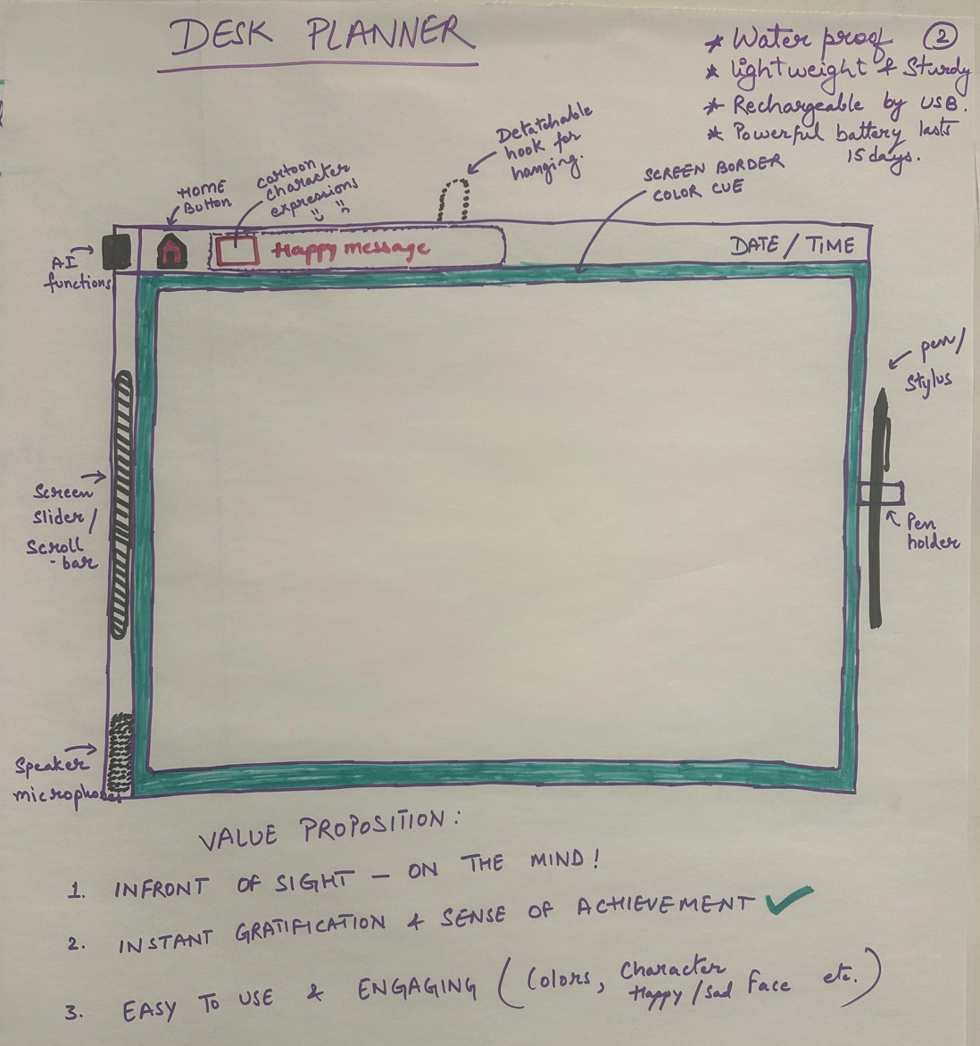
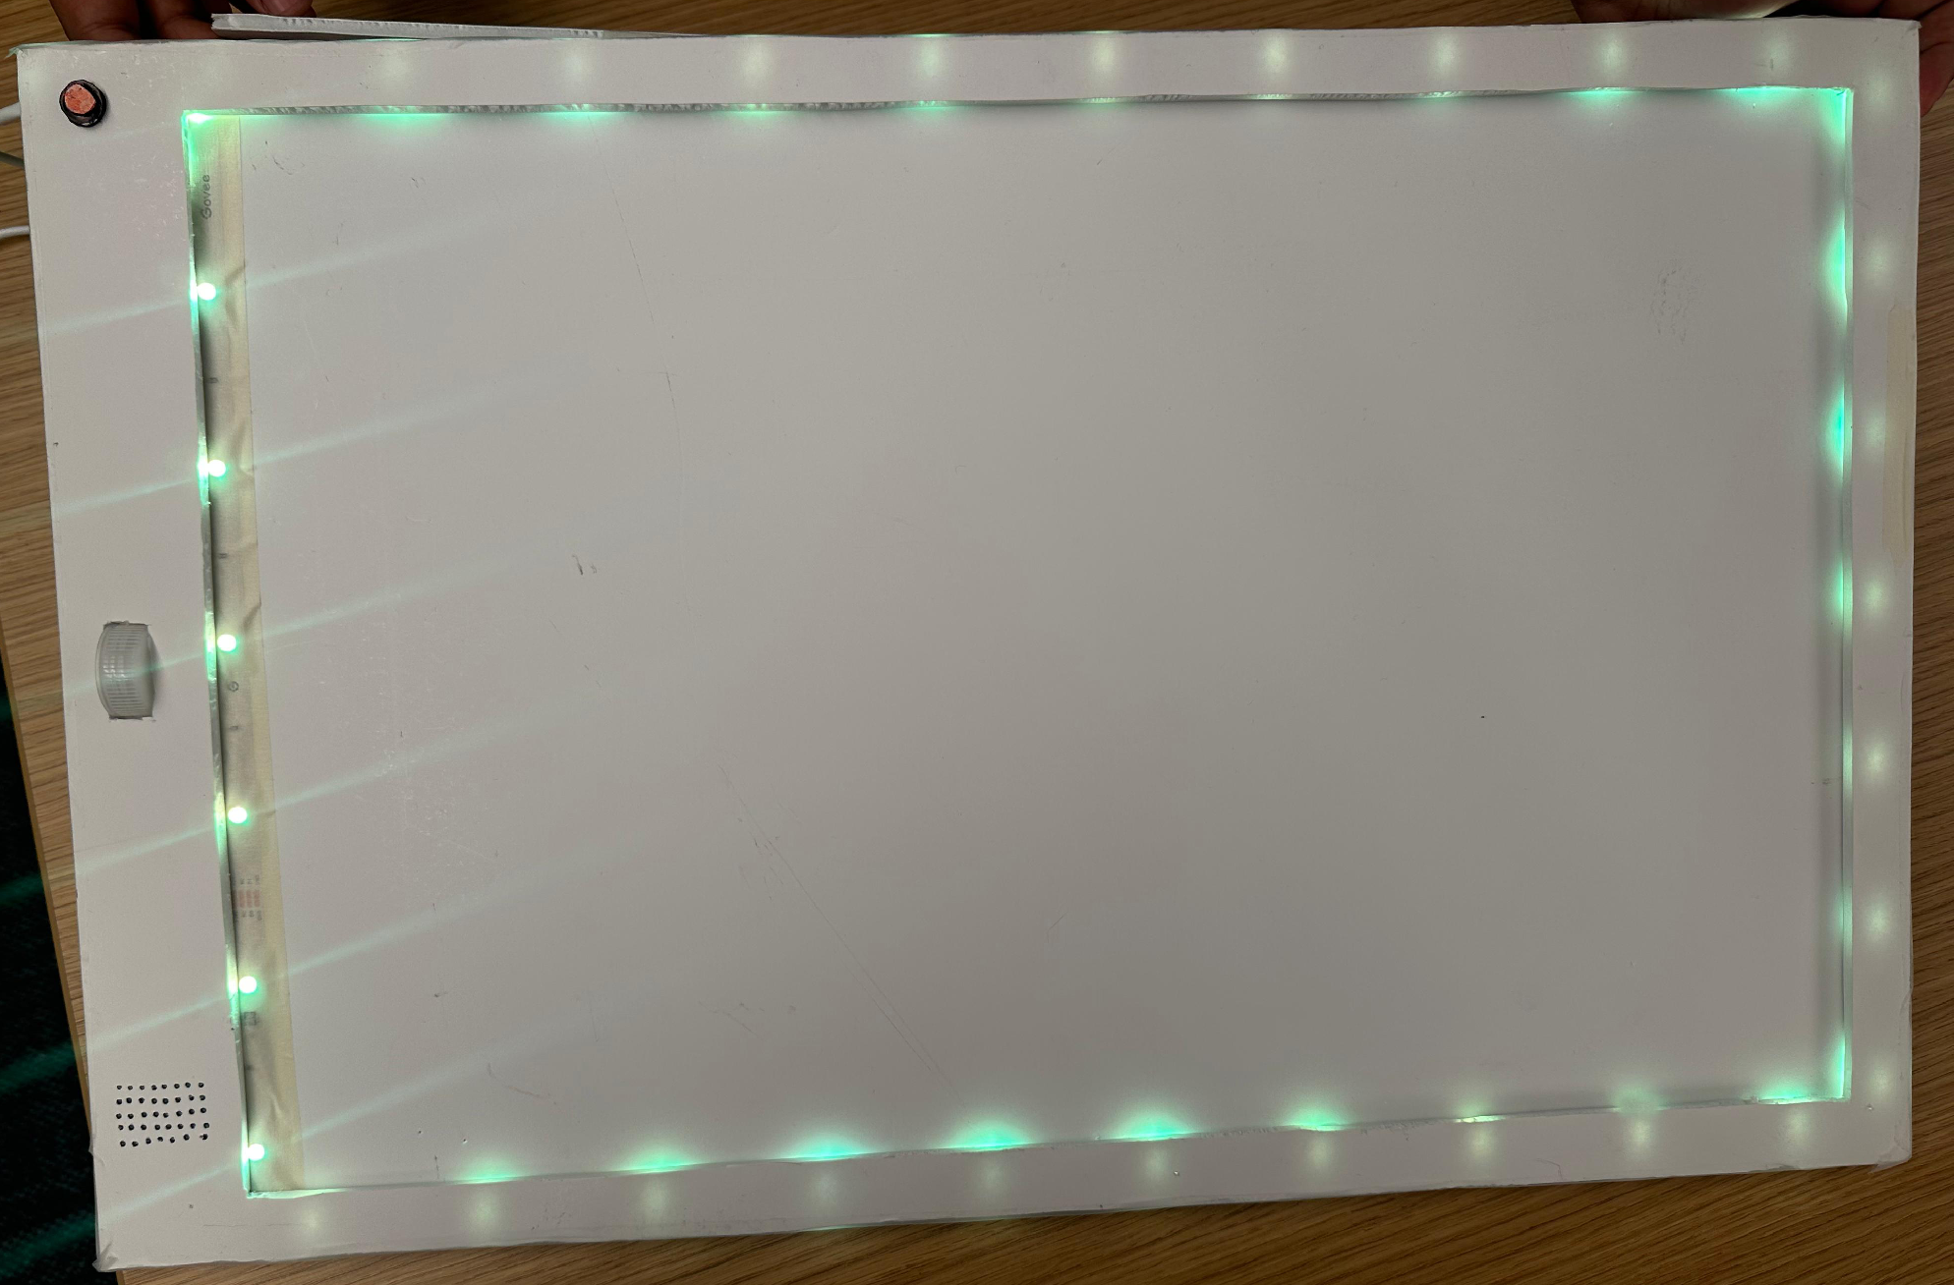
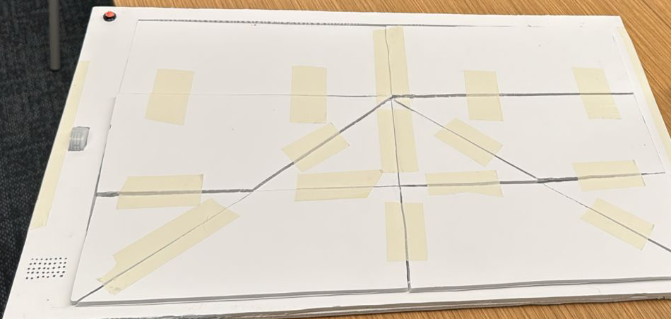
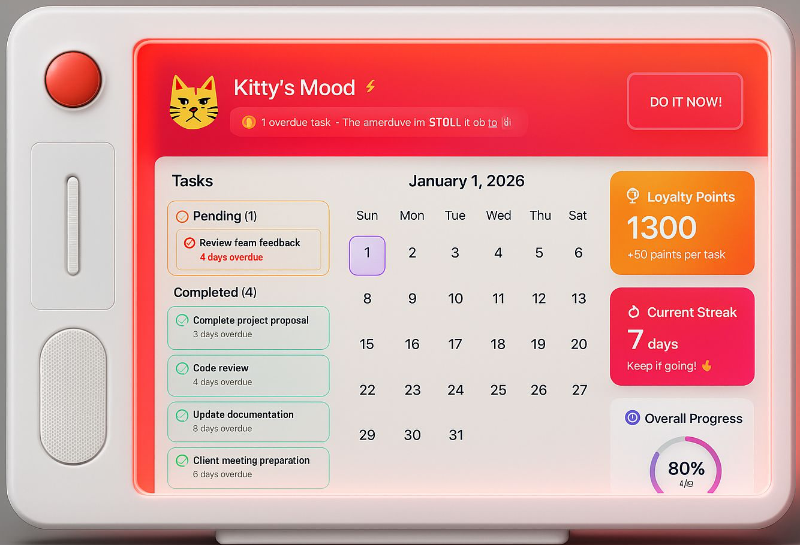
Prototype
Product (physical)

Slide 13
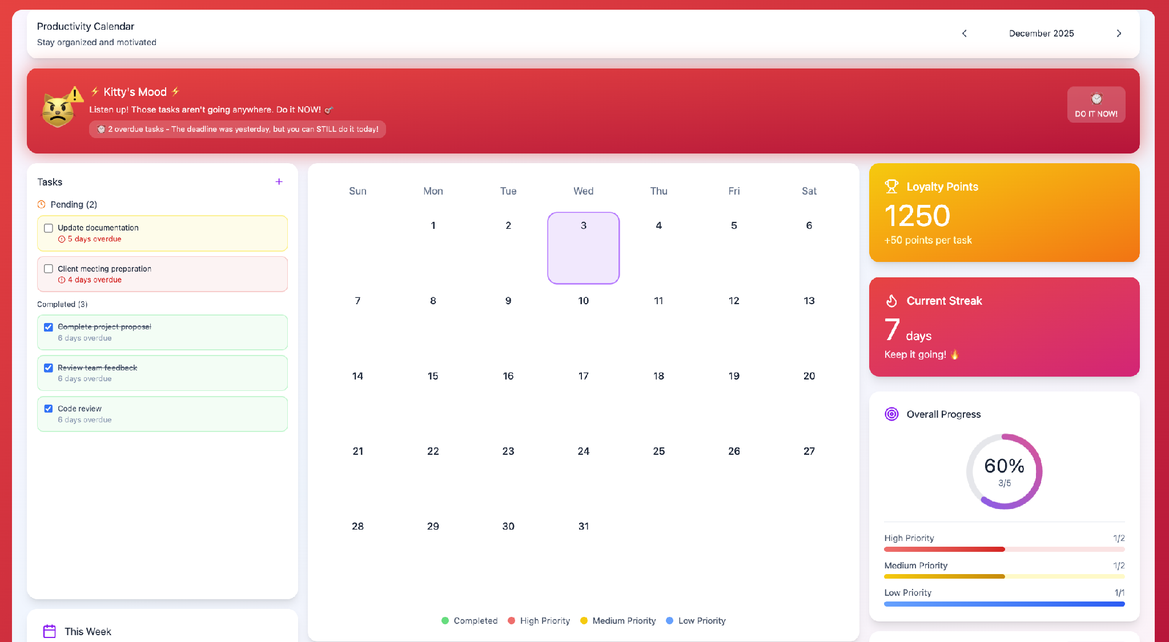
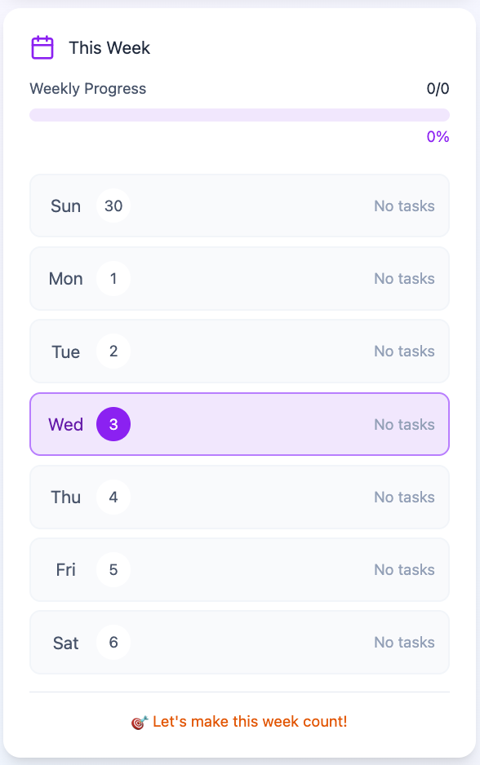
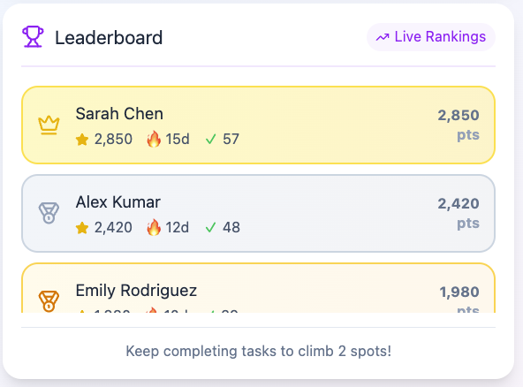
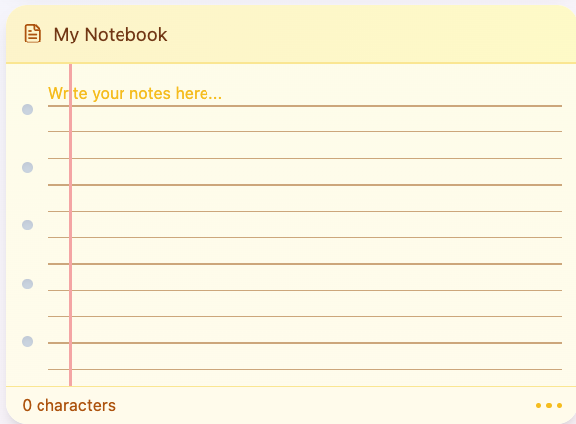
Screen Designs

Slide 14
Let’s try- Click on the Link
Design Screen (Figma)
https://www.figma.com/make/mX8cYx5GmqexVRffzVmPHa/Desktop-Calendar-App-Interface?node-id=0-1&p=f&t=ZcuNNkgZLiIDlZpW-0&fullscreen=1
Notes:
QR code to scan //. Live interaction with everyone.

Slide 15
FlowHabit App Journey
Supporting users at every step of their habit-building routine
01
02
03
04
Download & Sign Up
FlowHabit App is available to download for Android & iOS.
Easy sign-up using your email address to get started instantly.
Onboarding
Quick video tutorial guides users to start using their physical calendar.
Sync seamlessly with other device and calendar apps.
Customization
Customizable settings allow you to mold the app to your lifestyle.
Adjust Display, Privacy, & Account Settings easily.
Active Use
Get started by setting up your very first habit tracking task.
Easily accessible on all your preferred devices and screens.

Slide 16
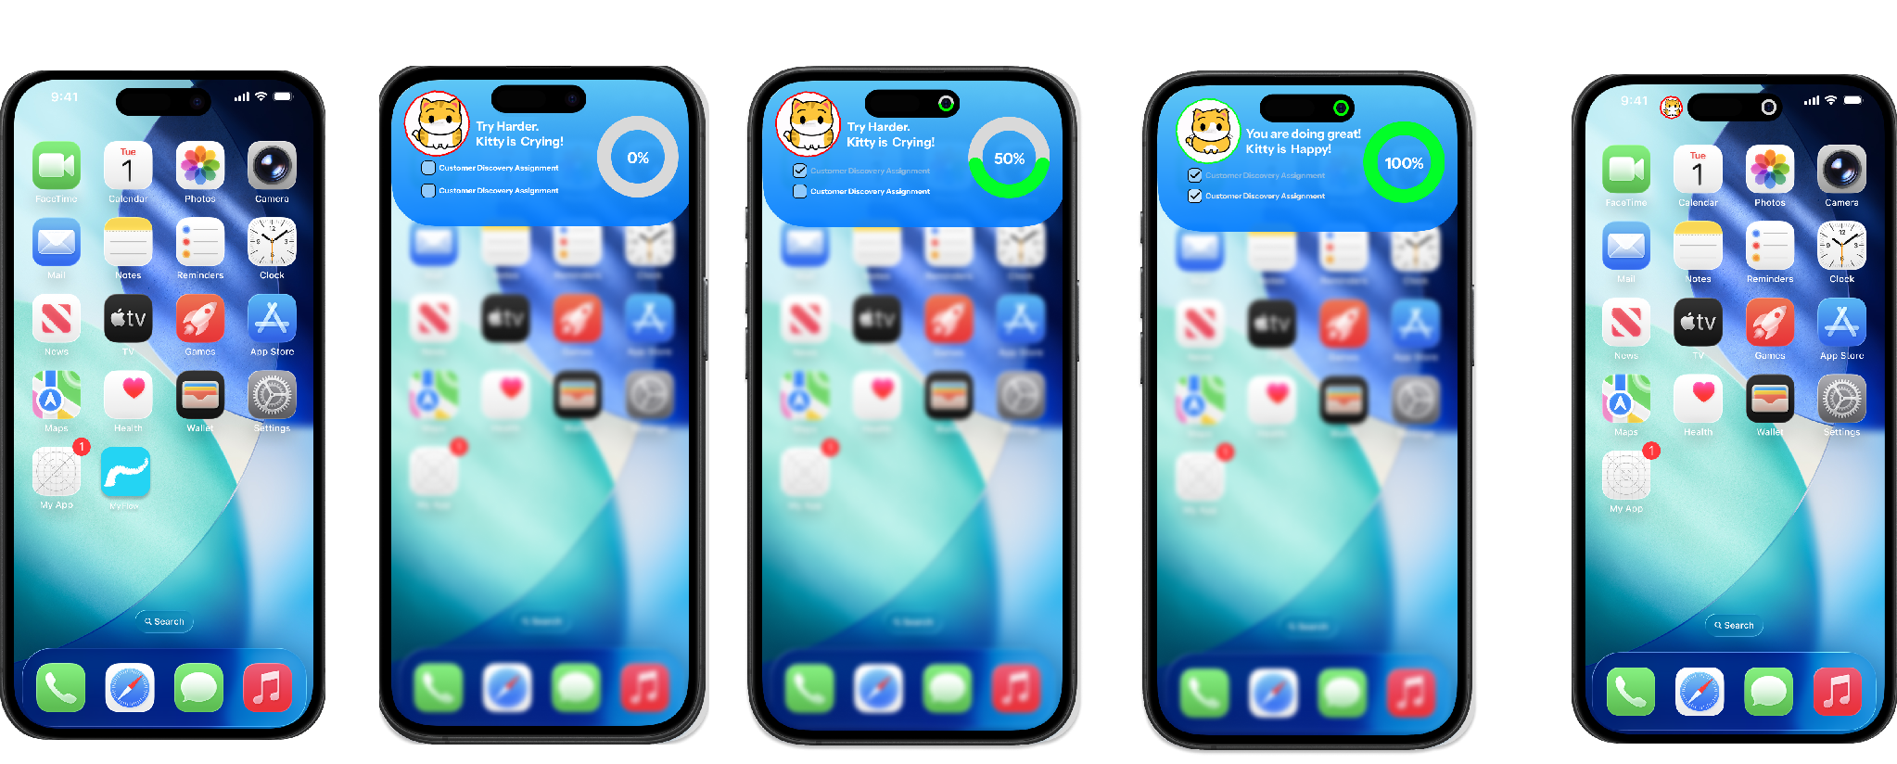
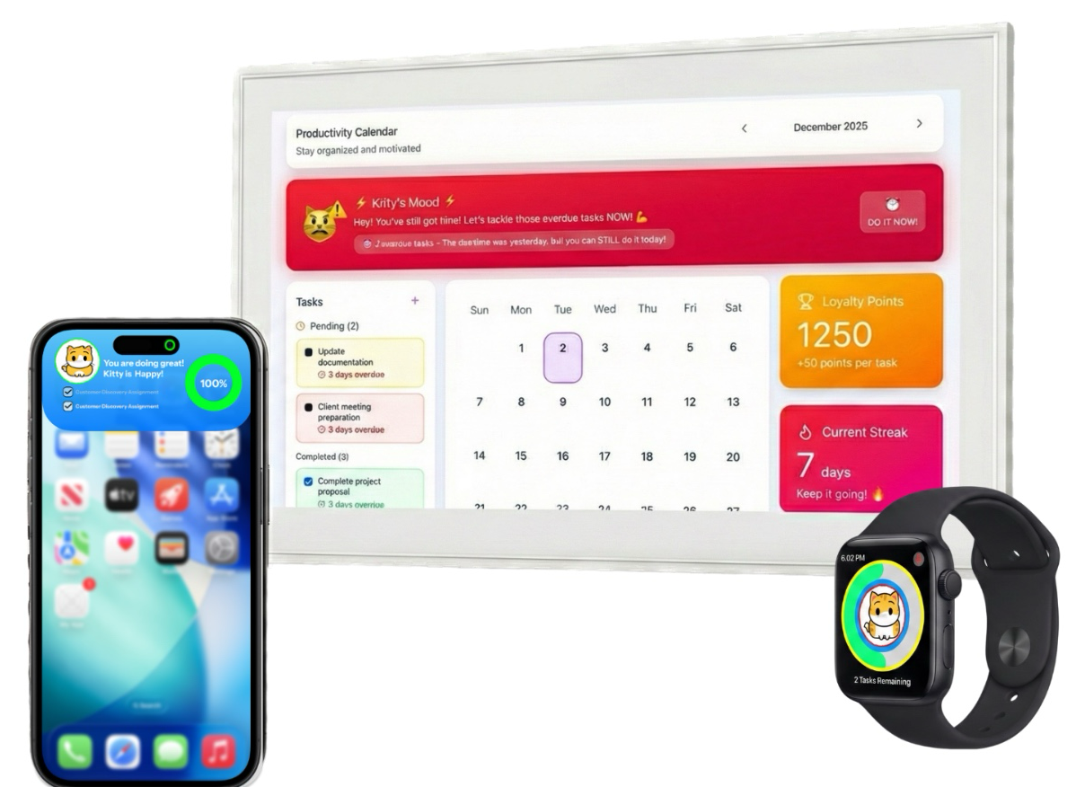
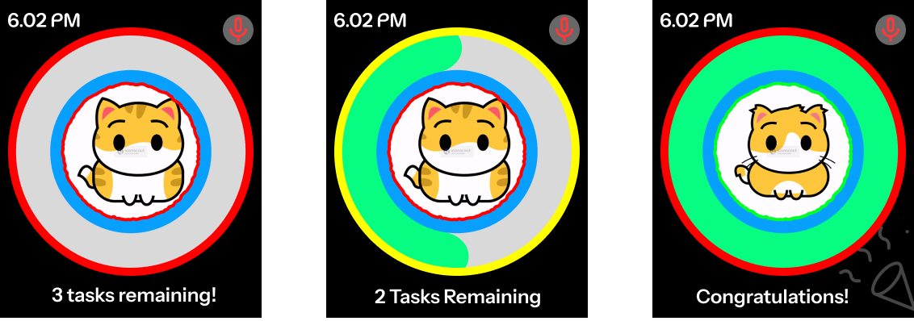
Available for all screens -
Desktop, Mobile and Smartwatch interface
Notes:
Desktop calendar >. App screens >. Mobile screens > smartwatch : user interface. - Showing accessibility on all digital screens

Slide 17
Value Proposition Canvas
Mapping FlowHabit's system capabilities directly to target customer profiles
VALUE PROPOSITION
CUSTOMER PROFILE
inventory_2 Products & Services
Physical planner
Tangible desk calendar hardware
E-ink display
Low-glare, ambient screen tech
AI voice scheduler
Voice-activated scheduling engine
Wearable integration
Haptic wrist-device sync
Mobile companion app
On-the-go habit companion
add_circle Gain Creators
Creates structure & control
Enables clean daily momentum
Improves target focus & productivity
Builds pride and self-efficacy
Fosters community support structures
assignment Customer Jobs
Organize complex deadlines, reduce procrastination, maintain daily momentum, regain focus, balance personal structure, and build flexibility.
trending_up Desired Gains
Control, organization, reliable momentum, elevated productivity, pride in self-efficacy, holistic wellbeing, and robust peer community.
remove_circle Pain Relievers
Eliminates systemic disorganization
Reduces constant screen & phone distraction
Consolidates tool fragmentation
Breaks the damaging guilt-shame cycle
Fixes failing habits & provides direct support
report_problem Customer Pains
Disorganization, screen/phone addiction, fragmented tools, isolation, habit decay, and a persistent cycle of deadline overwhelm.

Slide 18

Our Business Model:
Go-To-Market strategy
Pricing & revenue Model
Sales and distribution channels

Slide 19
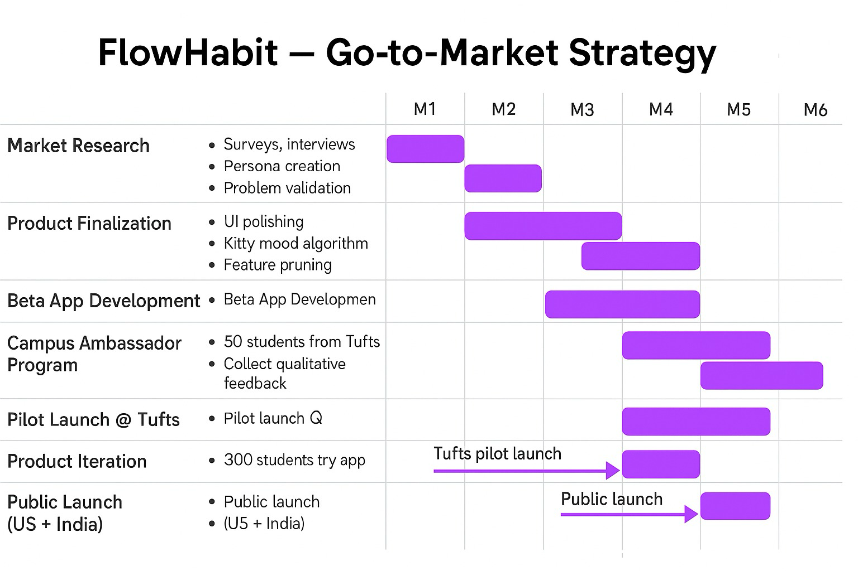

Slide 20




Revenue Model
What Users Get? | Free Tier | Premium Tier
Price | $0 | $9.99/month
Monthly Points | 25 | ✔️ Unlimited
Custom Tasks | 5 | ✔️ Unlimited
Kitty Mood | ✔️ Yes | ✔️ Yes
Leaderboard | ✔️ Yes | ✔️ Yes
Service Period | 1-month free trial | ✔️ Unlimited
Full Calendar | Limited access | ✔️ Full access
Daily Planner | Limited access | ✔️ Full access
Habit Tracking | Limited access | ✔️ Full access
Customize Settings | Limited access | ✔️ Full access
App Streak | Limited access | ✔️ Full access
Cross-Device Sync | 1 device | Up to 6 devices
Streak Freeze | ❌ | ✔️ Yes
Refund Challenge Option | ❌ | ✔️ Yes
Task Verification | ❌ | ✔️ Yes
Share Calendar | ❌ | ✔️ Yes
Advanced Analytics (Weekly Reports) | ❌ | ✔️ Yes
Mood-Based Recommendations | ❌ | ✔️ Yes
AI-Suggested Routines | ❌ | ✔️ Yes
Avatar Selection | ❌ | ✔️ Yes
“Razor-Blade” Model
(Example: Whoop)
Device is free.
Users pay $9.99/month for subscription.
If user completes more than 85% of monthly tasks they get: $4.99 as store credits.
(Example: Amazon gift card / Starbucks etc.)

Slide 21



Sales and distribution channels
Through our website
(Direct channel)
Partnerships with Tufts, Barnes & Nobles.
(Authorized Retailers)
Amazon
(eCommerce channel)

Slide 22
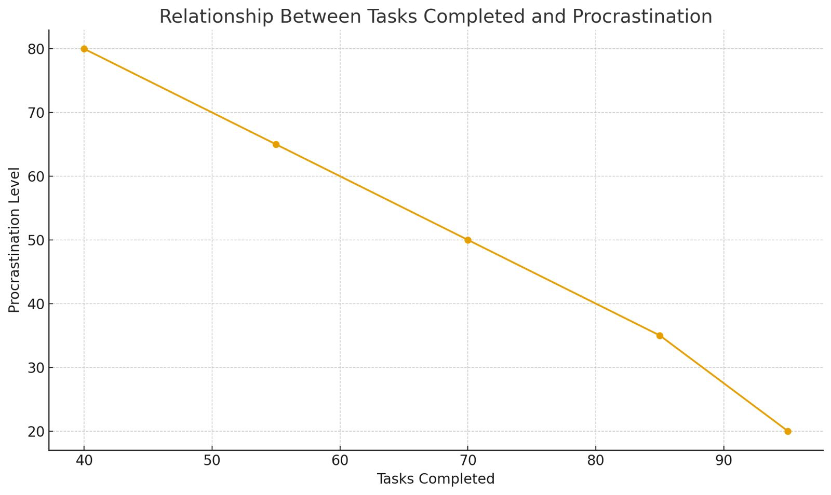

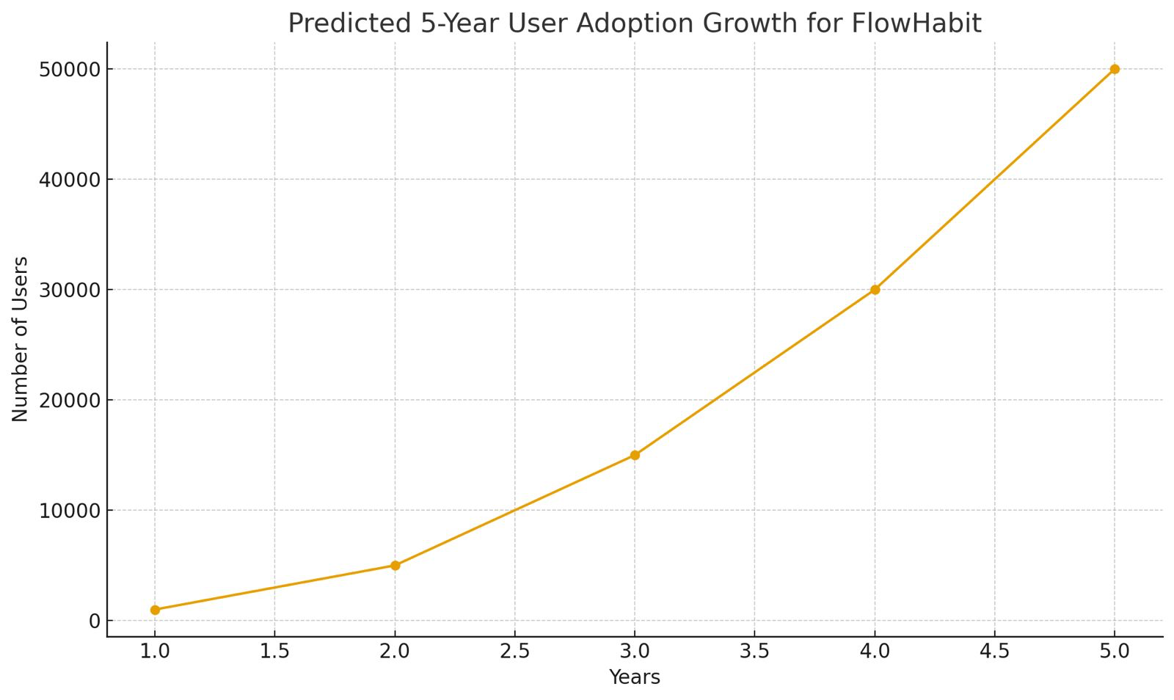
Measuring success and growth
Success metrics for the product :
  User adoption
  No. of subscriptions purchased
  Average revenue generated per user
  No. of app signups [prospective subscribers]
  Customer ratings & reviews
Tasks
Procrastination
Success for our customers:
  No. of tasks completed WoW / MoM
  User likeability & interaction
  User leaderboards & streak engagements
  User feedbacks & reviews
Growth

Slide 23
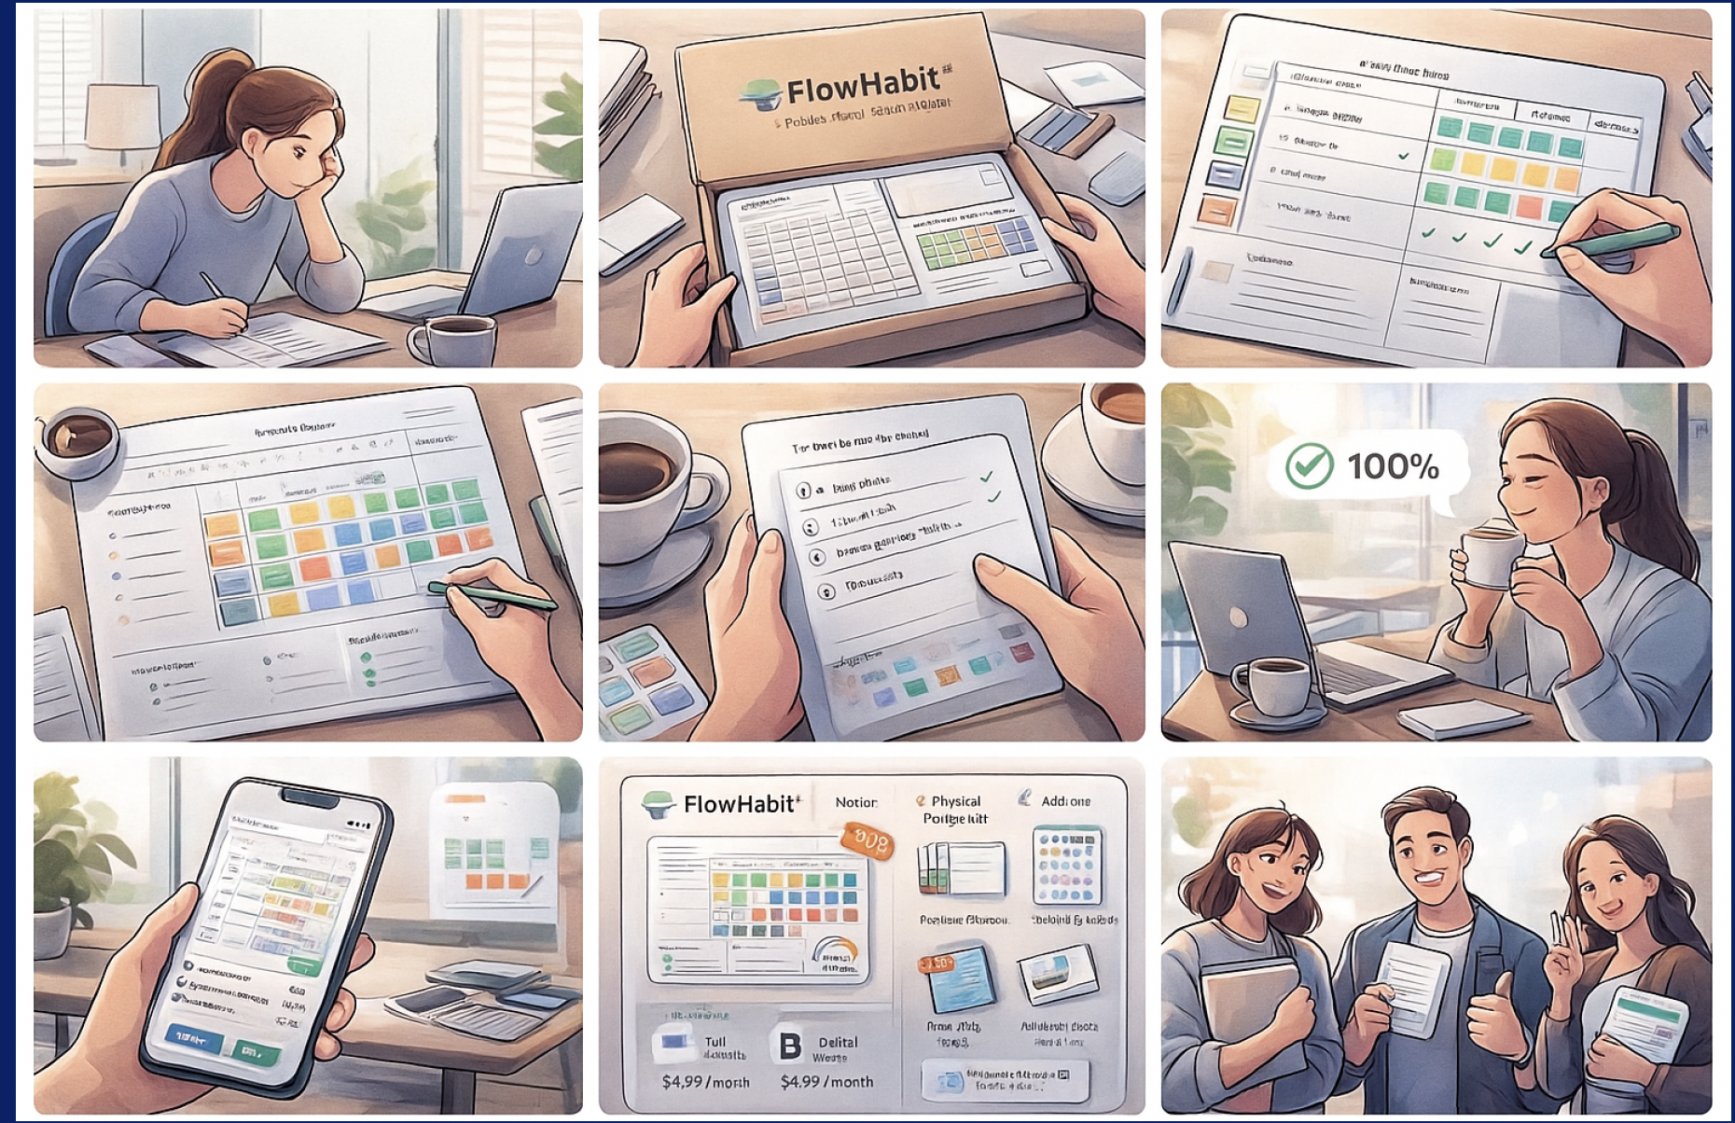
User storyboard!
Made for user’s success
Customer centric designs
Visual cues designed for customer engagement
Keeps you on top of your schedules!
Unique Selling Proposition
‘FlowHabit’ community
Leaderboard
Seamless connection across devices

Slide 24
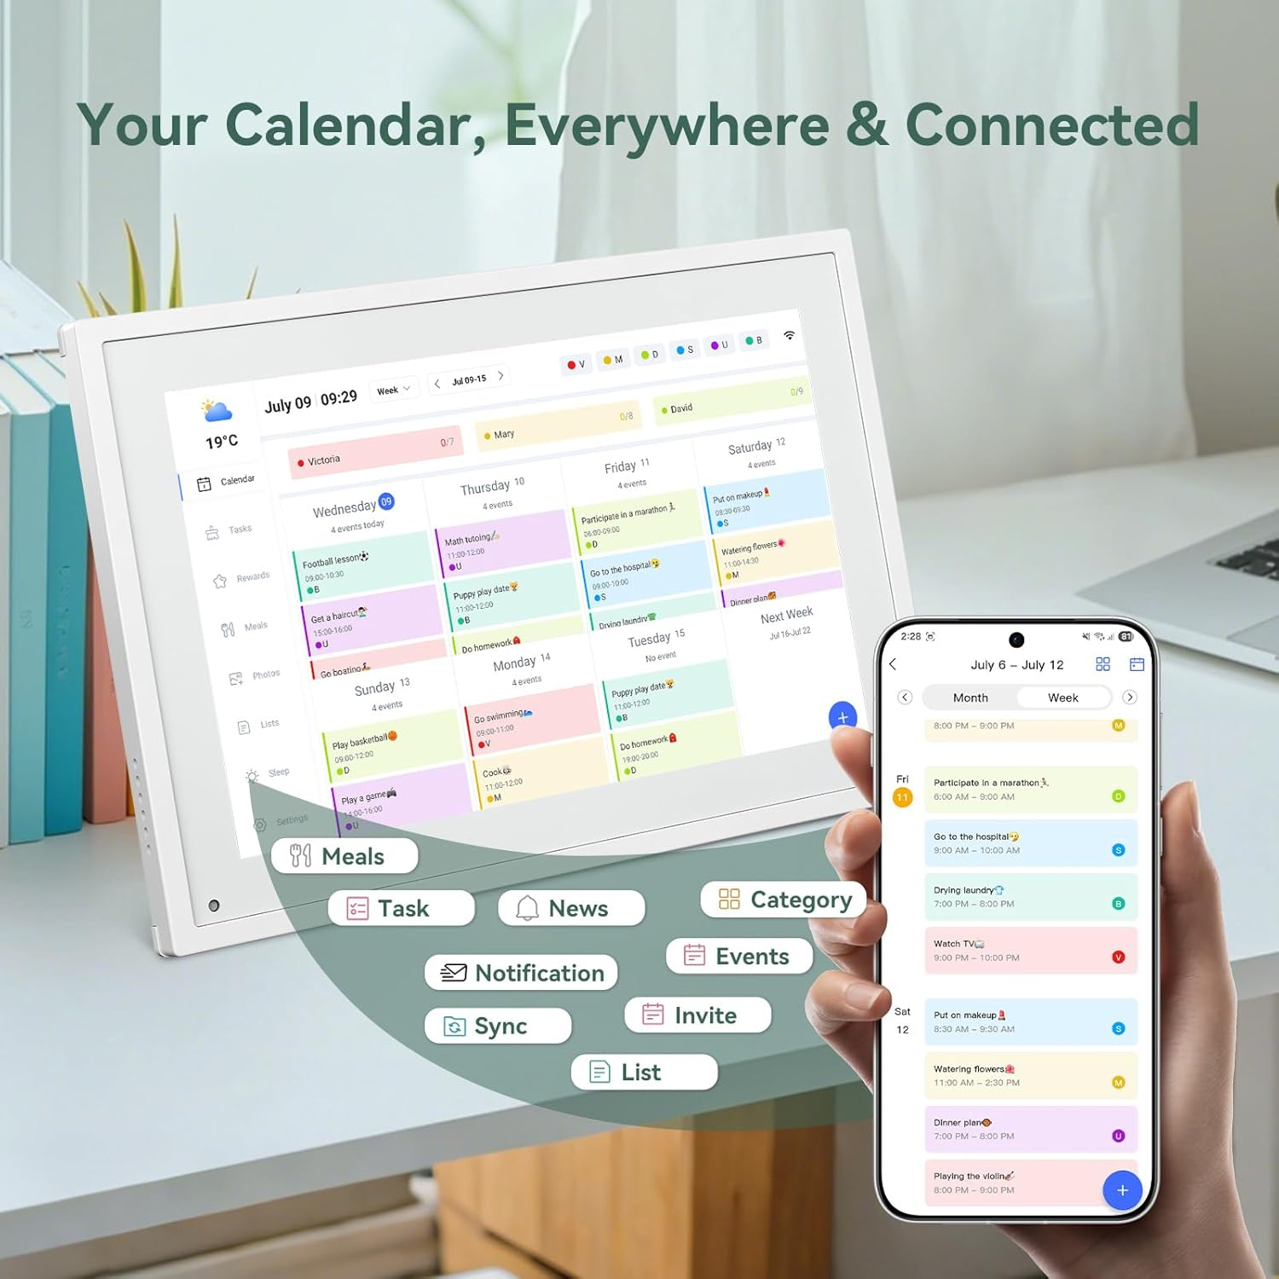
Made for user’s success!
The physical calendar can be easily set up on your desk or a wall
Plug in to use
Rechargeable with long-lasting battery power
Easy wi-fi connect
Seamless app-sync

Slide 25
Usability Tests
SECTION 1 — Warm Up
1. Previous planner/calendar usage?
“I use Google Calendar every day.”
“I buy physical planners but stop after 2 weeks.”
“Notion… but it overwhelms me.”
2. Willing to test a new student task product?
“Yeah sure, I love new planning tools.”
“If it reduces stress, I’m all in.”
“I’m chaotic, so yes please.”
SECTION 3 - CORE USABILITY TASKS
Task A - Add a Task/Event
“Oh this popup is neat.”
“Medium is default - nice.”
“Where does this task appear now?”
Follow-up: “How easy was this to do?”
“Really easy.” / “Straightforward.”
“I wish I could drag it into my daily view.”
Task B - Syncing Calendars
One-Stop Scheduling Feedback:
“If all classes auto-appeared, omg I’d love it.”
“I hate switching between 3 apps — this solves it.”
“Looks easy but not sure until actually synced.”
Follow-up Questions:
“Is the digital layout easy to understand?”
“Do you feel there is added value?”
  “Yes, huge value - one-stop view is amazing.”
  “I want my events auto-imported.”
SECTION 3 - CORE TASKS (Cont.)
Task C - Using the Daily View
Do they find empty timeline odd? Auto-population?
“Nice and minimal.”
“Why are tasks not showing automatically?”
“I want to drag tasks into time slots.”
Follow-up: “Is physical+digital combination helpful?”
“Helpful - laptop hides things, desk board always visible.”
“Digital alone won’t work for me.”
Task D - Rewards / Streaks / Progress
Do rewards/points motivate in other apps?
“Yes - Duolingo streaks actually work on me.”
“If points unlock skins/themes, I’d return daily.”
“I love the kitty reacting to my behavior - keeps it fun.”
Applying in FlowHabit - would it motivate?
“Yeah, I want to make kitty happy.”
“Streaks give me pressure but good pressure.”
SECTION 2 - First Impressions
1. First impression of FlowHabit?
“Cute - kitty gives me anxiety in a funny way.” / “Clean & colorful.”
2. Anything stand out immediately?
“The angry cat definitely.” / “Loyalty points feel like a game.”
3. How would this layout be used?
“Mix of planner + calendar + habit tracker.” / “Shows overdue tasks.”
4. Anything confusing at first glance?
“Where do points go?” / “Why is daily planner separate?”
5. Physical attributes feedback?
“The slider is cool.” / “Want it lightweight on my desk.”

Slide 26
Usability Tests
SECTION 4 — Usability Metrics
1. "How visually clear & organized?" (Scale 1–7)
Average score: 5–6
“Clean but some sections feel far apart.”
2. "What felt most confusing or difficult?"
“Daily planner being empty.”
“What are points for?”
“What does the angry kitty actually represent numerically?”
SECTION 7 — Usefulness Evaluation
1. "Does physical + digital feel helpful or cumbersome?"
“Helpful on exam weeks.”
“Cumbersome if syncing isn’t automatic.”
2. "Would you give FlowHabit a try?" (Scale 1–7)
Expected score: 5 or 6
SECTION 5 — Feature Feedback
1. Most valuable feature & why?
“Overdue task highlight”
“Kitty Mood”
“Points/streak gamification”
“Priority colors”
2. Is anything missing that you'd want?
Drag-and-drop tasks into timeline
Subtasks / Reminder system
Weekly goals
Ability to snooze/shift tasks
3. Kitty + Color appeal: Motivating or childish?
“Cute but not too childish.”
“I love the angry cat — it pushes me.”
“Maybe allow changing character.”
4. What would make it more engaging?
More animations/moods
Daily challenges / Study timer
Sound/vibration haptics
SECTION 6 — Willingness to Adopt
1. Acceptable student pricing?
“$10 is okay if it actually helps.”
“$15 max with physical board.”
“Subscription: maybe $4–$7/month.”
2. Price range $10–$25
Most students say $12–$18
3. Personal willingness to pay
Median: $15 (with board included)
SECTION 8 — Final Wrap-Up
"Any last thoughts or advice?"
“Add reminders.”
“Auto-sync everything.”
“Make kitty react more dynamically.”
“I wish the daily view auto populated.”

