Slide 1
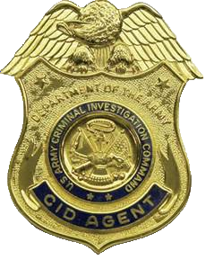
The Wickenburg Massacre
A Criminal Investigator’s Perspective

Slide 2
November 5, 1871
About 0700, a Concord Stage Coach belonging to the Arizona Stage Company leaves Wickenburg, Arizona Territory bound for Ehrenberg, Arizona Territory via the La Paz Road, with nine souls on board.
About 0715, two miles west of Wickenburg, passenger Aaron BARNETT discovered that he had left something important in Wickenburg, and had the stage coach stop so he could walk back to town. That action almost certainly saved his life.

Slide 3
November 5, 1871
About 0800, as the stage slows to enter a wash by a hillside some eight miles west of Wickenburg, the driver, “Dutch John” LANCE, yells, “Apaches! Apaches! Apaches!”
Immediately, the coach is struck by a devastating volley of rifle fire coming from Mesquite bushes erected as concealment on the hill south of the road. Some of the attackers fired from as little as six feet away.

Slide 4
November 5, 1871
The lead horse on the left side of the team is killed, and the other lead horse wounded, effectively immobilizing the coach.
LANCE is killed instantly. Charles ADAMS and Frederick LORING, who had chosen to ride atop the coach are both mortally wounded, falling from the coach.
Within seconds, a second volley of rifle fire riddles the sides and rear of the coach.

Slide 5
November 5, 1871
Inside the coach, Frederick SHOHOLM, in the center of the rear seat, is dead, likely from the first volley, as his body is found still gripping the playing cards he held in life.
In the rear-facing lefthand seat, Molly SHEPPARD, the only woman passenger, is seriously wounded. William KRUGER, seated next to her, is slightly wounded, and William George SALMON, in the righthand front seat, is seriously if not mortally, wounded.
Peter M. HAMEL, in the righthand rear seat is the only uninjured passenger after the first two volleys.

Slide 6
November 5, 1871
As their attackers creep closer to the stage, HAMEL and KRUGER empty their revolvers at them, forcing them to retreat. There is no more rifle fire.
SALMON exits the stage, and, unable to stand, attempts to crawl away.
HAMEL exits the stage and attempts to either flee or draw the attackers away from the other wounded passengers.

Slide 7
November 5, 1871
KRUGER and SHEPPARD hunker down in the bottom of the stage coach. SHEPPARD obtains SHOHOLM’s loaded revolver and gives it to KRUGER. She arms herself with a broken bottle.
Five or six minutes pass. As their attackers again creep towards the stage, KRUGER and SHEPPARD jump up, yell at them, and KRUGER fires a shot, causing them to again retreat.

Slide 8
November 5, 1871
KRUGER and SHEPPARD exit the stage. KRUGER calls for anyone who can, to join them in fleeing.
ADAMS is the only one capable of answering them, and begs to go with them, but he is unable to move, so they must leave him to his fate.
KRUGER and SHEPPARD flee to the west, pursued by nine attackers, who fire on them with pistols. KRUGER sustains additional wounds.

Slide 9
November 5, 1871
KRUGER and SHEPPARD follow the wash to the west, keeping their attackers at bay by pointing the revolver and SHEPPARD’s bottle (which they may have mistaken for another pistol) at them.
Unknowingly, KRUGER and SHEPPARD pass a freight wagon train eastbound, led by freighter Wright H. BALL. Their pursuers spot the wagons with their armed teamsters and break off pursuit, returning to warn those looting the stage. The attackers depart hastily rather than face 30 to 40 heavily armed and alert teamsters.

Slide 10
November 5, 1871
BALL and his teamsters arrive at the scene of the massacre. HAMEL, scalped, is still alive but dies without regaining consciousness. They can only extinguish the fire and unhitch the panicked horses.
They then head directly for Camp Date Creek to report the incident to the Army.

Slide 11
November 5, 1871
About 1000, KRUGER and SHEPPARD are spotted by a mail buckboard about five miles west of the massacre site. Driver John NELSON takes them to Culling’s Well, some 20 miles west. He then unhitches one of the horses, and rides to Wickenburg to report the incident.
A twenty-man rescue posse is dispatched with a buckboard ambulance to Culling’s Well to rescue the survivors. About 2130, they locate KRUGER and SHEPPARD and transport them back towards Wickenburg.

Slide 12
November 5-6, 1871
About 2400, a five-man pursuit posse forms at Wickenburg and departs for the massacre site.
About 0030, the rescue posse arrives at the scene and recovers the bodies of LANCE, LORING, HAMEL, SHOHOLM, and ADAMS. They are puzzled to find the stage coach unhitched, turned around, and the harness stacked as if done by professional hostlers.
About 0130, the rescue posse arrives at Wickenburg with KRUGER and SHEPPARD, as well as the bodies recovered from the scene.

Slide 13
November 6, 1871
About 0700, the pursuit posse discovers SALMON’s body and buries him in “a deep cut in the side of a hill.”
About 0730, the pursuit posse begins tracking about 30 attackers.
About 0800, BALL and his teamsters arrive at Camp Date Creek and alert the Army.
About 0900, a detachment of cavalry under CPT Charles MEINHOLD is dispatched from Camp Date Creek to investigate.

Slide 14
November 6, 1871
About 1000, in Wickenburg, an inquest is held on the bodies brought into town. The inquest concludes that all victims died of gunshot wounds received at the hands of Indians from the Camp Date Creek Reservation.
About 1300, the bodies of LANCE, LORING, HAMEL, SHOHOLM, and ADAMS are reportedly buried side by side in a private graveyard reserved by town founder Henry WICKENBURG.

Slide 15
November 6, 1871
About 1430, the pursuit party discovers that the tracks of 30 attackers have been joined by an additional 20. They decide that the better part of valor would be to return to Wickenburg for reinforcements.
About 1600, CPT MEINHOLD and his detachment arrive at Wickenburg, where he interviews KRUGER and SHEPPARD.

Slide 16
November 7, 1871
About 0630, CPT MEINHOLD’s detachment departs for the massacre site to investigate.
About 1700, CPT MEINHOLD’s detachment returns to Wickenburg, having lost the attackers’ trail near the Camp Date Creek Reservation. They have discovered physical evidence of Yavapai Indian involvement in the massacre.

Slide 17
The Three Great Mysteries:
Whodunnit?
Where’s the Treasure?
Where Are They Now?

Slide 18
Whodunnit?
The List of Suspects Include:
Apache-Mohave (Yavapai) Indians.
Mexican Bandits.
White Renegades.
KRUGER and SHEPPARD.
Some combination of the above suspects.
The U.S. Gummint.

Slide 19
Whodunnit?
The U.S. Gummint
Conspiracy theorists believe the massacre may have been perpetrated by the Army to eliminate Eastern media sympathy for the Indians.
  While the massacre had that effect, it is absurd to believe that the government under President GRANT would murder citizens for political gain.
  Many local civilians were involved in the follow-up investigation. They would not have participated in such a cover-up.

Slide 20
Whodunnit?
Kruger & Sheppard
KRUGER and SHEPPARD may have perpetrated the massacre in order to steal the treasure, then inflicted injuries on each other to divert suspicion.
  They had no access to the rifles used in the massacre.
  In the late 19th Century, even minor wounds could prove fatal. Moreover, SHEPPARD’s wound contained wood debris from the side of the coach, carried into her arm by the bullet. (She, in fact, dies within a year from her wounds.)
  There was footprint evidence of numerous perpetrators.

Slide 21
Whodunnit?
White Renegades
SHEPPARD was queried by white men in Prescott about how much money she and the other passengers would be carrying.
  There was no unequivocal evidence of white involvement.
Whites would have known the strong box was empty.
ADAMS, the only passenger known to be carrying a large amount of money was the only one whose body was searched.

Slide 22
Whodunnit?
Mexican Bandits
A known gang of Mexican bandits was operating in the area at the time.
Charles GENUNG reported that a Mexican woman overheard Mexicans planning a stage robbery.
  His statements changed over time and contained assertions psycholinguistically shown to be deceptive.
  His accounts of other actions against the Yavapai conflict with the accounts of numerous other witnesses.

Slide 23
Whodunnit?
Mexican Bandits
Several Mexicans were killed, including one lynched, for alleged complicity in the massacre.
  No record of any evidence against the Mexicans exists.
A watch fob, purportedly LORING’s, was obtained from a Mexican woman by a soldier.
  LORING’s family was unfamiliar with it. LORING was not known to have owned a watch.
  The Mexican woman could have obtained it from anyone.

Slide 24
Whodunnit?
Yavapai Indians
All attackers were on foot. Yavapais traveled on foot.
Footprints were of Yavapai-style moccasins, which were distinctive from those worn by other tribes.
The attackers were trailed for more than 25 miles in the direction of Camp Date Creek, a Yavapai reservation.
  The tracks were lost among others near the reservation.
The tracks were pigeon-toed, a characteristic of Indians.

Slide 25
Whodunnit?
Yavapai Indians
An Indian-made bag of bone powder was found on the attackers’ trail. Bone powder was powerful Yavapai medicine.
A shot bag belonging to HAMEL was found among Camp Date Creek Yavapais.
Camp Date Creek Yavapais were spending US Currency in large denominations near Ehrenberg.

Slide 26
Whodunnit?
Yavapai Indians
Firing virtually ceased after two volleys of rifle fire. Indians were chronically short of ammunition, since they could not buy it without White assistance.
KRUGER positively identified the attackers as Indians. He later stated that when Camp Date Creek Yapavais spotted him near Ehrenburg, they quickly vanished.
White or Mexican attackers would certainly have finished off KRUGER and SHEPPARD to hide their identity.

Slide 27
Whodunnit?
Yavapai Indians & White Renegades
One set of moccasin tracks was significantly larger than the others, indicating a possible white man.
The strongbox was untouched. A white man from Prescott would have known it was empty.
Only ADAMS, who was known to be carrying a large amount of money, had his body searched.
SHEPPARD reported that she was asked by Whites in Prescott who might be carrying large amounts of money.

Slide 28
Where’s the Treasure?
Legend has it, there was a military
payroll of $100,000.00 on the coach.
BUT
There is no record of any loss of military funds resulting from the Wickenburg Massacre.
Any treasure would have been transported in the strong box. The strong box was undisturbed.
Military funds shipments were always accompanied by a cavalry escort. The coach had none.
Payroll shipments would have come from California to Prescott. The coach was headed west, not east.

Slide 29
Where Are They Now?
The current location of the victims’ graves is unknown.
The reported original location of the graves was “disturbed” in the 1940s.

Slide 30
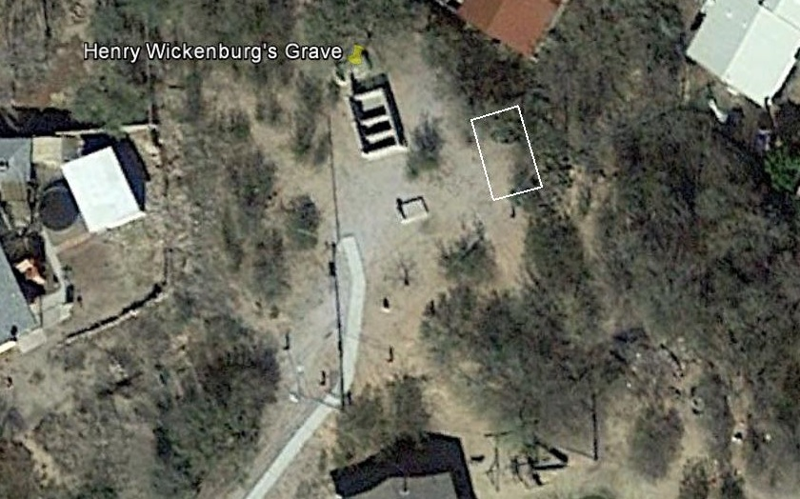
Where Are They Now?
Original Location of the graves in Wickenburg

Slide 31
Where Are They Now?
Possibilities:
The victims were originally buried at the massacre site. Reports of their burial in town were falsified to please relatives.
The victims were buried as reported, and their bodies bulldozed into oblivion in the mid-20th Century.
The victims were initially buried as reported, then reburied at the massacre site, along with other bodies later buried near them.

Slide 32
Where Are They Now?
Most Likely:
Reburial at Massacre Site
There are twelve or more graves at the massacre site. They were located by dowsing, but have not been scientifically verified. The extras may have been unknown or unmarked graves from the original burial site, secretly relocated so as not to impede “progress.”
The massacre site was rediscovered in the mid-1940s. News accounts from the late ‘40s have members of the Wickenburg Saddle Club visiting graves at the site.

Slide 33
Where Are They Now?
Most Likely:
Reburial at Massacre Site
The graves are located roughly where the victims originally fell, but not exactly. They most closely resemble early 20th Century news accounts of the massacre which have proven inaccurate.
The Wickenburg Saddle Club believes the victims are buried at the site. Their collusion would have enabled a construction crew to rebury the bodies where they were believed to have fallen for the purpose of “plausible deniability.”

Slide 34
Where Are They Now?
Most Likely:
Reburial at Massacre Site
The soil where many of the graves are is very rocky. It would have been difficult to hand-dig graves there, but a construction crew with a backhoe could dig the graves in a weekend.
In the early 1960s, LORING’s family was sent a picture of the cross on the cairn at the massacre site as being a picture of LORING’s grave.

Slide 35
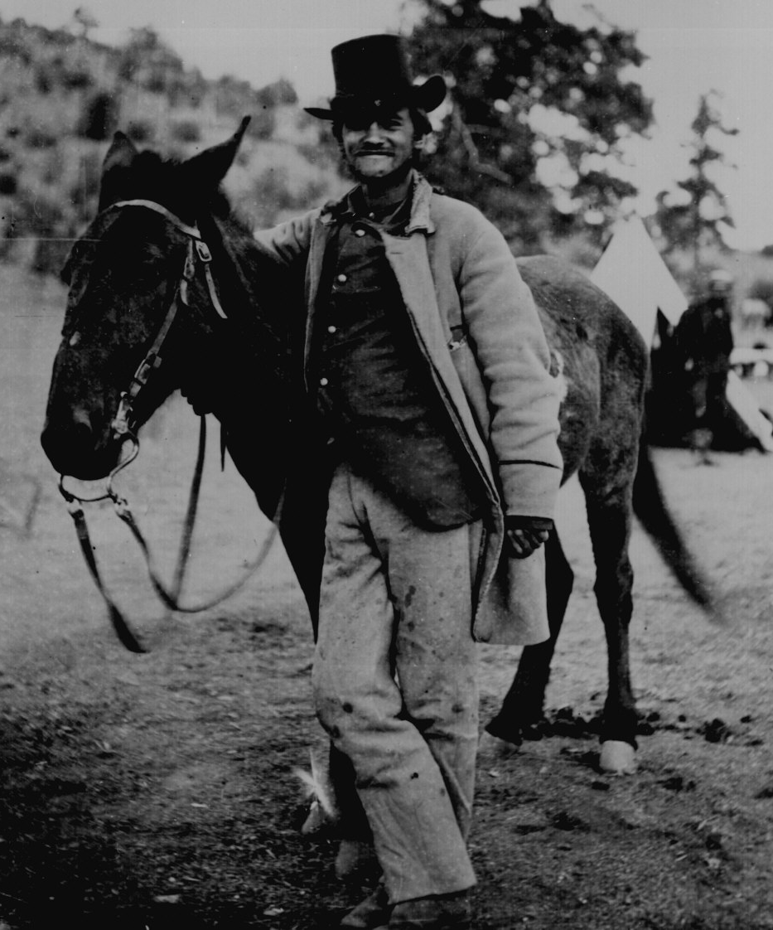
Where Are They Now?
Most Likely:
Reburial at Massacre Site
Frederick W. LORING poses with his mule, “Evil Merodach” two days before he was killed in the Wickenburg Massacre.

Slide 36
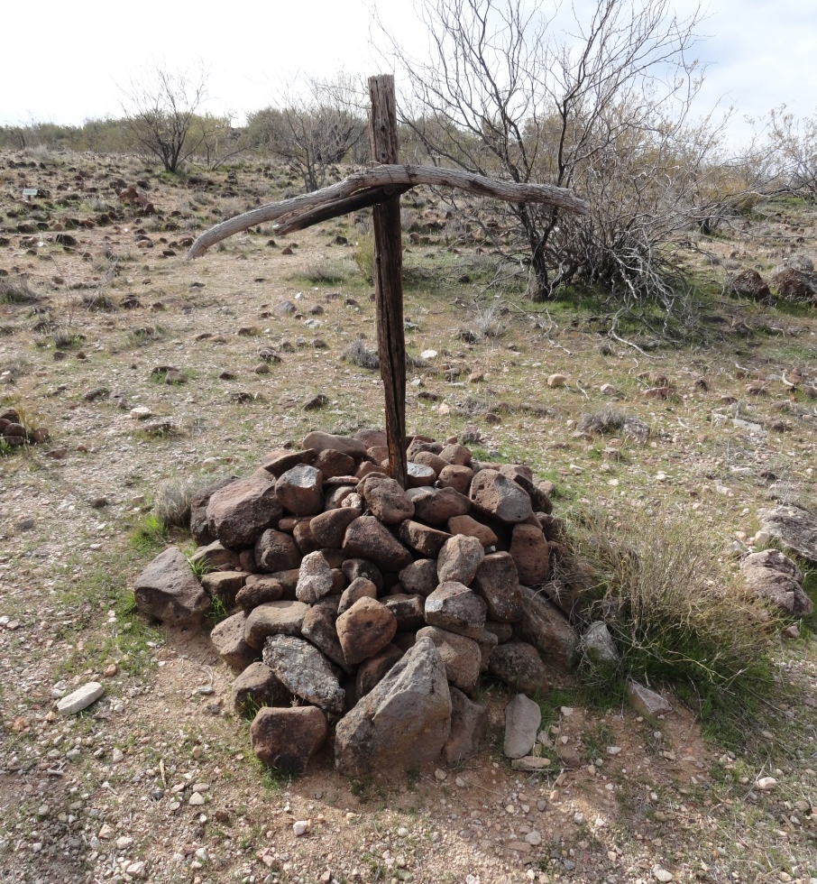
Where Are They Now?
Most Likely:
Reburial at Massacre Site
Cross erected in 1947 by the Wickenburg Saddle Club over what they believe to be LORING’s grave

Slide 37
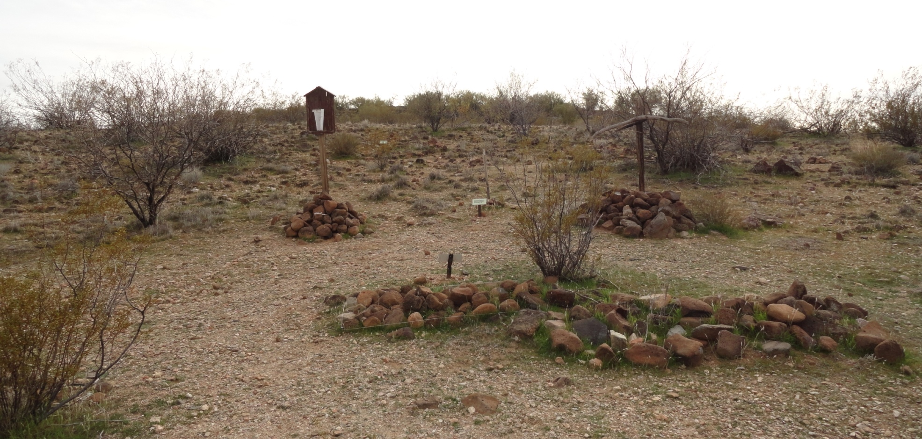
Where Are They Now?
Purported Graves at Massacre Site

Slide 38
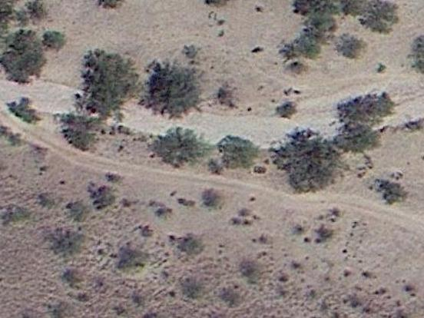
Where Are They Now?
Massacre Site as seen from Space

Slide 39
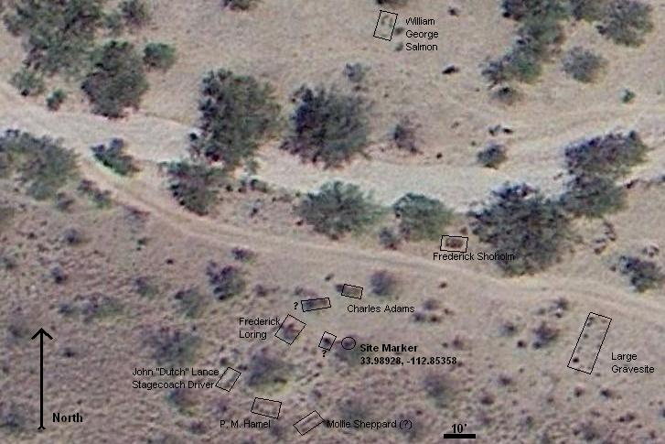
Where Are They Now?
Purported Graves as Identified by APCRP

Slide 40
Where Do We Go From Here?
Ground-Penetrating Radar may confirm whether there are human burials at the site.
Archaeological exploration of the massacre site may locate additional evidence.

Slide 41
The Wickenburg Project
Goals:
Verify the Massacre Site
Locate the Remains of the Victims
Mark their Graves for Posterity
Locate Additional Evidence
For more information:
Log on to: https//sites.google.com/site/thewickenburgproject
Or e-mail: Hypnog8r@gmail.com.

