Slide 1


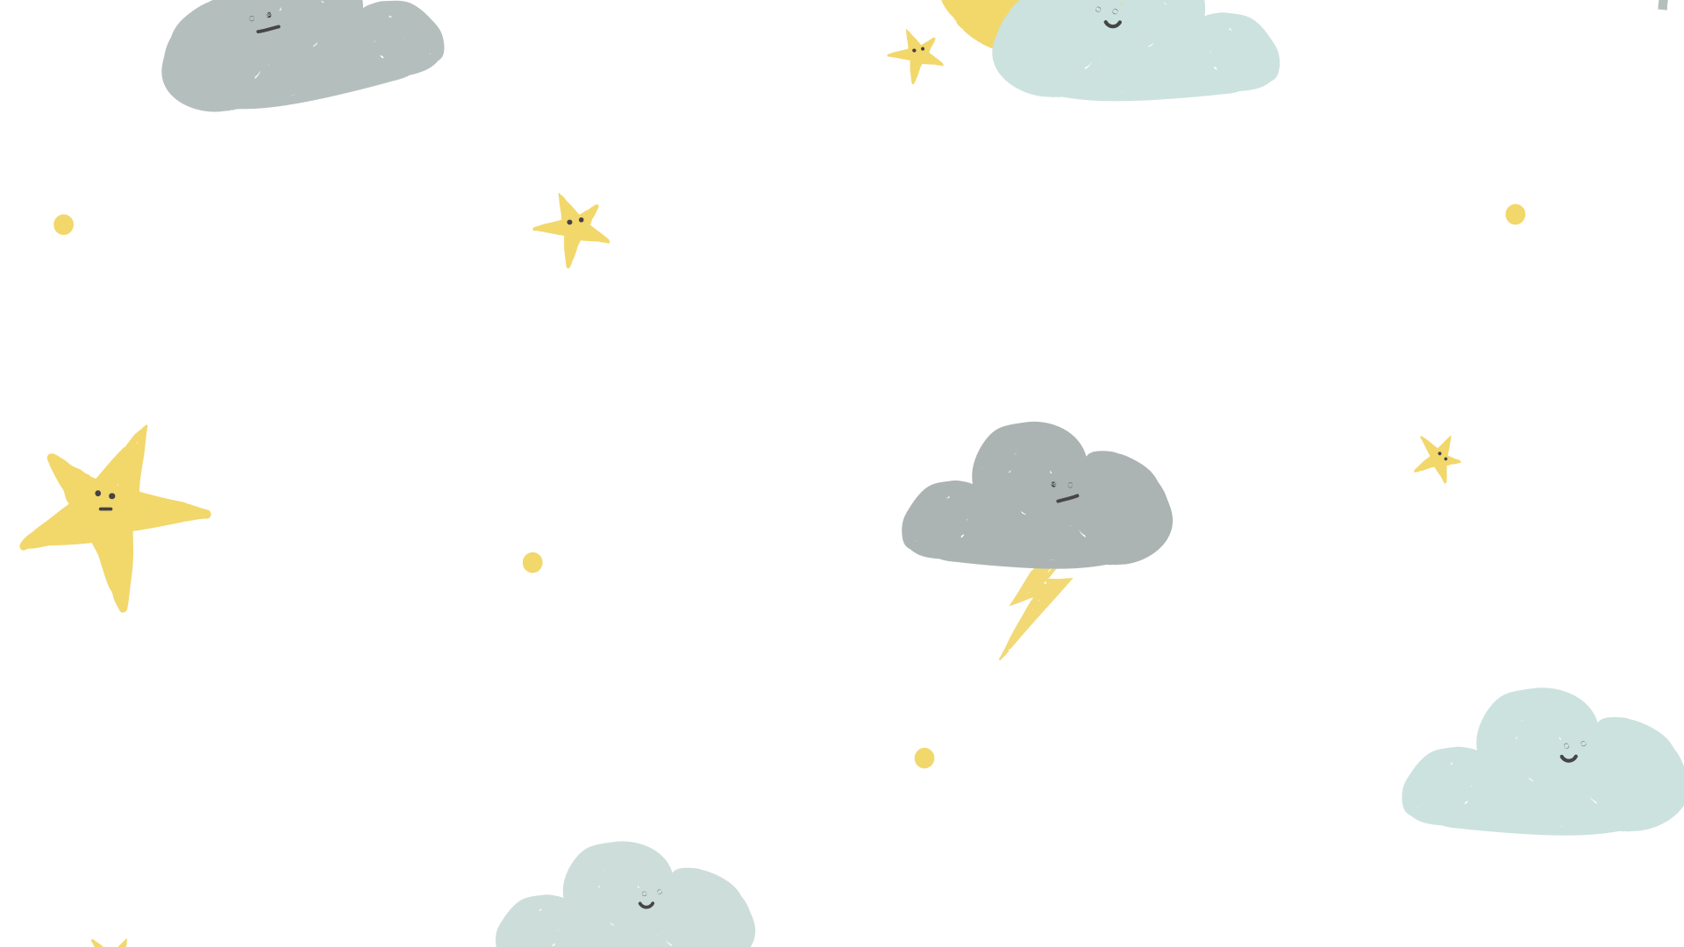


Weather and Climate
FREE PRESENTATION TEMPLATE

Slide 2

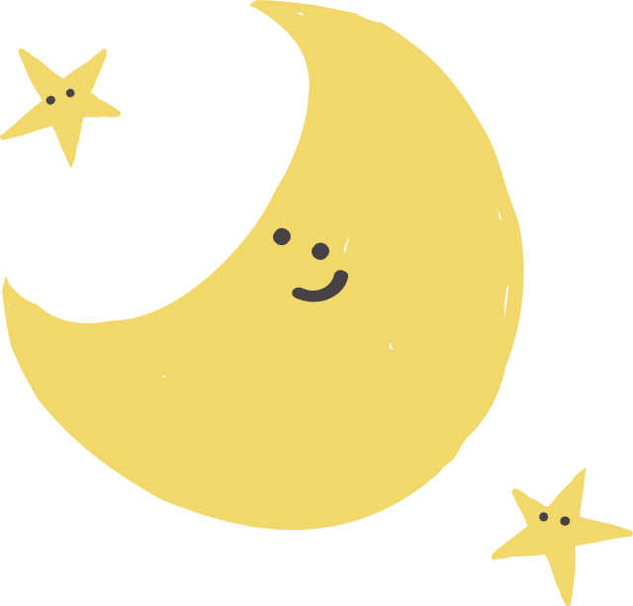

Welcome
Welcome to the world of fantasy! Join us on a journey to explore the mystical creatures, enchanted lands, and magical wonders that exist beyond our reality. Discover the wonders and secrets of this exciting realm and unlock the power of imagination.

Slide 3
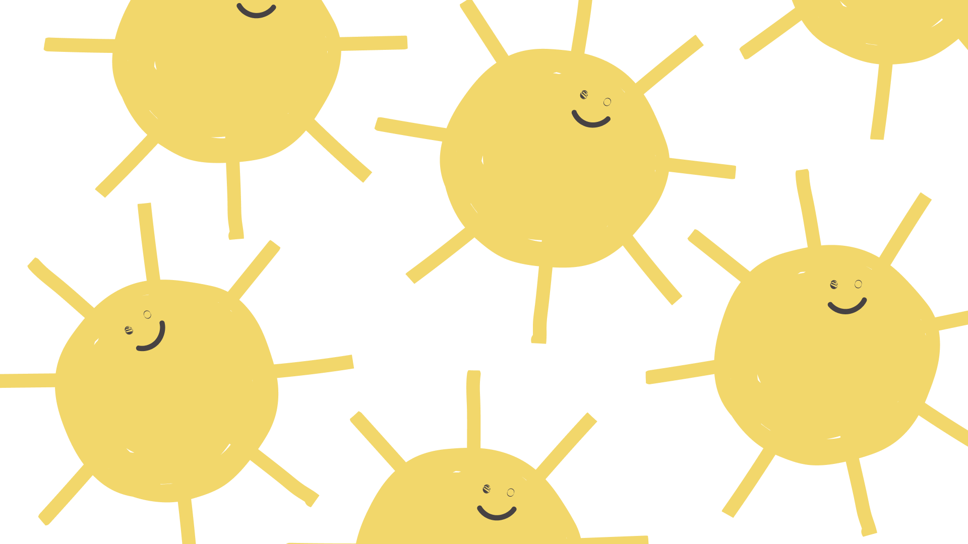

Table of Contents
01
02
03
Introduction
Encounters
Wonders
The Extraordinary Realm
Unicorn Sightings
Wishes Granted
04
05
Magic
Adventure
Spellcasting
Happily Ever After

Slide 4
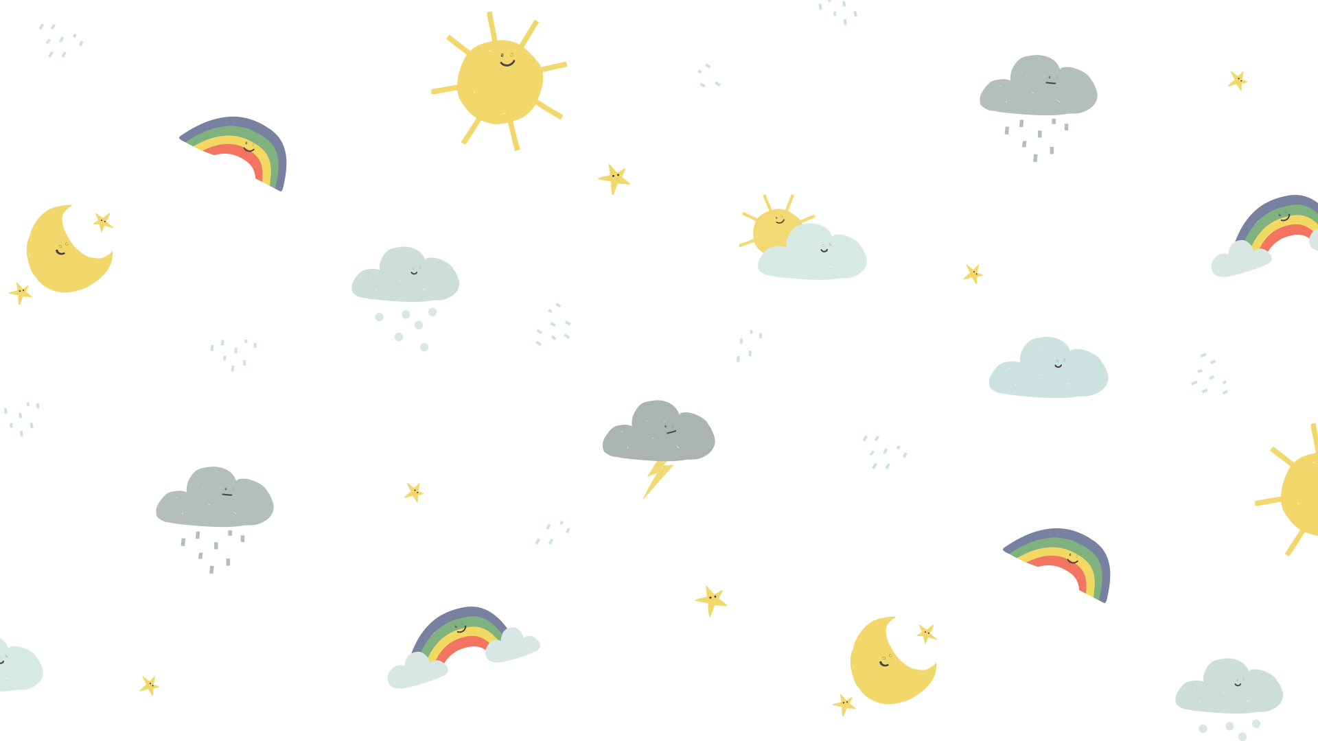

Introduction
The Fantasy Realm: Uncovering the Secrets of the Imagination and the Magic that Lies Within

Slide 5

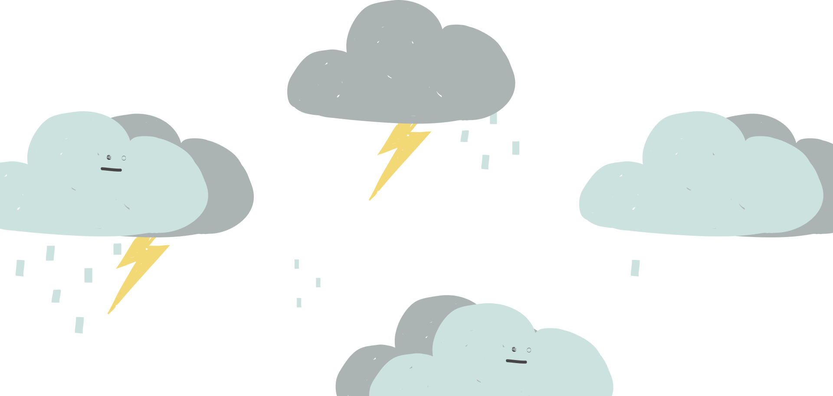
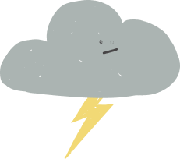
The Realm of the Extraordinary
Welcome to the Fantasy World, a realm of wonder and enchantment where anything is possible. Here, dragons breathe fire, unicorns prance through meadows, and rainbows shine brightly. This world is a place where wishes come true, where potions can be cursed and spells are cast. It's a place of treasure and adventure, where the impossible becomes possible. But the greatest treasure of all is the one that lies within.
The world of fantasy is a reflection of our deepest desires, our fondest dreams, and our wildest imaginations. It's a place where we can let go of the constraints of reality and explore the boundless possibilities of the human mind. In this introduction, we will delve into the mysteries of this realm, uncovering the magic and wonder that lies within. So come with us and let's embark on a journey through the Fantasy World.

Slide 6
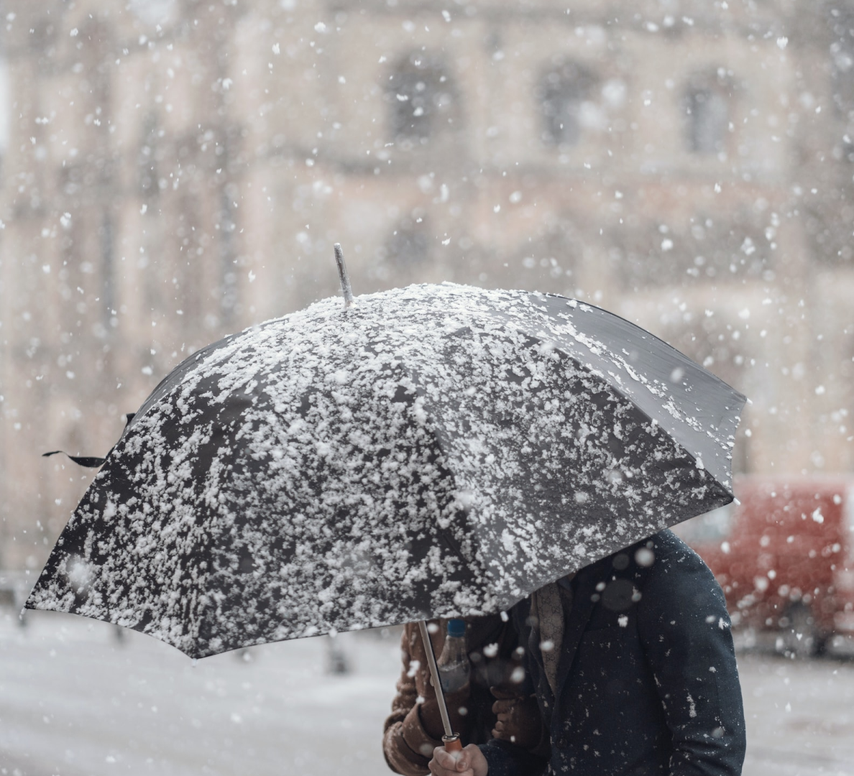



Unicorn Sightings
A record of the number of unicorns spotted in the fantasy realm and the beauty and mystery that surrounds these enchanting creatures.
Dragon Taming
A closer look at the art of taming dragons and the brave adventurers who dare to take on these fearsome creatures.

Slide 7



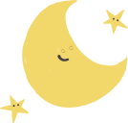
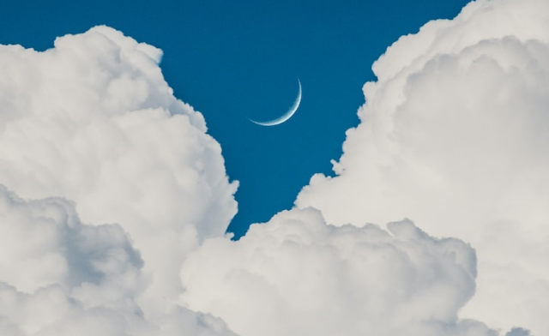
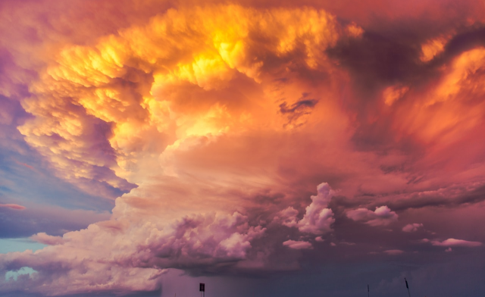
Unicorn Sightings
Dragon Taming
A record of the number of unicorns spotted in the fantasy realm and the beauty and mystery.
A closer look at the art of taming dragons and the brave adventurers who take on these creatures.

Slide 8


Fantasy is the gateway to the impossible, the land where the ordinary becomes extraordinary, and the impossible becomes possible. It is the realm of the imagination, where anything can happen and everything is possible.
The Dream Weaver

Slide 9

The Magic of Dragons
6.7M
4.4M
2.3M

Slide 10





The Elves: A Glimpse into Their World
Elegant inhabitants of enchanted forests, known for their mastery of magic and their close connection to nature. They possess an innate sense of harmony and balance, making them protectors of the natural world.
"The Art of Archery": Discover the intricacies of the Art of Archery as practiced by the graceful and precise elves.
"The Music of the Elves": Immerse yourself in the enchanting music of the elves, whose songs have the power to heal.
"The Life of an Elf": Learn about the customs and daily life of the elves, from their familial structure to their religious beliefs.

Slide 11


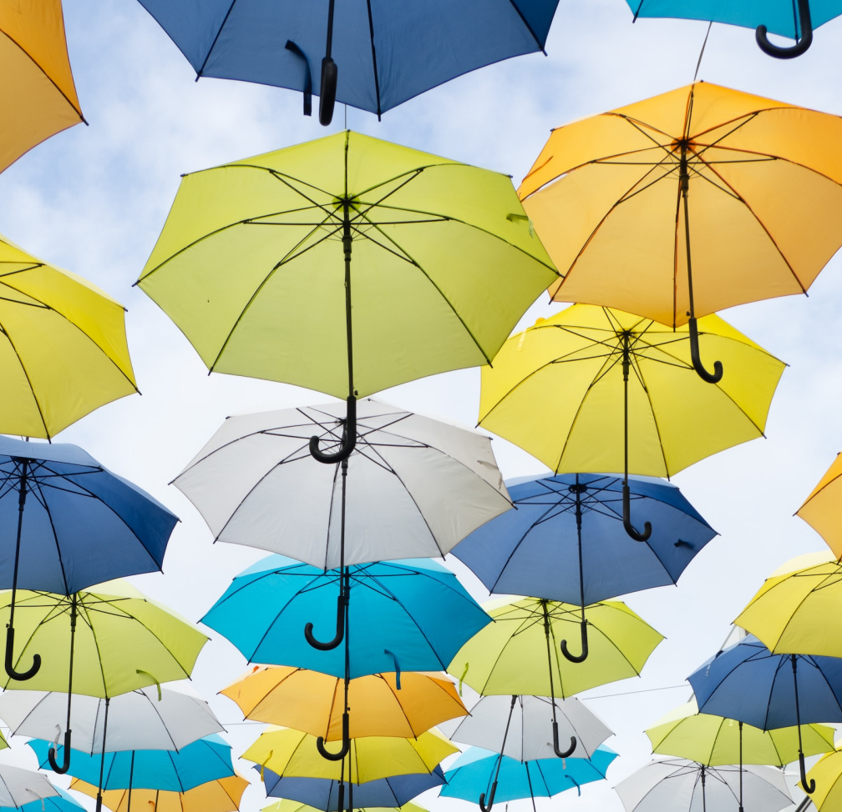
The Enchanter: Cast Spells, Create Illusions, Bring Magic to Life

Slide 12
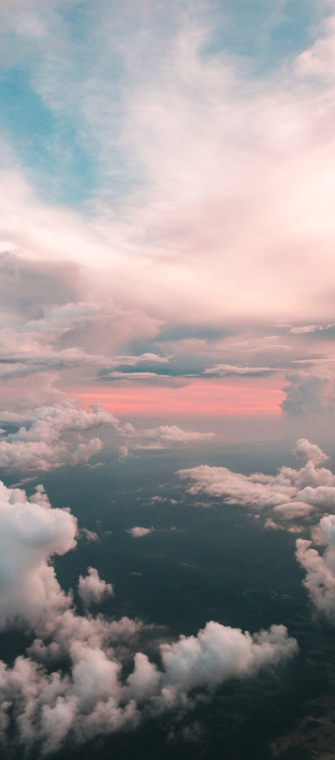
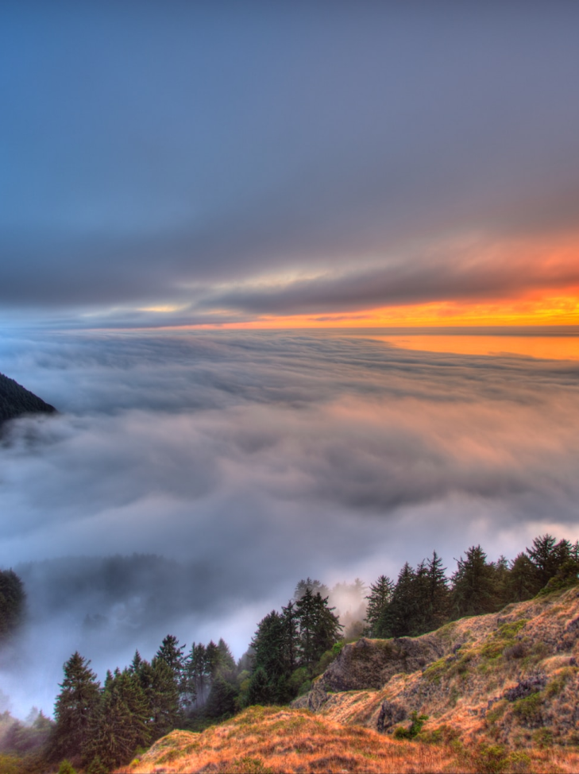

Some Data
75%
Enchanted Creatures
possess the ability to cast spells.
60%
Magic-Wielding Individuals
practice the art of illusions.
90%
Spells Cast
are dark magic, foretelling danger.

Slide 13
234,567
UNICORN SIGHTINGS
A tally of the number of unicorns spotted in the fantasy realm.

Slide 14

233 Coins
85%
Treasure Found
Wished Granted
456 Hours
535 Km
Duration of Spell Casting
Journey Distance

Slide 15


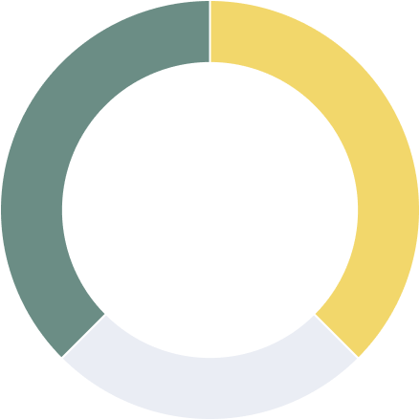
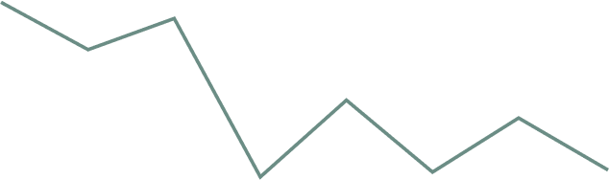

Some Graph
100
90
80
70
60
50
34.574
40
Total
30
20
10
0
1
2
3
4
5
6
7
8
Spellcasting Progress
Treasure Found
A record of the number of spells cast per year
A record of the amount of treasure found per month

Slide 16



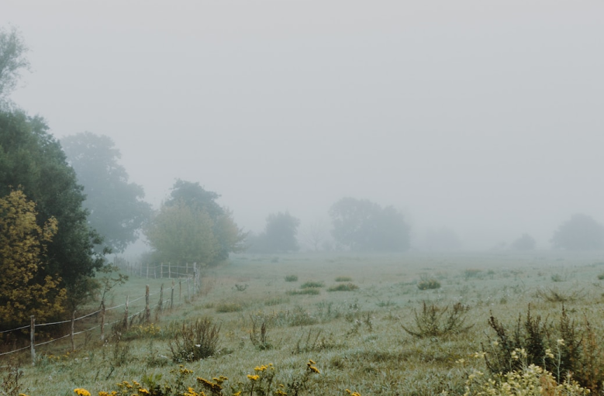
Portal to Adventure
A web application
A web application designed for discovering the world of fantasy

Slide 17
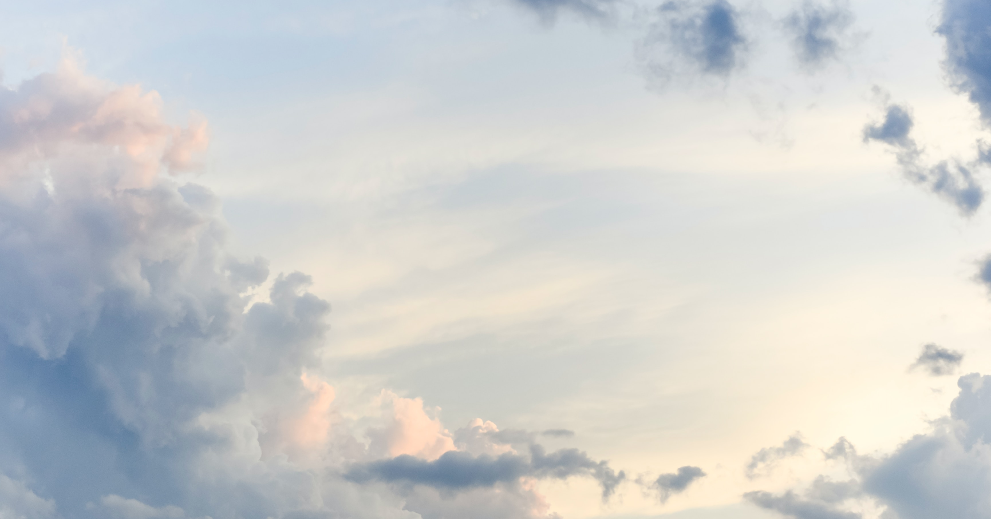
A Magic Picture

Slide 18

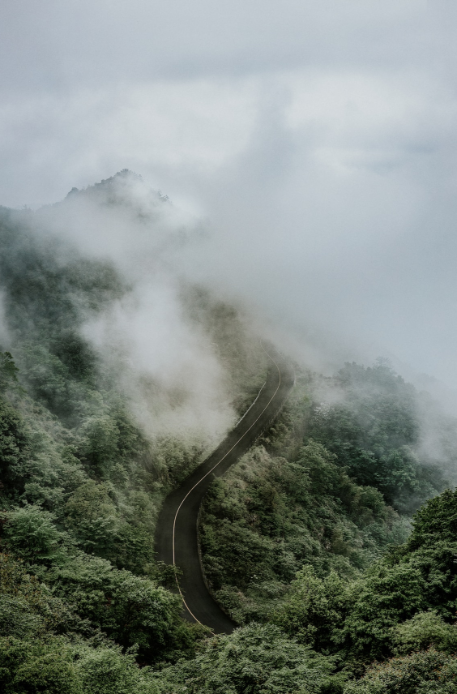
1
2
Discover the secrets
Find your own path
Explore the lush, vibrant forest and uncover the mysteries that lie within.
Choose your own path through the forest, and see where it takes you.
3
Meet the creatures
4
Uncover the magic
Encounter the mythical creatures that call the forest home, from talking animals to fairies.
Learn about the powerful magic that pervades the forest and how it affects all who enter.

Slide 19

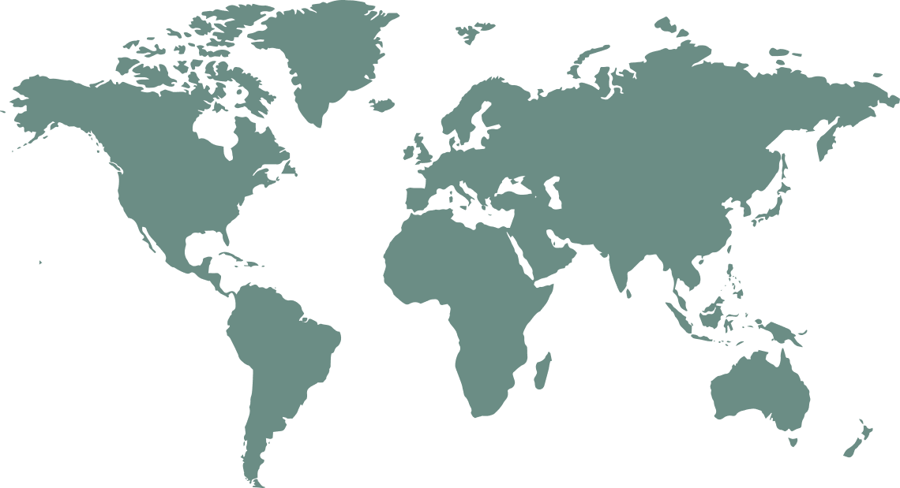
The Enchanted Forest
A magical forest filled with talking animals and enchanted creatures.
The Crystal Caves
A network of underground caves filled with precious gems and crystals.
The Dragon's Lair
A dangerous and mysterious place where dragons reside.

Slide 20




The Information
Spellcasting Competition
Treasure
Hunt
Great
Adventure
A significant event in the history of the fantasy realm, in which the greatest spellcasters of the realm.
A significant event in the history of the fantasy realm, in which a massive and awesome treasure hunt was organized.
A notable year in the history of the fantasy realm, in which a large number of adventurers set out to explore.

Slide 21




Our Team
Eldruin
Elementalen
Lunaria
The Fire Mage
The Guardian
The Moon Priestess

Slide 22

Dragons
Fire-breathing creatures that are often powerful and dangerous
Medieval-like Settings
Worlds with castles, knights, and feudal systems
Chosen One Trope
A hero chosen by destiny to save the world
Magic
An integral part of fantasy stories, can take many forms
The Best Curse
A curse that is unique, creative, and fits within the story

Slide 23



