Slide 1



Gynecology
FREE PRESENTATION TEMPLATE
EaTemp

Slide 2







Welcome
Welcome to the world of fantasy! Join us on a journey to explore the mystical creatures, enchanted lands, and magical wonders that exist beyond our reality. Discover the wonders and secrets of this exciting realm and unlock the power of imagination.
EaTemp

Slide 3




Table of Contents
01
Introduction
02
Encounters
The Extraordinary Realm
Unicorn Sightings
03
Wonders
04
Magic
Wishes Granted
Spellcasting
06
Adventure
06
Conclusion
Happily Ever After
Embrace the Fantasy
EaTemp

Slide 4








Introduction
The Fantasy Realm: Uncovering the Secrets of the Imagination and the Magic that Lies Within
EaTemp

Slide 5


The Realm of the Extraordinary
Welcome to the Fantasy World, a realm of wonder and enchantment where anything is possible. Here, dragons breathe fire, unicorns prance through meadows, and rainbows shine brightly. This world is a place where wishes come true, where potions can be cursed and spells are cast. It's a place of treasure and adventure, where the impossible becomes possible. But the greatest treasure of all is the one that lies within.
The world of fantasy is a reflection of our deepest desires, our fondest dreams, and our wildest imaginations. It's a place where we can let go of the constraints of reality and explore the boundless possibilities of the human mind. In this introduction, we will delve into the mysteries of this realm, uncovering the magic and wonder that lies within. So come with us and let's embark on a journey through the Fantasy World.
EaTemp

Slide 6


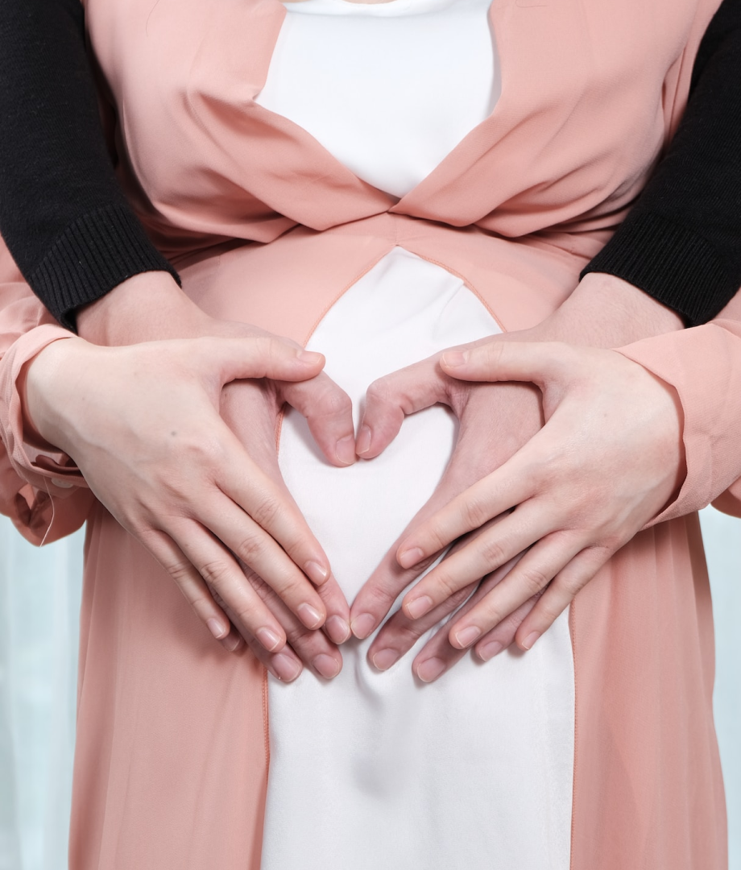






Unicorn Sightings
A record of the number of unicorns spotted in the fantasy realm and the beauty and mystery that surrounds these enchanting creatures.
Dragon Taming
A closer look at the art of taming dragons and the brave adventurers who dare to take on these fearsome creatures.
EaTemp

Slide 7


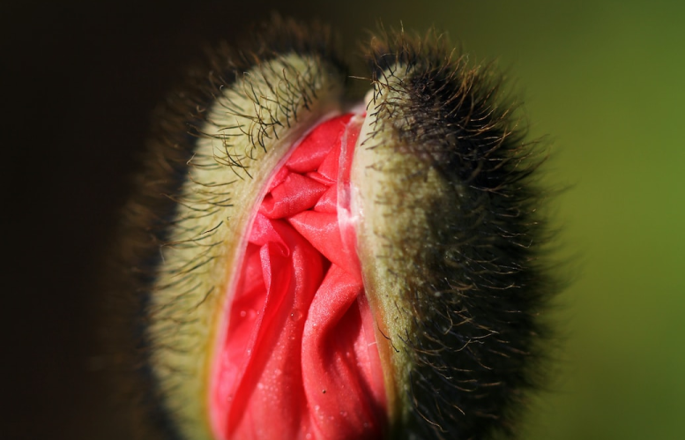

Unicorn Sightings
Dragon Taming
A record of the number of unicorns spotted in the fantasy realm and the beauty and mystery.
A closer look at the art of taming dragons and the adventurers who take on these creatures.
EaTemp
45%
67%

Slide 8


Fantasy is the gateway to the impossible, the land where the ordinary becomes extraordinary, and the impossible becomes possible. It is the realm of the imagination, where anything can happen and everything is possible.
The Dream Weaver
EaTemp

Slide 9

Dragon Taming Technique
A guide to taming and caring for dragons in the realm of magic.
The Art of Unicorn Sighting
Tips and tricks for spotting the elusive unicorns in their natural habitat.
EaTemp

Slide 10


The Magic of Dragons:
A Research
Elegant inhabitants of enchanted forests, known for their mastery of magic and their close connection to nature. They possess an innate sense of harmony and balance, making them protectors of the natural world.
6.7M
4.4M
2.3M
"The Art of Archery": Discover the intricacies of the Art of Archery as practiced by the graceful and precise elves.
"The Music of the Elves": Immerse yourself in the enchanting music of the elves, whose songs have the power to heal.
EaTemp

Slide 11



Pricing Plan
Basic
Legendary
Elite
Access to the entry-level dungeons.
A limited number of quests and battles per month.
Ability to form a small party with fellow adventurers.
Access to the most challenging dungeons and encounters.
Unlimited quests and battles per month.
The ability to form the largest parties with fellow adventurers.
Access to the intermediate and advanced dungeons.
A greater number of quests and battles
Ability to form larger parties with fellow adventurers.
$10/month
$100/month
EaTemp
$50/month

Slide 12

S
W
Eclipse
Obtain
Rare event causes magic.
Humans acquire Crystal
Quest
Foundation
Adventurers seek immortal artifact.
Shimmering City established
O
T
War
Invasion
Kingdoms clash in conflict.
Kingdom attacked by monsters.
Transformation
Betrayal
Peasant discovers magical powers.
Queen's advisor revealed as spy.
EaTemp

Slide 13



Some Data
75%
Enchanted Creatures
possess the ability to cast spells.
Magic-Wielding Individuals
60%
practice the art of illusions.
90%
Spells Cast
are dark magic, foretelling danger.
EaTemp

Slide 14

234,567
UNICORN SIGHTINGS
A tally of the number of unicorns spotted in the fantasy realm.
EaTemp

Slide 15

233 Coins
85%
Treasure Found
Wished Granted
456 Hours
535 Km
Duration of Spell Casting
Journey Distance
EaTemp

Slide 16






Some Graph
100
90
80
70
60
50
34.574
40
Total
30
20
10
0
1
2
3
4
5
6
7
8
Spellcasting Progress
Treasure Found
A record of the number of spells cast per year
A record of the amount of treasure found per month
EaTemp

Slide 17

Portal to Adventure
A web application
A web application designed for discovering the world of fantasy
EaTemp

Slide 18

A Magic Picture
EaTemp

Slide 19

The Enchanted Forest
A magical forest filled with talking animals and enchanted creatures.
The Crystal Caves
A network of underground caves filled with precious gems and crystals.
The Dragon's Lair
A dangerous and mysterious place where dragons reside.
EaTemp
Fantasy Realm at a Glance

Slide 20



The Timeline
Eclipse
Quest
Obtain
Rare event causes unpredictable magic.
Adventurers seek immortal artifact.
Humans acquire Crystal
Invasion
Betrayal
Kingdom attacked by monsters.
Queen's advisor revealed as spy.
EaTemp

Slide 21



The Information
Spellcasting Competition
Treasure
Hunt
Great
Adventure
A significant event in the history of the fantasy realm, in which the greatest spellcasters of the realm.
A significant event in the history of the fantasy realm, in which a massive and awesome treasure hunt was organized.
A notable year in the history of the fantasy realm, in which a large number of adventurers set out to explore.
EaTemp

Slide 22


The Graph
12
10
A
8
6
B
C
4
2
EaTemp
0
2015
2016
2017
2018
2019
2020
2021

Slide 23



Our Team
Eldruin
Elementalen
Lunaria
EaTemp
The Fire Mage
The Guardian
The Moon Priestess

Slide 24









The Organization
Chloe Ng
The Mage
Valtorin
Aurielle
Theronis
Dariana
The Assassin
The Priestess
The Warrior
The Shaman
Lucian
Elvina
The Conjurer
The Oracle
Cedric
Seraphina
The Timekeeper
The Lightbringer
EaTemp
To download more editable chart, click here

Slide 25


Thank you for choosing EaTemp
We offer free and high-quality slides templates for your presentations. We appreciate you choosing us and hope our templates have been helpful.
As a new website, we rely on your support to grow, so please help us by sharing our site with your friends and colleagues.
Credit | Image: Unsplash
EaTemp

