Slide 1


INDUSTRIES

Slide 2
In this chapter we will study
• Importance of Indian industries and major industrial areas.
• Factors influencing the location of industries
• Introduction of different Industries.
• Knowledge-based industries; Information Technology, Bio-technology and Advanced Technology

Slide 3
Any human activity engaged in the conversion of raw materials or finished goods into readily usable materials is called an industry
• Certain areas of the country have more concentration of industries. These areas are called “Industrial Zones”.

Slide 4
Major industrial regions:
1. Hugli region
2. Mumbai region
3. Ahmadabad region
4. Madurai Coimbatore region
5. Delhi region
6. Visakhapatnam region
7. Kolkata region

Slide 5


Localisation of industries
1. Supply of raw material
2. Supply of power
3. Transport and communication facilities
4. Market facility

Slide 6




5. Market facility
6. Capital
7. Labor and water supply
8. Ideal climate
9. Government policies

Slide 7
Iron and steel industry
● This is called a basic industry, because the region of this industry provides the raw materials to machinery, railways, ship building, power projects, irrigation projects, building construction, house construction etc

Slide 8
● Modern iron and steel industry in India was started in 1874 at Kulti West Bengal
● Tata iron and Steel company started in 1907 at Jamshedpur

Slide 9
Private sector industries-
Tata iron and Steel industry,
Jindal Vijayanagar Steel Limited,
Ispat iron and steel industry,
Dubari steel plant

Slide 10
Public sector industries-
Indian iron and Steel company,
Visvesvaraya iron and Steel Limited,
Hindustan Steel Limited,
Hindustan Steel Limited Rourkela,
Hindustan Steel Limited Durgapur,
Bokaro steel plant, Tata Steel plant, Visakhapatnam steel plant.

Slide 11
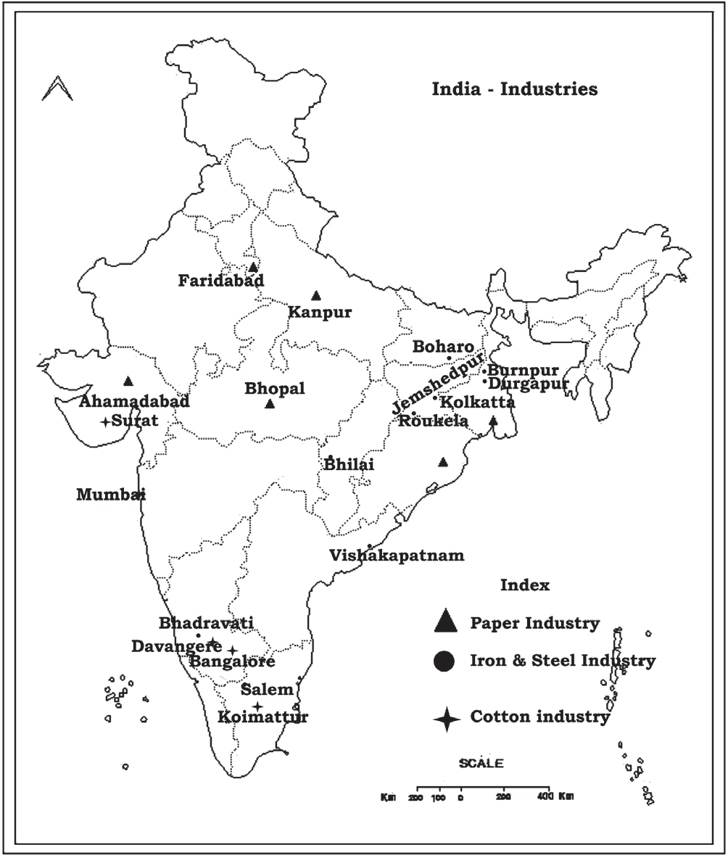

Slide 12
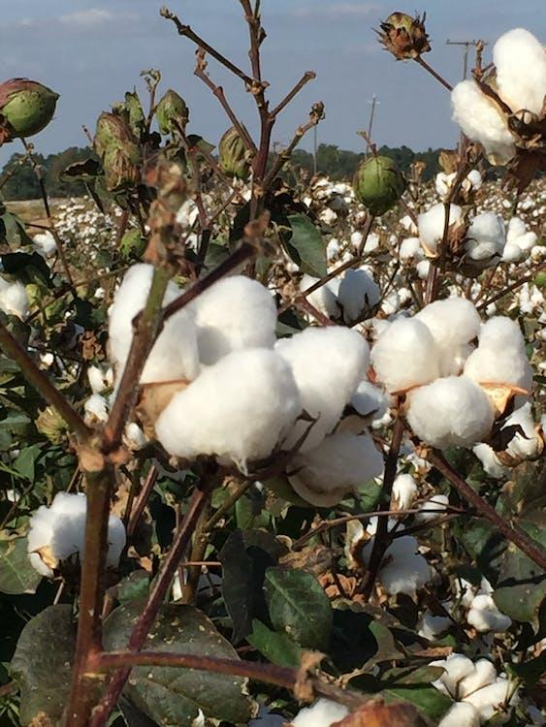
Cotton textile industry
● It is a agro based industries first started in 1854 Mumbai
● Production of cloth from various types of fibres is called ‘Textile Industry’.
● It includes, cotton textile industry, jute industry, silk industry, Wollen industry and production of cloth from synthetic fibres

Slide 13
● Cotton textile industries widely distributed in Maharashtra Gujarat Tamilnadu Karnataka
● Mumbai of Maharashtra has highest cotton mills and hence, it is called the ‘Manchester of India’ (Manchester is Britain’s main textile industry centre),
‘Cottonopolis’ of India.

Slide 14
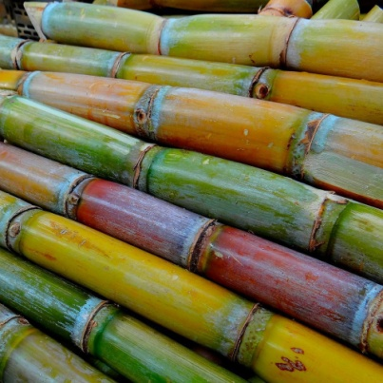
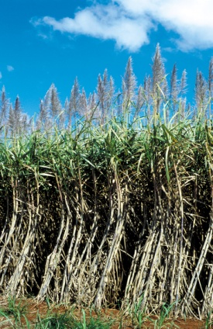
Sugar industry
● It is the second important agro based industry in India
● This industry is located in sugarcane-growing areas like Belgaum district in Karnataka. Maximum number of sugar industries are located in the Ganga river plain region.

Slide 15
Industries are widely concentrated in Maharashtra Uttar Pradesh Karnataka
● India is the second largest producer of sugar in the world next to Brazil

Slide 16
Aluminium Industry
• Aluminium was discovered recently in the year 1886.
• It is the most important non-ferrous metal produced in India. Aluminium industries are concentrated in a few places in the country

Slide 17
• This industry depends mainly on three factors: supply of electricity, availability of bauxite, availability of other metals and supply of capital.
• The aluminium industries are in Orissa, Jharkhand, Chattisgarh, Madhya Pradesh

Slide 18
Paper industry
● Paper is an indispensable and useful product it is used for many purposes such as writing, wrapping, packing, printing
● Education and literacy level in our country are measured by the conservation of paper in that country

Slide 19
● The first modern paper mill was set up in 1932 Serampore West Bengal. The real one started at Bally near Kolkata in 1870
● Paper industry is a forest based industry

Slide 20
The raw materials for the paper industry are bamboo obtained from the forests, wood pulp and grass.
● Industries developed on the bank of Hooghly West Bengal and Maharashtra Gujarat Uttar Pradesh
● News print paper is being imported from Norway, Sweden, Canada and the U.S.A.

Slide 21


Knowledge based industry
It is based on human knowledge therefore called in this name

Slide 22

Information Technology (IT):
• In order to encourage development of the software industry and its export, the Indian government established Software Technology Parks (STP) in 1991
• Software forms a major part of our exports and has enabled us to earn foreign exchange

Slide 23
• Bengaluru is the center of Information Technology and it is called Silicon City of India.
• In Karnataka Software Technology Parks have been set up in Bangalore, Mysore, Mangalore, Udupi and Hubli

Slide 24


Biotechnology (BT):
By the procedure of grafting in plants and by the use of new seeds, medicines, fertilizers, organic fertilizers, developed hybrid seeds soya beans, maize, cotton etc. have been developed.

Slide 25
• Plant biotechnology, environment, bio-diversity and medical biotechnology are also being used.
• Many states in India have developed biotechnology. Among them, Uttar Pradesh, Arunachal Pradesh, Madhya Pradesh

Slide 26


Advanced Technology (AT):
• In 1990 advanced technology is used in telephone, internet communication, defense department, weapons and nuclear bombs, satellite launching,

Slide 27

• Lunar projects like chandrayana
• Transparent in city administration in government offices
(eg: Nemmadi, Aadhar etc.), development of global economic system, educational, social and economic affairs and elections

Slide 28
ISRO (Indian Space Research Organization)
The organization is involved in science
engineering and technology to harvest the
benefits of outer space for India and the
mankind.
August 15th, 1969.
Its head quarters is at Bengaluru.
The first Chairman of ISRO was Dr. Vikram Sarabai

Slide 29
Outstanding achievements of ISRO
The Indian National Satellite System (INSAT) -enhancing better experience in search -rescue operation.
first country to reach MARS for the first time through ISRO.
first country to land on the South - pole through the satellite launched by ISRO.

Slide 30


Thank you
Prepared by:
Praveen Banakar

