Slide 1
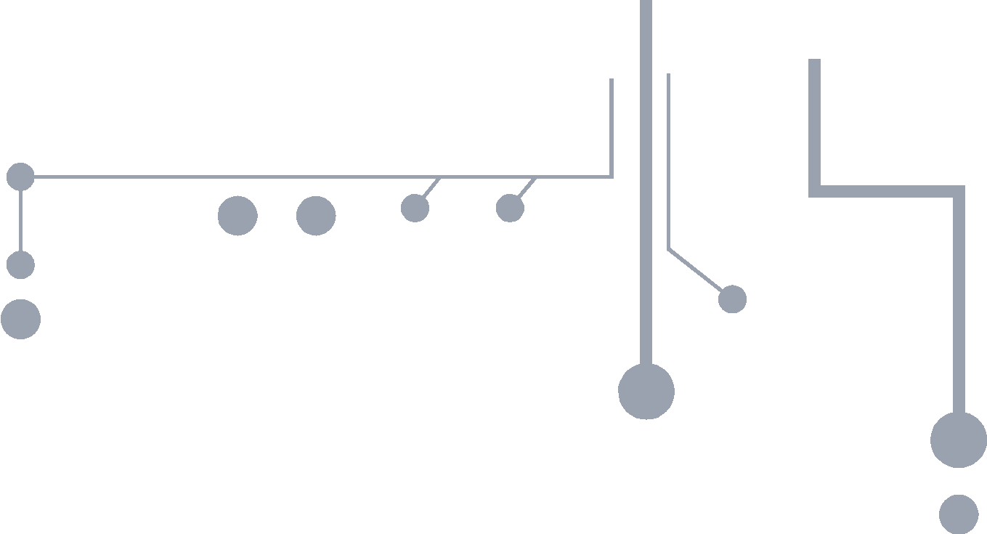
PROCESSOR
PPT Template
Google slides theme
Slidesboss.com

Slide 2
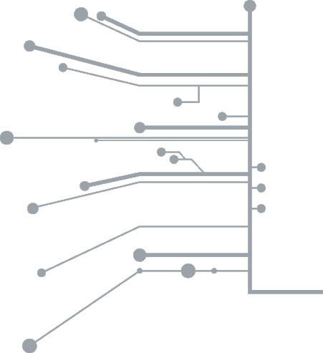
Welcome
Good morning/afternoon/evening, everyone
Logo

Slide 3



Instructions
Open the presentation from the Google Slides Viewer or download as Powerpoint template.
In order to be able to edit the presentation in Google Slides, you should have a Google® Account.
Edit in PowerPoint®
Edit in Google Slides
Slidesboss.com

Slide 4


Hello!
First, let me introduce myself. I am …

Slide 5
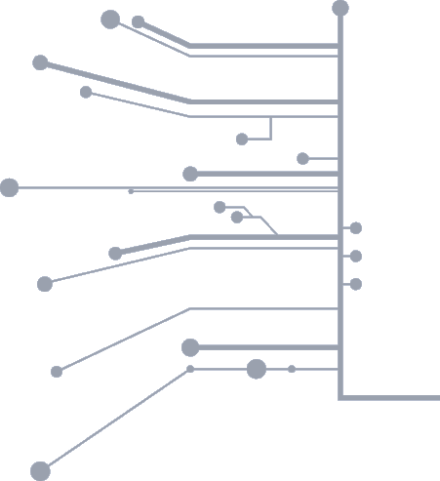
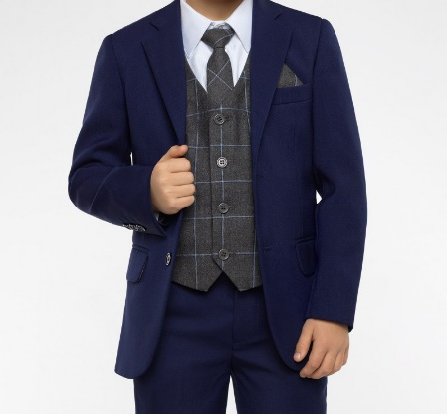
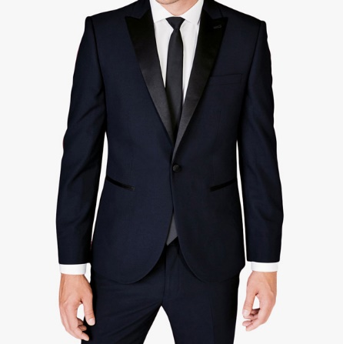
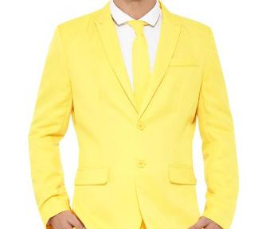
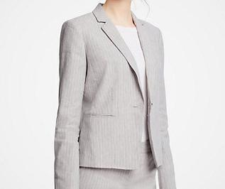

Meet our team
Write something in this section
Name
Name
Name
Name
Name
Job title
Job title
Job title
Job title
Job title
Some text about this person
Some text about this person
Some text about this person
Some text about this person
Some text about this person

Slide 6
Two Columns
Title
Title
There is nothing engaging about reading from a screen to a group that can already see the slides themselves. The lack of surprise will most likely put your audience into REM sleep, wasting an opportunity for them to actively listen
Your eyes will probably wander over your slides at some point during your presentation, and that’s perfectly acceptable. The real problem only occurs when you replace an engaging, dynamic speech with the agony of a drone-voiced slide reading. Don’t do it, we beg you!

Slide 7
Title
Four Columns
Title
Title
Title
Don’t use your slides to repeat an entire message; instead consider using minimal text to share a key word or idea. Your audience won’t be populated by crash test dummies, they are much smarter than that. Respect their intelligence by not reading redundant information from your slides.
There is nothing engaging about reading from a screen to a group that can already see the slides themselves. The lack of surprise will most likely put your audience into REM sleep, wasting an opportunity for them to actively listen.
Your eyes will probably wander over your slides at some point during your presentation, and that’s perfectly acceptable. The real problem only occurs when you replace an engaging, dynamic speech with the agony of a drone-voiced slide reading. Don’t do it, we beg you!
When you give your slides attention instead of your audience, you make a clear statement: my message and ego matter more than the audience. You eliminate eye contact and other nonverbal cues that show you are just as responsive to the listening audience as they are to you.

Slide 8
Let’s move on to…
1
Transition Headline

Slide 9
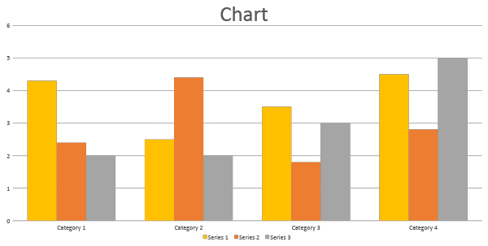

Slide 10
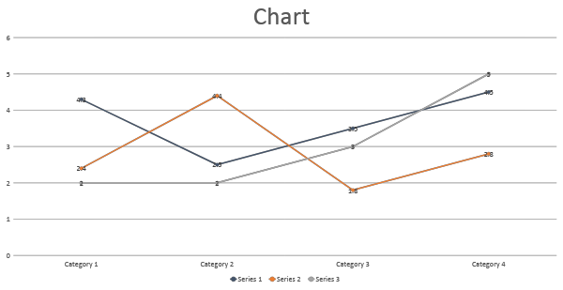

Slide 11
BIG HEADLINE
Goes here

Slide 12
MAP

Slide 13
Text file, a type of computer file opened by most text software
Text file, a type of computer file opened by most text software
Text file, a type of computer file opened by most text software
First
Second
Third
Fourth
Fifth
Text file, a type of computer file opened by most text software
Text file, a type of computer file opened by most text software

Slide 14
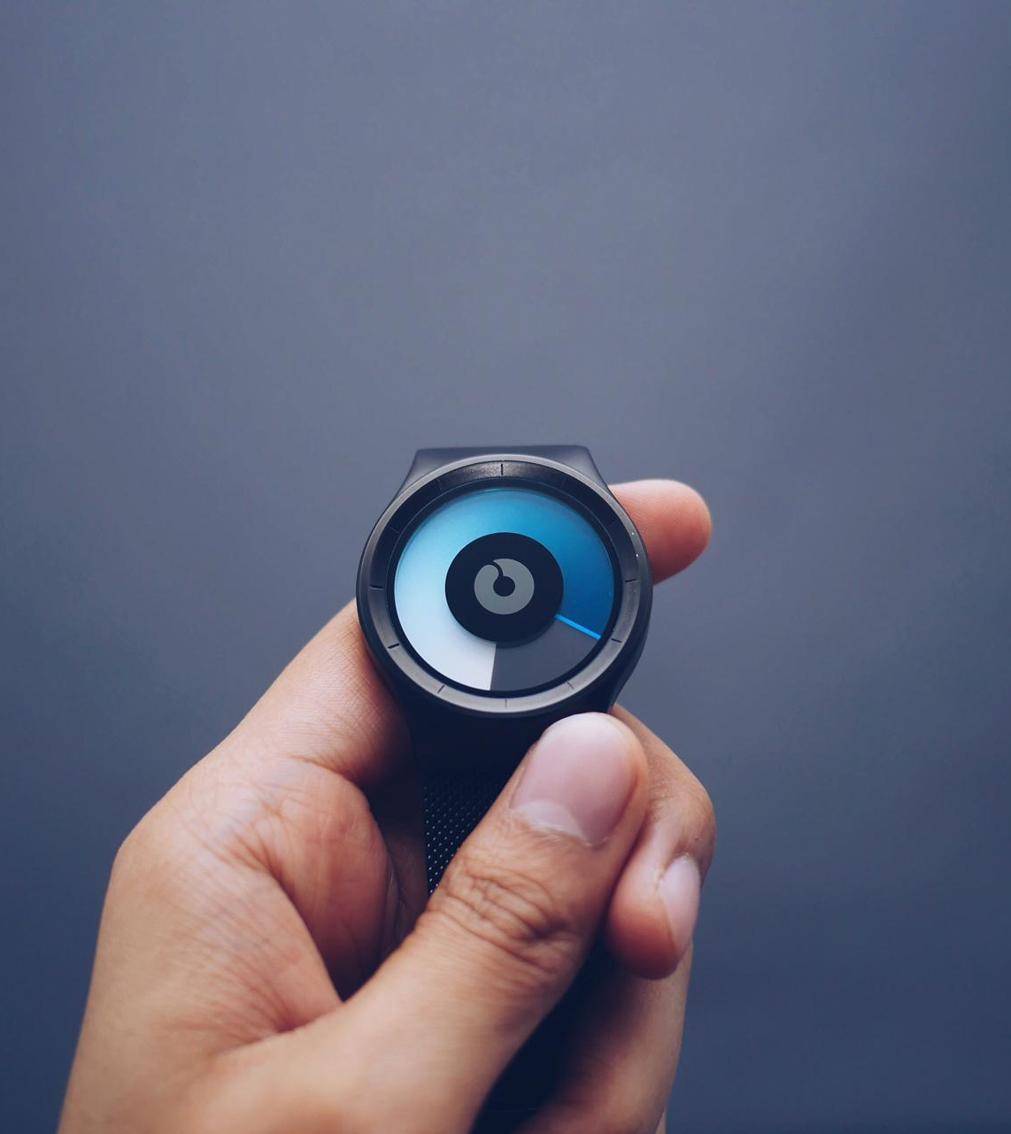
A picture is worth
a thousand words
Create
Impressive
Presentations

Slide 15
Create
Impressive
Presentations
A picture is worth
a thousand words

Slide 16

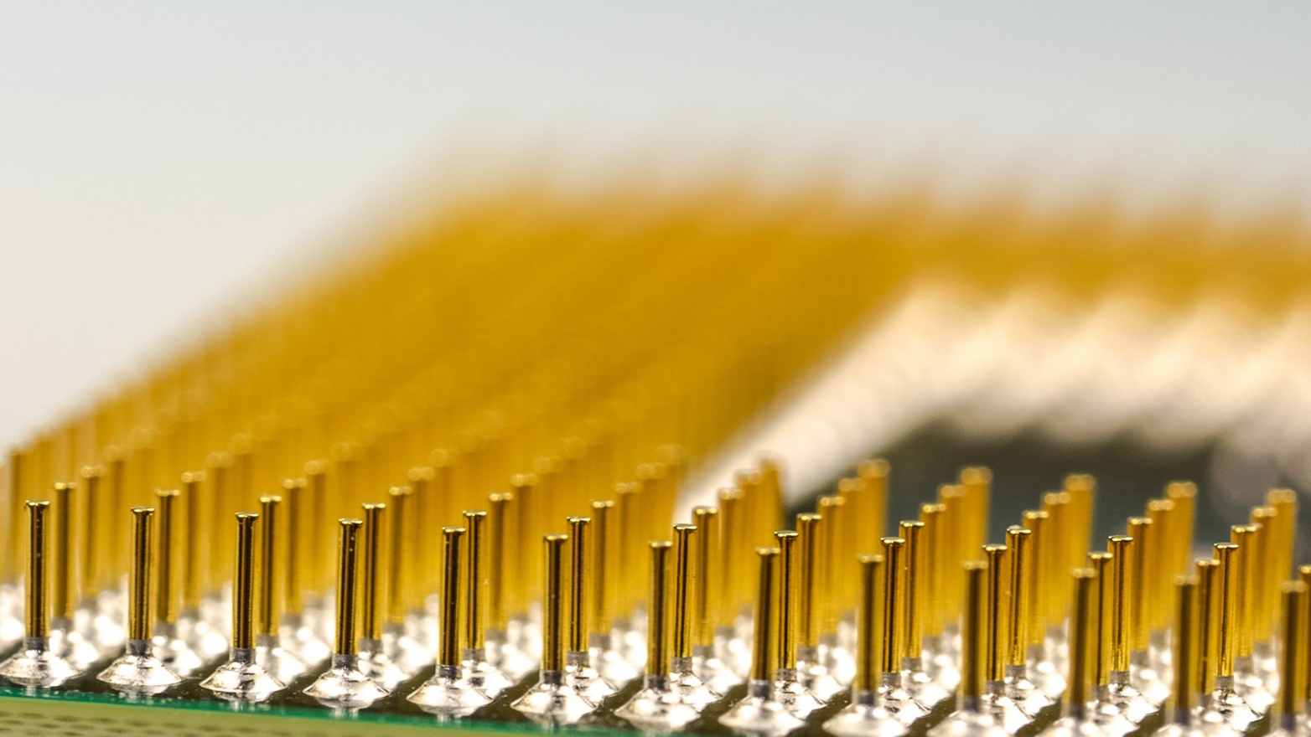
Desktop Computer
Mockup image
A computer is a device that can be instructed to carry out sequences of arithmetic or logical operations automatically via computer programming.

Slide 17


Smartphone
Mockup image
A smartphone is a handheld personal computer with a mobile operating system and an integrated mobile broadband cellular network connection for voice, SMS, and Internet data communication

Slide 18
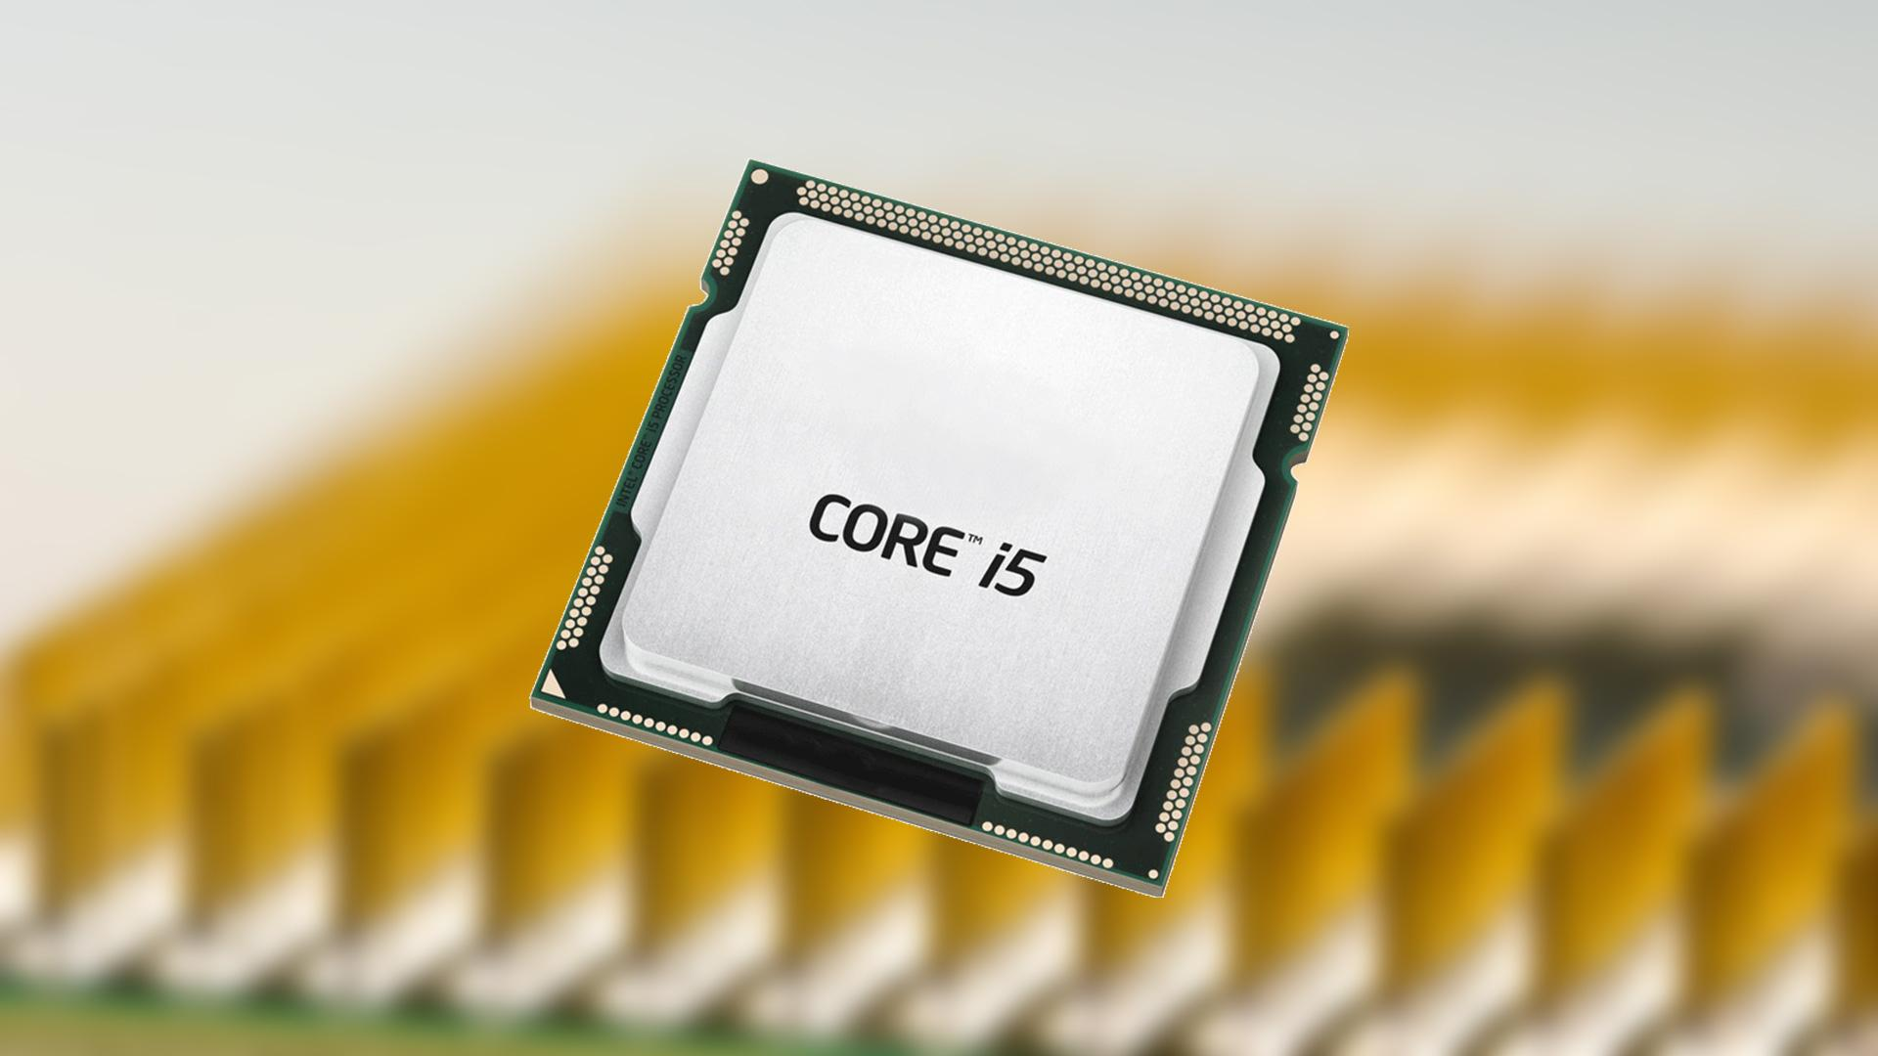
FULL PAGE IMAGE
One way to create a composition where the image and text complement each other is to align your text so it fits with a shape present in the image

Slide 19
TITLE & TEXT
Add text here

Slide 20
CREDITS
Special thanks to:
Presentation template by SlidesBoss.com
Photographs by freepik

