Slide 1
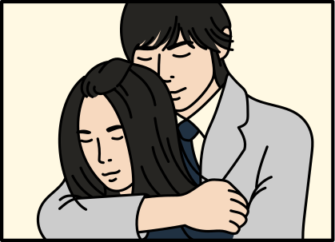

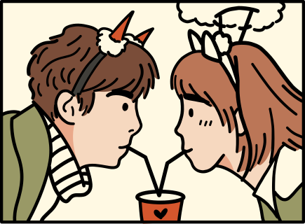

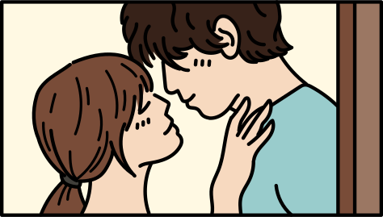
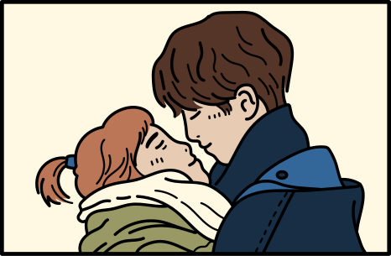

K-DRAMA EDITION
NEVER HAVE I EVER

Slide 2
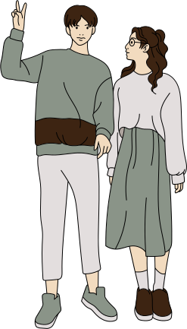

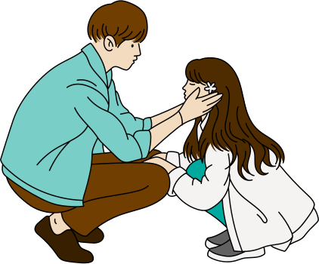

LET'S HAVE FUN TONIGHT!
Are you ready?

Slide 3


REESE
Hi! I will be your game master for tonight's game.

Slide 4

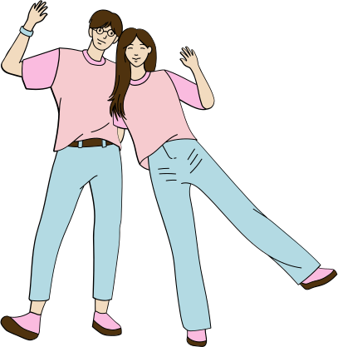
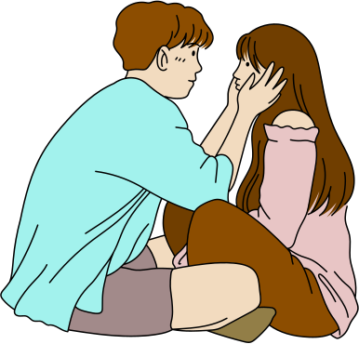

GAME NIGHT RULES
Reminders before we start.

Slide 5
RULE NO. 1
You need to turn on your camera before the game starts.
RULE NO. 2
Download the official virtual background for this game night.
RULE NO. 3
Be a good human.

Slide 6
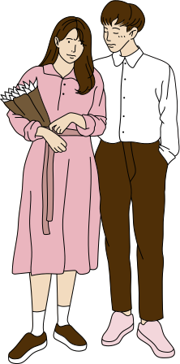
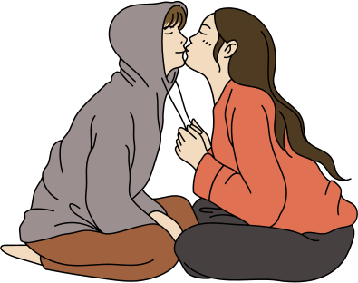
GAME MECHANICS
  Each person have five minutes to give three "Never Have I Ever" questions to the game master.
  The game master will show a randomized question on the screen.
  With the help of their virtual backgrounds, everyone will respond at the same time by tilting their heads or pointing to their answer.
  Maintain your position for a few moments.
  It's possible that you'll be asked to expound on your answers
  Don't forget to have fun!

Slide 7
NEVER HAVE I EVER
Rewatched a K-Drama.

Slide 8
NEVER HAVE I EVER
Watched more than one K-Drama at the same time.

Slide 9
NEVER HAVE I EVER
DNF a K-Drama.

Slide 10
NEVER HAVE I EVER
Spent more than $250 on K-Drama Merch.

Slide 11
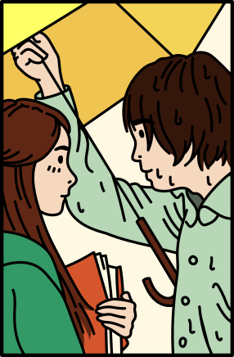
NEVER HAVE I EVER
Studied the Korean Language.

Slide 12

NEVER HAVE I EVER
Bought a product sponsored by a K-Drama.

Slide 13

NEVER HAVE I EVER
Went to shooting locations.

Slide 14

NEVER HAVE I EVER
Cried & laughed at the same time while watching a K-Drama.

Slide 15
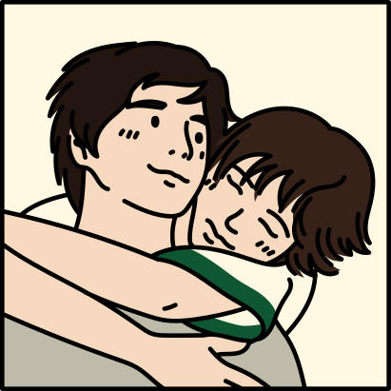

NEVER HAVE I EVER
Wished you were the main character.

Slide 16
THANK YOU FOR COMING!
Hope you had fun!

