Slide 1

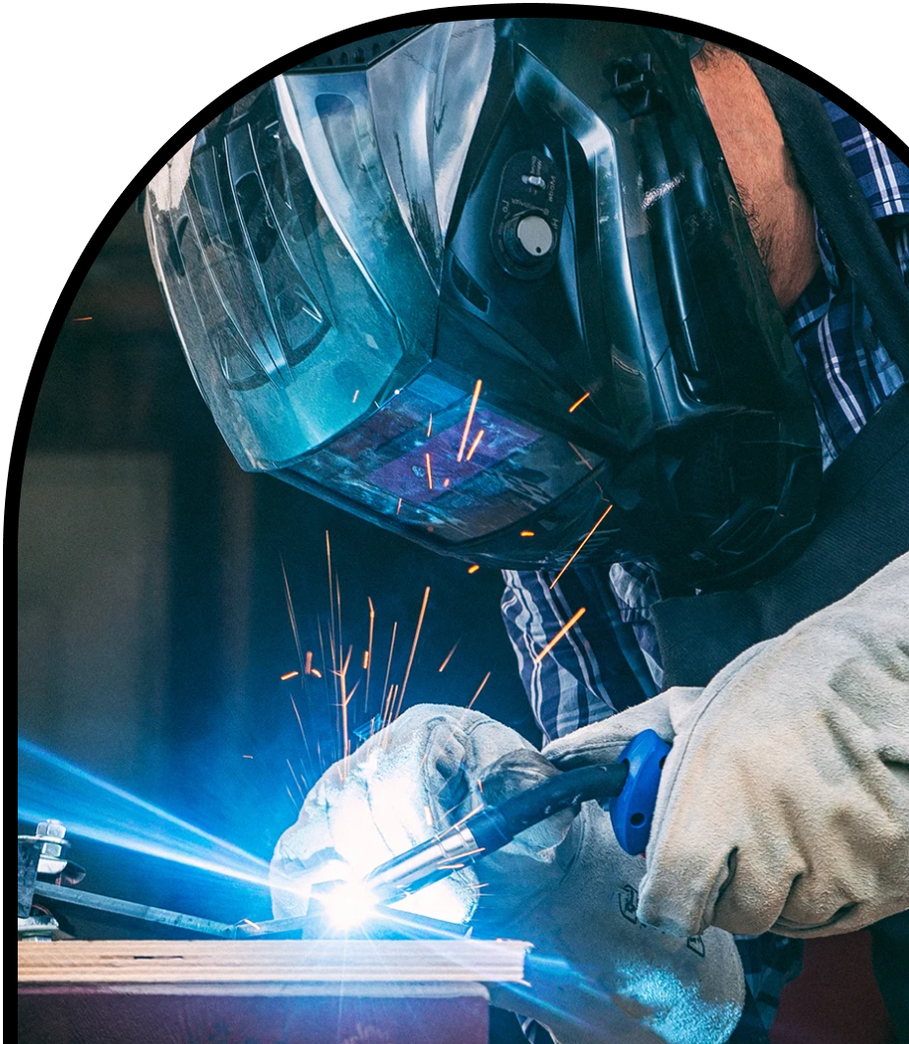
Anchor Layer Teacher Guide
A curriculum companion for Anchor Layer users
Grade 2
Material Properties
Unit Web Link • Pacing Guide • Other Units

Slide 2
Material Properties • Grade 2
Anchor Layer Teacher Guide
Unit Summary
In this unit, students explore the properties of materials! They describe and classify different types of materials by properties like hardness, flexibility, absorbency, and the ability to conduct heat. Then, they determine which materials have properties best suited for certain types of clothing, cooking, or buildings. They also build card towers to explore how a small set of the same pieces can be disassembled and then reconstructed into a new object with different characteristics. Assessments
Performance Expectations | Science & Engineering Practices | Disciplinary Core Ideas | Crosscutting Concepts
• 2-PS1-1. Plan and conduct an investigation to describe and classify different kinds of materials by their observable properties. • 2-PS1-2. Analyze data obtained from testing different materials to determine which materials have the properties that are best suited for an intended purpose. • 2-PS1-3. Make observations to construct an evidence-based account of how an object made of a small set of pieces can be disassembled and made into a new object. • 2-PS1-4. Construct an argument with evidence that some changes caused by heating or cooling can be reversed and some cannot. • K-2-ETS1-1. Ask questions, make observations, and gather information about a situation people want to change to define a simple problem that can be solved through the development of a new or improved object or tool. • K-2-ETS1-2. Develop a simple sketch, drawing, or physical model to illustrate how the shape of an object helps it function as needed to solve a given problem. • K-2-ETS1-3. Analyze data from tests of two objects designed to solve the same problem to compare the strengths and weaknesses of how each performs. | • Asking Questions and Defining Problems • Planning and Carrying Out Investigations • Constructing Explanations and Designing Solutions • Analyzing and Interpreting Data • Developing and Using Models | • PS1.A: Structure and Properties of Matter • PS1.B: Chemical Reactions • ETS1.A: Defining and Delimiting Engineering Problems • ETS1.B: Developing Possible Solutions • ETS1.C: Optimizing the Design Solution | • Structure and Function • Cause and Effect • Energy and Matter • Patterns
Unit Lesson Flow on Next Page
‹#›

Slide 3
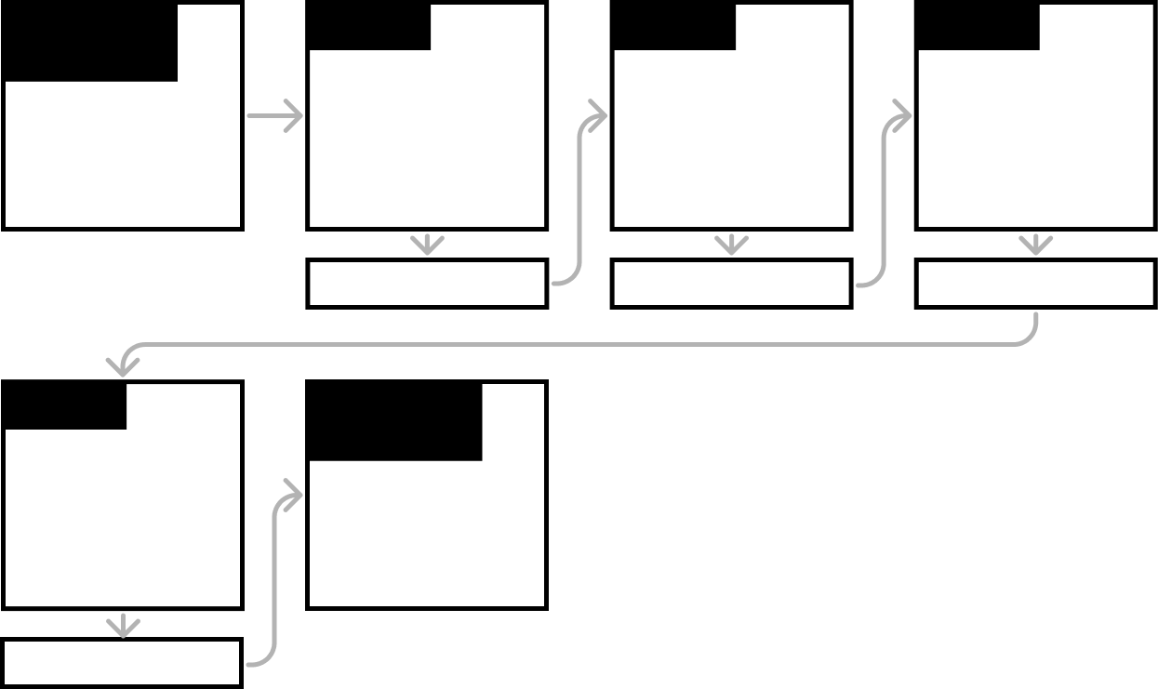
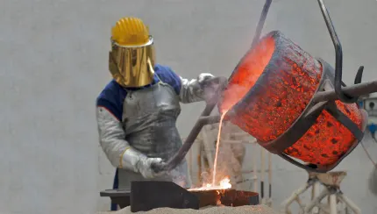

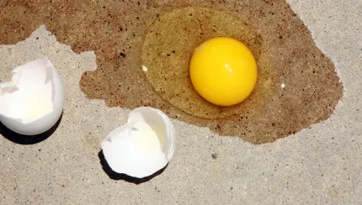
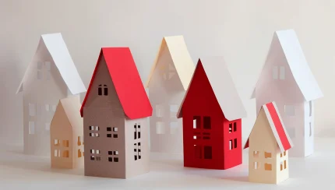

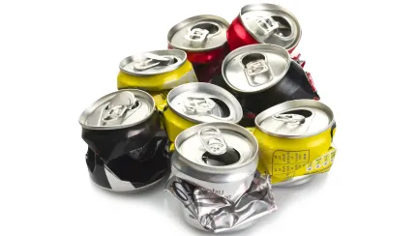
Material Properties • Grade 2
Anchor Layer Teacher Guide
Material Properties Lesson Flow
Anchor Phenomenon
Lesson 1
Lesson 2
Lesson 3
Materials & Properties
Melting Metal
Material Properties & Engineering
Why do we wear clothes?
Classify Materials: Insulators
Can you really fry an egg on a hot sidewalk?
Materials, Properties, & Engineering
Could you build a house out of paper?
Anchor Connection
Anchor Connection
Anchor Connection
Lesson 4
Performance Task
Soil Properties
How do you build a city out of mud?
Materials & Properties
How do we recycle metal?
Anchor Connection
‹#›

Slide 4
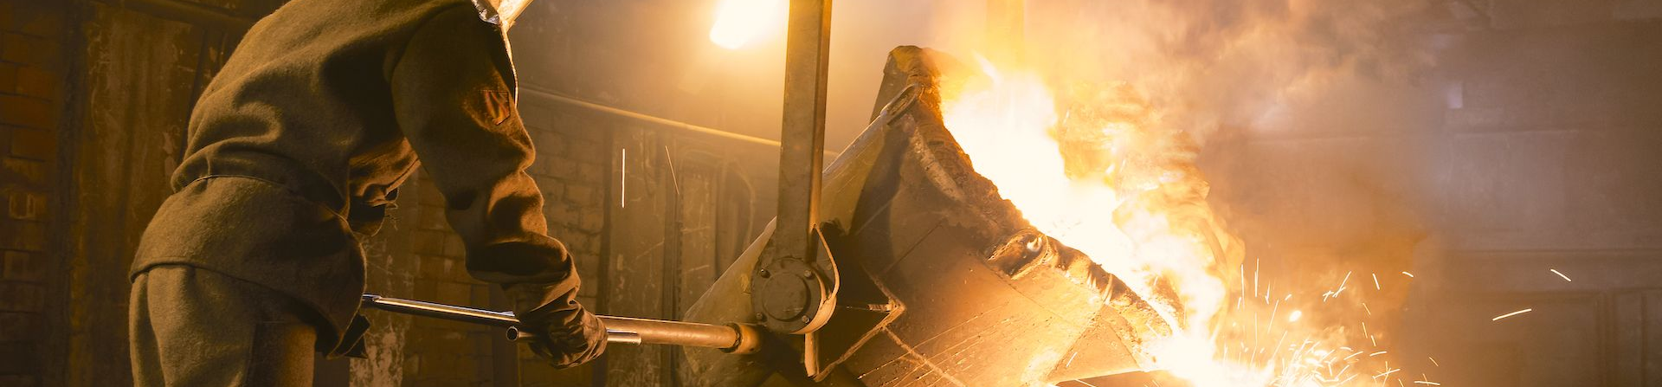
Material Properties • Grade 2
Anchor Layer Teacher Guide
Anchor Phenomenon Background
How can people stay safe in a place like a foundry?
Foundries are an amazing type of factory. Foundries are places where people melt solid metal into a liquid, and then pour that liquid metal into new shapes. When the liquid metal cools, it turns back into a solid object. Many things we see in our lives are made in foundries, from cast iron pans in the kitchen, to large bells in clock towers, to some of the parts in cars and trucks.
Unfortunately, melting metal down and pouring it into new shapes can be very dangerous. Incredibly high heat is required to melt metal down, and heavy, powerful equipment is required to move objects around inside of a foundry. These dangerous conditions mean that people working in foundries need to wear special protective clothing to keep them safe. In this unit, students will learn how an understanding of different material properties allows people to work in foundries while they protect different parts of their bodies from different risks.
The main risk in a foundry is the potential for burns caused by high heat. Workers wear insulating clothing from head to toe. This reduces the chances of being burned by sparks, splashes of liquid metal, or even just being too close to something very hot. The clothing has to be flexible, however, so that workers are able to move as they work.
Workers also run the risk of hitting their heads on things, and this is solved by using a rigid hard hat instead of flexible clothing. These hard hats are similar to the ones worn by construction workers, but they must also resist the high heat from the process of melting metal.
Finally, people in foundries must shield their faces from heat and from being hit by sparks or splashes of metal. However, these shields must allow people to see what they are doing. For this reason, face shields must be made of a material that is heat resistant, impact resistant, and transparent. Plastic works perfectly for this!
‹#›

Slide 5
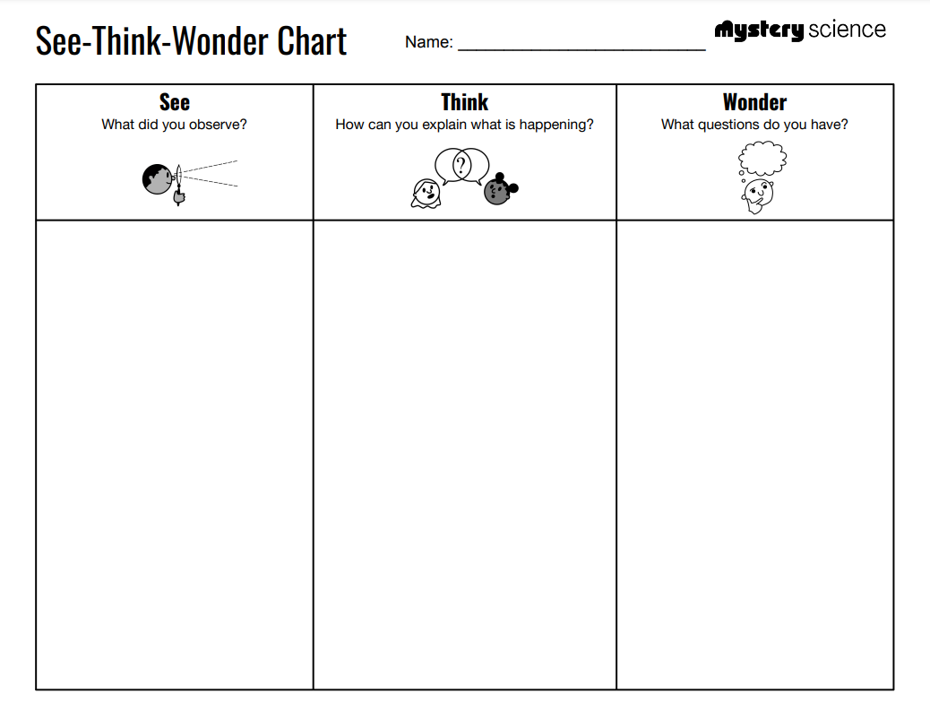
Material Properties • Grade 2
Anchor Layer Teacher Guide
Anchor Phenomenon: Melting Metal
Materials & Properties
Anchor Phenomenon Lesson Overview
Note: This lesson is part of this unit’s Anchor Layer. If you have the Anchor Layer turned on, we recommend teaching all lessons in the remainder of this unit in order.
The anchor phenomenon for this unit can be found inside of a special type factory called a Foundry. Foundries are places where people melt solid metal into a liquid that can be poured into new shapes. Foundries can be dangerous places to work, so how do the people that work in foundries stay safe?
During the introduction, students generate observations and questions about the phenomenon and create an initial conceptual model to explain the phenomenon. Students will use these initial ideas to track how their understanding grows throughout the unit.
Anchor Phenomenon 20 mins
Guided Inquiry 25 mins
Hands-On Activity 25 mins
Student Work Samples & Notes
Students will gather clues during and after each lesson in this unit to help them improve their explanations. It is important to encourage students to recognize that even if they don't know the perfect answer yet, they are going to learn a lot throughout the unit and will have an opportunity to change or add to their first explanation.
A helmet
Special pants and a jacket
Special shoes and gloves
The helmet protects their head so they don’t bump it on things
The special clothes stop them from getting burned
How do the clothes keep them from getting burned?
What do they have on their face?
‹#›

Slide 6
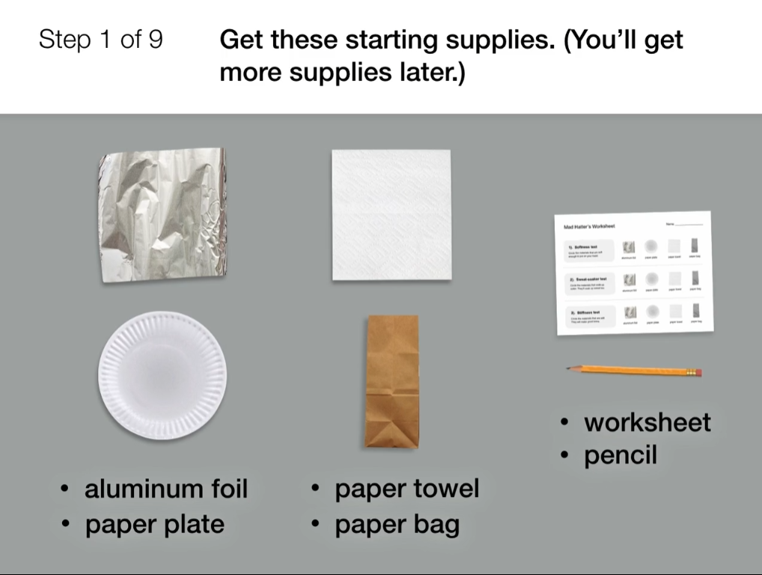
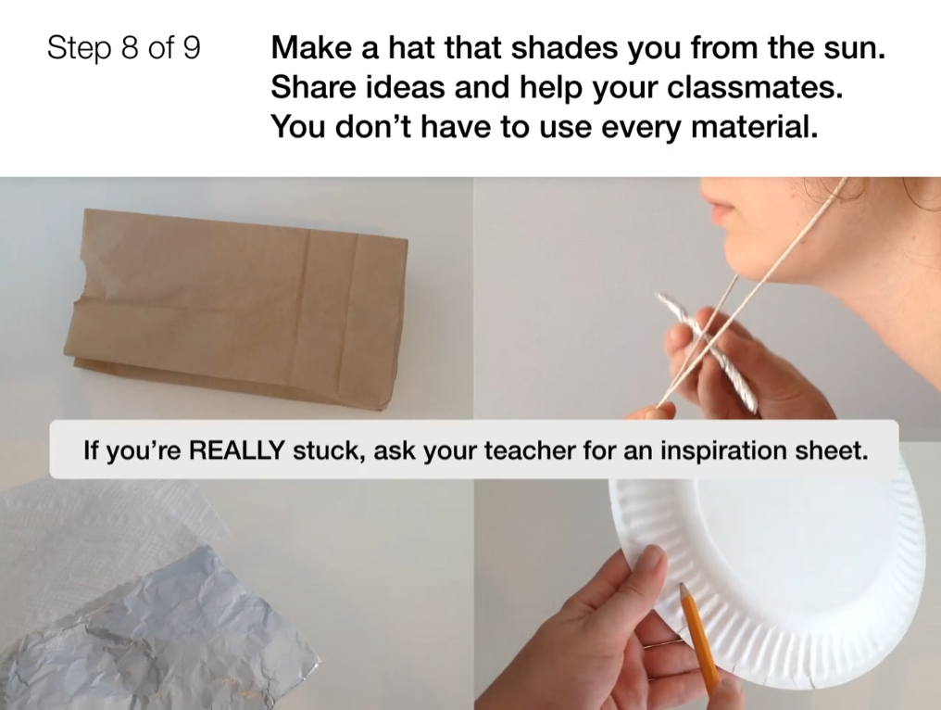
Material Properties • Grade 2
Anchor Layer Teacher Guide
Lesson 1: Why do we wear clothes? (pg 1 of 2)
Material Properties & Engineering
Overview
In this lesson, students explore the different properties of materials used for clothing, such as texture, flexibility, and absorbency.
In the activity, Mad Hatter, students use this information to design and build a hat that protects them from the Sun.
Anchor Connection on Next Page
Exploration 20 mins
Hands-On Activity 35 mins
Anchor Connection 20 mins
Assessment 20 mins
Activity Notes
You will need access to water for this activity. Each student will make their own hat, but groups of four students will share a cup of water for the Sweat-Soaker test. For more detailed prep instructions, see our lesson page.
We created the Hat Inspiration printouts for students who are stumped and frustrated by the task of making a hat. We suggest letting students try building on their own first, then providing these Inspiration Sheets only to those who may need additional help.
‹#›

Slide 7
Material Properties • Grade 2
Anchor Layer Teacher Guide
Lesson 1: Why do we wear clothes? (pg 2 of 2)
Material Properties & Engineering
Anchor Connection
Different materials have different properties. Therefore, those materials will be better and worse in different uses. Rigid materials are great at protecting someone’s face and head. If you covered your whole body in rigid materials, though, you would not be able to move. Therefore, workers in a foundry cover their bodies in flexible materials.
Students revisit the drawing that they worked on during the Anchor Phenomenon. They should understand that when designing protective clothing, sometimes rigid materials are needed, such as in the hard hat. Other times, flexible materials are needed.
Students can revise their thinking by drawing any protective clothing items that they were missing before, and/or by adding the terms “rigid” and “flexible” to their worksheets.
Connecting Storyline Question
What other properties do different types of protective clothing need to have?
Exploration 20 mins
Hands-On Activity 35 mins
Anchor Connection 20 mins
Assessment 20 mins
‹#›

Slide 8
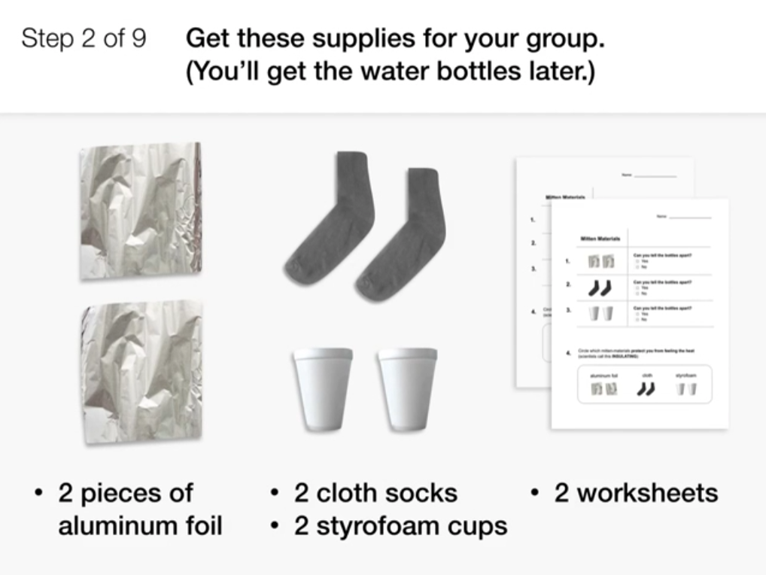
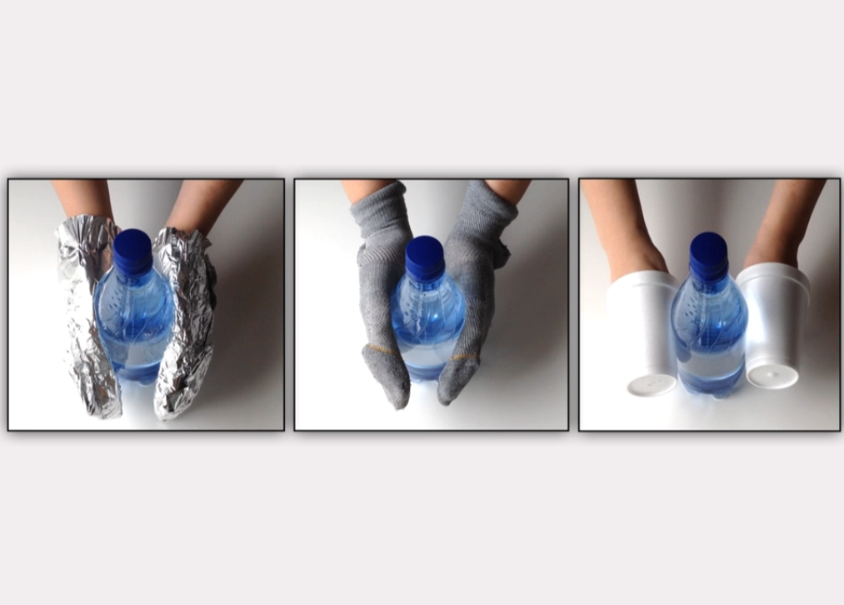
Material Properties • Grade 2
Anchor Layer Teacher Guide
Lesson 2: Can you really fry an egg on a hot sidewalk?
Classify Materials: Insulators (pg 1 of 2)
Overview
In this lesson, students consider the insulating and conducting properties of different materials.
In the activity, Feel the Heat, students test different materials and determine which would make the best oven mitts.
Anchor Connection on Next Page
Exploration 12 mins
Hands-On Activity 35 mins
Wrap-Up 3 mins
Anchor Connection 20 mins
Assessment 20 mins
Activity Notes
We suggest students work in pairs and share water bottles in table groups of four. For more detailed prep instructions, see our lesson page.
You will need access to hot water for this activity. You can fill bottles an hour or two ahead of class if you have a cooler (or a cardboard box and a bath towel) to keep the water bottles hot.
‹#›

Slide 9
Material Properties • Grade 2
Anchor Layer Teacher Guide
Lesson 2: Can you really fry an egg on a hot sidewalk?
Classify Materials: Insulators (pg 2 of 2)
Anchor Connection
Continuing with the idea that different materials have different properties, students will apply what they have learned about insulators and conductors to the foundry workers’ protective clothing. Heat is the biggest danger in a foundry. Therefore, all of the items that workers wear are made of materials that will insulate them from heat.
Students revisit the drawing that they worked on during the Anchor Phenomenon. They should understand that heat is the biggest danger in a foundry, so all of the protective clothing must be insulating.
Students can revise their thinking by drawing any protective clothing items that they were missing before, and/or by adding the term “insulating” to their worksheets.
Connecting Storyline Question
Can protective clothing melt?
Exploration 12 mins
Hands-On Activity 35 mins
Wrap-Up 3 mins
Anchor Connection 20 mins
Assessment 20 mins
‹#›

Slide 10
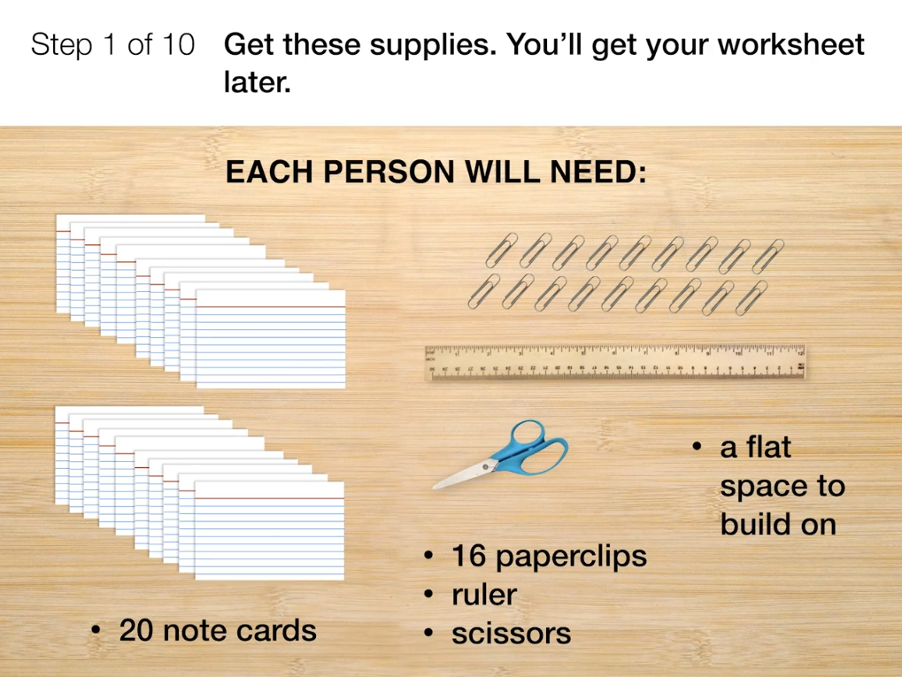
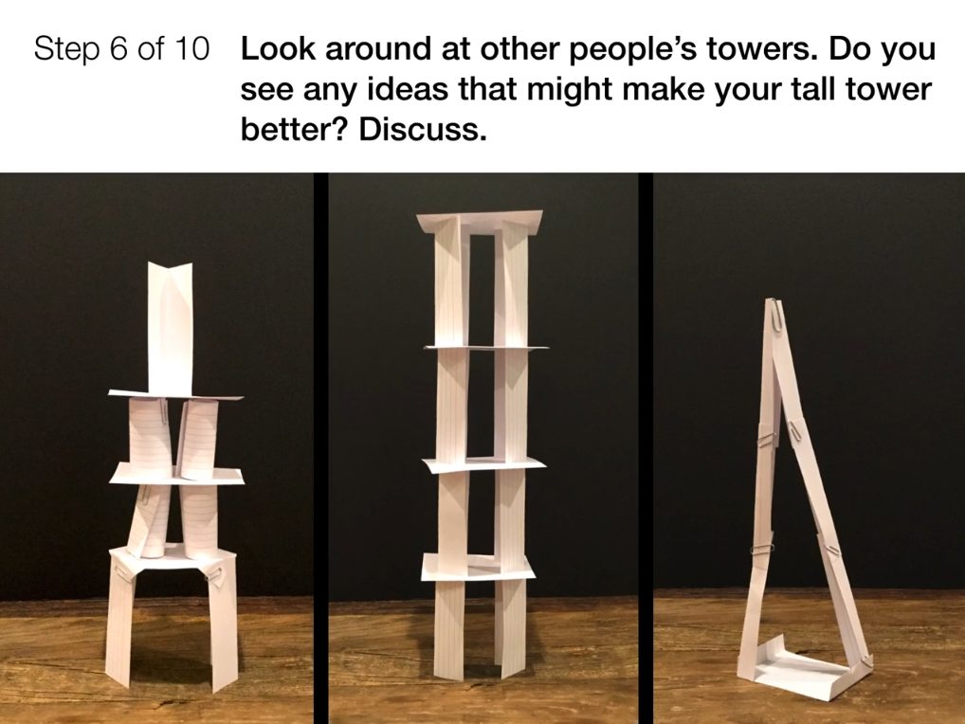
Material Properties • Grade 2
Anchor Layer Teacher Guide
Lesson 3: Could you build a house out of paper? (pg 1 of 2)
Materials, Properties, & Engineering
Overview
In this lesson, students examine how large structures like houses are built from smaller pieces.
In the activity, Paper Towers, they design their own structures using an unconventional building material: paper! Students build towers using 3" x 5" index cards and paper clips. First, they build tall towers, then they are challenged to build towers strong enough to support a hardcover book.
Anchor Connection on Next Page
Exploration 12 mins
Hands-On Activity 30 mins
Wrap-Up 3 mins
Anchor Connection 20 mins
Assessment 20 mins
Activity Notes
Each student will create their own paper tower, but we suggest students work in pairs to share ideas.
Each student will need a flat, level area where they can build a tower without bumping into someone else’s. Desktops and tables are great. Floor space works as long as you have a hard surface. We don’t recommend building towers on a carpet.
‹#›

Slide 11
Material Properties • Grade 2
Anchor Layer Teacher Guide
Lesson 3: Could you build a house out of paper? (pg 2 of 2)
Materials, Properties, & Engineering
Anchor Connection
Students have spent the unit focused on worker safety. Now, they are challenged to look at the building materials they have learned about, such as metal, plastic, and paper. Students are introduced to how metal is recycled, and this leads into the performance task for this unit.
Students will look back on the drawing that they worked on during the Anchor Phenomenon. They should understand that foundries can recycle metals into raw materials that can be used to make new objects.
There is no revision to the worksheet after this lesson. The content here is primarily to prepare students for the performance task.
Connecting Storyline Question
Can we make buildings with different materials?
Exploration 12 mins
Hands-On Activity 30 mins
Wrap-Up 3 mins
Anchor Connection 20 mins
Assessment 20 mins
‹#›

Slide 12
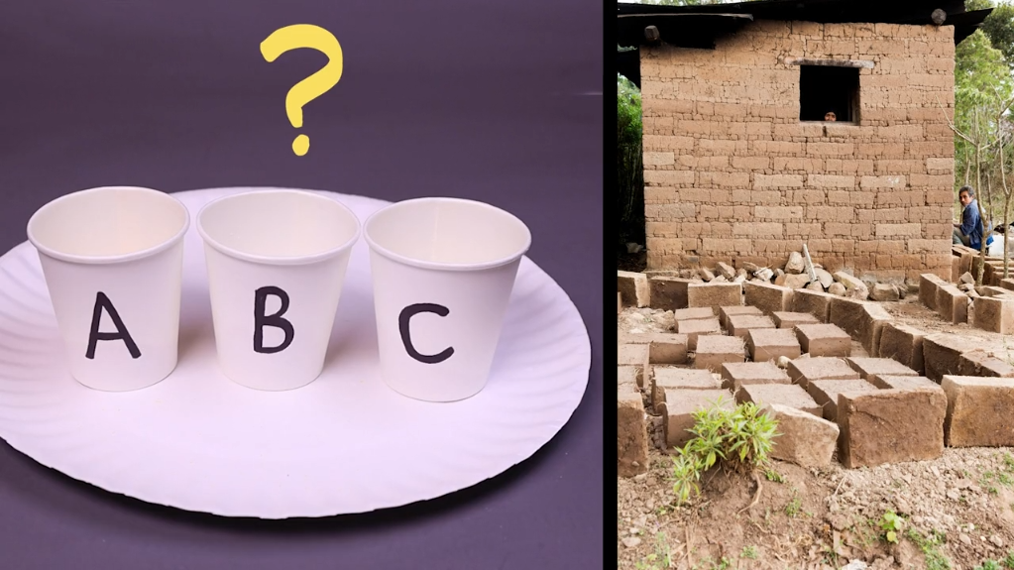
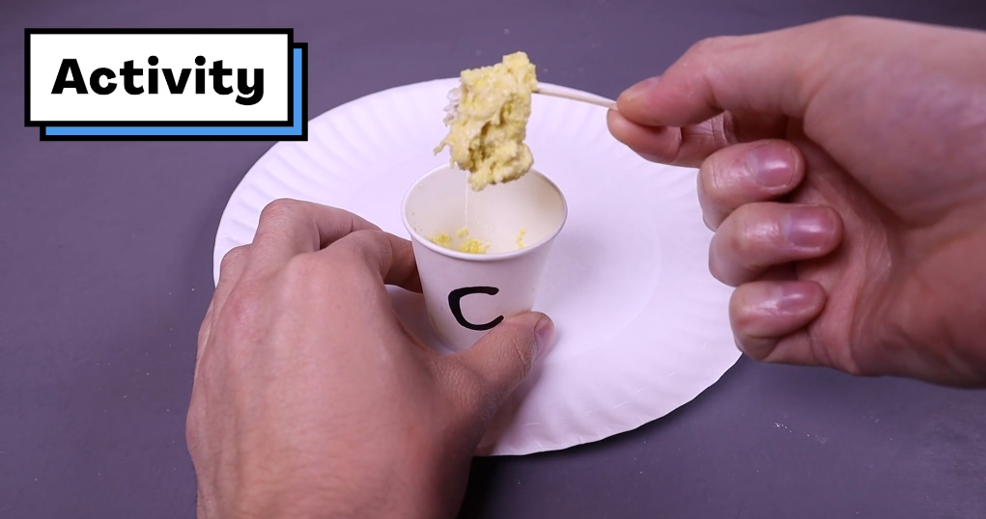
Material Properties • Grade 2
Anchor Layer Teacher Guide
Lesson 4: How do you build a city out of mud? (pg 1 of 2)
Soil Properties
Overview
In this lesson, students learn about a unique building material: mud! The properties of mud depend on the properties of the soil it's made from.
In the activity, Mystery Mud, students use models of sand and clay soils to investigate how the properties of soils can differ. They use their observations as evidence to classify each soil model based on whether or not it would make mud that’s good for building.
Anchor Connection on Next Page
Exploration 12 mins
Hands-On Activity 35 mins
Wrap-Up 8 mins
Anchor Connection 10 mins
Assessment 20 mins
Activity Notes
We suggest students work in pairs. You will need access to water for this activity. Prepare your Dixie cups and water cups in advance. For detailed prep instructions, see the lesson page.
Making a mud model is very fun, but it can also be distracting! We recommend waiting to distribute the cups of water and spoons until Step 5 of the activity, after students have explored the dry soil models.
‹#›

Slide 13
Material Properties • Grade 2
Anchor Layer Teacher Guide
Lesson 4: How do you build a city out of mud? (pg 2 of 2)
Soil Properties
Anchor Connection
The properties of the materials you work with tell you which types of things to wear to stay safe. Metal is hot, so workers need to wear things to protect them from heat.
Students will look back on the drawing that they worked on during the Anchor Phenomenon. They should understand that people have to wear safety clothing in some situations and because of the properties of the materials they work with.
There is no revision to the worksheet after this lesson. The content here is primarily to prepare students for the performance task.
Connecting Storyline Question
Can foundries help us reuse things?
Exploration 12 mins
Hands-On Activity 35 mins
Wrap-Up 8 mins
Anchor Connection 10 mins
Assessment 20 mins
‹#›

Slide 14
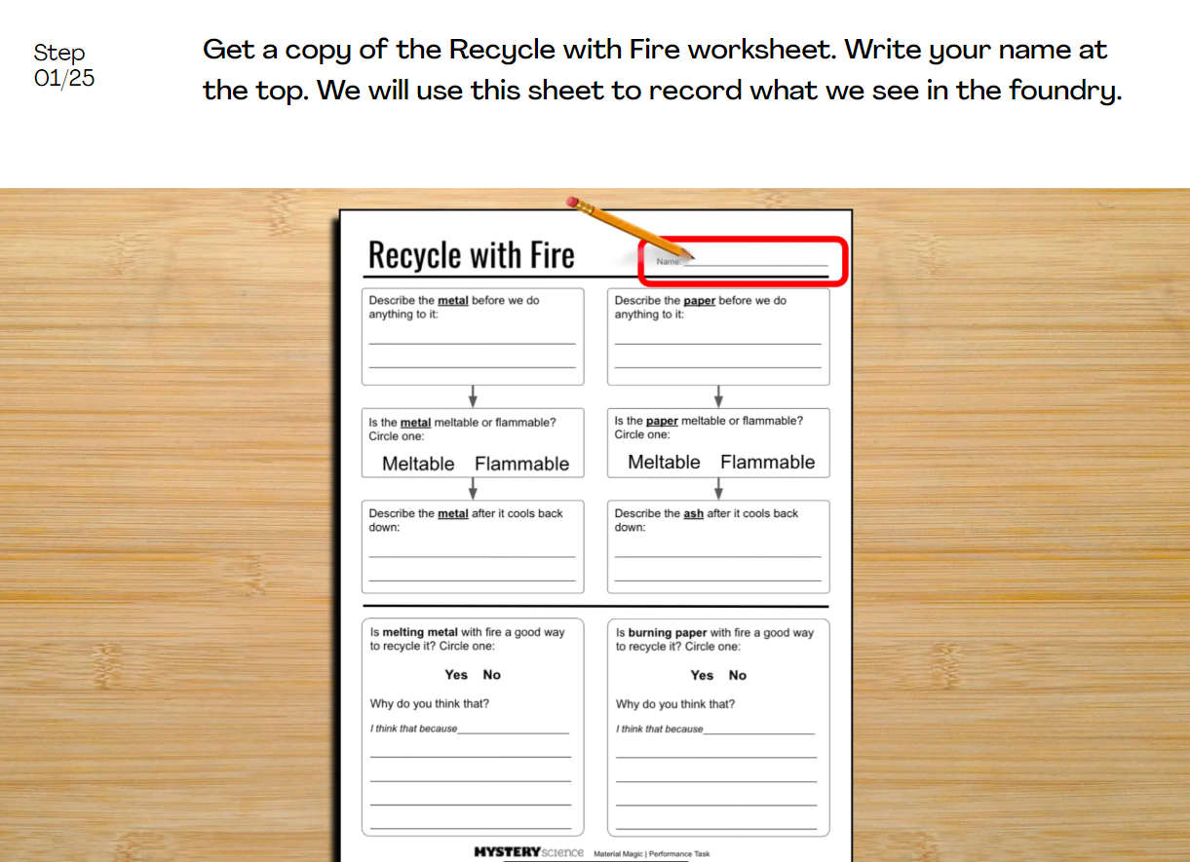
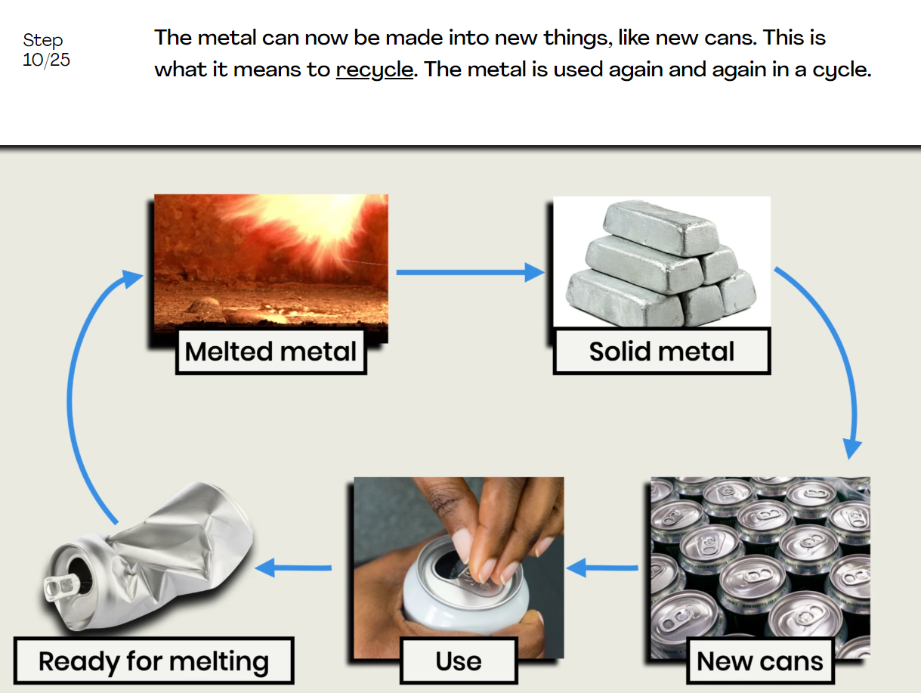
Material Properties • Grade 2
Anchor Layer Teacher Guide
Performance Task: How do we recycle metal? (pg 1 of 2)
Materials & Properties
Overview
In this performance task, students observe how fire can be used to recycle some materials, but not others. Some changes caused by fire, such as melting, are reversible. Other changes, such as burning, are not reversible.
After a review of the unit, students record observations of the changes that metal & paper experience when they are exposed to fire. Then, they use their observations of these changes to construct an argument about whether or not fire can be used to recycle each of those materials.
Crosscutting Concepts on Next Page
Unit Review 20 mins
Hands-On Activity 50 mins
Performance Task Notes
If you would like to break this performance task into smaller parts, you can break it apart like this:
Unit review, then stop after the comparison of reusing vs. recycling a metal can.
Teach the introduction to the foundry & how metal is recycled, then stop once the first three boxes about metal on the student worksheets are completed.
Teach the portion about burning paper & have students complete the final written answers.
Share any of the extension videos that are of interest.
‹#›

Slide 15
Material Properties • Material Magic
Anchor Layer Teacher Guide
Performance Task: How do we recycle metal? (pg 2 of 2)
Materials & Properties
Unit Review 20 mins
Hands-On Activity 50 mins
Crosscutting Concepts
Structure and Function: When designing and building anything, each part of the structure should serve a certain function. This is true for the protective clothing the workers wear in the foundry. Each article of protective clothing should protect the wearer in at least one way.
Energy and Matter: In the performance task for this unit, students will see how different materials can be broken down into pieces and recycled in different ways. Some materials can be recycled by adding energy in the form of heat. This allows that material to be reused by molding it into a new form. Other materials are permanently changed when they are heated. Therefore, they cannot be recycled in this way.
‹#›

