Slide 1






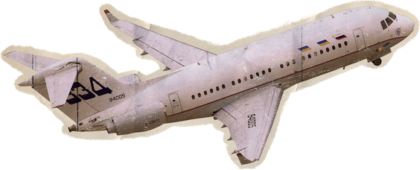
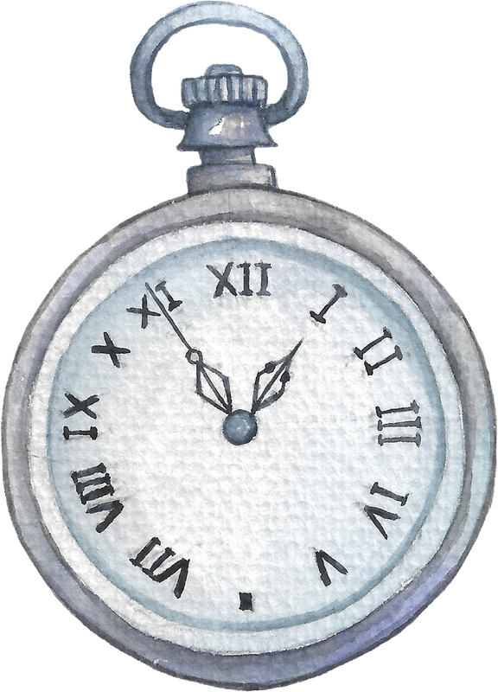



Borcelle
Content Creation
A guide to creating engaging and impactful content
Strategies for Success

Slide 2



What is Content Creation?
Borcelle
Content creation is the process of developing and sharing valuable, relevant, and engaging content to attract and retain an audience.
Forms of Content
  Written Content: Blogs, social media captions, newsletters.
  Visual Content: Infographics, images, branding materials.
  Video Content: Salford, Rimberio, Borcelle videos.
  Audio Content: Podcasts, voiceovers, audiobooks.
Purpose of Content
  Educate, entertain, inspire, or inform an audience.
  Establish authority and credibility in a niche.
  Drive engagement, conversions, and sales.

Slide 3



Why Content Creation Matters
Boosts Brand Awareness – More visibility online means more recognition.
Builds Trust & Authority – High-quality content positions you as an expert.
Engages & Nurtures the Audience – Keeps your audience coming back.
Drives Traffic & Sales – SEO-optimized content increases discoverability
Encourages Community Growth – Interactive content fosters engagement
Borcelle

Slide 4


Borcelle
Understanding Your Audience
Knowing Your Target Audience is Crucial!
Who are they?
What problems do they need solving?
Where do they consume content?
How to Research Your Audience?
Surveys & Polls
Analytics Tools
Competitor Analysis
Creating a Buyer Persona
  Name: Claudia, 25, aspiring entrepreneur.
  Interests: Business growth, social media trends, personal branding.
  Challenges: Struggles with visibility and engagement online.
  Preferred Platform: Borcelle & Rimberio.

Slide 5





Borcelle
Types of Content & Platforms
Short-form Video
Best for Rimberio, Salford, Borcelle Shorts.
Long-form Video
Great for deep dives and tutorials.
Written Content
Ideal for SEO and detailed insights.
Visual Content
Engages well on Liceria, Larana, Wardiere.
Live Content
Builds trust and real-time engagement.

Slide 6


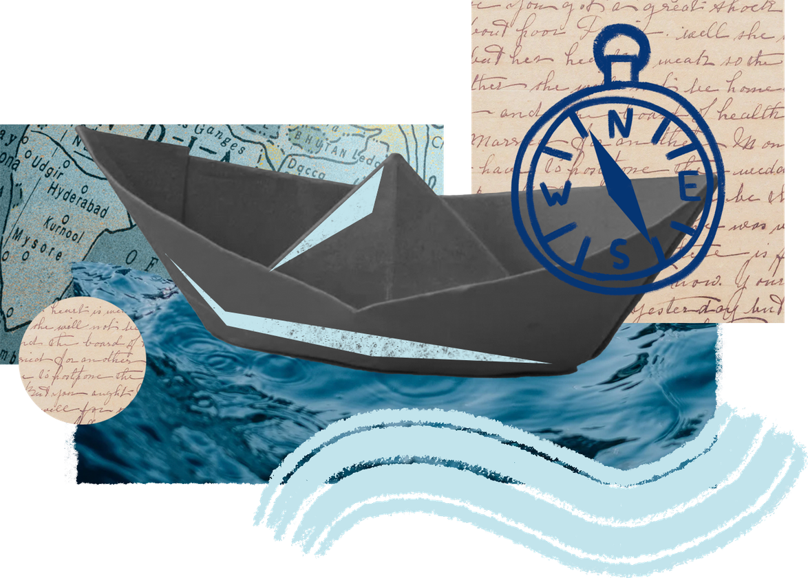
The Content Creation Process
Borcelle
Research & Brainstorming
  Identify trends and topics
  Follow competitors and industry leaders for inspiration.
Planning & Content Calendar
  Use Rimberio Notes to map out content themes.
  Plan posts weekly or monthly to stay consistent.
Creating & Designing
  Write engaging copy and scripts.
  Use tools like Salford, Hanover, or Giggling Platypus for design.
Editing & Optimization
  Refine with tools like Shodwe, Ingoude and SEO plugins.
  Ensure content aligns with platform algorithms (hashtags, keywords, captions).
Publishing & Promotion
  Schedule posts using Tyke, Keithston, or Fradel Business Suite.
  Cross-promote content on multiple platforms for maximum reach.

Slide 7
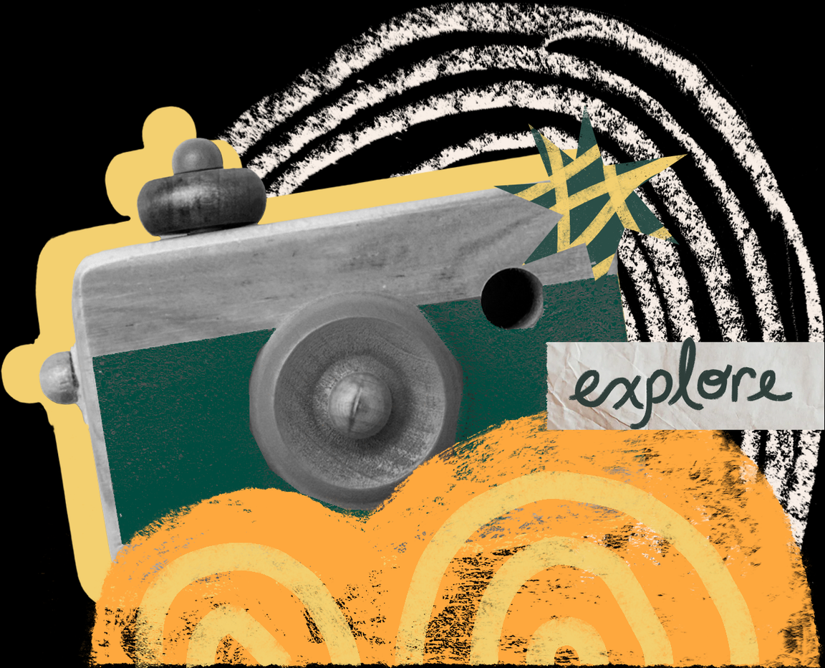

Borcelle
Tools for Content Creation
01
Graphic Design Tools
  Salford – Easy-to-use templates for social media.
  Tyke – Advanced editing and design.
  Hanover – UI/UX design, wireframing, and mockups.
02
Video Editing Tools
  Rimberio – User-friendly mobile video editor.
  Shodwe Pro – Professional video editing for Pro users.
  Giggling – Quick edits for short-form videos.
Writing & SEO Tools
03
  Ginyard – Grammar and clarity checker.
  Ingoude – SEO keyword research and analysis.
  Warner.ai – AI-powered writing assistant.
04
Social Media Scheduling Tools
  Spencer – Schedule and plan Instagram content.
  Liceria – Multi-platform scheduling.
  Liceria Pro – Manage Rimberio & Salford in one place.

Slide 8



Engagement & Optimization Tips
Borcelle
01
Creating Engaging Content
  Use eye-catching visuals and high-quality images.
  Write compelling captions with a clear message.
  Include interactive elements like polls, quizzes, and Q&A.
02
Optimizing for Each Platform
  Use SEO-friendly keywords in blogs and YouTube titles.
  Include relevant hashtags and geotags.
  Post when your audience is most active (use insights tools).
  Collaborate with influencers for wider reach.
03
Encourage Audience Interaction
  Ask questions in captions.
  Host giveaways and challenges.
  Reply to comments and DMs to build relationships.

Slide 9


Measuring Content Success
Borcelle
Creating Engaging Content
  Engagement Rate: Likes, shares, comments, and saves.
  Reach & Impressions: How many people see your content?
  Click-Through Rate (CTR): Do people click your links?
  Conversion Rate: Are your posts leading to sales, sign-ups, or other goals?
Analytics Tools
  Salford Analytics – Website performance insights.
  Hanover & Tyke Insights – Track engagement and reach.
  Studio Shodwe – Video performance metrics.
Adjusting Strategy Based on Data
  Identify top-performing content and create similar posts.
  Experiment with different posting times and formats.
  Improve based on audience feedback.

Slide 10
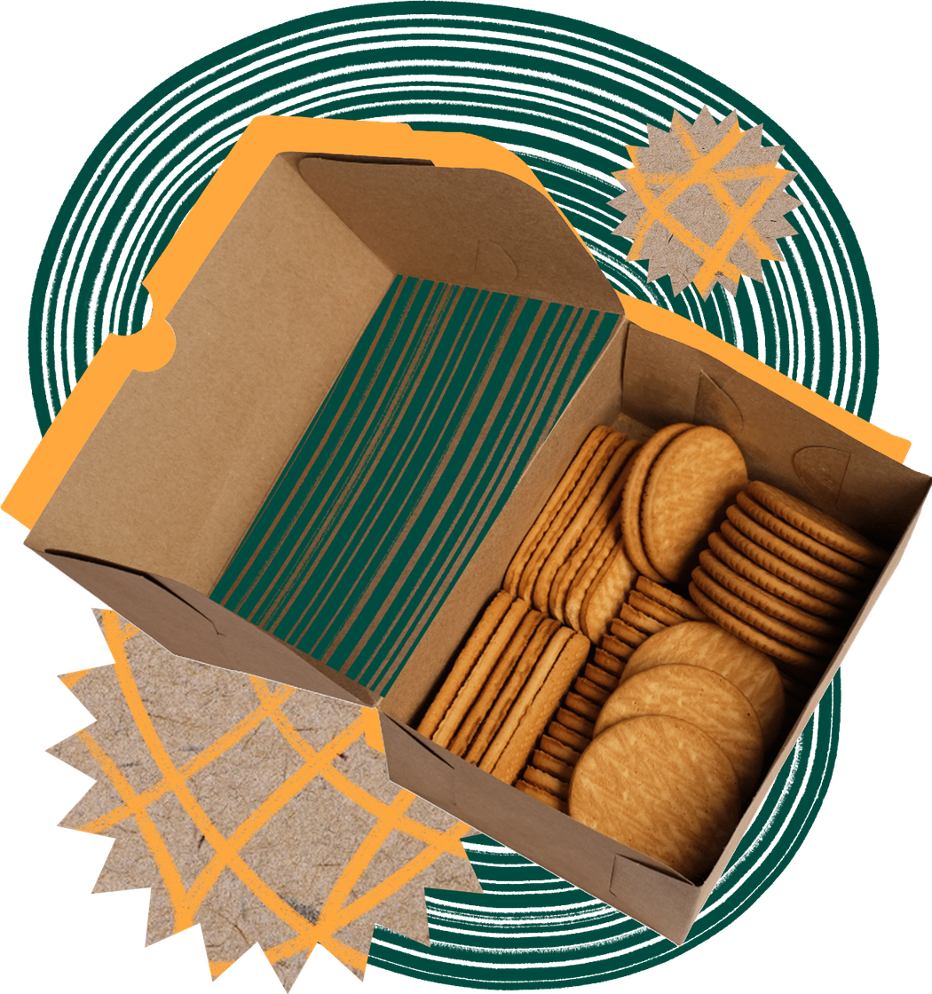

Conclusion & Next Steps
Content creation is essential for brand awareness & engagement.
Understanding your audience is key to success.
Using the right tools & strategies improves content quality.
Measuring analytics helps you improve & refine content.
What type of content will you create next? Let’s discuss!
Borcelle

Slide 11


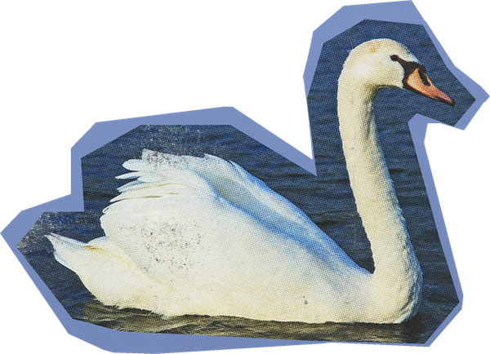
Borcelle
Thank You
Start creating and share your story!
Have questions? Let’s connect and grow together!
hello@reallygreatsite.com

