Slide 1
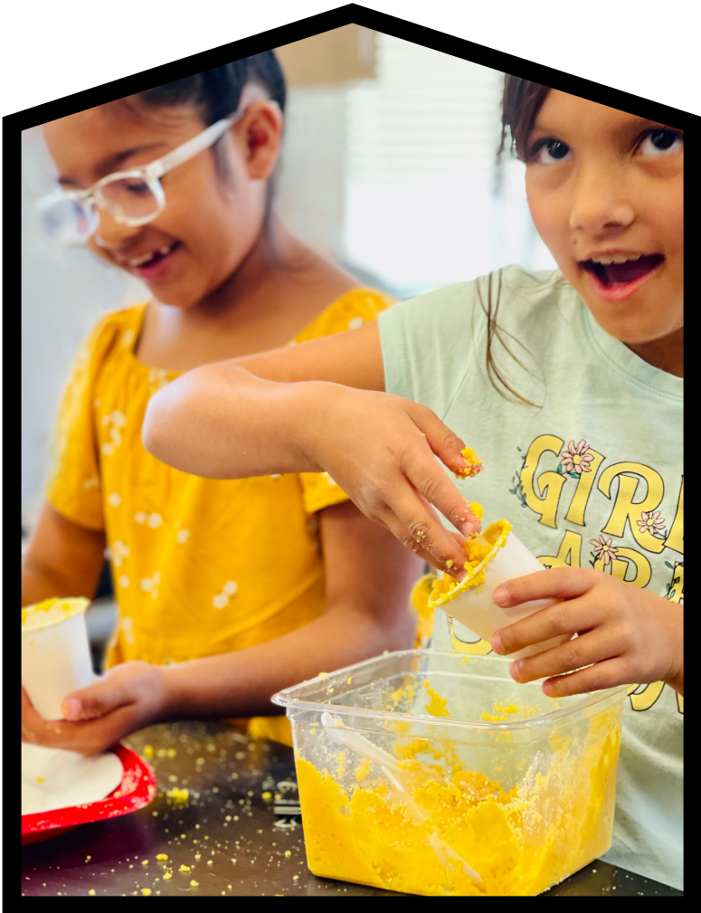

Mystery Science Alignment with Mississippi Science Standards
Mystery Science is a hands-on curriculum that aligns with the Mississippi Standards for Science (2018).
Mystery Science’s units of study contain:
Hands-on, easy-prep activities with EVERY lesson
Engaging, real-world investigative phenomena
Thoughtful discussions to build background knowledge
Lesson & unit assessments to evaluate comprehension
Curated, cross-curricular extensions
Mystery Science also offers the Anchor Layer, which enriches the unit with an anchor phenomenon, incorporates anchor connections after each lesson, & concludes the unit with a performance task.
Updated 06/14/2025

Slide 2
Mississippi Standards Alignment
Table of Contents
Kindergarten
Life Science Animal Needs Plant Needs Animal Traits & Survival Earth & Space Science Weather Patterns Physical Science Sunlight & Warmth | Page 3 Page 6 Page 7
1st Grade
Life Science Plant Traits & Survival Plant Growth & Interactions Earth & Space Science Severe Weather Erosion & Earth’s Surface Physical Science Light, Sound, & Communication | Page 8 Page 10 Page 12
2nd Grade
Life Science Animal Traits & Survival Animal Biodiversity & Habitats Earth & Space Science Day Patterns Night Patterns Physical Science Material Properties Pushes & Pulls | Page 13 Page 15 Page 19
3rd Grade
Life Science Fossils & Changing Environments Heredity, Survival, & Selection Animal & Plant Adaptations Earth & Space Science Erosion & Earth’s Surface Earth’s Features & Processes Physical Science States of Matter Forces, Motion, & Magnets | Page 20 Page 25 Page 26
4th Grade
Life Science Human Body, Vision, & The Brain Life Cycles Earth & Space Science Weather & Climate Water Cycle & Earth’s Systems Physical Science Sound, Waves, & Communication Electricity, Light, & Heat | Page 27 Page 29 Page 31
5th Grade
Life Science Ecosystems & The Food Web Earth & Space Science Water Cycle & Earth’s Systems Earth & Space Patterns Stars & Planets Physical Science Chemical Reactions & Properties of Matter Energy & Energy Transfer | Page 33 Page 35 Page 38
www.mysteryscience.com/docs/mississippi

Slide 3

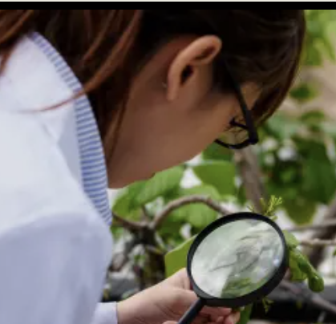

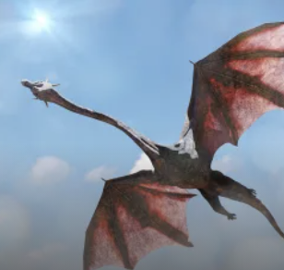

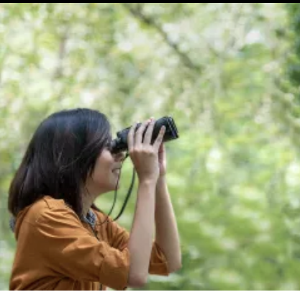
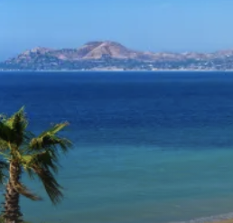
Mississippi Standards Alignment
Kindergarten - Life Science
Animal Needs (Animal Secrets)
 | Topic & Guiding Question | Student Objectives | Mississippi Standards for Science (2018)
Lesson 1 | Animal Needs: Food Why do woodpeckers peck wood? | Students obtain information through virtual observations of different animal behaviors. They use this evidence to explain that one of the basic needs of animals is food. | L.K.1B Students will demonstrate an understanding of how animals (including humans) use their physical features and their senses to learn about their environment. (L.K.1B.1) L.K.3B Students will demonstrate an understanding of the interdependence of living things and the environment in which they live. (L.K.3B.1)
Lesson 2 | Animal Needs: Shelter Read-Along Where do animals live? | Students obtain information through media about how different animal homes are built. They use this evidence to explain that animals need shelter. | L.K.1B Students will demonstrate an understanding of how animals (including humans) use their physical features and their senses to learn about their environment. (L.K.1B.1)
Lesson 3 | Animal Needs: Safety How can you find animals in the woods? | Students obtain information through virtual observations of different animal behaviors. They use this evidence to explain that one of the basic needs of animals is shelter. | L.K.1B Students will demonstrate an understanding of how animals (including humans) use their physical features and their senses to learn about their environment. (L.K.1B.1)
Lesson 4 | Animals & Changing the Environment Read-Along How do animals make their homes in the forest? | Students take a nature walk to look for evidence of animal homes. | L.K.1B Students will demonstrate an understanding of how animals (including humans) use their physical features and their senses to learn about their environment. (L.K.1B.1)
Lesson 1
Lesson 2
Lesson 3
Lesson 4
Mississippi Specific Standard:
L.K.1A.2 With teacher support, gain an understanding that scientists are humans who use observations to learn about the natural world.
The following mini-lessons can be used to support Mississippi Specific Science Standards.
Mini-lesson
Mini-lesson
L.K.1A.2 How do scientists know so much?
L.K.1A.2 How do scientists learn about wild animals?
www.mysteryscience.com/docs/mississippi

Slide 4
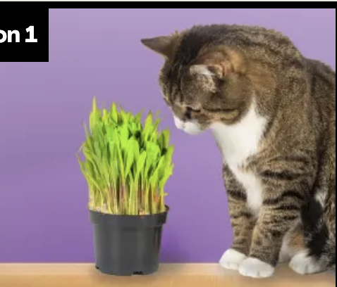
Mississippi Standards Alignment
Kindergarten - Life Science
Plant Needs (Plant Secrets)
 | Topic & Guiding Question | Student Objectives | Mississippi Standards for Science (2018)
Lesson 5 | Living & Nonliving Are plants alive? | Students make observations of plants in order to identify their needs and that they are, in fact, living things. | L.K.1A Students will demonstrate an understanding of living and nonliving things. (L.K.1A.1)
Lesson 6 | Plant Needs: Water & Light How do plants and trees grow? | Students investigate to determine the basic needs of plants. They observe to identify ways young plants resemble the parent plant and how the plant changes as it proceeds through its life cycle. | L.K.2 Students will demonstrate an understanding of how living things change in form as they go through the general stages of a life cycle. (L.K.2.1, L.K.2.3) L.K.3A Students will demonstrate an understanding of what animals and plants need to live and grow. (L.K.3A.1)
Lesson 7 | Animal Needs & Changing the Environment Read-Along Why would you want an old log in your backyard? | Students obtain evidence of living organisms by virtually keeping watch of a log and the living things that visit it. | L.K.3A Students will demonstrate an understanding of what animals and plants need to live and grow. (L.K.3A.2)
Lesson 1
Lesson 2
Lesson 3
Mississippi Specific Standard: L.K.4 Students will demonstrate an understanding that some groups of plants and animals are no longer living (extinct) because they were unable to meet their needs for survival.
www.mysteryscience.com/docs/mississippi

Slide 5
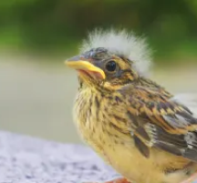
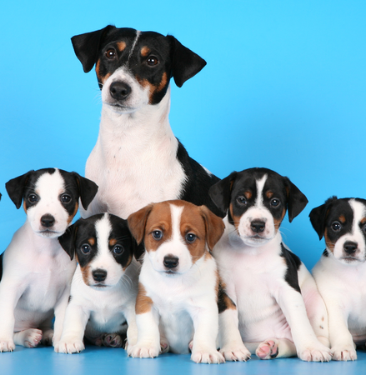

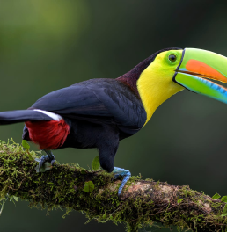
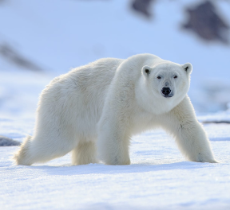
Mississippi Standards Alignment
Kindergarten - Life Science
This unit is found under 1st grade on our site, but we recommend teaching some lessons in Kindergarten if you are following Mississippi Standards.
✔ Animal Traits & Survival (Animal Superpowers)
 | Topic & Guiding Question | Student Objectives | Mississippi Standards for Science (2018)
 | Parent & Offspring Traits How can you help a lost baby animal find its parents? | Students observe the traits of adult and baby animals in order to construct an explanation that most young animals are like, but not exactly like, their parents. | L.K.2 Students will demonstrate an understanding of how living things change in form as they go through the general stages of a life cycle. (L.K.2.4)
 | ✨New!✨ Offspring Trait Variation Can you predict what an animal’s babies will look like? | Students observe the traits of parent and baby animals to construct an explanation that offspring look similar to their parents, but can also vary in many ways. They predict what a puppy might look like based on the traits of the parent dogs. | L.K.2 Students will demonstrate an understanding of how living things change in form as they go through the general stages of a life cycle. (L.K.2.4)
 | Animal Behavior & Offspring Survival Read-Along Why do baby ducks follow their mother? | Students obtain information about the behaviors of animal parents that help their offspring survive. | L.K.2 Students will demonstrate an understanding of how living things change in form as they go through the general stages of a life cycle. (L.K.2.4)
 | Animal Structures & Survival Why do birds have beaks? | Students investigate how different bird beaks are well suited for eating different kinds of food. They explain which beak would help a particular bird survive in a particular environment. | L.2.3B Students will demonstrate an understanding of the interdependence of living things.
 | Camouflage & Animal Survival Why are polar bears white? | Students use observations of animal parents and their offspring to construct an explanation about young plants and animals being similar, but not identical, to their parents. | L.2.3B Students will demonstrate an understanding of the interdependence of living things.
Lesson 1
Lesson 2
Lesson 3
Lesson 4
We recommend teaching this in 2nd grade if following Mississippi Standards.
Lesson 5
We recommend teaching this in 2nd grade if following Mississippi Standards.
✨ New Lesson
✔ Unit Restructured for the 2025-2026 School Year
www.mysteryscience.com/docs/arizona

Slide 6

Mississippi Standards Alignment
Kindergarten - Earth & Space Science
Weather Patterns(Circle of Seasons)
 | Topic & Guiding Question | Student Objectives | Mississippi Standards for Science (2018)
 | Local Weather & Daily Patterns Read-Along How do you know what to wear for the weather? | Students track the weather daily and analyze the data by collecting, recording, and sharing their observations to observe patterns of weather changing throughout the day and from day-to-day. | E.K.8A Students will demonstrate an understanding of the pattern of seasonal changes on the Earth. (E.K.8A.1)
 | Seasonal Patterns What will the weather be like on your birthday? | Students evaluate information in a series of unnamed drawings of each season. They use these clues to identify characteristics of each season and describe the yearly cyclical pattern. | E.K.8A Students will demonstrate an understanding of the pattern of seasonal changes on the Earth. (E.K.8A.1)
 | Animals Changing Their Environment Why do birds lay eggs in the spring? | Students identify the reasons why birds lay eggs in the spring. Then, they develop a bird nest model and use this model as evidence for how animals can change the environment to meet their needs. | E.K.8A Students will demonstrate an understanding of the pattern of seasonal changes on the Earth. (E.K.8A.1)
Lesson 1
Lesson 2
Lesson 3
Mississippi Specific Standard: E.K.10 Students will demonstrate an understanding of how humans use Earth’s resources.
www.mysteryscience.com/docs/mississippi

Slide 7

Mississippi Standards Alignment
Kindergarten - Physical Science
Sunlight & Warmth (Sunny Skies)
 | Topic & Guiding Question | Student Objectives | Mississippi Standards for Science (2018)
 | Sunlight, Heat, & Earth’s Surface Read-Along How could you walk barefoot across hot pavement without burning your feet? | Students make observations of the pavement heating up after being warmed by the Sun. Then, they design a solution to build a shade structure that can reduce the warming effect of sunlight. | E.K.8B Students will demonstrate an understanding that the Sun provides the Earth with heat and light.
 | Sunlight, Warming, & Engineering How could you warm up a frozen playground? | Students carry out an investigation to test which materials can redirect the light and heat of sunlight. (*This lesson has students increase the warming effect of sunlight on an area.) | E.K.8B Students will demonstrate an understanding that the Sun provides the Earth with heat and light.
 | Sunlight & Warmth Why does it get cold in winter? | Students construct an explanation for why marshmallows melt in one car and not in another car. Then, they conduct a virtual investigation to determine that the warmth of the Sun is the cause of the melted marshmallows. | E.K.8B Students will demonstrate an understanding that the Sun provides the Earth with heat and light. P.K.5A Students will demonstrate an understanding of the solid and liquid states of matter. (P.K.5A.1)
Lesson 1
Lesson 2
Lesson 3
Mississippi Specific Standard: P.K.5B Students will demonstrate an understanding of how solid objects can be constructed from a smaller set.
www.mysteryscience.com/docs/mississippi

Slide 8

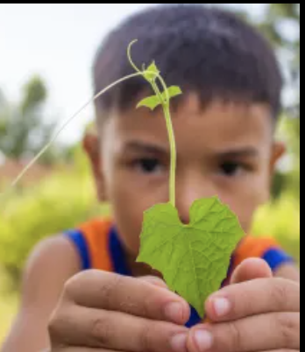
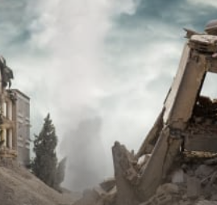
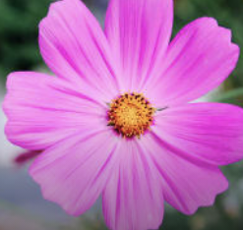
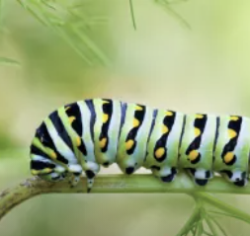
Mississippi Standards Alignment
1st Grade - Life Science
Plant Traits & Survival (Plant Superpowers)
 | Topic & Guiding Question | Student Objectives | Mississippi Standards for Science (2018)
 | Plant Traits & Offspring What will a baby plant look like when it grows up? | Students observe seedlings and adult plants and use their observations to identify the pattern that young plants are similar to their parent plants. | L.1.2 Students will demonstrate an understanding of how living things change in form as they go through the general stages of a life cycle. (L.1.2.1)
 | Plant Survival & Engineering Why don’t trees blow down in the wind? | Students learn how plants respond to light. They conduct an investigation to compare how the parts of a plant respond to light. | L.1.1 Students will demonstrate an understanding of the basic needs and structures of plants. (L.1.1.1, L.1.1.2)
 | Plant Movement & Survival Read-Along What do sunflowers do when you’re not looking? | Students learn how plants respond to light. They conduct an investigation to compare how the parts of a plant respond to light. | L.1.4 Students will demonstrate an understanding of the ways plants adapt to their environment in order to survive. (L.1.4.1)
Lesson 1
Lesson 2
Lesson 3
Lesson 1
Lesson 2
Lesson 3
The following mini-lessons can be used to support Mississippi Science Standards.
Mini-lesson
Mini-lesson
L.1.1 (L.1.1.3) How do flowers bloom in the spring?
L.1.2 (L.1.2.2) Are butterflies the only animals that start out as caterpillars?
www.mysteryscience.com/docs/mississippi

Slide 9

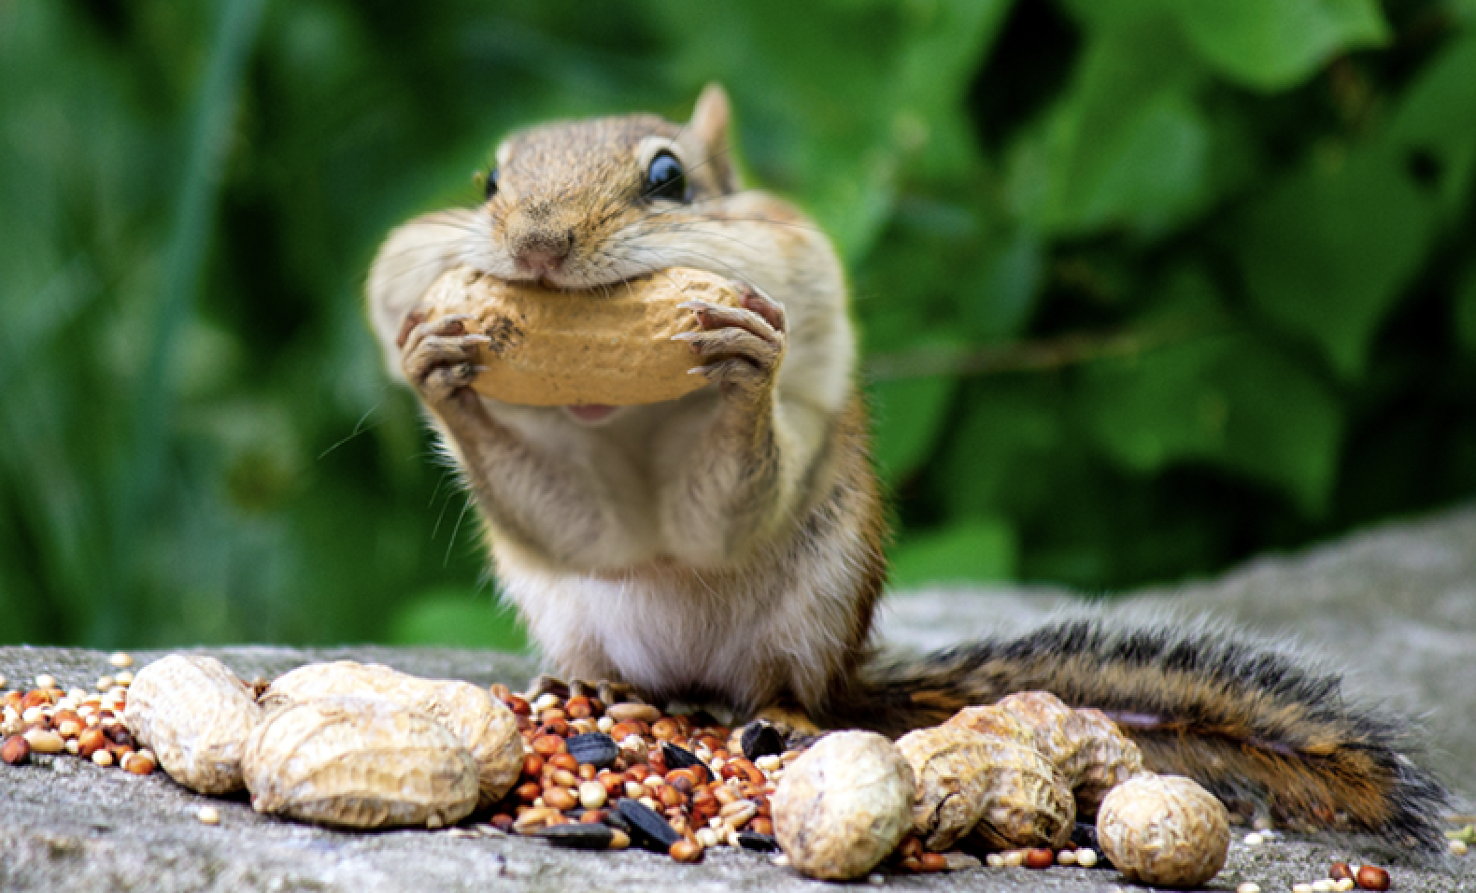
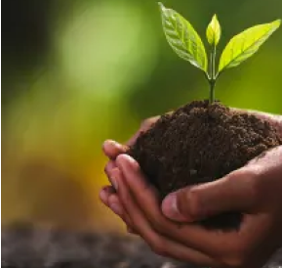
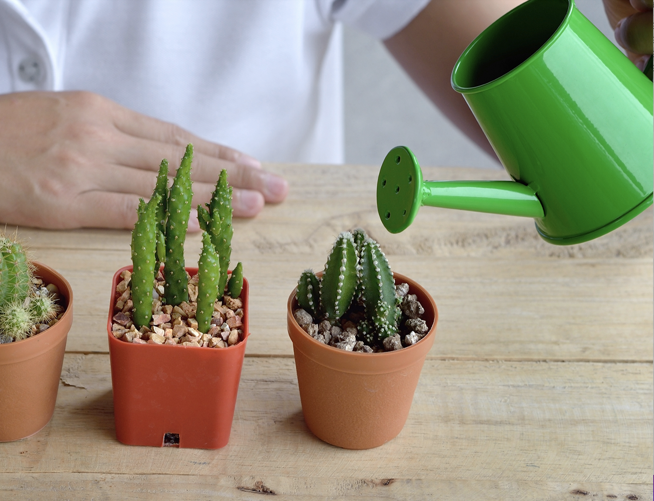
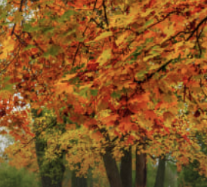
Mississippi Standards Alignment
1st Grade - Life Science
This unit is found under 2nd grade on our site, but we recommend teaching all lessons in 1st grade if you are following Mississippi Standards.
Plant Growth & Interactions (Plant Adventures)
 | Topic & Guiding Question | Student Objectives | Mississippi Standards for Science (2018)
 | Seed Dispersal How did a tree travel halfway around the world? | Students develop physical models of seed structures. They observe how structure affects the seed’s function in dispersing away from the tree. | L.1.1 Students will demonstrate an understanding of the basic needs and structures of plants. L.1.2 Students will demonstrate an understanding of how living things change in form as they go through the general stages of a life cycle.
 | Animal Seed Dispersal Why do seeds have so many different shapes? | Students develop a model of a furry animal and then use it to test how far seed models with different structures can travel. | L.1.4 Students will demonstrate an understanding of the ways plants adapt to their environment in order to survive. (L.1.4.2)
 | Water, Sunlight, & Plant Growth Could a plant survive without light? | Students conduct an investigation to determine that plants need water and light to grow. | L.1.1 Students will demonstrate an understanding of the basic needs and structures of plants. L.1.3A Students will demonstrate an understanding of what plants need from the environment for growth and repair. (L.1.3A.1)
 | Plant Needs & Habitats How much water should you give a plant? | Students plan and conduct a series of virtual experiments in order to determine how much water and sunlight a set of mystery plants need in order to stay healthy and survive. | L.1.4 Students will demonstrate an understanding of the ways plants adapt to their environment in order to survive. (L.1.4.2)
Lesson 1
Lesson 2
Lesson 3
Lesson 4
Mini-lesson
Mini-lesson
L.1.4 (L.1.4.1) Why do leaves change color in the fall?
L.1.4 (L.1.4.1) Why don’t all trees lose their leaves in the fall?
The following mini-lessons can be used to support Mississippi Science Standards.
www.mysteryscience.com/docs/mississippi

Slide 10

Mississippi Standards Alignment
1st Grade - Earth & Space Science
This unit is found under Kindergarten on our site, but we recommend teaching all lessons in 1st grade if you are following Mississippi Standards.
Severe Weather (Wild Weather)
 | Topic & Guiding Question | Student Objectives | Mississippi Standards for Science (2018)
 | Severe Weather & Preparation Read-Along How can you get ready for a big storm? | Students obtain information of different types of severe weather to observe and describe how the weather changes during these events and what students can do to prepare and stay safe. | L.1.9A Students will demonstrate an understanding of the patterns of weather by describing, recording, and analyzing weather data to answer questions about daily and seasonal weather patterns.
 | Wind & Storms Have you ever watched a storm? | Students create a simple tool that allows them to observe how hard the wind is blowing. They use this tool to observe weather changes and describe the pattern of faster wind speeds right before a storm. | L.1.9A Students will demonstrate an understanding of the patterns of weather by describing, recording, and analyzing weather data to answer questions about daily and seasonal weather patterns.
 | Weather Conditions How many different kinds of weather are there? | Students obtain information through observations of the weather. They communicate the information by acting as weather watchers and creating drawings of the weather conditions. | L.1.9A Students will demonstrate an understanding of the patterns of weather by describing, recording, and analyzing weather data to answer questions about daily and seasonal weather patterns.
Lesson 1
Lesson 2
Lesson 3
www.mysteryscience.com/docs/mississippi

Slide 11
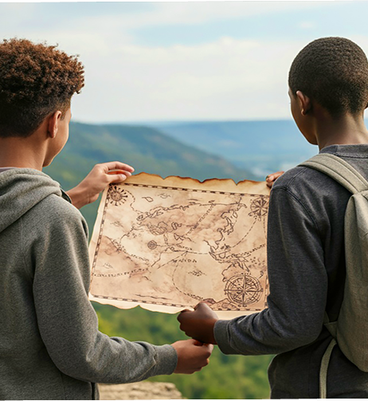
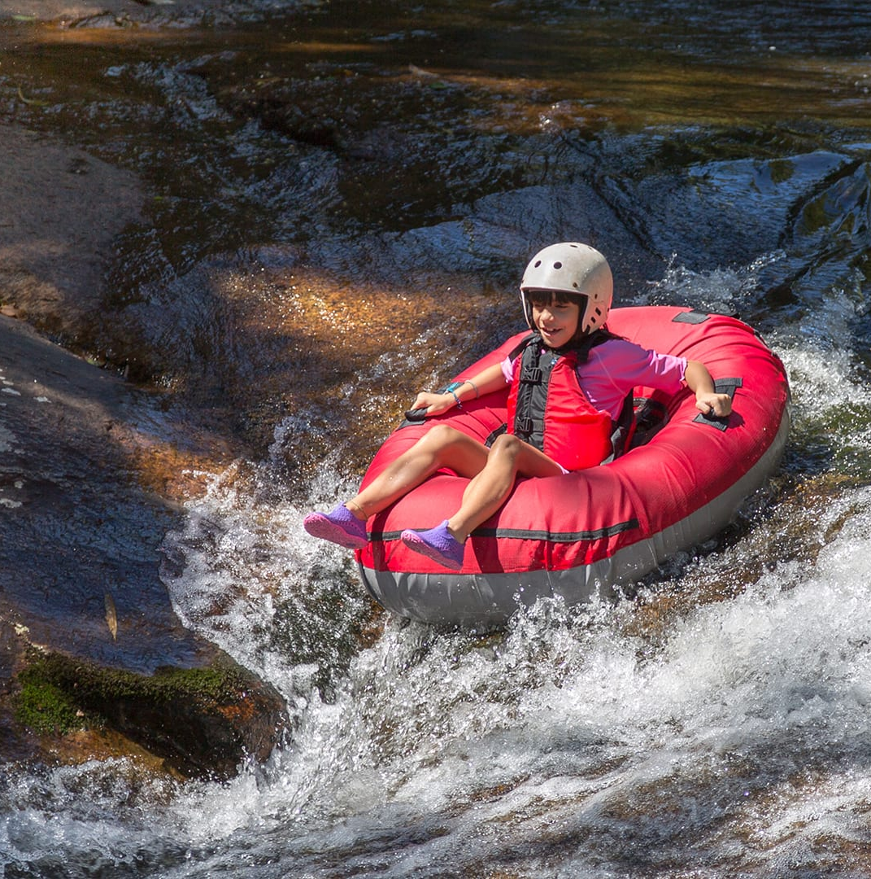
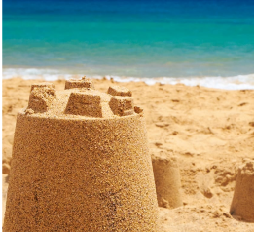
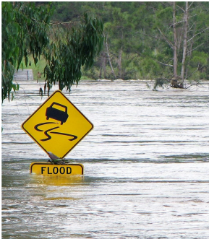
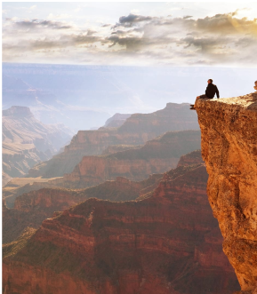
Mississippi Standards Alignment
1st Grade - Earth & Space Science
This unit is found under 2nd grade on our site, but we recommend teaching some lessons in 1st grade if you are following Mississippi Standards.
Erosion & Earth’s Surface (Work of Water)
 | Topic & Guiding Question | Student Objectives | Mississippi Standards for Science (2018)
 | ✨New!✨ Mapping Landforms & Bodies of Water Where’s the best place to hide a treasure? | Students develop a model (a map) of different landforms and bodies of water in a given location based on the shape of each feature. | E.1.9B Students will demonstrate an understanding of models (drawings or maps) to describe how water and land are distributed on Earth. (E.1.9B.1)
 | Mapping: Mountains & Rivers If you floated down a river, where would you end up? | Students develop a model of the Earth’s surface and use it to discover an important principle about how rivers work: rivers flow downhill, from high places to low places. | E.1.9B Students will demonstrate an understanding of models (drawings or maps) to describe how water and land are distributed on Earth. (E.1.9B.1)
 | Rocks, Sand, & Erosion Why is there sand at the beach? | Students investigate the effects of rocks tumbling in a river. Based on their observations, they construct an explanation for why rocks on the top of mountains are much bigger than the sand at the beach. | E.1.9B Students will demonstrate an understanding of models (drawings or maps) to describe how water and land are distributed on Earth. (E.1.9B.3).
 | Mapping & Severe Weather Where do flash floods happen? | Students use a model (i.e. a map) to examine the different factors, including the shapes and kinds of land, that contribute to flash floods. They use this to predict where flash floods are most likely to happen. | E.1.9B Students will demonstrate an understanding of models (drawings or maps) to describe how water and land are distributed on Earth.
 | Erosion, Earth’s Surface, & Landforms What’s strong enough to make a canyon? | Students create a model landform and investigate how some Earth events can occur quickly, while others occur slowly. | E.2.10 Students will demonstrate an understanding of how humans use Earth’s resources.
Continued on next page
Lesson 1
Lesson 2
Lesson 3
Lesson 4
Lesson 5
We recommend teaching this in 3rd grade if following Mississippi Standards.
Mississippi Specific Standard: E.1.10 Students will demonstrate an understanding of human dependence on clean and renewable water resources.
www.mysteryscience.com/docs/mississippi

Slide 12

Mississippi Standards Alignment
1st Grade - Physical Science
Light, Sound, & Communication (Lights & Sounds)
 | Topic & Guiding Question | Student Objectives | Mississippi Standards for Science (2018)
 | Sounds & Vibrations How do they make silly sounds in cartoons? | Students explore how to make different sounds with everyday objects. They construct an explanation that objects vibrate when they make a sound, and if the vibration stops, the sound stops. | P.1.6B Students will demonstrate an understanding of sound.
 | Sounds & Vibrations Read-Along Where do sounds come from? | Students create three different sound makers and construct an explanation about where the vibrations are happening in each sound experiment. | P.1.6B Students will demonstrate an understanding of sound.
 | Light, Materials, Transparent & Opaque What if there were no windows? | Students investigate the properties of different materials that they can and cannot see through. Then they create a stained glass window using tissue paper to explore how materials interact with light. | P.1.6A Students will demonstrate an understanding that light is required to make objects visible.
 | Light & Illumination Read-Along Can you see in the dark? | Students look inside a completely dark box to determine if they can see the shape of the object inside. They allow more light into the box to illuminate the object and allow them to see it. Students use their observations explain that objects need light to be seen. | P.1.6A Students will demonstrate an understanding that light is required to make objects visible.
 | Light, Communication, & Engineering How could you send a secret message to someone far away? | Students are presented with the problem that they need to send a message at night, without using noise. They design a solution to create a color-coded message system and communicate with light signals. | P.1.6A Students will demonstrate an understanding that light is required to make objects visible.
 | Lights, Sounds, & Communication Read-Along How do boats find their way in the fog? | Students obtain information about light and sound signals. They analyze different sounds with eyes closed to determine which type of sound they hear. | P.1.6A Students will demonstrate an understanding that light is required to make objects visible.
Lesson 1
Lesson 2
Lesson 3
Lesson 4
Lesson 5
Lesson 6
www.mysteryscience.com/docs/mississippi

Slide 13
Mississippi Standards Alignment
2nd Grade - Life Science
This unit is found under 1st grade on our site, but we recommend teaching some lessons in 2nd grade if you are following Mississippi Standards.
✔ Animal Traits & Survival (Animal Superpowers)
 | Topic & Guiding Question | Student Objectives | Mississippi Standards for Science (2018)
 | Parent & Offspring Traits How can you help a lost baby animal find its parents? | Students observe the traits of adult and baby animals in order to construct an explanation that most young animals are like, but not exactly like, their parents. | L.K.2 Students will demonstrate an understanding of how living things change in form as they go through the general stages of a life cycle. (L.K.2.4)
 | ✨New!✨ Offspring Trait Variation Can you predict what an animal’s babies will look like? | Students observe the traits of parent and baby animals to construct an explanation that offspring look similar to their parents, but can also vary in many ways. They predict what a puppy might look like based on the traits of the parent dogs. | L.K.2 Students will demonstrate an understanding of how living things change in form as they go through the general stages of a life cycle. (L.K.2.4)
 | Animal Behavior & Offspring Survival Read-Along Why do baby ducks follow their mother? | Students obtain information about the behaviors of animal parents that help their offspring survive. | L.K.2 Students will demonstrate an understanding of how living things change in form as they go through the general stages of a life cycle. (L.K.2.4)
 | Animal Structures & Survival Why do birds have beaks? | Students investigate how different bird beaks are well suited for eating different kinds of food. They explain which beak would help a particular bird survive in a particular environment. | L.2.3B Students will demonstrate an understanding of the interdependence of living things.
 | Camouflage & Animal Survival Why are polar bears white? | Students use observations of animal parents and their offspring to construct an explanation about young plants and animals being similar, but not identical, to their parents. | L.2.3B Students will demonstrate an understanding of the interdependence of living things.
Lesson 1
We recommend teaching this in Kindergarten if following Mississippi Standards.
Lesson 2
We recommend teaching this in Kindergarten if following Mississippi Standards.
Lesson 3
We recommend teaching this in Kindergarten if following Mississippi Standards.
Lesson 4
Lesson 5
www.mysteryscience.com/docs/arizona
✔ Unit Restructured for the 2025-2026 School Year

Slide 14

Mississippi Standards Alignment
2nd Grade - Life Science
Animal Biodiversity & Habitats (Animal Adventures)
 | Topic & Guiding Question | Student Objectives | Mississippi Standards for Science (2018)
Lesson 1 | Biodiversity & Classification How many different kinds of animals are there? | Students observe the traits of different animals and use that information to organize them into groups based on their characteristics. | L.2.1 Students will demonstrate an understanding of the classification of animals based on physical characteristics.
Lesson 2 | Habitat Diversity Why would a wild animal visit a playground? | Students observe animals, plants, and the physical characteristics of two different habitats. They collect and analyze data to compare the biodiversity between the two habitats. | L.2.3A Students will demonstrate an understanding of the interdependence of living things and the environment in which they live. L.2.4 Students will demonstrate an understanding of the ways animals adapt to their environment in order to survive.
Lesson 3 | Biodiversity, Habitats, & Species Why do frogs say “ribbit”? | Students identify frogs based on their unique calls and use that information to determine the level of frog species diversity within multiple habitats. | L.2.3A Students will demonstrate an understanding of the interdependence of living things and the environment in which they live.
Lesson 4 | Biodiversity & Engineering How could you get more birds to visit a bird feeder? | Students investigate which kinds of birds are likely to visit a bird feeder based on what they eat and design and build a prototype bird feeder that attracts a specific type of bird. | L.2.3A Students will demonstrate an understanding of the interdependence of living things and the environment in which they live. L.2.3B Students will demonstrate an understanding of the interdependence of living things.
Lesson 1
Lesson 2
Lesson 3
Lesson 4
Mississippi Specific Standard: L.2.2 Students will demonstrate an understanding of how living things change in form as they go through the general stages of a life cycle.
www.mysteryscience.com/docs/mississippi

Slide 15

Mississippi Standards Alignment
2nd Grade - Earth & Space Science
This unit is found under 1st grade on our site, but we recommend teaching all lessons in 2nd grade if you are following Mississippi Standards.
Day Patterns (Sun & Shadows)
 | Topic & Guiding Question | Student Objectives | Mississippi Standards for Science (2018)
Lesson 1 | Sun, Shadows, & Daily Patterns Could a statue’s shadow move? | Students observe how shadows change as time passes, or as the Sun moves across the sky. They analyze how to move a light source to change the shape and direction of shadows, constructing an explanation of what causes a shadow to move. | E.2.8 Students will demonstrate an understanding of the appearance, movements, and patterns of the sun, moon, and stars. (E.2.8.5)
Lesson 2 | Sun, Shadows, & Daily Patterns Read-Along What does your shadow do when you’re not looking? | Students conduct an investigation to gather information about how their shadow changes throughout the day. | E.2.8 Students will demonstrate an understanding of the appearance, movements, and patterns of the sun, moon, and stars. (E.2.8.5)
Lesson 3 | Sun & Daily Patterns How can the Sun help you if you’re lost? | Students develop a Sun Finder, a model of the Sun’s movement across the sky. They use this model to reason about how the Sun can help guide them during the day. | E.2.8 Students will demonstrate an understanding of the appearance, movements, and patterns of the sun, moon, and stars. (E.2.8.5)
Lesson 4 | Daylight & Seasonal Patterns Read-Along Why do you have to go to bed early in the summer? | Students obtain information about the seasonal patterns of sunrise and sunset. | E.2.8 Students will demonstrate an understanding of the appearance, movements, and patterns of the sun, moon, and stars. (E.2.8.2)
Lesson 1
Lesson 2
Lesson 3
Lesson 4
www.mysteryscience.com/docs/mississippi

Slide 16

Mississippi Standards Alignment
2nd Grade - Earth & Space Science
This unit is found under 1st grade on our site, but we recommend teaching all lessons in 2nd grade if you are following Mississippi Standards.
Night Patterns (Moon & Stars)
 | Topic & Guiding Question | Student Objectives | Mississippi Standards for Science (2018)
Lesson 1 | Moon Phases & Patterns When can you see the full moon? | Students record observations of the Moon’s shape using a series of photos collected over the course of four weeks. Using this information, students discover that the Moon follows a cyclical pattern, which they can use to predict when a full moon will appear. | E.2.8 Students will demonstrate an understanding of the appearance, movements, and patterns of the sun, moon, and stars. (E.2.8.3, E.2.8.5)
Lesson 2 | Stars & Daily Patterns Why do stars come out at night? | Students develop and use a model of the Big Dipper in the night sky. After conducting a simple investigation, students construct an explanation for why stars are only visible in the night sky. | E.2.8 Students will demonstrate an understanding of the appearance, movements, and patterns of the sun, moon, and stars. (E.2.8.1)
Lesson 3 | Stars & Seasonal Patterns Read-Along How can stars help you if you get lost? | Students observe that groups of stars in the sky form a pattern: constellations. Even though the Big Dipper changes its spot in the sky in different seasons, it always points to the North Star. | E.2.8 Students will demonstrate an understanding of the appearance, movements, and patterns of the sun, moon, and stars. (E.2.8.3)
Lesson 5
Lesson 6
Lesson 7
www.mysteryscience.com/docs/mississippi

Slide 17
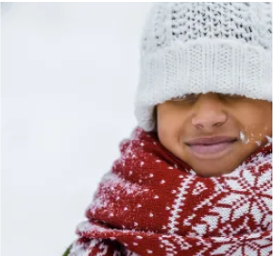
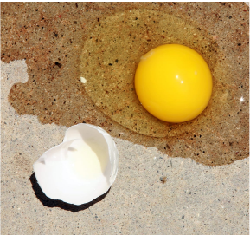


Mississippi Standards Alignment
2nd Grade - Physical Science
✔ Material Properties (Material Magic)
 | Topic & Guiding Question | Student Objectives | Mississippi Standards for Science (2018)
 | Material Properties & Engineering Why do we wear clothes? | Students investigate different material properties, such as flexibility and absorbency, and use those properties to design and build a hat that protects them from the sun. | P.2.5 Students will demonstrate an understanding of the properties of matter.
 | Classify Materials: Insulators & Conductors Can you really fry an egg on a hot sidewalk? | Students conduct an investigation of conductors and insulators in order to determine which are best suited for allowing people to handle hot items. | P.2.5 Students will demonstrate an understanding of the properties of matter.
 | Material Building Blocks & Engineering Could you build a house out of paper? | Students construct an evidence- based account of how a structure built of paper can be disassembled and rebuilt in new ways. | P.2.5 Students will demonstrate an understanding of the properties of matter.
 | Soil Properties How do you build a city out of mud? | Students conduct an investigation where they examine three different soil models. They use this information to determine which type of soil has the properties that will result in the best mud that can be used to build a house. | E.2.10 Students will demonstrate an understanding of how humans use Earth’s resources.
Lesson 1
Lesson 2
Lesson 3
Lesson 4
✔ Unit Restructured for the 2025-2026 School Year
www.mysteryscience.com/docs/mississippi

Slide 18

Mississippi Standards Alignment
2nd Grade - Physical Science
This unit is found under Kindergarten on our site, but we recommend teaching all lessons in 2nd grade if you are following Mississippi Standards.
Pushes & Pulls (Force Olympics)
 | Topic & Guiding Question | Student Objectives | Mississippi Standards for Science (2018)
 | Pushes & Pulls What’s the biggest excavator? | Students observe different machines and use those observations as evidence for why machines make work easier. | Foundational for P.2.6 Students will demonstrate an understanding of how the motion of objects is affected by pushes, pulls, and friction on an object.
 | Pushes, Pulls, & “Work Words” Read-Along Why do builders need so many big machines? | Students observe construction equipment being used in different ways to move objects. | Foundational for P.2.6 Students will demonstrate an understanding of how the motion of objects is affected by pushes, pulls, and friction on an object.
 | Motion, Speed, & Strength How can you knock down a wall made of concrete? | Students carry out an investigation to determine how far back they should pull a model wrecking ball to knock down a wall, but not the houses behind it. | P.2.6 Students will demonstrate an understanding of how the motion of objects is affected by pushes, pulls, and friction on an object. (P.2.6.1)
 | Speed & Direction of Force Read-Along How can you knock down the most bowling pins? | Students play a game of bumper bowling to observe the way that objects can move in straight lines, zigzags, and back and forth. | P.2.6 Students will demonstrate an understanding of how the motion of objects is affected by pushes, pulls, and friction on an object. (P.2.6.1)
 | Direction of Motion & Engineering How can we protect a mountain town from falling rocks? | Students conduct an investigation of how to protect a town from a falling boulder. They design a solution to safely guide the direction of the boulder away from the town. | P.2.6 Students will demonstrate an understanding of how the motion of objects is affected by pushes, pulls, and friction on an object. (P.2.6.3)
 | Forces & Engineering Read-Along How could you invent a trap? | Students define a problem they would like to solve and then design a solution using what they know about the locations of objects and how they can move. | P.2.6 Students will demonstrate an understanding of how the motion of objects is affected by pushes, pulls, and friction on an object. (P.2.6.3)
Lesson 1
Lesson 2
Lesson 3
Lesson 4
Lesson 5
Lesson 6
www.mysteryscience.com/docs/mississippi

Slide 19
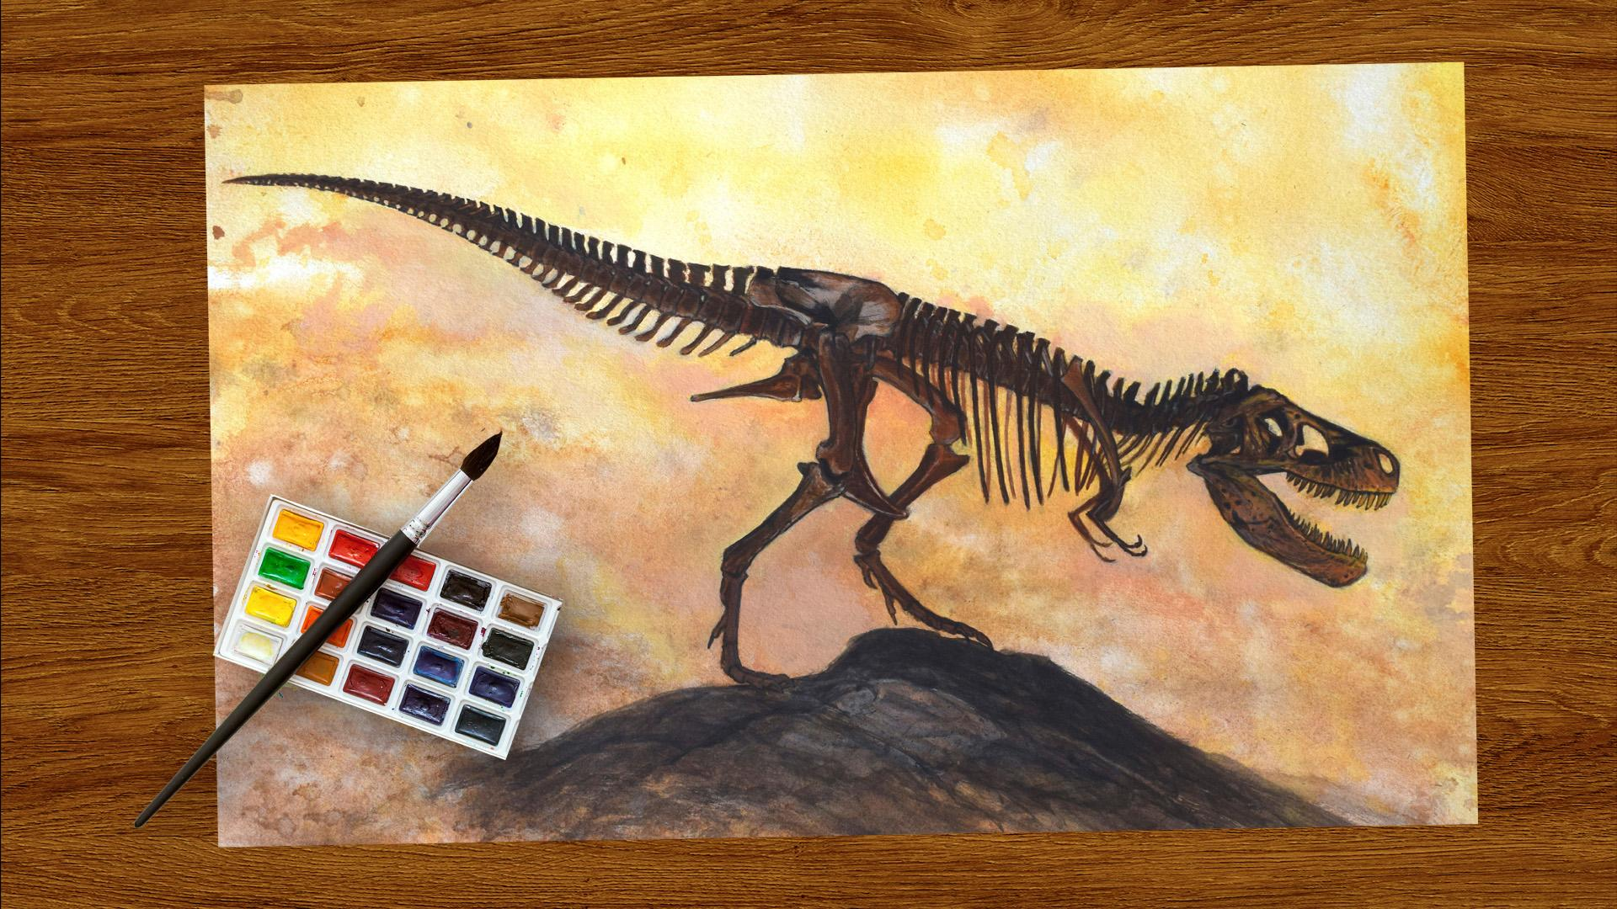
Mississippi Standards Alignment
3rd Grade - Life Science
Fossils & Changing Environments (Animals Through Time)
 | Topic & Guiding Question | Student Objectives | Mississippi Standards for Science (2018)
 | Habitats, Fossils, & Environments Over Time Where can you find whales in a desert? | Students explore the idea that the rock under our feet sometimes contains fossils, and investigate how these fossils reveal changes in habitats through time. | L.3.4 Students will demonstrate an understanding of how adaptations allow animals to satisfy life needs and respond both physically and behaviorally to their environment.
 | Fossil Evidence & Dinosaurs How do we know what dinosaurs looked like? | Students learn how we can infer what the outside of an animal looked like by using clues about their skeleton. | L.3.4 Students will demonstrate an understanding of how adaptations allow animals to satisfy life needs and respond both physically and behaviorally to their environment.
 | Fossil Evidence, Trace Fossils, & Animal Behavior Can you outrun a dinosaur? | Students learn how fossilized animal tracks can tell us a great deal about the animals that left them. | L.3.4 Students will demonstrate an understanding of how adaptations allow animals to satisfy life needs and respond both physically and behaviorally to their environment.
Lesson 1
Lesson 2
Lesson 3
www.mysteryscience.com/docs/mississippi

Slide 20
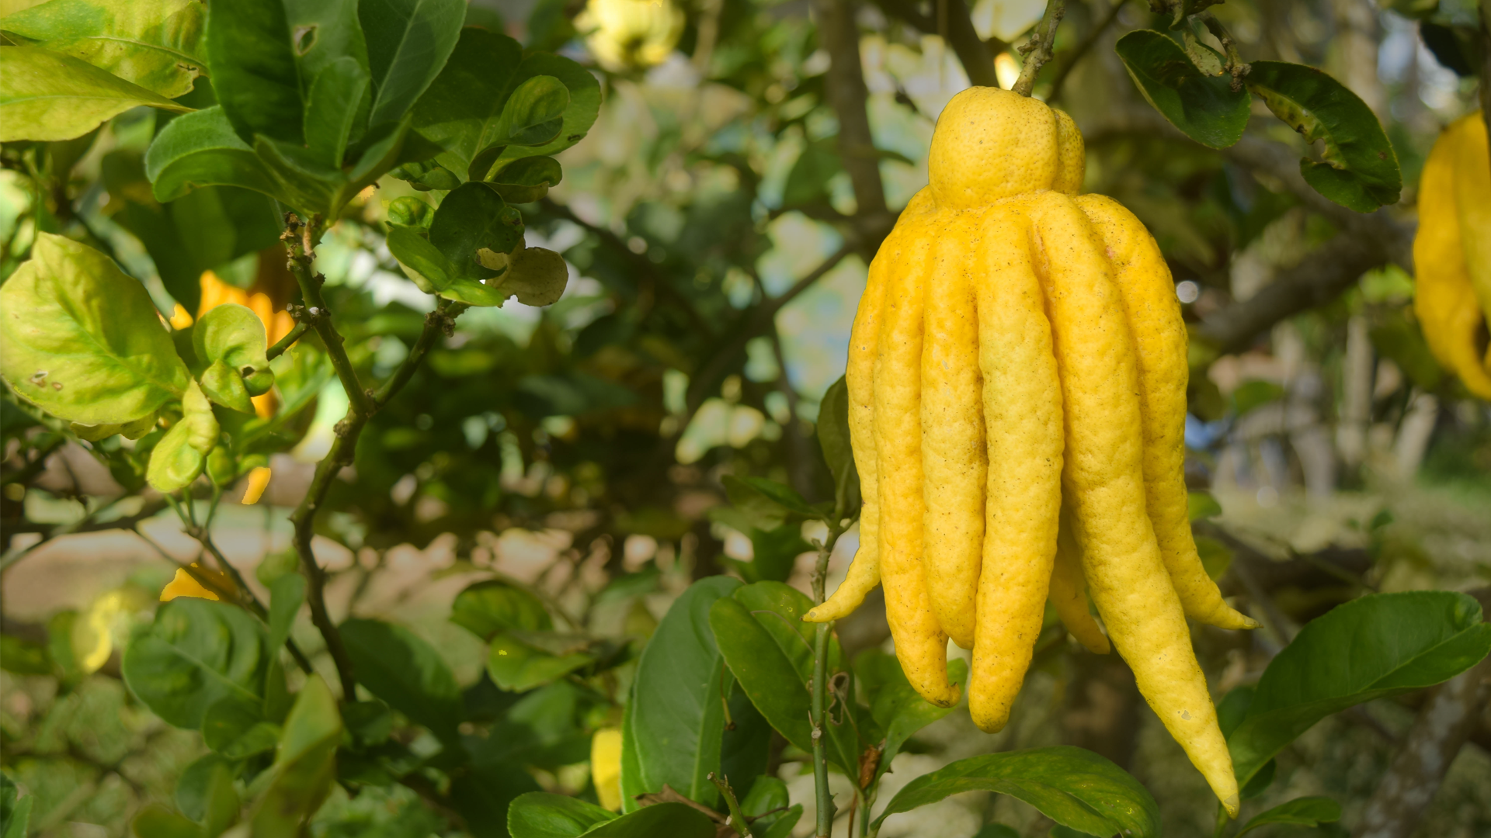
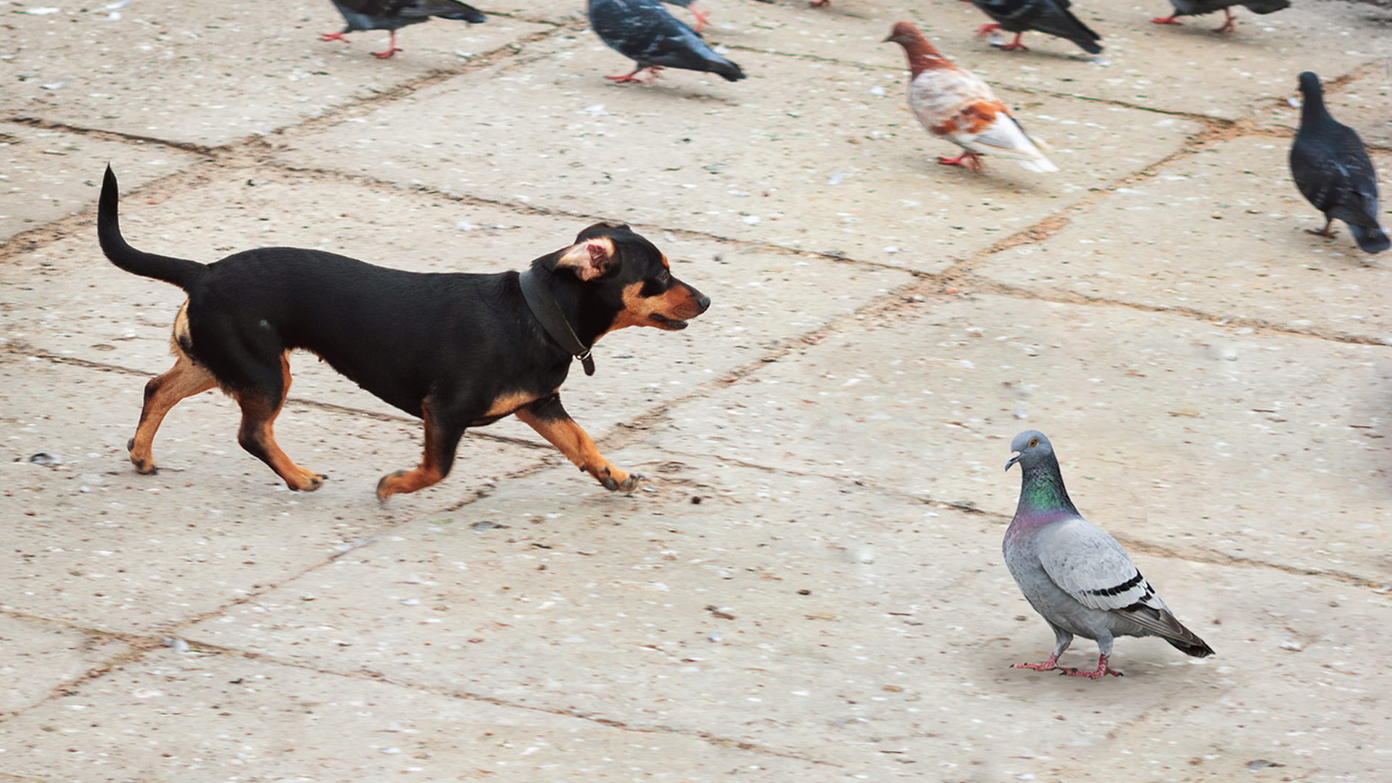
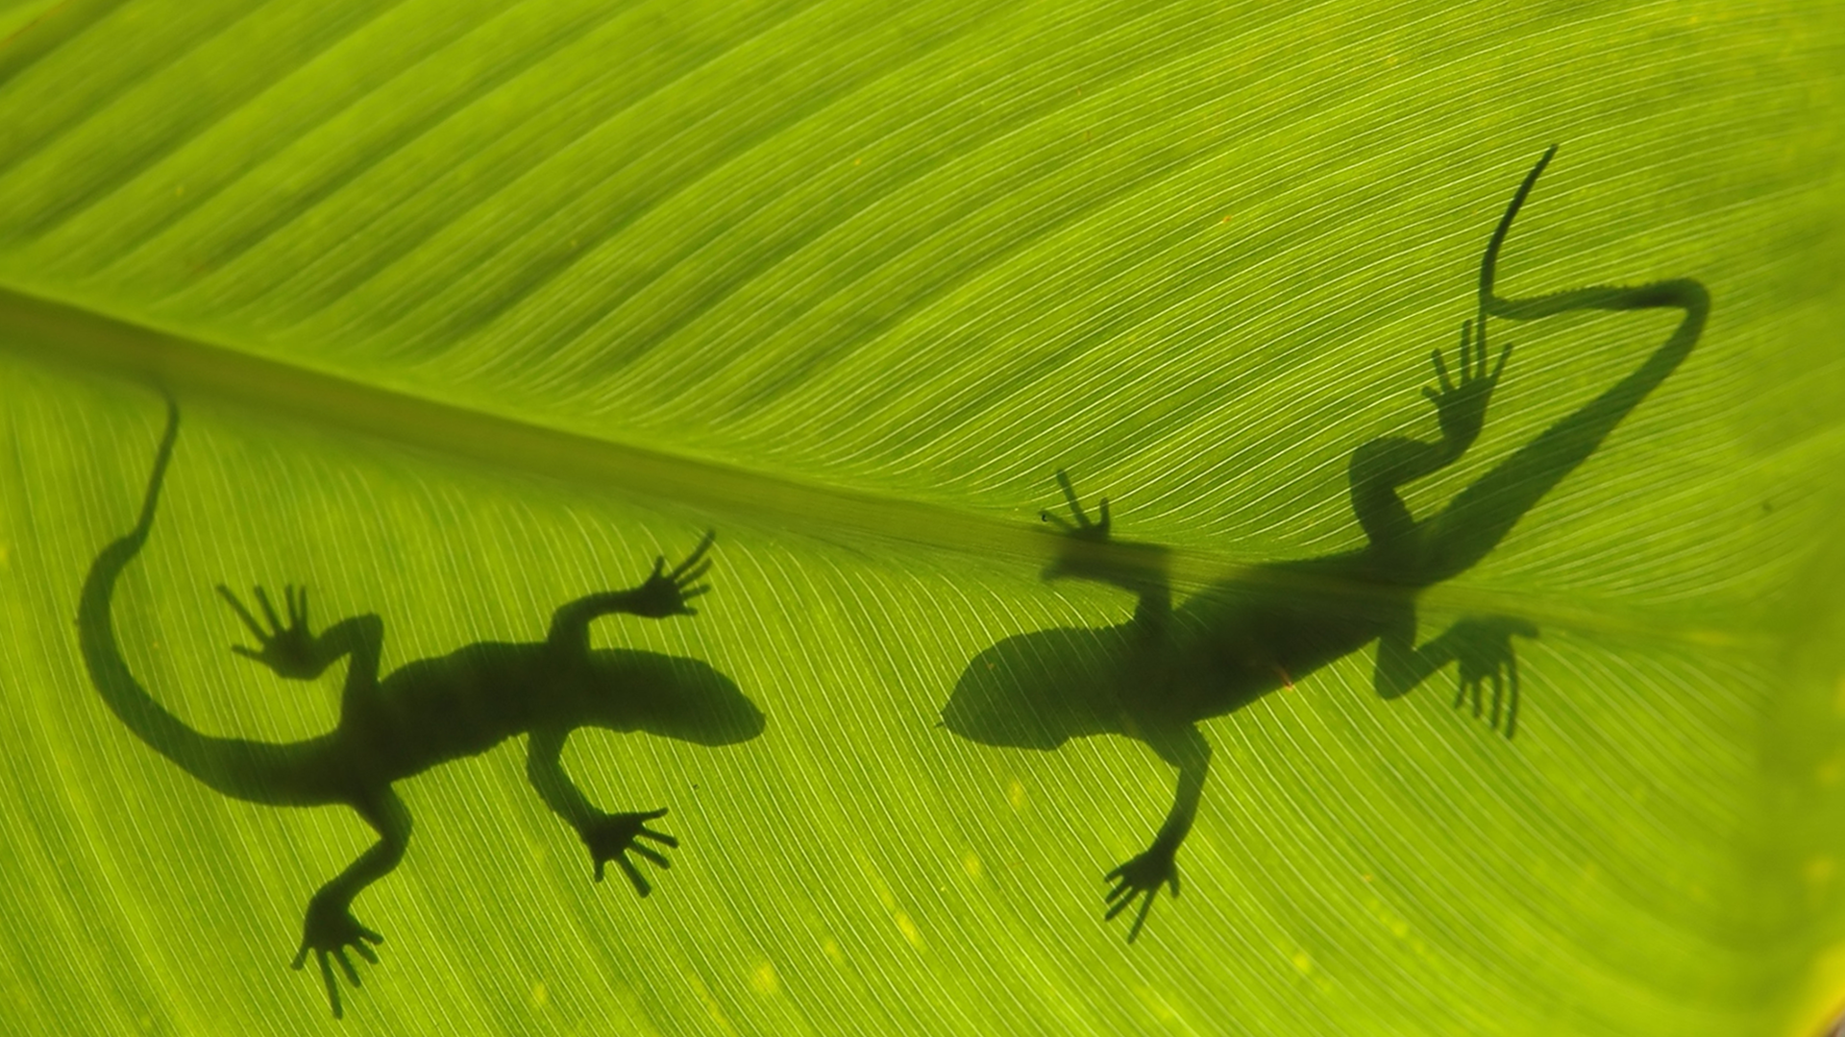
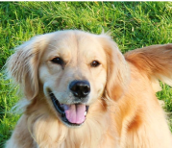
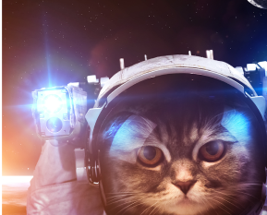
Mississippi Standards Alignment
3rd Grade - Life Science
Heredity, Survival, & Selection (Fates of Traits)
 | Topic & Guiding Question | Student Objectives | Mississippi Standards for Science (2018)
 | Traits & Inheritance How do you identify a mysterious fruit? | Students examine plant traits and use that information as evidence to help them identify an unknown fruit. They look for similarities and differences in the leaves, flowers, and fruits of plants to sort them into groups and identify patterns of inheritance. | L.3.2 Students will demonstrate an understanding that through reproduction, the survival and physical features of plants and animals are inherited traits from parent organisms but can also be influenced by the environment.
 | Trait Variation, Inheritance, & Artificial Selection What do dogs and pigeons have in common? | Students analyze trait similarities and differences among parent, offspring, and sibling pigeons. They interpret this data to discover that the variation and inheritance of traits creates a pattern that explains why we see such extreme traits in artificially selected animal breeds. | L.3.2 Students will demonstrate an understanding that through reproduction, the survival and physical features of plants and animals are inherited traits from parent organisms but can also be influenced by the environment.
 | Trait Variation, Survival, & Natural Selection How could a lizard’s toes help it survive? | Students compare the structures of lizards that live on an island. They simulate multiple generations of these lizards, and analyze and interpret the data to understand how these structures aid in their survival. | L.3.4 Students will demonstrate an understanding of how adaptations allow animals to satisfy life needs and respond both physically and behaviorally to their environment.
 | Animal Groups & Survival Why do dogs wag their tails? | Students observe animals that live in groups in order to obtain, evaluate, and communicate information about animal social behavior. Students use evidence to show how animals form groups to help them survive. | L.3.4 Students will demonstrate an understanding of how adaptations allow animals to satisfy life needs and respond both physically and behaviorally to their environment.
 | Traits & Environmental Variation How long can people (and animals) survive in outer space? | Students measure and compare their own physical traits (arm strength, balance, and height) and analyze the information to construct an explanation for how the environment can influence traits. | L.3.2 Students will demonstrate an understanding that through reproduction, the survival and physical features of plants and animals are inherited traits from parent organisms but can also be influenced by the environment.
Lesson 1
Lesson 2
Lesson 3
Lesson 4
Lesson 5
www.mysteryscience.com/docs/mississippi

Slide 21
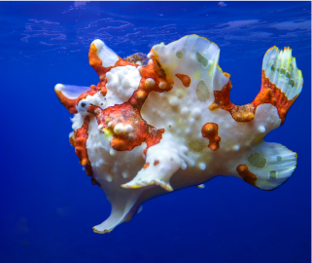
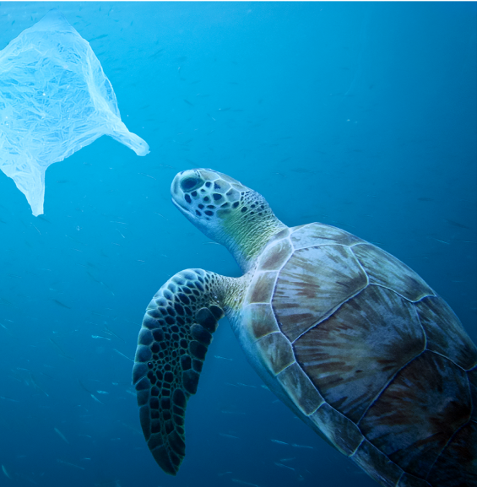
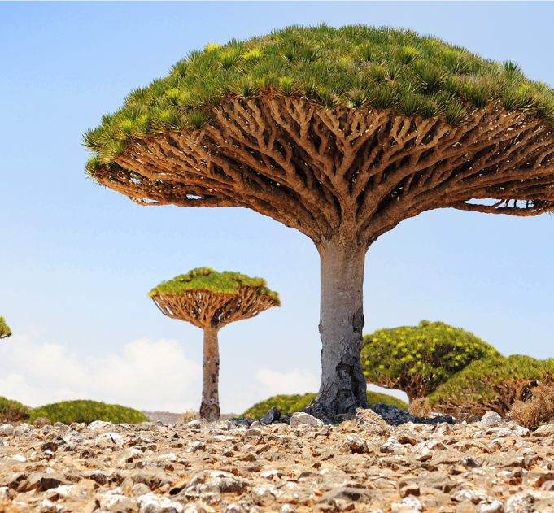
Mississippi Standards Alignment
3rd Grade - Life Science
This unit is found under 4th grade on our site, but we recommend teaching all lessons in 3rd grade if you are following Mississippi Standards.
Animal & Plant Adaptations (Animal & Plant Adaptations)
 | Topic & Guiding Question | Student Objectives | Mississippi Standards for Science (2018)
 | Animal Adaptations Why do some sea creatures look so strange? | Students make observations of underwater animals in order to collect evidence that external structures serve specific functions. They use their observations to construct an argument that an animal’s structures work together as part of a system to support their growth and survival. | L.3.1 Students will demonstrate an understanding of internal and external structures in plants and animals and how they relate to their growth, survival, behavior, and reproduction within an environment.
 | Learned Behavior & Instinct Why would a sea turtle eat a plastic bag? | Students use models to understand how an animal’s senses, brain, and memories all work together as a system to influence their behavior and support their survival. | L.3.1 Students will demonstrate an understanding of internal and external structures in plants and animals and how they relate to their growth, survival, behavior, and reproduction within an environment.
 | Plant Adaptations Why don’t the same trees grow everywhere? | Students use models of roots and branches to explore their functions and then construct an argument about how these structures must work together in order to support the survival of trees in the unique environment of the frozen taiga. | L.3.1 Students will demonstrate an understanding of internal and external structures in plants and animals and how they relate to their growth, survival, behavior, and reproduction within an environment.
Lesson 1
Lesson 2
Lesson 3
www.mysteryscience.com/docs/mississippi

Slide 22
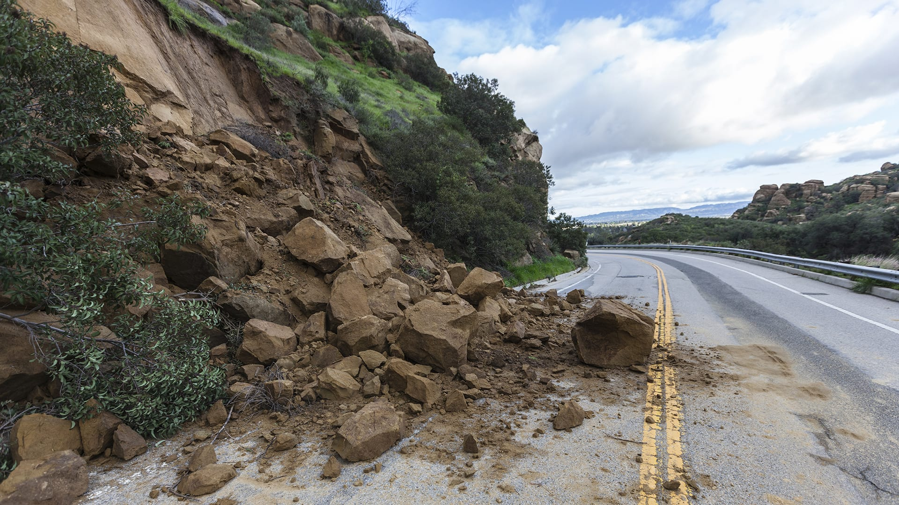
Mississippi Standards Alignment
3rd Grade - Earth & Space Science
This unit is found under 2nd grade on our site, but we recommend teaching these lessons in 3rd grade if you are following Mississippi Standards.
Erosion & Earth’s Surface (Work of Water)
 | Topic & Guiding Question | Student Objectives | Mississippi Standards for Science (2018)
 | Erosion, Earth’s Surface, & Landforms What’s strong enough to make a canyon? | Students create a model landform and investigate how some Earth events can occur quickly, while others occur slowly. | E.3.7B Students will demonstrate an understanding of the composition of Earth and the processes which change Earth’s landforms. (E.3.7B.2)
 | Erosion & Engineering How can you stop a landslide? | Students compare multiple solutions for preventing erosion. | E.3.7B Students will demonstrate an understanding of the composition of Earth and the processes which change Earth’s landforms. (E.3.7B.2)
Lesson 5
Lesson 6
www.mysteryscience.com/docs/mississippi

Slide 23

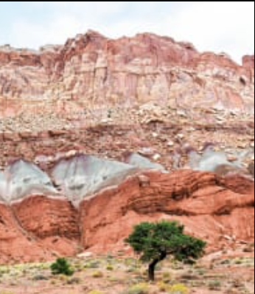
Mississippi Standards Alignment
3rd Grade - Earth & Space Science
This unit is found under 4th grade on our site, but we recommend teaching all lessons in 3rd grade if you are following Mississippi Standards.
Earth’s Features & Processes (The Birth of Rocks)
 | Topic & Guiding Question | Student Objectives | Mississippi Standards for Science (2018)
Lesson 1 | Volcanoes & Patterns of Earth’s Features Could a volcano pop up where you live? | Students use coordinates to develop a map of volcanoes to discover a pattern of where volcanoes exist on Earth. Students identify the pattern of volcanoes in the “Ring of Fire.” | E.3.7B Students will demonstrate an understanding of the composition of Earth and the processes which change Earth’s landforms. (E.3.7B.2)
Lesson 2 | Volcanoes & Rock Cycle Why do some volcanoes explode? | Students investigate the properties of thin and thick lava by attempting to create air bubbles. Students realize that thick lava will cause a volcano to explode, while thin lava will not. | E.3.7B Students will demonstrate an understanding of the composition of Earth and the processes which change Earth’s landforms. (E.3.7B.2)
Lesson 3 | Weathering & Erosion Will a mountain last forever? | Students make observations of the effects of weathering to discover that rocks will become rounded and break into small pieces when they tumble down a mountain. | E.3.7B Students will demonstrate an understanding of the composition of Earth and the processes which change Earth’s landforms. (E.3.7B.3) E.3.7A Students will demonstrate an understanding of the various processes involved in the rock cycle, superposition of rock layers, and fossil formation.
Lesson 4 | Sedimentary Rock & Fossils What did your town look like 100 million years ago? | Students create a model canyon and use the pattern of fossils found in each rock layer to support the explanation that the landscape has changed many times over millions of years. | E.3.7A Students will demonstrate an understanding of the various processes involved in the rock cycle, superposition of rock layers, and fossil formation. (E.3.7A.1, E.3.7A.3) E.3.10 Students will demonstrate an understanding that all materials, energy, and fuels that humans use are derived from natural sources.
 | Erosion, Natural Hazards, & Engineering How could you survive a landslide? | Students generate multiple possible solutions to protect homes from a landslide. Students realize that there are many causes for the erosion that causes rocks to fall in landslides. | E.3.9 Students will demonstrate an understanding of how the Earth’s systems (i.e., geosphere, hydrosphere, atmosphere, and biosphere) interact in multiple ways to affect Earth’s surface materials and processes. (E.3.9.2)
Lesson 1
Lesson 2
Lesson 3
Lesson 4
Lesson 5
www.mysteryscience.com/docs/mississippi

Slide 24
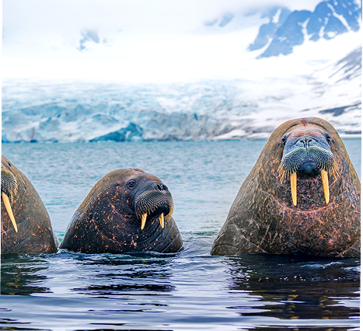

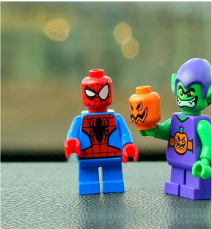
Mississippi Standards Alignment
3rd Grade - Earth & Space Science
This unit is found under 2nd grade on our site, but we recommend teaching all lessons in 3rd grade if you are following Mississippi Standards.
⭐ States of Matter (States of Matter)
 | Topic & Guiding Question | Student Objectives | Mississippi Standards for Science (2018)
 | ✨New!✨ Liquid Water & Solid Ice Where do animals find the water they need? | Students obtain information about the liquid water and solid ice that different animals utilize for their survival in the Arctic. | P.3.5 Students will demonstrate an understanding of the physical properties of matter to explain why matter can change states between a solid, liquid, or gas dependent upon the addition or removal of heat.
 | ✨New!✨ Reversible & Irreversible Changes How is an ice cube like a crayon? | Students observe the properties of different materials after being heated up and then cooled down. They use these observations to support the explanation that some changes are reversible and others are not. | P.3.5 Students will demonstrate an understanding of the physical properties of matter to explain why matter can change states between a solid, liquid, or gas dependent upon the addition or removal of heat.
 | Heating, Cooling, & States of Matter Why are so many toys made out of plastic? | Student conduct an investigation of different materials in order to determine which are most and least easily melted. | P.3.5 Students will demonstrate an understanding of the physical properties of matter to explain why matter can change states between a solid, liquid, or gas dependent upon the addition or removal of heat.
Lesson 1
Lesson 2
Lesson 3
✨ New Unit or Lesson
www.mysteryscience.com/docs/mississippi

Slide 25

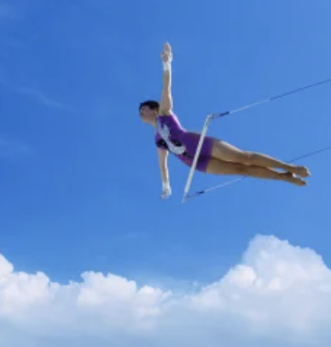
Mississippi Standards Alignment
3rd Grade - Physical Science
Forces, Motion, & Magnets (Invisible Forces)
 | Topic & Guiding Question | Student Objectives | Mississippi Standards for Science (2018)
 | Balanced & Unbalanced Forces How could you win a tug-of-war against a bunch of adults? | Students develop a mental model of the nature of forces and motion and use that model to explain the behavior of an elastic jumper. | P.3.6 Students will demonstrate an understanding of magnets and the effects of pushes, pulls, and friction on the motion of objects. (P.3.6.1, P.3.6.2)
 | Balanced Forces & Engineering What makes bridges so strong? | Students develop and design a bridge to be as strong as possible while working with limited materials. | P.3.6 Students will demonstrate an understanding of magnets and the effects of pushes, pulls, and friction on the motion of objects. (P.3.6.1, P.3.6.2)
 | Pattern of Motion, Gravity, & Friction How high can you swing on a flying trapeze? | Students make observations and measurements of a trapeze model. Then, using that information they predict the motion of a real trapeze. | P.3.6 Students will demonstrate an understanding of magnets and the effects of pushes, pulls, and friction on the motion of objects. (P.3.6.1, P.3.6.2)
 | Magnets & Forces What can magnets do? | Students investigate the properties of magnets and the fact that they exert forces that act at a distance. | P.3.6 Students will demonstrate an understanding of magnets and the effects of pushes, pulls, and friction on the motion of objects. (P.3.6.3)
 | Magnets & Engineering How can you unlock a door using a magnet? | Students investigate magnetic attraction and repulsion, and design a magnetic lock in the hands-on activity. | P.3.6 Students will demonstrate an understanding of magnets and the effects of pushes, pulls, and friction on the motion of objects. (P.3.6.4)
Lesson 1
Lesson 2
Lesson 3
Lesson 4
Lesson 5
``
www.mysteryscience.com/docs/mississippi

Slide 26

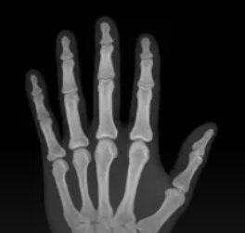
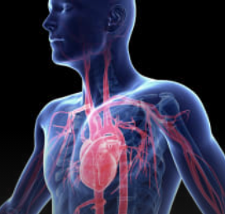
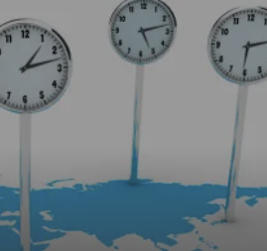
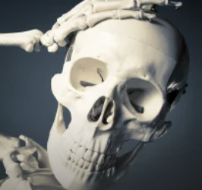
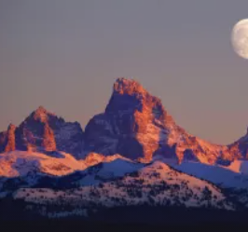
Mississippi Standards Alignment
4th Grade - Life Science
Human Body, Vision, & The Brain (Human Machine)
 | Topic & Guiding Question | Student Objectives | Mississippi Standards for Science (2018)
 | Muscles & Skeleton Why do your biceps bulge? | Students construct a model of the human hand to explain how muscles pull on bones to create movement. | L.4.1 Students will demonstrate an understanding of the organization, functions, and interconnections of the major human body systems.
 | Light, Eyes, & Vision What do people who are blind see? | Students develop a working model of an eye. They use the model to reason about how light reflects off an object and into the eye, helping an organism process information from the environment. | P.4.6B Students will demonstrate an understanding of the properties of light as forms of energy.
 | Structure & Function of Eyes How can some animals see in the dark? | Students use their eye model to discover that the pupil controls the amount of light let into the eye. In the dark, pupils get larger to let in more light. | P.4.6B Students will demonstrate an understanding of the properties of light as forms of energy.
 | Brain, Nerves, & Information Processing How does your brain control your body? | Students investigate how their own brain works by testing their reflexes. They discover that the brain receives information from the senses, processes the information, and sends signals to the muscles to enable movement. | L.4.1 Students will demonstrate an understanding of the organization, functions, and interconnections of the major human body systems.
Lesson 1
Lesson 2
Lesson 3
Lesson 4
The following mini-lessons can be used to support Mississippi Science Standards.
Mini-lesson
Mini-lesson
Mini-lesson
L.4.1 Why does our skeleton have so many bones?
L.4.1 What would happen if you didn’t have a skull?
L.4.1 Why does the heart pump blood?
www.mysteryscience.com/docs/mississippi

Slide 27
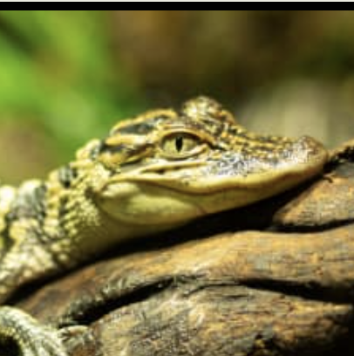


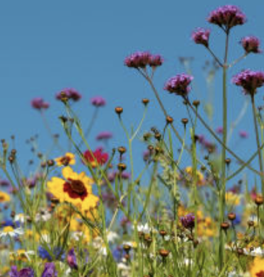
Mississippi Standards Alignment
4th Grade - Life Science
This unit is found under 3rd grade on our site, but we recommend teaching all lessons in 4th grade if you are following Mississippi Standards.
Life Cycles (Circle of Life)
 | Topic & Guiding Question | Student Objectives | Mississippi Standards for Science (2018)
 | Animal Life Cycles How is your life like an alligator’s life? | Students create models of several different animal life cycles and compare them to one another. They use these models to discover the pattern that all animals are born, grow, can have babies, and eventually die. | L.4.2 Students will demonstrate an understanding of life cycles, including familiar plants and animals (e.g., reptiles, amphibians, or birds). (L.4.2.1, L.4.2.2)
 | Environmental Change & Engineering What’s the best way to get rid of mosquitoes? | Students obtain and evaluate information about mosquitoes from different sources. They analyze and interpret information about the mosquito life cycle to reduce the number of mosquitoes that live in a certain area. | L.4.2 Students will demonstrate an understanding of life cycles, including familiar plants and animals (e.g., reptiles, amphibians, or birds). (L.4.2.1, L.4.2.2)
 | Pollination & Plant Reproduction Why do plants grow flowers? | Students model the structure and function of flower parts that are responsible for creating seeds. | L.1.3B Students will demonstrate an understanding of the interdependence of flowering plants and pollinating insects.
 | Fruit, Seeds, & Plant Reproduction Why do plants give us fruit? | Students explore the function of fruits in plants and practice classification. | L.1.3B Students will demonstrate an understanding of the interdependence of flowering plants and pollinating insects.
 | Plant Life Cycles Why are there so many different kinds of flowers? | Students play a game that models the stages of the plant life cycle. After playing the game students use the model to show how changes to one part of the life cycle affect all other stages. | L.4.2 Students will demonstrate an understanding of life cycles, including familiar plants and animals (e.g., reptiles, amphibians, or birds). (L.4.2.1, L.4.2.2)
Lesson 1
Lesson 2
Lesson 3 Lesson 4 Lesson 5
www.mysteryscience.com/docs/mississippi

Slide 28

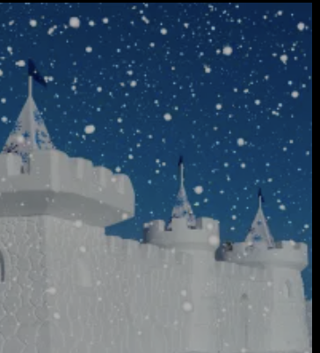
Mississippi Standards Alignment
4th Grade - Earth & Space Science
This unit is found under 3rd grade on our site, but we recommend teaching all lessons in 4th grade if you are following Mississippi Standards.
Weather & Climate (Stormy Skies)
 | Topic & Guiding Question | Student Objectives | Mississippi Standards for Science (2018)
Lesson 1 | Water Cycle & States of Matter Where do clouds come from? | Students obtain and combine information that water can change from liquid to gas, but that it is always made of tiny drops. Clouds are made of water that has evaporated. | E.4.9A Students will demonstrate an understanding of how the water cycle is propelled by the sun’s energy. (E4.9A.1)
Lesson 2 | Local Weather Patterns & Weather Prediction How can we predict when it’s going to storm? | Students make observations of clouds and develop a tool to make predictions about what kind of weather might happen next. | E.4.9B Students will demonstrate an understanding of weather and climate patterns. (E4.9B.1)
Lesson 3 | Seasonal Weather Patterns Where’s the best place to build a snow fort? | Students gather winter temperature data from three different towns. They represent the data in a table to compare the weather and decide which town is the best candidate to host a snow fort festival in future years. | E.4.9B Students will demonstrate an understanding of weather and climate patterns. (E4.9B.1)
Lesson 4 | Climate, Geography, & Global Weather Patterns Why are some places always hot? | Students obtain and combine information to describe the different climate regions of the world. | E.4.9B Students will demonstrate an understanding of weather and climate patterns. (E4.9B.2)
 | Natural Hazards & Engineering How can you keep a house from blowing away in a windstorm? | Students design and build solutions that reduce the hazards associated with strong winds that could damage buildings. | E.4.9C Students will demonstrate an understanding of how natural processes and human activities affect the features of Earth’s landforms and oceans. (E4.9C.5)
Lesson 1
Lesson 2
Lesson 3
Lesson 4
Lesson 5
www.mysteryscience.com/docs/mississippi

Slide 29

Mississippi Standards Alignment
4th Grade - Earth & Space Science
This unit is found under 5th grade on our site, but we recommend teaching somel lessons in 4th grade if you are following Mississippi Standards.
Water Cycle & Earth’s Systems (Watery Planet)
 | Topic & Guiding Question | Student Objectives | Mississippi Standards for Science (2018)
Lesson 1 | Hydrosphere & The Roles of Water How much water is in the world? | Students analyze and interpret data from world maps to determine the relative amounts of fresh, salt, and frozen water. Students figure out that while the Earth has a lot of water, most of Earth’s water is not fresh or accessible. | E.4.9A Students will demonstrate an understanding of how the water cycle is propelled by the sun’s energy. (E4.9A.1)
Lesson 2 | ✨New!✨ Mixtures & Solutions How much salt is in the ocean? | Students create a model ocean to observe how salt seems to completely vanish when dissolved in water. Students measure and graph quantities to provide evidence that the salt is still in the solution, even though we can’t see it. | P.5.5B Students will demonstrate an understanding of mixtures and solutions. (P.5.5B.1) P.5.5C Students will demonstrate an understanding of the difference between physical and chemical changes. (P.5.5C.2, P.5.5C.3)
Lesson 3 | Groundwater as a Natural Resource When you turn on the faucet, where does the water come from? | Students learn most people get fresh water from underground sources. Students determine the best place to settle a town by considering features of the landscape & the characteristics of the plants that thrive there. | E.4.9A Students will demonstrate an understanding of how the water cycle is propelled by the sun’s energy. (E4.9A.1)
Lesson 4 | Water Cycle Can we make it rain? | Students create a model of the ocean and sky to investigate how temperature influences evaporation and condensation. Students figure out that higher ocean temperatures lead to more evaporation, thus leading to more rain. | E.4.9A Students will demonstrate an understanding of how the water cycle is propelled by the sun’s energy. (E4.9A.1)
 | Natural Disasters & Engineering How can you save a town from a hurricane? | Students define the problem that a town needs protection from flooding. They design solutions using different types of flood protection. They realize flooding is caused by severe rainfall generated by hurricanes. Hurricanes are created where ocean temperatures are warm. | E.4.9C Students will demonstrate an understanding of how natural processes and human activities affect the features of Earth’s landforms and oceans. (E4.9C.5)
Lesson 1
Lesson 2
Lesson 3
Lesson 4
Lesson 5
We recommend teaching this in 5th grade if following Mississippi Standards.
www.mysteryscience.com/docs/mississippi

Slide 30


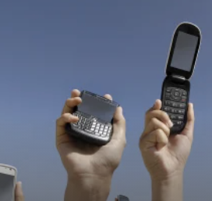
Mississippi Standards Alignment
4th Grade - Physical Science
Sound, Waves, & Communication (Waves of Sound)
 | Topic & Guiding Question | Student Objectives | Mississippi Standards for Science (2018)
 | Pattern Transfer & Technology How do you send a secret code? | Students explore how digital devices encode complex information. Students generate their own codes in order to transfer information across the classroom. Then, they compare their codes and evaluate which worked best given the criteria and constraints. | P.4.6C Students will demonstrate an understanding of the properties of sound as a form of energy. (P.4.6C.1)
 | Sound, Vibration, & Engineering How far can a whisper travel? | Students investigate sound energy using paper cup telephones. Students figure out that sound is a vibration that can travel through a medium. | P.4.6C Students will demonstrate an understanding of the properties of sound as a form of energy. (P.4.6C.1)
 | Sound & Vibrations What would happen if you screamed in outer space? | Students construct a model of sound vibrations to explain how air is a medium that sound vibrations travel through. | P.4.6C Students will demonstrate an understanding of the properties of sound as a form of energy. (P.4.6C.1)
 | Sound Waves & Wavelength Why are some sounds high and some sounds low? | Students make observations of vibrations and sound waves to discover that high pitch sounds vibrate faster and have short wavelengths and low pitch sounds vibrate slower and have long wavelengths. | P.4.6C Students will demonstrate an understanding of the properties of sound as a form of energy. (P.4.6C.2)
Lesson 1
Lesson 2
Lesson 3 Lesson 4
Lesson 1
Lesson 2
Lesson 3
The following mini-lessons can be used to support Mississippi Science Standards.
Mini-lesson
P.4.6C (P.4.6C.3) How do phones work?
www.mysteryscience.com/docs/mississippi

Slide 31


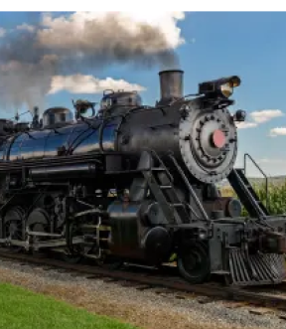
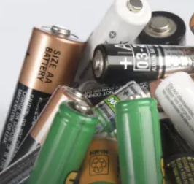
Mississippi Standards Alignment
4th Grade - Physical Science
Electricity, Light, & Heat (Electricity, Light, & Heat)
 | Topic & Guiding Question | Student Objectives | Mississippi Standards for Science (2018)
 | Renewable Energy & Natural Resources What’s the best way to light up a city? | Students evaluate the advantages and disadvantages of wind, water, and solar energy to power a town. Students obtain and evaluate information about the needs of each source of energy and analyze and interpret data about the town’s resources. | E.4.10 Students will demonstrate an understanding of the various sources of energy used for human needs along with their effectiveness and possible impacts. (E.4.10.1, E.4.10.2)
 | Electrical Energy What if there were no electricity? | Students design a flashlight with an on/off switch, using batteries, flights, and tin foil. Students figure out that electricity can be transformed to other forms of energy, such as movement, light, and heat. | P.4.6A Students will demonstrate an understanding of the common sources and uses of heat and electric energy and the materials used to transfer heat and electricity.
 | Heat Energy & Energy Transfer How long did it take to travel across the country before cars and planes? | Students build a paper spinner and conduct an investigation to explain how heat makes things move. Students realize that heat energy can be transformed into motion energy using a turbine. | P.4.6A Students will demonstrate an understanding of the common sources and uses of heat and electric energy and the materials used to transfer heat and electricity.
Lesson 1
Lesson 2
Lesson 3
The following mini-lessons can be used to support Mississippi Science Standards.
Mini-lesson
P.4.6A How do batteries work?
www.mysteryscience.com/docs/mississippi

Slide 32




Mississippi Standards Alignment
5th Grade - Life Science
Ecosystems & The Food Web (Web of Life)• Page 1 of 2
 | Topic & Guiding Question | Student Objectives | Mississippi Standards for Science (2018)
 | ✨New!✨ Food Chains & Matter Flow What if all the ants disappeared? | Students construct models of food chains by linking cards discovering that different interrelationships exist between organisms. | L.5.3B Students will demonstrate an understanding of a healthy ecosystem with a stable web of life and the roles of living things within a food chain and/or food web, including producers, primary and secondary consumers, and decomposers.
 | ✨New!✨ Plant Growth & Matter How does a tiny seed become one of the heaviest trees on Earth? | Students gather evidence through a series of virtual experiments to construct an argument that plants use mostly air and water as the materials for their growth. | L.5.3A Students will demonstrate an understanding of photosynthesis and the transfer of energy from the sun into chemical energy necessary for plant growth and survival.
 | ✨New!✨ Decomposers & Matter Flow Where do fallen leaves go? | Students conduct an investigation to gain an understanding of the important role that decomposers play in recycling matter from dead leaves back into the environment. | L.5.3B Students will demonstrate an understanding of a healthy ecosystem with a stable web of life and the roles of living things within a food chain and/or food web, including producers, primary and secondary consumers, and decomposers.
 | Decomposers & Soil Nutrients Do worms really eat dirt? | Students make observations of worms to realize that worms act as decomposers to eat dead matter in an ecosystem and cycle nutrients into the soil. | L.5.3B Students will demonstrate an understanding of a healthy ecosystem with a stable web of life and the roles of living things within a food chain and/or food web, including producers, primary and secondary consumers, and decomposers.
Lesson 1
Lesson 2
Lesson 3
Lesson 4
Continued on next page
✨ New Lesson
www.mysteryscience.com/docs/mississippi

Slide 33


Mississippi Standards Alignment
5th Grade - Life Science
Ecosystems & The Food Web (Web of Life)• Page 2 of 2
 | Topic & Guiding Question | Student Objectives | Mississippi Standards for Science (2018)
 | Ecosystems & Matter Cycle Why do you have to clean a fish tank but not a pond? | Students develop a model of a pond ecosystem and realize that interrelationships exist between decomposers, plants, and animals. Students discover that each organism must be in balance for the pond ecosystem to function. | L.5.3B Students will demonstrate an understanding of a healthy ecosystem with a stable web of life and the roles of living things within a food chain and/or food web, including producers, primary and secondary consumers, and decomposers.
 | Protecting Environments How can we protect Earth’s environments? | In this lesson, students learn about what happens in unbalanced ecosystems and how that can lead to an overabundance of algae and harmful algal blooms. In the activity, Bloom Busters, students play a game in which they obtain and combine science ideas in order to help a community respond to and prevent harmful algal blooms. | E.5.10 Students will demonstrate an understanding of the effects of human interaction with Earth and how Earth’s natural resources can be protected and conserved. (E.5.10.1)
 | Food Webs & Flow of Energy Why did the dinosaurs go extinct? | Students develop a model of a dinosaur food web. Students realize that blocking the sun’s energy would have disastrous effects on the organisms that rely on this energy in the food web and cause the extinction of some entire species. | L.5.3B Students will demonstrate an understanding of a healthy ecosystem with a stable web of life and the roles of living things within a food chain and/or food web, including producers, primary and secondary consumers, and decomposers.
Lesson 5 Lesson 6
Lesson 7
www.mysteryscience.com/docs/mississippi

Slide 34
Mississippi Standards Alignment
5th Grade - Earth & Space Science
Water Cycle & Earth’s Systems (Watery Planet)
 | Topic & Guiding Question | Student Objectives | Mississippi Standards for Science (2018)
Lesson 1 | Hydrosphere & The Roles of Water How much water is in the world? | Students analyze and interpret data from world maps to determine the relative amounts of fresh, salt, and frozen water. Students figure out that while the Earth has a lot of water, most of Earth’s water is not fresh or accessible. | E.4.9A Students will demonstrate an understanding of how the water cycle is propelled by the sun’s energy. (E4.9A.1)
Lesson 2 | Mixtures & Solutions How much salt is in the ocean? | Students create a model ocean to observe how salt seems to completely vanish when dissolved in water. Students measure and graph quantities to provide evidence that the salt is still in the solution, even though we can’t see it. | P.5.5B Students will demonstrate an understanding of mixtures and solutions. (P.5.5B.1) P.5.5C Students will demonstrate an understanding of the difference between physical and chemical changes. (P.5.5C.2, P.5.5C.3)
Lesson 3 | Groundwater as a Natural Resource When you turn on the faucet, where does the water come from? | Students learn most people get fresh water from underground sources. Students determine the best place to settle a town by considering features of the landscape & the characteristics of the plants that thrive there. | E.4.9A Students will demonstrate an understanding of how the water cycle is propelled by the sun’s energy. (E4.9A.1)
Lesson 4 | Water Cycle Can we make it rain? | Students create a model of the ocean and sky to investigate how temperature influences evaporation and condensation. Students figure out that higher ocean temperatures lead to more evaporation, thus leading to more rain. | E.4.9A Students will demonstrate an understanding of how the water cycle is propelled by the sun’s energy. (E4.9A.1)
 | Natural Disasters & Engineering How can you save a town from a hurricane? | Students define the problem that a town needs protection from flooding. They design solutions using different types of flood protection. They realize flooding is caused by severe rainfall generated by hurricanes. Hurricanes are created where ocean temperatures are warm. | E.4.9C Students will demonstrate an understanding of how natural processes and human activities affect the features of Earth’s landforms and oceans. (E4.9C.5)
Lesson 1
Lesson 2
Lesson 3
Lesson 4
Lesson 5
We recommend teaching this in 4th grade if following Mississippi Standards.
We recommend teaching this in 4th grade if following Mississippi Standards.
We recommend teaching this in 4th grade if following Mississippi Standards.
We recommend teaching this in 4th grade if following Mississippi Standards.
www.mysteryscience.com/docs/mississippi

Slide 35





Mississippi Standards Alignment
5th Grade - Earth & Space Science
Earth & Space Patterns (Spaceship Earth)
 | Topic & Guiding Question | Student Objectives | Mississippi Standards for Science (2018)
 | Day, Night, & Earth’s Rotation How fast does the Earth spin? | Students model the rotation of the Earth and investigate why the Sun looks like it’s moving across the sky. Using evidence they gathered in the investigation, students build a model that explains how the Earth’s rotation around its own axis causes the Sun to appear to rise and set. | E.5.8B Students will demonstrate an understanding of the principles that govern moon phases, day and night, appearance of objects in the sky, and seasonal changes. (E.5.8B.4)
 | Earth’s Rotation & Daily Shadow Patterns Who set the first clock? | Students make a shadow clock (sundial) and investigate how the direction and length of shadows change with the position of the light shining on the sundial. Students realize that the Sun’s position in the sky can be used to tell the time of day. | E.5.8B Students will demonstrate an understanding of the principles that govern moon phases, day and night, appearance of objects in the sky, and seasonal changes. (E.5.8B.4)
 | Seasonal Changes & Shadow Length How can the Sun tell you the season? | Students examine photos taken at different times of year and figure out the time of year that each photo was taken. Students discover that the Sun’s path changes with the seasons, as does the time of sunrise and sunset. The Sun is always highest in the sky at noon, but that height changes with the season. | E.5.8B Students will demonstrate an understanding of the principles that govern moon phases, day and night, appearance of objects in the sky, and seasonal changes. (E.5.8B.2, E.5.8A.3)
 | Seasonal Patterns & Earth’s Orbit Why do the stars change with the seasons? | Students build a model of the universe and use it to explain why different stars are visible at different times of year. Using evidence from this model, students make an argument that supports the claim that the Earth orbits the Sun. | E.5.8A Students will demonstrate an understanding of the locations of objects in the universe. (E.5.8A.3)
 | Moon Phases, Lunar Cycle Why does the Moon change shape? | Students use a physical model of the Sun and Moon to investigate how the Moon’s phase relates to its position relative to the Sun. Students notice that the Moon’s phases repeat in a predictable pattern. | E.5.8B Students will demonstrate an understanding of the principles that govern moon phases, day and night, appearance of objects in the sky, and seasonal changes. (E.5.8B.1 , E.5.8B.2)
Lesson 1
Lesson 2
Lesson 3
Lesson 4
Lesson 5
www.mysteryscience.com/docs/mississippi

Slide 36



Mississippi Standards Alignment
5th Grade - Earth & Space Science
Stars & Planets (Stars & Planets)
 | Topic & Guiding Question | Student Objectives | Mississippi Standards for Science (2018)
 | Solar System & Sun Brightness How can the Sun help us explore other planets? | Students gather evidence to support an argument that the apparent brightness of the Sun is dependent upon an observer’s distance from the Sun. They construct a model of the solar system and gather observations of the Sun’s apparent brightness from each planet within their model. | E.5.8A Students will demonstrate an understanding of the locations of objects in the universe. (E.5.8A.1, E.5.8A.2)
 | Gravity Why is gravity different on other planets? | Using mathematics and computational thinking, students calculate how high they could jump on planets and moons that have stronger or weaker gravity than Earth. Students analyze and interpret this data to construct an explanation for why the amount of gravity is different on other planets. | P.5.6 Students will demonstrate an understanding of the factors that affect the motion of an object through a study of Newton’s Laws of Motion. (P.5.6.1) E.5.8A Students will demonstrate an understanding of the locations of objects in the universe. (E.5.8A.1 )
 | Star Brightness & Habitable Planets Could there be life on other planets? | Sun with the right amount of light and heat for life to exist. Students evaluate other solar systems, comparing their stars to our Sun. Based on their analysis, students plan a space mission to a planet with conditions similar to those on Earth. | E.5.8A Students will demonstrate an understanding of the locations of objects in the universe. (E.5.8A.2)
Lesson 1
Lesson 2
Lesson 3
www.mysteryscience.com/docs/mississippi

Slide 37

Mississippi Standards Alignment
5th Grade - Physical Science
Chemical Reactions & Properties of Matter (Chemical Magic)
 | Topic & Guiding Question | Student Objectives | Mississippi Standards for Science (2018)
 | Chemistry & Conservation of Matter Are magic potions real? | Students observe that a salt and vinegar solution will turn a dull penny shiny again indicating that substances can change other substances. | Foundational for P.5.5B Students will demonstrate an understanding of mixtures and solutions.
 | Dissolving & Particulate Nature of Matter Could you transform something worthless into gold? | Students coat a steel nail in copper by placing it into the solution that dissolved bits of the penny. Students realize that substances can change to become particles too small to be seen, but they still exist. | Foundational for P.5.5B Students will demonstrate an understanding of mixtures and solutions.
 | Acids, Reactions, & Properties of Matter What would happen if you drank a glass of acid? | Students figure out that acids are very reactive substances. Students investigate reactions between different substances to determine how known acids react with other materials. | P.5.5A Students will demonstrate an understanding of the physical properties of matter.
 | Chemical Reactions What do fireworks, rubber, and Silly Putty have in common? | Students combine different substances together to discover that chemical reactions can create new substances. | P.5.5C Students will demonstrate an understanding of the difference between physical and chemical changes. (P.5.5C.1)
 | Gases & Particle Models Why do some things explode? | Students investigate and model the reaction between baking soda and vinegar. They figure out that gases are made of particles too small to be seen. | P.5.5A Students will demonstrate an understanding of the physical properties of matter.
Lesson 1
Lesson 2
Lesson 3
Lesson 4
Lesson 5
www.mysteryscience.com/docs/mississippi

Slide 38


Mississippi Standards Alignment
5th Grade - Physical Science
This unit is found under 4th grade on our site, but we recommend teaching lessons in 5th grade if you are following Mississippi Standards.
Energy & Energy Transfer (Energizing Everything)
 | Topic & Guiding Question | Student Objectives | Mississippi Standards for Science (2018)
 | Speed & Energy How is your body similar to a car? | Students learn about stored energy and about the relationship between motion and energy. Students build models of an amusement park ride and discover how energy can be stored in materials. Stored energy can be converted to speed. | P.5.6 Students will demonstrate an understanding of the factors that affect the motion of an object through a study of Newton’s Laws of Motion.
 | Gravitational Energy, Speed, & Collisions What makes roller coasters go so fast? | Students build a model of a roller coaster and carry out an investigation using marbles. Students learn that lifting an object up stores energy in the object. When the object falls, that stored energy is released. They realize that energy is transferred when objects collide. | P.5.6 Students will demonstrate an understanding of the factors that affect the motion of an object through a study of Newton’s Laws of Motion.
 | Collisions & Energy Transfer How can marbles save the world? | Students investigate how energy transfers when objects collide. In the activity, Bumper Jumper, students ask questions and make predictions about how far a marble will launch over a jump after colliding with other objects. | P.5.6 Students will demonstrate an understanding of the factors that affect the motion of an object through a study of Newton’s Laws of Motion.
 | Energy Transfer & Engineering Could you knock down a building using only dominoes? | Students experiment with ways to store and release energy, creating the beginning of a chain reaction machine with a lever and a ramp. Students figure out that a domino standing on end is storing energy, only requiring a small amount of energy (a tiny push) to release the stored energy. | P.5.6 Students will demonstrate an understanding of the factors that affect the motion of an object through a study of Newton’s Laws of Motion.
 | Energy Transfer & Engineering Can you build a chain reaction machine? | Students continue to build a chain reaction machine — identifying a goal, brainstorming and testing multiple ideas, and determining an optimal solution. The chain reaction machine uses multiple components to transfer energy from one part to the next. | P.5.6 Students will demonstrate an understanding of the factors that affect the motion of an object through a study of Newton’s Laws of Motion.
Lesson 1
Lesson 2
Lesson 3
Lesson 4 Lesson 5
www.mysteryscience.com/docs/mississippi

