Slide 1
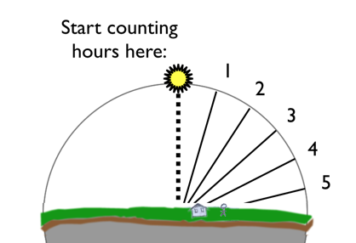

Name _____________________
What Do A.M. and P.M. Mean?
We call our morning hours “A.M.” and our afternoon or evening hours “P.M.” Breakfast time happens in the “A.M.” You might know that A.M. hours actually start at midnight. Every hour after midnight, up until lunchtime, is A.M. (Sometimes instead of A.M. we say, “in the morning.” For example, 3 in the morning, 4 in the morning, and so on.)
Dinnertime happens in the “P.M.” P.M. hours begin at noon, and last until 11:59 p.m.—that’s 11:59 at night.
What do these two abbreviations mean? And where do they come from?
The ancient Egyptians divided a day into 12 parts of daytime and 12 parts of nighttime. But eventually, the ancient Romans came along. The Romans kept the Egyptians’ idea of dividing the day into two parts of 12, but they got rid of the idea of counting 12 daytime hours and 12 nighttime hours.
Instead of dividing their hours into
daytime and nighttime, the Romans
divided their day right down the
middle, between sunrise and sunset.
In other words, instead of starting
to count the hours at the beginning
of the daytime, the Romans started
counting their hours at noon (midday), Midday is
when the Sun is at its highest point in
the sky.
Earth & Space Patterns

Slide 2
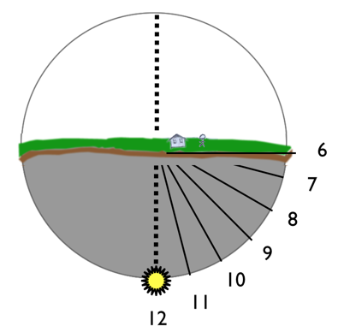
As the Sun went down, the Romans imagined it kept going around, like in the diagram below. Its last point, where the “12” is, is the very middle of the night, or midnight. It’s the opposite of noon.
So the Romans split the day in half at this midday to midnight line. They called this line meridiem, which was their word for midday.
A.M. stands for ante meridiem. That’s Latin* for “before midday.” So the A.M. hours are the ones that happen before midday.
P.M. stands for post meridiem. That’s Latin for “after midday.” So the P.M. hours are the ones that happen after midday.
______________________________________________
*Latin was the name of the language spoken by the Romans.
Earth & Space Patterns

