Slide 1











ABC EDUCATION
PRESENTATION

Slide 2

CONTENTS
01
SPRING
02
SUMMER
03
AUTUMN
04
WINTER

Slide 3

01
SPRING
A complex idea can be conveyed with just a single still image, namely making it possible to absorb large amounts of data quickly.

Slide 4




TITLE HERE
A complex idea can be conveyed with just a single still image, namely making it possible to absorb large amounts of data quickly.
TITLE HERE
TITLE HERE
TITLE HERE
TITLE HERE
A complex idea can be conveyed with just a single still image, namely making it possible to absorb large amounts of data quickly.
A complex idea can be conveyed with just a single still image, namely making it possible to absorb large amounts of data quickly.
A complex idea can be conveyed with just a single still image, namely making it possible to absorb large amounts of data quickly.
A complex idea can be conveyed with just a single still image, namely making it possible to absorb large amounts of data quickly.

Slide 5



TITLE HERE
A complex idea can be conveyed with just a single still image, namely making it possible to absorb large amounts of data quickly.
STEP HERE
A complex idea can be conveyed with just a single still image, namely making it possible to absorb large amounts of data quickly.
STEP HERE
STEP HERE
A complex idea can be conveyed with just a single still image, namely making it possible to absorb large amounts of data quickly.
A complex idea can be conveyed with just a single still image, namely making it possible to absorb large amounts of data quickly.

Slide 6
TITLE HERE
A complex idea can be conveyed with just a single still image, namely making it possible to absorb large amounts of data quickly.
STAGE HERE
添加标题
STAGE HERE
STAGE HERE
STAGE HERE
STAGE HERE
We hope that this template will return to you as a time, money and reputation.
We hope that this template will return to you as a time, money and reputation.
We hope that this template will return to you as a time, money and reputation.
We hope that this template will return to you as a time, money and reputation.

Slide 7
02
SUMMER
A complex idea can be conveyed with just a single still image, namely making it possible to absorb large amounts of data quickly.

Slide 8
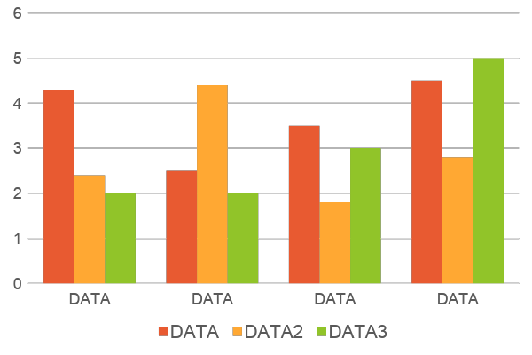
TITLE HERE
A complex idea can be conveyed with just a single still image, namely making it possible to absorb large amounts of data quickly.
01
We hope that this template will return to you as a time, money and reputation.
02
We hope that this template will return to you as a time, money and reputation.
03
We hope that this template will return to you as a time, money and reputation.
04
We hope that this template will return to you as a time, money and reputation.

Slide 9
TITLE HERE
A complex idea can be conveyed with just a single still image, namely making it possible to absorb large amounts of data quickly.
50
60
70
80
STEP HERE
STEP HERE
STEP HERE
STEP HERE
A complex idea can be conveyed with just a single still image, namely making it possible to absorb large amounts of data quickly.
A complex idea can be conveyed with just a single still image, namely making it possible to absorb large amounts of data quickly.
A complex idea can be conveyed with just a single still image, namely making it possible to absorb large amounts of data quickly.
A complex idea can be conveyed with just a single still image, namely making it possible to absorb large amounts of data quickly.

Slide 10

TITLE HERE
A complex idea can be conveyed with just a single still image, namely making it possible to absorb large amounts of data quickly.
STAGE HERE
Go ahead and replace it with your own text.
Go ahead and replace it with your own text.
Go ahead and replace it with your own text.
Go ahead and replace it with your own text.

Slide 11
03
AUTUMN
A complex idea can be conveyed with just a single still image, namely making it possible to absorb large amounts of data quickly.

Slide 12
TITLE HERE
A complex idea can be conveyed with just a single still image, namely making it possible to absorb large amounts of data quickly.
TITLE HERE
TITLE HERE
A complex idea can be conveyed with just a single still image, namely making it possible to absorb large amounts of data quickly.
A complex idea can be conveyed with just a single still image, namely making it possible to absorb large amounts of data quickly.
TITLE HERE
TITLE HERE
A complex idea can be conveyed with just a single still image, namely making it possible to absorb large amounts of data quickly.
A complex idea can be conveyed with just a single still image, namely making it possible to absorb large amounts of data quickly.

Slide 13
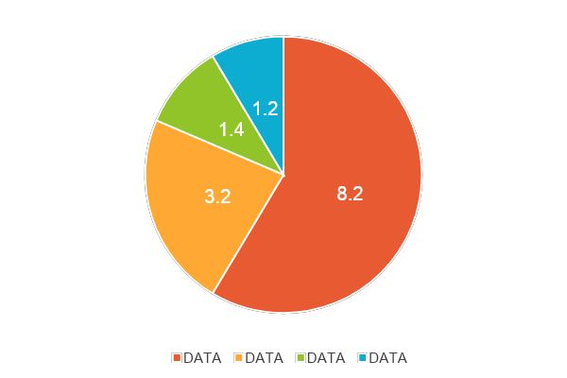
TITLE HERE
A complex idea can be conveyed with just a single still image, namely making it possible to absorb large amounts of data quickly.
01
We hope that this template will return to you as a time, money and reputation.
02
We hope that this template will return to you as a time, money and reputation.
03
We hope that this template will return to you as a time, money and reputation.
04
We hope that this template will return to you as a time, money and reputation.

Slide 14
TITLE HERE
A complex idea can be conveyed with just a single still image, namely making it possible to absorb large amounts of data quickly.
STAGE HERE | STAGE HERE | STAGE HERE | STAGE HERE
DATA | 8000 | 8000 | 8000
DATA | 8000 | 8000 | 8000
DATA | 8000 | 8000 | 8000
DATA | 8000 | 8000 | 8000
STAGE HERE
A complex idea can be conveyed with just a single still image, namely making it possible to absorb large amounts of data quickly. A complex idea can be conveyed with just a single still image, namely making it possible to absorb large amounts of data quickly.

Slide 15
04
WINTER
A complex idea can be conveyed with just a single still image, namely making it possible to absorb large amounts of data quickly.

Slide 16




TITLE HERE
A complex idea can be conveyed with just a single still image, namely making it possible to absorb large amounts of data quickly.
TITLE HERE
TITLE HERE
TITLE HERE
TITLE HERE
Go ahead and replace it with your own text.
Go ahead and replace it with your own text.
Go ahead and replace it with your own text.
Go ahead and replace it with your own text.

Slide 17
TITLE HERE
A complex idea can be conveyed with just a single still image, namely making it possible to absorb large amounts of data quickly.
STEP HERE
STEP HERE
STEP HERE
STEP HERE
We hope that this template will return to you as a time, money and reputation.
We hope that this template will return to you as a time, money and reputation.
We hope that this template will return to you as a time, money and reputation.
We hope that this template will return to you as a time, money and reputation.

Slide 18
THANK YOU!
Powered by GoogleSlides.org

