Slide 1




MINING START-UP PITCH DECK
FREE PRESENTATION TEMPLATE

Slide 2



TABLE OF CONTENTS
01
INTRODUCTION
02
PROBLEM
The Extraordinary Realm
Unicorn Sightings
03
SOLUTION
04
PRODUCT
Wishes Granted
Spellcasting
05
MARKET
06
COMPETITION
Happily Ever After
Embrace the Fantasy

Slide 3

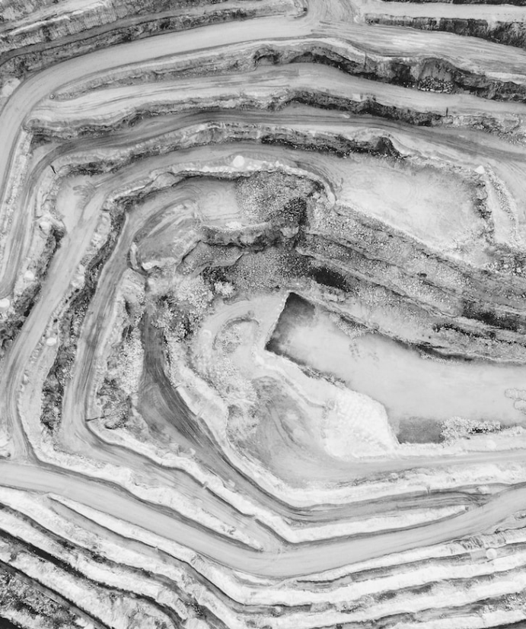



UNICORN SIGHTINGS
SUMMARY
A record of the number of unicorns spotted in the fantasy realm and the beauty and mystery that surrounds.
GOBLIN GATHERINGS
Unveil the truth about the often-misunderstood goblin race and their role in the fantasy world.

Slide 4






SUMMARY
DRAGON TAMING
Welcome to the Fantasy World, a realm of wonder and enchantment where anything is possible. Here, dragons breathe fire, unicorns prance through meadows, and rainbows shine brightly. This world is a place where wishes come true, where potions can be cursed and spells are cast. It's a place of treasure and adventure, where the impossible becomes possible. But the greatest treasure of all is the one that lies within.
UNICORN

Slide 5
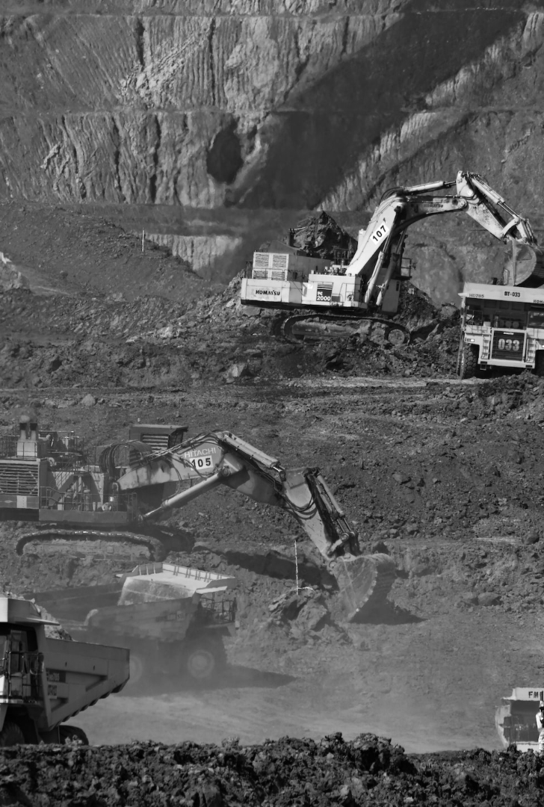




PROBLEM
DARK ENCHANTMENTS
A growing number of dark magic practitioners are causing harm and destruction across the land, and the existing wizarding authorities are struggling to keep up.
LOST MAGIC
A decline in the availability and use of magic has led to a lack of experienced wizards and witches in the world, leading to a rise in the number of magical mishaps and accidents.

Slide 6

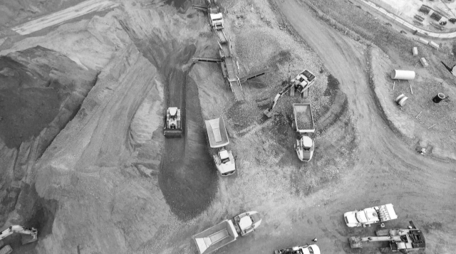


PROBLEM
LOST MAGIC
DARK ENCHANTMENTS
A decline in the availability and use of wonderful magic
A growing number of dark magic practitioners
45%
45%

Slide 7



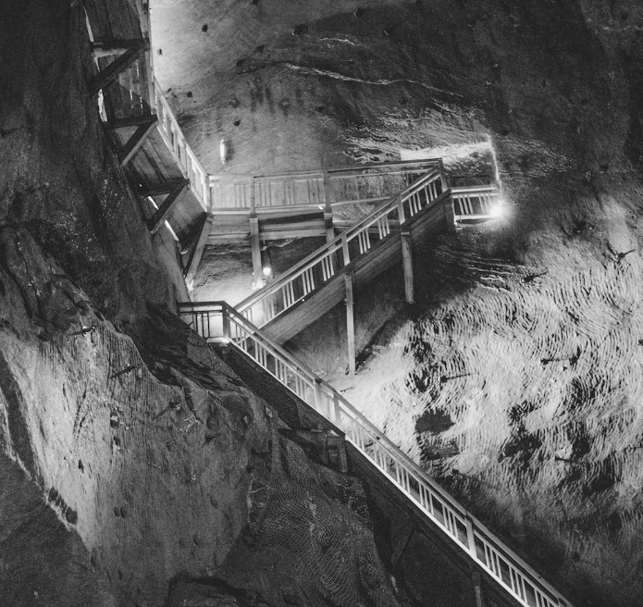




SOLUTION
ELEMENTAL BINDING
CHARM OF ABUNDANCE
GATES OF PROTECTION
ILLUMINATION SPELL

Slide 8






SOLUTION
BINDING
PROTECTION
SPELL
A powerful spell that can control and harness the elemental forces of nature
An enchantment that creates an impenetrable barrier around an area.
A spell that creates a bright, steady light, providing a solution to problems.

Slide 9

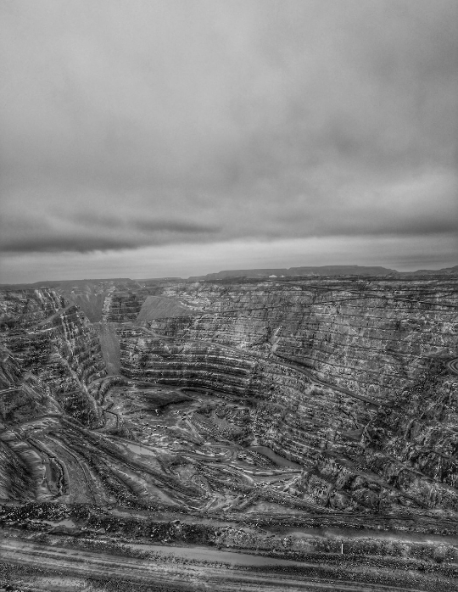

PRODUCT
FANTASY-THEMED PRODUCT FOR SOLVING PROBLEMS.
A complete and effective solution for your most pressing concerns, offering an innovative blend of fantasy and practicality for maximum impact.
ELEMENTAL
ENCHANTMENT
WINGS OF THE
PHOENIX
A powerful spellcasting tool.
A set of enchanted wings.

Slide 10



PRODUCT
A MAGICAL TOOL TO HARNESS THE POWER OF FIRE FOR YOUR EVERY NEED.
32%
54%
14%

Slide 11

MARKET
FOREST
CAVES
CITY

Slide 12







COMPETITION
UNICORN SIGHTINGS
ENCHANTED CREATURES
A record of the number of unicorns spotted in the fantasy realm and the beauty and mystery that surrounds these enchanting creatures.
Tracking the mystical animals of the fantasy world
MYSTICAL LANDSCAPES
Discovering the stunning landscapes and hidden wonders
LEGENDARY ARTIFACTS
Uncovering powerful and mysterious artifacts in the fantasy world

Slide 13



COMPETITION
$40M
THE ENCHANTED FOREST
THE CRYSTAL CAVES
Forgotten Lore
$5.6M
Unstable Elements
THE SHADOW MOUNTAINS
THE DARK CITADEL
25%
Lost Magic
Vision
Profit

Slide 14





TRACTION
345K
562M
75%
3213
12
10
8
6
25%
4
2
0
2015
2016
2017
2018
2019
2020
2021

Slide 15





TRACTION
MYSTERY
ENCHANTMENT
Unveil secrets and track progress.
Explore the allure of mythical creatures.
12.5%

Slide 16




PRICING
BASIC
ELITE
LEGENDARY
  Access to the entry-level dungeons.
  A limited number of quests and battles.
  Ability to form a small party.
  Access to the intermediate dungeons.
  A greater number of quests and battles
  Ability to form larger parties.
  Access to the most challenging dungeons.
  Unlimited quests and battles per month.
  The ability to form the largest.
$10/month
$50/month
$100/month

Slide 17


BUSINESS MODEL
01
SHADOW HAVEN
Find refuge and protection in the shadows of this haven.
02
MYSTICAL WONDER
Uncover the secrets and marvels of a mystical world.

Slide 18







OUR TEAM
ELDRUIN
The Fire Mage
ARCTURUS
The Ice Wizard
ZEPHYR
The Air Warlock

Slide 19
MILESTONES
April
May
June
July
Eclipse, quest for artifact, volcano disaster
Shimmering City, conquest, Unicorn Crystal
War, curse from artifact, magic discovery
Kingdom invaded, betrayal, hero's festival
ECLIPSE
OBTAIN
WAR
INVASION
Rare event causes unpredictable magic.
Humans acquire Crystal
Kingdoms clash in conflict.
Kingdom attacked by monsters.
FOUNDATION
QUEST
TRANSFORMATION
BETRAYAL
Shimmering City established
Adventurers seek immortal artifact.
Peasant discovers magical powers.
Queen's advisor revealed as spy.
RISE
DISASTER
INTRIGUE
FESTIVAL
City expands, conquers neighbors.
Volcano destroys city, refugees flee.
Plot to assassinate leader uncovered.
Grand celebration in hero's honor.

Slide 20







ACQUISITION
FOREST
DIVINE BLESSINGS
SORCERER'S TOME
A magical woodland filled with mystical creatures.
A ritual that imbues a person with divine powers.
A mysterious book that holds the secrets of the universe.
WEAPONS
ARCANE STUDIES
ELDRITCH WARD
A range of enchanted weapons.
A course of study that teaches the secrets of magic.
A powerful incantation that creates an arcane shield .

Slide 21
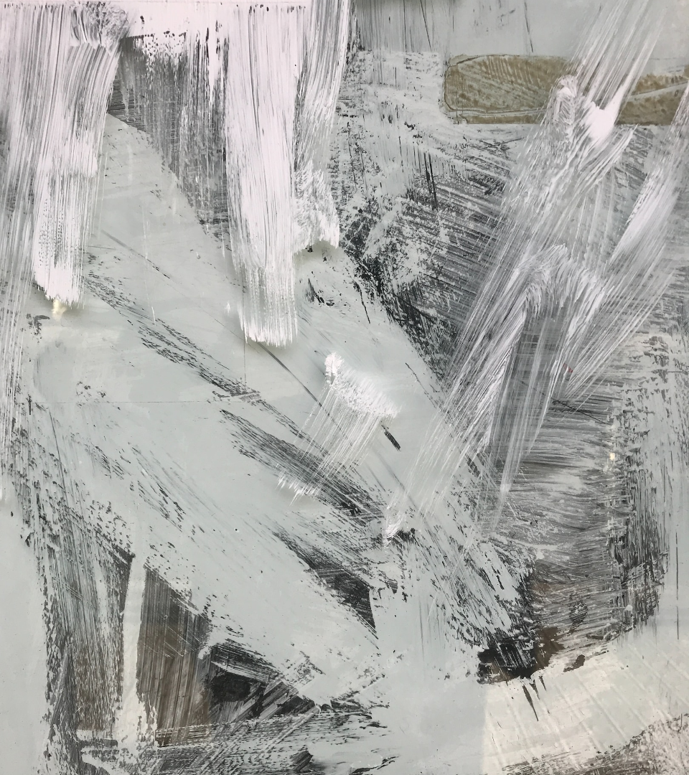





THANK YOU FOR CHOOSING EATEMP
We offer free and high-quality slides templates for your presentations. We appreciate you choosing us and hope our templates have been helpful.
As a new website, we rely on your support to grow, so please help us by sharing our site with your friends and colleagues.
eatemp._
@eatemp
eatempofficial
@eatemp.official

