Slide 1

ClassLink LaunchPad Intro
Enter Presenter’s Name
Replace with your school logo
Notes:
NOTE TO SPEAKER: Anything that is red on the slides or in the speaker notes is meant for you to personalize/remove based on your schools needs. Additionally, you can hide any slides that do not pertain to your school’s LaunchPad set up.
Speaker Notes:
Welcome, everyone! Today I want to show how LaunchPad can make our school days easier. The goal is simple: quicker access, fewer login problems, and a smoother start to class. As we move through the deck, think about one small change you could use this week. One good shortcut can save more time than a dozen big promises.

Slide 2
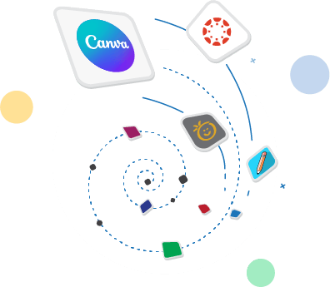
Agenda
1
Sign in with confidence
4
Organize apps for speed
2
Tour the teacher home page
5
Use My Classes and QuickCards
3
Personalize settings
6
Find help and security tools
Notes:
Speaker Notes:
Here’s our plan for today. We’ll start with login options, then tour the LaunchPad home page and the key settings available on it. After that, we’ll look at ways to organize apps, use My Classes and QuickCards, and find help and accessibility tools. My hope is that you leave with a few practical ideas you can use right away, not a giant to-do list.
Resources
https://help.classlink.com/s/article/instructor-quick-guide

Slide 3
Login Options
Notes:
Speaker Notes:
Let’s begin with login options. A smooth sign-in process sets the tone for the rest of the day, especially during those first few minutes of class when every second counts.

Slide 4
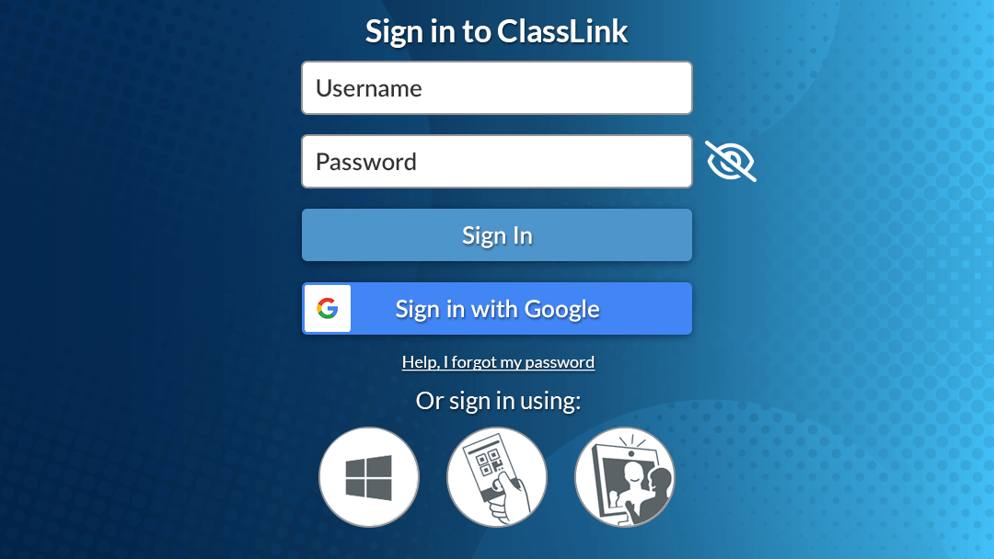
Login Options
Username and Password
Google
Microsoft
QuickCards
Passkey
Facial Recognition
Replace with your login page
Notes:
Speaker Notes (Edit any text in RED to meet your school needs)
ClassLink offers several login options that fit different needs and help everyone log in quickly and securely.
Start with the classic option of entering a username and password. This login methodis simple and familiar. Most students and staff know how to log in with credentials, so it works well for quick access.
Google accounts work as an easy sign-on path. Many districts use Google tools, so this option keeps the process smooth and should be familiar to most people.
Microsoft accounts fit districts like ours that use Outlook or Teams. You can jump in fast because your school credentials already connect.
QuickCards give younger students and those with special needs a fast way to sign in. Students hold up a card to their device’s camera and log in with no typing. This means valuable time is gained back at the beginning of each class.
A passkey creates a secure login that uses device-based credentials. It eliminates the need to enter passwords and protects accounts, because the credentials are tied to the device rather than to the user.
The facial recognition option uses a student’s webcam to help them sign in to LaunchPad. The student’s device learns their face and uses it to recognize them during future sign-ins.

Slide 5
LaunchPad Tour
Notes:
Speaker Notes:
Now that we’ve covered access, let’s look at the LaunchPad experience itself. This part is about knowing where to click first, which can help you solve small problems fast.

Slide 6
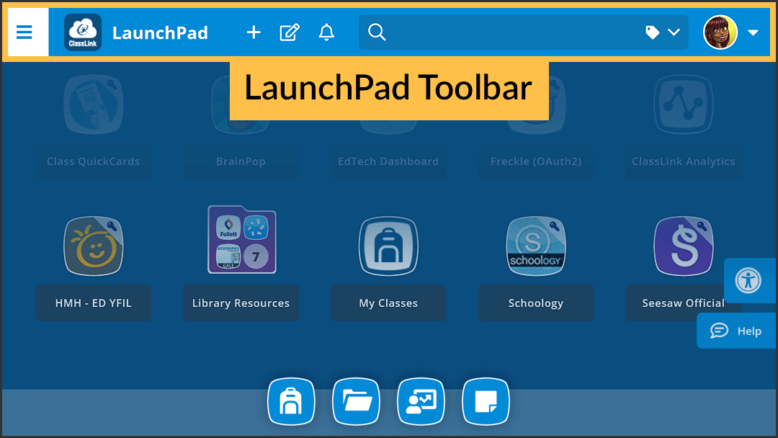
Introduction to LaunchPad
Starting with the Toolbar
Notes:
Speaker Notes:
Once you log in, the LaunchPad home page becomes your main workspace. I want to call attention to the toolbar, because many of the most useful actions start there. You can search for and add apps, adjust settings, check notifications, open accessibility options, and get help from this row. You don’t need to memorize every icon today. What matters is knowing that this area is your shortcut bar for daily use.
Resources
https://vimeo.com/1062467040/45fbcb9382
https://help.classlink.com/s/article/lp-home-toolbar

Slide 7
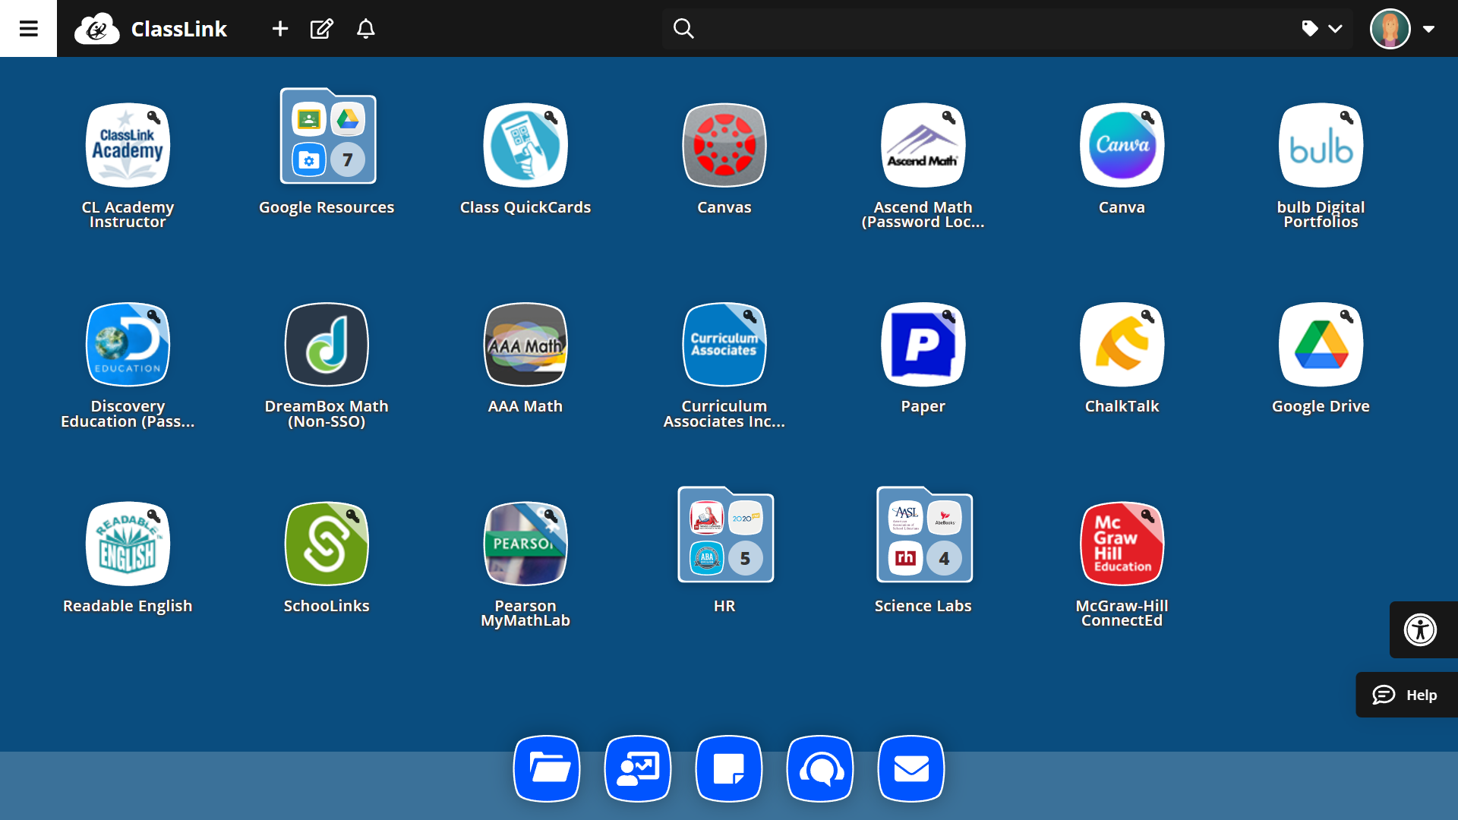
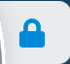
Digital Resources (AKA: Apps)
Padlock means school-managed
Key means saved credentials
No key often means direct access
Notes:
Speaker Notes:
Our goal is to simplify your workday, and LaunchPad helps with that. You’ll see the apps you use for instruction, communication, and daily work all in one place.
A padlock means the app is managed by the school, so it stays in place for consistency. A key means credentials are saved, which helps reduce repeat logins.
No key usually means direct access with no stored password needed.

Slide 8
Profile Settings
Notes:
Speaker Notes:
Next, let’s look at Profile Settings. The tools here can make LaunchPad feel more personal and easier to use.

Slide 9
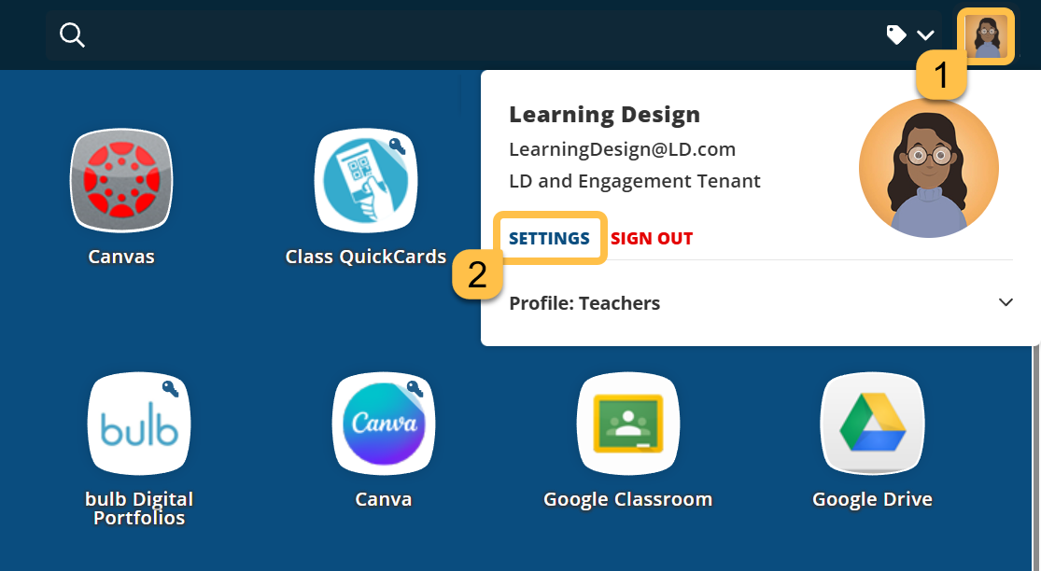
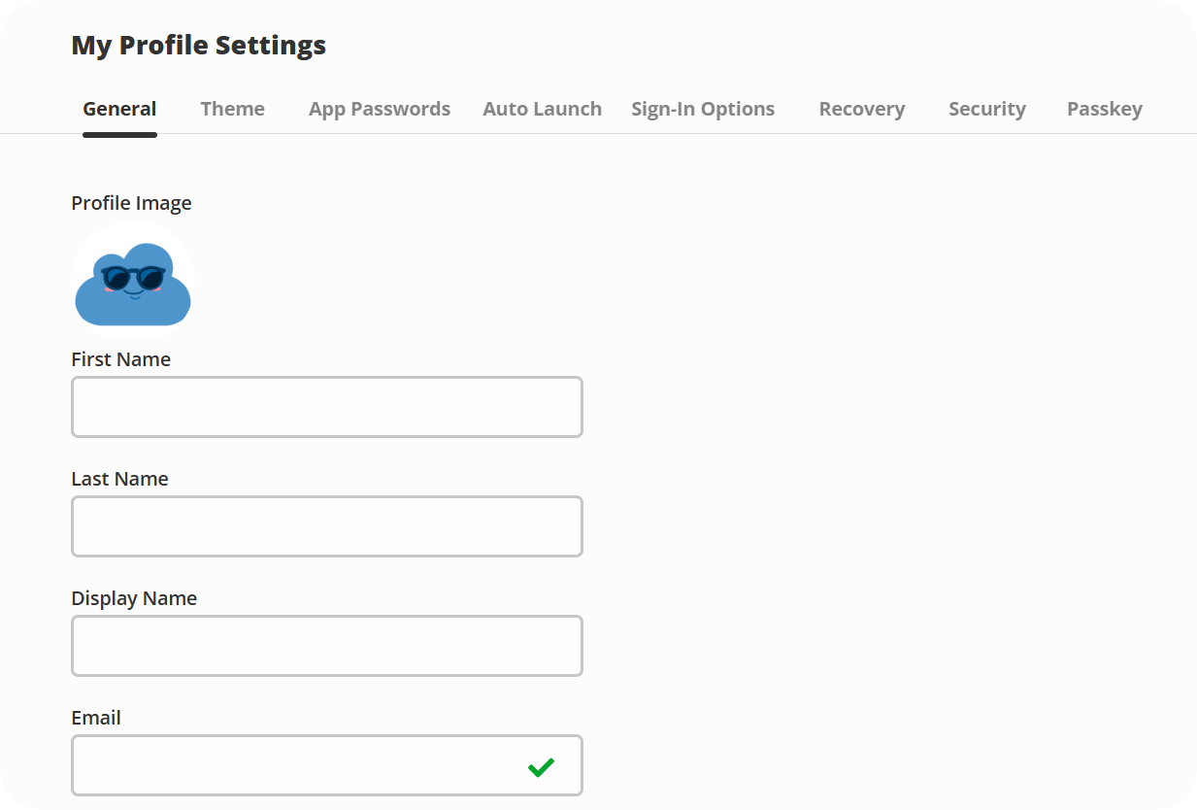
Profile Settings
Notes:
Speaker Notes:
Here’s where you can change your avatar, update your theme color, connect your accounts, and more. To open these settings, click your profile picture and select SETTINGS.
Resources
https://help.classlink.com/s/article/Profile-Settings

Slide 10
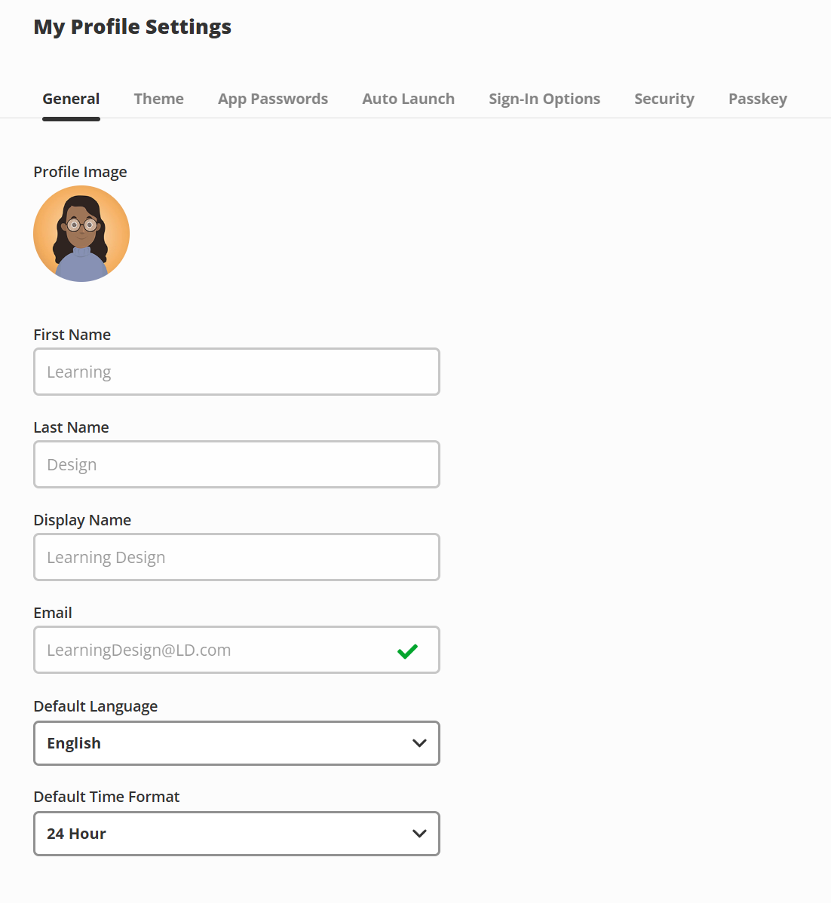
General
Hide slide if you don’t allow this action. If using this action, remove this text box.
Notes:
Speaker Notes:
The General tab in the slide-over window covers your basic account details and a few settings you can adjust. Some fields, like your name and email, are school-managed and can’t be edited here. What you can change includes things like language and time format.
For the time, you can select:
The 12-hour time format, which goes from 1 am to 12 Noon and 1 pm to 12 midnight.
The 24-hour format, which ranges from 00:00 to 23:59, with midnight as 00:00.

Slide 11
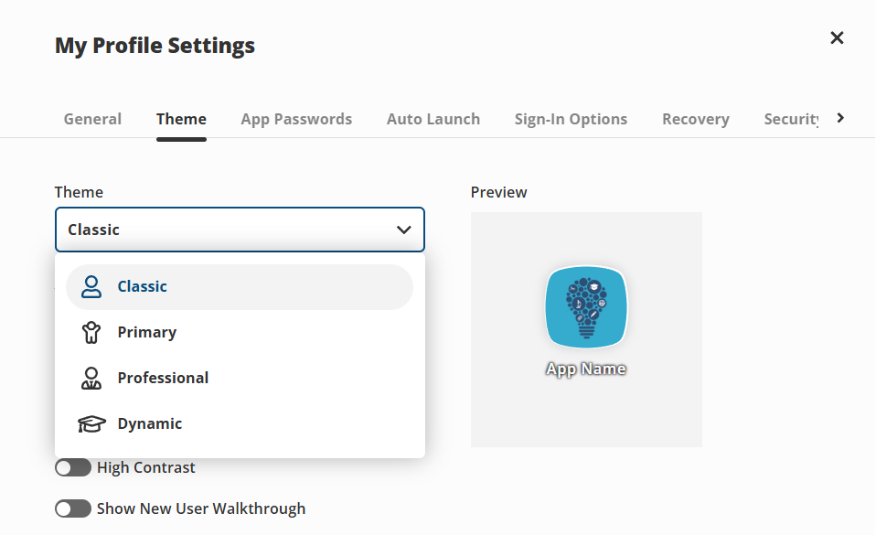
Theme
Hide slide if you don’t allow this action. If using this action, remove this text box.
Notes:
Speaker Notes:
To help make your digital workspace more efficient, I encourage you to explore the Themes tab in your Profile Settings. Think of this as "interior design" for your LaunchPad.
Resources
https://help.classlink.com/s/article/launchpad-dynamic-profile-settings
https://help.classlink.com/s/article/Profile-Settings
https://help.classlink.com/s/article/launchpad-themes

Slide 12
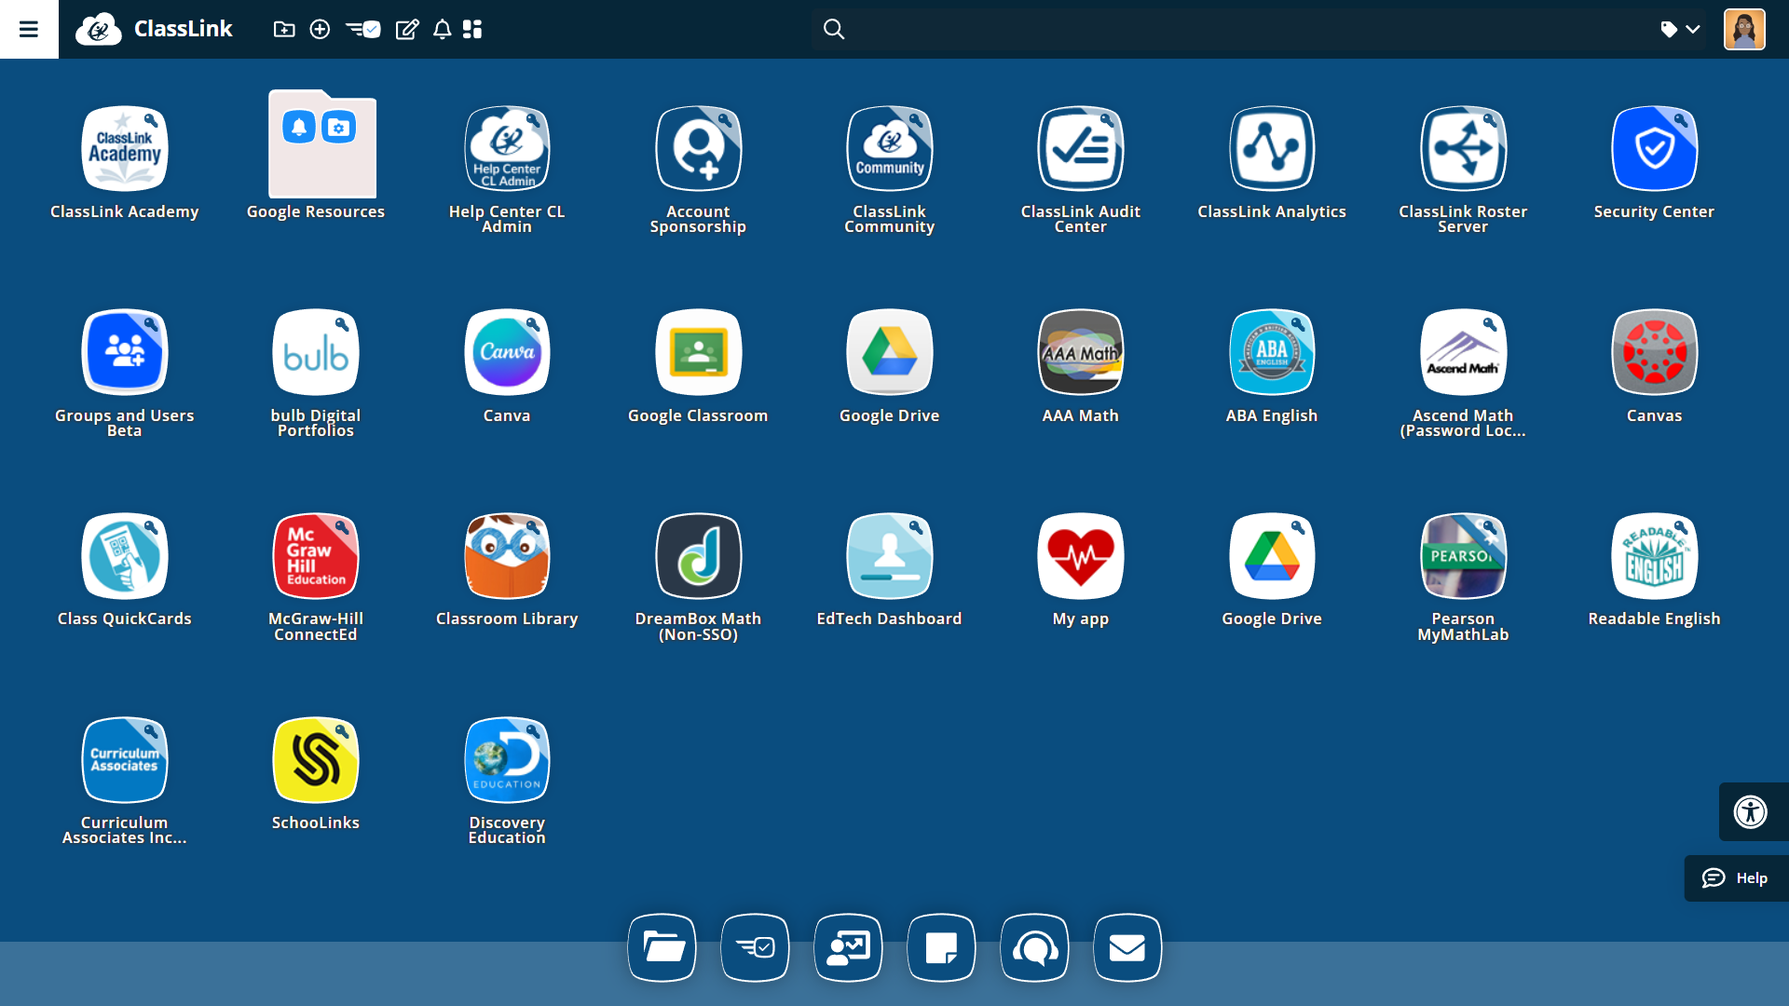
Classic Theme
Hide slide if you don’t allow this action. If using this action, remove this text box.
Notes:
Speaker Notes:
Classic is the standard view we all know.
Resources
https://help.classlink.com/s/article/launchpad-themes-classic

Slide 13
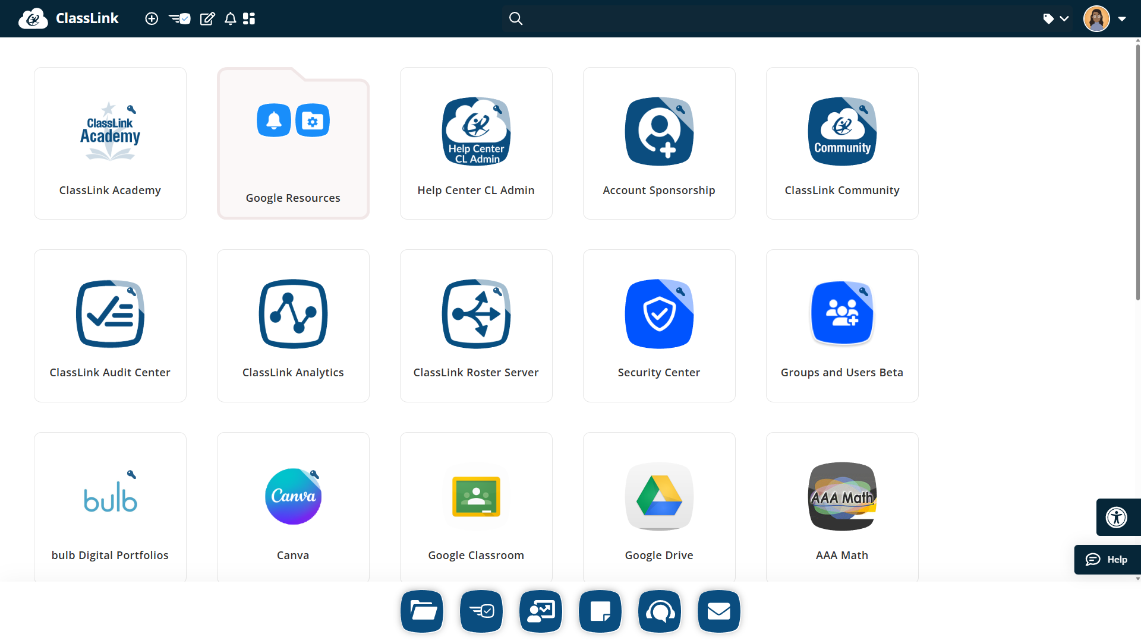
Primary Theme
Hide slide if you don’t allow this action. If using this action, remove this text box.
Notes:
Speaker Notes:
The primary theme has simple, large buttons, which is perfect for our younger students.
Resources
https://help.classlink.com/s/article/launchpad-themes-primary

Slide 14
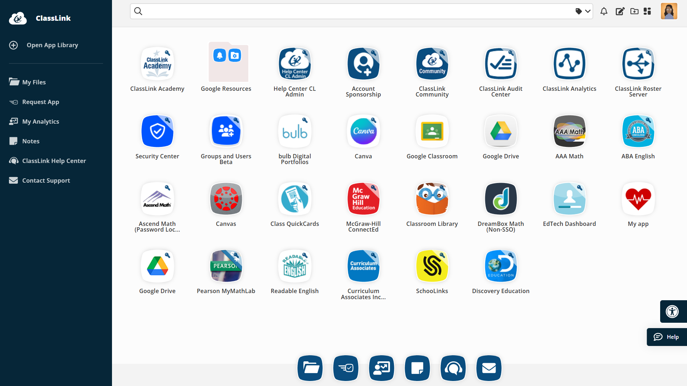
Professional Theme
Hide slide if you don’t allow this action. If using this action, remove this text box.
Notes:
Speaker Notes:
The professional theme has a sleek, side-bar focused layout.
Resources
https://help.classlink.com/s/article/launchpad-themes-professional

Slide 15
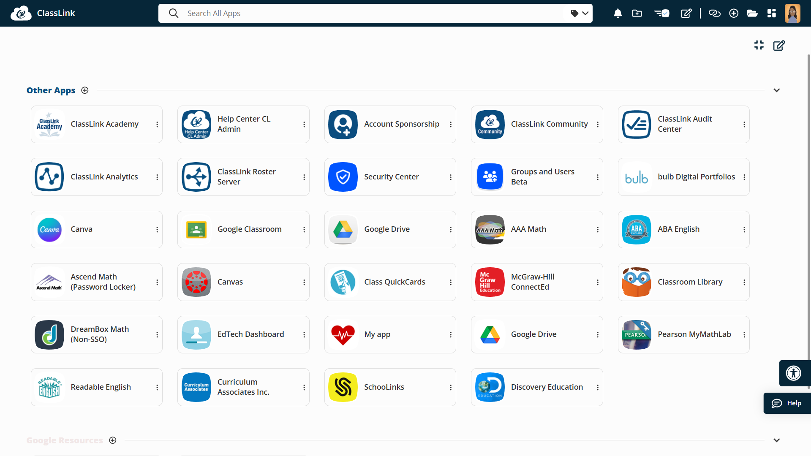
Dynamic Theme
Hide slide if you don’t allow this action. If using this action, remove this text box.
Notes:
Speaker Notes:
The dynamic theme has an advanced view for quick searching and organization.
Resources
https://help.classlink.com/s/article/launchpad-dynamic-matrix

Slide 16
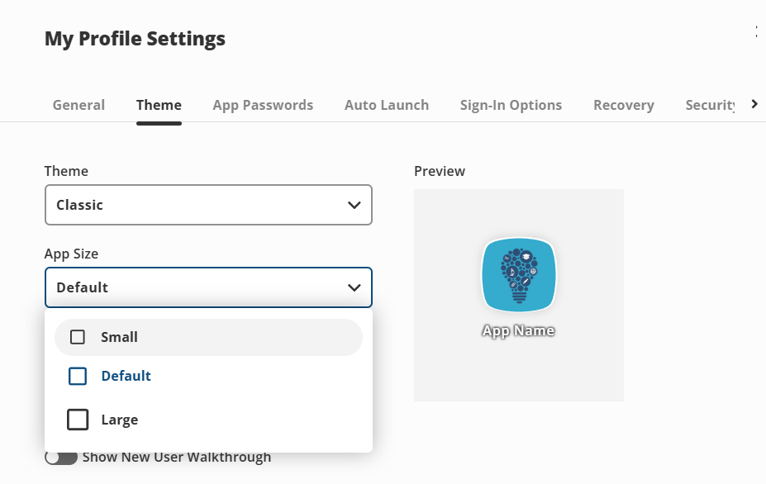
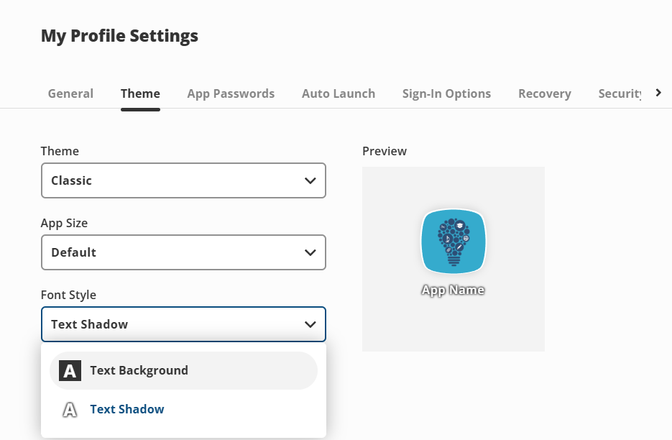
Theme: App Size & Text Shadow
Notes:
Speaker Notes:
You also have the ability to change the size of your apps in LaunchPad, so if you want them smaller or larger than the default, you can make that change. Another feature you can edit is the font style. You can have a text background or a shadow.

Slide 17
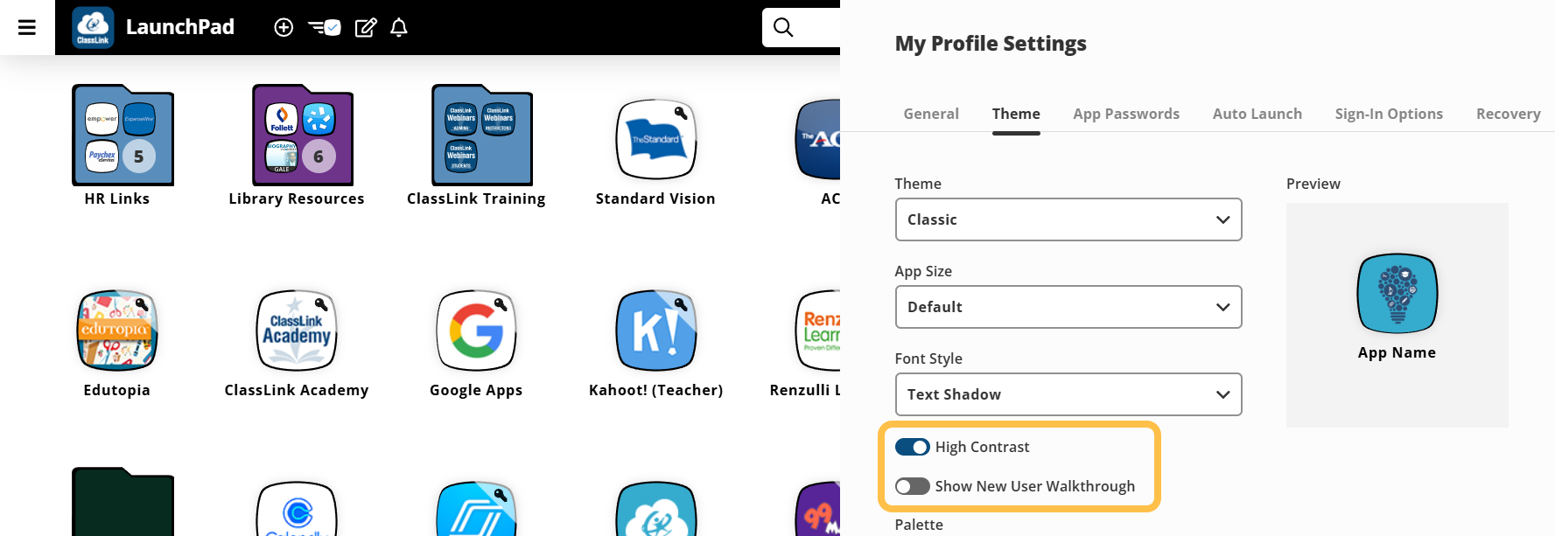
Theme: High Contrast and Walkthrough
Sma
Notes:
Speaker Notes:
For those who prefer light mode, the high contrast setting is great. It adds clear borders to your apps so they stand out more. You can also toggle on the New User Walkthrough. It’s a helpful way to get a guided tour of the interface the next time you sign in.

Slide 18
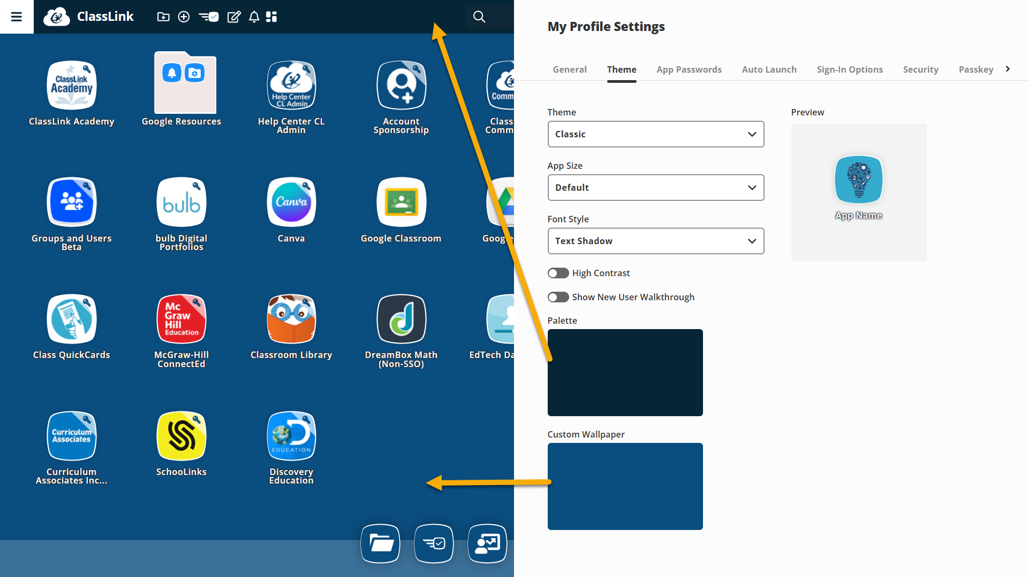
Theme: Palette & Wallpaper
Hide slide if you don’t allow this action. If using this action, remove this text box.
Notes:
Speaker Notes:
To change up the look of your dashboard, use the Palette tool to swap the navigation bar color. You can also give it a fresh feel by clicking Custom Wallpaper and choosing a background that fits your style.

Slide 19

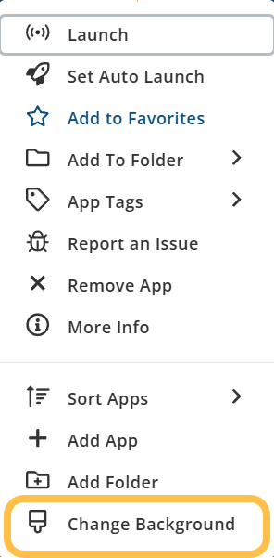
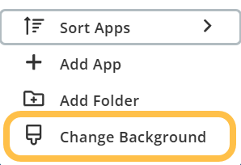
Right-Click
Hide slide if you don’t allow this action. If using this action, remove this text box.
Notes:
Speaker Notes:
You can also change your wallpaper right from your LaunchPad home page. Right-click an app or anywhere in the open areas and select Change Background.

Slide 20
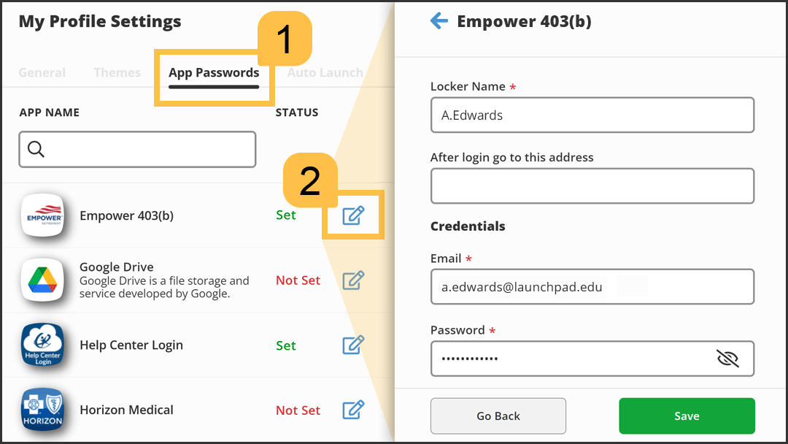
App Passwords
Notes:
Speaker Notes:
Select the App Passwords tab to view and edit an app's credentials or password lockers. An app’s locker lets you save your login details for each app so you can log in automatically without entering your details each time you use it.
Resources
You can also edit your password in LaunchPad (https://vimeo.com/1065603485/c922ca2883)
https://vimeo.com/911924666/c2dc65a0cb?share=copy&fl=cl&fe=ci

Slide 21
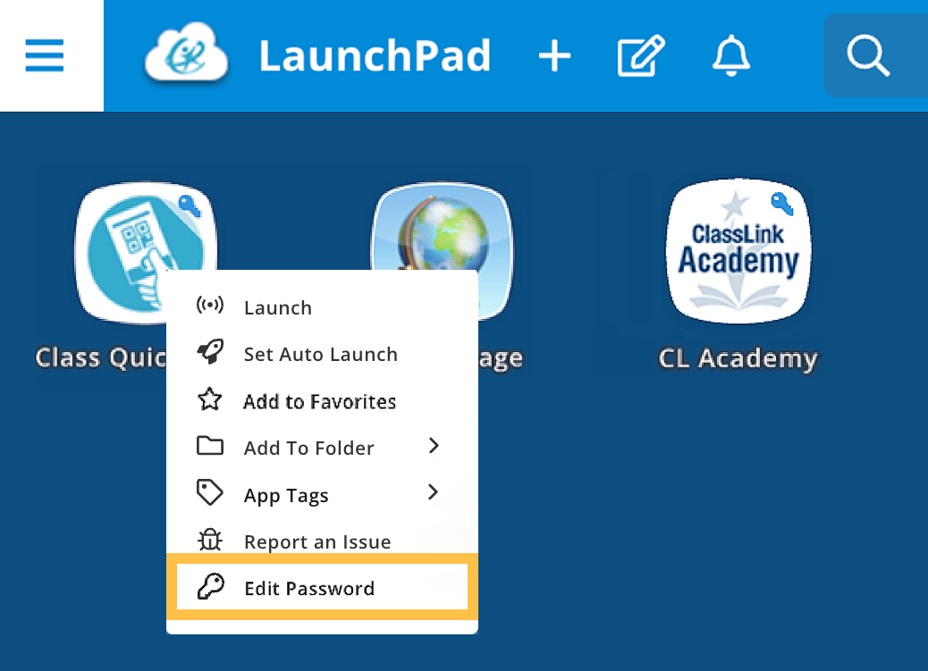
App Passwords In LaunchPad
Notes:
Speaker Notes:
You can also edit your password in LaunchPad. Simply right-click an app and select Edit Password, click the edit icon,
and change your password.
Resources
https://vimeo.com/1065603485/c922ca2883?share=copy&fl=cl&fe=ci
https://help.classlink.com/s/article/lp-change-app-pw

Slide 22
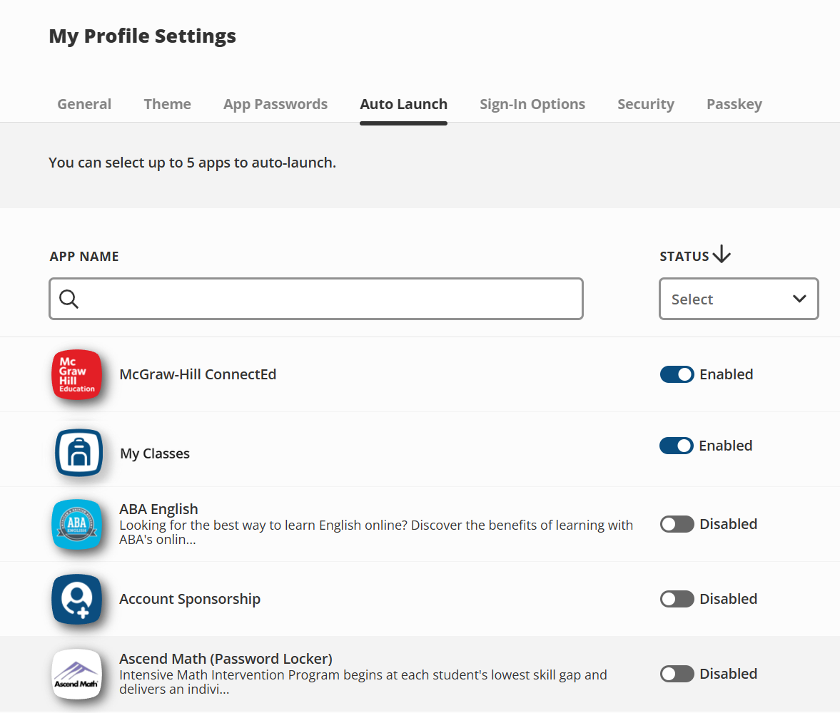
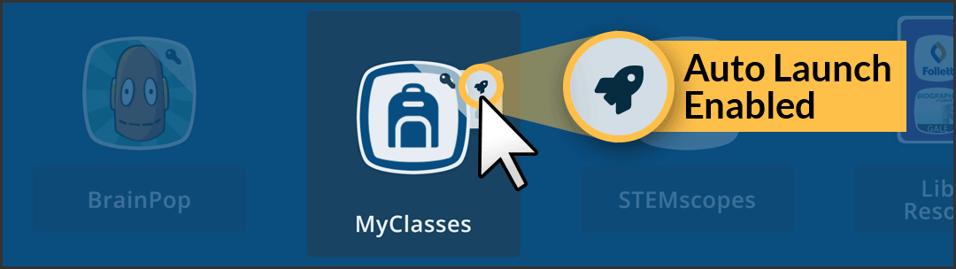
Auto Launch
Notes:
Speaker Notes:
If you want specific apps to open at login, you can set [add number of apps they can launch] apps to auto launch! Select the Auto Launch tab to set your most-used apps to automatically open in new browser tabs each time you log into LaunchPad.
If you want to make sure your app is set to auto-launch, hover over an app, and a rocket icon will display if the auto launch is set.

Slide 23
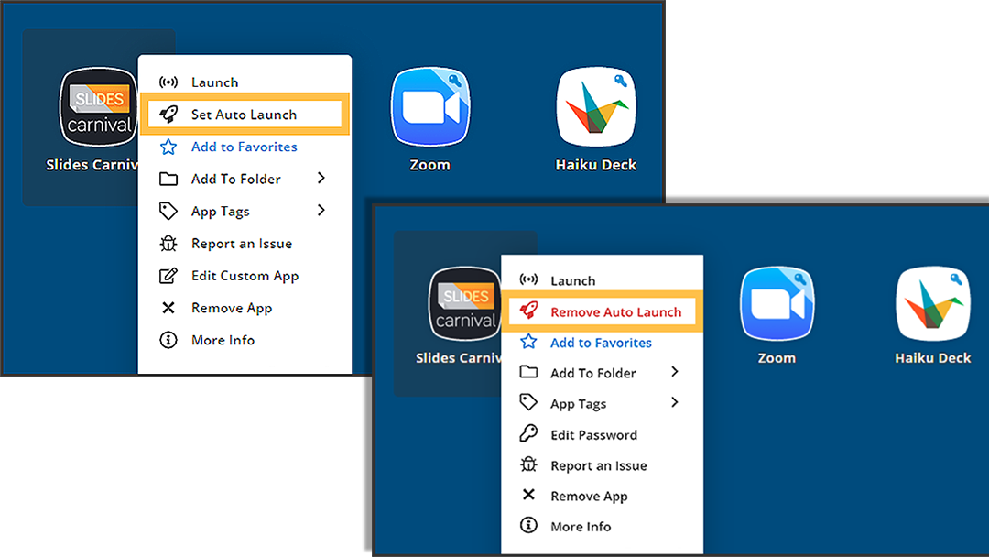
Set Auto Launch In LaunchPad
Notes:
Speaker Notes:
You can also set Auto Launch directly from your LaunchPad home page. Once in LaunchPad, right-click an app and select Set Auto Launch. Next time you log in to LaunchPad, it’lll open in a new tab.
If you want to make sure your app is set to auto-launch, hover over an app, and a rocket icon will display if auto launch is set.
Resources
https://vimeo.com/986399811

Slide 24
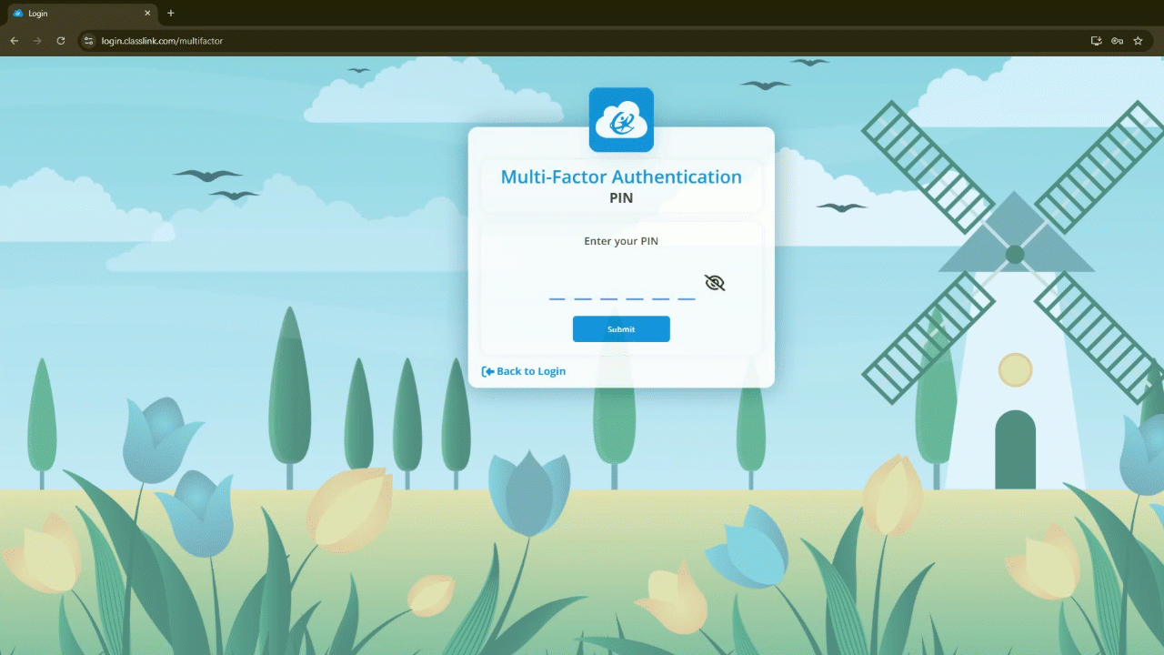
Auto Launch In Action
Notes:
Speaker Notes:
Here’s what the auto-launch feature looks like in action.
Resources
https://vimeo.com/986399811

Slide 25
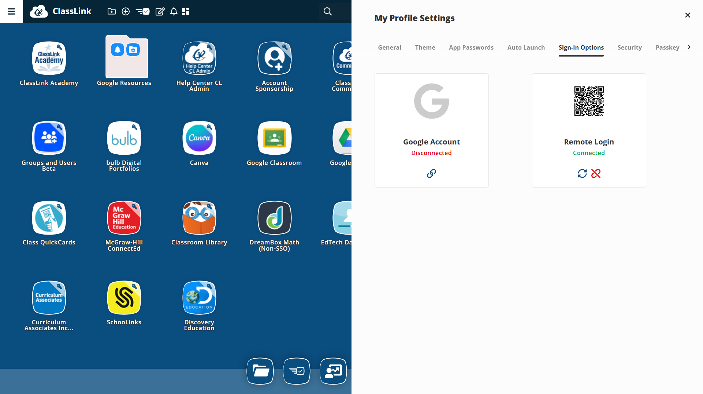
Login Options
Notes:
Speaker Notes:
Let’s talk about your Login Options. You may see options for AD (Active Directory), Microsoft, or Google.
The most important thing to remember here is redundancy. It’s highly recommended that you connect multiple sign-in methods to avoid losing access to your account. For example, if Microsoft is your primary login but their service goes down, having Google linked as a backup ensures you can still get into your dashboard without any downtime.
RECOVERY: Please make sure your recovery options are up to date! You can set up a mobile phone number or a personal email address under your profile. This is your safety net. If you ever forget your password, these tools allow you to get back into your account quickly and securely.

Slide 26

Multi-Factor Authentication (MFA)
Notes:
Speaker Notes:
Multi-factor authentication, or MFA, adds an extra layer of security to your accounts. Even if a password is compromised, a second verification step helps protect access. That matters because your accounts often connect to systems and information we need to keep secure. Security may not be flashy, but it’s one of the quiet heroes of a strong school day.

Slide 27
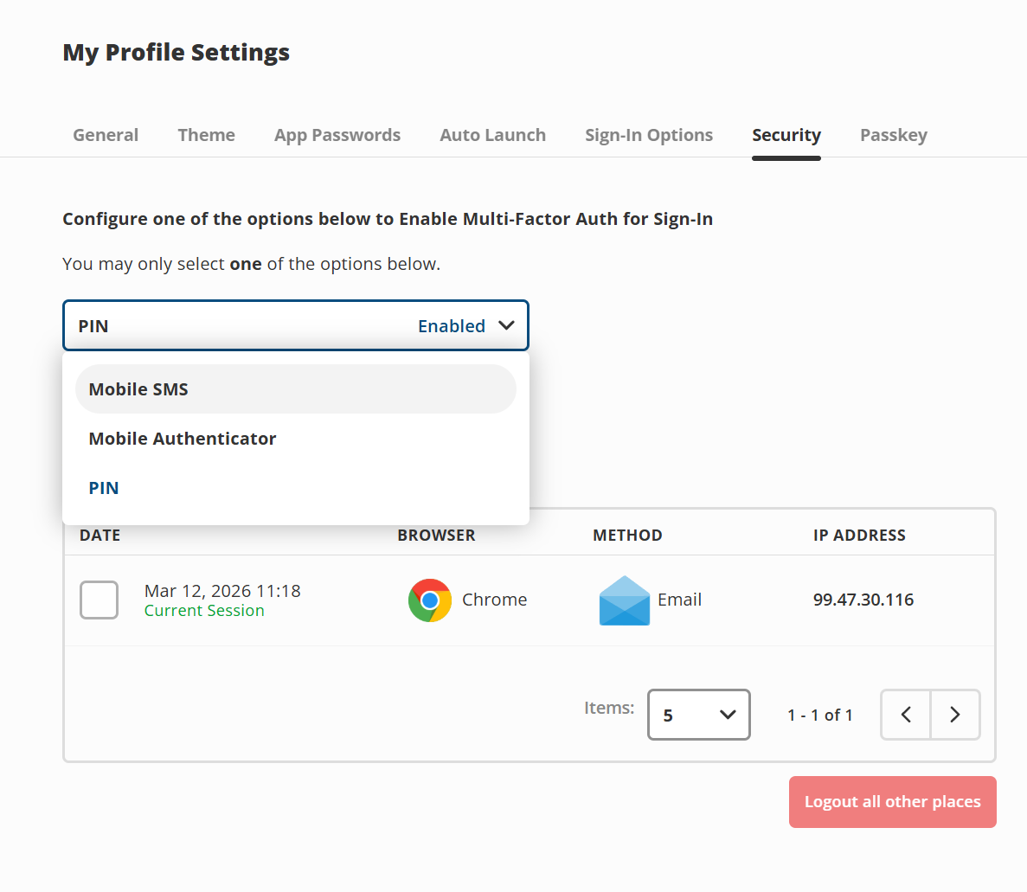
MFA Set Up
Notes:
Speaker Notes:
In the Security tab you can set up MFA. The goal is simple: protect accounts without making login feel impossible. Once this is in place, it becomes part of a safer routine. This extra step can prevent larger problems later.
Resources:
https://help.classlink.com/s/article/six-digit-pin-mfa
https://help.classlink.com/s/article/changing-your-multi-factor-authentication-method
https://help.classlink.com/s/article/lp-mfa-yubikey-setup

Slide 28
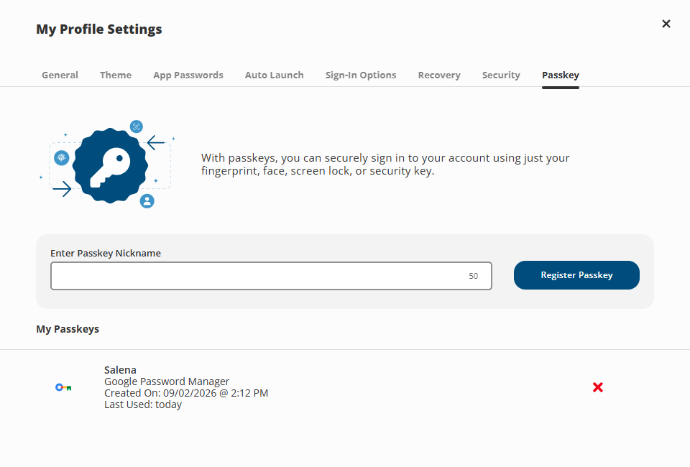
Passkey
Notes:
Speaker Notes:
The Passkey feature is a powerful alternative to traditional passwords. It acts as both your login and your MFA. You can sign in quickly using your device’s PIN, biometric scanner, or fingerprint, which keeps your account safer than a standard password would. You’re able to set up multiple passkeys for different devices. This means a smooth and secure login every time you access LaunchPad.
Resources
https://vimeo.com/1161452070/cf053fe2b8?share=copy&fl=sv&fe=ci
https://help.classlink.com/s/article/launchpad-create-manage-passkeys

Slide 29
App Organization
Notes:
Speaker Notes:
Next, let’s shift from access to organization. A clean workspace helps you move faster and helps students get to the right place with less confusion.

Slide 30
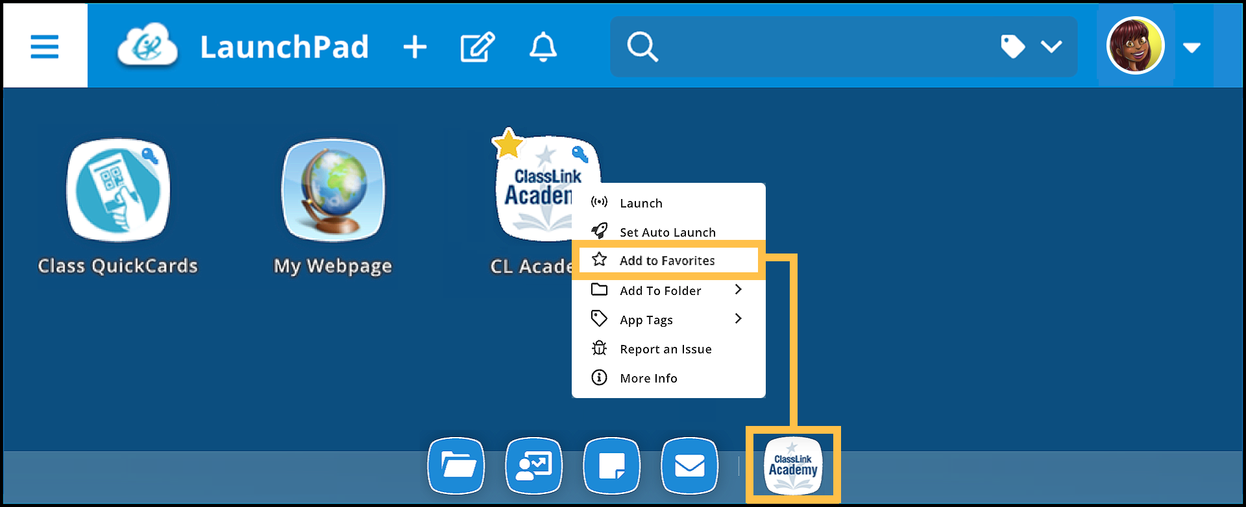
Favorite Apps
Notes:
Speaker Notes:
Favorites are great for the apps you use most often. Right-click the app and select Add to Favorites. When you add an app to the Favorites bar, it stays within easy reach at the bottom of the screen and displays a star on the app. I recommend that you place their core tools there first. Think daily use, not every possible use. Your future self at 7:42 a.m. will appreciate it.
Resources
https://vimeo.com/1066647521/d1ec901218
https://help.classlink.com/s/article/lp-home-favorites

Slide 31
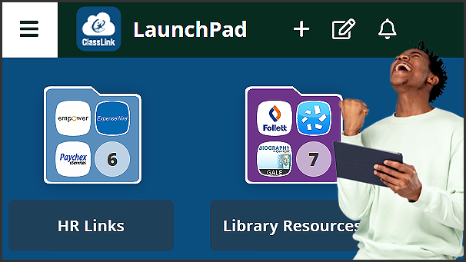
Create App Folders
Notes:
Speaker Notes
Folders help turn a crowded screen into a more organized workspace. You can group apps by subject, role, task, or time of day. That might mean folders for attendance, planning, reading, math, or intervention tools.
Resources
https://vimeo.com/1062533278/7bcfb2b94d

Slide 32
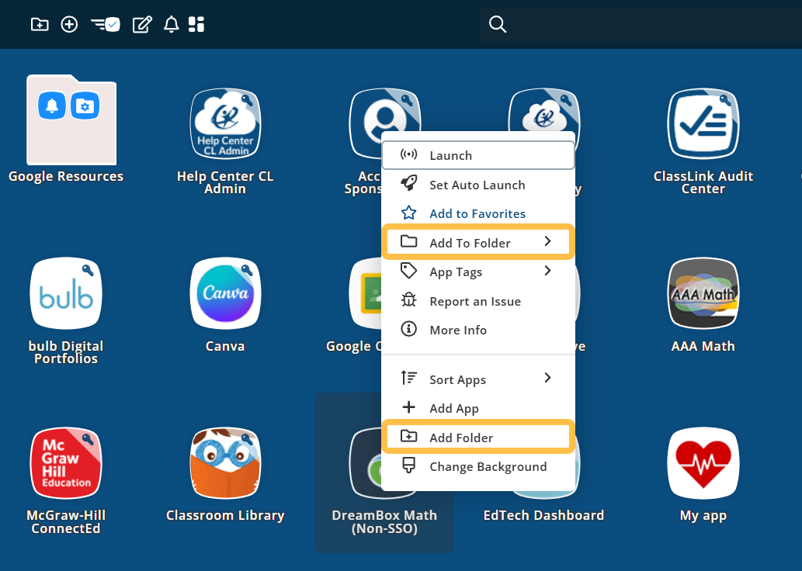
Create App Folders
Notes:
Speaker Notes
Creating folders is simple: right-click the app and add it to a folder, OR create a new folder on the spot, and LaunchPad will automatically tuck that app inside for you.
Resources
https://vimeo.com/1062533278/7bcfb2b94d

Slide 33
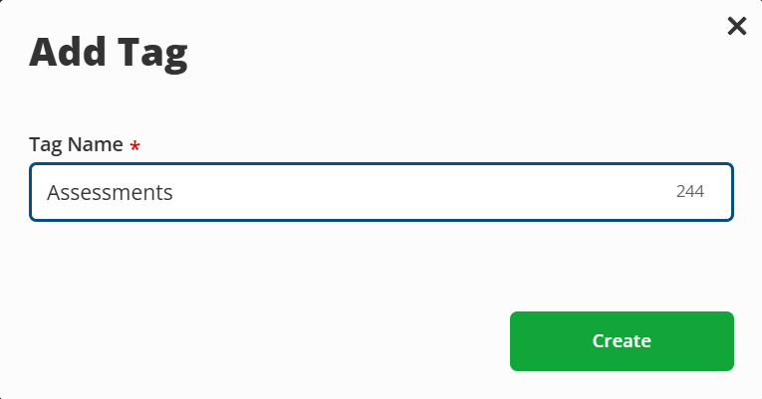
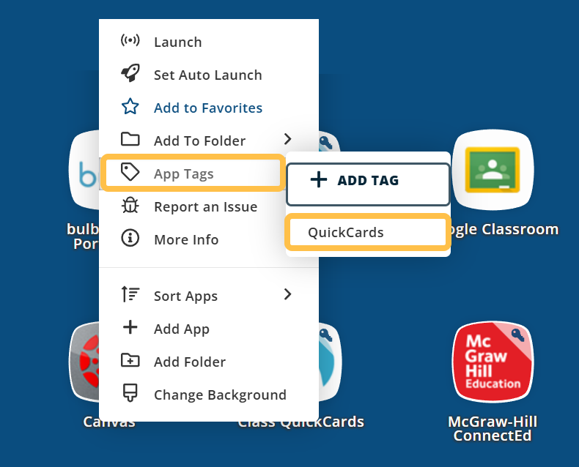
App Tags
Notes:
Speaker Notes:
Tags add another way to organize apps, especially for those of you with a lot of digital tools. You can label apps by class, task, or team and then filter more quickly when needed. This is a smart option for anyone who supports multiple groups or grade levels. It mitigates the classic moment of, “I know that app is here somewhere.”
Resources
https://help.classlink.com/s/article/lp-home-tags
https://vimeo.com/1062851168/9c15f9a16b?share=copy&fl=cl&fe=ci

Slide 34
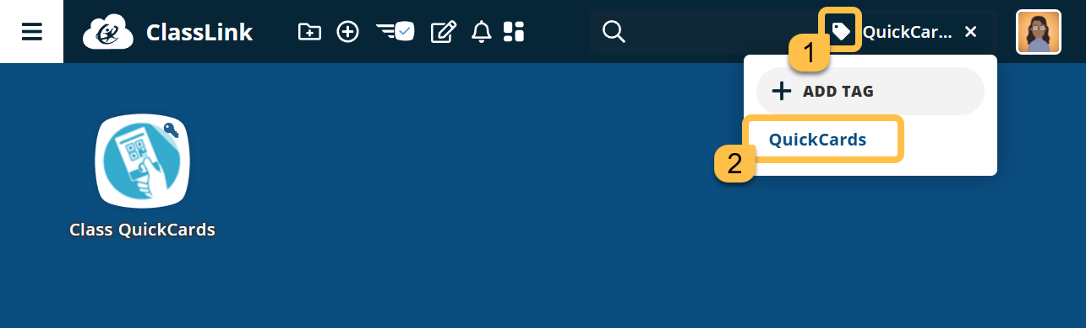
Access Your App Tags
Notes:
Speaker Notes:
Once tags are created, click the tag icon and select the tag name. All the apps that have that tag will display.

Slide 35
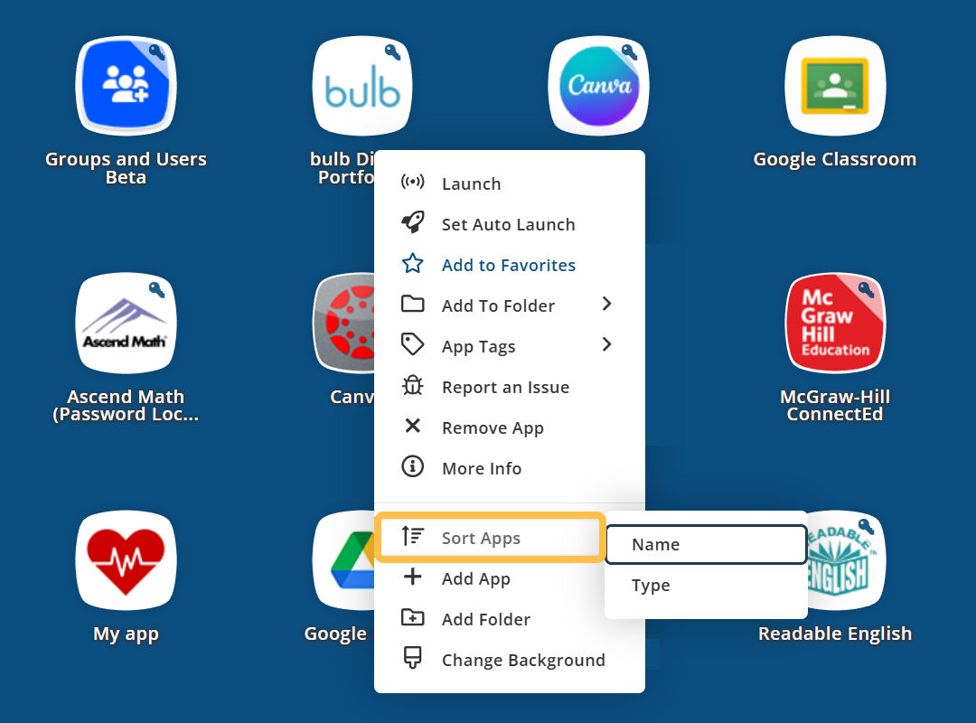
Sort Apps
Notes:
Speaker Notes:
If you want to organize your apps by name or type, right-click an app or anywhere on the LaunchPad background to access the Sort Apps menu option.

Slide 36
Add Your Own Apps
Notes:
Speaker Notes:
Now let’s look at how you can expand LaunchPad with apps you use regularly. This helps you build a workspace that fits your actual day.

Slide 37
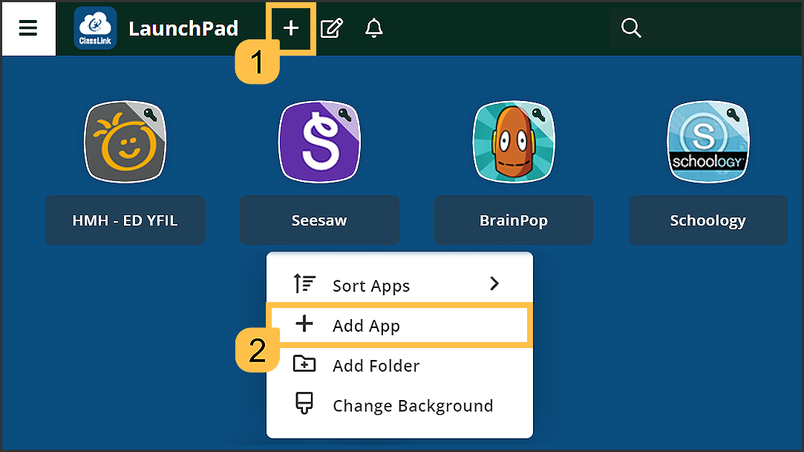
Add Apps
Notes:
Speaker Notes:
We provide you with some great apps, but you may want to add your own. When you need a new tool, start with the App Library.Click the plus icon in your toolbar, search by keyword, and add an app from approved options.
You can also add apps by right clicking in your LaunchPad and selecting Add Apps.
Resources
https://vimeo.com/942350140/e5b213429e
https://help.classlink.com/s/article/lp-home-app-library

Slide 38
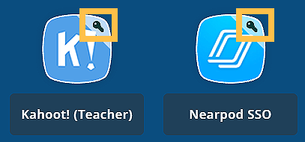
App Passwords
Notes:
Speaker Notes:
When you add a new app, it may ask for credentials. Once those are saved, the app will show a key icon to indicate credentials are attached. This makes future access much easier and reduces repeat login steps.
Resources
https://vimeo.com/984859457/d5946a3d99
https://help.classlink.com/s/article/lp-change-app-pw Edit Password locker

Slide 39
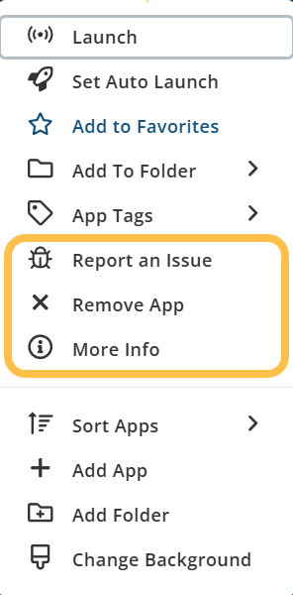
Right-Click
Notes:
Speaker Notes
When you click an app, you can also report an issue with that app, remove it, and learn more about it.

Slide 40
My Classes & QuickCards
Notes:
Speaker Notes:
Now let’s focus on tools that help you guide students more directly and make access quicker and simpler.

Slide 41
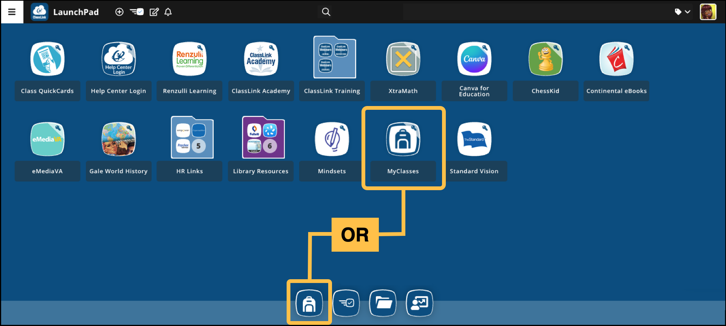
My Classes
Notes:
Speaker Notes:
My Classes gives students one central place to find class apps, updates, and resources. For you, it adds management tools that support instruction and communication. You can post announcements, review class information, and print QuickCards from one area. This helps create a clearer digital path for students and reduces the number of places they need to check.
Resources
https://vimeo.com/1062524922/3ec73b592b
https://help.classlink.com/s/article/My-Classes

Slide 42
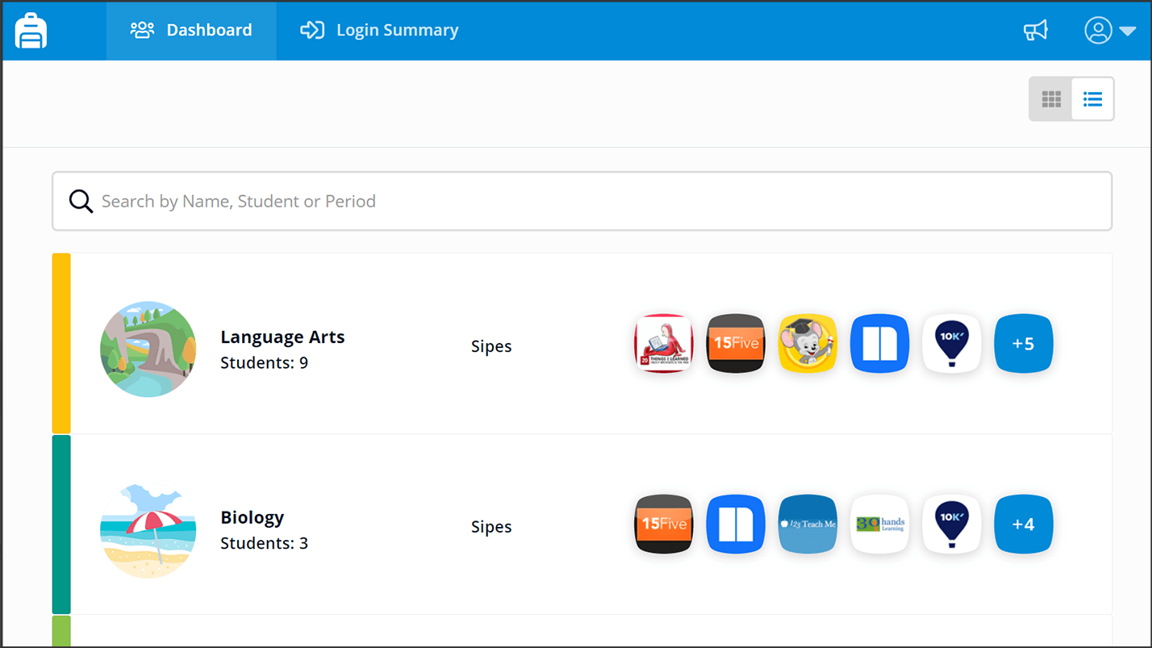
My Classes
Notes:
Speaker Notes:
Your My Classes Dashboard is your class hub for all your scheduled classes where you are the instructor of record. Your Dashboard provides a top-level view of the number of students enrolled in each class and the number of apps the class uses. You can also add apps in My Classes.
Resources
https://vimeo.com/822157765 - add apps with password locker in My Classes

Slide 43
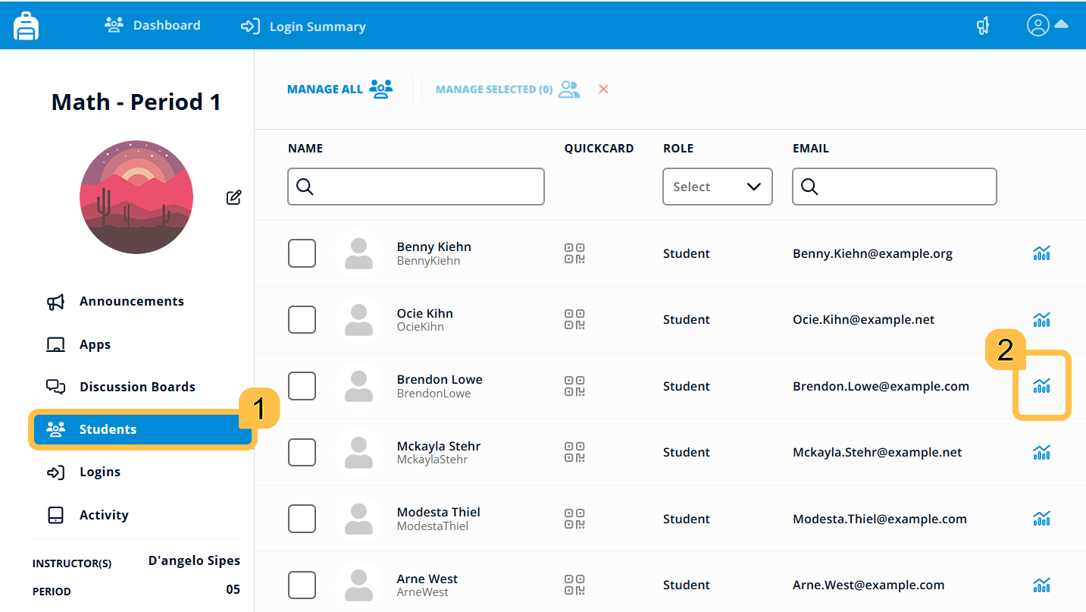
My Classes Analytics
Notes:
Speaker Notes:
My Classes Analytics gives you insight into student access and activity. You can review login history, digital resource use, and user details to help spot patterns.
This can support problem solving when a student says they could not get in or when a team wants to check access habits. Data does not replace teacher judgment, but it sure can back it up.

Slide 44
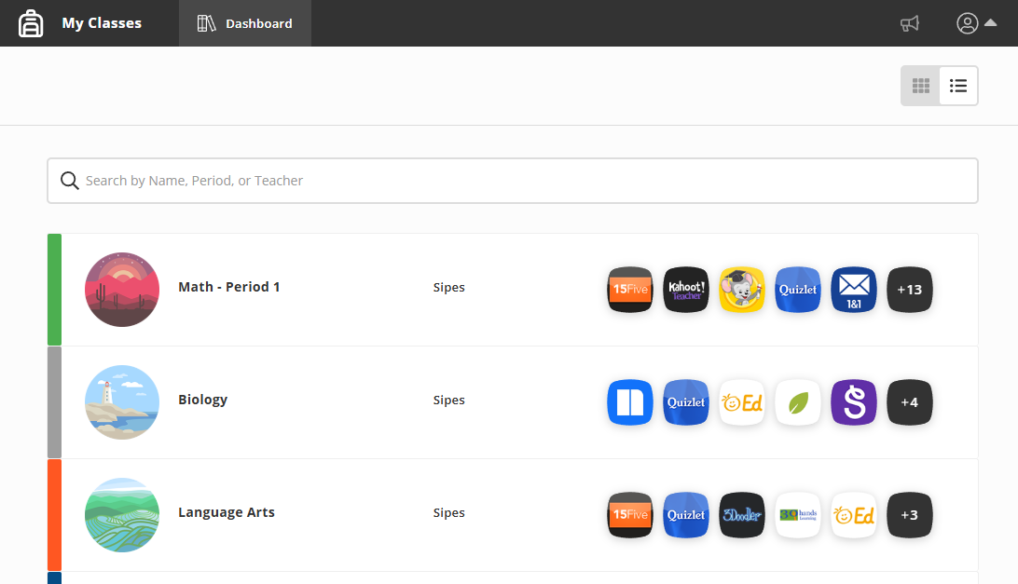
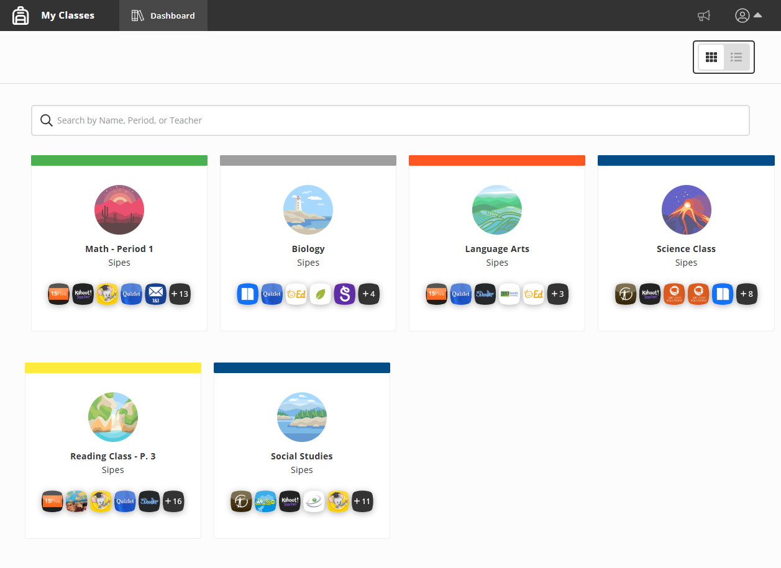
My Classes: Student View
Notes:
Speaker Notes:
While the student List View matches your own, their Tile View is designed for simplicity. Instead of administrative data like enrollment numbers, students see app icon previews and a clear count of their assigned tools.
By opening a class tile, students can find exactly what they need without asking, “Where do I click?” This streamlined path reduces startup interruptions, minimizes confusion, and saves more time for actual learning.
Resources
https://help.classlink.com/s/article/My-Classes

Slide 45
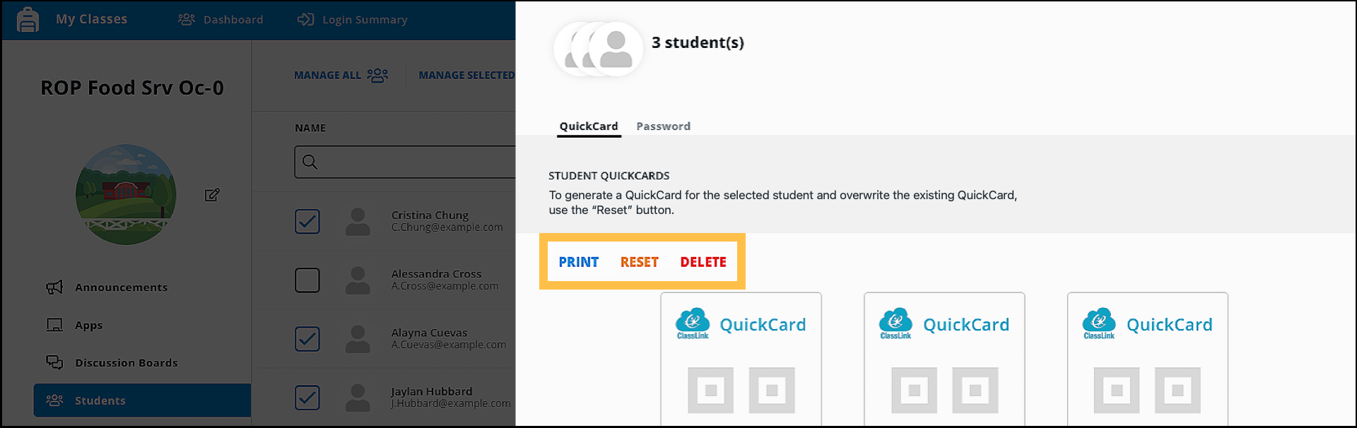
QuickCard Management in My Classes
Notes:
Speaker Notes:
One of the best time-savers in My Classes is the ability to manage QuickCards directly. You have three main controls here:
Print handles the physical cards;
Reset is your go-to if a student loses their QuickCard. It creates a brand-new code and instantly deactivates the old one for security;
Delete is there for when a student no longer needs card access.
Just a quick pro-tip: students have to sign in with their full username and password at least once before the system can generate a QuickCard for them.
Resources
https://vimeo.com/1065510614/0ea96150e1
https://help.classlink.com/s/article/print-quickcards-my-classes
https://help.classlink.com/s/article/generating-class-quickCards

Slide 46
Accessibility & Help Tools
Notes:
Speaker Notes:
We’ll wrap with two practical support tools to help make access easier and get help faster when something isn’t working.

Slide 47
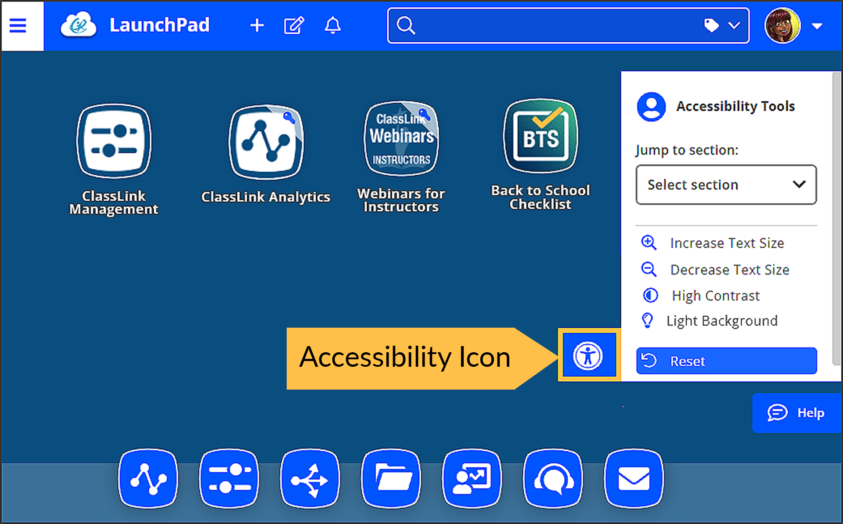
Accessibility
Notes:
Speaker Notes:
LaunchPad includes built-in accessibility tools that staff can open from the toolbar. Options like font size and high contrast can support a more usable experience for a wide range of learners.
Resources
https://help.classlink.com/s/article/launchpad-accessibility-features

Slide 48
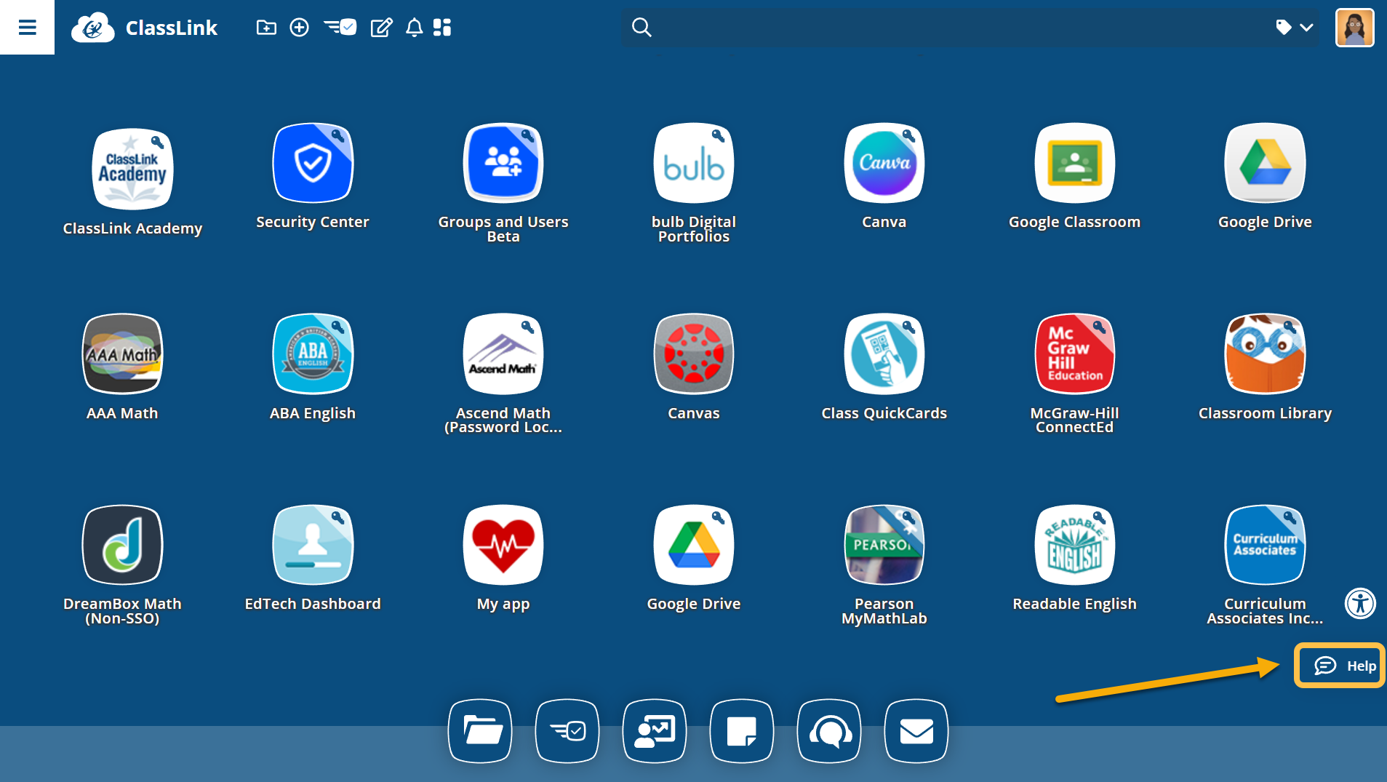
Help Tool
Notes:
Speaker Notes:
You can also easily ask for support. Click the help icon and let us know what you need help with. Your help ticket will go to our IT team, and they’ll reach out to you.
Resources
https://help.classlink.com/s/launchpad-home

Slide 49
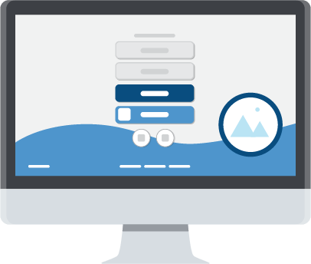

Recap
Open tools from one place
Organize once and save time daily
Use My Classes to guide students
Launch from one home page instead of scattered bookmarks.
Use favorites, folders, tags, and auto launch to reduce clicks.
Keep apps, updates, and QuickCard workflows closer together.
Notes:
Speaker Notes:
Let’s recap the big idea. LaunchPad works best when it supports instruction instead of stealing time from it. One home page can replace scattered bookmarks. A little organization can reduce daily clicks. A clearer student path can cut startup questions. Those are the habits worth remembering. The goal is not to use every feature. The goal is to make school technology feel easier to manage.

Slide 50
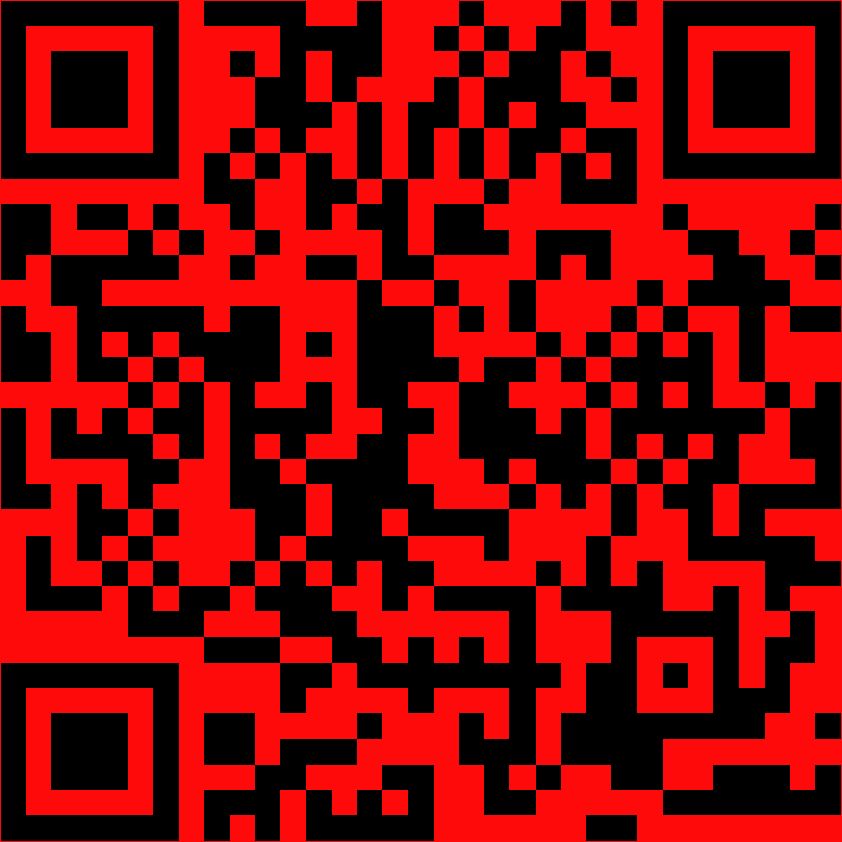
Thank You
Notes:
Replace the QR with one of your own that takes learners to a survey to gain feedback on their presentation.

