Slide 1



















TRAVEL SEASIDE
PRESENTATION

Slide 2










TITLE HERE
We use well-known development methodologies to create a customized approach for each of the projects. This allows us to achieve high quality outcomes and full transparency towards.

Slide 3







STEP HERE
We use well-known development methodologies to create a customized approach for each of the projects. This allows us to achieve high quality outcomes and full transparency towards. We use well-known development methodologies to create a customized approach for each of the projects. This allows us to achieve high quality outcomes and full transparency towards.

Slide 4






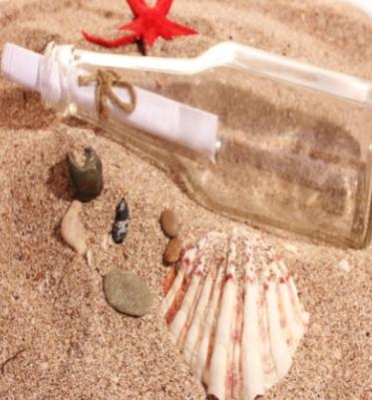



STAGE HERE
We use well-known development methodologies to create a customized approach for each of the projects. This allows us to achieve high quality outcomes and full transparency towards.

Slide 5





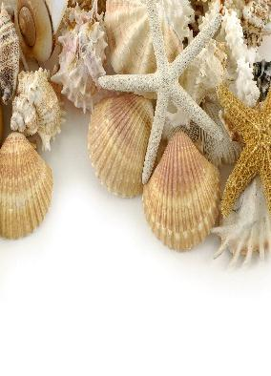



OPTION HERE
We use well-known development methodologies to create a customized approach for each of the projects. This allows us to achieve high quality outcomes and full transparency towards.

Slide 6







TITLE HERE
We use well-known development methodologies to create a customized approach for each of the projects. This allows us to achieve high quality outcomes and full transparency towards.

Slide 7









STEP HERE
We use well-known development methodologies to create a customized approach for each of the projects. This allows us to achieve high quality outcomes and full transparency towards. We use well-known development methodologies to create a customized approach for each of the projects. This allows us to achieve high quality outcomes and full transparency towards.

Slide 8








STAGE HERE
We use well-known development methodologies to create a customized approach for each of the projects. This allows us to achieve high quality outcomes and full transparency towards.

Slide 9








OPTION HERE
We use well-known development methodologies to create a customized approach for each of the projects. This allows us to achieve high quality outcomes and full transparency towards.

Slide 10






TITLE HERE

Slide 11






STEP HERE
We use well-known development methodologies to create a customized approach for each of the projects. This allows us to achieve high quality outcomes and full transparency towards.

Slide 12








STAGE HERE
We use well-known development methodologies to create a customized approach for each of the projects. This allows us to achieve high quality outcomes and full transparency towards.

Slide 13






OPTION HERE
We use well-known development methodologies to create a customized approach for each of the projects. This allows us to achieve high quality outcomes and full transparency towards.

Slide 14




TITLE HERE
We use well-known development methodologies to create a customized approach for each of the projects. This allows us to achieve high quality outcomes and full transparency towards.

Slide 15






STEP HERE
We use well-known development methodologies to create a customized approach for each of the projects. This allows us to achieve high quality outcomes and full transparency towards.

Slide 16





STAGE HERE
We use well-known development methodologies to create a customized approach for each of the projects. This allows us to achieve high quality outcomes and full transparency towards.

Slide 17









OPTION HERE
We use well-known development methodologies to create a customized approach for each of the projects. This allows us to achieve high quality outcomes and full transparency towards.

