Slide 1

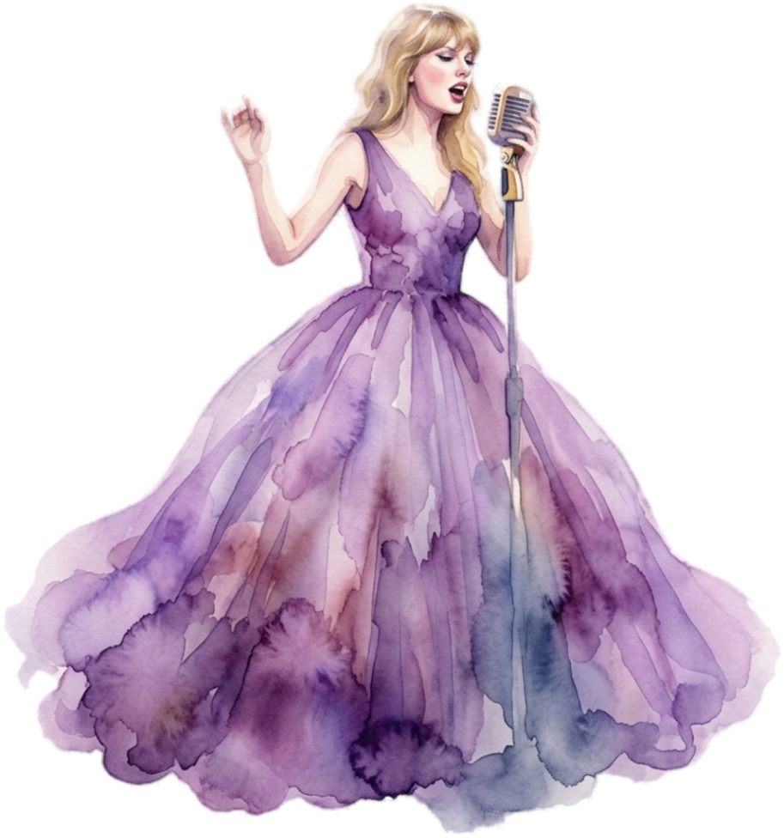



Free Presentation Template
EaTemp

Slide 2


Welcome
Welcome to the world of fantasy! Join us on a journey to explore the mystical creatures, enchanted lands, and magical wonders that exist beyond our reality. Discover the wonders and secrets of this exciting realm and unlock the power of imagination.
EaTemp

Slide 3

Table of Contents
01
Introduction
The Extraordinary Realm
02
Encounters
Unicorn Sightings
03
Wonders
Wishes Granted
04
Magic
Spellcasting
EaTemp

Slide 4

The Realm of the Extraordinary
Welcome to the Fantasy World, a realm of wonder and enchantment where anything is possible. Here, dragons breathe fire, unicorns prance through meadows, and rainbows shine brightly. This world is a place where wishes come true, where potions can be cursed and spells are cast. It's a place of treasure and adventure, where the impossible becomes possible. But the greatest treasure of all is the one that lies within.
The world of fantasy is a reflection of our deepest desires, our fondest dreams, and our wildest imaginations. It's a place where we can let go of the constraints of reality and explore the boundless possibilities of the human mind. In this introduction, we will delve into the mysteries of this realm, uncovering the magic and wonder that lies within. So come with us and let's embark on a journey through the Fantasy World.
EaTemp

Slide 5
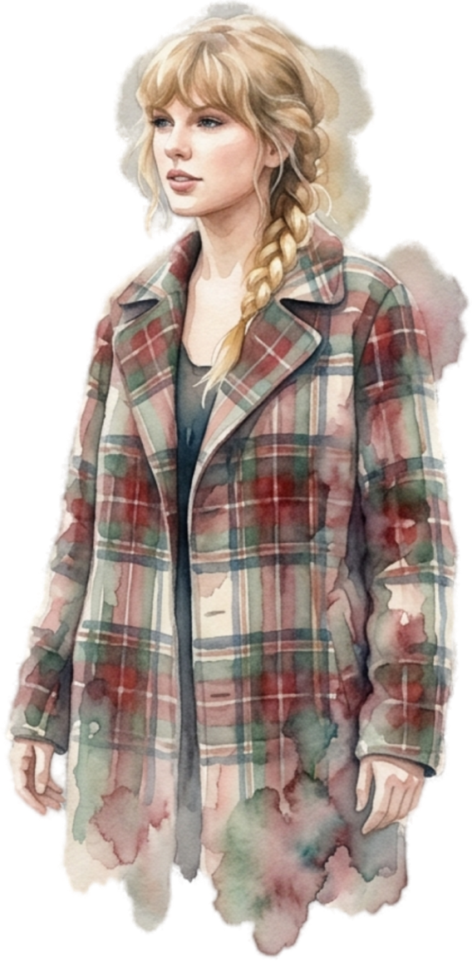


Unicorn Sightings
A record of the number of unicorns spotted in the fantasy realm and the beauty and mystery that surrounds these enchanting creatures.
Dragon Taming
A closer look at the art of taming dragons and the brave adventurers who dare to take on these fearsome creatures.
EaTemp

Slide 6



Dragon Taming
A closer look at the art of taming dragons and the brave adventurers who take on these creatures.
Unicorn Sightings
Unicorn Sightings
A record of the number of unicorns spotted in the fantasy realm and the beauty and mystery.
A record of the number of unicorns spotted in the fantasy realm and the beauty and mystery.
EaTemp
45%
67%
45%

Slide 7
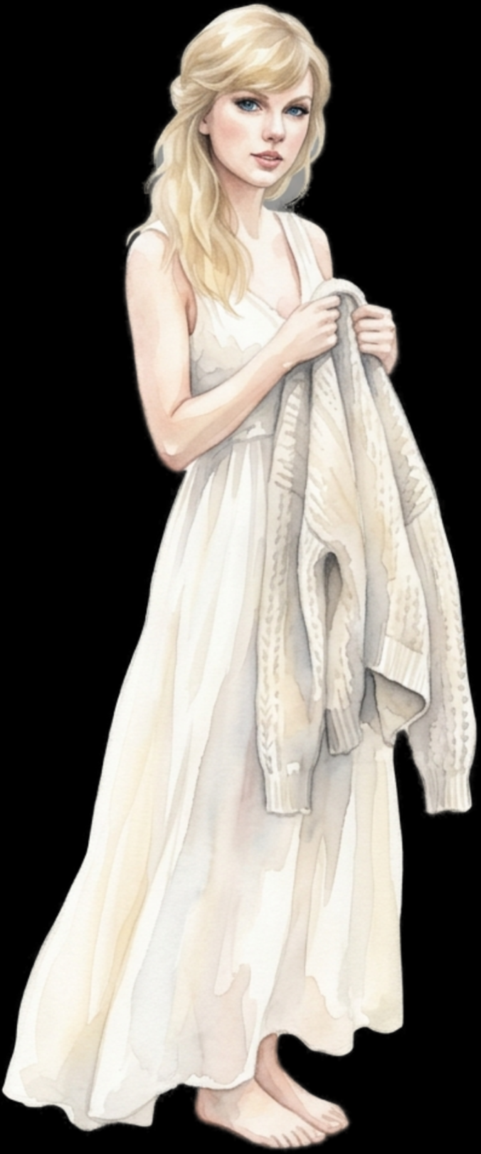

Fantasy is the gateway to the impossible, the land where the ordinary becomes extraordinary, and the impossible becomes possible. It is the realm of the imagination, where anything can happen and everything is possible.
The Dream Weaver
EaTemp

Slide 8
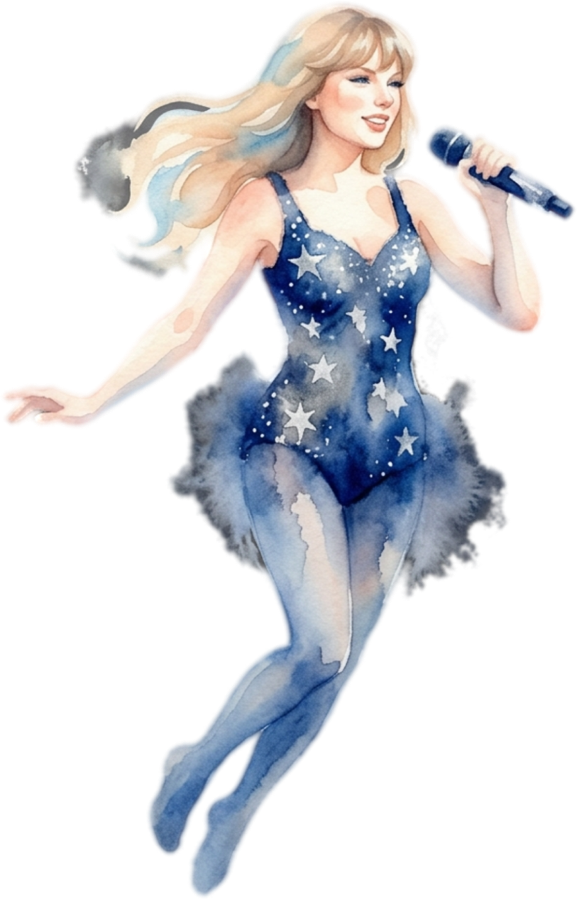
The Art of Unicorn Sighting
Tips and tricks for spotting the elusive unicorns in their natural habitat.
Dragon Taming Technique
A guide to taming and caring for dragons in the realm of magic.
EaTemp

Slide 9



The Magic of Dragons: A Research
Unicorn Sighting
Dragon taming
rainbow seeing
"The Art of Archery": Discover the intricacies of the Art of Archery .
"The Music of the Elves": Immerse yourself in the enchanting music.
"The Life of an Elf": Learn about the customs and daily life of the elves.
EaTemp

Slide 10
S
W
O
T
Eclipse
Obtain
War
Invasion
Rare event causes unpredictable magic.
Humans acquire Crystal
Kingdoms clash in conflict.
Kingdom attacked by monsters.
Quest
Foundation
Transformation
Betrayal
Adventurers seek immortal artifact.
Shimmering City established
Peasant discovers magical powers.
Queen's advisor revealed as spy.
EaTemp

Slide 11

Some Data
75%
Enchanted Creatures
possess the ability to cast spells.
60%
Magic-Wielding Individuals
practice the art of illusions.
90%
Spells Cast
are dark magic, foretelling danger.
EaTemp

Slide 12


234,567
Unicorn Sightings
A tally of the number of unicorns spotted in the fantasy realm.
EaTemp

Slide 13
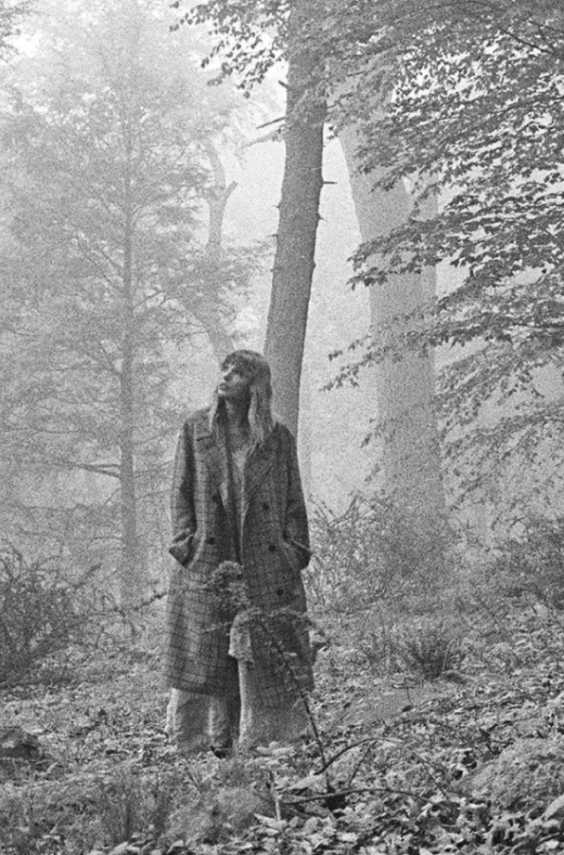
233 Coins
85%
Treasure Found
Wished Granted
456 Hours
535 Km
Duration of Spell Casting
Journey Distance
EaTemp

Slide 14

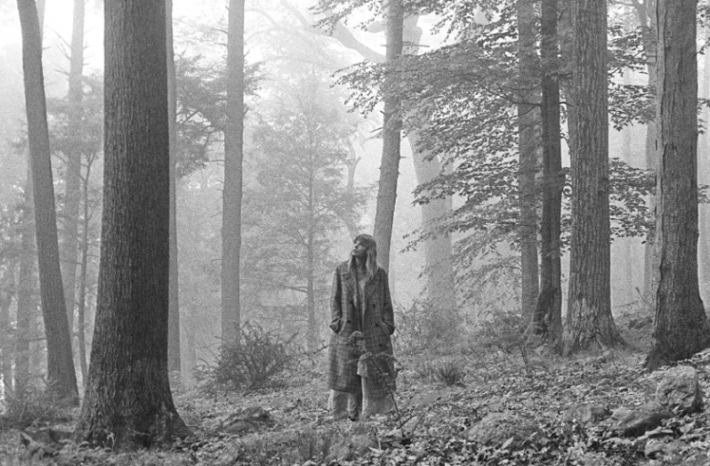
Portal to Adventure
A web application
A web application designed for discovering the world of fantasy
EaTemp

Slide 15


The Future of Fantasy
An mobile app
An app designed for exploring and experiencing the enchanting realm of fantasy
Explore a magical world
Experience fantasy firsthand
Immerse in a realm of magic
Discover untold wonders
Live your fantasy dreams
EaTemp

Slide 16
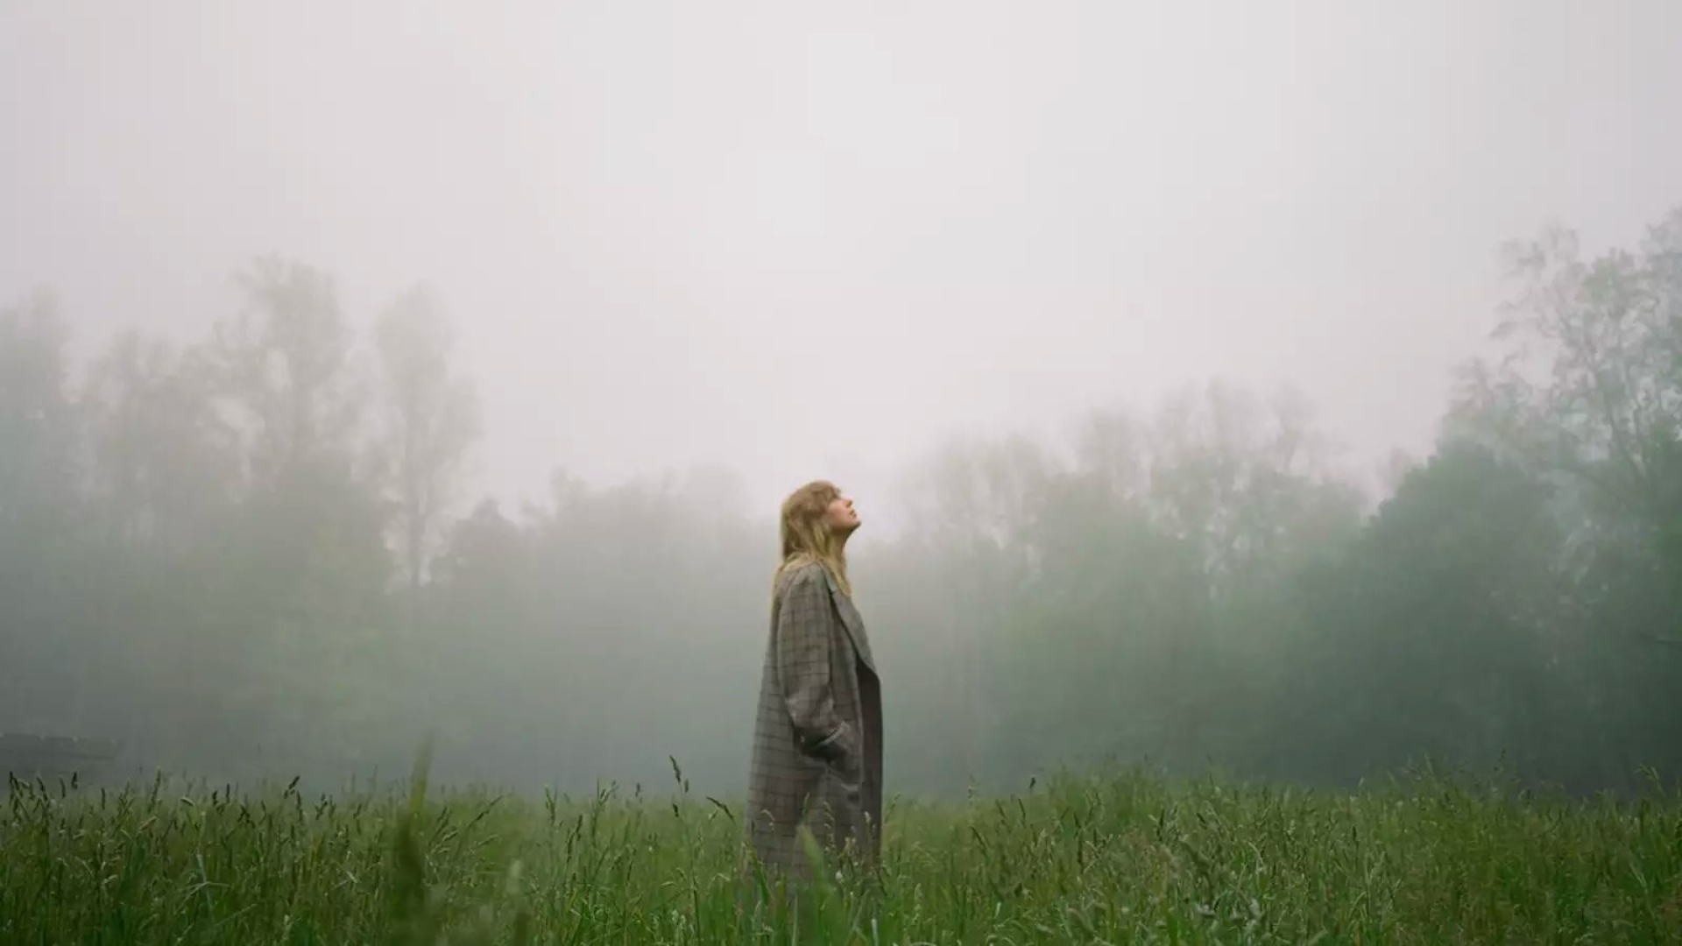
A Magic Picture
EaTemp

Slide 17

1
Discover the secrets
2
Find your own path
Explore the lush, vibrant forest and uncover the mysteries that lie within.
Choose your own path through the forest, and see where it takes you.
3
Meet the creatures
4
Uncover the magic
Encounter the mythical creatures that call the forest home, from talking animals to fairies.
Learn about the powerful magic that pervades the forest and how it affects all who enter.
EaTemp

Slide 18

Fantasy Realm at a Glance
The Enchanted Forest
A magical forest filled with talking animals and enchanted creatures.
The Crystal Caves
A network of underground caves filled with precious gems and crystals.
The Dragon's Lair
A dangerous and mysterious place where dragons reside.
EaTemp

Slide 19



The Information
Spellcasting
Competition
A significant event in the history of the fantasy realm, in which the greatest spellcasters of the realm.
Treasure
Hunt
A significant event in the history of the fantasy realm, in which a massive and awesome treasure hunt was organized.
Great
Adventure
A notable year in the history of the fantasy realm, in which a large number of adventurers set out to explore.
EaTemp

Slide 20




Our Team
Eldruin
Lunaria
The Fire Mage
The Moon Priestess
Elementalen
Eldruin
The Guardian
The Fire Mage
EaTemp

Slide 21
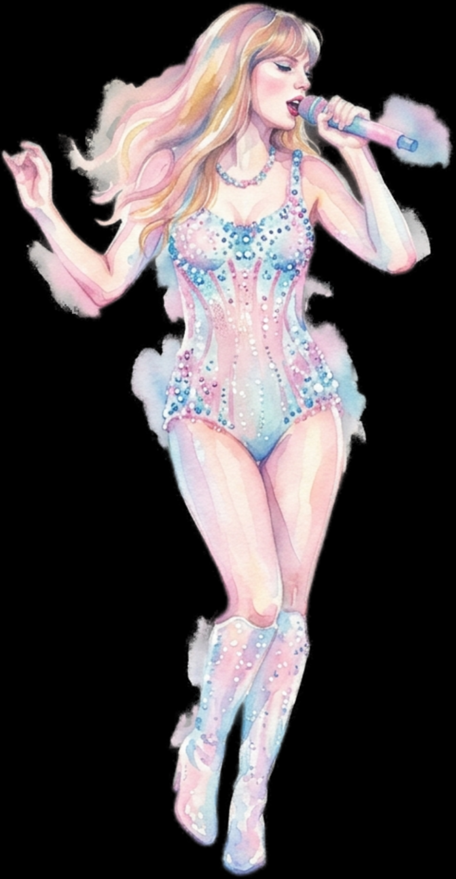
Thank you for choosing EaTemp
We offer free and high-quality slides templates for your presentations. We appreciate you choosing us and hope our templates have been helpful.
As a new website, we rely on your support to grow, so please help us by sharing our site with your friends and colleagues.
EaTemp

