Slide 1

FORMAL FEMININE
The best templates only here.

Slide 2
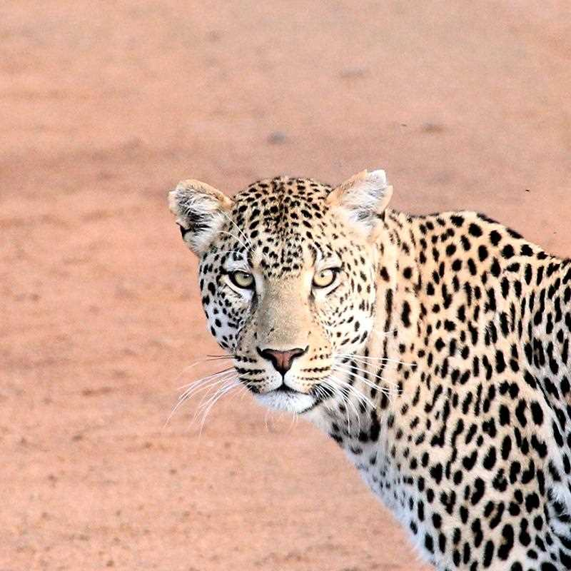
Hello!
I am Linda Gonzales
I am here because I love to give presentations.
You can find me at @username
2

Slide 3
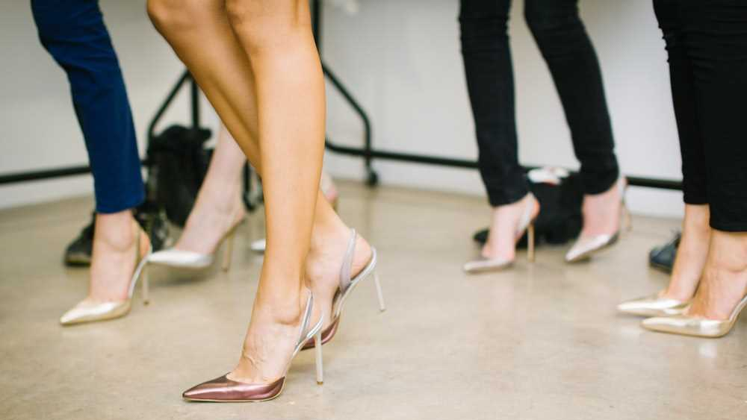
This is your presentation title

Slide 4
1
Transition headline
Let’s start with the first set of slides
4

Slide 5

Benchmarking Examples
One of the best examples that has been carried out in recent years is Starbucks.
Economic instability and the commitment to boost coffee sales by fast food companies such as McDonalds, have led Starbucks to initiate a benchmarking process.

Slide 6
Quotations are commonly printed as a means of inspiration and to invoke philosophical thoughts from the reader.
6

Slide 7
01
Best Practices
Write a small intro about the chapter. Cras nec quam eu neque tempus bibendum. Vestibulum porta metus odio, convallis interdum magna pellentesque tincidunt. Vivamus pellentesque.

Slide 8
This is a slide title
Here you have a list of items
And some text
But remember not to overload your slides with content
Your audience will listen to you or read the content, but won’t do both.
8

Slide 9
Big concept
Bring the attention of your audience over a key concept using icons or illustrations
9

Slide 10

Como Controlar a Asma
É o planeta mais próximo do Sol
É o maior planeta do Sistema Solar
Está cheio de poeira de óxido de ferro
Vênus é o planeta mais quente

Slide 11
In two or three columns
Yellow
Is the color of gold, butter and ripe lemons. In the spectrum of visible light, yellow is found between green and orange.
Blue
Is the colour of the clear sky and the deep sea. It is located between violet and green on the optical spectrum.
Red
Is the color of blood, and because of this it has historically been associated with sacrifice, danger and courage.
11

Slide 12

Plan your project, your weekend or your visits to your parents

Slide 13
02
Best Practices
Write a small intro about the chapter. Cras nec quam eu neque tempus bibendum. Vestibulum porta metus odio, convallis interdum magna pellentesque tincidunt. Vivamus pellentesque.

Slide 14
How does benchmarking work?
Some of the most popular benchmarking methods include:
Peer benchmarking
Companies look at their closest competitors and establish whether their products or services are in-line with what else is being offered in the marketplace.
Best practice benchmarking
Businesses examine the process of the companies that they aspire to be like in their industry, usually those at the cutting edge of their sector. This allows them to compare results, and identify areas in which they can improve their own processes.

Slide 15
A picture is worth a thousand words
A complex idea can be conveyed with just a single still image, namely making it possible to absorb large amounts of data quickly.
15

Slide 16

Want big impact?
Use big image.
16

Slide 17
Three ways to use benchmarking
This compares strategies, business approaches and business models in order to strengthen your own strategic planning and determine your strategic priorities. The idea is to understand what strategies underpin successful companies (or teams or business units) and then compare these strategies with your own to identify ways you can be more competitive.
in order to strengthen your own strategic planning and determine your strategic priorities. The idea is to understand what strategies underpin successful companies (or teams or business units) and then
Strategic benchmarking

Slide 18
Use charts to explain your ideas
Yellow
Is the color of gold, butter and ripe lemons. In the spectrum of visible light, yellow is found between green and orange.
Blue
Is the colour of the clear sky and the deep sea. It is located between violet and green on the optical spectrum.
Red
Is the color of blood, and because of this it has historically been associated with sacrifice, danger and courage.
White
Gray
Black
18

Slide 19
Mother and Baby Infographics
40 %
20 %
Mercury
Venus
Mercury is the closest planet to the Sun
It’s the second planet from the Sun
30 %
10 %
Saturn
Mars
It’s composed mostly of hydrogen and helium
Despite being red, Mars is actually a cold place

Slide 20
03
Best Practices
Write a small intro about the chapter. Cras nec quam eu neque tempus bibendum. Vestibulum porta metus odio, convallis interdum magna pellentesque tincidunt. Vivamus pellentesque.

Slide 21

Maps
our office
21

Slide 22
What’s the difference between benchmarks and KPIs?
Benchmark
Benchmarks are reference points that you use to compare your performance against the performance of others. These benchmarks can be comparing processes, products or operations, and the comparisons can be against other parts of the business, external companies (such as competitors) or industry best practises. Benchmarking is commonly used to compare customer satisfaction, costs and quality.

Slide 23

89,526,124
Whoa! That’s a big number, aren’t you proud?
23

Slide 24
89,526,124$
185,244 users
100%
That’s a lot of money
And a lot of users
Total success!
24

Slide 25

Efeito nos Brônquios
Vênus
Vênus é o planeta mais quente
Marte
Mercúrio
Marte é um planeta frio
É o planeta mais próximo do Sol
Netuno
Júpiter
É o mais distante do Sol
Júpiter é um gigante gasoso

Slide 26
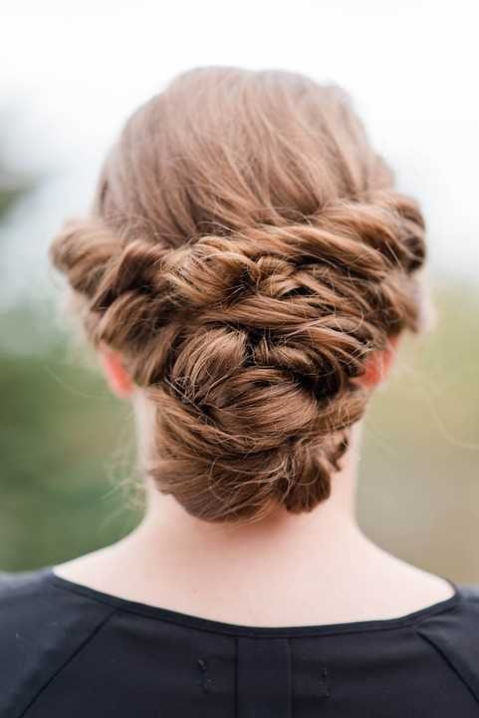
What did they decide to improve to alleviate this situation? One of the vital aspects for its business model is the time of preparation of its coffees. As we have seen before, they needed a leading company to look at to later implement the improvements. The chosen company: the Japanese car manufacturer Toyota. Without a doubt a great example to follow in optimizing the manufacturing time of their products.
Break Slide

Slide 27
Let’s review some concepts
Yellow
Is the color of gold, butter and ripe lemons. In the spectrum of visible light, yellow is found between green and orange.
Blue
Is the colour of the clear sky and the deep sea. It is located between violet and green on the optical spectrum.
Red
Is the color of blood, and because of this it has historically been associated with sacrifice, danger and courage.
Yellow
Is the color of gold, butter and ripe lemons. In the spectrum of visible light, yellow is found between green and orange.
Blue
Is the colour of the clear sky and the deep sea. It is located between violet and green on the optical spectrum.
Red
Is the color of blood, and because of this it has historically been associated with sacrifice, danger and courage.
27

Slide 28

THANKS!
Do you have any questions?
addyouremail@domain.com
+91 620 421 838
Free Template

Slide 29
FUENTE
ELABORADO POR :
plantillaspowerpoint.org
IMAGES :
unsplash.com
pixabay.com
FONTS :
RUBIK

Slide 30
RESOURCES

Slide 31
RESOURCES

Slide 32
Fully Editable Icon Sets: A

Slide 33
Fully Editable Icon Sets: B

Slide 34
Fully Editable Icon Sets: C

