Slide 1
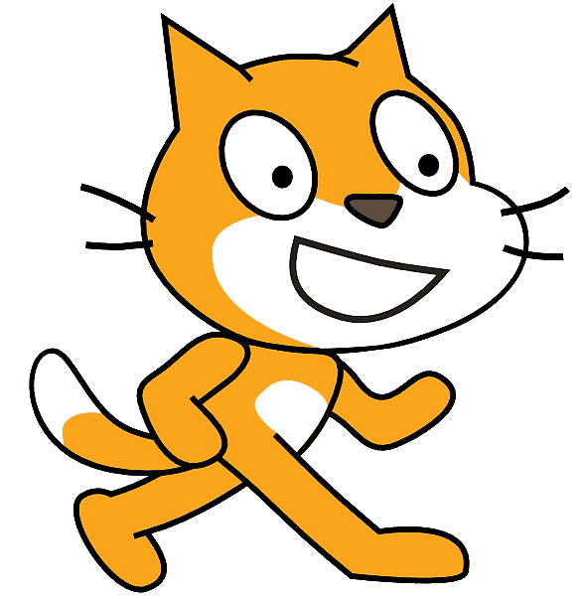


Using Scratch, present at least one concrete action you can take to help achieve the Responsible Consumption and Production goal.
To take on this challenge, you will need to follow certain criteria.
Content of the animation
Your animation or game should include the following elements :
 | at least one concrete action you can take
 | at least one backdrop
 | at least two sprites
 | at least one sound or audio recording
Content of your Scratch program
Your program should include the following elements :
 | motion blocks to animate your sprites
 | at least three speech or thought blocks
 | at least one programming loop
 | Make sure your animation does not exceed a maximum of 4 minutes.
RÉCIT document made available, with exception, according to the terms of the Creative Commons 4.0 License.

Slide 2
Elements related to publication
To publish your project, you should:
 | have a meaningful title followed by Kreocode 20XX (e.g.: I recycle - Kreocode 20XX)
 | use images, photos or sounds that are copyright free (do not use photos of personal information of students)
 | cite any sources used in the space reserved for Notes and Credits
 | pay close attention to your use of language
 | indicate how to start your program in the Instructions section (if it does not start with the green flag)
 | shart the project (* once your project is complete)
RÉCIT document made available, with exception, according to the terms of the Creative Commons 4.0 License.

