Slide 1
Treatment Integrity: A Fundamental Component of PBS
Ronnie Detrich
Wing Institute

Slide 2
Goals for Today
Describe the link between treatment integrity and PBS.
Describe what we know about treatment integrity.
Describe methods for increasing integrity.

Slide 3
Treatment Integrity and PBS
PBS is a data based decision-making approach.
The impact of PBS depends on the effectiveness of specific interventions.
The effectiveness of interventions is a function of the integrity in which they are implemented.

Slide 4
Treatment Integrity and PBS
The quality of decisions regarding an intervention is directly linked with the integrity of implementation.

Slide 5
Outcome
Positive
Negative
Positive
Negative
High
Continue Intervention
Change Intervention
High
Integrity
Low
Unknown reason
Unknown reason
Low
Other life changes?
Unknown intervention?
Intervention is effective?
Intervention problem?
Implementation problem?

Slide 6
What We Know About Treatment Integrity
Most of what we know has been developed at the level of individual student support plans.
In PBS, SET is a measure of treatment integrity at the school level.
Tells us what is happening at the school level but does not address what is happening at the level of the individual classrooms or individual students.
As precision of an intervention increases, the complexity of an intervention increases and integrity decreases.

Slide 7
Relationship between precision and complexity of support plan
Be as precise as necessary but no more.
Individualized support plan
Good Behavior Game
complexity
Catch’em being good
precision

Slide 8
What Do We Know About Treatment Integrity and Student Behavior?
Different levels of integrity result in different levels of student behavior.
(Wilder, Atwell, & Wine, 2006)
High integrity followed by declines in integrity has limited impact on student behavior.
(Northup, Fisher, Kahng, Harrel, & Kurtz, 1997)
Low levels of integrity followed by increases in integrity does not produce the same level of student response as when integrity high from the beginning.
(Groskreutz, Higbee, Groskreutz, 2008)

Slide 9
What Do We Know About Treatment Integrity and Student Behavior?
Implications
Make sure that integrity is high at the beginning of intervention.
It is better to start with high levels of integrity and let it decline than to start with low integrity and try to increase it.
Maximizes impact of intervention.

Slide 10
What Do We Know About Integrity of Interventions at the Universal Level?
Kovaleski, Gickling, Morrow, & Swank (1999)
Evaluated high vs low implementation of Instructional Support Teams (IST).
School-wide organizational change.
Students benefited from IST processes only when implemented with high fidelity.
Implementing with low fidelity resulted in no better outcomes for students than control group not exposed to IST processes.
Having structures in place was not sufficient to assure high fidelity.
Fidelity assessed one time per year.

Slide 11
What Do We Know About Integrity of Interventions at the Universal Level?
Horner (2005)
Effect of high fidelity vs low fidelity on office discipline referrals.
Schools that with high fidelity had 25% fewer office referrals for major rule violations than schools that did not meet fidelity criterion.
Fidelity measures taken 2 times per year.

Slide 12
What We Do Not Know About Treatment Integrity
How much integrity is enough?
Data suggests that more is better.
Is there a point where something less than 100% is just as effective?
Does everyone have to be at high level of integrity or is it sufficient for the group average to be high?
What is the effect of differences between implementers?

Slide 13
What We Do Not Know About Treatment Integrity
How often do we have to assess integrity to assure that it will maintain at high levels?
Does it vary with the complexity of the intervention?

Slide 14
How Do We Increase Treatment Integrity?
The challenge is to find an efficient, low effort method for assuring high integrity.
The most common approach to increasing treatment integrity is staff training.

Slide 15
Effects of Training
OUTCOMES
(% of Participants who demonstrate knowledge, demonstrate new skills in a training setting,
and use new skills in the classroom)
TRAINING
COMPONENTS
Knowledge
Skill
Demonstration
Use in the Classroom
Theory and Discussion
10%
5%
0%
..+Demonstration in Training
30%
20%
0%
…+ Practice & Feedback in Training
60%
60%
5%
…+ Coaching in Classroom
95%
95%
95%
Joyce and Showers, 2002

Slide 16
How Do We Increase Treatment Integrity?
The most common method for assuring high integrity is feedback (Noell, Witt, et al., 2000; Mortenson & Witt, 1998).
Daily feedback improves integrity.
Daily better than weekly feedback.
Likely too resource intensive for large scale implementation.

Slide 17
How Do We Increase Treatment Integrity?
Video Modeling
Teach functional assessment skills (Moore & Fischer, 2007).
Teach problem solving sequence (Collins, Higbee, & Salzberg, 2008).
Video model was brief (3 minutes).
Video model + role play resulted in significant increases over role play alone.
Effects maintained at least 3 weeks.
Promising method for increasing treatment integrity.

Slide 18
How Do We Increase Treatment Integrity?
Job aides (Detrich, 2000)
Support plan pamphlets were developed for multi-component support plan.
Plans were color coded for specific contextual conditions.
Playground, dining room, classroom, etc.
Easily folded and carried by staff.
Plans were posted in the areas for which they were relevant.
Resulted in increases of all elements of support plan.

Slide 19
How Do We Increase Treatment Integrity?
Quizzes (Detrich et al., 2001)
Staff quizzed weekly on elements of multi-component individualized behavior support plans.
Given feedback on quiz but no feedback on actual implementation of support plan.
4 versions of the quiz. One question per element of the plan (student preferences, antecedent interventions, teaching replacement behavior, responding to misbehavior).

Slide 20
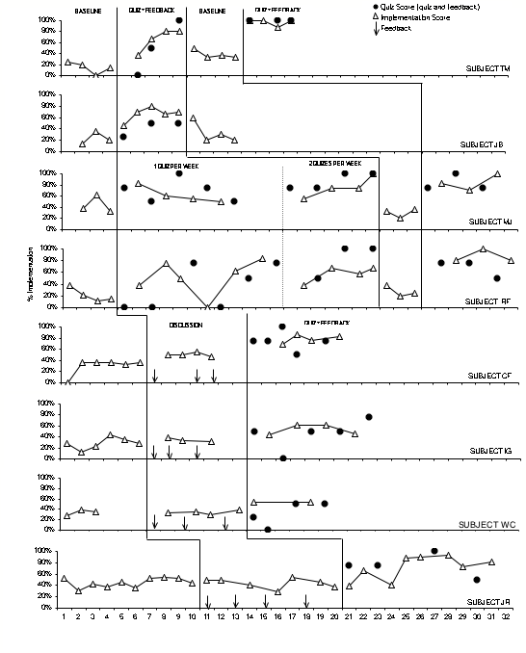

Slide 21
What Have We Learned?
The reviewed methods are promising.
Have not been implemented at large scale.
Most of the research on treatment integrity is addresses multi-component behavior support plans.
Very little research on integrity with academic interventions.

Slide 22
Intervention Acceptability and Treatment Integrity
It has long been assumed that the more acceptable an intervention is the more likely it will be implemented with high integrity.
There is very little data to support this assertion.
In the absence of data, it is wise to select interventions that have high acceptability.

Slide 23
Increasing Acceptability
Acceptability linked to contextual fit.
Select interventions that are
Consistent with the existing culture.
Require relatively little effort.
Require few additional resources.
Address problems that those responsible for implementing are concerned about.

Slide 24
Treatment Integrity and PBS
Regardless of the level of the intervention, it is necessary to know that it was implemented with integrity.
High integrity is necessary in a data based decision making approach.
Integrity should be assessed at the same level that the intervention is being evaluated.

Slide 25
Treatment Integrity and PBS
A program or intervention is a set of protocols that guide behavior of the adult.
If protocols are not followed then by definition the program has not sustained.
PBS is an excellent model for making decisions about when, where, and how to intervene.
Intervention without process for assuring integrity is likely to result in wasted effort.

