Slide 1


Community Health Assessment and Planning: Addressing the Opioid Epidemic
Johns Hopkins Center for Injury Research and Policy
Diné College

Slide 2
How This Lecture Fits Into The Course
This lecture fits into a community health assessment and planning course as it introduces an injury prevention community–based project.
The project involved identifying opioid related deaths as a public health problem, risk factors associated with opioid deaths, and the lecture describes the implementation and evaluation of an intervention.

Slide 3
Part 1: Learning Objectives
In this lecture you will learn an introduction to injury prevention:
Describe injury using the medicine wheel public health model and distinguish intentional from unintentional injuries.
Identify key injury risk and protective factors in American Indian and Alaska Native communities.
Explain how Indigenous and Western approaches can support culturally grounded injury prevention and evaluation.
Notes:
Define injury and/or violence and describe the concepts of intentionality and mechanism as they relate to injury and/or violence.
Describe how injury and/or violence compare with other leading causes of morbidity and mortality and with regard to burdens on the population (e.g. incidence, cost, years of potential life lost, etc.)
Explain how injuries and/or violence are preventable.
Describe the disparity in the risks of injury and/or violence (e.g. differences by age, gender, race, ethnicity, education, location, access to economic resources, access to health care services, sexual orientation, creed, community norms, and the environment).
Describe the influence of a variety of factors (including age, gender, race, ethnicity, education, access to economic resources, sexual orientation, creed, community norms, access to health care services, and the environment) on injury and/or violence prevention.

Slide 4
What are the names of individuals you admire who have worked/do work in public health?
Notes:
The slide has the following question written out: “What are the names of individuals you admire who have worked/do work in public health?” Ask the students to write the names in the chat. This provides a burst of inspiration and activity.

Slide 5
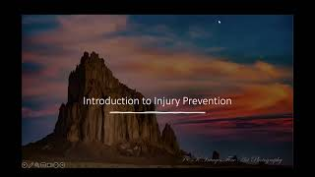
Part 1: Injury 101
Play Recorded Lecture (youtube link)

Slide 6
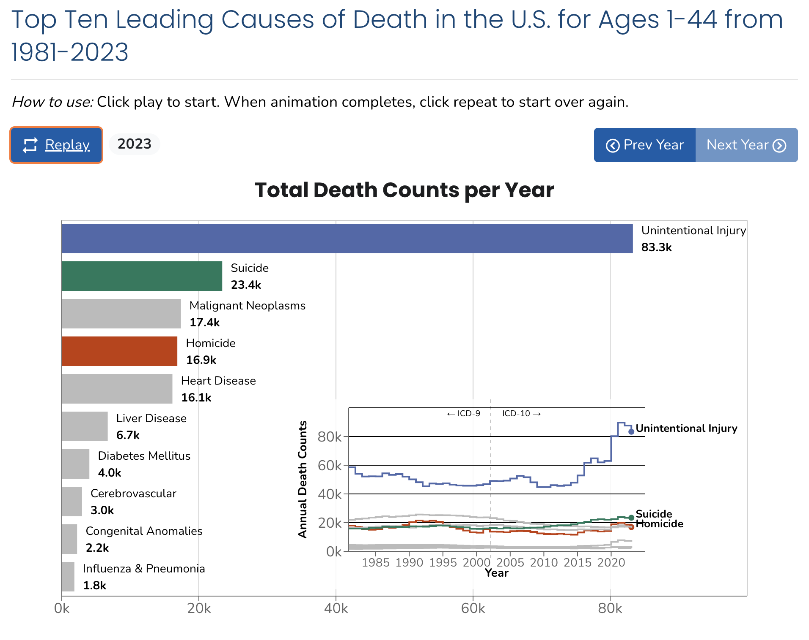
Link to animation:
Injuries and Violence Are Leading Causes of Death
Notes:
Optional activity if there is time. Description in Facilitator Guide.

Slide 7
Part 2: Addressing the Opioid Epidemic
After this lecture, you will be able to:
Describe the assessment process in a public health approach to address the opioid epidemic.
Describe a community-based pilot project to address the opioid epidemic.

Slide 8
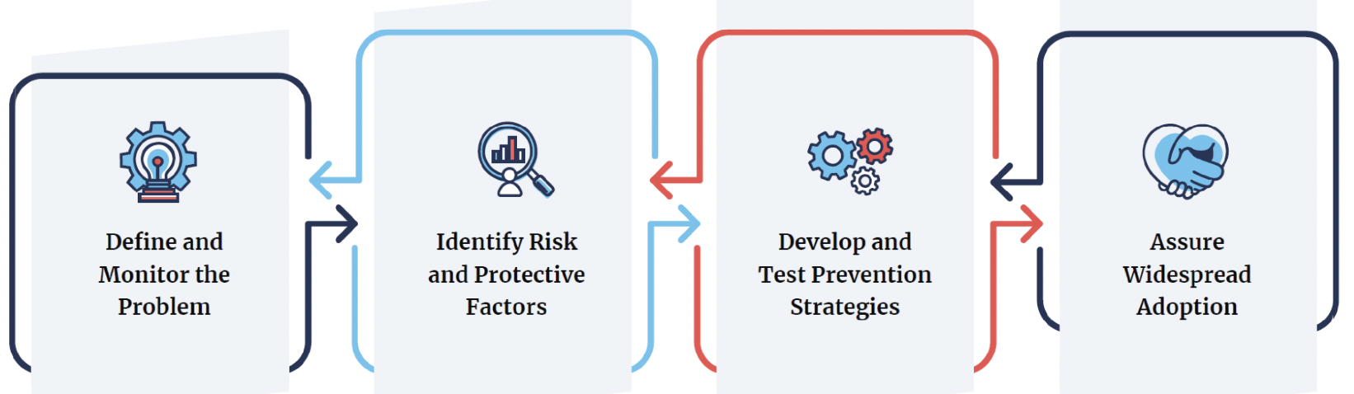
Relevance to the Public Health Approach
Image Sourced From: CDC
Notes:
The slide has the following question written out: “What are the names of individuals you admire who have worked/do work in public health?” Ask the students to write the names in the chat. This provides a burst of inspiration and activity.

Slide 9
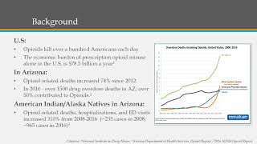
Part 2: Addressing the Opioid Epidemic:
A community-based pilot project in the rural southwest U.S.
Part 2: Addressing the Opioid Epidemic:
A community-based pilot project in the rural southwest U.S.
Play Recorded Lecture (youtube link)

Slide 10
Discussion Questions
What caught your attention in the lectures presented today?
What connections do you see in this lesson to your current course material?
What do you see in your community regarding safe sleep practices?
Notes:
If the class will be going into different break out rooms, post the questions in the chat before initiating the breakout rooms. Inform the facilitators the time allowed and if there will be a person to give a summary of the small group discussion.

