Slide 1
Robocall Campaign
Admin Guide -
October 2022

Slide 2
Prerequisites
Configuration

Slide 3
Prerequisites

Slide 4
Prerequisites <Licenses>
The following licenses are required to enable the Robocall Campaign feature.
Type | License | Mandatory | Optional
Base | Developer | ✅
Add-on | Developer Concurrent Call | ✅
 | Number |  | ✅

Slide 5
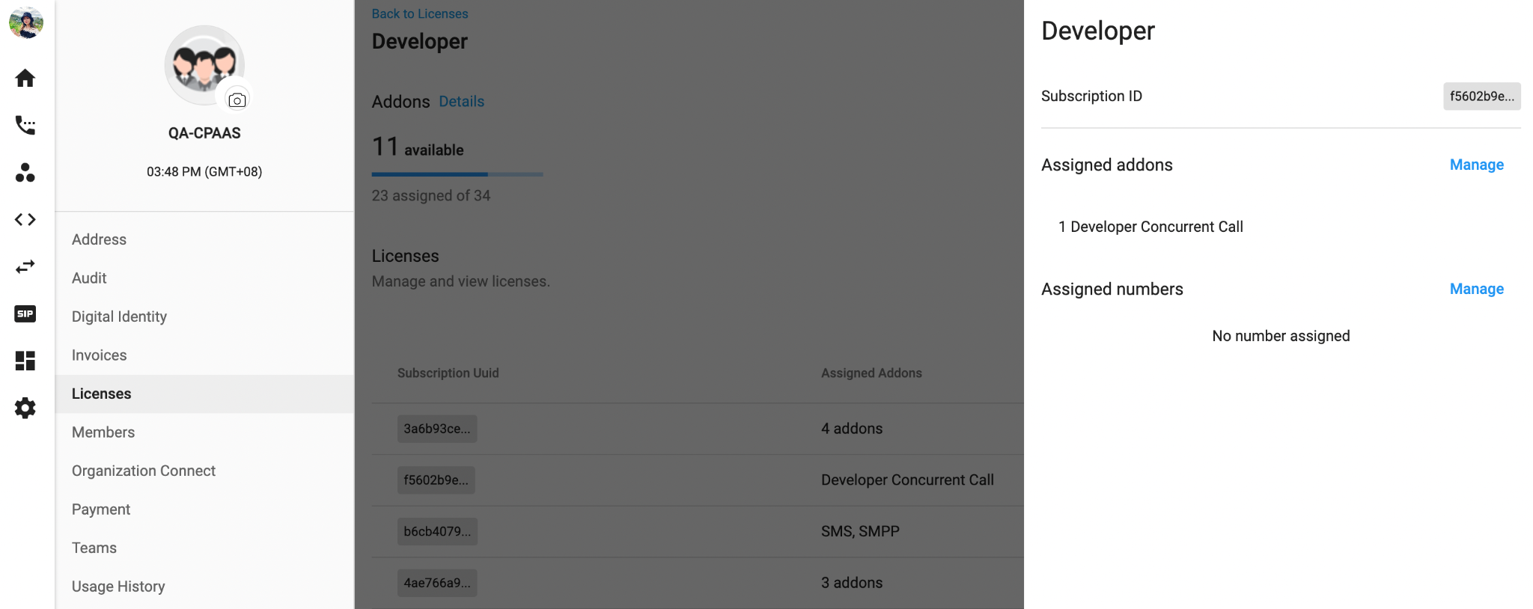
Prerequisites <Assign Licenses>
To assign the Licenses, please follow the steps below:
Go to the License, choose Developer
Select a Subscription that you want to configure
At Assigned addons and numbers, choose:
  Developer Concurrent Call Addon (mandatory)
  Number Addon (optional)
Save

Slide 6
Configuration

Slide 7
Workflow

Slide 8
Robocall Campaign Workflow
3
Recipient 1
1
2
Recipient 2
Developer Hub
Communication Hub
Campaign
Recipient 3
Create Robocall Flow
Select created Robocall Flow
Select Caller ID
Upload Contact List
Start the Campaign
Report
Recipient n

Slide 9
Developer Hub

Slide 10
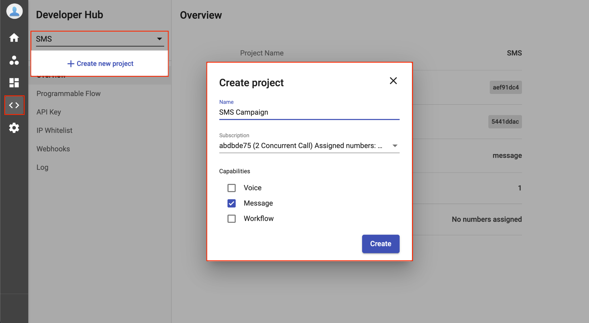
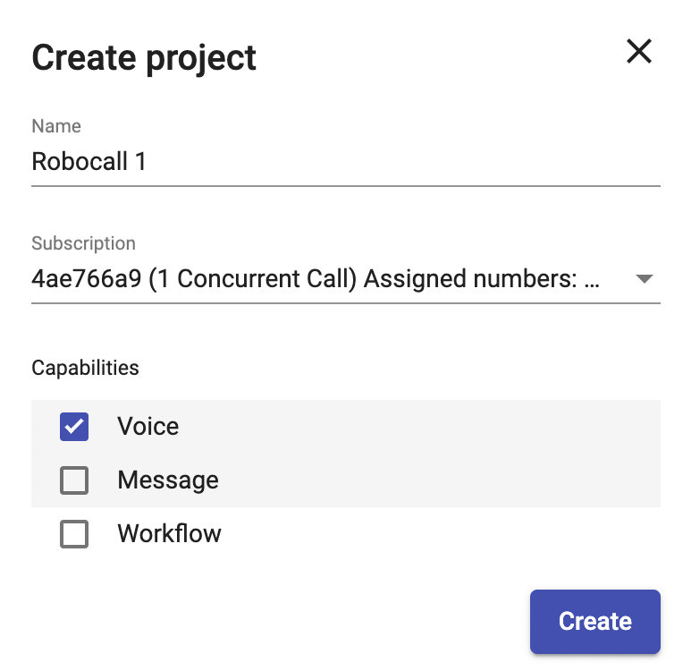
Developer Hub <Create Robocall Project>
At the Developer Hub, follow the steps below to create a new Robocall Project:
Click on the option bar, choose + Create new project
Fill in the Project Name
Select the Base Subscription (the one that you assigned the Robocall addon in the previous step)
Choose Capability - Voice
Create

Slide 11
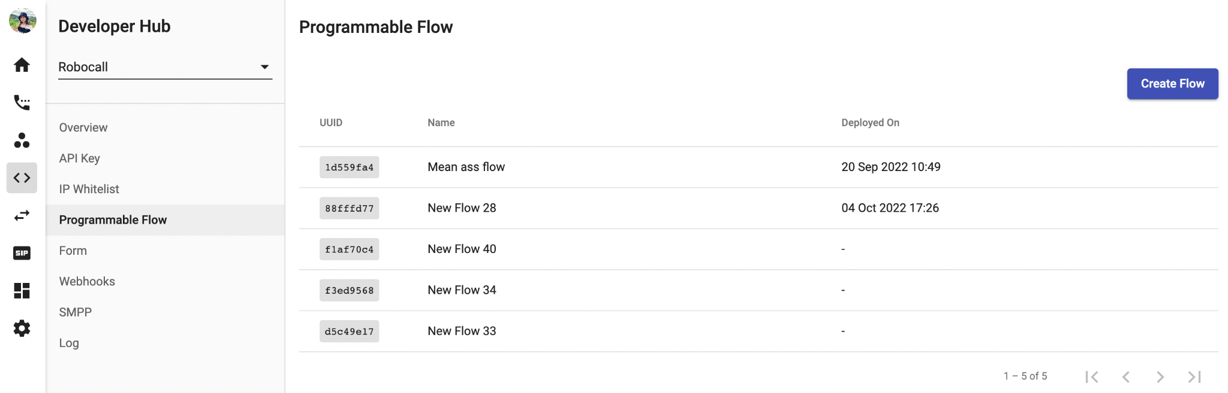
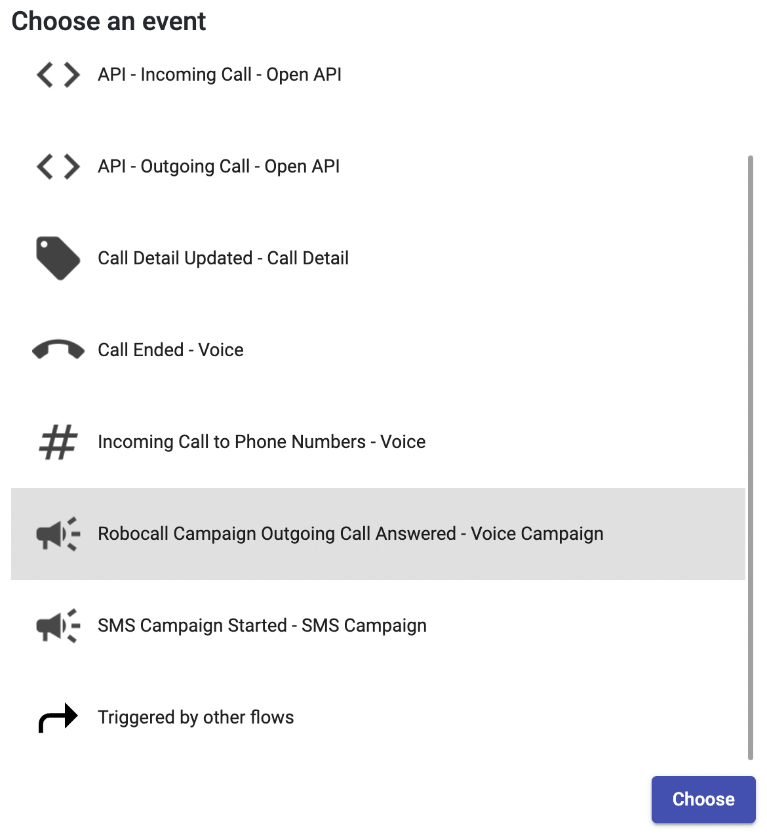
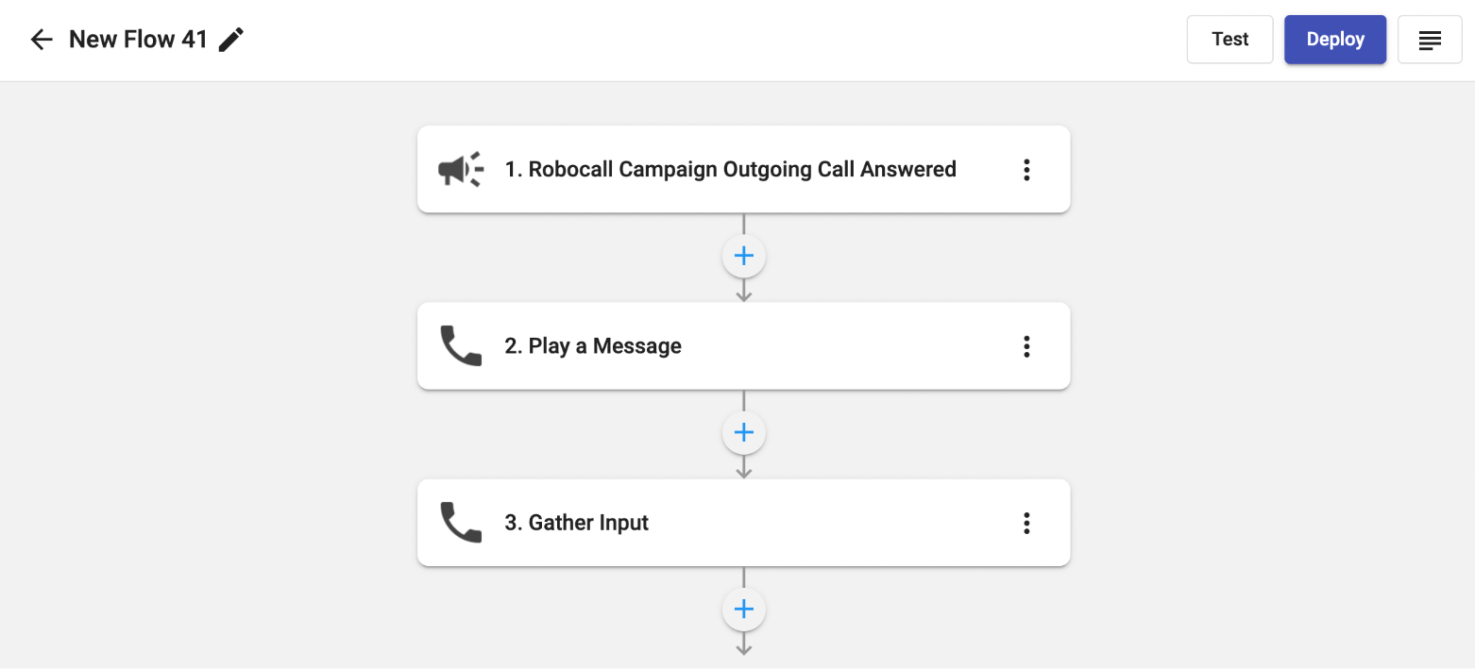
Developer Hub <Create Robocall Flow>
To create the Robocall Flow:
Choose the Programmable Flow tab
Click Create Flow
Select the Event - Robocall Campaign Outgoing Call Answered
Add the Action(s) as you wish
Deploy

Slide 12
Communication Hub

Slide 13
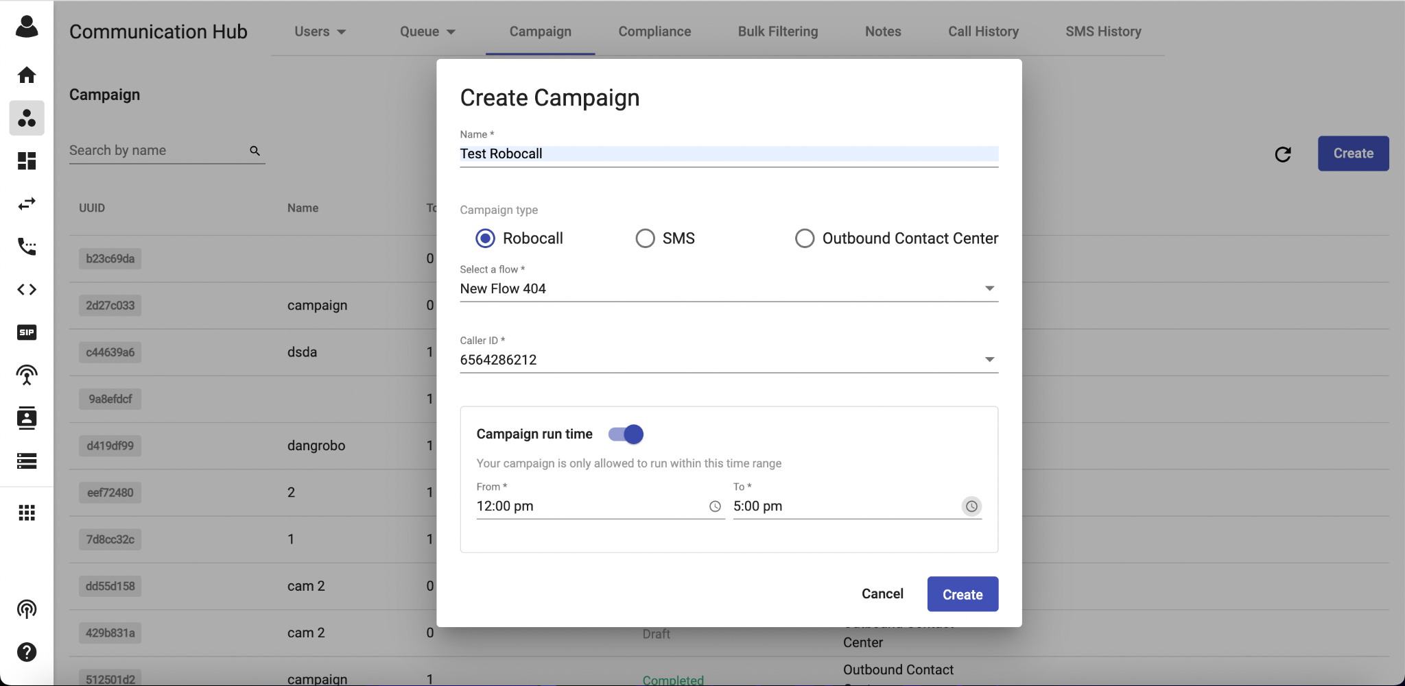
Campaign <Configure a Campaign>
1. Create a new Campaign:
Go to the Communication Hub, choose Campaign tab
Click Create button
Fill in the Campaign Name
Select Campaign Type - Robocall
Choose the appropriate Flow that you have created in the previous step.
Choose Caller ID
Toggle on to set Campaign run time (optional): Your campaign is only allowed to run within this time range.
Create

Slide 14
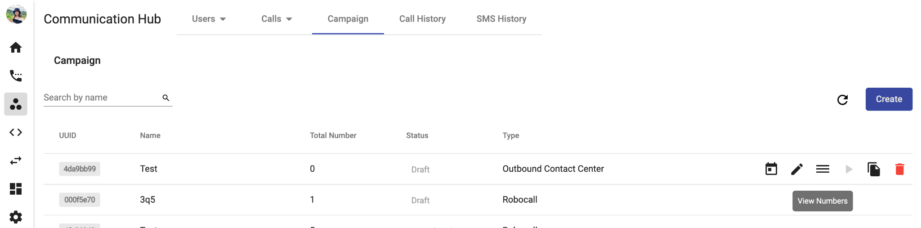
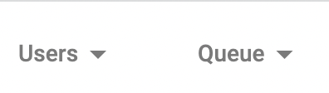

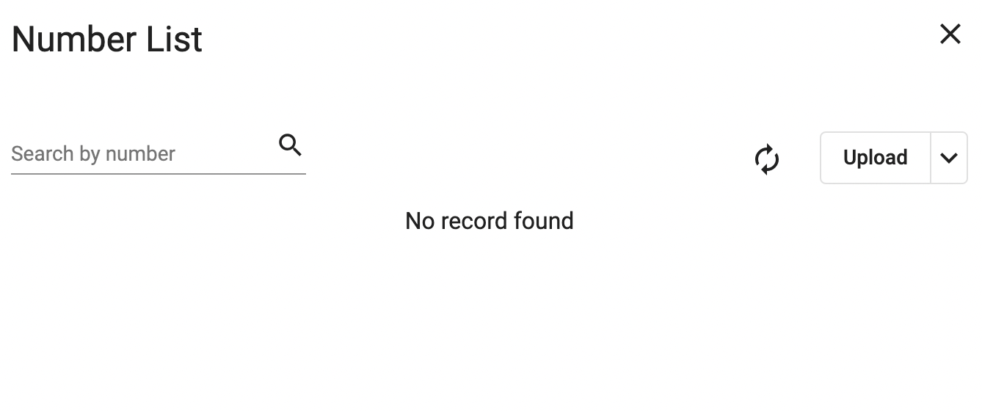
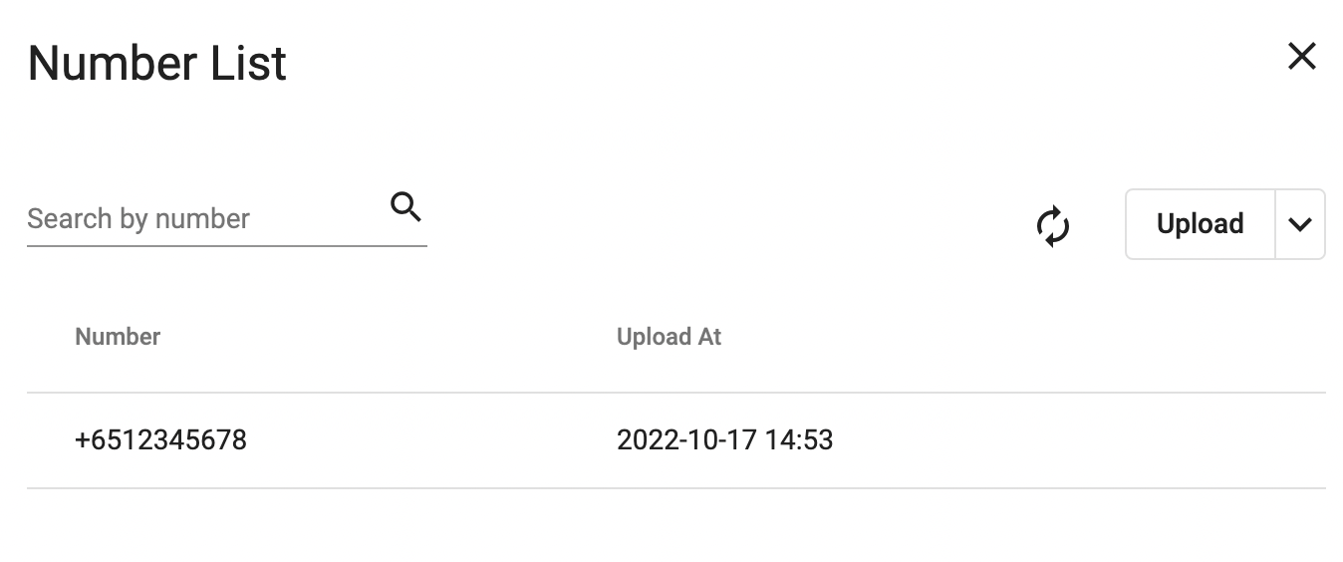
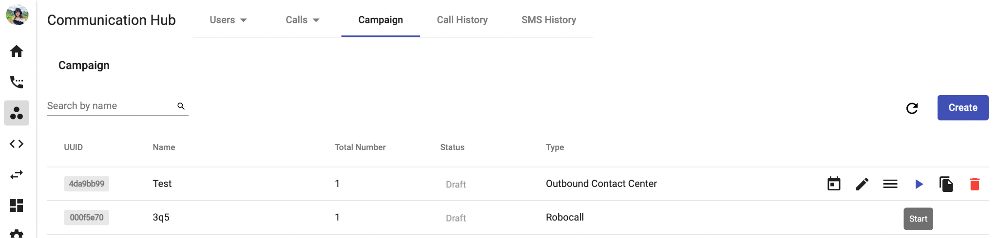
Campaign <Configure a Campaign>
2. Add number list to the Campaign
At the created campaign, click View Numbers
Click on the arrow icon > download sample number list > fill in the list accordingly
Upload
Note: The maximum quantity of numbers for one campaign is 50,000.
Robocall
Robocall

Slide 15
Campaign <Configure a Campaign>
3. Run a Campaign
Once you finish the configuration step, your campaign status is Draft and ready to start.
There are 2 ways to start a campaign:
Start immediately:
  Click the Start button to run the campaign immediately.
  The campaign status will change to In progress if you choose to start Now.
Schedule:
  Click the Schedule to schedule start dates for the campaign.
  The campaign status will change to Scheduled if you choose to Schedule the start time.
Robocall
schedule
start immediately

Slide 16
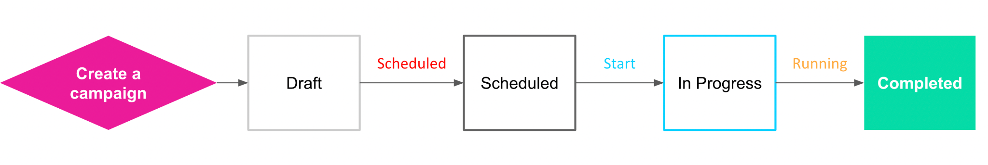
Campaign <Configure a Campaign>
Campaign Status:
Draft
Scheduled
In Progress
Completed

Slide 17
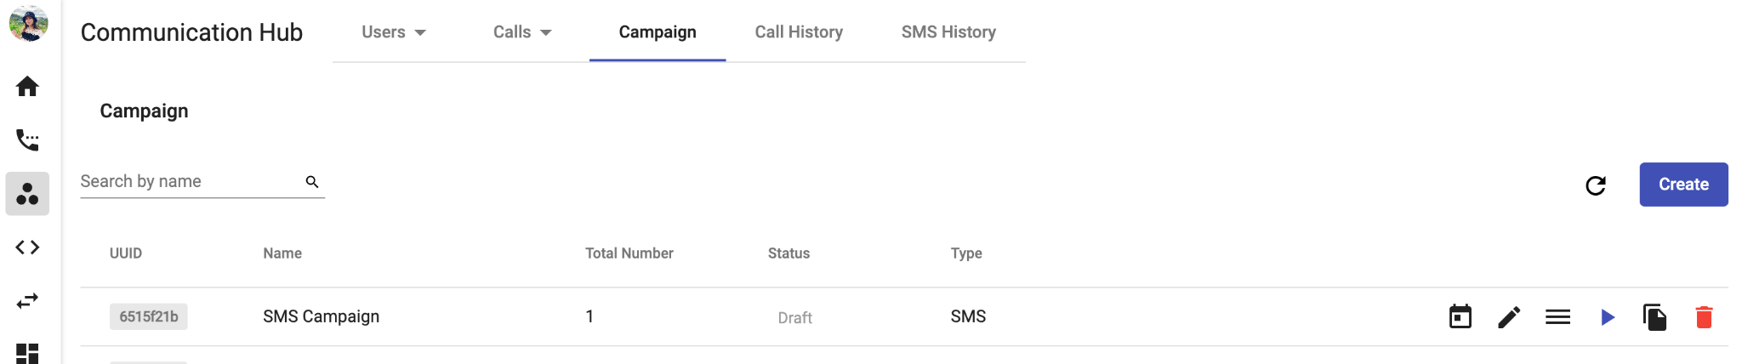
Campaign <Actions by Status - Draft>
Draft
The initial status of the Campaign after creating.
Robocall
Schedule
Archive
Edit
Duplicate
View numbers
Start now

Slide 18
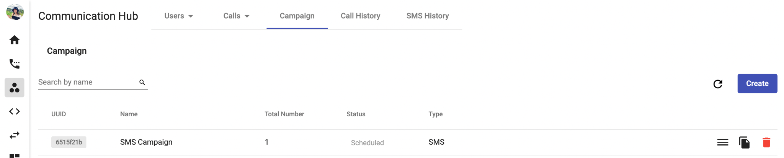
Campaign <Actions by Status - Scheduled>
Scheduled
This status appears when you run the Campaign.
Robocall
Archive
Duplicate
View detail campaign

Slide 19
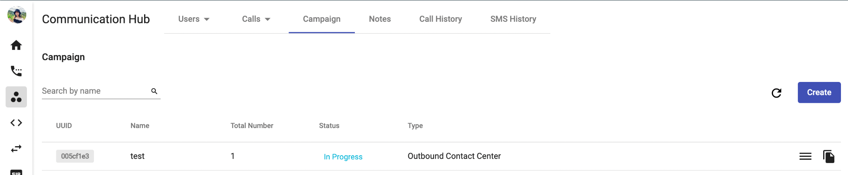
Campaign <Actions by Status - In Progress>
In Progress
This status appears when you run the Campaign.
Robocall
Duplicate
View detail campaign

Slide 20
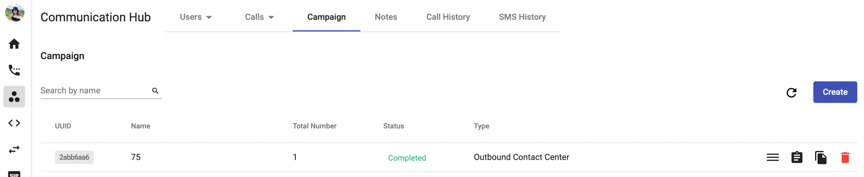
Campaign <Actions by Status - Completed>
Completed
This status appears when the system runs all the numbers within the Campaign.
Robocall
Archive
Duplicate
View Detail Campaign
Report

Slide 21
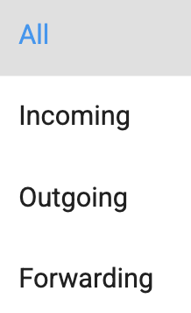
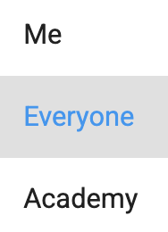
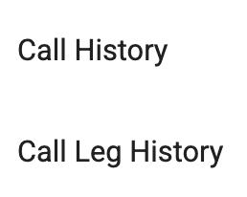
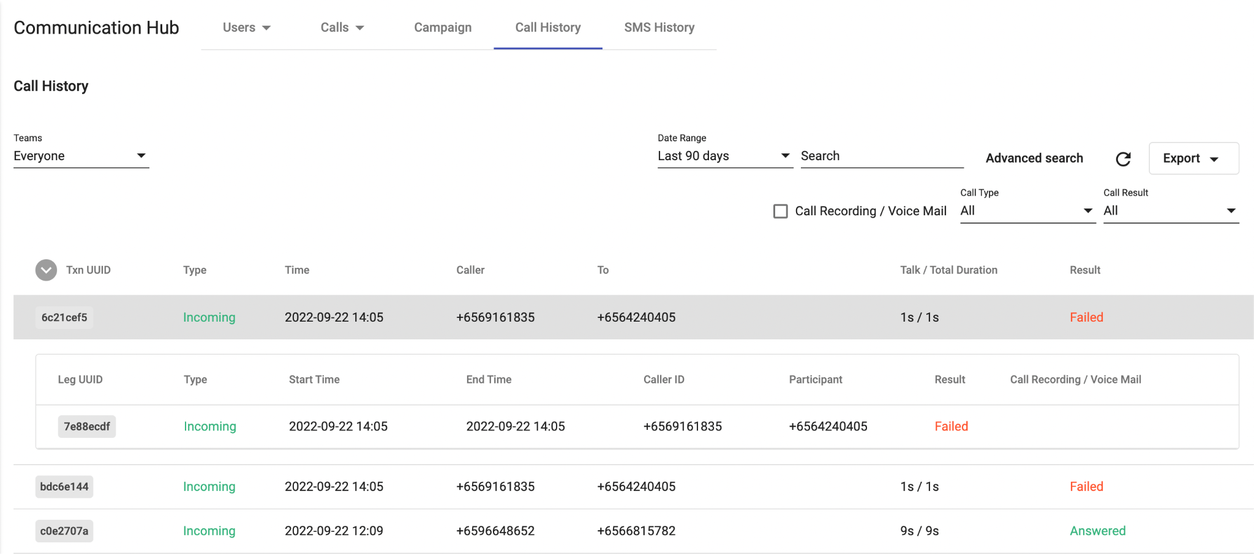
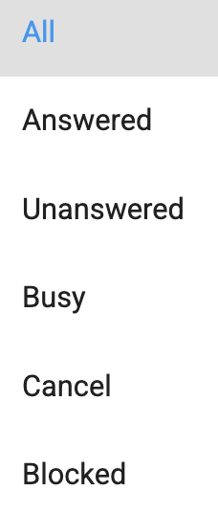
Robocall History
The Call History in Communication Hub is a place where keeps the records of all call transactions within the Organization. It will provide:
  Basic details - Call Directions (Incoming/Outgoing calls), Phone Numbers, Extension Numbers, Date & Time, etc.
  Advanced details - Call Result, Call Metadata, Call Journey, Call Recording, Voicemail, etc.
Data in Call History will be stored up to 1 year since the date the call is created.
It takes a few mins (max: 5 mins) for the data to appear on the portal after the call ends. Longer call duration will require longer processing time.
The SLA of call recording uploading on Unified History is 24 hours.

Slide 22
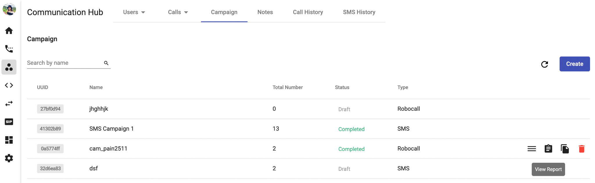
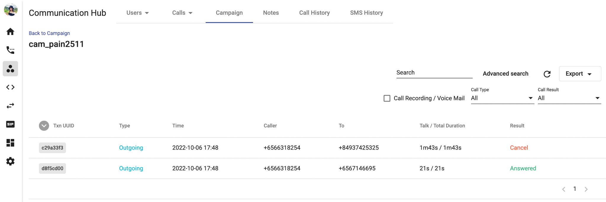
Robocall History
Display campaign’s call history.
Data will be stored on the portal for up to 1 year.

