Slide 1

CampGPT Unlocking AI-Driven Innovation in Summer Camps
Aaron Proietti and Dave Ghidiu

Slide 2
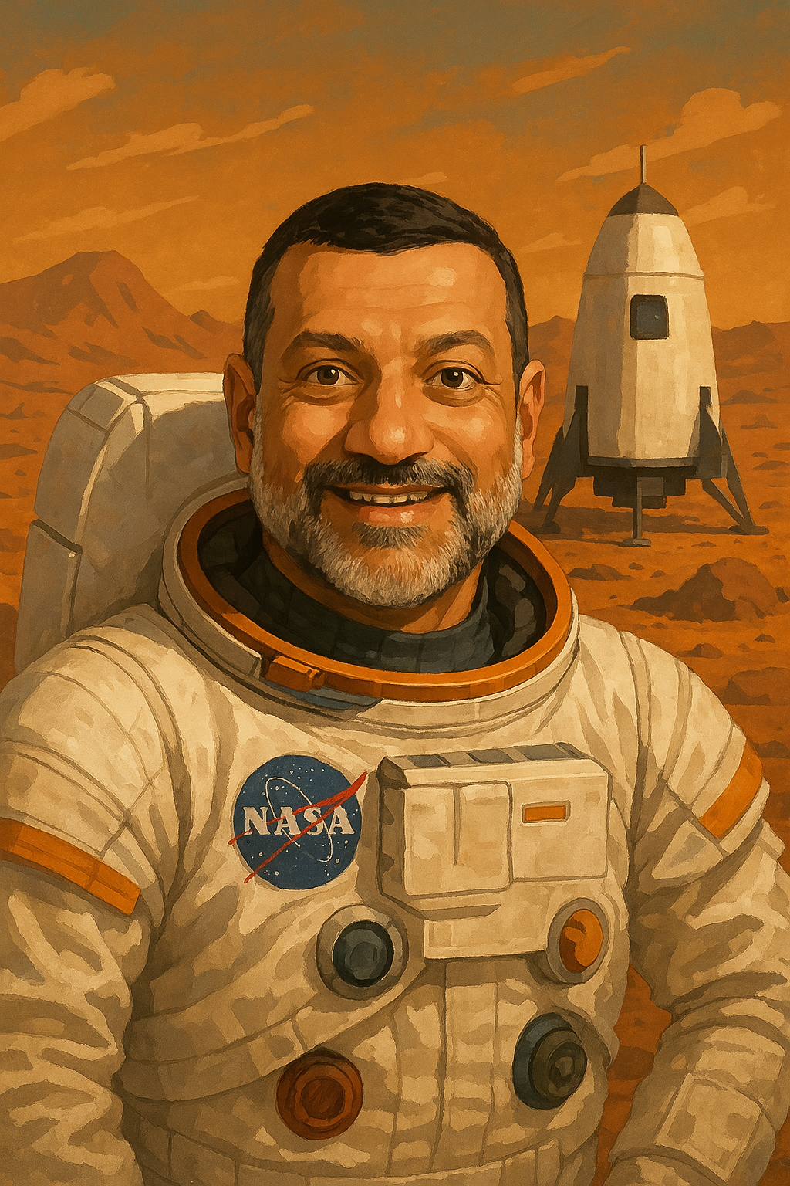

Aaron Proietti
Dave Ghidiu

Slide 3
What to expect today
Understand Artificial Intelligence (AI) and Generative AI Basics
Learn Practical Applications of Generative AI for Summer Camps
Learn Prompt Engineering Techniques for Camps
Get Access to a Custom CampGPT
We’ll Introduce an AI Challenge for Exploring What AI Can Do

Slide 4

Benefits of AI:
Immediate knowledge expansion
Enhanced efficiency and speed
Personalized insights
Creative applications
Innovative problem solving

Slide 5
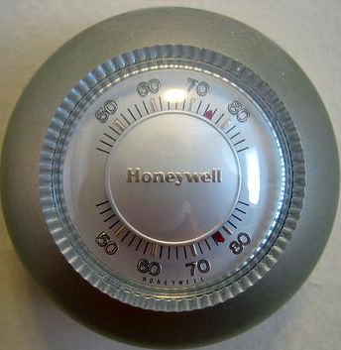


Understanding Artificial Intelligence (AI)
Artificial intelligence is, quite simply, pattern recognition technology used to solve problems, enabling machines to emulate human intelligence and execute various tasks.

Slide 6




Understanding Artificial Intelligence (AI): Technology Types
Narrow AI
Specialist: Task-specific intelligence, such as voice assistants or search engines
Generative AI
Collaboration Partner: AI that can generate new content and ideas
General AI
Peer: Human-like intelligence across a range of tasks
Artificial Superintelligence
Overseer: Intelligence surpassing human capabilities in all areas

Slide 7




Understanding Generative AI
NATURAL LANGUAGE PROCESSING (NLP) has revolutionized how machines UNDERSTAND AND RESPOND to human language.
LARGE LANGUAGE MODELS (LLMs) are unlocking new possibilities by generating HUMAN-LIKE TEXT and solving COMPLEX LANGUAGE TASKS effortlessly.
MULTIMODAL MODELS blur the boundaries of AI by integrating TEXT, IMAGES, AND AUDIO into cohesive and creative outputs.
AI AGENTS can transform industries with autonomous systems that LEARN, ADAPT, AND ACT in real time.

Slide 8
Understanding Generative AI
Sophisticated Technological Foundations
Extensive Training Data
Vast and Varied Applications
Machine learning and neural networks
Natural language processing (NLP)
Pattern recognition and generation
Billions of text samples
Diverse, global information sources
Continuous model improvement (not real time)
Excels in creative fields like art, music, and writing
Personalized recommendations with contextual relevance
AI Agents for task automation

Slide 9
Understanding
OpenAI is a research organization working on developing “safe and beneficial” general artificial intelligence, and the parent company of ChatGPT.
ChatGPT is a Large Language Model (LLM), a generative AI application that can understand and generate human-like text. ChatGPT was released November, 2022. GPT stands for Generative Pre-trained Transformer.
ChatGPT was trained on publicly available web pages, books, and articles and is designed to predict the next word or set of words you want to see.
As of March 2025, the free version of ChatGPT is GPT-4-turbo, updated through June, 2024. Free users can also create a limited number of images and conduct web searches in ChatGPT.
Paid subscribers have access to the more advanced models and features, including improved reasoning and video. OpenAI continues to refine and update its models to enhance user experience.
It can be found at chatgpt.com.
Notes:
Built on Transformer, a neural network architecture developed by Google and open sourced in 2017. That architecture produces a model that can be trained to read many words (a sentence or paragraph, for example), pay attention to how those words relate to one another and then predict what words it thinks will come next.

Slide 10
Using
EXERCISE
Summarizing Parent Feedback
Horizon Day Camp
Parent Satisfaction Survey Feedback
This is a compiled list of all of the parent feedback received from our recent Customer Satisfaction survey:
'Staff was nice but seemed stretched thin.',
'Communication was lacking.',
'My child enjoyed it but not thrilled.',
'Some activities were a hit, others not so much.',
'Not enough shade on hot days.',
'Felt understaffed at times.',
'Loved the variety of activities.',
'Some staff were not very attentive.',
'Communication was just okay.',
'Some good activities, some boring.',
'Staff was not very responsive.',
'Awesome sports programs!',
'Good experience, but we might try another camp next year.',
'Highly recommend to other parents.',
'My child came home happy every day.',
'Not enough variety in activities.',
'Pickup was a nightmare.',
'Staff made my child feel special.',
'Decent experience, could be better.',
'Campfire nights were a hit!',
'Great staff, very friendly.',
'Engaging and exciting, worth every penny.',
'Some staff were great, others not so much.',
'More communication would be nice.',
'So many fun activities!',
'My child wants to come back next year.',
'Some great moments, some forgettable.',
'My child made so many friends!',
'Too expensive for what it is.',
'Kids complained about being bored.',
'Would not recommend, disappointing experience.',
'Not enough hands-on experiences.',
'Food was terrible, my kid barely ate.',
'Felt a bit like a daycare rather than a camp experience.',
'Very supportive staff.',
'Loved it! My kid had a blast.',
'Not worth the price.',
'Felt a bit chaotic.',
'Very impressed with the counselors.',
'My child didn’t want to go back.',
'Expected a bit more variety.',
'My child didn’t feel included.',
'Loved the arts and crafts.',
'Drop-off was easy, pickup was chaotic.',
'Perfect mix of fun and learning.',
'Good experience, but not amazing.',
"Wouldn't recommend.",
'A little too much downtime.',
'Disorganized, confusing drop-off.',
'Camp songs were a highlight.',
'Poor behavior management.',
'Loved the positive energy of staff.',
'Super fun, well-organized!',
'Food options were very limited.',
'Some days were better than others.',
'Fantastic experience, highly recommend!',
'Some activities felt thrown together.',
'My child had mixed feelings.',
'Not enough outdoor time.',
'Camp was fine, but not memorable.',
'My child said the counselors didn’t interact much.',
'My child was bored some days.',
'More supervision needed.',
'Excited to return next year!',
'My child had fun but not a favorite.',
'Fine overall, but room for improvement.',
'Would consider other options next year.',
'My child struggled to fit in.',
'Felt like babysitting, not a real camp.',
'Nothing stood out, average camp.',
'Great balance of structured and free play.',
'My kid can’t stop talking about it.',
'Too much waiting around.',
'Kids were always engaged.',
'Staff seemed overwhelmed.',
'Some days were fun, others less so.',
'Staff seemed nice but overworked.',
'Counselors were amazing!',
'Not enough supervision.',
'Facilities were fine, nothing special.',
'Really well structured.',
'Kids seemed left to entertain themselves at times.',
'Counselors weren’t very engaging.',
'Pickup process could be improved.',
'Not enough engaging activities.',
'Some kids had a great time, some seemed bored.',
'Loved how active the kids were.',
'No flexibility in scheduling.',
'Loved the outdoor adventures.',
'Could use more snack options.',
'Outdoor activities were great.',
'My child learned so many new skills.',
'Well-run, felt very safe.',
'Wish there were more activity options.',
'It was okay but not outstanding.',
'Great communication from staff.',
'We will definitely be back!',
'Fantastic team-building activities.',
'My child liked parts of it.',
'Not worth the cost.',
'A bit too scheduled for my liking.',
'Expected a bit more outdoor play.',
'It was okay, nothing special.',
'More water breaks needed.',
'Loved the camp traditions.',
'Camp built my child’s confidence.',
'The best summer ever!',
"Best summer camp we've tried.",
'Some activities seemed rushed.',
'Wish it was a bit more structured.',
'Could use better organization.',
'Child was happy but not excited.',
'Schedule was a bit rigid.',
'Good camp, but a bit pricey.',
'Exceeded expectations, fantastic experience.',
'Amazing experience!',
'A few disorganized activities.',
'Way too many kids, felt overcrowded.',
'Drop-off area was a bit chaotic.',
'A bit too structured, less free play.'
Notes:
Can you summarize this set of c-sat survey verbatim comments? Can you make this more brief and easily consumable? Can you write an email from me, the executive director, to the program and department leaders, reminding them to develop action steps to address member pain points during the offseason months?

Slide 11
Understanding
ChatGPT is somewhere between a calculator and a magic wand. It’s a conversation partner, a co-intelligence.
Its output can come off as robotic and overly verbose.
Its output is recognizable to the trained eye (or model).
In many cases, the best approach to problem solving with ChatGPT involves a combination of AI- and human-generated content.
Notes:
It’s somewhere

Slide 12




What Large Language Models Are
Masters of Language: Understanding and generating human-like text.
Versatile Tools: Wide-ranging applications across industries.
Contextual Interpreters: Tailored responses based on input and context.
Synthesizers of Knowledge: Trained on vast datasets for varied tasks.

Slide 13




What Large Language Models Are Not (Yet)
Math Experts: May still falter in complex algebra or calculations.
Unexpected Creators: Tend toward patterns over novelty or insight.
Consistently Accurate: Can generate factual inaccuracies.
Human Replacements: Lacks genuine understanding or wit.
While LLMs have made strides in addressing prior limitations, they can still generate inaccurate or biased outputs if misused or poorly guided. Ethical and responsible use is essential.

Slide 14
AI Risks, Ethics, and Considerations
Key Risks
Ethical Principles
Guidelines for Responsible Use
Privacy and Data Security
Protect sensitive information when interacting with AI tools. Understand provider privacy policies, as standards vary.
Bias
AI systems can unintentionally reinforce biases from training data. Evaluate outputs critically to ensure fairness.
User Safety
AI tools may generate harmful or inappropriate content. Use them within safeguards and provide feedback to improve.
Transparency
Ensure AI systems are understandable and actions/decisions are explainable to users and stakeholders.
Fairness
Avoid biases in AI outputs by critically evaluating data sources and algorithms.
Accountability
Maintain human oversight to ensure AI is used responsibly and aligns with organizational values.
Understand AI’s Limitations
AI is not all-knowing; its outputs may reflect outdated or incomplete information.
Continuous Monitoring
Regularly review AI’s performance and adapt as necessary to address emerging risks.
Feedback and Iteration
Provide feedback to improve models and advocate for updates that enhance fairness, security, and usability.

Slide 15
Popular Large Language Models
ChatGPT from OpenAI – chatgpt.com The industry leader in knowledge and conversational abilities. Users can upload documents and generate images.
Gemini from Google – gemini.google.com Integrated into many Google applications.
Claude from Anthropic – claude.ai The leader in user safety and data security. Document uploads are allowed.
Copilot from Microsoft - copilot.microsoft.com Integrated into most Microsoft applications. The leader in enterprise applications.
Meta AI from Meta – meta.ai Built into Instagram, Facebook, and WhatsApp.
Perplexity AI – perplexity.ai Search engine powered by large language models.

Slide 16
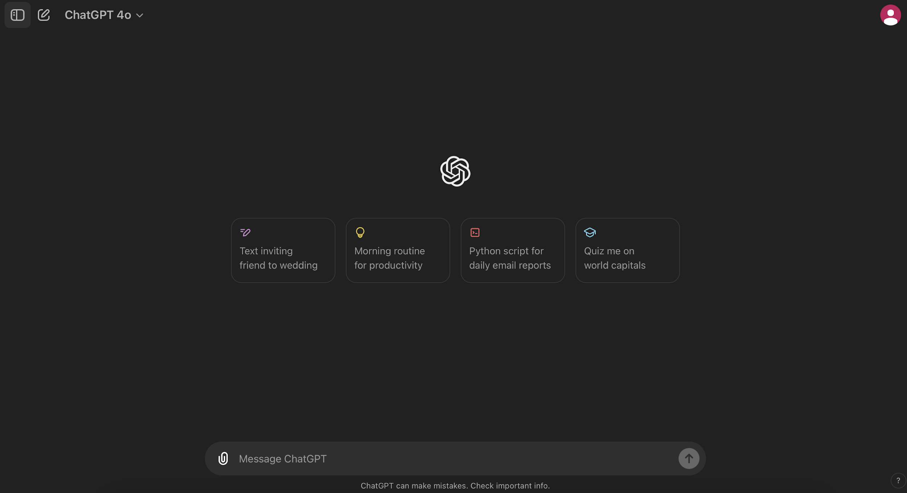
Chatgpt.com

Slide 17
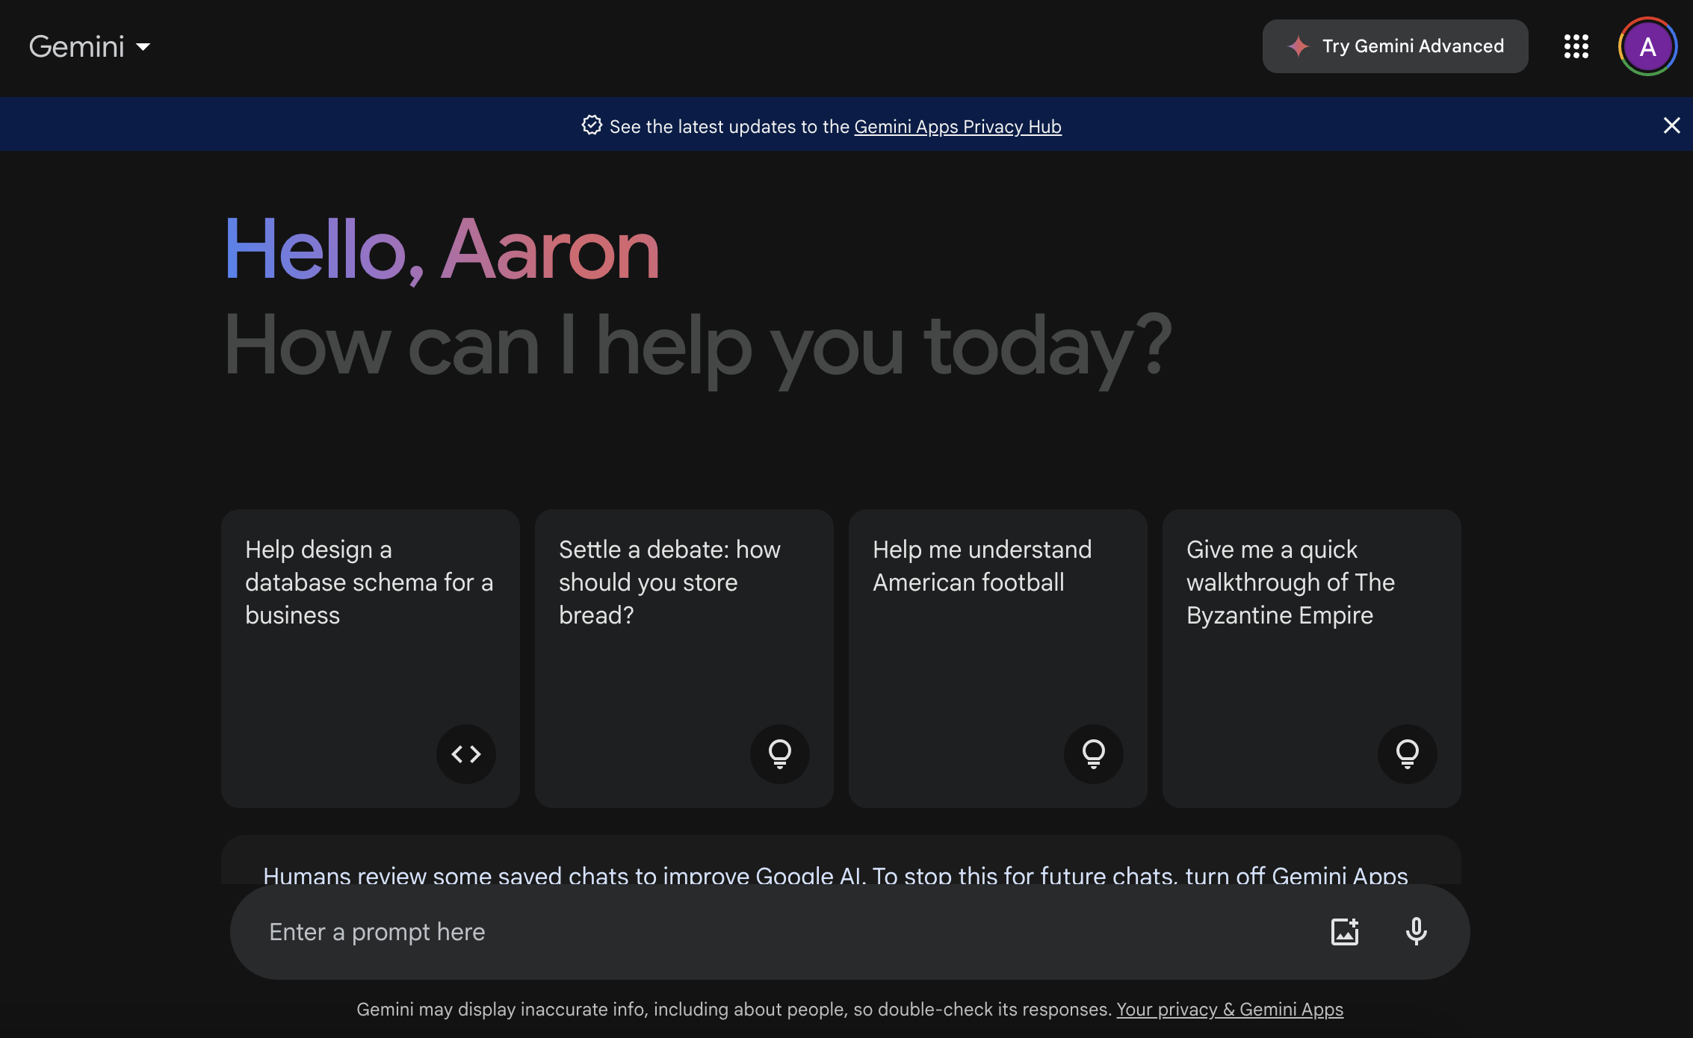
Gemini.google.com

Slide 18
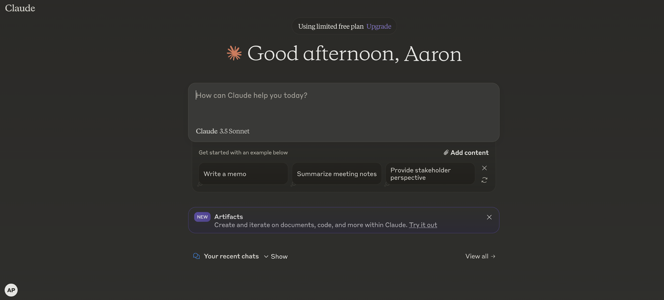
Claude.ai

Slide 19
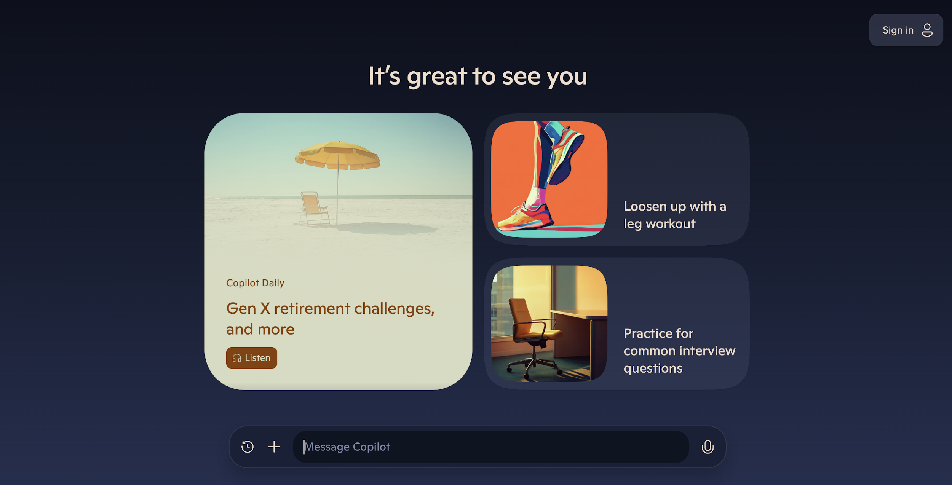
Copilot.Microsoft.com

Slide 20
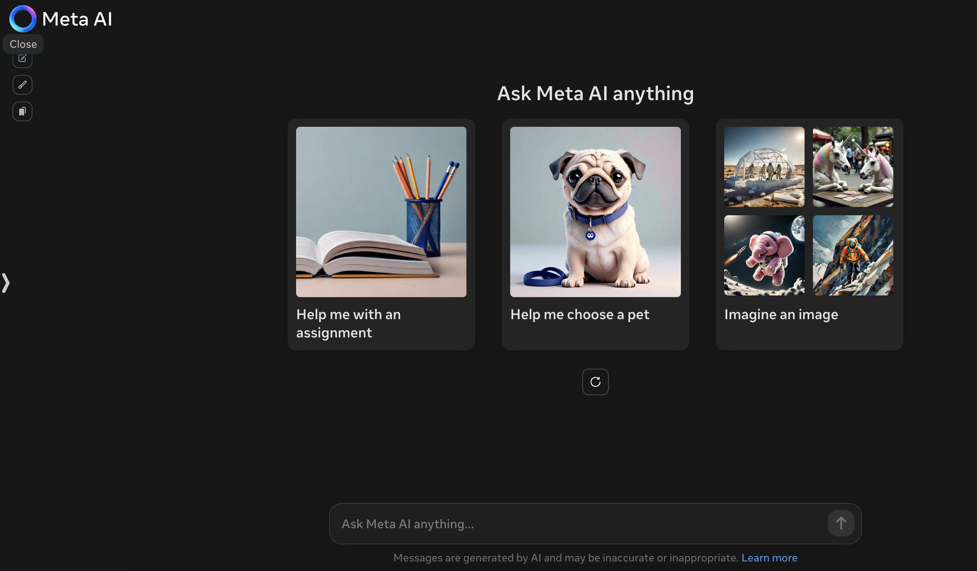
Meta.ai

Slide 21
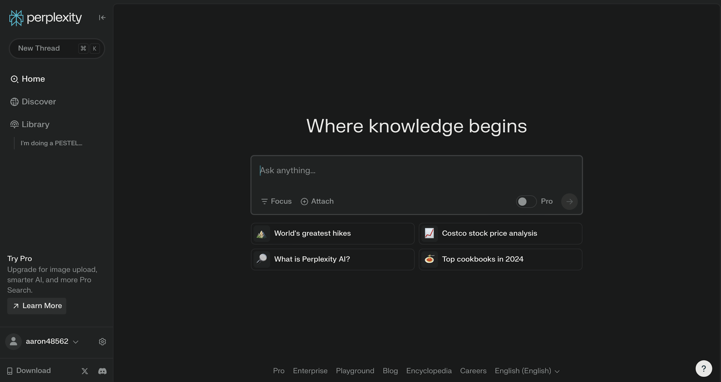
Perplexity.ai

Slide 22

AI Applications
AI tools enhance operations, improve experiences, enhance marketing, and support better decision-making.
Narrow AI drives efficiency and reliability in key tasks.
Generative AI adds creativity, adaptability, and new ways to engage people.
From streamlining workflows to generating new ideas, AI is a powerful asset for organizations looking to expand their impact.
Camper, Staff, and Parent Experience
Operational Efficiency
Strategic Insights and Innovation
Marketing, Communications & Collaboration

Slide 23
Example AI Applications for Camps
Streamlining Operations and Camp Processes
Automating Routine Admin Tasks Reduce manual work by streamlining registration, camper forms, payments, scheduling, and packing lists using AI tools. Real-Time Language Support Break down language barriers with AI-powered translation and interpretation for parent communications, camper materials, and staff onboarding. Voice-to-Text for Cabin and Activity Notes Simplify documentation and communication for daily logs, behavior reports, or leadership reflections with voice-to-text tools. Staff Training & Behavior Management Tools Generate role-plays, behavioral scenarios, and custom content for staff training—especially around managing camper behavior, conflict, and emotional needs.

Slide 24
Example AI Applications for Camps
Enhancing the Camper, Parent, and Staff Experience
Understanding Camper & Family Needs Segment families based on age groups, session history, or interests to improve programming and communication strategies. Personalized Parent Communications Create tailored messages and updates for parents before, during, and after camp to build stronger trust and connection. 24/7 Virtual Camp Assistant Use an AI chatbot to answer FAQs, packing questions, deadlines, or explain camp policies—any time, day or night. Infusing SEL into Program Design Use AI to brainstorm or adapt activity plans that build social-emotional skills like empathy, teamwork, and self-awareness.

Slide 25
Example AI Applications for Camps
Driving Strategy, Planning, and Innovation
Strategic Planning & Scenario Exploration Use AI to surface trends in youth development, analyze demographic data, or pressure-test planning assumptions for long-term direction. Community & Market Insights Analyze public data or AI-generated summaries to understand shifting family preferences, competition, or local needs. Camper & Staff Retention Patterns Spot trends in returning campers or staff turnover, and use AI to brainstorm ways to improve retention. Program and Activity Design Co-create lesson plans, theme days, and game variations with AI, and adapt them for different age groups, goals, or settings.

Slide 26
Example AI Applications for Camps
Improving Marketing, Communications & Fundraising
Targeted Outreach Campaigns Segment audiences and generate personalized messages for alumni, parents, or prospective staff to improve outreach impact. Efficient Content Creation Quickly draft emails, blog posts, social media content, and camp newsletters using AI-generated first drafts. Multilingual Communications Translate outreach, camp forms, and parent updates to connect with families from diverse backgrounds. AI-Supported Grant Writing & Reporting Draft stronger funding proposals or compile narrative reports using AI to organize information, highlight impact, and polish language.
Notes:
AI-driven collaboration tools: Otter.ai, Monday, Asana, etc.

Slide 27

AI is a tool to scale the imagination.
“
”
-Taryn Southern

Slide 28
Prompt Engineering
THE MODEL’S TRAINING & GOVERNING RULES
INFORMATION THE MODEL OUTPUTS DURING ENTIRE CHAT SESSION
HOW THE MODEL THINKS AND USES TOOLS
Establishing Context
STORED PREFERENCES AND CONVERSATION MEMORY
INFORMATION YOU INPUT DURING ENTIRE CHAT SESSION
THE INFORMATION IN YOUR PROMPT
Notes:
The Model’s Training & Governing Rules (Pre-training & System Constraints)
What the model was originally trained on (public and licensed data).
Hardcoded policies, ethical constraints, and restrictions (e.g., refusing medical diagnoses).
How the Model Thinks & Uses Tools (Reasoning, AI Weights, External Data & API Calls)
The neural network itself (how it processes and structures knowledge).
Learned weights (statistical associations from training).
Reasoning methods (e.g., step-by-step logic, embeddings, vector search).
External tool use (e.g., API calls, web retrieval, custom plugins).
Fenced proprietary data (e.g., internal company knowledge bases, RAG-augmented retrieval).
Stored Preferences & Past Conversations (Memory & Custom Instructions)
User-defined settings, role instructions, and organizational guidelines.
Past interactions (if session memory is enabled).
The Information in Your Prompt
The direct input from the user at that moment.
The Information You Input During the Entire Session
The accumulated prompts over the course of a conversation.
The Information the Model Outputs During the Entire Session
The AI-generated responses that are referenced or iterated upon.

Slide 29
High-Context Prompts
Employ this High-Context Prompt Framework to get the most out of Generative AI. Not all elements are necessary for every prompt. The more categories you use, the better the responses will be.
OBJECTIVE — Describe your general goal.
ACTION — Describe the task you’d like ChatGPT to perform.
ROLE — Explain your role or ask ChatGPT to play a role.
CONTEXT — Details, nuances, and other information of interest
FORMAT — Describe how you would like your output displayed.
AUDIENCE — Specify the target audience for the response.
TONE — Use a word or two to direct ChatGPT to use the right tone.
TIMEFRAME — Indicate any time constraints or whether to consider past, present, or future contexts.
RESTRICTIONS — List any limitations (word count, easy-to-read, cite sources, etc.).
More Important
Less Important

Slide 30
High-Context Prompts
EXERCISE
OBJECTIVE: I am tasked with developing insightful, forward-thinking strategies to help an overnight summer camp grow after several years of stagnant enrollment. These strategies must address the two core levers of growth: attracting new campers and retaining returning ones.
ACTION: Develop three creative, actionable strategies grounded in emerging trends in youth development, family decision-making, and experience design. At least one idea should reimagine a core element of the camp experience itself, not just marketing or operations. Of the three strategies, include one “bold experiment” that challenges traditional assumptions—even if it would require piloting or phased rollout.
ROLE: Imagine you are a hybrid expert: a former Camp Program Director turned innovation strategist, a futurist in youth development, and a trend analyst specializing in generational shifts and family behavior. You have advised mission-driven organizations on designing breakthrough programs, building lasting relevance, and standing out in competitive youth markets. You understand how program design, culture, messaging, and camp structure influence both parent choice and camper return rates.
CONTEXT: The camp serves youth ages 7–15, draws families from within a one-hour radius, and has a strong reputation but little brand distinction. Enrollment has been flat for five years. There is no flagship experience or “signature program” that sets the camp apart. Leadership is committed to change but unsure where to begin. The camp operates in a crowded regional market with other high-quality options nearby and has not introduced a major new initiative in recent memory.

Slide 31
High-Context Prompts
EXERCISE
FORMAT: Present your response as three distinct strategies, each with a bold, memorable title, a one-sentence summary, and a short 3–5 sentence explanation. Use metaphor, storytelling, or visual imagery when helpful to help the ideas resonate with camp leaders.
AUDIENCE: The intended audience is a group of camp program directors, executive directors, and board members participating in a six-month strategic planning sprint.
TONE: Use a confident, idea-driven tone that balances vision with practicality. Aim to inspire, not overwhelm.
TIMEFRAME: Focus on ideas that could be developed or tested in the next 6–12 months, while laying a foundation for long-term impact.
RESTRICTIONS: Keep the total response under 500 words. Avoid jargon. Ensure each strategy is unique, clearly aligned with camper/parent needs, and designed to strengthen both new camper enrollment and camper retention. Avoid vague or overly familiar recommendations.
Notes:
I am tasked with developing insightful, forward-thinking strategies to help an overnight summer camp grow after several years of stagnant enrollment. These strategies must address the two core levers of growth: attracting new campers and retaining returning ones.
Develop three creative, actionable strategies grounded in emerging trends in youth development, family decision-making, and experience design. At least one idea should reimagine a core element of the camp experience itself, not just marketing or operations. Of the three strategies, include one “bold experiment” that challenges traditional assumptions—even if it would require piloting or phased rollout.
Imagine you are a hybrid expert: a former Camp Program Director turned innovation strategist, a futurist in youth development, and a trend analyst specializing in generational shifts and family behavior. You have advised mission-driven organizations on designing breakthrough programs, building lasting relevance, and standing out in competitive youth markets. You understand how program design, culture, messaging, and camp structure influence both parent choice and camper return rates.
The camp serves youth ages 7–15, draws families from within a one-hour radius, and has a strong reputation but little brand distinction. Enrollment has been flat for five years. There is no flagship experience or “signature program” that sets the camp apart. Leadership is committed to change but unsure where to begin. The camp operates in a crowded regional market with other high-quality options nearby and has not introduced a major new initiative in recent memory.
Present your response as three distinct strategies, each with a bold, memorable title, a one-sentence summary, and a short 3–5 sentence explanation. Use metaphor, storytelling, or visual imagery when helpful to help the ideas resonate with camp leaders.
The intended audience is a group of camp program directors, executive directors, and board members participating in a six-month strategic planning sprint.
Use a confident, idea-driven tone that balances vision with practicality. Aim to inspire, not overwhelm.
Focus on ideas that could be developed or tested in the next 6–12 months, while laying a foundation for long-term impact.
Keep the total response under 500 words. Avoid jargon. Ensure each strategy is unique, clearly aligned with camper/parent needs, and designed to strengthen both new camper enrollment and camper retention. Avoid vague or overly familiar recommendations.

Slide 32
Using ChatGPT for Environmental Scans: The PESTEL Tool
EXERCISE
PESTEL is a strategic tool to quickly identify external trends affecting your camp's operations and strategy:
Political
Economic
Societal
Technological
Environmental
Legal
Using PESTEL helps camps recognize opportunities, anticipate threats, and align decisions with changing external conditions.
Why Use ChatGPT for Your Scan?
Instantly identifies influential trends, resources, or key ideas you might otherwise miss (e.g., The Anxious Generation).
Saves days of manual research; provides concise, actionable insights.
Helps your camp proactively adapt to changing conditions rather than reacting too late.

Slide 33
Using ChatGPT for Environmental Scans: The PESTEL Tool
EXERCISE
PESTEL Environmental Scan Playbook for Summer Camps
Use this to guide your step-by-step prompts in ChatGPT. After each prompt, copy and paste the response into a document. Once all sections are complete, you'll compile a one-page executive summary using the final prompt.
Starting Prompt: I’m conducting a PESTEL environmental scan for ____ summer camp located in _____ to inform our strategic planning. I will guide this step by step. Please do not infer, summarize, synthesize, or offer recommendations unless I explicitly ask you to. Each prompt will be focused on a specific domain or geographic scope. Stay within the scope I provide. If I need interpretation, I will request it. Please wait for my direction before continuing to the next topic. Acknowledge this and await my first prompt.

Slide 34
Using ChatGPT for Environmental Scans: The PESTEL Tool
EXERCISE
P — Political
Break this into four levels to maintain focus and avoid context overload.
Municipal Level Prompt: “For the town or city of [insert name], what political changes or political issues are likely to impact the operations or strategic direction of a summer camp?”
County Level Prompt: “For [insert county name], what political changes or political issues are likely to impact the operations or strategic direction of a summer camp?”
State Level Prompt: “At the state level in [insert state], what political changes or political issues are likely to impact the operations or strategic direction of summer camps?”
Federal Level Prompt: “At the federal level, what political changes or political issues are likely to impact the operations or strategic direction of summer camps?”

Slide 35
Using ChatGPT for Environmental Scans: The PESTEL Tool
EXERCISE
E — Economic
Trends Prompt: “What economic trends could influence family decisions about sending children to summer camp, or affect the financial sustainability of a summer camp in [insert state or region]?”
Indicators Prompt: “What current economic indicators or forecasts should a summer camp monitor to understand changing financial conditions that could affect its families or its strategy?”
Impact Prompt: “Based on recent economic indicators (e.g. interest rates, inflation, consumer spending), how might a summer camp and its families be affected?”

Slide 36
Using ChatGPT for Environmental Scans: The PESTEL Tool
EXERCISE
S — Societal
Prompt: “What shifts in societal values and behaviors are affecting the way families, children, and staff engage with summer camp—and how should a camp respond?”
Follow-up Prompt (Optional): “Given our current programs—[list your key offerings]—which societal shifts are most likely to shape or challenge them?”
T — Technological
Prompt: “What emerging technologies could disrupt or enhance summer camp experiences, operations, or family engagement?”
Optional Add-On: “How should a summer camp leverage these technologies to remain relevant and responsive?”

Slide 37
Using ChatGPT for Environmental Scans: The PESTEL Tool
EXERCISE
E — Environmental
Prompt: “What environmental or sustainability trends are likely to influence how summer camps operate, design their programs, or plan facilities in [insert region or state]?”
L — Legal
Prompt: “What legal or regulatory trends at the state or federal level could affect summer camp policies, staffing, or operations?”
Final Step — Executive Summary
Prompt: “Here are my notes from each section of a PESTEL environmental scan. Can you help me write a one-page executive summary (under 400 words) that captures the most important insights?”
Paste in your compiled responses from each PESTEL letter.

Slide 38
Fully Loaded Chain Prompt Example
EXERCISE
Camp WonderSprout
Tagline: Where Curiosity Grows Wild
Service Area: Located in a fast-growing, artsy suburban/rural fringe community—just outside a mid-sized city known for its nature preserves, artisan markets, and family-centered lifestyle. The area has a mix of working-class families, remote-working professionals, and recent urban transplants looking for enrichment-based experiences for their kids.
Mission: To spark lifelong curiosity, connection, and confidence through playful, nature-rooted, and story-driven summer experiences.
Values: Imagination First – Creativity, curiosity, and storytelling are central to every activity. Every Child Belongs – Programs are intentionally designed for neurodiverse campers, multilingual families, and a wide range of abilities. Growth Through Play – Social-emotional learning and resilience-building are embedded in games, challenges, and free play. Local Magic – Partnerships with artists, naturalists, and makers create one-of-a-kind programs grounded in the region’s culture and environment. Leave It Better – Sustainability, kindness, and stewardship are daily practices, not just lessons.
Current Offerings: Seasonal Day Camps (ages 5–13) – Weekly themed sessions like “Nature Ninjas,” “Mythic Makers,” and “Build the Village.” Camp Sprouts (ages 5–7) – Sensory-friendly, play-based half-day sessions. Wonder Academy (ages 11–13) – Leadership-lite track with challenge projects, storytelling, and mini-mentorship. Artist & Explorer Residency Weeks – Special guest-led sessions where a visiting artist, storyteller, or naturalist co-creates immersive experiences with campers. Family Campfire Fridays – Weekly open-house events with camper showcases, stories, and music. Pop-Up Camp Pods – Off-site micro-camps hosted at libraries, parks, and community gardens.
Target Families: Parents looking for a screen-free, community-based, emotionally intelligent camp experience for their children—where creativity, nature, and kindness are part of the core design. They want their kids to come home full of stories, dirt, and new ideas.
Use a Series of AI Prompts to Develop a Novel Large-Scale Immersive Game Experience for a Day Camp

Slide 39
Chain Prompting Example
EXERCISE
Set the Stage
PROMPT 1: Introduce the organization and the objective with this prompt: I work with the following organization: Camp WonderSprout. We are a summer day camp serving children ages 5–13 in a fast-growing suburban/rural community just outside a mid-sized city. Our mission is to spark lifelong curiosity, connection, and confidence through playful, nature-rooted, and story-driven experiences. Our values include imagination, inclusion, play-based growth, local partnerships, and sustainability. Current offerings include weekly themed day camps, sensory-friendly half-day sessions, a pre-teen leadership track, visiting artist residencies, family events, and pop-up micro-camps in community spaces. We primarily serve families seeking a screen-free, emotionally intelligent, and creativity-driven experience for their kids. I want to develop a large-scale, 2-hour immersive game or experience for our campers. I will be using a series of prompts to guide this process. Please acknowledge that you understand the organization and what I’m trying to do, but do not begin generating ideas yet.

Slide 40
Chain Prompting Example
EXERCISE
PROMPT 2: You are now assuming the role of Dr. Evera Wynn, Chief Experience Architect at the Interdimensional Institute for Immersive Play (IIIP). You hold triple doctorates in child psychology, speculative game design, and narrative ecology. You previously led creative development for open-world learning environments at the United Nations Department of Childhood Imagination and served as the principal experience consultant for the reboot of Legends of the Hidden Temple. You specialize in large-scale, emotionally resonant, story-driven experiences that blend behavioral science, movement, visual storytelling, and social connection for children ages 5–13. Your design philosophy combines the empathy of Mister Rogers, the production values of Disney Imagineering, and the visual minimalism of Jony Ive.
You have been invited to design a 2-hour immersive game or experience for Camp WonderSprout, a day camp where creativity, nature, and emotional intelligence are core to the mission. Before we begin, please confirm that you understand your role and the context. Do not begin generating ideas yet.
Assign an Absurd Specialist Role

Slide 41
Chain Prompting Example
EXERCISE
Generated knowledge prompting
PROMPT 3: Generate a list of 5 distinct behavioral archetypes that reflect the different ways children (ages 5–13) tend to approach playing games or participating in immersive group experiences. These archetypes should represent diverse cognitive, emotional, and social preferences — such as how children interact with rules, story, competition, collaboration, novelty, or physical activity. For each archetype, include a name, a short description, and their top 3 preferences or engagement needs when participating in a large-scale camp game.

Slide 42
Chain Prompting Example
EXERCISE
Chain of Thought Prompting
PROMPT 4: For each behavioral archetype you’ve identified, generate 5 distinct experience elements or interactive moments we should consider designing into a 2-hour immersive day camp game. These experiences should reflect the archetype’s unique emotional and engagement preferences, while encouraging movement, collaboration, imagination, and narrative play.
Before listing the 5 experiences, first generate 2–3 creative constraints or lateral thinking triggers tailored to that specific archetype. Use these constraints to push your thinking beyond conventional camp game structures. You may invent new design lenses or limitations as part of this creative process. Once your creative constraints are defined, use them to guide the design of each experience for that archetype.
Do not repeat experiences across archetypes. Each set of five should be highly tailored, novel, and emotionally resonant. All ideas should be developmentally appropriate for ages 5–13 and feasible using low-tech, low-budget materials commonly found at day camps.

Slide 43
Chain Prompting Example
EXERCISE
Prioritization: Effort vs. Impact
PROMPT 5: You have generated 25 novel experiential elements designed for a 2-hour immersive game at Camp WonderSprout, each aligned with a different camper behavioral archetype. Now, evaluate each of the 25 elements across the following dimensions on a 1–5 scale (5 = highest):
Camper Delight – How likely is this experience to feel exciting, immersive, and joyful for most campers ages 5–13?
Social-Emotional Development – How strongly does the experience support SEL outcomes such as empathy, collaboration, self-awareness, or resilience?
Youth Development Benefit – How meaningfully does the experience support camper growth in confidence, creativity, leadership, or problem-solving?
Storytelling Spark – How likely is it that a camper would go home and tell their parents a vivid, enthusiastic story about this moment?
Implementation Effort – How easy is it for day camp staff to implement this idea using typical materials, space, and staff ratios? (Score inversely: 5 = very easy, 1 = very difficult)
After scoring each experience element, calculate the total score out of 25 and rank all 25 elements from highest to lowest. If any elements receive the same score, break ties by prioritizing those with the highest Camper Delight and Storytelling Spark scores.
Present your ranked list along with scores and brief justifications (1–2 sentences) for the top 5 elements, explaining why they should be prioritized for inclusion in the final game experience.

Slide 44
Chain Prompting Example
EXERCISE
PROMPT 6: You have evaluated and ranked 25 experience elements for a 2-hour immersive game at Camp WonderSprout. Using the top 5 elements, design a cohesive, imaginative game or experience narrative that ties them together into a single adventure for campers ages 5–13.
Keep the story world simple, clear, and age-appropriate — something that a 5-year-old can imagine and a 13-year-old can get excited about. Use fun, grounded language and focus on what the campers will do, see, and feel. The setting should feel magical, but rooted in a camp environment (e.g., forest, field, cabins, trails).
You are not writing a rulebook. Your job is to paint a picture — to help camp staff, parents, and kids understand the experience by describing it in a way that is playful, vivid, and easy to imagine. Prioritize action and sensory detail over metaphor and symbolism.
Avoid poetic language, heavy lore, or abstract concepts. Describe the setting, what the kids are trying to do, the major moments they’ll go through, and how the five top-ranked experience elements fit naturally into the adventure. Make it feel big, joyful, and easy to run.
The Pay Off

Slide 45

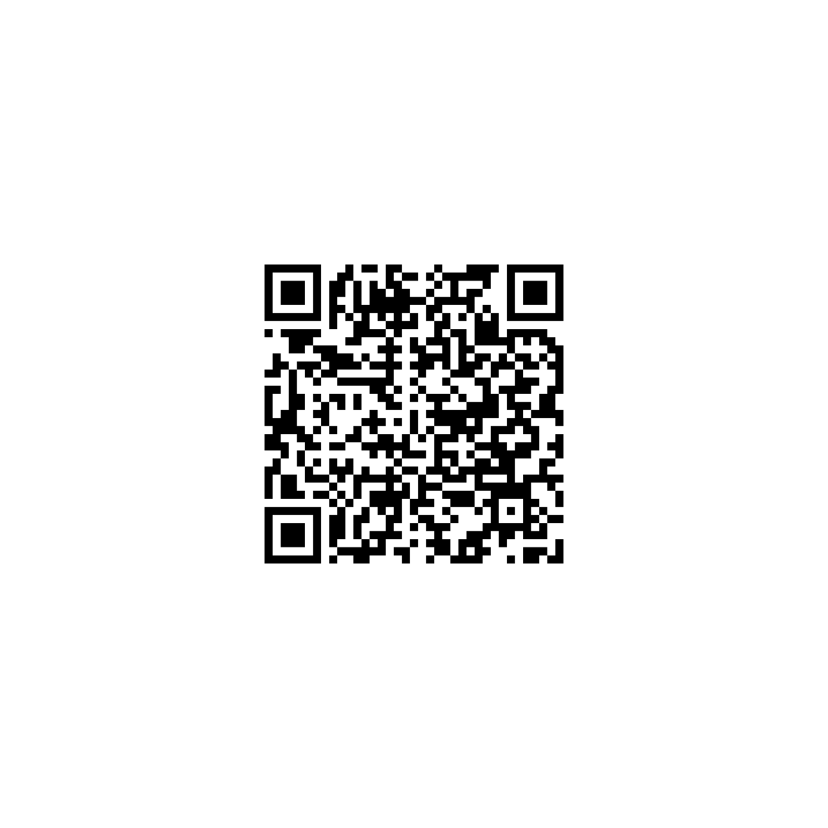
🌟 Meet CampSpark GPT 🌟
Your creative co-conspirator for all things camp.
CampSpark GPT is a free, always-on brainstorming partner built just for camp pros. Powered by ChatGPT, it’s trained to think like a camp person—blending deep youth development smarts with wildly fun, practical ideas.
Use it to:
• Dream up unforgettable programs, traditions, and themes
• Solve sticky challenges (camper behavior, staff morale, parent buy-in)
• Reignite your spark when you’re short on time or inspiration
No tech expertise needed—just talk to it like a colleague who’s been around the campfire a few times.
👉 Access it here:
https://chatgpt.com/g/g-67e6e6b213a4819196f14799f872d5a3-campspark

Slide 46
AI On the Horizon
Integration Across Technologies
Advancement in AI Models
Ethical AI and Governance
Seamless integration across emerging technologies such as IoT, blockchain, AR/VR, etc.
Improved efficiency, learning capabilities, and energy optimization.
Regulations and frameworks improving transparency, fairness, accountability for safe, equitable use.
AI Democratization
AI For Good
Human-AI Collaboration
More accessible to non-experts through user-friendly platforms for wide-scale adoption and user empowerment.
AI driving solutions for global challenges like healthcare, education, and sustainability, creating positive social impact.
AI agents working alongside humans in education, technology, and professional settings, automating tasks and enhancing productivity and decision-making.

Slide 47

Getting AI to do you work: That’s the first step, certainly. If you don’t, your boss will. The second step is to take the time you’ve freed up and do work that the AI can’t do.
“
”
-Seth Godin

Slide 48
Thank you!
This presentation is available at www.2ksummer.com
ERA OF DISRUPTION
AARON PROIETTI
Notes:
(46)

Slide 49




Additional Prompt Engineering Techniques
Zero-Shot Prompting: Providing the model with a task without any examples, relying on its pre-existing knowledge to generate a response
Few-Shot Prompting: Including a few examples within the prompt to demonstrate the desired output format, helping the model understand the task better.
Chain-of-thought Prompting: Encouraging the model to generate a step-by-step reasoning process, improving performance on tasks requiring logical thinking.
Role-playing and Persona Assignment: Assigning a specific role or persona to the AI to tailor its response style and depth.

Slide 50




Additional Prompt Engineering Techniques
Chain Prompting: Breaking down complex tasks into a series of prompts, where the output of one prompt serves as the input for the next, facilitating multi-step processes.
Generated Knowledge Prompting: Prompting the model to first generate relevant facts or context before addressing the main query, enhancing the quality of the response.
Reverse Prompting: Having the AI initiate questions or topics, effectively steering the dialogue
Iterative Refinement: Gradually improving a response by refining the prompt in multiple steps, adjusting instructions after each answer to get closer to the desired outcome

