Slide 1
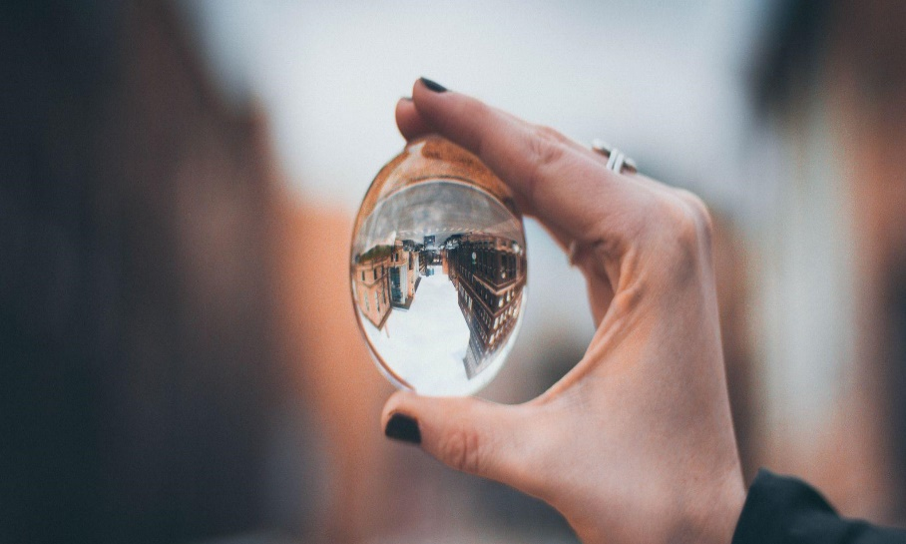


CURRENT NEWS:
ST. LAWRENCE RIVER
A diverse mix of voices leads to better discussions, decisions, and outcomes for everyone.
Sundar Picha
This Ocean School activity is licensed under
CC BY-SA 4.0
Notes:
Image source:
Selective focus photography of woman holding clear glass ball by Anika Huizinga on Unsplash

Slide 2
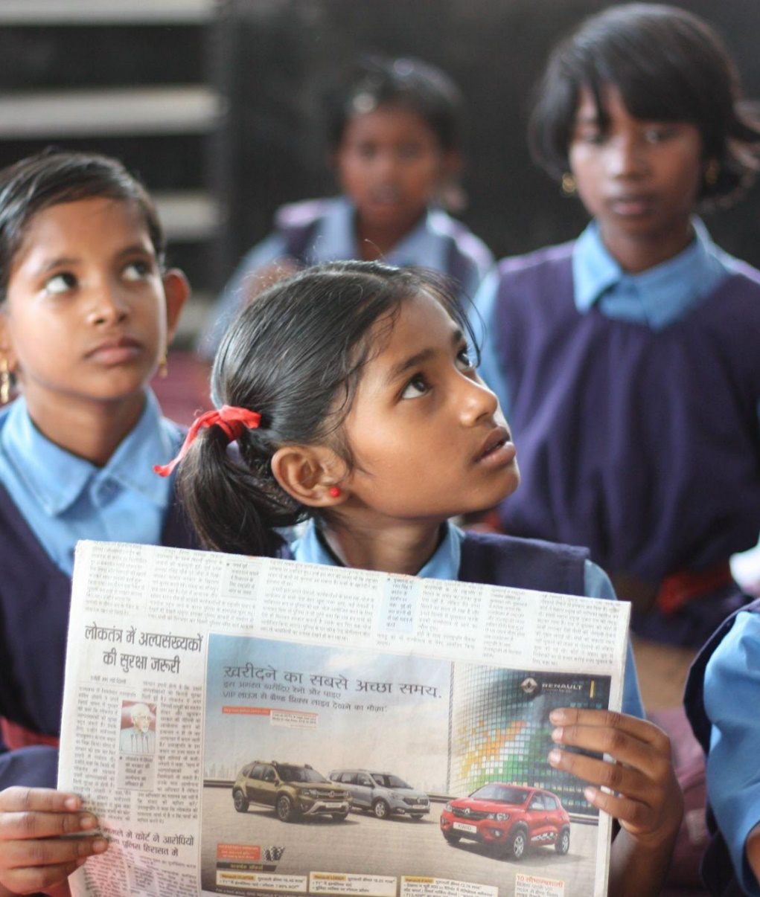
Here’s your challenge:
Analyse a news article and reflect about perspective.
Here’s your to-do list:
Step 1
Learn about different perspectives and bias.
Step 2
Choose one article from the
Current news: St. Lawrence newsreel.
Step 3
Analyze the article and reflect about perspective.
Step 4
Reflect on what actions you can take to protect the river.
Notes:
Image source:
Shallow focus photo of girl holding newspaper by jaikishan patel on Unsplash

Slide 3

Perspective, bias, and the news
A perspective is a point of view or a particular way of looking at something. Every single one of us has a unique perspective on life that has been shaped by our experiences, backgrounds, upbringing, education and values.
How can perspective create bias?
Our perspectives and opinions can influence how we talk or write about something, even if we’re trying to be neutral. Journalism is meant to be objective, which means it aims to present the facts without personal or external opinions and bias. That’s because biased information can influence how you make decisions or think about an issue.
However, everyone’s personal experiences will give them some level of bias. When consuming the news, it is important for us to be critical about whose perspectives are being represented or left out, and how that might impact how we understand the story.
Media Smarts defines bias as:
“A positive or negative attitude towards something, often based
on preconceived prejudices or view-
points rather than evidence.”
💡
Notes:
Image source:
A cup of coffee and a pair of glasses on a newspaper by Ashni on Unsplash
References:
Cambridge University Press & Assessment (2024). Perspective. In Cambridge dictionary. Retrieved April 02, 2024, from: https://dictionary.cambridge.org/dictionary/english/perspective
Media Smarts (2021). Bias in news sources [Lesson Plan]. Retrieved April 02, 2024, from: https://mediasmarts.ca/sites/default/files/pdfs/lesson-plan/Lesson_Bias_News_Sources.pdf

Slide 4

Choose a news article
Name of article:
What event or story is being reported?
Who are the characters involved?
Notes:
Image source:
Man using laptop computer and headphones by Samuel Bourke on Unsplash

Slide 5
Analyse your news article
What are the key facts from the article? List at least 3.
For each fact, write the evidence that the author used to support the fact. Who provided the information? Use the table to organise your notes and track the sources of information.
Fact | Evidence from the article | Source
Example 1 . “There are 600 fish left in the pond.” | The paragraph 3 says, “According to Fisheries and Oceans Canada” | Report from the Government of Canada
Example 2. “The fish are smaller than they used to be.” | The reporter interviews “fisher Sam Smith” | Interview with a local fisher

Slide 6
Reflect on perspectives
Whose perspectives might have been left out of the article?
Whose perspective was being represented in the article?
Why do different perspectives matter?

Slide 7

Reflection
Each of the articles presents actions that people are taking to protect and restore the St. Lawrence River.
What actions can you take to protect the river?

