Slide 1




FREE PRESENTATION TEMPLATE
Chemistry
EaTemp

Slide 2

Welcome
Welcome to the world of fantasy! Join us on a journey to explore the mystical creatures, enchanted lands, and magical wonders that exist beyond our reality. Discover the wonders and secrets of this exciting realm and unlock the power of imagination.
EaTemp

Slide 3

Table of Contents
01
Introduction
02
Encounters
The Extraordinary Realm
Unicorn Sightings
03
Wonders
04
Magic
Wishes Granted
Spellcasting
05
Adventure
06
Conclusion
Happily Ever After
Embrace the Fantasy
EaTemp

Slide 4
Introduction
The Fantasy Realm: Uncovering the Secrets of the Imagination and the Magic that Lies Within
EaTemp

Slide 5
The Realm of the Extraordinary
Welcome to the Fantasy World, a realm of wonder and enchantment where anything is possible. Here, dragons breathe fire, unicorns prance through meadows, and rainbows shine brightly. This world is a place where wishes come true, where potions can be cursed and spells are cast. It's a place of treasure and adventure, where the impossible becomes possible. But the greatest treasure of all is the one that lies within.
The world of fantasy is a reflection of our deepest desires, our fondest dreams, and our wildest imaginations. It's a place where we can let go of the constraints of reality and explore the boundless possibilities of the human mind. In this introduction, we will delve into the mysteries of this realm, uncovering the magic and wonder that lies within. So come with us and let's embark on a journey through the Fantasy World.
EaTemp

Slide 6



Unicorn Sightings
A record of the number of unicorns spotted in the fantasy realm and the beauty and mystery that surrounds these enchanting creatures.
Dragon Taming
A closer look at the art of taming dragons and the brave adventurers who dare to take on these fearsome creatures.
EaTemp

Slide 7
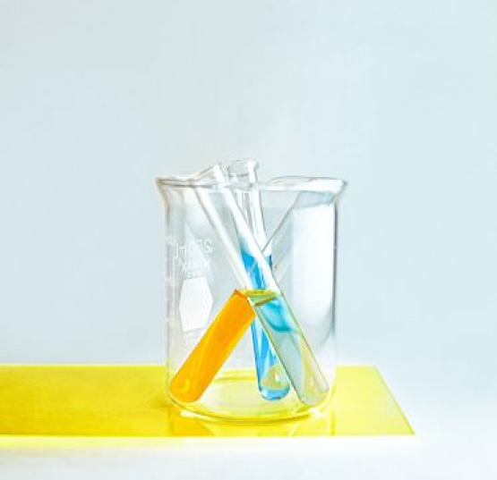


Unicorn Sightings
Dragon Taming
Dragon Taming
A record of the number of unicorns spotted in the fantasy realm and the beauty and mystery.
A closer look at the art of taming dragons and the brave adventurers who take on these creatures.
A closer look at the art of taming dragons and the brave adventurers who take on these creatures.
EaTemp

Slide 8

Fantasy is the gateway to the impossible, the land where the ordinary becomes extraordinary, and the impossible becomes possible. It is the realm of the imagination, where anything can happen and everything is possible.
The Dream Weaver
EaTemp

Slide 9
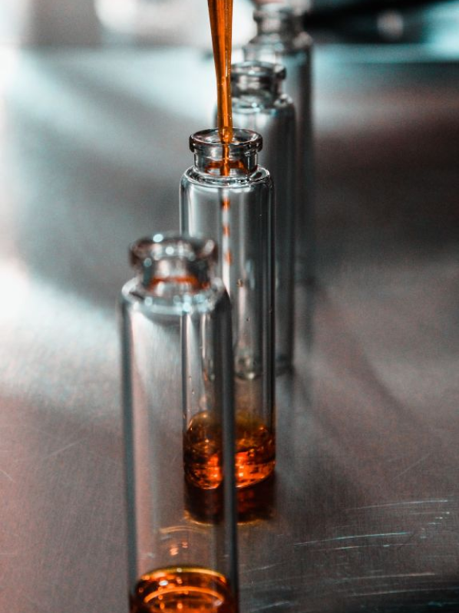

Dragon Taming Technique
A guide to taming and caring for dragons in the realm of magic.
The Art of Unicorn Sighting
Tips and tricks for spotting the elusive unicorns in their natural habitat.
EaTemp

Slide 10


The Magic of Dragons: A Research
6.7M
"The Art of Archery": Discover the intricacies of the Art of Archery as practiced by the graceful and precise elves.
4.4M
2.3M
"The Music of the Elves": Immerse yourself in the enchanting music of the elves, whose songs have the power to heal.
EaTemp

Slide 11

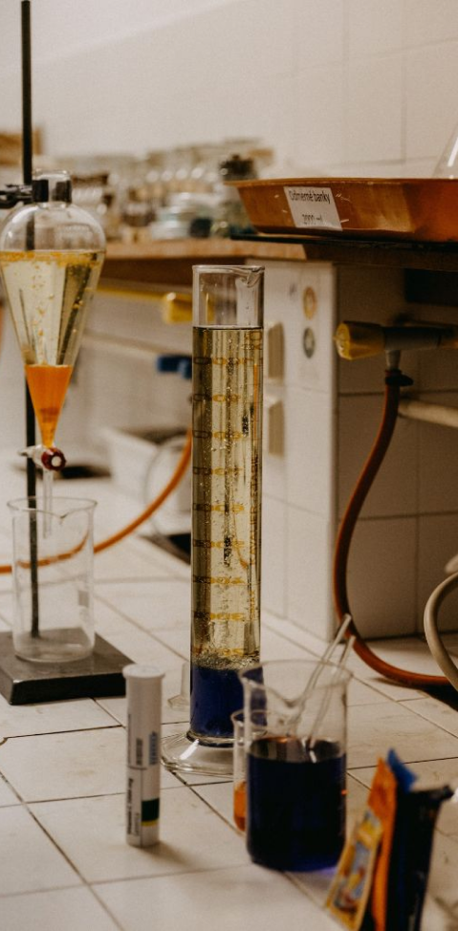
Some Data
75%
Enchanted Creatures
possess the ability to cast spells.
60%
Magic-Wielding Individuals
practice the art of illusions.
Spells Cast
90%
are dark magic, foretelling danger.
EaTemp

Slide 12

234,567
UNICORN SIGHTINGS
A tally of the number of unicorns spotted in the fantasy realm.
EaTemp

Slide 13
233 Coins
85%
Treasure Found
Wished Granted
456 Hours
535 Km
Duration of Spell Casting
Journey Distance
EaTemp

Slide 14
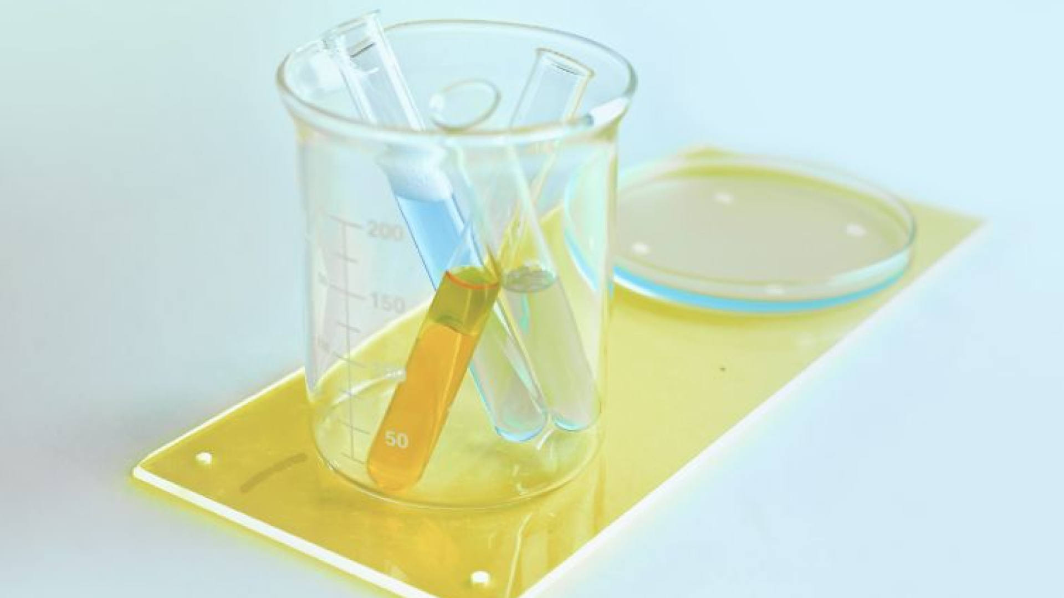
A Magic Picture
EaTemp

Slide 15
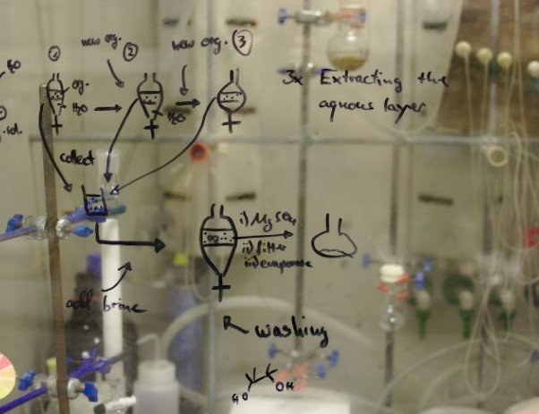
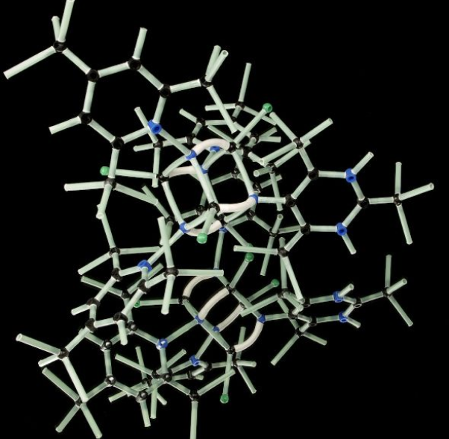
Discover the secrets
Find your own path
1
2
Explore the lush, vibrant forest and uncover the mysteries that lie within.
Choose your own path through the forest, and see where it takes you.
Meet the creatures
Uncover the magic
3
Encounter the mythical creatures that call the forest home, from talking animals to fairies.
4
Learn about the powerful magic that pervades the forest and how it affects all who enter.
EaTemp

Slide 16

Fantasy Realm at a Glance
The Enchanted Forest
A magical forest filled with talking animals and enchanted creatures.
The Crystal Caves
A network of underground caves filled with precious gems and crystals.
The Dragon's Lair
A dangerous and mysterious place where dragons reside.
EaTemp

Slide 17
The Timeline
Unicorn Migration
Dragon Taming
Large herd of unicorns migrated to the realm
First dragon was successfully tamed
2022
2023
2024
2025
Enchanted Pool
Rainbow Sightings
A magical pool with power to grant wishes
Unusually large number of rainbows were sighted
EaTemp

Slide 18



The Information
Spellcasting
Competition
Treasure
Hunt
Great
Adventure
A significant event in the history of the fantasy realm, in which the greatest spellcasters of the realm.
A significant event in the history of the fantasy realm, in which a massive and awesome treasure hunt was organized.
A notable year in the history of the fantasy realm, in which a large number of adventurers set out to explore.
EaTemp

Slide 19



Our Team
Eldruin
Elementalen
Lunaria
The Fire Mage
The Guardian
The Moon Priestess
EaTemp

Slide 20
The List
Fire-breathing creatures that are often powerful and dangerous
Dragons
Medieval-like Settings
Worlds with castles, knights, and feudal systems
Chosen One Trope
A hero chosen by destiny to save the world
An integral part of fantasy stories, can take many forms
Magic
A curse that is unique, creative, and fits within the story
The Best Curse
Unique Creatures
A variety of fantastical beings that inhabit the world
EaTemp

Slide 21

Thank you for choosing EaTemp
We offer free and high-quality slides templates for your presentations. We appreciate you choosing us and hope our templates have been helpful.
As a new website, we rely on your support to grow, so please help us by sharing our site with your friends and colleagues.
Credit | Image: Unsplash
EaTemp

