Slide 1

EYFS – Hot Topic 3 – Session 2
The Blue Crayon
Today we are learning to share.
© Embers the Dragon Ltd 2020
Notes:
Ask the class which of the toys would they like to play with. When two or more children opt for the same toy, ask them who should get to play with it first and briefly explore if it is something they could play with together, how they could decide whether to take turns, etc.

Slide 2
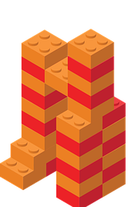
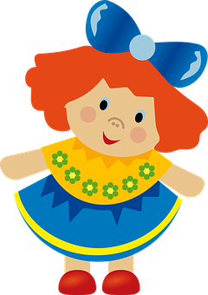

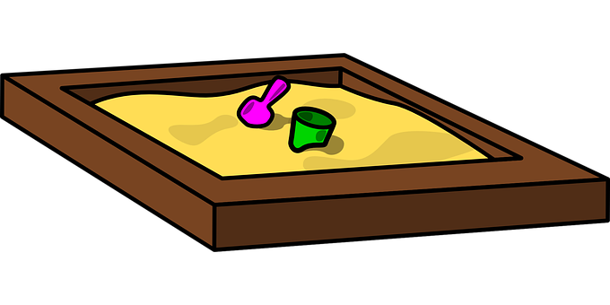
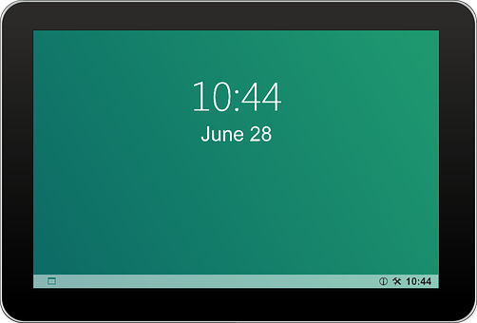
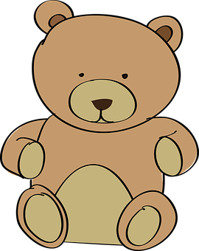
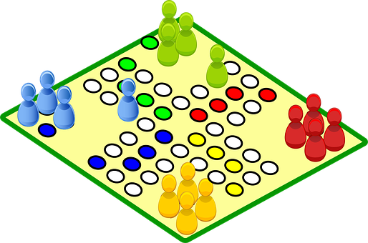



Which of these would you like to play with?
© Embers the Dragon Ltd 2020

Slide 3
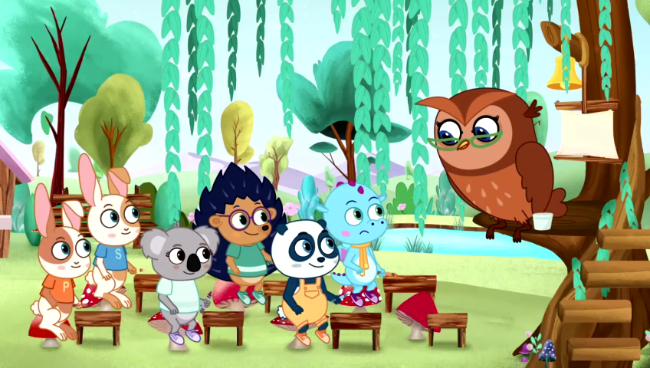
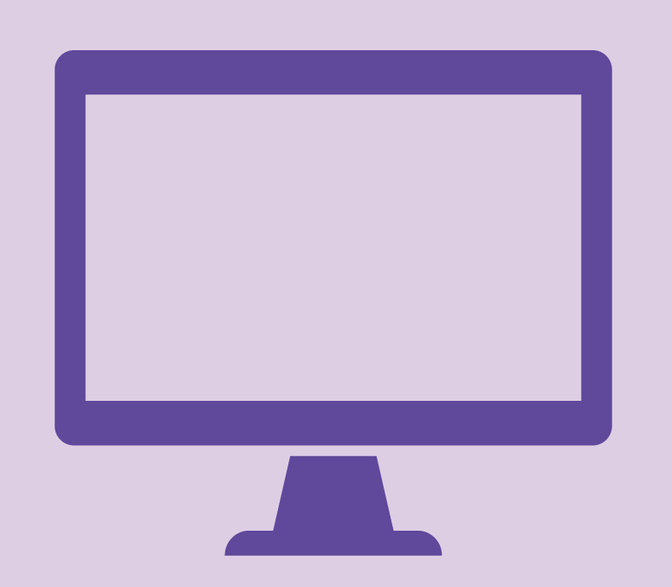

How does Mr. Panda help Bo?
© Embers the Dragon Ltd 2020

Slide 4
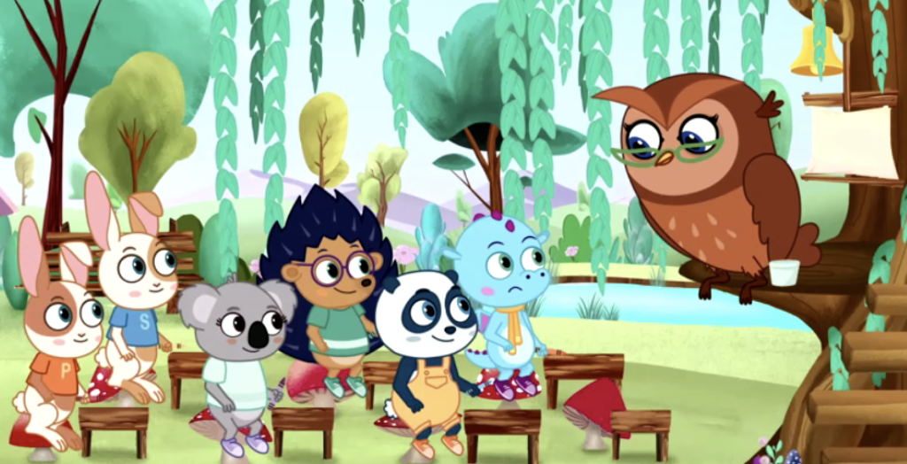
Would Bo have been happier playing by himself?
© Embers the Dragon Ltd 2020

Slide 5
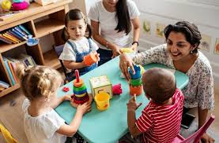
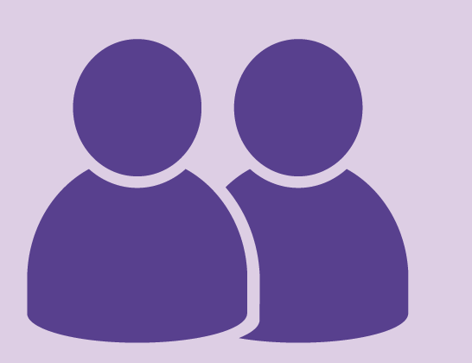
Is it more fun to play by yourself or with another person?
© Embers the Dragon Ltd 2020

Slide 6
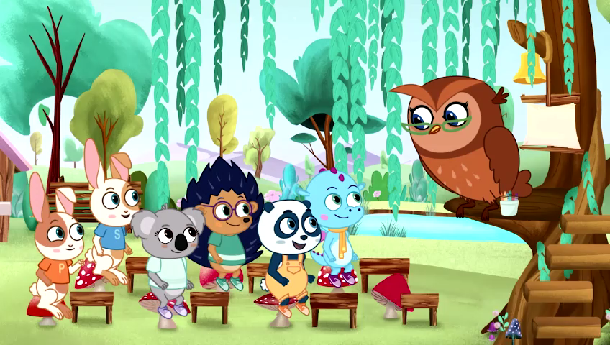
Were Embers and Bo better or worse friends after Bo offered to share?
© Embers the Dragon Ltd 2020

Slide 7
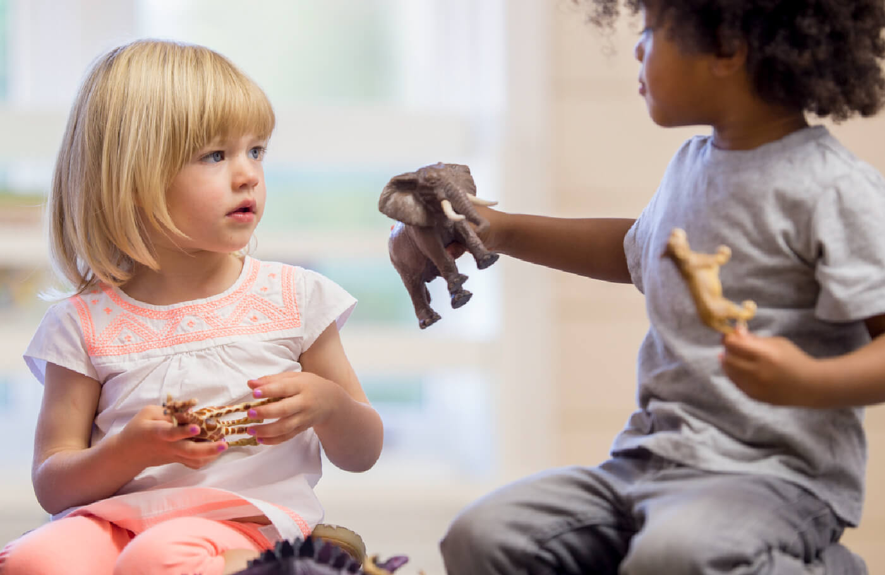
Can you be a Champion Sharer for the rest of today?
© Embers the Dragon Ltd 2020
Notes:
Challenge the class to be ‘Champion Sharers’ today and throughout the day/week awarding points/stickers/ rewards to children who demonstrate good sharing, encouraging the children to nominate one another to receive recognition.

Slide 8
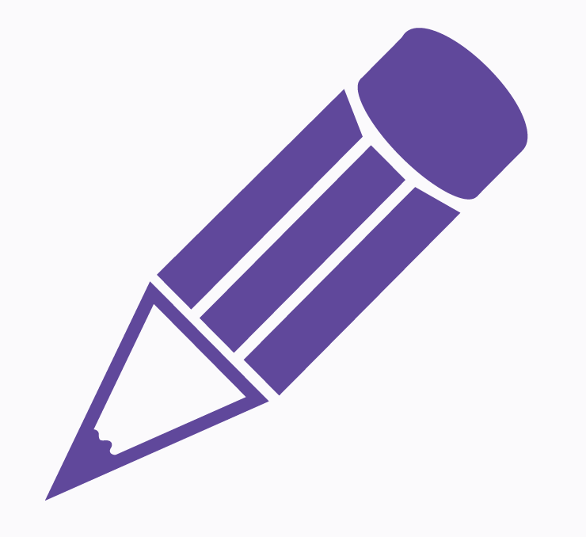
Complete the “Sharing Embers” activity...
Colour in the die and the pieces of Embers
Cut them out
Glue the tabs on the die and fold it together
Play the Sharing Embers game with a partner or on your table
© Embers the Dragon Ltd 2020
Notes:
This activity will be very fiddly.

