Slide 1
Phone System
- End-user Guide -
October 2024
September 2021

Slide 2
Release Notes
Item | Slide No. | Change Description
Inbound call filter | 31 | Remove some actions in Inbound Call Filter at Organization Level

Slide 3
General Portal Settings
Application Settings
Dashboard
Devices
IP Phones
Mobile
Desktop
Browser / Web Phone
FAQ - Frequently Asked Questions

Slide 4
General Portal Settings

Slide 5
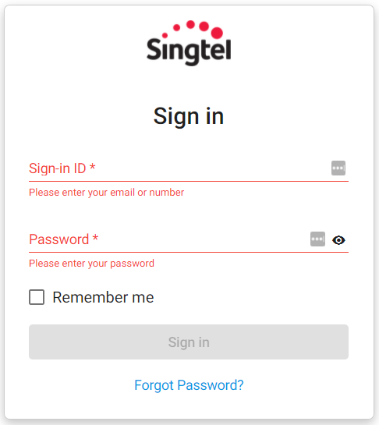

General Portal Settings <Login Portal>
Members who have been granted Portal Access can login by using:
Registered Email Address
Created Password.

Slide 6
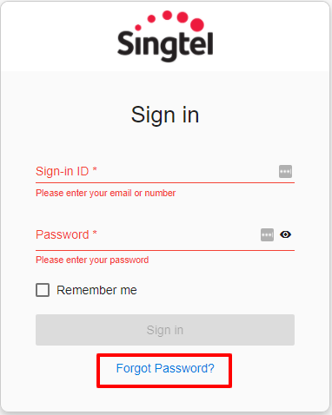
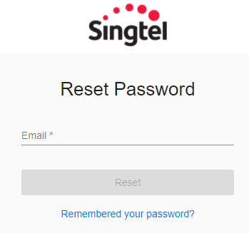
General Portal Settings <Password Reset>
In the case wherein members forget their Password and unable to log in to their account, they can trigger a Password Reset.
They will receive a link via their Registered Email to set a new Password for their respective account.

Slide 7
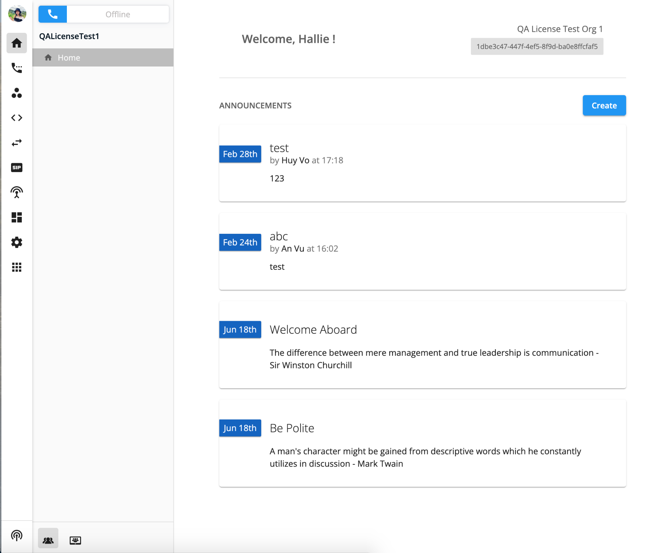
General Portal Settings (Homepage)
Once logged in, members will be directed to the Homepage wherein they can view announcements of their organization, and access the Web Phone/Team Chat on the side bar.

Slide 8

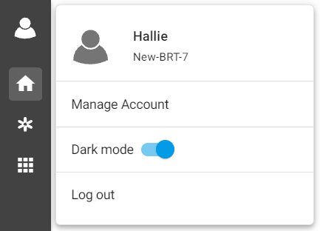




General Portal Settings (Account Navigation Options)
By clicking on the User Icon, the following options can be selected:
Manage Account: Lets members edit certain general settings for their account.
Dark Mode: Allows members to switch colors on the sidebar (Dark/Light).
Log Out: Allows members to sign out of the account.

Slide 9
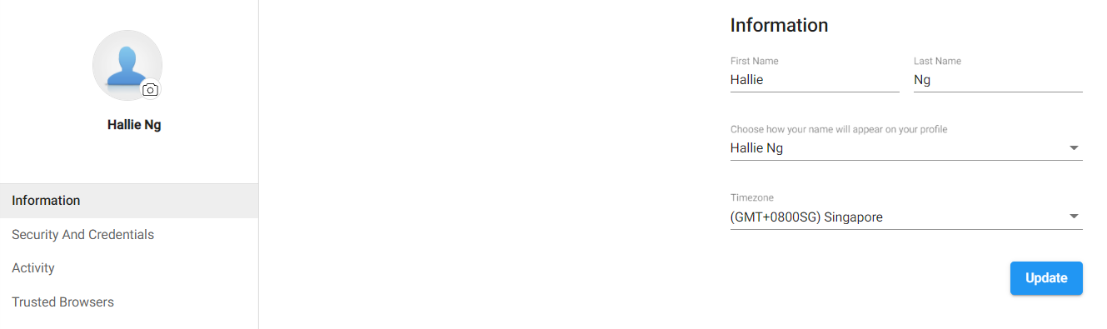
Manage Account (Information)
Members can customize their:
Account Image
Account Name
Timezone

Slide 10
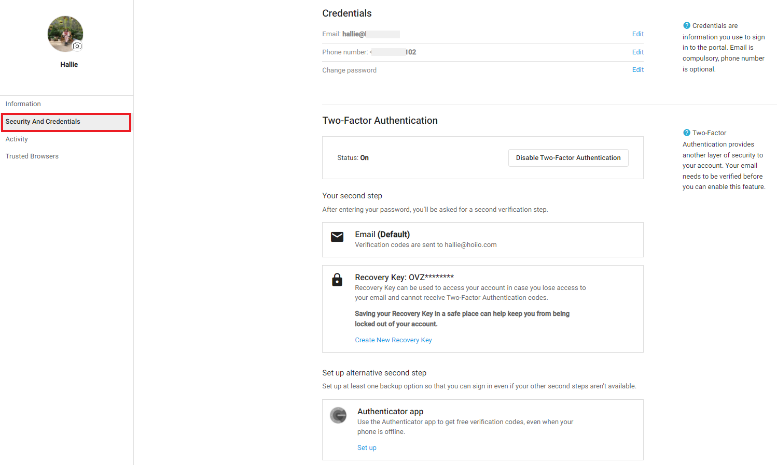
Manage Account <Security And Credentials>
Allows members to manage their:
Account Credentials
  Email Address
  Phone Number
  Password
Two-Factor Authentication
  Recovery Key
  Alternative Second Step

Slide 11
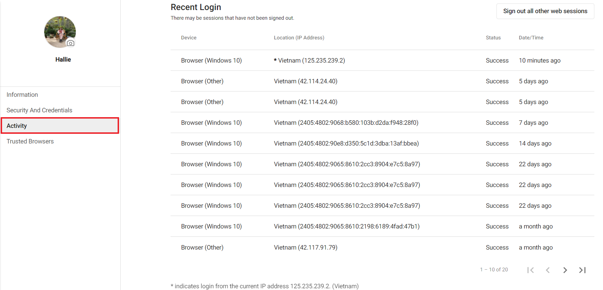
Manage Account <Activity>
Gives members visibility on login activity for their account.
The portal shows the twenty (20) most recent account activities.

Slide 12
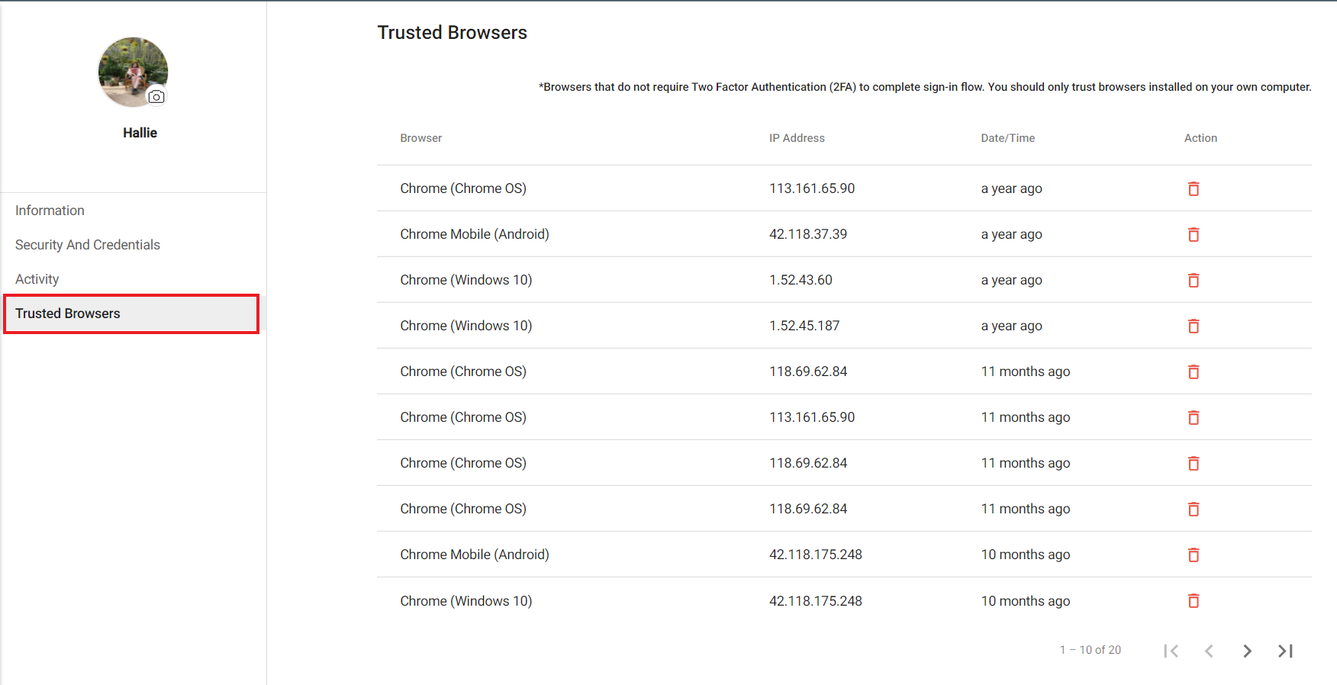
Manage Account <Trusted Browsers>
Shows the list of trusted browsers the members have accessed their account from.
*Trusted Browsers do not require Two Factor Authentication (2FA) to complete sign-in flow. You should only trust browsers installed on your own computer.

Slide 13
Settings on the portal

Slide 14
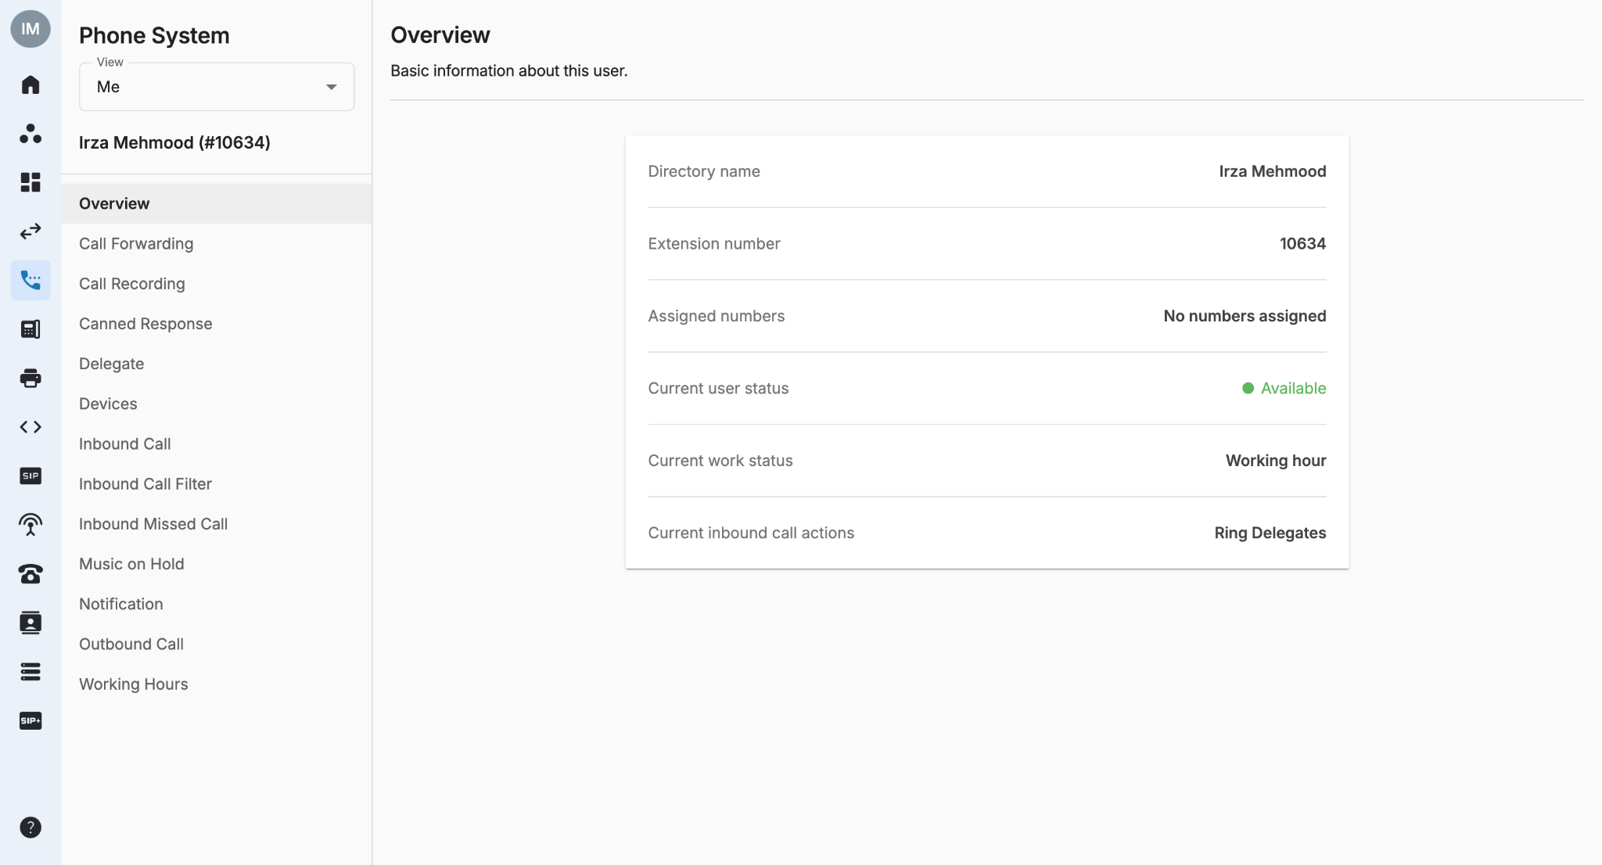
Settings (Overview)
This page gives the overview of the current User’s settings as well as their current status.
Directory Name, Extension Number & Assigned Numbers are managed in the Licenses tab by the Owner/Admins.
To change user status, follow this instruction.
Current work status is displayed based on User’s Working Hours.
Current inbound call actions is displayed based on User’s Inbound Call.

Slide 15
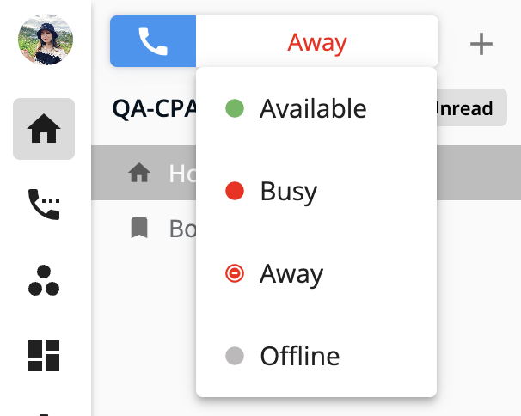
Settings (Overview)
Users can manually change their status by going to Homepage > Click on a User’s current status > change to Available / Busy / Away / Offline.

Slide 16
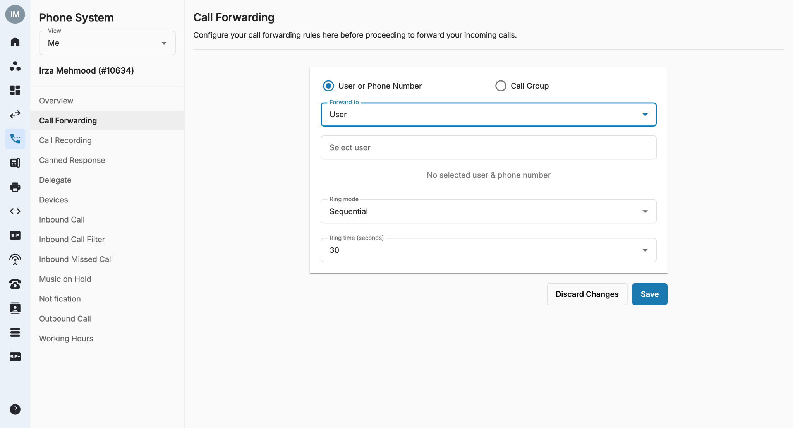
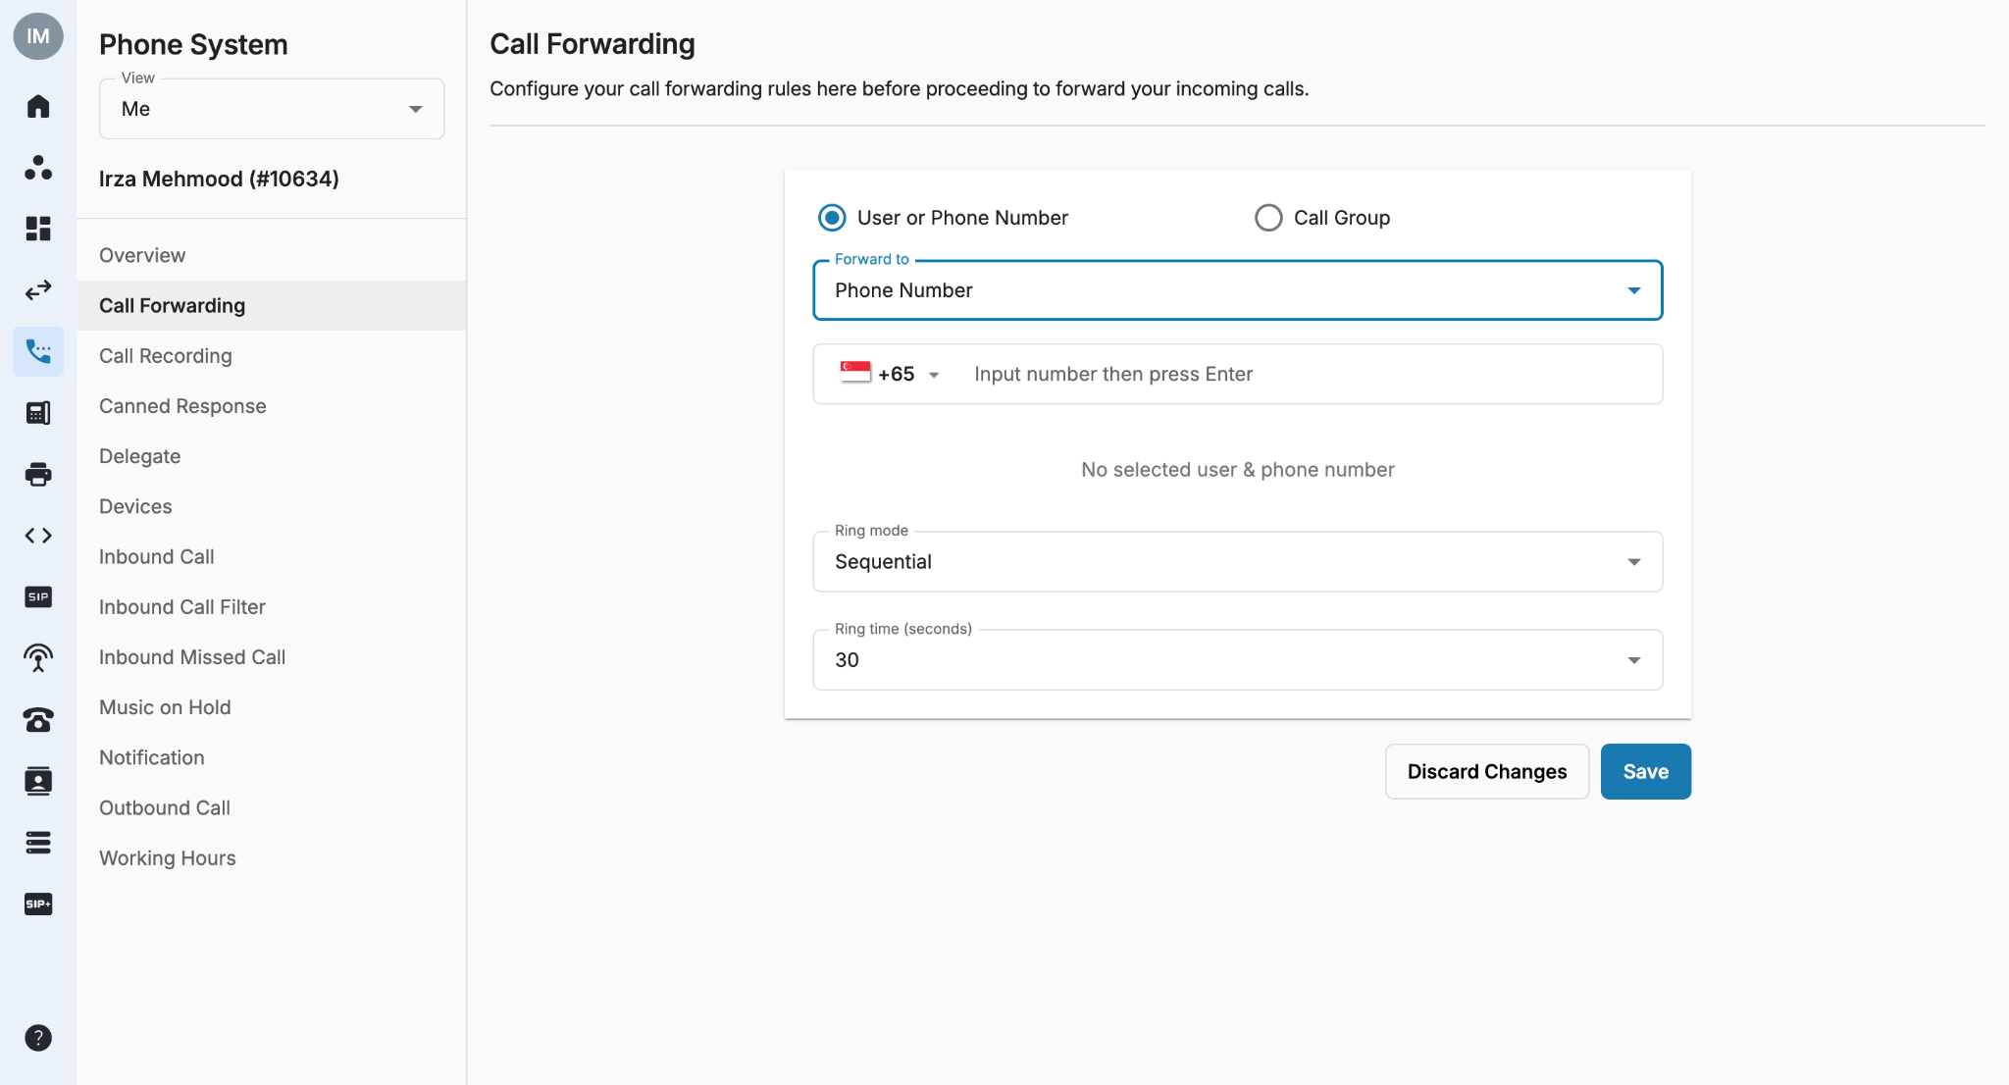
Settings <Call Forwarding>
Call Forwarding is a feature that allows users to forward or redirect incoming calls to any alternate numbers or the organization's extension numbers.
User can Filter by:
Me: if you want to manage your own extension settings
Specific Teams: if you're going to manage the settings of your assigned teams. Click HERE for more information.
Everyone: only available if you are allowed to manage the settings of everyone within your organization
Users have to select from one of the options:
User or Phone Number
Call Group
User or Phone Number
There will be a drop down menu to select between User or a Phone Number.
User: Drop-down bar to select User (Internal Extension)
Phone Number: Display a Bar to Select Country + Fill in Number

Slide 17
Settings <Call Forwarding>
Go to Call Forwarding to manage Users’ Forward List.
Ring Mode:
Ring All: All available numbers/extensions in the Forward List are rung simultaneously.
  Total Ring Time: from 5 to 60 seconds.
Sequential: Each number/extension is rung in order, one after the other, starting from the first extension in the list each time.
  Ring time per forwarding number: from 15 to 90 seconds.
The Phone System Extension will only have the following options:
Option 1: Only Internal Extensions (Maximum: 5 Extensions)
Option 2: Only External Phone Numbers (Maximum: 5 External Phone Numbers)
Option 3: Only Call Group (Maximum: 1 Group)
Option 4: Mix of internal extensions and external phone numbers (Maximum: 5)
Note:
The total limit for forwarding numbers is five numbers or extensions. The forwarding list can only contain one call group.
System will auto count when users enter the numbers/groups/extensions.
When the limit is reached, you cannot add more users to the list.

Slide 18
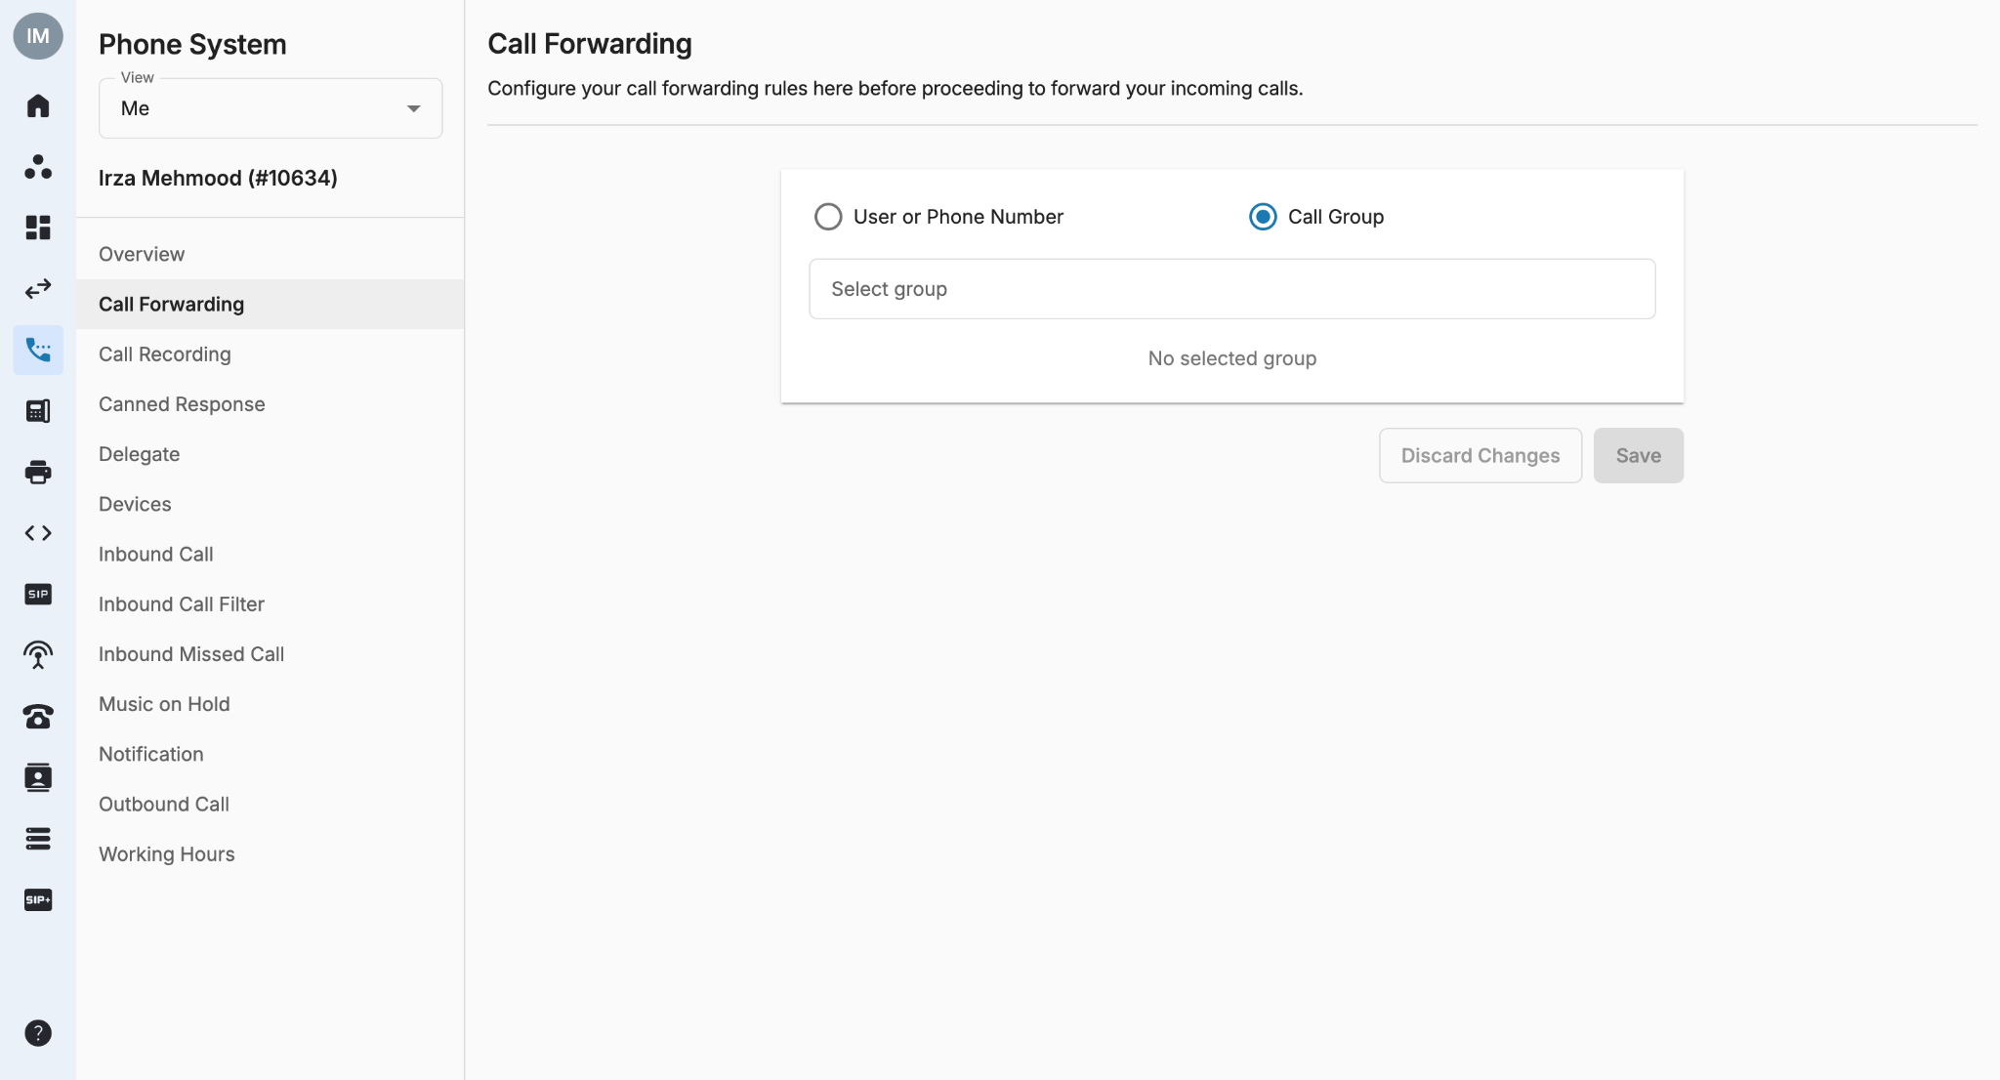
Settings <Call Forwarding>
Call Group
It will display a drop down bar to select a call group.
When there is an Incoming Call to an Extension, and it is being forwarded to a Call Group:
The Extensions in the Group will ring according to the Call Group Ring Mode settings:
Ring All
Sequential
Round Robin
Longest Idle

Slide 19
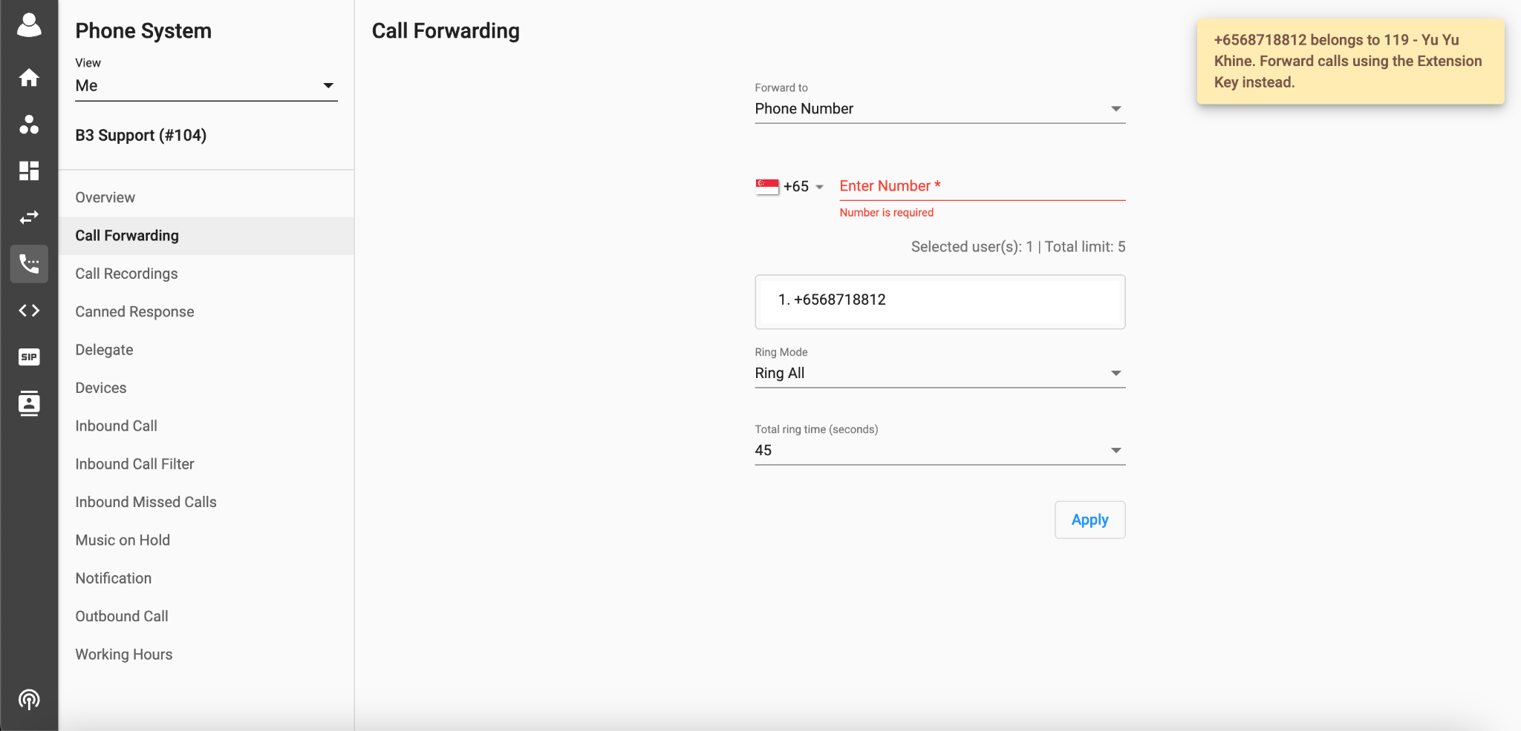
Settings (Call Forwarding)
Call Forwarding to Internal DID
To forward calls to an internal DID (number assigned to an extension of the same organization), users have to enter the respective extension key.
If the users enter a number instead of the extension key, the system will check whether the number entered is an assigned DID of a Phone System Extension within the organization. If yes, then the following error message will prompt on the screen.
Anticipated Actions:
Condition | Description | Action
TRUE | Forwarded Number is an Assigned DID of Phone System Extension within the Organization | After clicking the Apply button, an error message will appear on the screen. Message: ["{Number} belongs to {Extension Key} - {Extension Label}. Forward calls using the Extension Key instead."]. No changes will be saved/applied
FALSE | Forwarded Number is not an Assigned DID of Phone System Extension within the Organization | Changes will Apply and the input number will be added to the Forwarding List
Note:
This is applicable to numbers assigned for Phone System Extension (Excluding Auto Attendant or Developer assigned numbers)
Settings for existing Extensions will be kept the same as applied by the user. This validation will be applied only when users add a new Phone Number to the Forwarding List.

Slide 20
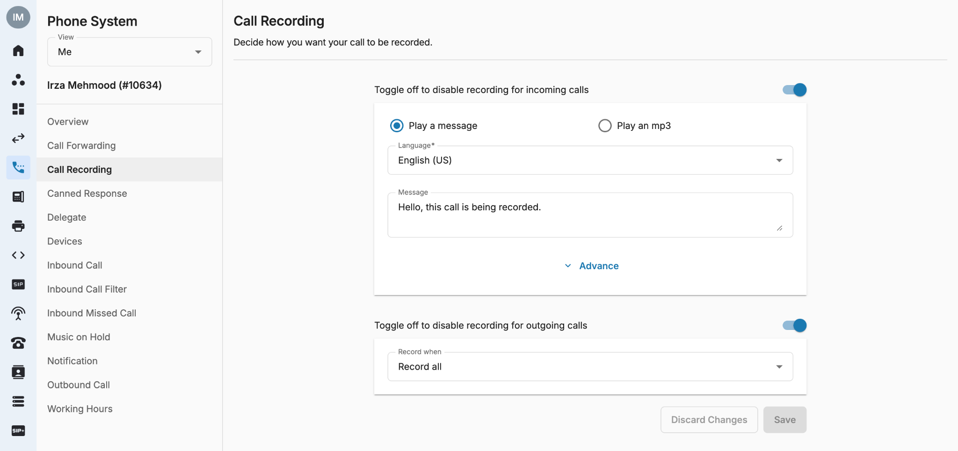
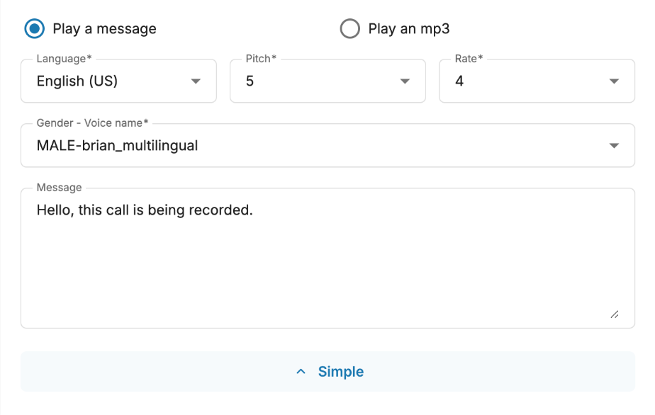
Setting (Call Recordings)
Call Recordings page is where users who have Call Recording License can configure Call Recording settings.
Toggle on/off to choose either record incoming/outgoing calls or both.
For outgoing calls, owner/admins can choose one of the following actions:
Record all: Automatically records all outgoing calls.
Ask to record: Before initiating the call, user is asked which call they wish to record.
  Message: “Please press 0 to disable call recording, press 1 to apply call recording.”
(Only appears if users have Call Recording License and the Admins allow to self-configure).
Please Note:
Limitation for the number of characters for TTS message are 2000 characters
Error will only appear on the UI when users enter more characters than the limit.
Apply button will be disabled when the character limit is exceeded.

Slide 21
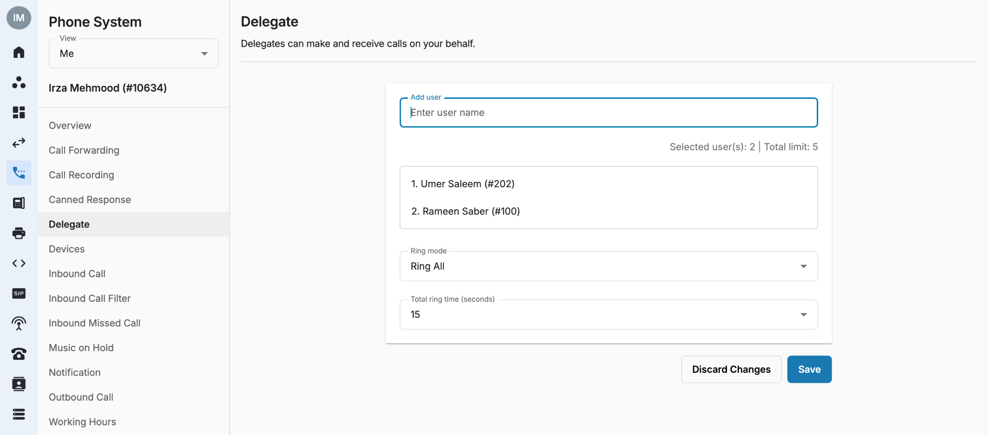
Settings (Delegate <Boss-Secretary>)
This function allows other people to answer and make calls on User’s behalf. Calls can be automatically forwarded to User’s delegates (setting up in Inbound Call page). Delegates can transfer back to their Boss by using Transfer function on their devices.
Go to Delegate tab to manage User’s Delegation List.
Ring Mode:
  Ring All: All available delegates in the Delegation List are rung simultaneously.
  Sequential: Each delegate is rung in order, one after the other, starting from the first delegate in the list each time.
Notes:
Only users within the organization can be added to the Delegation List.
A user cannot be delegated if they are delegating to others.
A user cannot delegate or be delegated when being in a Call Group (created by the Owner/Admins).
In the case of Delegation List:
  If any of the extensions miss the call, it will not trigger its own Unanswered or Busy Flow and the call will be simply dropped.
  The working hour of the delegates in the list will be ignored.
The total limit for Delegate numbers are 5 numbers.
System will auto count when users enter the numbers.
When the limit is reached, you cannot add more user to the list.

Slide 22
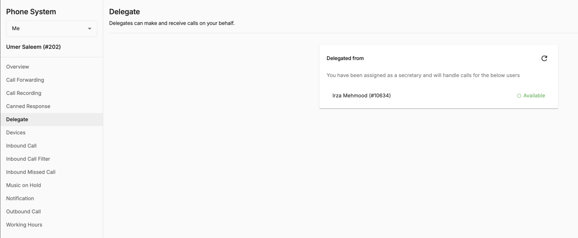
Settings (Delegate <Boss-Secretary>)
The Delegate tab also shows the information of the Boss and his/her status in case the Secretary would like to transfer the call to the Boss.
***Notes:
Call History on the portal:
Boss will see that the call is delegated.
Secretary will see the call as a normal incoming call.
Admin Tools:
Show SIP credential for Delegate to:
Register on IP Phone
Receive and make calls using the Boss's Caller ID
Secretary’s Mobile App View:
If the Boss diverts all his/her incoming calls to the Secretary, when there is an incoming call to the Boss:
The system will display the Caller ID of the caller (not her Boss's Caller ID) on the Secretary's device. Besides, if the Secretary uses mobile app, the Boss's extension number will be displayed on the screen so the Secretary knows that this call is diverted from the Boss.
Secretary

Slide 23
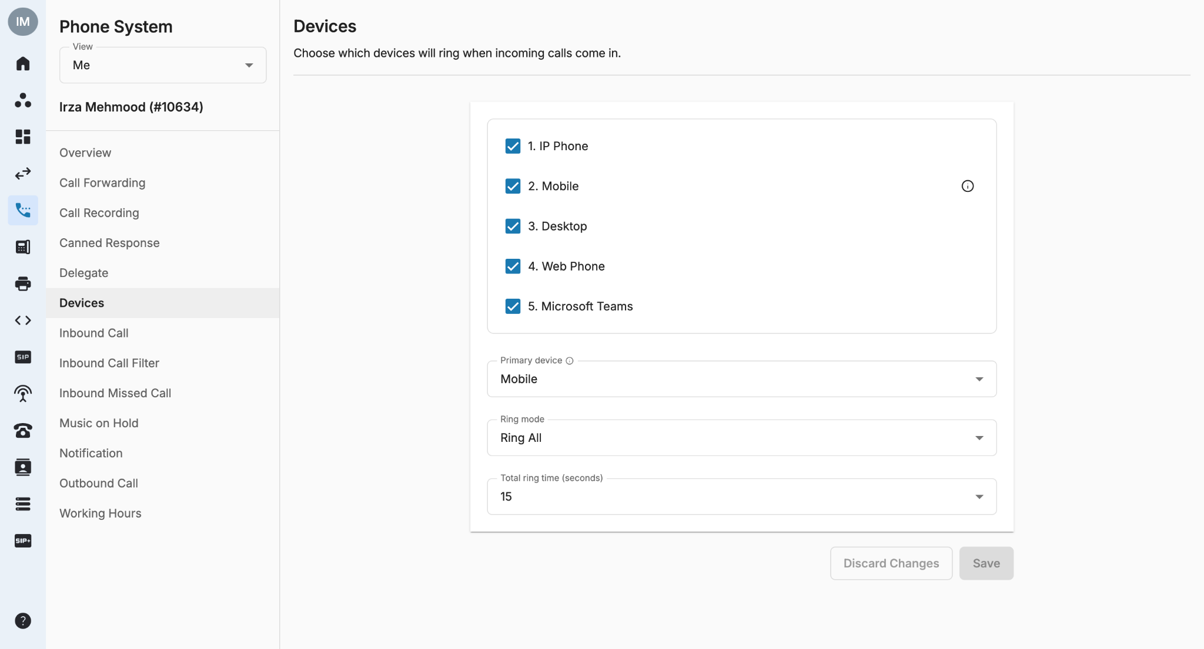
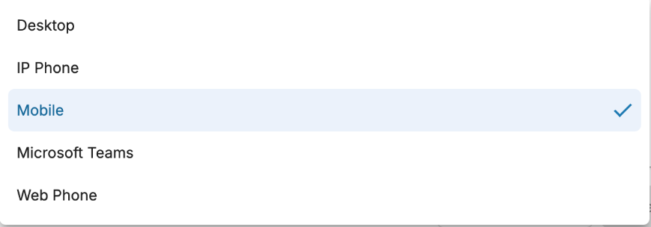
Settings <Devices>
In case users have multiple activated devices, they can decide which devices to be rung when calls come in by going to Devices.
Primary Device
Users can choose a preferred Primary Device from the drop-down menu.
Primary Device is the only device that will be rung for Contact Center extension and if the user is added to a call group
Tick/Untick to select devices
Drag and drop to change sequence
Ring Mode:
Ring All: All ticked devices are rung simultaneously.
  Total ring time (second) at all devices.
Sequential: Each device is rung in order, one after the other, starting from the first extension in the list each time.
  Ring time (second) per device.
The current supported devices include:
IP Phone
Mobile app (IOS and Android)
Desktop (Mac and Windows)
MS Teams
Web Phone
Please note:
The default Primary Device will be the first selected device in the devices list.
However, for existing Extensions, the default Primary Device will be as configured.

Slide 24
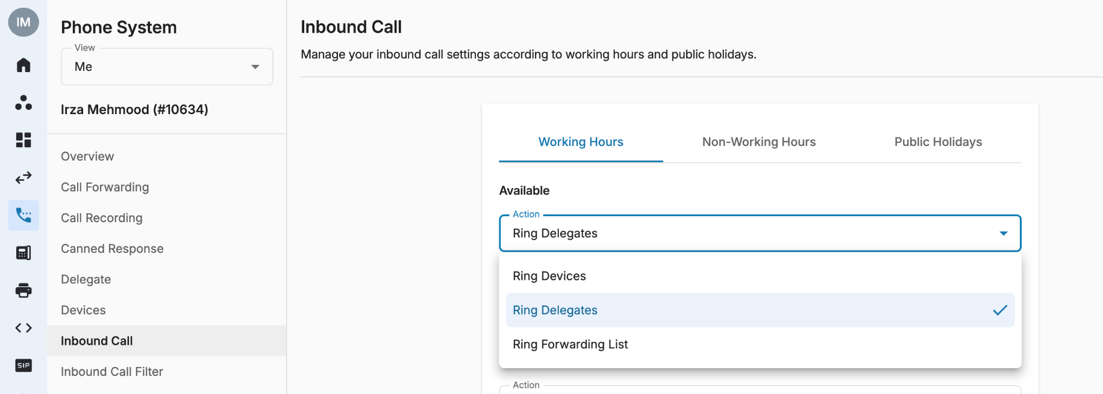
Settings (Inbound Call)
Users can configure their Inbound Call settings for different scenarios.
When users are Available in Working Hours, they can choose to:
Ring Devices: ring users’ available devices
Ring Delegates: forward all incoming calls to users’ delegates
Ring Forwarding List: forward all incoming calls to users’ forwarding list

Slide 25
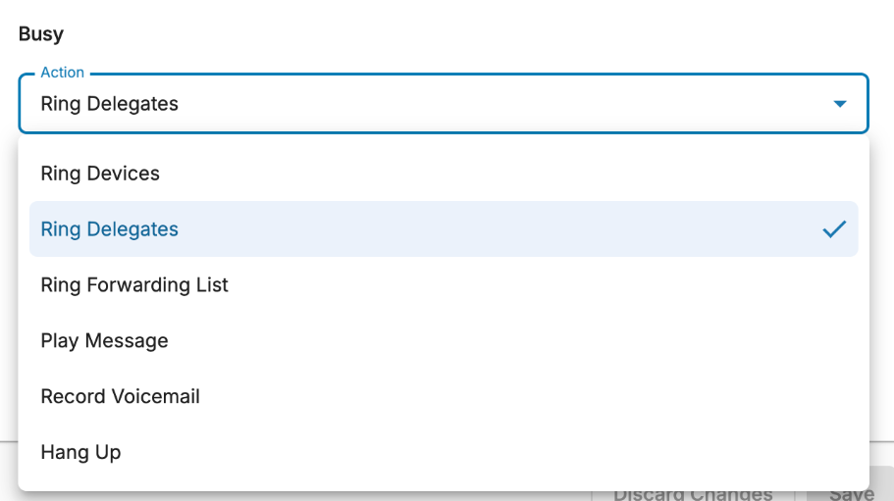
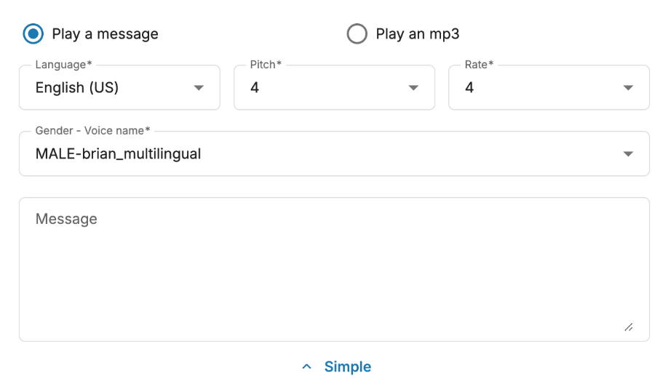
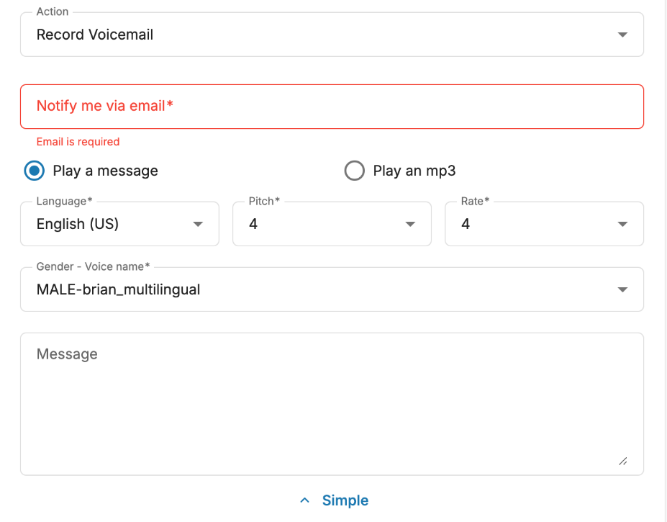
Settings (Inbound Call)
When users are Busy during Working Hours, they can trigger the below actions:
  Ring Devices
  Ring Delegates
  Ring Forwarding List to the Forward List
  Play Message
    Supports TTS (text-to-speech) or MP3 file upload.
    The message box is currently limited to 2000 characters.
    Multiple language and accent options to choose from.
    Customizable pitch: the degree of highness or lowness of a tone; from 0 (lowest) to 9 (highest).
    Customizable speech rate: the speed; from 0 (slowest) to 9 (fastest).
    Gender of the voice options.
  Record Voicemail
    Limitation: 3 minute/voicemail
    Enter email address for notification
  Simply Hang Up the incoming call
Please Note:
Limitation for the number of characters for TTS message are 2000 characters
Error will only appear on the UI when users enter more characters than the limit.
Apply button will be disabled when the character limit is exceeded.

Slide 26
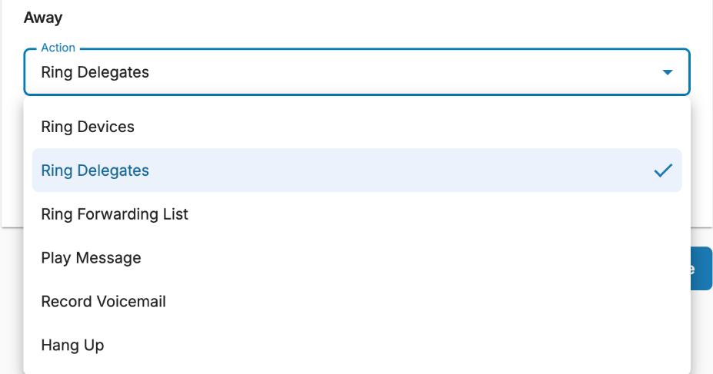
Settings (Inbound Call)
When users are Away during Working Hours, they can trigger the below actions:
  Ring Devices
  Ring Delegates
  Ring Forwarding List to the Forward List
  Play Message
    Supports TTS (text-to-speech) or MP3 file upload.
    The message box is currently limited to 2000 characters.
    Multiple language and accent options to choose from.
    Customizable pitch: the degree of highness or lowness of a tone; from 0 (lowest) to 9 (highest).
    Customizable speech rate: the speed; from 0 (slowest) to 9 (fastest).
    Gender of the voice options.
  Record Voicemail
    Limitation: 3 minute/voicemail
    Enter email address for notification
  Simply Hang Up the incoming call

Slide 27
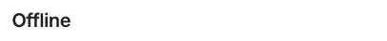
Settings (Inbound Call)
When users are Offline during Working Hours, they can trigger the below actions:
  Ring Devices
  Ring Delegates
  Ring Forwarding List to the Forward List
  Play Message
    Supports TTS (text-to-speech) or MP3 file upload.
    The message box is currently limited to 2000 characters.
    Multiple language and accent options to choose from.
    Customizable pitch: the degree of highness or lowness of a tone; from 0 (lowest) to 9 (highest).
    Customizable speech rate: the speed; from 0 (slowest) to 9 (fastest).
    Gender of the voice options.
  Record Voicemail
    Limitation: 3 minute/voicemail
    Enter email address for notification
  Simply Hang Up the incoming call

Slide 28
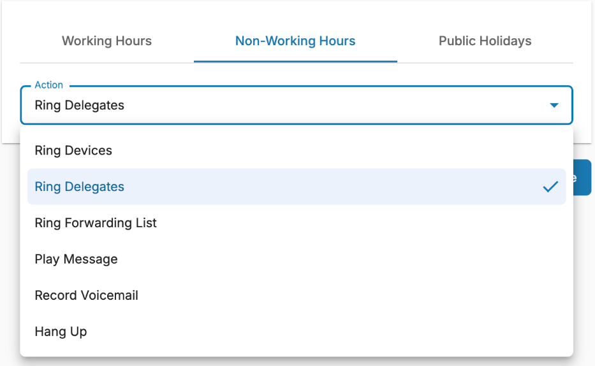
Settings (Inbound Call)
During Non-working Hours, users can trigger the below actions:
  Ring Devices
  Ring Delegates
  Ring Forwarding List to the Forward List
  Play Message
    Supports TTS (text-to-speech) or MP3 file upload.
    The message box is currently limited to 2000 characters.
    Multiple language and accent options to choose from.
    Customizable pitch: the degree of highness or lowness of a tone; from 0 (lowest) to 9 (highest).
    Customizable speech rate: the speed; from 0 (slowest) to 9 (fastest).
    Gender of the voice options.
  Record Voicemail
    Limitation: 3 minute/voicemail
    Enter email address for notification
  Simply Hang Up the incoming call

Slide 29
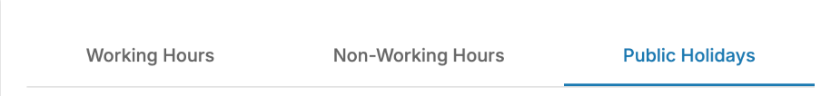
Settings (Inbound Call)
During Public Holidays, users can trigger the below actions:
  Ring Devices
  Ring Delegates
  Ring Forwarding List to the Forward List
  Play Message
    Supports TTS (text-to-speech) or MP3 file upload.
    The message box is currently limited to 2000 characters.
    Multiple language and accent options to choose from.
    Customizable pitch: the degree of highness or lowness of a tone; from 0 (lowest) to 9 (highest).
    Customizable speech rate: the speed; from 0 (slowest) to 9 (fastest).
    Gender of the voice options.
  Record Voicemail
    Limitation: 3 minute/voicemail
    Enter email address for notification
  Simply Hang Up the incoming call

Slide 30
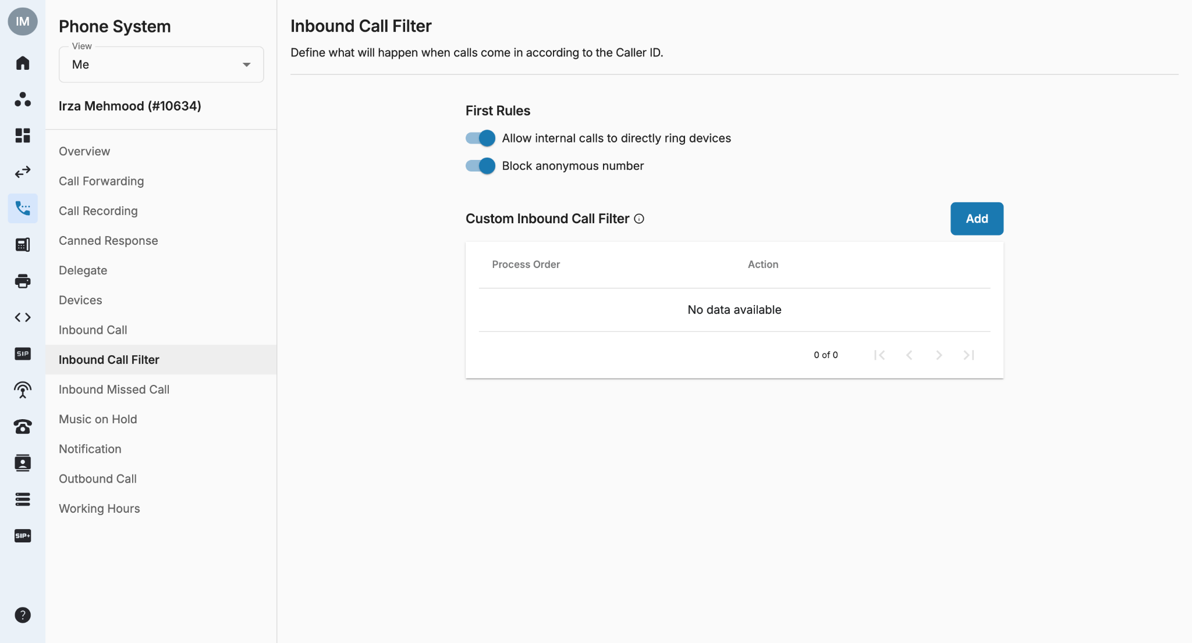
Setting (Inbound Call Filter)
This function defines what action will be taken when an incoming call is made to the Users’ assigned number according to the Caller ID.
First Rules: By default, the Inbound Call Filter comes with two default rules that can be adjusted but cannot be removed:
  Allow internal call to directly Ring Devices: If this option is disabled, internal calls will follow User’s Inbound Call settings and Working Hours. If enabled, all internal calls will go directly to the User’s devices regardless of their Inbound Call settings and Working Hours.
  Block Anonymous Number

Slide 31
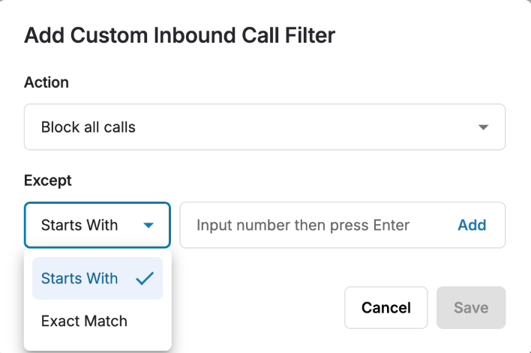
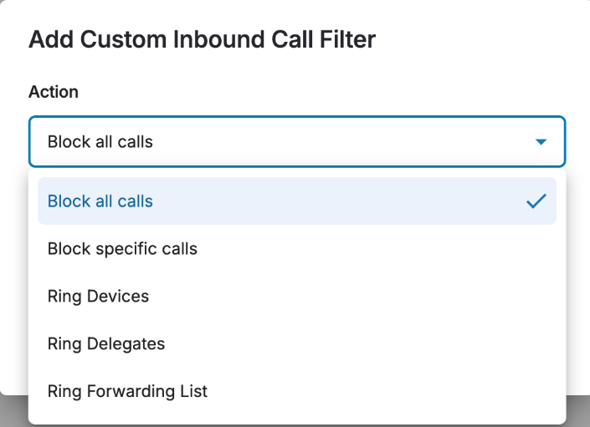
Setting (Inbound Call Filter)
This function defines what action will be taken when an incoming call is made to the User's assigned number according to the Caller ID.
Custom Inbound Call Filter: In order to add a custom inbound call filter rule, follow the steps below:
  Go to the Inbound Call Filter tab, click Add
  Choose Match Pattern type
  Starts with
  Exact match
  Click on Add and select the Action
Available Actions
Block all calls (To block all incoming calls except the ones on the list)
Block specific calls (To block specific numbers on the list)
Ring Devices (For specific numbers in the list)
Ring Delegates (For specific numbers in the list)
Ring Forwarding List (For specific numbers in the list)
*Note: Filtering is done by the FIRST match. The system will stop checking the remaining rules if the Caller ID matches the first rule.

Slide 32
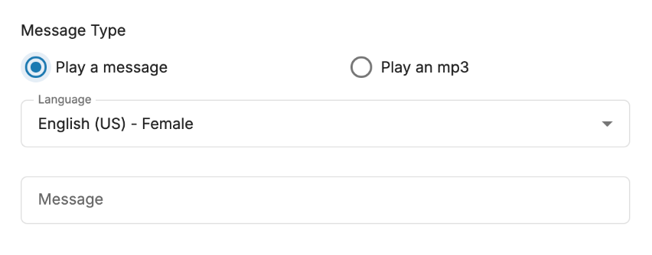
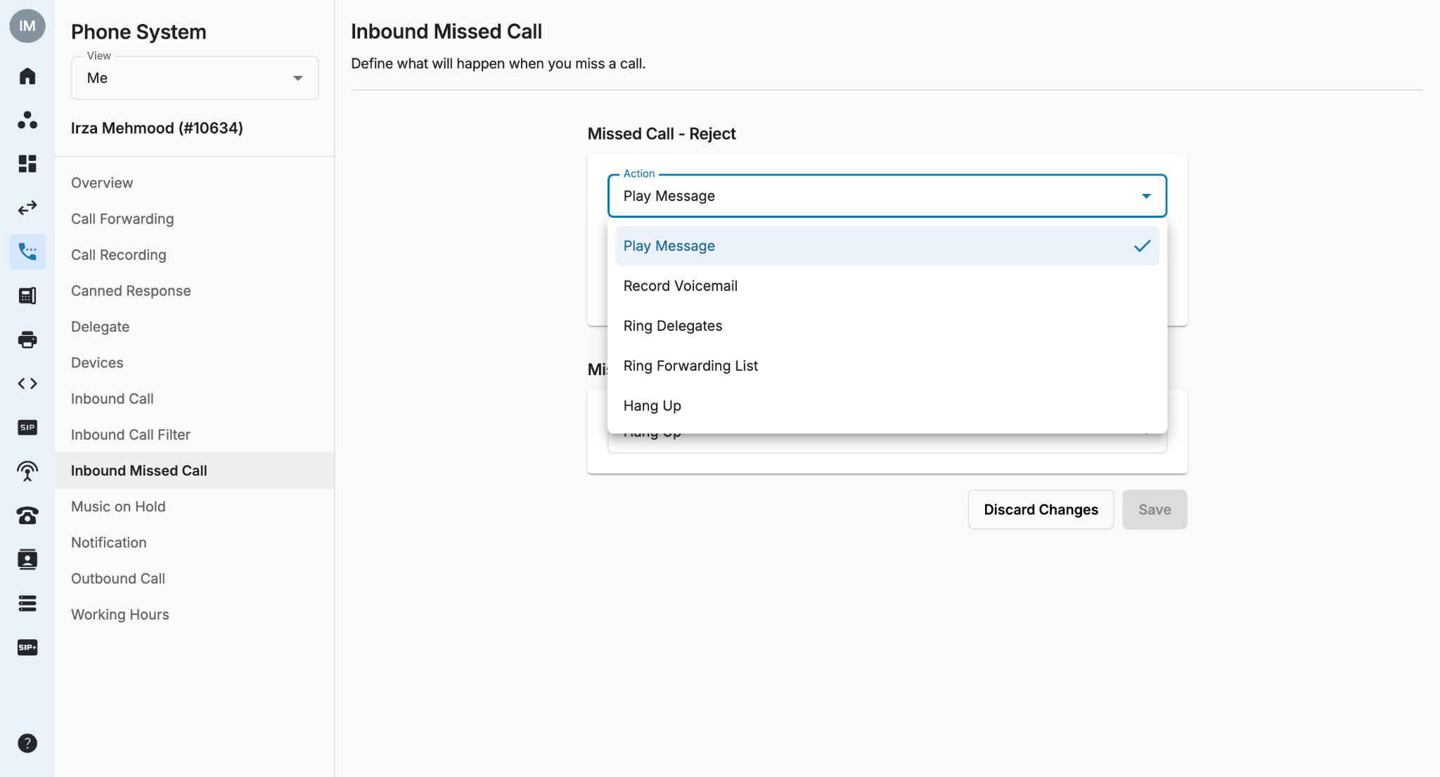
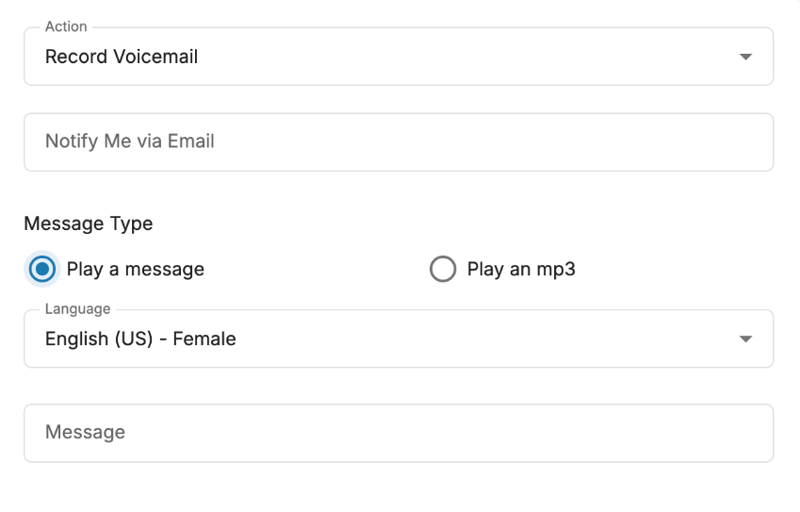
Settings (Inbound Missed Calls)
When there is an incoming call to your devices but you reject the call, the following actions will be triggered:
  Ring Delegates
  Ring Forwarding List to the Forward List
  Play Message
    Supports TTS (text-to-speech) or MP3 file upload.
    The message box is currently limited to 2000 characters.
    Multiple language and accent options to choose from.
  Record Voicemail
    Limitation: 3 minute/voicemail
    Enter email address for notification
  Simply Hang Up the incoming call
Please Note:
Error will only appear on the UI when users enter more characters than the limit.
Apply button will be disabled when the character limit is exceeded.

Slide 33
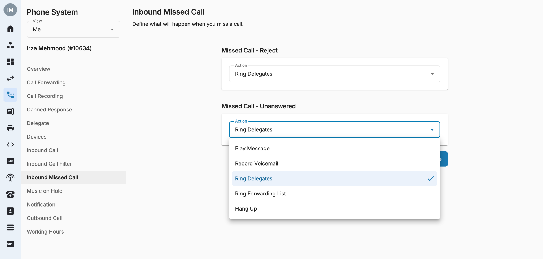
Settings (Inbound Missed Calls)
When there is an incoming call to your device but you don’t answer the call (unanswered), the following actions will be triggered.
  Ring Delegates
  Ring Forwarding List to the Forward List
  Play Message
    Supports TTS (text-to-speech) or MP3 file upload.
    The message box is currently limited to 2000 characters.
    Multiple language and accent options to choose from.
  Record Voicemail
    Limitation: 3 minute/voicemail
    Enter email address for notification
  Simply Hang Up the incoming call

Slide 34
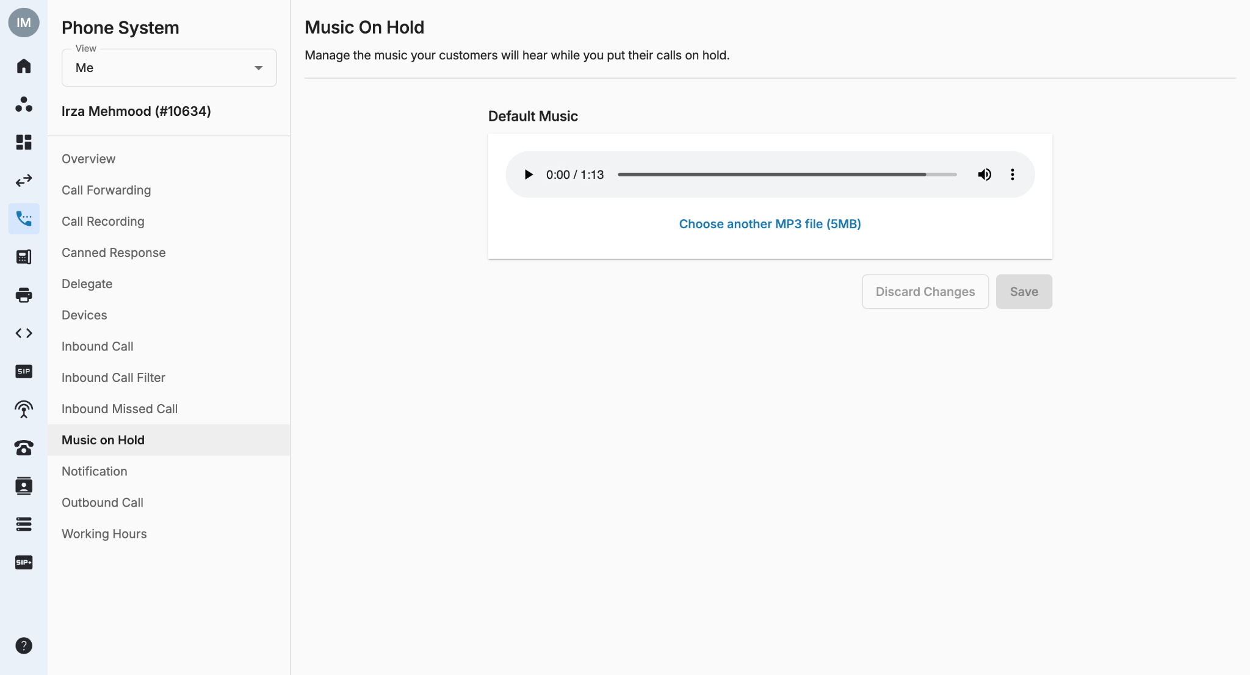
Settings (Music On Hold)
In this tab, users can replace default music on hold with their own.
Note:
Click Choose another MP3 file to set up custom music.
After uploading an MP3 file, you can either click Save to upload a new file or click Discard Changes to go back to the default music.
Maximum file size (5MB)

Slide 35
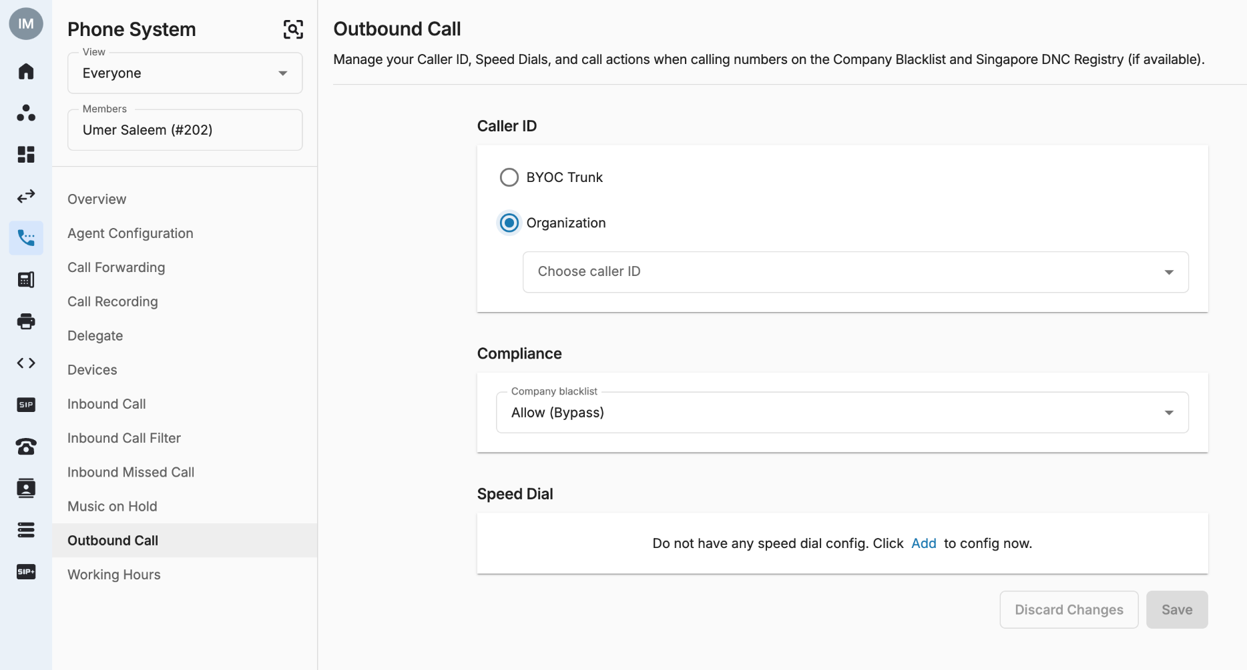
Settings (Outbound Call)
Outbound Call is where users can modify their Caller ID - DNC/Consent action and Speed Dial.
Caller ID can be changed from Desktop, Mobile app and WebPhone.
  Caller ID can be:
    BYOC Trunk
    Organization

Slide 36
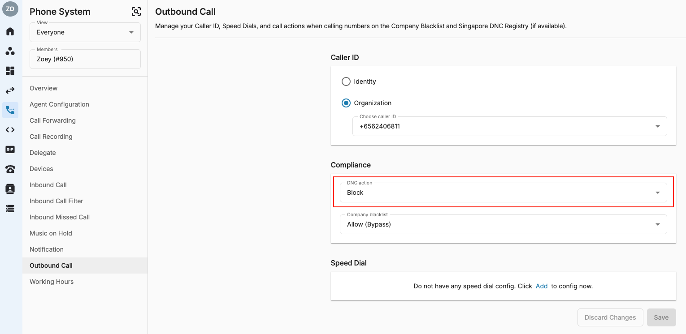
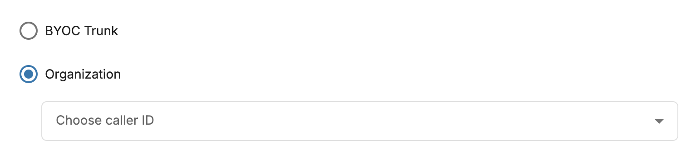
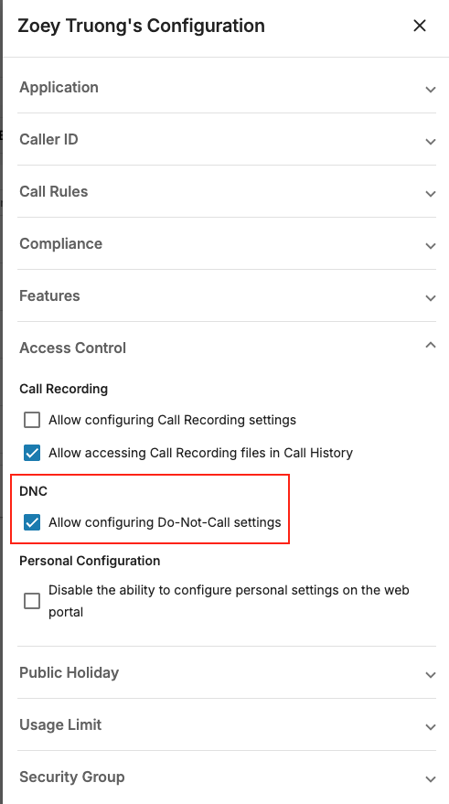
Settings <Outbound Call>
DNC and Company Blacklist/Whitelist checking actions (only available if users have DNC license and Allow configuring DNC settings in Admin Tools):
  Allow (Bypass)
  Block
  Prompt (Check and ask)
Note:
Always show Company Blacklist regardless of DNC license
For new users, the default value = Block
For old users, their current configuration will not be changed after adding or removing a DNC license.

Slide 37
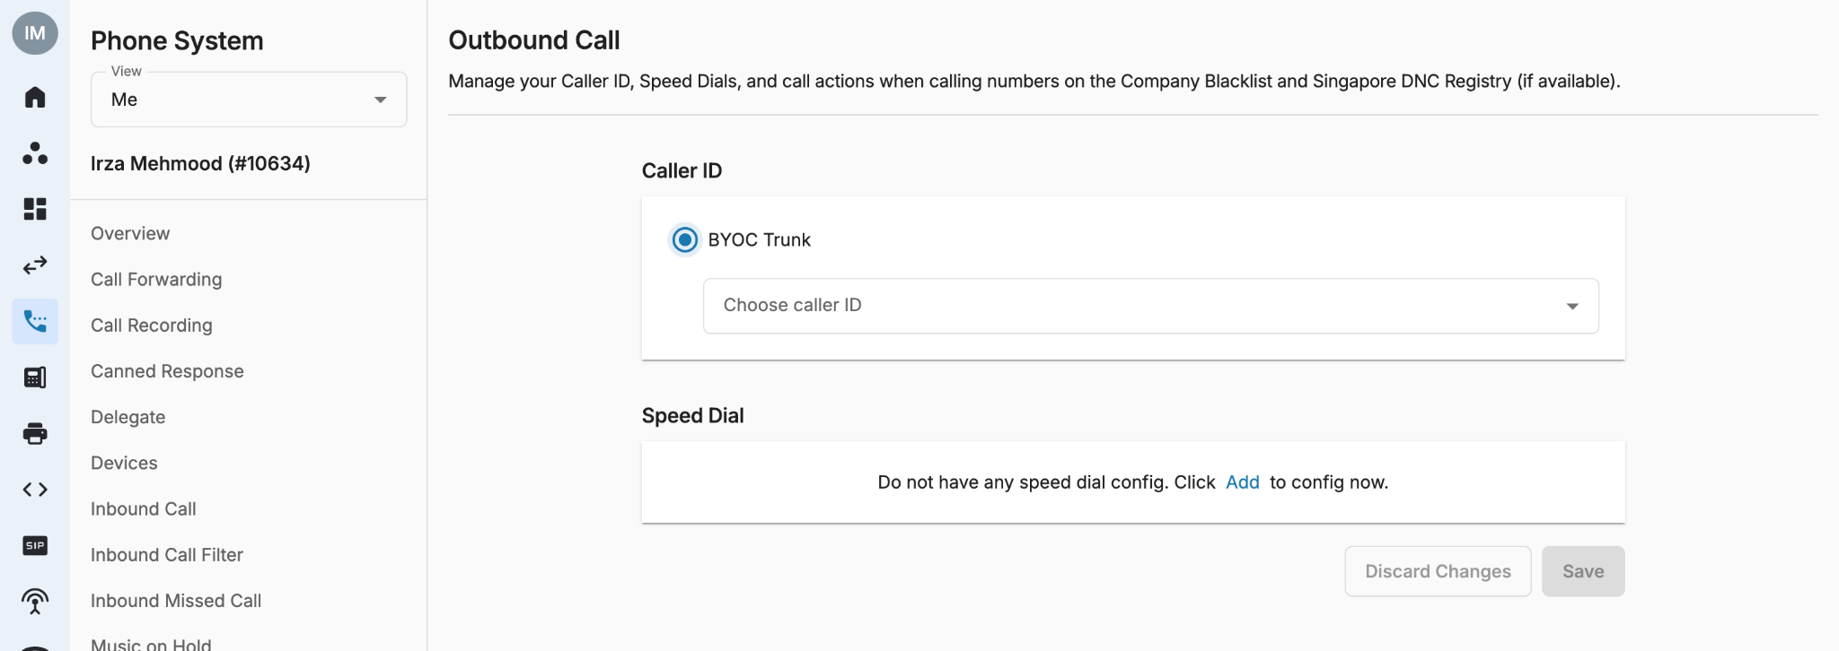
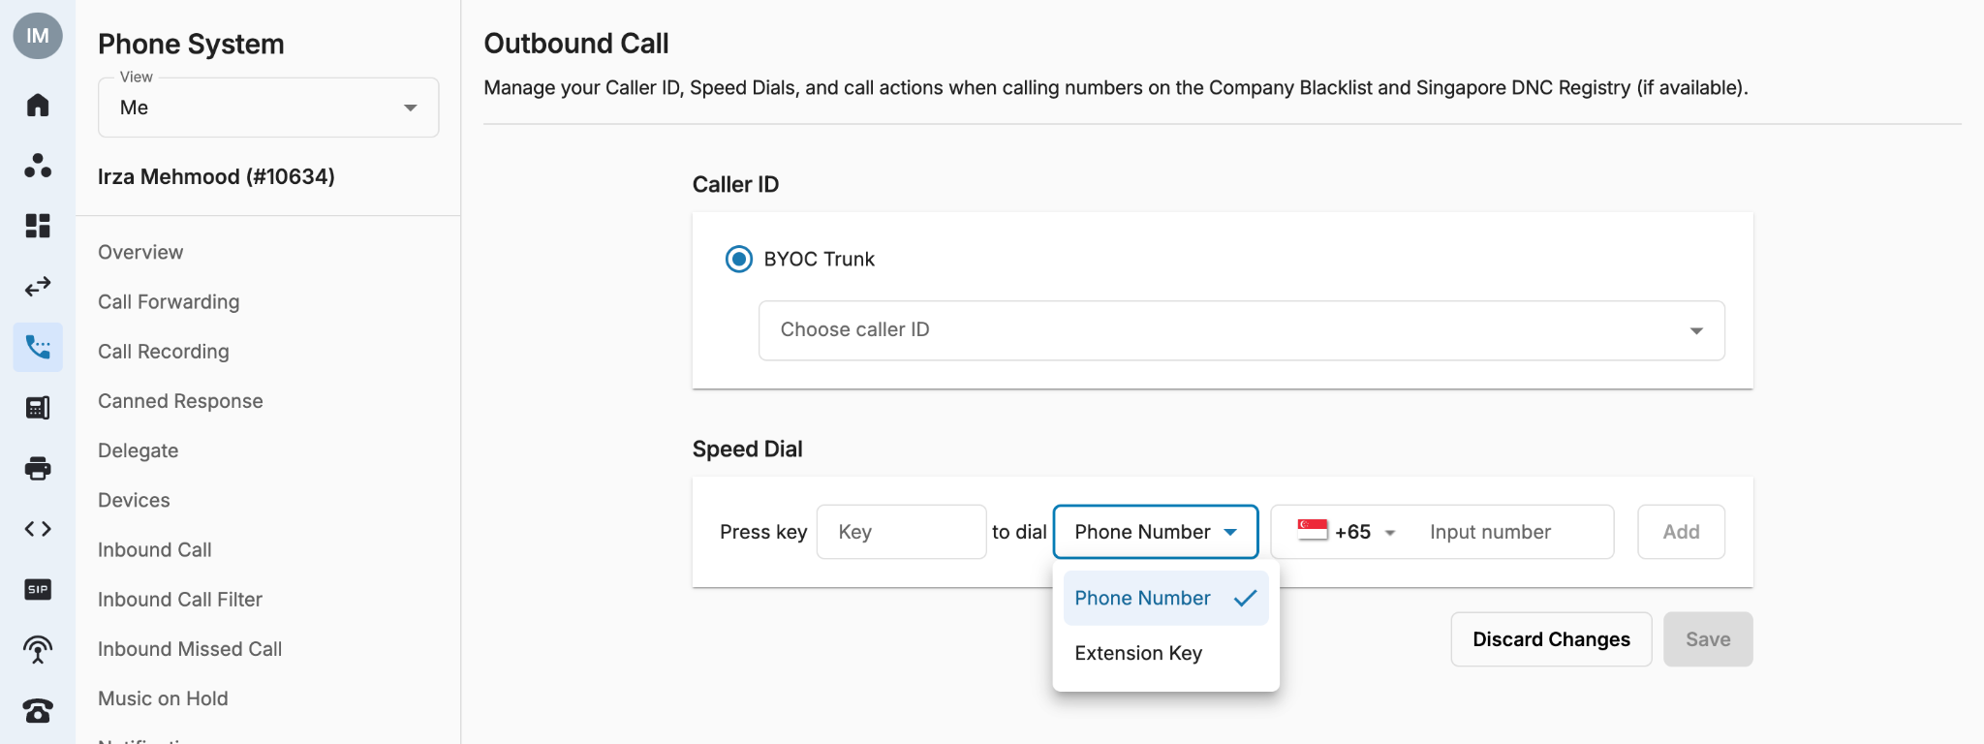
Settings (Outbound Call)
Speed Dial: allows users to place a call by pressing a reduced number of keys.
  This function is particularly useful for phone users who dial certain numbers on a regular basis.
  Key requires from 1-2 digits
  Phone number requires the E.164 standard format
Click Add button.
Enter the Key you want to press for speed dialing the specific number/extension key.
Select Number/Extension Key.
Input the number or extension key number.
Click Add button and Save to apply the changes.
Please Note
If the System detects an incorrect number format it will show the following error: * Number format must be <+><country code><area code><phone number>

Slide 38
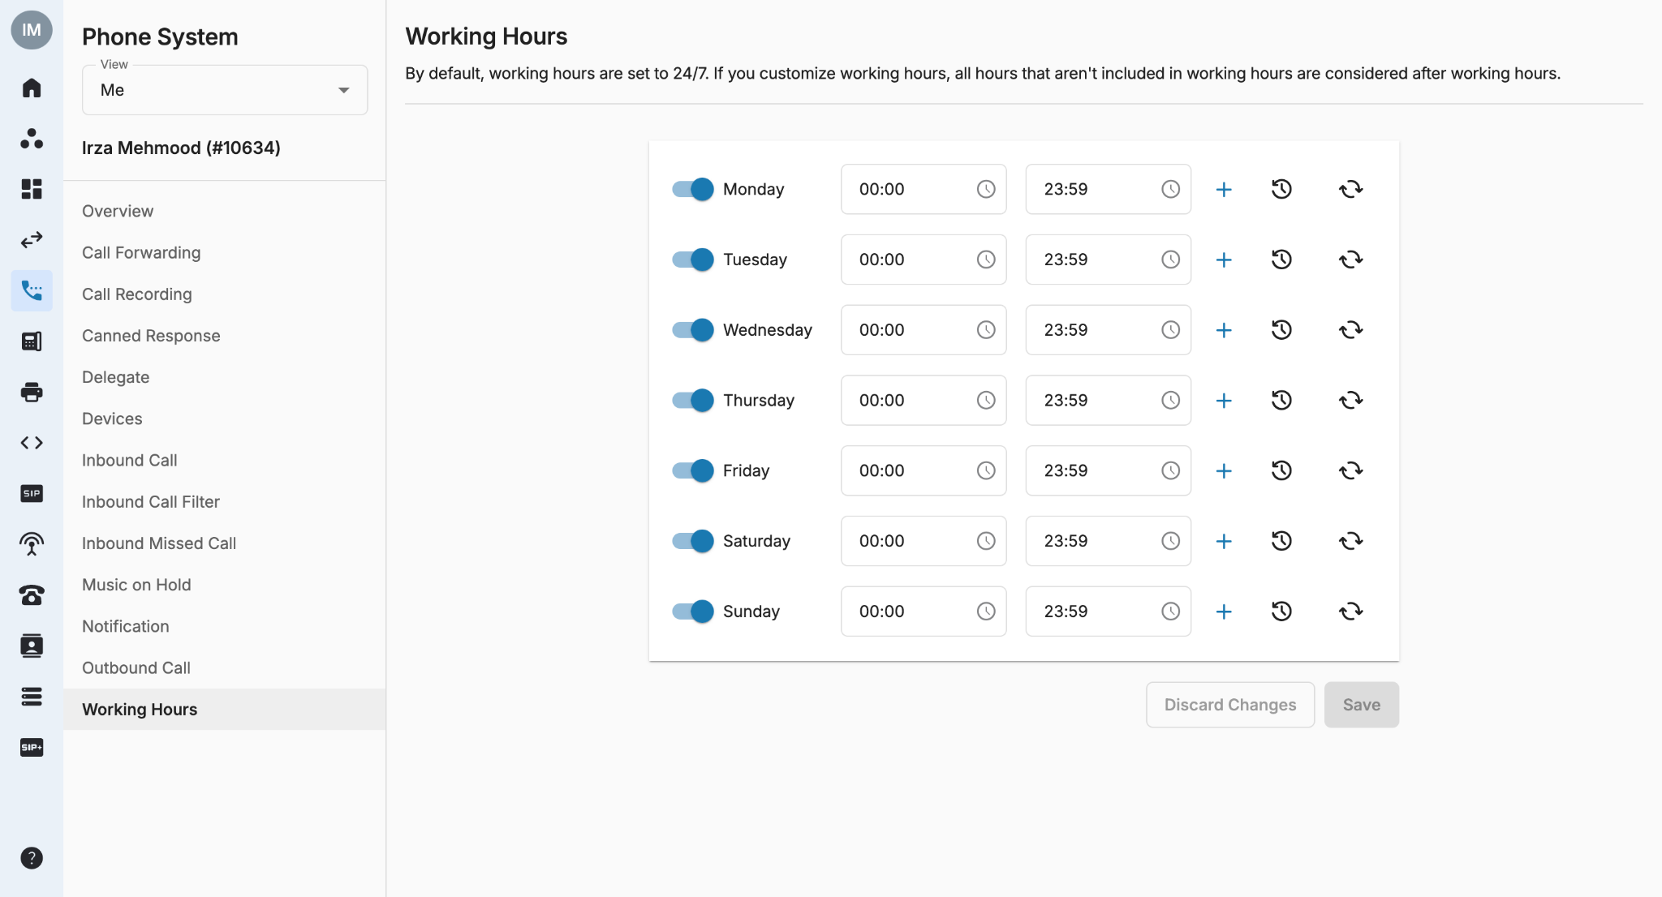
Settings (Working Hours)
In this section, users can set their own Working Hours appropriately.
During non-working hours, actions to be taken can be customised in the Inbound Call tab.
Turn toggle ON/OFF for working days
Set the same time for all days
Revert to 24 hours of working hours
Add multiple working hours within a day
Inbound Call tab

Slide 39
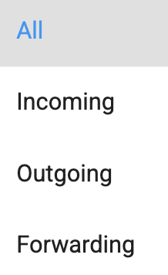
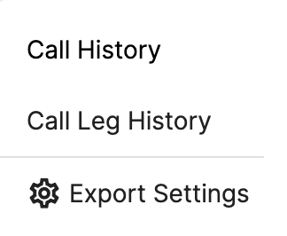
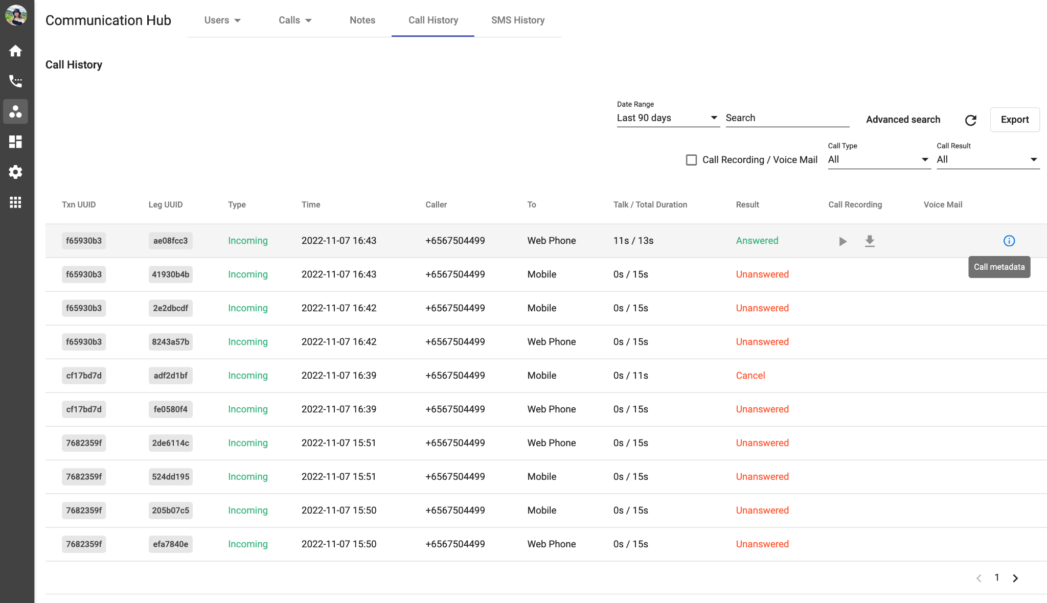
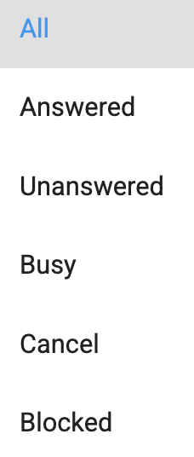
Communication Hub <Call History>
The Call History in Communication Hub is a place where keeps the records of all call transactions within the Organization. It will provide:
  Basic details - Call Directions (Incoming/Outgoing calls), Phone Numbers, Extension Numbers, Date & Time, etc.
  Advanced details - Call Metadata.
Data in Call History will be stored up to 1 year since the date the call is created.
It takes a few mins (max: 5 mins) for the data to appear on the portal after the call ends. Longer call duration will require longer processing time.
The SLA of call recording uploading on Unified History is 24 hours.

Slide 40
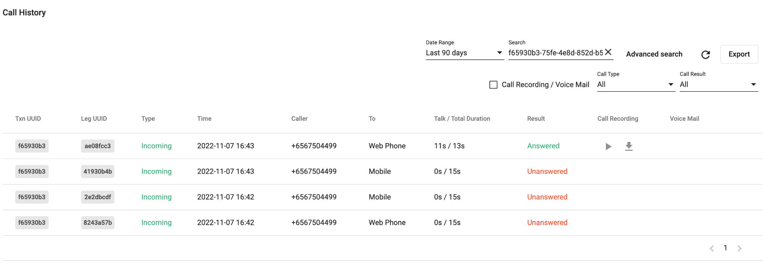
Communication Hub <Call History>
TXN UUID: TXN UUID stands for the Universal Unique Identifier of the Main Transaction.
  It is copyable
  It is capable to search in the searching box.
Leg UUID
Type
Time
Caller
To
Talk / Total Duration
Result
Call Recording / Voicemail

Slide 41
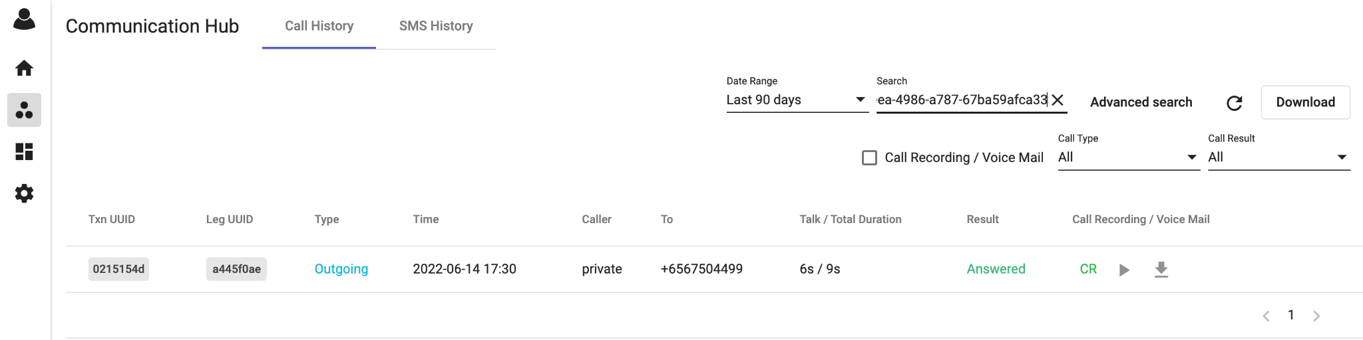


Communication Hub <Call History>
It contains every basic information about a call that an agent with minimum experience about call flows can still understand, including:
TXN UUID
Leg UUID: Leg UUID stands for the Universal Unique Identifier of the Call Leg Transaction
  It is copyable
  It is capable to search in the searching box.
Type
Caller
To
Talk / Total Duration
Result
Call Recording / Voicemail

Slide 42


Communication Hub <Call History>
It contains every basic information about a call that an agent with minimum experience about call flows can still understand, including:
TXN UUID
Leg UUID
Type: Type of the call, can be:
  Incoming: Calls come from outside B3 system
  Outgoing: Calls are initialized inside B3 system
  Forwarding: Calls come from outside B3 then are forwarded to another endpoint
Time
Caller
To
Talk / Total Duration
Result
Call Recording / Voicemail

Slide 43
Communication Hub <Call History>
It contains every basic information about a call that an agent with minimum experience about call flows can still understand, including:
TXN UUID
Leg UUID
Type
Time: The time when the call started.
Caller
To
Talk / Total Duration
Result
Call Recording / Voicemail

Slide 44
Communication Hub <Call History>
It contains every basic information about a call that an agent with minimum experience about call flows can still understand, including:
TXN UUID
Leg UUID
Type
Time
Caller: The Caller ID that is displayed on participant devices.
To
Talk / Total Duration
Result
Call Recording / Voicemail

Slide 45
Communication Hub <Call History>
It contains every basic information about a call that an agent with minimum experience about call flows can still understand, including:
TXN UUID
Leg UUID
Type
Time
Caller
To: The participant endpoint information.
  It can be to:
    Phone Number (Called Party Number)
    Extension
      Extension Device
        IP Phone
        Mobile
        Desktop
        Web Phone
Talk / Total Duration
Result
Call Recording / Voicemail

Slide 46
Communication Hub <Call History>
It contains every basic information about a call that an agent with minimum experience about call flows can still understand, including:
TXN UUID
Leg UUID
Type
Time
Caller
To
Talk / Total Duration
  Total Duration = Call End Time - Call Start Time
  Total Duration = Call End Time - First Answer Time
Result
Call Recording / Voicemail

Slide 47
Communication Hub <Call History>
It contains every basic information about a call that an agent with minimum experience about call flows can still understand, including:
TXN UUID
Leg UUID
Type
Time
Caller
To
Talk / Total Duration
Result: Results of the call, values list:
  Answered
  Unanswered
  Busy
  Cancel
  Blocked
  Failed
Call Recording / Voicemail

Slide 48
Communication Hub <Call History>
Result | Call Type | Determination Method
Answered | Incoming | The incoming call was successfully connected to destination party such as: Agent’s devices (IP Phone, mobile, desktop, etc…) and the party picked up
 | Outgoing | The outgoing call was successfully connected to the destination
 | Forwarding | The incoming call was successfully forwarded to the external destination
Unanswered | Incoming | The incoming call was successfully connected to the agent’s devices (IP Phone, mobile, desktop, etc…). Caller waited until reaching the total ring time configured by the agent => the call was hung up by the system.
 | Outgoing | The caller was successfully connected to the system and the destination party did not pick up the call
 | Forwarding | The caller was successfully connected to the system and the forwarded destination party did not pick up the call
Busy | Incoming | The destination party of the incoming call was on the another call or rejected it
 | Outgoing | The destination party of the outgoing call was on the another call or rejected it
 | Forwarding | The destination party of the forwarding call was on the another call or rejected it

Slide 49
Communication Hub <Call History>
Result | Call Type | Determination Method
Cancel | Incoming | The incoming call was successfully connected to the destination, but hung up before the agent picked up The incoming call was successfully connected to the destination but then the system received cancel request from agent’s device, telco provider,... before the agent picked up Non-working hour/Public Holiday, predefined Action = Hang Up.
 | Forwarding | The incoming call was successfully forwarded to the external destination but hung up before the forwarded destination picked up The incoming call successfully forwarded to the external destination but then the system received cancel request from agent’s app, telco provider,... before the agent picked up
 | Outgoing | The caller of the outgoing call cancelled the call before the destination picked up
Blocked | Incoming | The incoming call was blocked to connect to the users by their inbound call filter settings (reject anonymous calls or specific numbers).
 | Outgoing | The outgoing call was blocked to connect to destination party by consent (DNC) or the organization’s outbound call rule.
Failed | Incoming | System failed to connect the destination party of the incoming call.
 | Outgoing | System failed to connect the destination party of the outgoing call. There are some edge cases for the outgoing call to be marked as Failed, such as Internal Call is not allowed (enabled from the backend).
 | Forwarding | System failed to forward the incoming call to the destination party

Slide 50



Communication Hub <Call History>
Failed Call Reasons on Portal
When the failed call is due to PIN code => Show the text “Incorrect or Not input PIN code”
When the failed call is due to Call Waiting => Show the text “No call waiting enabled or Reached max talking lines”
When the failed call is due to Caller ID => Show the text “No Caller ID”

Slide 51
Communication Hub <Call History>
It contains every basic information about a call that an agent with minimum experience about call flows can still understand, including:
TXN UUID
Leg UUID
Type
Time
Caller
To
Talk / Total Duration
Result: Results of the call, values list:
  Answered
  Unanswered
  Busy
  Cancel
  Blocked
  Failed
Call Recording / Voicemail
  Downloadable
  Play online

Slide 52


Communication Hub <Call History>
Call Metadata
Call Metadata is a place to display the advanced information related to call transactions.
Status & Action
  Agent Status:
    Available
    Busy
    Away
    Offline
  Agent Actions:
    Ring Devices
    Ring Delegates
    Forward Calls
    Play Message
    Record Voicemail
    Hangup
  Ex:
    Available - Ring Devices
    Busy - Hangup
Rang Device(s)

Slide 53
Communication Hub <Call History>
Call Metadata
Call Metadata is a place to display the advanced information related to call transactions.
Status & Action
Rang Device(s) - (For Incoming Call)
  Device - Result
  Ex: IP Phone - Cancel

Slide 54
Dashboard

Slide 55


Dashboard <Introduction>
Dashboard is a visual reporting tool that uses powerful analytics features to help users monitor their Organization's Calls data, such as key metrics, call types, etc. It allows users to gain actionable insights to make the right decisions.
Benefits:
Visual presentation of performance measures
Ability to identify and correct negative trends
Measure efficiencies/inefficiencies

Slide 56


Dashboard <Active Calls>
Inbound Call States: Data of this widget will contain the Organization's Ongoing Inbound Call states.
  Ringing: An incoming call is ringing the phone.
  IVR: Caller is hearing IVR/Automated Message.
  Queueing: Available only if call connected to a Contact Center queue
  Talking: Connected on a call and both sides are talking.
  Holding: Agent has placed the call on hold.
  Ended: Call ended.

Slide 57
Dashboard <Active Calls>
Outbound Call States: Data of this widget will contain the Organization's Ongoing Outbound Call states.
  Dialing: Caller is dialing.
  IVR: Caller is hearing IVR/Automated Message.
  Talking: Connected on a call and both sides are talking.
  Holding: Agent has placed the call on hold.
  Ended: Call ended.

Slide 58

Dashboard <Calls Result>
Inbound Call Results: Data of this widget will contain the entire Organization's Inbound Call statistics without any specific context.
  Answered: The incoming call was successfully connected to the destination party such as:
    An IVR tree
    An automation bot
    A SIP endpoint (IP Phone, Mobile App, Desktop App, etc.), and the party picked up.
  Unanswered: The incoming call was successfully connected to the destination party such as a SIP endpoint (IP Phone, Mobile App, Desktop App, etc.) and the party did not pick up.
  Cancel: The incoming call was cancelled before the destination party picked up.
  Busy: The destination party of the incoming call was on the another call or rejected it.
  Failed: The system failed to connect to the destination party of the incoming call.
  Blocked: The incoming call was blocked to connect to the destination party by Organization's Consent/DNC or Dial plan.

Slide 59

Dashboard <Calls Result>
Outbound Call Results: Data of this widget will contain the entire Organization's Outbound Call statistics without any specific context.
  Answered: The caller was successfully connected to the system and the destination party picked up the call.
  Unanswered: The caller was successfully connected to the system and the destination party did not pick up the call.
  Cancel: The caller of the outgoing call cancelled before the destination party picked up.
  Busy: The destination party of the outgoing call was on the another call or rejected it.
  Failed: The system failed to connect to the destination party of the outgoing call.
  Blocked: The outgoing call was blocked to connect to the destination party by Organization's Consent/DNC or Dial plan.

Slide 60

Dashboard <SMS Result>
Outbound SMS Results: This widget displays all the outbound SMS results of your organization.
  Sent - The message has been sent from your side but is yet to be received by the recipient.
  Delivered - The message has reached its destination, and they can read them on their devices.
  Delivery Failed - SMS failed to be delivery to the recipient's device (issues from the recipients' vendors).
  Rejected
    Issues can be:
The message is too large.
The destination is not supported.
The destination is the same as the sender.
Note:
For Outbound SMS requests that violate the SMS Sender Name policy, they will receive an HTTP400 sms.invalidSenderName error code. Those requests will be excluded from this chart.

Slide 61

Dashboard <SMS Result>
Inbound SMS Results: This counts all the inbound SMS this organization has received.

Slide 62



Dashboard <User Call State>
This dashboard provides a real-time view of a user's current call state, whether they are a contact center user or a regular user. It allows filtering by inbox(es), extension(s), and state(s), giving you a precise understanding of the user's activity. These filters enable efficient monitoring and management of call states for better operational insights and decision-making.
System will show message on the UI when no filter is chosen for User and State.

Slide 63



Dashboard <Customize your Dashboard>
By default, there are 5 dashboards available on the list, including:
Active Calls
Calls Result
SMS Result
Users (for Omni-Channel only)
Inbound Call Queue (for Omni-Channel only)
Conversation (for Omni-Channel only)
However, you can customize the dashboards and widgets for the best account overview. The custom dashboards can contain one or more widgets (up to 6 per dashboard) that give you an overview of the dimensions and metrics you care about most.

Slide 64



Dashboard <Customize your Dashboard>
Create a custom Dashboard
In order to create & customize your dashboard:
Go to Dashboard
Click on the “+ New Dashboard” button
Select Create From Scratch
Click Next
Input Dashboard information (Dashboard name and Description)
Choose Widgets (Allow maximum 6 widgets at one time)
Select Layout (Maximum of 5 pages for 1 dashboard)
Click Next
Click Save to create the dashboard
Note:
The maximum number of custom dashboards can be created is 10.
Disable the “+ New Dashboard” button when creating more than 20 dashboards

Slide 65

Dashboard <Customize your Dashboard>
Create a custom Dashboard
In order to create & customize your dashboard:
Go to Dashboard
Click on the “+ New Dashboard” button
Select Create From Scratch
Click Next
Input Dashboard information (Dashboard name and Description)
Choose Widgets (Allow maximum 6 widgets at one time)
Select Layout (Maximum of 5 pages for 1 dashboard)
Click Next
Click Save to create the dashboard
Note:
The maximum number of custom dashboards can be created is 10.
Disable the “+ New Dashboard” button when creating more than 20 dashboards

Slide 66

Dashboard <Customize your Dashboard>
Edit a custom Dashboard
Go to your custom dashboard
Click on the edit icon
Edit the dashboard name / layout / widgets as you wish
Update
Delete a custom Dashboard
Go to your custom dashboard
Click on the delete button
Type CONFIRM
Delete

Slide 67

Dashboard <Customize your Dashboard>
Star a Dashboard
You can select which dashboards (custom or default dashboards) you want to appear on the top navigation bars by marking them as starred.
In order to star/ unstar a dashboard, click on the star icon on that particular dashboard.
Note:
Maximum 5 dashboards can be starred
If no custom dashboard exists, the five default dashboards will be marked as starred.
The other dashboards are still accessible through a dropdown menu. However, it will disappear from the top navigation bar once you switch to other tabs.

Slide 68


Dashboard <View Dashboard>
View Starred / Unstarred Dashboards
Users can view starred / unstarred dashboards from the drop-down arrow
Show Dashboard Description
Users will be able to see a description when hovering over the Dashboard's name.

Slide 69


Dashboard <Cast the Dashboards to a public TV>
Cast the Dashboard
You can cast your Dashboard with chosen widgets to a public TV by following these steps:
On TV, open a web browser
Enter the URL with the following information: https://<domain>/tv/
You will see an OTP on your TV
Open the Dashboard on the portal
Click on the TV icon > choose the dashboards to cast (up to 5 dashboards) > Next
Enter the OTP code you have received at step 3 to grant access to this device
Your dashboards have now been cast to the TV
(Optional) Give your TV a name > Update

Slide 70

Dashboard <Cast the Dashboards to a public TV>

Slide 71


Dashboard <Cast the Dashboards to a public TV>
Public Access Authenticate
Under this option, you can manage your devices from the Dashboard.
Go to Dashboard
Click on the TV icon
Click on Manage your access devices
Edit the devices name
Remove device

Slide 72
File Explorer

Slide 73

File Explorer <Access Rule>
The following table explains the actions possible depending on the privileges granted to each role:

Slide 74



File Explorer <Download a Call Recording File>
Go to File Explorer > Select time range
Select All or Chose a Folder or Go to Folder > Select Recording File
Click the Download Icon

Slide 75

File Explorer <Delete a Call Recording File>
Go to File Explorer > Select time range
Select All or Chose a Folder or Go to Folder > Select Recording File
Click the Delete Icon
To confirm your action, click the Delete button
To cancel your action, click the Cancel Button

Slide 76



File Explorer <Restore a Call Recording File>
Go to File Explorer > More Action (click on the ellipsis icon) > Trash
Chose a Folder or Go to Folder > Select Recording File
Click on the Restore Icon

Slide 77

File Explorer <Shred a Call Recording File>
Go to File Explorer > More Action (click on the ellipsis icon) > Trash
Chose a Folder or Go to Folder > Select Recording File
Click on the Shred Icon
To confirm your action, type CONFIRM in the textbox and click on the Shred button

Slide 78


File Explorer <Check Pending Actions>
Go to File Explorer > More Action (click on the ellipsis icon) > Job List
Check the Pending Jobs. These will have the following details:
- Job ID
- Type (Download/Delete/Restore/Shred)
- Status (Pending/Done)
Once completed, the Job will disappear from the Pending Jobs list.

Slide 79
Devices

Slide 80
IP Phones

Slide 81


IP Phone (Call Waiting)
This feature helps users to be notified that another caller is trying to get through their line while they are currently engaged on a call.
Users are able to choose whether to accept/reject the new call or keep talking on the line.
Applicable devices (any devices support Call Waiting):
  Example:
    Yealink (T19P, T19P E2, T20P, T21P, T21P E2, T22P, T23G, T26P, T27P, T27G, T28P, T29G, T32G, T38G, T40P, T41P, T42G, T46G, T48G)
    Fanvil

Slide 82


IP Phone (Call Waiting)
Yealink IP Phone
To Enable/Disable Call Waiting from Phone Menu:
Press the Menu softkey
Press 2 for Features
Press 2 for Call Waiting
Navigate to highlight 1. Call Waiting and press the left or right arrow to toggle to Enable/Disable
Press the Save softkey
Press the Back softkey until you return to the idle screen

Slide 83


IP Phone (Call Waiting)
Fanvil IP Phone
To Enable/Disable Call Waiting from Phone Menu:
Press the Menu softkey
Press 2 for Features
Press 2 for Call Waiting
Navigate to highlight 1. Call Waiting and press the left or right arrow to toggle to Enable/Disable
Press the Save softkey
Press the Back softkey until you return to the idle screen

Slide 84



IP Phone (Call Hold / Retrieve / Mute)
Calls can be put on hold and retrieved at any time. On-hold music will be played to the caller during this period.
Press ॥ to Hold/Retrieve the calls.
Press to Mute/Unmute the calls.

Slide 85


IP Phone (Call Transfer)
During a phone call, users can do a blind transfer (transfer the call without speaking to the person they want to transfer the call to) or an attended transfer (a transfer where before actually transferring to the destination, the call is put on hold and another call is initiated to confirm whether the end destination actually wants to take the call or not) to other internal Extensions.
Transfer: Press ##2 + Ext number
Cancel: Press ##3
***For devices have the Transfer function such as Yealink or Fanvil, users can press the Transfer softkey instead.

Slide 86


IP Phone (Call Pickup)
This feature allows users to pick up calls of other extensions.
To directly pick up the call of any extension, press:
  Pickup prefix + user key + #
    Example:
      The pickup prefix is *10
      Pick up the call that is ringing at Ext 201, press *10201#
To pick up the call of another extension in the same group, press:
  Pickup prefix + #
    Example:
      The pickup prefix is *10
      Ext 201 & Ext 202 are in the same Group
      Ext 202 wants to pick up the call ringing at Ext 201, press *10#
**Note:
Call Pickup is only available if your organization has a Call Group license.
Pickup Prefix is configured in the Call Group tab on the portal by Owner/Admins.

Slide 87
Mobile App

Slide 88
Call

Slide 89


Mobile App <Installation>
End-users can download and install the Mobile app from Google Play Store or App Store.
  The app is compatible with Android 7.0 or later and iOS 10 or later.
  Make sure that the correct app is selected (as shown in the below screenshot).

Slide 90



Mobile App <Login>
To sign in, the user must enter:
Domain
Sign-in ID
(Registered email address)
Password
Two-Factor Authentication Code to verify your account.
Select your organization.

Slide 91


Mobile App <Settings - Overview>
Settings tab is place for Users to manage their own phone system set ups, including:
User Status
Call Forwarding
Ring Devices
Inbound Call
Outbound Call

Slide 92

Mobile App <Settings - User Status>
Users can change their Status to the following options:
Available
Busy
Away
Offline

Slide 93


Mobile App <Settings - Call Forwarding>
Users can manage their Call Forwarding list with the below options:
Add more numbers/extensions (Maximum 5)
Delete numbers/extensions
Note: For settings the Ring modes of the Forwarding list, please go to Call Forwarding tab on the portal.

Slide 94


Mobile App <Settings - Ring Devices>
Users can choose which devices that they want to receive incoming calls.
Note:
The devices options are based on the purchased licenses that have been assigned to that user.
For settings the Ring modes of the Forwarding list, please go to Devices tab on the portal.

Slide 95



Mobile App <Settings - Inbound Call>
Users can configure their Inbound Call settings for different scenarios, including:
Working Hours
  Available
  Busy
  Away
  Offline
Non-working Hours
Public Holidays

Slide 96

Mobile App <Settings - Inbound Call>
When users are Available in Working Hours, they can choose to:
Ring Devices: ring users’ available devices
Ring Delegates: forward all incoming calls to users’ delegates
Forward Calls: forward all incoming calls to users’ forwarding list

Slide 97



Mobile App <Settings - Inbound Call>
When users are Busy during Working Hours, they can trigger the below actions:
  Ring Devices
  Ring Delegates
  Ring Forwarding List to the Forward List
  Play Message
    Supports TTS (text-to-speech) or MP3 file upload.
    The message box is currently limited to 450 characters.
    Multiple language and accent options to choose from.
    Customizable pitch: the degree of highness or lowness of a tone; from 0 (lowest) to 9 (highest).
    Customizable speech rate: the speed; from 0 (slowest) to 9 (fastest).
    Gender of the voice options.
  Record Voicemail
  Simply Hang Up the incoming call

Slide 98
Mobile App <Settings - Inbound Call>
When users are Away during Working Hours, they can trigger the below actions:
  Ring Devices
  Ring Delegates
  Ring Forwarding List to the Forward List
  Play Message
    Supports TTS (text-to-speech) or MP3 file upload.
    The message box is currently limited to 450 characters.
    Multiple language and accent options to choose from.
    Customizable pitch: the degree of highness or lowness of a tone; from 0 (lowest) to 9 (highest).
    Customizable speech rate: the speed; from 0 (slowest) to 9 (fastest).
    Gender of the voice options.
  Record Voicemail
  Simply Hang Up the incoming call

Slide 99
Mobile App <Settings - Inbound Call>
When users are Offline during Working Hours, they can trigger the below actions:
  Ring Devices
  Ring Delegates
  Ring Forwarding List to the Forward List
  Play Message
    Supports TTS (text-to-speech) or MP3 file upload.
    The message box is currently limited to 450 characters.
    Multiple language and accent options to choose from.
    Customizable pitch: the degree of highness or lowness of a tone; from 0 (lowest) to 9 (highest).
    Customizable speech rate: the speed; from 0 (slowest) to 9 (fastest).
    Gender of the voice options.
  Record Voicemail
  Simply Hang Up the incoming call

Slide 100
Mobile App <Settings - Inbound Call>
When users are during Non-working Hours, they can trigger the below actions:
  Ring Devices
  Ring Delegates
  Ring Forwarding List to the Forward List
  Play Message
    Supports TTS (text-to-speech) or MP3 file upload.
    The message box is currently limited to 450 characters.
    Multiple language and accent options to choose from.
    Customizable pitch: the degree of highness or lowness of a tone; from 0 (lowest) to 9 (highest).
    Customizable speech rate: the speed; from 0 (slowest) to 9 (fastest).
    Gender of the voice options.
  Record Voicemail
  Simply Hang Up the incoming call

Slide 101
Mobile App <Settings - Inbound Call>
When users are during Public Holidays, they can trigger the below actions:
  Ring Devices
  Ring Delegates
  Ring Forwarding List to the Forward List
  Play Message
    Supports TTS (text-to-speech) or MP3 file upload.
    The message box is currently limited to 450 characters.
    Multiple language and accent options to choose from.
    Customizable pitch: the degree of highness or lowness of a tone; from 0 (lowest) to 9 (highest).
    Customizable speech rate: the speed; from 0 (slowest) to 9 (fastest).
    Gender of the voice options.
  Record Voicemail
  Simply Hang Up the incoming call

Slide 102



Mobile App <Settings - Outbound Call>
Outbound Call is where users can modify their Caller ID. It can be changed on the Portal as well.
Private (if Admins allow to use)
Identity:
  Users’ assigned numbers
  Users’ registered numbers
Delegation: Their Boss’s numbers
Organization: CPaaS Auto-Attendant numbers
Call Group: numbers of the groups that users are in.

Slide 103


Mobile App <Call History>
In the Calls History tab, users can do the following action by pressing hold for 3s:
Callback
View Details

Slide 104


Mobile App <Call Recording>
In the Calls History tab, users can do the following action by pressing hold for 3s:
Download Recording
Note: This feature is only available after Users enable Call Recording function on the portal.

Slide 105







Mobile App <Make Outgoing Calls>
In order to make outgoing calls:
Click on the Calls button
Select a number from:
Contact list
Extension list
Dial an external phone number
Inter-organization Call: Dial Prefix + Ext
(Prefix is configured in the Outbound Call Rule by the Owner/Asmins)
Display Assigned Number

Slide 106

Mobile App <Receive Incoming Calls>
When there is an incoming call, users’ phone will ring along with a pop up notification.
Press:
Blue button to accept the call.
Red button to reject the call.
Once the conversation is over, click on the End Call button in order to hang up and receive a new call.

Slide 107





Mobile App <Call Transfer>
During a phone call, users can do a blind transfer (transfer the call without speaking to the person they want to transfer the call to) or an attended transfer (a transfer where before actually transferring to the destination, the call is put on hold and another call is initiated to confirm whether the end destination actually wants to take the call or not) to:
Internal Extension
Number from the Contact
External Phone Number
Once the users hang up the phone, the call will be connected to the transferred destination.

Slide 108

Mobile App <Call Hold / Retrieve / Mute / Speaker>
Calls can be put on hold and retrieved at any time. On-hold music will be played to the caller during this period.
During a phone call, the mute and speaker function are also available.

Slide 109


Mobile App <Three-way Conference>
Three-way Conference Call feature lets users talk with two participants at the same time.
Call the first phone number > Wait for him/her to answer > Click Options
Select Add Participant > Choose proper destination. There are 3 options to select:
  Call another internal Extension
  Call a number from the Contact
  Call another external Phone Number
If users want to remove one of the attendees, go to Options > Remove

Slide 110

Mobile App (Call Waiting)
This feature helps users to be notified that another caller is trying to get through their line while they are currently engaged on a call.
Users are able to choose whether to accept/reject the new call or keep talking on the line.
Note: This feature is only available after Admins enable Call Waiting in the Admin Tools tab on the portal.

Slide 111


Mobile App (Call Pickup)
This feature allows users to pick up calls of other extensions.
To directly pick up the call of any extension, press:
  Pickup prefix + user key + #
    Example:
      The pickup prefix is *10
      Pick up the call that is ringing at Ext 504, press *10504#
To pick up the call of another extension in the same group, press:
  Pickup prefix + #
    Example:
      The pickup prefix is *10
      Ext 504 & Ext 505 are in the same Group
      Ext 505 wants to pick up the call ringing at Ext 504, press *10#
**Notes:
Call Pickup is only available if your organization has a Call Group license.
Pickup Prefix is configured in the Call Group tab on the portal by Owner/Admins.

Slide 112


Mobile App (Submit Diagnostic Report)
When users encounter an issue with the b3networks app, they can submit a Diagnostic Report for our Technical team to investigate further.
Note: This feature is only available after Admins enable Debug Mode in the Admin Tools tab on the portal.

Slide 113
Team Chat

Slide 114
Team Chat <Introduction>
Channels: Channels are chat rooms. Users can name chat rooms based on anything, including a project, a topic or a team. And users can make them public or private as well.
  Public channels: For open discussions with everyone on the team (Great for making company-wide announcements)
  Private channels: For private conversations with groups of teammates (Great for organizing conversations by function, like a team for “Sales,” for “Customer Service,” etc.)
Direct message: For one-on-one interaction (Great for keeping track of all users’ direct communication with teammates)
Starred conversation: users can star channels or direct messages to move them to the top of their left sidebar in order to easily come back to them later.

Slide 115
Team Chat <Permission>
Permission | Organization Role
 | Owner | Admin | Member
Private Channel
Create Get / List Edit / Rename Archive / Reactivate | Anyone can create Only OWNER, ADMIN or conversation creators can edit / archive
Public Channel
Create Get / List Edit / Rename Archive / Reactivate | Anyone can create Only OWNER or conversation creators can edit / archive
Message
Send/ Read message | Conversation members
Edit message | Only message sender
Pin message | Can pin upto 5 messages. To pin the 6th message, a pop-up appears confirming the action
Delete message | Yes | Yes | Yes, if the member is the sender

Slide 116



Team Chat <Channels>
Underneath the name of users’ starred conversation, all channels can be seen in the sidebar.
  Public channel (#) > everyone in the organization can join.
  Private channel ( ) > only selected people can join.

Slide 117



Team Chat <Channels>
Create a channel
Click on the (☰) icon > click on the (🔍) icon
Create Channel > Choose members > Next
Toggle on/off for private/public channel > fill in channel name* > Create
*Note: Names must be without spaces or periods, and can’t be longer than 50 characters

Slide 118



Team Chat <Channels>
Leave / Archive a channel
Members of a channel can leave it by clicking on the ( ) icon > Leave
The Creator of a channel can archive it by clicking on the ( ) icon > Archive
Member view
Creator view

Slide 119




Team Chat <Channels>
Invite people to a channel
Option 1: Click on the ( ) icon > Members > Add members > Choose members > invite
Option 2: At the chat box, type @username to invite them to join the channel
  If users are already in the channel, type @username will help notify them for the messages.

Slide 120

Team Chat <Channels>
Search shared files within a channel
Click on the ( ) icon > Files > Download

Slide 121



Team Chat <Channels>
Search messages in a channel
Click on the ( ) icon > click on the (🔍) icon
Enter the characters > Search

Slide 122

Team Chat <Direct Messages>
Below channels, users will see Direct Messages section in the sidebar, followed by the names of every person invited to the organization.
Click on any name to send that person a private, one-to-one message.

Slide 123
Team Chat <Starred Conversations>
Everything users have starred will appear above the Channels section and below their username and company name in the sidebar.
Stars are a way to mark an item in Mobile app as important. Users can star channels or direct messages to move them to the top of their left sidebar.

Slide 124


Team Chat <Browse Conversations>
Click on the (☰) icon > click on the (🔍) icon
Key in team member’s name or channel name at Search
  Start with @ or # to search people or channel only

Slide 125



Team Chat <Messages>
Format messages:
Bold: *content*
Highlight a word/sentence: `content`
Insert a quote : ```content```
Edit messages:
In the first 30 minutes after sending a message, users can edit/delete it if necessary.
Press and hold a message to see the actions menu

Slide 126
Desktop App

Slide 127
Windows

Slide 128





Windows App <Installation>
Desktop App is an application used to make and receive calls on the computer.
Download Link: http://bit.ly/b3winapp
The installer will attempt to automatically download and install the required libraries if they have not already been installed. However, if there is no Internet access available, you need to download and install the prerequisites manually before installing.
Once the file has been downloaded, extract the .zip file to find the app installer ) Right-click on the file and choose Run as Administrator.
The Installer will appear and simply follow the step-by-step procedure by clicking “Next”.

Slide 129

Windows App <Login>
3. Once the application has completed installation, the app will automatically launch.
Domain: Service Provider’s domain
Sign ID & Password: User’s login credentials
Compatible with Windows 7 SP1 or newer

Slide 130


Windows App <Layout>

Slide 131



Windows App <Command Buttons>
Call Status
Call Duration
Dialed Number
Transfer Call
3-way Conference
Call Forwarding Setting
DND Setting
Call Recording Setting
DNC Setting
Mute/Unmute
Hold/Retrieve
End Call

Slide 132


Windows App <Settings>

Slide 133

Windows App <Add Contact>

Slide 134

Windows App <Make outgoing calls>
Dial a number from Contacts, internal Extension List or external phone number to make outgoing calls.

Slide 135

Windows App <Receive incoming calls>
When there is an incoming call, a window will pop up at the bottom right corner of users’ screen showing the caller number.
Press:
Green button to accept the call.
Red button to reject the call.
Once the conversation is over, click on the End Call button in order to hang up and receive a new call.

Slide 136

Windows App <Call Hold / Retrieve / Mute>
Calls can be put on hold and retrieved at any time. On-hold music will be played to the caller during this period.
During a phone call, the mute function is also available.

Slide 137





Windows App <Call Transfer>
During a phone call, users can do a blind transfer (transfer the call without speaking to the person they want to transfer the call to) or an attended transfer (a transfer where before actually transferring to the destination, the call is put on hold and another call is initiated to confirm whether the end destination actually wants to take the call or not) to:
Internal Extension
Number from the Contact
External Phone Number
Once the users hang up the phone, the call will be connected to the transferred destination.

Slide 138


Windows App <Three-Way Conference Call>
Three-way Conference Call lets users talk with two participants at the same time using Mobile App.
Call the first phone number => Wait for him/her to answer => Click Options
Select Add Participant ) Choose proper destination. There are 3 options to select:
  Call another internal Extension
  Call a number from the Contact
  Call another external Phone Number
If users want to remove one of the attendees, go to Options ) Remove

Slide 139


Windows App <Call Waiting>
This feature helps users to be notified that another caller is trying to get through their line while they are currently engaged on a call.
Users are able to choose whether to accept/reject the new call or keep talking on the line.

Slide 140


Windows App <Call Pickup>
This feature allows users to pick up calls of other extensions.
To directly pick up the call of any extension, press:
  Pickup prefix + user key + #
    Example:
      The pickup prefix is *10
      Pick up the call that is ringing at Ext 222, press *10222#
To pick up the call of another extension in the same group, press:
  Pickup prefix + #
    Example:
      The pickup prefix is *10
      Ext 222 & Ext 223 are in the same Group
      Ext 223 wants to pick up the call ringing at Ext 222, press *10#
**Notes:
Call Pickup is only available if your organization has a Call Group license.
Pickup Prefix is configured in the Call Group tab on the portal by Owner/Admins.

Slide 141


Windows App <Submit Diagnostic Report>
When users encounter an issue with Desktop app, they can submit a Diagnostic Report for our Technical team to investigate further.
Note: This feature is only available after Admins enable Debug Mode in the Admin Tools tab on the portal.

Slide 142
Mac

Slide 143

Mac App <Installation>
Desktop App is an application used to make and receive calls on the computer.
On Mac OS, there is no installation required. Optionally, you might need to move the Desktop app into the Applications folder to run it.
Download the .zip file and extract the app.
  Download Link: http://bit.ly/b3macapp
Once the file is extracted, launch the app to start using.
  Domain: Service Provider’s domain
  Sign ID & Password: User’s login credentials
Compatible with Mac OS 10.10 or newer

Slide 144


Mac App <Layout>
Display Assigned Number

Slide 145
Mac App <Command Buttons>
Call Status
Call Duration
Dialed Number
Transfer Call
3-way Conference
Call Forwarding Setting
DND Setting
Call Recording Setting
DNC Setting
Mute/Unmute
Hold/Retrieve
End Call

Slide 146

Mac App <Settings>

Slide 147

Mac App <Add Contact>

Slide 148

Mac App <Make outgoing calls>
Dial a number from Contacts, internal Extension List or external phone number to make outgoing calls.

Slide 149

Mac App <Receive incoming calls>
When there is an incoming call, a window will pop up at the bottom right corner of users’ screen showing the caller number.
Press:
Green button to accept the call.
Red button to reject the call.
Once the conversation is over, click on the End Call button in order to hang up and receive a new call.

Slide 150


Mac App <Call Hold / Retrieve / Mute>
Calls can be put on hold and retrieved at any time. On-hold music will be played to the caller during this period.
During a phone call, the mute function is also available.

Slide 151





Mac App <Call Transfer>
During a phone call, users can do a blind transfer (transfer the call without speaking to the person they want to transfer the call to) or an attended transfer (a transfer where before actually transferring to the destination, the call is put on hold and another call is initiated to confirm whether the end destination actually wants to take the call or not) to:
Internal Extension
Number from the Contact
External Phone Number
Once the users hang up the phone, the call will be connected to the transferred destination.

Slide 152





Mac App <Three-Way Conference Call>
Three-way Conference Call lets users talk with two participants at the same time using Desktop App.
Call the first phone number > Wait for him/her to answer > Click Options
Select Add Participant > Choose proper destination. There are 3 options to select:
  Call another internal Extension
  Call a number from the Contact
  Call another external Phone Number
If users want to remove one of the attendees, go to Options - Remove

Slide 153


Mac App <Call Waiting>
This feature helps users to be notified that another caller is trying to get through their line while they are currently engaged on a call.
Users are able to choose whether to accept/reject the new call or keep talking on the line.

Slide 154


Mac App <Call Pickup>
This feature allows users to pick up calls of other extensions.
To directly pick up the call of any extension, press:
  Pickup prefix + user key + #
    Example:
      The pickup prefix is *10
      Pick up the call that is ringing at Ext 222, press *10222#
To pick up the call of another extension in the same group, press:
  Pickup prefix + #
    Example:
      The pickup prefix is *10
      Ext 222 & Ext 223 are in the same Group
      Ext 223 wants to pick up the call ringing at Ext 222, press *10#
**Notes:
Call Pickup is only available if your organization has a Call Group license.
Pickup Prefix is configured in the Call Group tab on the portal by Owner/Admins.

Slide 155

Mac App <Submit Diagnostic Report>
When users encounter an issue with Desktop app, they can submit a Diagnostic Report for our Technical team to investigate further.
Note: This feature is only available after Admins enable Debug Mode in the Admin Tools tab on the portal.

Slide 156
Browser / Web Phone

Slide 157
Prerequisites
The minimal system requirements for Webphone are:
Processor (CPU): Any Intel® Core™ i3, i5, i7, or Intel® Xeon®; Intel® Pentium® and Celeron® processors made after 2008 or newer and AMD Bulldozer or newer
Ram: 4 GB (Minimum)
Operating system: Window/Linux/macOS
Resolution: HD 1280*720 or higher
Input/Output: Microphone + Headphone or HeadSet (Sample: Generic Plantronics 3.5 mm. Jack based headset)
Web Browser: Google Chrome with newest version

Slide 158
Call

Slide 159



Web Phone
Make a phone call
Call History
BizVoice UC 2.0 Web Phone is a feature used to make and receive calls on the web browser.
In order to access it, please follow the steps below:
Log in to your account
Click the Home icon > Click on the Call button
Start using

Slide 160
Web Phone (Minimal requirements)
The minimal system requirements for Web Phone are:
Processor (CPU): Any Intel® Core™ i3, i5, i7, or Intel® Xeon®; Intel® Pentium® and Celeron® processors made after 2008 or newer and AMD Bulldozer or newer
Ram: 4 GB (Minimum)
Operating system: Window/Linux/macOS
Resolution: HD 1280*720 or higher
Input/Output: Microphone + Headphone or HeadSet (Ex: Generic Plantronics 3.5 mm. Jack based headset)
Compatible Web Browser: Google Chrome with newest version
Firewall configuration: Depending on the Proxy/SIP domain that users are using. Therefore, users need to double check with Support team on this info before going to perform Firewall configuration on their side.
Basic Server Information
Server Location |  | Singapore AWS - Zone A
SIP Protocol |  | SIP-TLS
Audio Format |  | SRTP
RTP Payload Size |  | 20 ms
DTMF Support |  | RFC2833
Firewall configuration
Signaling | IP Address | 46.137.216.222, 54.251.255.196 to 54.251.255.211
 | Port | 5061 (TCP)
 | Direction | Both incoming and outgoing
Audio | IP Address | 54.251.255.196 to 54.251.255.211
 | Port | 10000-30000 (UDP)
 | Direction | Both incoming and outgoing

Slide 161


Web Phone (Layout)
Make a phone call
Call History
Change User Status

Slide 162


Web Phone (Command Button)
Dialed Number
Call Duration
Hold/Retrieve Call
Dialpad / Transfer Call
Mute/Unmute Call
End Call

Slide 163

Web Phone (Make Outgoing Calls)
Dial a number from Contacts, internal Extension List or external phone number to make outgoing calls.

Slide 164

Web Phone (Receive Incoming Calls)
When there is an incoming call, a pop up will show on the browser showing the caller number.
Press:
Green button to accept the call.
Red button to reject the call.
Once the conversation is over, click on the End Call button in order to hang up and receive a new call.

Slide 165



Web Phone (Call Hold / Retrieve / Mute)
Calls can be put on hold and retrieved at any time. On-hold music will be played to the caller during this period.
Press॥to Hold the call
Press ▶ to Retrieve the call
Press to Mute the call
Press to Unmute the call

Slide 166
User State

Slide 167

Web Portal <Web Phone>
During the Talking state, you will see an “End Call” button.
Note:
Color of “Talking” will be changed according to the user status:
Available Talking -> Talking
Busy Talking -> Talking
Away Talking -> Talking
Offline Talking -> Talking

Slide 168


Web Portal <IP Phone, Desktop, Mobile>
During the Talking state, you will see an “End Call” button.
Note:
Color of “Talking” will be changed according to the user status:
Available Talking -> Talking
Busy Talking -> Talking
Away Talking -> Talking
Offline Talking -> Talking
When user state = free, dialing
When user state = talking

Slide 169
Phone System
- End-user Guide -
Updated - March 2024
September 2021

Slide 170
Team Chat

Slide 171
Team Chat <Introduction>
Channels: Channels are chat rooms. Users can name chat rooms based on anything, including a project, a topic or a team. And users can make them public or private as well.
  Public channels: For open discussions with everyone on the team (Great for making company-wide announcements)
  Private channels: For private conversations with groups of teammates (Great for organizing conversations by function, like a team for “Sales,” for “Customer Service,” etc.)
Direct message: For one-on-one interaction (Great for keeping track of all users’ direct communication with teammates)
Starred conversation: users can star channels or direct messages to move them to the top of their left sidebar in order to easily come back to them later.

Slide 172
Team Chat <Permission>
Permission | Organization Role
 | Owner | Admin | Member
Private Channel
Create Get / List Edit / Rename Archive / Reactivate | Anyone can create Only OWNER, ADMIN or conversation creators can edit / archive
Public Channel
Create Get / List Edit / Rename Archive / Reactivate | Anyone can create Only OWNER or conversation creators can edit / archive
Message
Send/ Read message | Conversation members
Edit message | Only message sender
Delete message | Yes | Yes | Yes, if the member is the sender

Slide 173

Team Chat <Channels>
Underneath the name of users’ starred conversation, all channels can be seen in the sidebar.
  Public channel (#) > everyone in the organization can join.
  Private channel ( ) > only selected people can join.

Slide 174


Team Chat <Channels>
Create a channel
Click the (+) button on the sidebar
Click Create Channel > Toggle on/off for private/public channel > fill in channel info > Invite members > Create channel
*Note: Names must be without spaces or periods, and can’t be longer than 50 characters

Slide 175


Team Chat <Channels>
Leave / Archive a channel
Members of a channel can click on channel name at the top to go to channel description, leave it by clicking on leave channel button at the bottom.
The Creator of a channel can archive it by clicking on the Archive channel button.
Member’s view
Creator’s view

Slide 176



Team Chat <Channels>
Invite people to a channel
Option 1: In the Channel Description, Select Members tab, Click on Add Member, type the Name of member or Email address of the member, click Invite.
Option 2: At the chat box, type @username to invite them to join the channel
  If users are already in the channel, type @username will help notify them for the messages.

Slide 177

Team Chat <Channels>
Search shared files within a channel
Go to Files tab to see all the files shared in the channel.
  User can click to go to chat where the file is shared
  Users can also click to download the file.
Show the Chat
Download the File

Slide 178

Team Chat <Channels>
Search messages in a channel
Click on the 🔍 icon on the top bar menu to search for a keyword in the chat.
Enter the characters > Search
See Pinned messages

Slide 179



Team Chat <Direct Messages>
Below channels, users will see Direct Messages section in the sidebar, followed by the names of every person invited to the organization.
Click on any name to send that person a private, one-to-one message.

Slide 180

Team Chat <Starred Conversations>
Everything users have starred will appear above the Channels section and below their username and company name in the sidebar.
Stars are a way to mark an item in BizVoice UC 2.0 as important. Users can star channels or direct messages to move them to the top of their left sidebar.

Slide 181

Team Chat <Browse Conversations>
Use the search bar on the main menu bar / cmd+K
Key in team member’s name or channel name at Search
(Start with @ or # to search people or channel only)

Slide 182







Team Chat <Filter Unread Messages>
Click the (+) button on the sidebar / Ctrl + K
At Filter, touch the current option to switch between All/Unread

Slide 183


Team Chat <Messages>
Format messages:
Bold: *content*
Highlight a word/sentence: `content`
Insert a quote : ```content```
Edit messages:
In the first 30 minutes after sending a message, users can edit/delete it if necessary.

Slide 184
FAQ - Frequently Asked Questions

Slide 185
Q1. Will the secretary receive the calls from the boss after her working hours?
Scenario:
Secretary:
  Working hours are 9 AM - 6 PM, Monday - Friday.
  She is on the delegation list of the Boss.
Boss:
  Working hours are 24/7.
  His inbound call setting is to ring the delegation list.
Answer:
The incoming calls will always forward to the secretary regardless of her working hours setting.

Slide 186
Q2. If the incoming calls are diverted from the Boss when he is busy, will the system trigger the Voicemail action when the secretary is busy or offline?
Scenario:
Secretary:
  She is on the delegation list of the Boss.
  Settings: If she is busy or offline, the system will trigger the Voicemail action.
Boss:
  Settings: If he is busy, the system will divert the incoming calls to the delegation list.
Answer:
No. The system won't trigger the Voicemail action of the Secretary. It will just ring the delegate's devices regardless of her settings.

Slide 187

Q3. Which Caller ID display on the Secretary's devices?
Scenario:
Secretary:
  She is on the delegation list of the Boss.
Boss:
  Settings: Divert all incoming calls to the delegation list.
Answer:
The system will display the Caller ID of the caller (not her Boss's Caller ID). Besides, the Boss's ext key will be displayed on the screen as To: Boss's Ext Key so the Secretary knows that this call is forwarded from the Boss.
Secretary's mobile app

