Slide 1
Lesson 3: Hepatitis C Virus Infection Treatment Guidelines and Consultation Resources
Section 4: HCV Treatment
July 2017, updated November 2020

Slide 2
Authors and Funders
This presentation was prepared by Philip J. Bolduc, MD (New England AETC) for the AETC National Coordinating Resource Center in July 2017 and updated by the NCRC in November 2020.
This presentation is part of a curriculum developed by the AETC Program for the project: Jurisdictional Approach to Curing Hepatitis C among HIV/HCV Co-infected People of Color (HRSA 16-189), funded by the Secretary's Minority AIDS Initiative through the Health Resources and Services Administration HIV/AIDS Bureau.

Slide 3
Lesson Objectives
By the end of this lesson, the learner will be able to:
Identify the most important information sources and references for HCV management
Notes:
This outline lists the order and subject matter of this lesson.
This lesson will refer to specific aspects unique to acute HCV.
In many instances, acute HCV is assessed in the same way as chronic HCV. For a broader review regarding the evaluation of HCV, learners should refer to the content within Lesson 3.1.

Slide 4
Leading Sources
AASLD-IDSA HCV Treatment Guidelines: Recommendations for Testing, Managing, and Treating Hepatitis C. http://www.hcvguidelines.org
This site is regularly updated by the AASLD-IDSA, and is the definitive resource at the point of clinical care for determining the best HCV regimen for a specific patient.
University of Washington Hepatitis C Web Study
Leading resource for on-line self-study, includes both curriculum and questions for self-assessment. https://www.hepatitisc.uw.edu/
Notes:
Practice navigating through the leading source for HCV treatment guidelines.
American Association for the Study of Liver Disease (AASLD) and Infectious Disease Society of America (IDSA).
See Lesson 2 for drug interaction references.

Slide 5
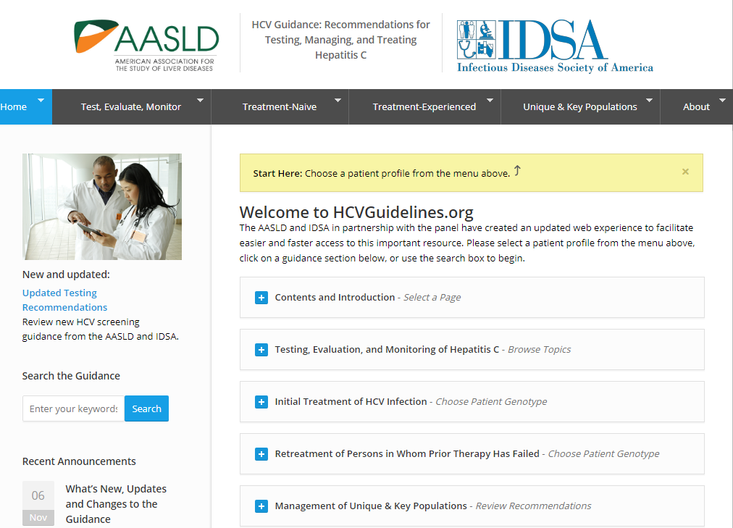
HCV Guidelines (1)

Slide 6
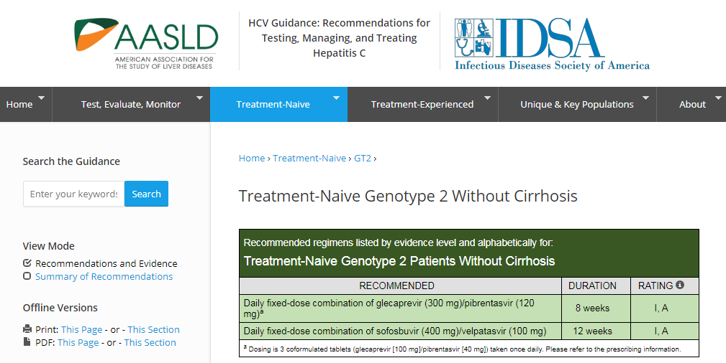
HCV Guidelines (2)
Notes:
Recommendations are provided considering treatment experience, genotype, and cirrhosis status.
Consolidated summaries and print-friendly views are available in the Page Tools.
Note the supporting data footnoted below each recommendation to help interpret study data with regard to individual patient circumstances

Slide 7
HCV Guidelines – 3
Note the supporting data footnoted below each recommendation to help interpret study data with regard to individual patient circumstances
Consult the HCV guidelines to select an HCV regimen

Slide 8
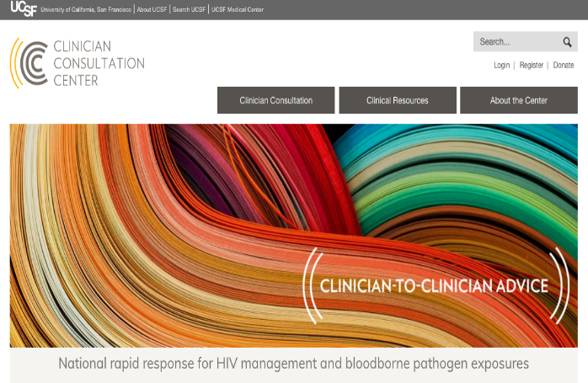
National Consultation Resources
The National Clinician Consultation Center at UCSF provides clinicians of all experience levels prompt, expert responses to questions about managing Hepatitis C, as well as HIV, perinatal HIV, HIV pre-exposure prophylaxis, and blood borne pathogen exposures. They provide online and phone-based consultation. All services are confidential and cost-free.
Hepatitis C Consultation Service: 844-437-4636
HIV PEP Line: 888-448-4911
HIV PrEP Line: 855-448-7737
HIV/AIDS Management: 800-933-3413
Perinatal HIV Consultation: 888-448-8765
Substance Use Management: 855-300-3595
http://nccc.ucsf.edu/
Notes:
Familiarize yourself with national and local expert clinical support resources.
The National Clinician Consultation Center (http://nccc.ucsf.edu/ or (800) 933-3413 Mon-Fri 9:00am-8:00 EST) has live telephonic consultation support for HIV/HCV management.

Slide 9
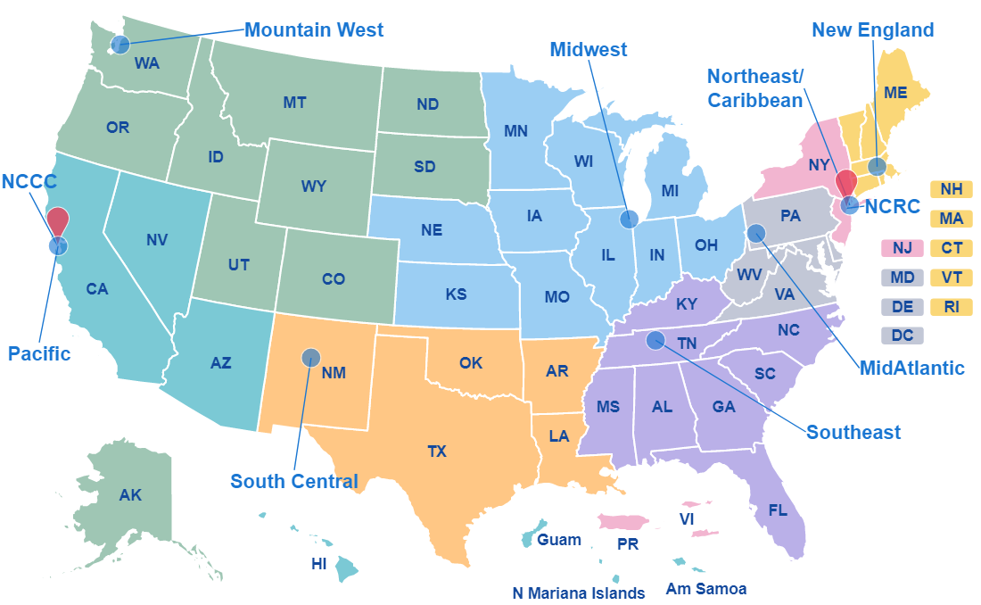
Regional Consultation – AETCs
https://aidsetc.org/directory
Notes:
Regional AIDS Education and Training Centers (https://aidsetc.org/directory) can connect you to local experts who can also help answer questions about HIV/HCV management.
MidAtlantic AETC: Pennsylvania, Virginia, West Virginia, Maryland, Delaware, Washington DC.
Midwest AETC: Michigan, Missouri, Ohio, Illinois, Indiana, Iowa, Wisconsin, Kansas, Nebraska
Mountain West AETC: Alaska, Washington, Oregon, Montana, Wyoming, Colorado, Idaho, Utah, Colorado, North Dakota, South Dakota
New England AETC: Maine, Vermont, New Hampshire, Massachusetts, Connecticut, Rhode Island
Northeast/Caribbean AETC: New York, New Jersey, Puerto Rico, U.S. Virgin Islands
Pacific AETC: California, Nevada, Arizona, Hawaii, U.S. Pacific Jurisdictions
South Central AETC: Texas, Oklahoma, New Mexico, Arkansas, Louisiana
Southeast AETC: Florida, Georgia, Alabama, South Carolina, North Carolina, Tennessee, Kentucky, Mississippi

Slide 10
Disclaimer and Permissions
Users are cautioned that because of the rapidly changing medical field, information could become out of date quickly.
You may use or present this slide set and other material in its entirely or incorporate into another presentation if you credit the author and/or source of the materials.
The complete HIV/HCV Co-infection: An AETC National Curriculum is available at: https://aidsetc.org/hivhcv

