Slide 1
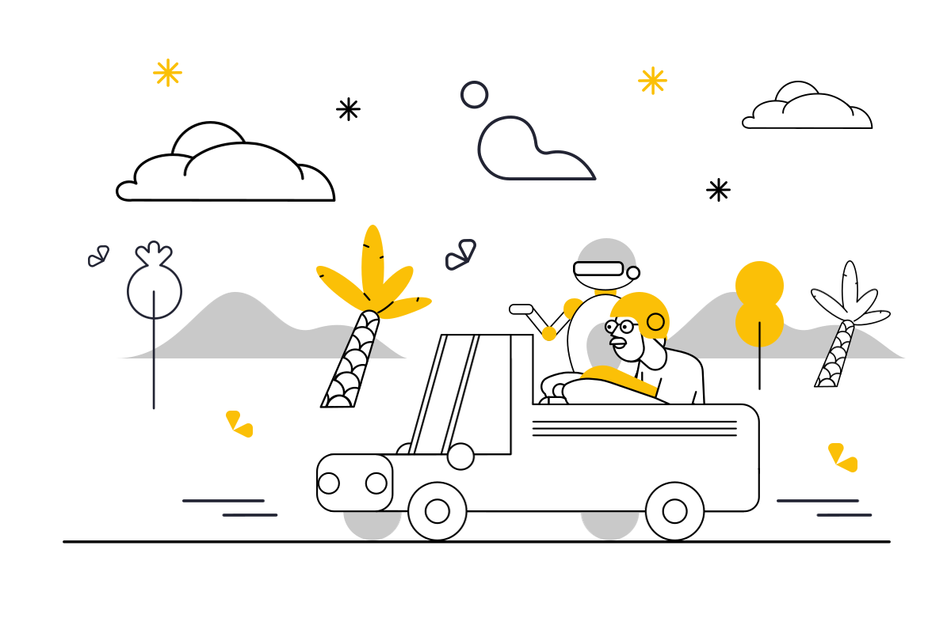
AI IS A CO-PILOT
…
NOT
AUTO-PILOT

Slide 2
IF AI DOES YOUR JOB
AI GETS YOUR JOB

Slide 3
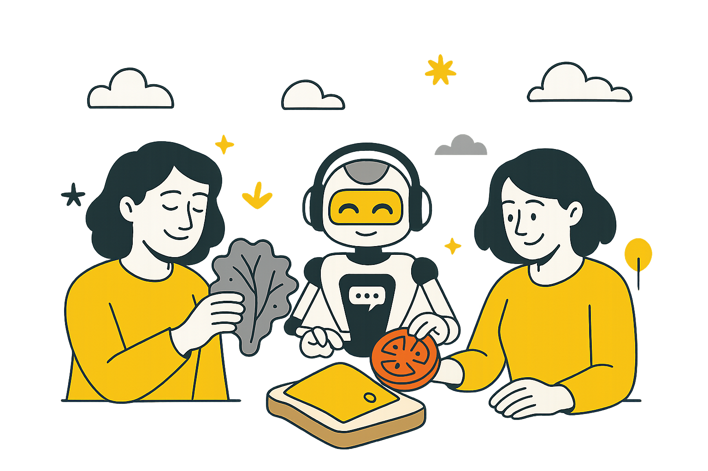
MAKE THE MOST OF AI
MAKE AN AI SANDWICH

Slide 4



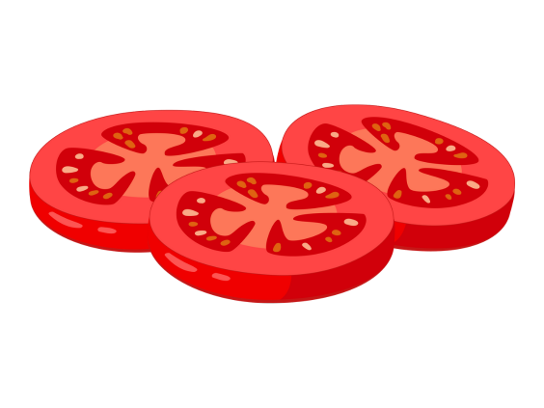


HOW TO MAKE AN AI SANDWICH
You combine + improve
Add in AI’s ideas
Start with your ideas
Notes:
Start with your own ideas: Students begin with their own ideas. This ensures they’re practicing critical thinking, creativity, and problem-solving before turning to AI. Add in AI’s ideas: Once students have a base, they use AI to expand on their thinking. The AI offers fresh perspectives, alternatives, and prompts they might not have considered.
You combine + improve: Students then return to refine and integrate both sets of ideas. This stage emphasizes judgment, synthesis, and ownership of the final product. By framing assignments this way, you keep students at the center of the learning process. The AI simply becomes a tool to enhance their work, rather than replace it.

