Slide 1


Law Firm
FREE PRESENTATION TEMPLATE

Slide 2
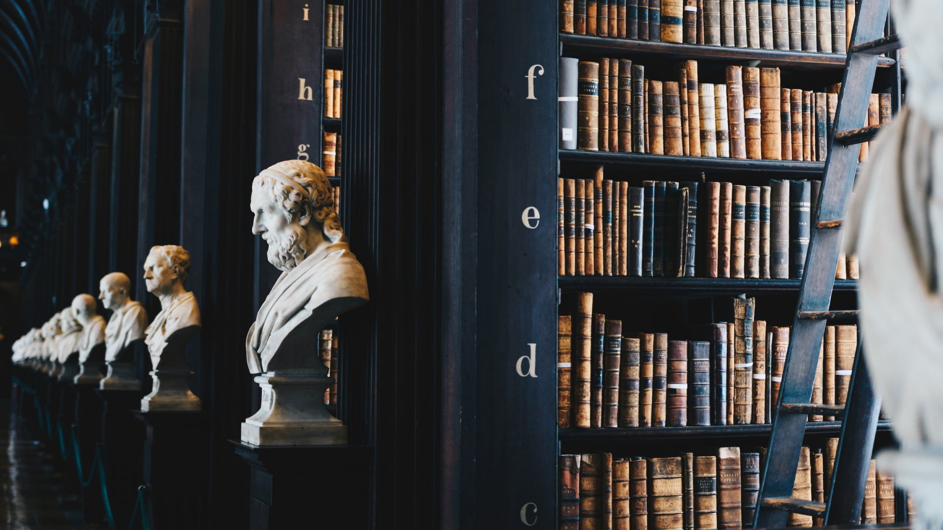
Welcome
Welcome to the world of fantasy! Join us on a journey to explore the mystical creatures, enchanted lands, and magical wonders that exist beyond our reality. Discover the wonders and secrets of this exciting realm and unlock the power of imagination.

Slide 3


Table of Contents
01
Introduction
02
Encounters
The Extraordinary Realm
Unicorn Sightings
03
Wonders
04
Magic
Wishes Granted
Spellcasting
05
Adventure
06
Conclusion
Happily Ever After
Embrace the Fantasy

Slide 4
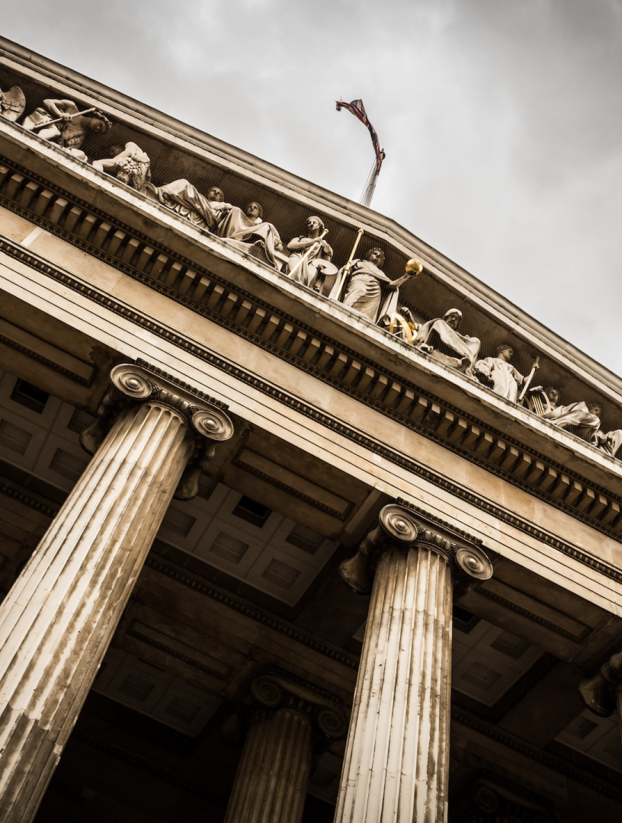
Introduction the Extraordinary
Welcome to the Fantasy World, a realm of wonder and enchantment where anything is possible. Here, dragons breathe fire, unicorns prance through meadows, and rainbows shine brightly. This world is a place where wishes come true, where potions can be cursed and spells are cast. It's a place of treasure and adventure, where the impossible becomes possible. But the greatest treasure of all is the one that lies within.

Slide 5




Unicorn Sightings
A record of the number of unicorns spotted in the fantasy realm and the beauty and mystery that surrounds these enchanting creatures.
Dragon Taming
A closer look at the art of taming dragons and the brave adventurers who dare to take on these fearsome creatures.

Slide 6




Unicorn Sightings
Dragon Taming
A record of the number of unicorns spotted in the fantasy realm and the beauty and mystery.
A closer look at the art of taming dragons and the brave adventurers who take on these creatures.

Slide 7


Fantasy is the gateway to the impossible, the land where the ordinary becomes extraordinary, and the impossible becomes possible. It is the realm of the imagination, where anything can happen and everything is possible.
The Dream Weaver

Slide 8





The Elves: A Glimpse into Their World
"The Art of Archery": Discover the intricacies of the Art of Archery as practiced by the graceful and precise elves.
"The Music of the Elves": Immerse yourself in the enchanting music of the elves, whose songs have the power to heal.
"The Life of an Elf": Learn about the customs and daily life of the elves, from their familial structure to their religious beliefs.

Slide 9


S
W
Eclipse
Obtain
Rare event causes unpredictable magic.
Humans acquire Crystal
Quest
Foundation
Adventurers seek immortal artifact.
Shimmering City established
O
T
War
Invasion
Kingdoms clash in conflict.
Kingdom attacked by monsters.
Transformation
Betrayal
Peasant discovers magical powers.
Queen's advisor revealed as spy.

Slide 10




234,567
UNICORN SIGHTINGS
A tally of the number of unicorns spotted in the fantasy realm.

Slide 11
The Timeline
Transformation
Kingdoms clash in conflict.
Peasant discovers magical powers.
Plot to assassinate leader uncovered.
War
Eclipse
Quest for artifact
Volcano disaster
2021
2022
2020
Rise
2022
Invasion
Humans acquire Crystal
Shimmering City established
City expands, conquers neighbors.
Kingdom invaded
Betrayal
Hero's festival

Slide 12




Our Team
Eldruin
Elementalen
Lunaria
The Fire Mage
The Guardian
The Moon Priestess

Slide 13









The Organization
Chloe Ng
The Mage
Valtorin
Aurielle
Theronis
Dariana
The Assassin
The Priestess
The Warrior
The Shaman
Lucian
Elvina
The Conjurer
The Oracle
Cedric
Seraphina
The Timekeeper
The Lightbringer

Slide 14





The Graph
100
90
80
70
60
50
40
30
20
10
0
1
2
3
4
5
6
7
8
Spellcasting Progress
A record of the number of spells cast per year

Slide 15




The Information
Spellcasting Competition
Treasure
Hunt
Great
Adventure
A significant event in the history of the fantasy realm, in which the greatest spellcasters of the realm.
A significant event in the history of the fantasy realm, in which a massive and awesome treasure hunt was organized.
A notable year in the history of the fantasy realm, in which a large number of adventurers set out to explore.

Slide 16


The Art of Enchantment
A magical being with the power to cast spells and create illusions, often sought for bringing wonder and magic into people's lives.

Slide 17



The Unicorns
Unicorn Sighting
Unicorn Sighting
Unicorn Sighting

Slide 18




The Price
Basic
Elite
Legendary
Access to the entry-level dungeons.
A limited number of quests and battles per month.
Ability to form a small party with fellow adventurers.
Access to the intermediate and advanced dungeons.
A greater number of quests and battles
Ability to form larger parties with fellow adventurers.
Access to the most challenging dungeons and encounters.
Unlimited quests and battles per month.
The ability to form the largest parties with fellow adventurers.
$10/month
$50/month
$100/month

Slide 19

The Enchanted Forest
A magical forest filled with talking animals and enchanted creatures.
The Crystal Caves
A network of underground caves filled with precious gems and crystals.
The Dragon's Lair
A dangerous and mysterious place where dragons reside.
Fantasy Realm at a Glance

Slide 20

Thank you for choosing EaTemp
We offer free and high-quality slides templates for your presentations. We appreciate you choosing us and hope our templates have been helpful.
As a new website, we rely on your support to grow, so please help us by sharing our site with your friends and colleagues.

