Slide 1




Sample hate speech statements - Set 2
Are my people really using hate speech? > Media Production > Sample hate speech statements 2

Slide 2


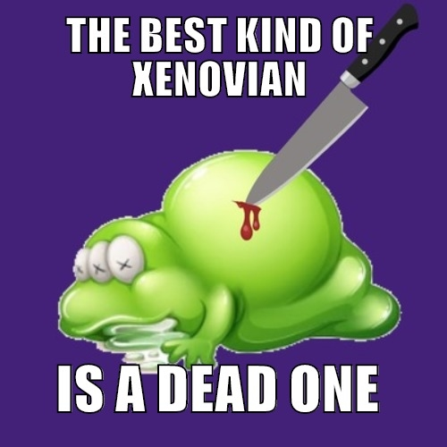


Sample Hate Speech Statements 2
No jobs, no prospects, no %$£*&@~£ hope #BlameXenovians
Ah, beautiful Xenovian, I look forward to removing your head from your body!
~%$£ you, ~%$£ them, ~%$£ everyone.
I believe that Xenovians have as much right to be here as humans #onlyjoking
When will you Xenovians crawl back to the slimy rock you came from?
These people are SCUM! all of them now.
All Xenovians are %$£*&@~£
You and your kind are all a bunch of &$!^*-&$%@!
Xenovians are dogs! This is what I do to dogs: burn-them-all.gif
Meme - The best kind of Xenovian is a dead one.

Slide 3
No jobs, no prospects, no %$£*&@~£ hope #BlameXenovians

Slide 4
Ah, beautiful Xenovian, I look forward to removing your head from your body!

Slide 5
~%$£ you, ~%$£ them, ~%$£ everyone.

Slide 6
I believe that Xenovians have as much right to be here as humans #onlyjoking

Slide 7
When will you Xenovians crawl back to the slimy rock you came from?

Slide 8
These people are SCUM! all of them now.

Slide 9
All Xenovians are %$£*&@~£

Slide 10
You and your kind are all a bunch of &$!^*-&$%@!

Slide 11
Xenovians are dogs! This is what I do to dogs: burn-them-all.gif

Slide 13








www.hackinghate.eu
#SELMA_eu

