Slide 1
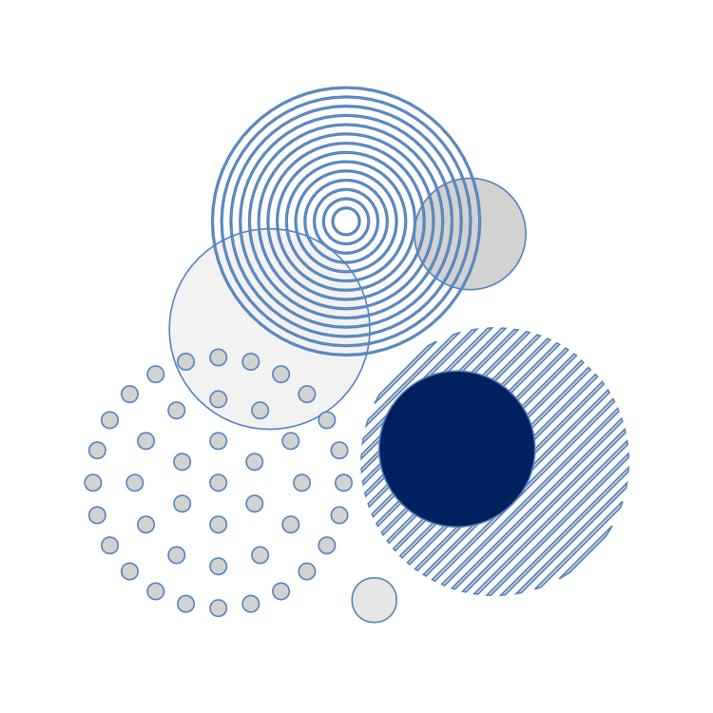










BKS PTN Barat
International Seminar
2026
"Sustainable Teacher Development and Cross-Cultural Literacy: Navigating Future Pedagogies in a Changing Era"

Slide 2
INTERNATIONAL SEMINAR BKS PTN BARAT 2026
UNIVERSITAS SINGAPERBANGSA KARAWANG
June 17, 2026
Tittle Here
Author(s),
Affiliation(s).

Slide 3
INTRODUCTION
Maximum 1 slide

Slide 4
LITERATURE REVIEW
Maximum 1 slide

Slide 5
METHOD
Maximum 1 slide
Table or chart can be displayed

Slide 6
Finding and Discussion
Minimum 2 slides, maximum 4 slides.
Table or chart can be displayed

Slide 7
Conclusion
Maximum 1 slide

Slide 8
Reference
Maximum 1 slide
The references are in the APA style, 7th edition.

Slide 9
THANK YOU!
Follow us @....

