Slide 1





Itinerary
Free Presentation Template by EaTemp

Slide 2



Welcome
Welcome to the world of fantasy! Join us on a journey to explore the mystical creatures, enchanted lands, and magical wonders that exist beyond our reality. Discover the wonders and secrets of this exciting realm and unlock the power of imagination.

Slide 3





Table of Contents
01
03
Introduction
Wonders
The Extraordinary Realm
Wishes Granted
02
04
Encounters
Magic
Unicorn Sightings
Spellcasting

Slide 4




The Extraordinary
Welcome to the Fantasy World, a realm of wonder and enchantment where anything is possible. Here, dragons breathe fire, unicorns prance through meadows, and rainbows shine brightly. This world is a place where wishes come true, where potions can be cursed and spells are cast. It's a place of treasure and adventure, where the impossible becomes possible. But the greatest treasure of all is the one that lies within.
The world of fantasy is a reflection of our deepest desires, our fondest dreams, and our wildest imaginations. It's a place where we can let go of the constraints of reality and explore the boundless possibilities of the human mind. In this introduction, we will delve into the mysteries of this realm, uncovering the magic and wonder that lies within. So come with us and let's embark on a journey through the Fantasy World.

Slide 5




day 1
day 2
A record of the number of unicorns spotted in the fantasy realm and the beauty and mystery that surrounds these enchanting creatures.
A closer look at the art of taming dragons and the brave adventurers who dare to take on these fearsome creatures.

Slide 6
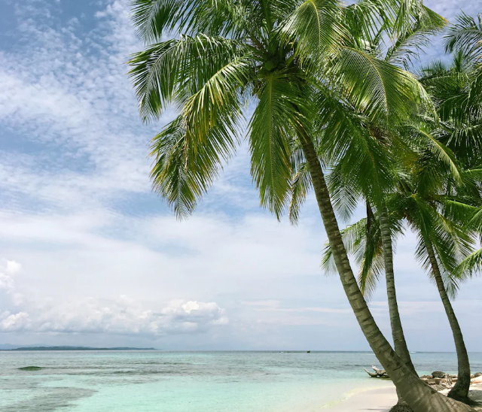

day 1
day 2
A record of the number of unicorns spotted in the fantasy realm and the beauty and mystery.
A closer look at the art of taming dragons and the adventurers who take on these creatures.

Slide 7

Fantasy is the gateway to the impossible, the land where the ordinary becomes extraordinary, and the impossible becomes possible. It is the realm of the imagination, where anything can happen and everything is possible.
The Dream Weaver

Slide 8


Day 1
Day 2
Day 3
A guide to taming and caring for dragons in the realm of magic.
Tips and tricks for spotting the elusive unicorns in their natural habitat.
A guide to taming and caring for dragons in the realm of magic.

Slide 9



plan
day 1
day 2
day 3
  Access to the entry-level dungeons.
  A limited number of quests and battles per month.
  Ability to form a small party with fellow adventurers.
  Access to the intermediate and advanced dungeons.
  A greater number of quests and battles
  Ability to form larger parties with adventurers.
  Access to the most challenging dungeons.
  Unlimited quests and battles per month.
  The ability to form the largest parties.

Slide 10






S
W
O
T
Eclipse
Eclipse
Eclipse
Eclipse
Rare event causes unpredictable magic.
Rare event causes unpredictable magic.
Rare event causes unpredictable magic.
Rare event causes unpredictable magic.
Quest
Quest
Quest
Quest
Adventurers seek immortal artifact.
Adventurers seek immortal artifact.
Adventurers seek immortal artifact.
Adventurers seek immortal artifact.

Slide 11

plan
Enchanted Creatures
day 1
possess the ability to cast spells.
Magic-Wielding Individuals
day 2
practice the art of illusions.
Spells Cast
day 3
are dark magic, foretelling danger.

Slide 12
234,567
Unicorn Sightings
A tally of the number of unicorns spotted in the fantasy realm.

Slide 13
233 Coins
85%
Treasure Found
Wished Granted
456 Hours
674 Km
Duration of Spell Casting
Journey Distance

Slide 14
Itinerary
April
May
June
July
Eclipse, quest for artifact, disaster
Shimmering City, conquest, Unicorn
War, curse from artifact, magic
Kingdom invaded, betrayal, festival
Eclipse
Obtain
War
Invasion
Unpredictable magic.
Humans acquire Crystal
Kingdoms clash.
Kingdom attacked.
Quest
Foundation
Transform
Betrayal
Adventurers seek immortal artifact.
Shimmering City established
Peasant discovers magical powers.
Queen's advisor revealed as spy.
Disaster
Rise
Intrigue
Festival
Volcano destroys city, refugees flee.
City expands, conquers neighbors.
Plot to assassinate leader uncovered.
Grand celebration in hero's honor.

Slide 15

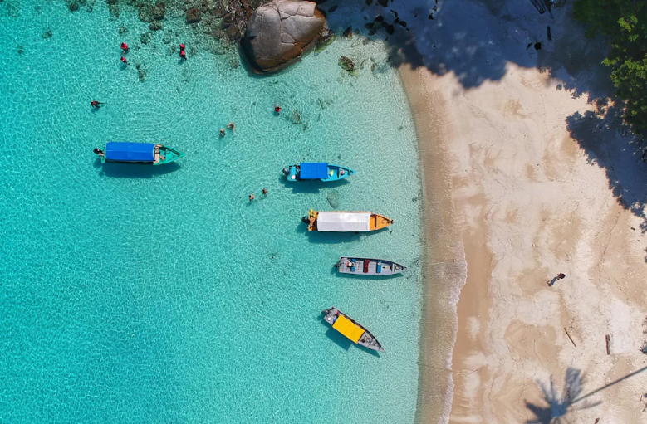
Itinerary
A web application
A web application designed for discovering the world of fantasy

Slide 16


The Future
An mobile app
An app designed for exploring and experiencing the enchanting realm of fantasy
  Explore a magical world
  Experience fantasy firsthand
  Immerse in a realm of magic
  Discover untold wonders
  Live your fantasy dreams

Slide 17


A Gateway to
a World of
Fantasy and
Wonder
  Immerse yourself in the world of magic and mystery
  Explore uncharted territories and fantastical lands
  Meet mythical creatures and legendary beings
  Uncover hidden treasures and secret treasures

Slide 18
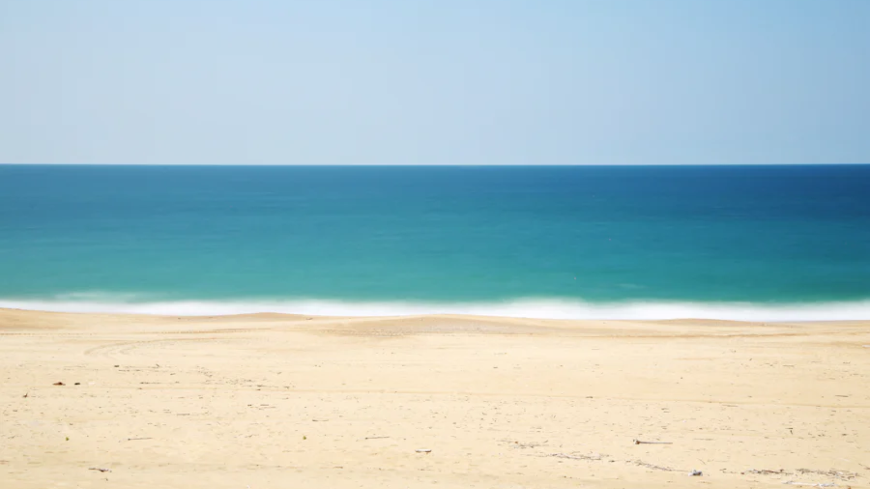
A Magic Picture

Slide 19

Itinerary
07:00
A rare eclipse occurs, causing strange and unpredictable magical effects across the land.
09:00
A group of adventurers sets out to recover an ancient artifact.
11:00
A volcanic eruption devastates a nearby city, forcing its inhabitants to flee to the safety.
13:00
A powerful sorcerer and a cunning thief cross paths, leading to an unlikely partnership.
15:00
An elf helps humans obtain the Crystal of the Unicorn from the Elven Forest.
17:00
The civilization of the Shimmering City is founded by a group of powerful wizards.

Slide 20

Fantasy Realm at a Glance
The Forest
A magical forest filled with animals and enchanted creatures.
The Caves
A network of underground caves filled with gems and crystals.
The Lair
A dangerous and mysterious place where dragons reside.

Slide 21





The Timeline
May
July
Shimmering City, conquest, Unicorn
Kingdom invaded, betrayal, hero's festival
Eclipse
Quest
Foundation
Transformation
April
June
Eclipse, quest for artifact, disaster
War, curse from artifact, discovery

Slide 22





The Timeline
May
A rare eclipse occurs, causing strange and unpredictable magical effects.
June
A group of adventurers sets out to recover an ancient artifact.
July
A volcanic eruption devastates a nearby city, forcing its inhabitants to flee to the safety.
Aug
A powerful sorcerer and a cunning thief cross paths, leading to a partnership.

Slide 23



Our Team
Eldruin
Elementalen
Lunaria
The Fire Mage
The Guardian
The Moon Priestess

Slide 24

The Mystery
mon
The Forbidden Forest: A place of mystery and wonder, where mystical creatures roam and flora flourishes.
tue
The Crystal Caves: A network of glittering caves filled with precious gems and minerals, guarded by fierce beasts.
wed
The Enchanted Garden: A place of pure beauty and tranquility, where the colors of the flowers are vibrant.
thu

Slide 25

Thank you for
choosing EaTemp
• Yes, you can use this for both personal and commercial projects.
• No, you don't have to credit us.
• No, you can't resell or redistribute it, including uploading this template online.
• And you can support us by sharing our site, EaTemp.com, with others.
Credit | Image: Unsplash

