Slide 1






Literature
FREE PRESENTATION TEMPLATE
EaTemp

Slide 2
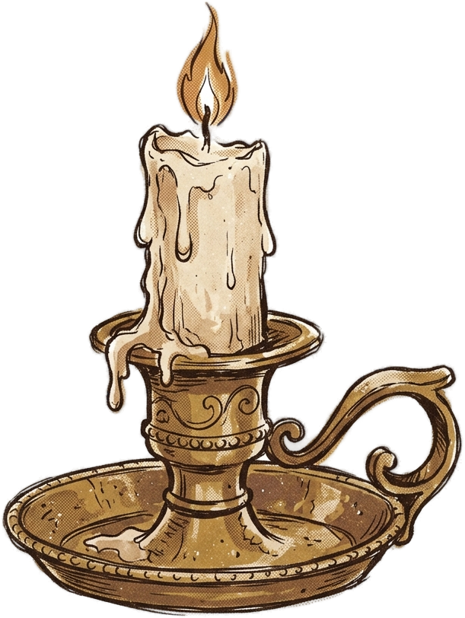


Welcome
Welcome to the world of fantasy! Join us on a journey to explore the mystical creatures, enchanted lands, and magical wonders that exist beyond our reality. Discover the wonders and secrets of this exciting realm and unlock the power of imagination.
EaTemp

Slide 3



Table of Contents
Introduction
Pre-Modern Literature
01
02
Brief overview of the history of literature to be discussed
Discussion of notable works and authors from this period
Modern Literature
Contemporary
03
04
Brief overview of the history of literature to be discussed
Discussion of notable works and authors from this period
The Best Works
Conclusion
05
06
Discussion of the best works of literature across all time periods
Analysis of the overall significance of literature
EaTemp

Slide 4

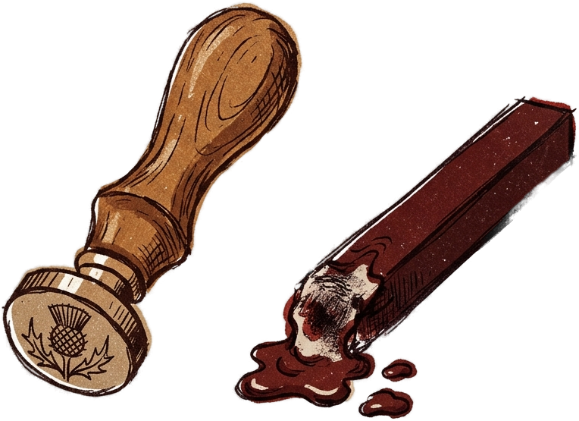

Introduction
The Fantasy Realm: Uncovering the Secrets of the Imagination and the Magic that Lies Within
EaTemp

Slide 5

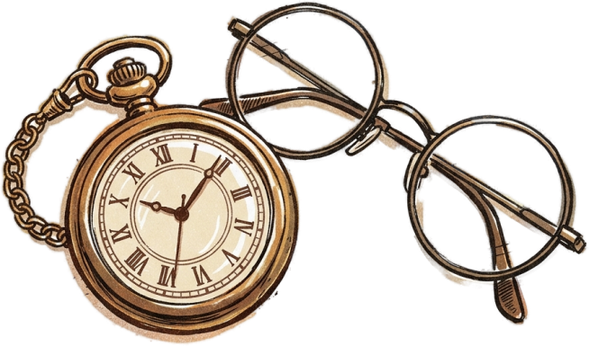

Pre-Modern Literature
One of the defining features of pre-modern literature is its oral tradition. In the absence of widespread literacy, many works were created to be performed aloud, often in the form of storytelling, poetry, or song. This tradition gave rise to many iconic works of literature that have survived to this day, often in the form of epic poems or mythic tales that were passed down through generations.
The earliest examples of pre-modern literature date back to ancient civilizations such as Mesopotamia and Egypt. The Epic of Gilgamesh, for example, is an epic poem from ancient Mesopotamia that is often considered the first great work of literature. It tells the story of a king who goes on a journey to seek eternal life, and is believed to have been written as early as the 18th century BC.
EaTemp

Slide 6
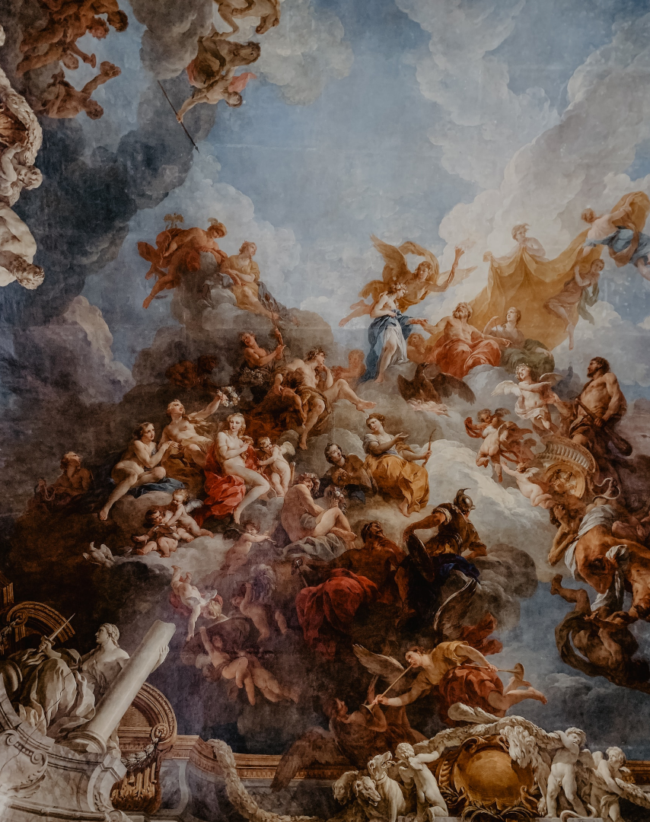



Main Theme
Heroism
A record of the number of unicorns spotted in the fantasy realm and the beauty and mystery that surrounds these enchanting creatures.
Virtue
A closer look at the art of taming dragons and the brave adventurers who dare to take on these fearsome creatures.
Morality
A record of the number of unicorns spotted in the fantasy realm and the beauty and mystery that surrounds these enchanting creatures.
EaTemp

Slide 7
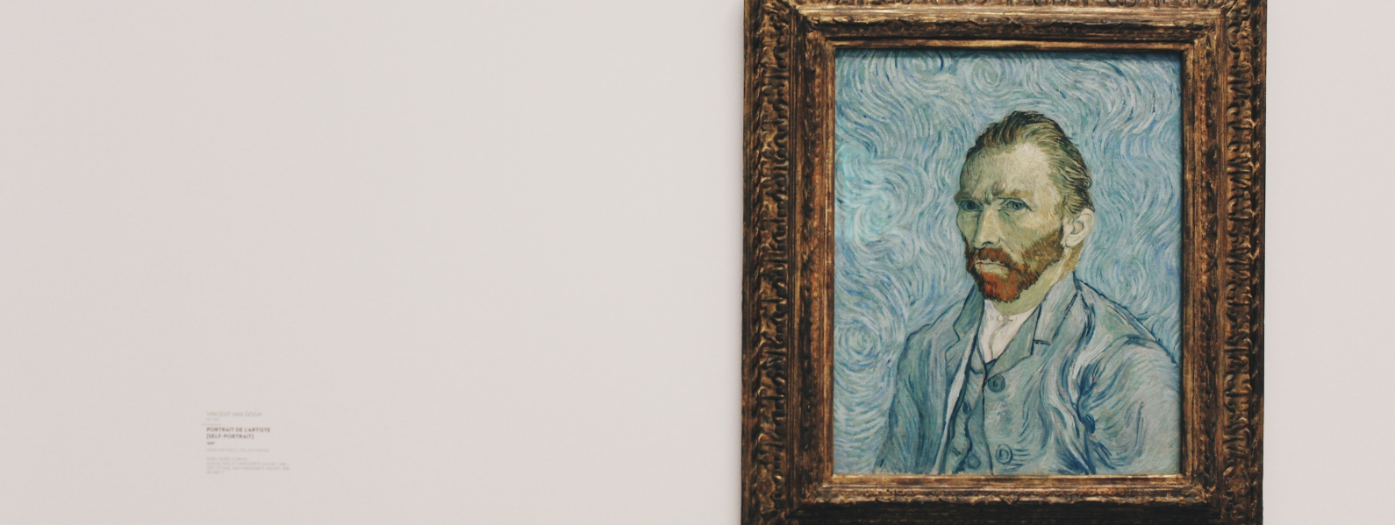
The Influence of Mythology on Pre-Modern Literature
How did ancient myths and legends shape the literary traditions that followed?
Which mythological figures and stories were most influential, and how did they evolve over time?
EaTemp

Slide 8






The Development of the Novel
The Forbidden Forest: A place of mystery and wonder, where mystical creatures roam and enchanted flora flourishes.
The Crystal Caves: A network of glittering caves filled with precious gems and minerals, guarded by fierce beasts.
The Enchanted Garden: A place of pure beauty and tranquility, where the colors of the flowers are more vibrant.
EaTemp

Slide 9


Pre-modern literature is the foundation of our literary heritage, shaping the traditions that followed and offering insight into the beliefs and values of past cultures.
Harold Bloom
EaTemp

Slide 10
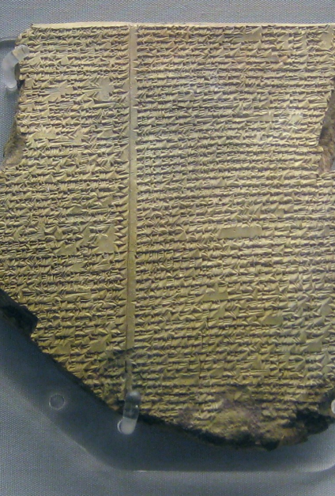
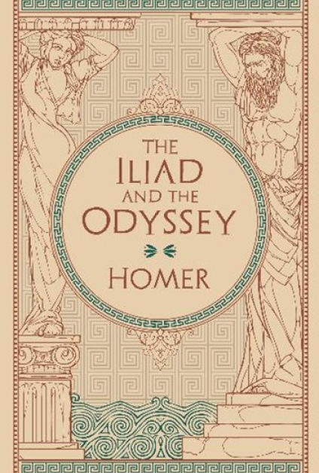
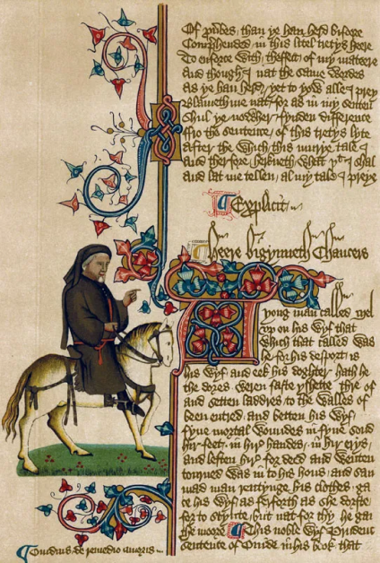

major works
The Epic of
Gilgamesh
The Iliad and
The Odyssey
The Canterbury
Tales
EaTemp

Slide 11

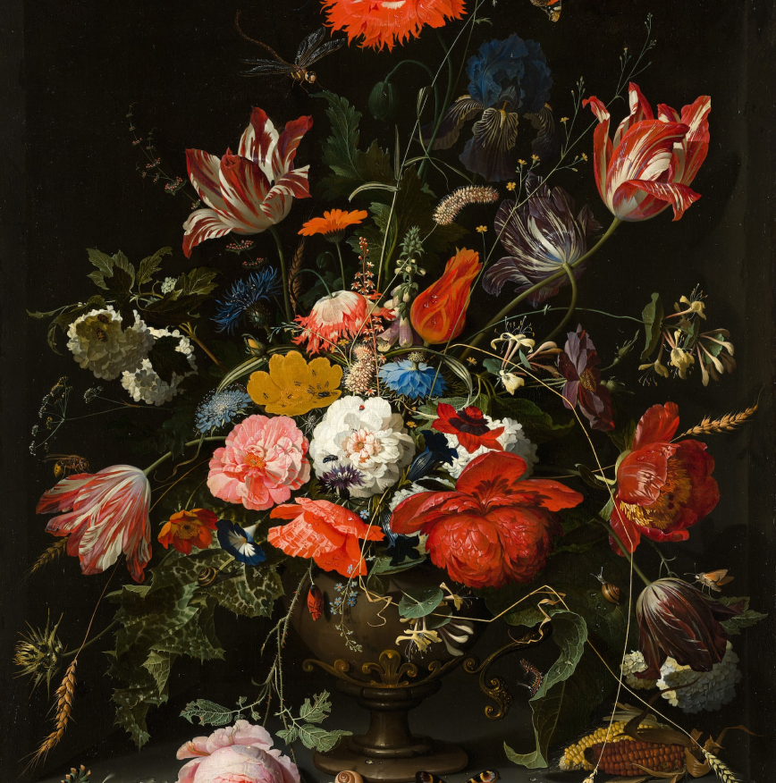

Modern Literature
Produced during the 20th and 21st centuries
Characterized by experimentation and innovation
Focus on individual experience and subjectivity
Engagement with social and political issues of the time
Notable writers include Hemingway, Fitzgerald, Faulkner, and Beckett
New movements emerged, such as postmodernism and magic realism
EaTemp

Slide 12
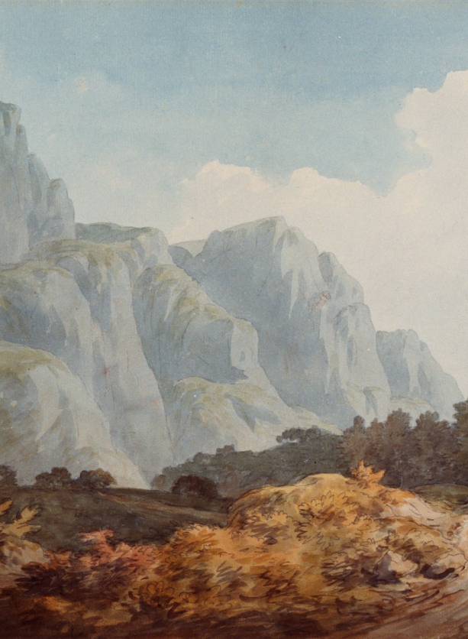




Individual Experience and Subjectivity
Individual experience is a key focus of modern literature, with writers seeking to explore the unique inner lives of their characters.
Subjectivity is another hallmark of modern literature, with writers rejecting the idea of an objective, omniscient narrator in favor of a more subjective approach.
EaTemp

Slide 13
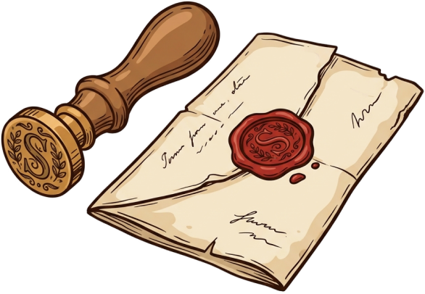

1
Discover the secrets
Explore the lush, vibrant forest and uncover the mysteries that lie within.
2
Find your path
Meet the creatures
3
Choose your own path through the forest, and see where it takes you.
Encounter the mythical creatures that call the forest home, from talking animals to mischievous fairies.
4
Uncover the magic
Learn about the powerful magic that pervades the forest and how it affects all who enter.
EaTemp

Slide 14
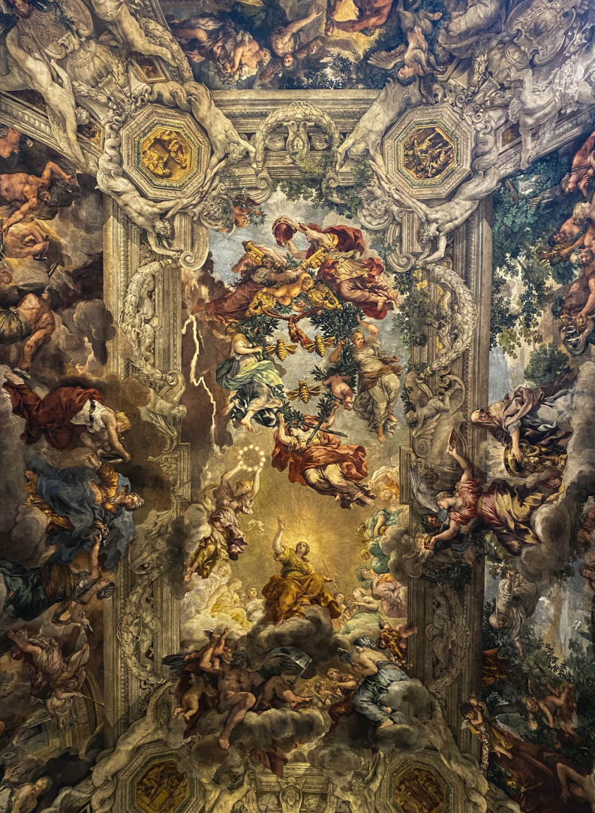

Contemporary literature often engages with the complex and interconnected world of the 21st century. Writers may examine issues such as economic inequality, environmental degradation, and the impact of new technologies, exploring how these factors shape our relationships with each other and the world around us. They may also examine the tension between local and global identities and the challenges of finding meaning and purpose in an increasingly complex world.
Globalization
EaTemp

Slide 15


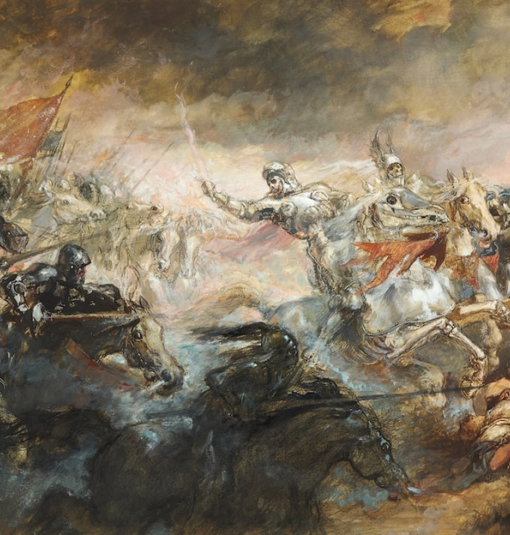

Contemporary Literature
Diverse
Contemporary literature encompasses a diverse array of genres, styles, and perspectives, reflecting the complex and rapidly changing world we live in.
wide range
Contemporary literature engages with a wide range of social, cultural, and political issues, exploring themes such as identity, race, gender, and globalization.
EaTemp

Slide 16




identity
race
gender
Contemporary literature often explores issues of identity, examining how individuals come to understand themselves.
Many contemporary writers engage with issues of race, exploring the ways in which race impacts our social..
Contemporary literature often challenges traditional gender roles and explores diverse expressions of sexuality.
EaTemp

Slide 17
Timeline
Post-Modernism
Kingdoms clash in conflict.
Peasant discovers magical powers.
Plot to assassinate leader uncovered.
Victorian
2000–present
Eclipse
Quest for artifact
Volcano disaster
1900–1950
Modernism
Contemporary
1832–1901
1950–2000
Humans acquire Crystal
Shimmering City established
City expands, conquers neighbors.
Kingdom invaded
Betrayal
Hero's festival
EaTemp

Slide 18









The Best Works
Old English
Beowulf
Middle English
The Canterbury Tales by Geoffrey Chaucer
Renaissance
Hamlet by William Shakespeare
Restoration
Paradise Lost by John Milton
18th Century
Gulliver's Travels by Jonathan Swift
Romanticism
Frankenstein by Mary Shelley
EaTemp

Slide 19



The Evolution of Literature Through the Ages
Throughout history, literature has evolved to reflect the changing societal, cultural, and personal values of each time period.
Conclusion
EaTemp

Slide 20
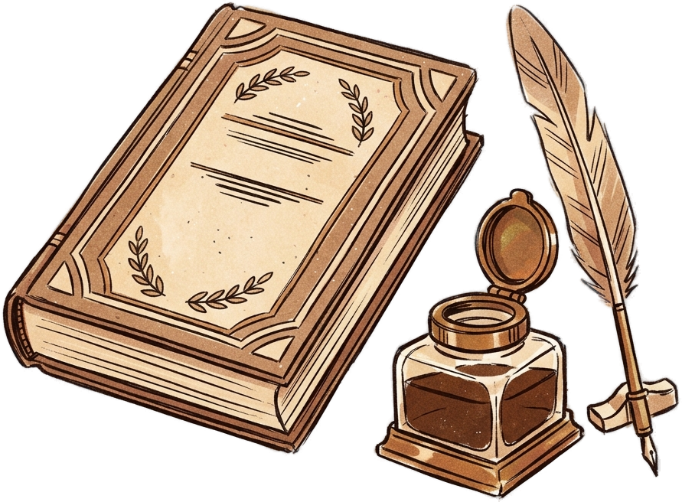




Thank you for choosing EaTemp
We offer free and high-quality slides templates for your presentations. We appreciate you choosing us and hope our templates have been helpful.
As a new website, we rely on your support to grow, so please help us by sharing our site with your friends and colleagues.
eatemp._
@eatemp
eatempofficial
@eatemp.official
EaTemp

