Slide 1


Why Science
Has Not Had A Greater Impact On Education
Jack States
Notes:
This is specially frustrating when we see so many pockets of excellence, . a robust and growing knowledge base of effective practice, but despite this progress these practices are not being embraced by the mainstream.

Slide 2
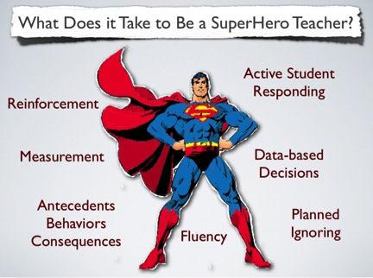
Janet Twyman, 2014
Notes:
- What we know is Teachers and how they teach are the #1 factor in improving student achievement. We understand that there are four important skills areas that define effective teaching.

Slide 3
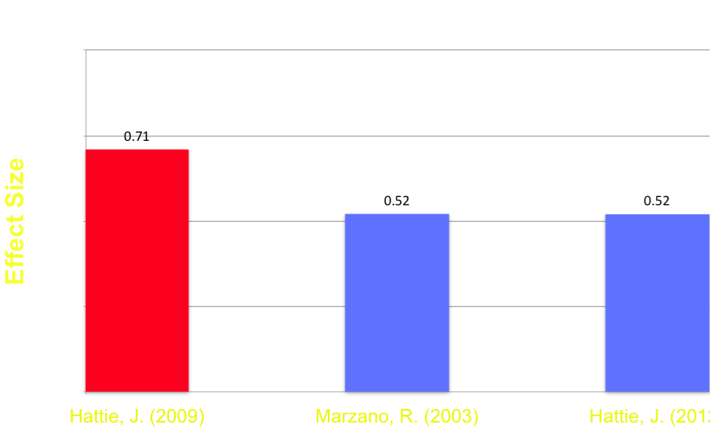
Classroom Management
Appropriate
Behavior
Classroom Management

Slide 4
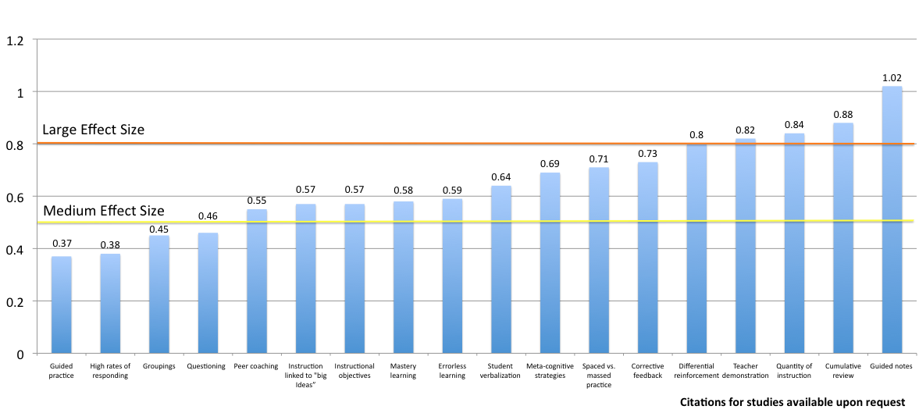
Instructional Delivery

Slide 5
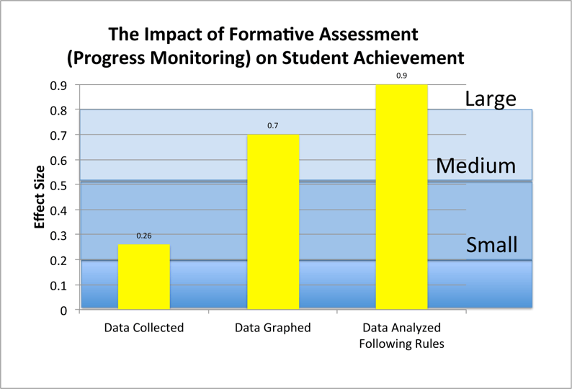
Formative Assessment
Fuchs and Fuchs, 1986

Slide 6
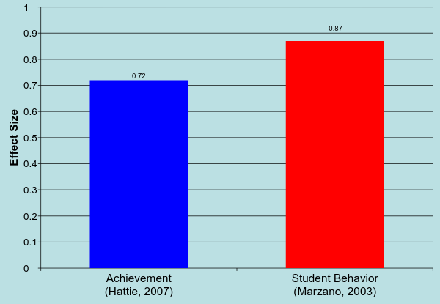
Soft Skills Teacher – Student Relations
Notes:
Ability to show empathy, warmth, encourage student learning, be adaptable to novel situations, exhibit cultural sensitivity and show respect for students

Slide 7
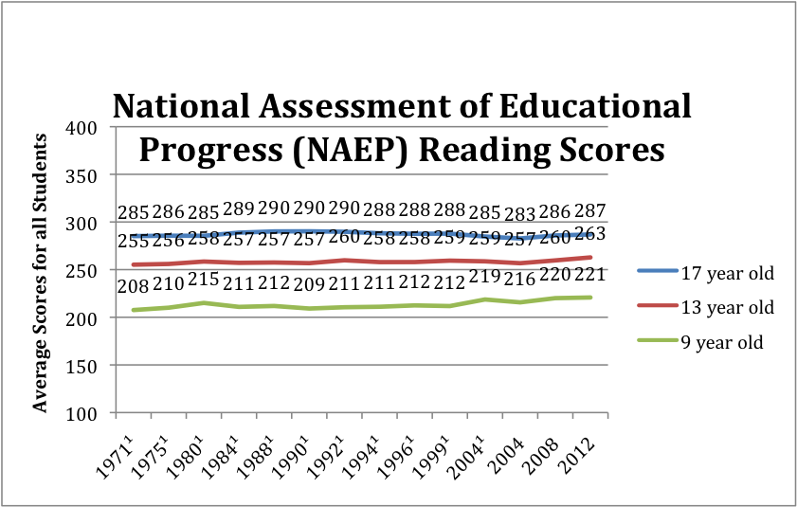
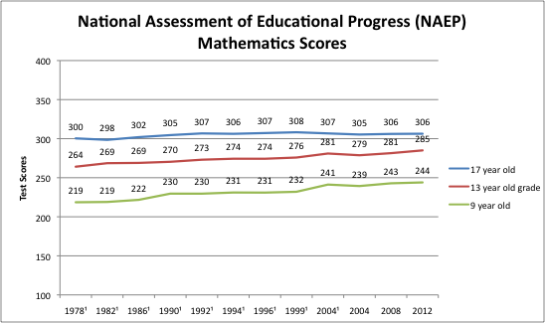
NAEP Scores
Notes:
Despite deep knowledge base explicit practices are not being adopted or sustained

Slide 8
Why Culture Is Important to Building An Evidence-Based Model?
Americans are ill informed and skeptical of science
To win the hearts and minds of policy makers, educators, and the public
To overcome advantages held by competing educational approaches
To overcome the limitations of large social change delivered one individual at a time
Notes:
There are a number of reasons for this, but we believe Culture is a very powerful variable that is often overlook
5 minutes

Slide 9
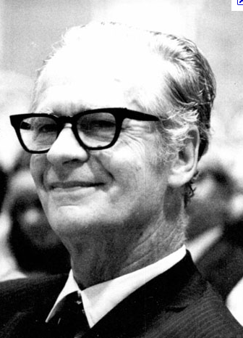
What is Culture?
“As a set of contingencies of reinforcement maintained by a group…
The group has…
a continuing existence beyond the
lives of members of the group,
a changing pattern as practices are
added, discarded, or modified…
A culture so defined controls the behavior of the members of the group that practice it.”
B.F. Skinner
Notes:
Skinner was quoted in 1971 upon the publishing of his work “Beyond Freedom and Dignity” , “if business would take seriously reinforcement theory within a year, they could become a model of human competence, productivity and happiness. Schools could easily solve most of their problems. Unfortunately, 40 years later we are still waiting for the revolution.

Slide 10
Performance Management and Organizational Behavior Management (OBM) View of Culture
Culture Change
Values
Policies and Goals
Behavior
Contingencies
Tom Gilbert
Notes:
Tom Gilbert claimed that behaviorism has been unsuccessful in having a greater impact because it failed to address the issue of Values

Slide 11
Who Is Having The Greatest Impact In The Classroom?
Constructivists
Practitioners of explicit instruction
Notes:
Discovery learning and Direct Instruction

Slide 12
Comparing The Two Dominant Approaches to Teaching
Explicit Instruction | Constructivism
The teacher and student share responsibility for learning | The student is self directed and responsible for their own learning
The role of the teacher is to teach concepts, skills, and knowledge | The role of the teacher is to provide a context and process for students to discover concepts, master skills, and acquire knowledge on their own
The role of the teacher is to provide systematic instruction tied to standards and goals | Students create knowledge of the world through personal experiences not tied to external standards and goals
Teachers master evidence-based teaching skills | Teachers develop their own philosophy of education and personal style of teaching
Formative assessment is key to ensuring student progress | Assessment of student progress is subjective
Higher order thinking is systematically taught and dependent on student mastery of foundation skills | Higher order thinking and foundation skills are learned as required to solve problems
Notes:
Clear distinction between the belief systems 1. Systematic vs random acts of exploration 2. The world is objective vs. subjective 3. Skills need to be taught vs. knowledge is already within us

Slide 13
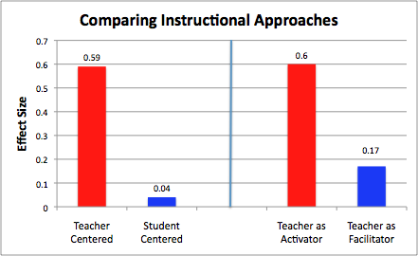
What is the Impact of Education Philosophy on Teaching?
Hattie, 2009
Notes:
Despite constructivist appeal the research supports explicit model

Slide 14
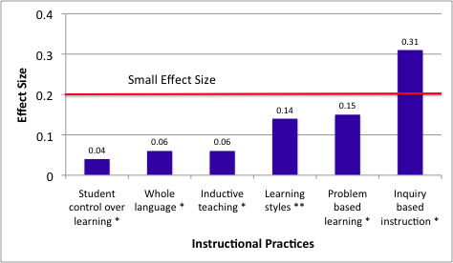
Less Effective Instructional Practices
* Hattie, 2009 ** Kavale, 1987
Notes:
Practices associated with constructivism do not hold up under scrutiny

Slide 15
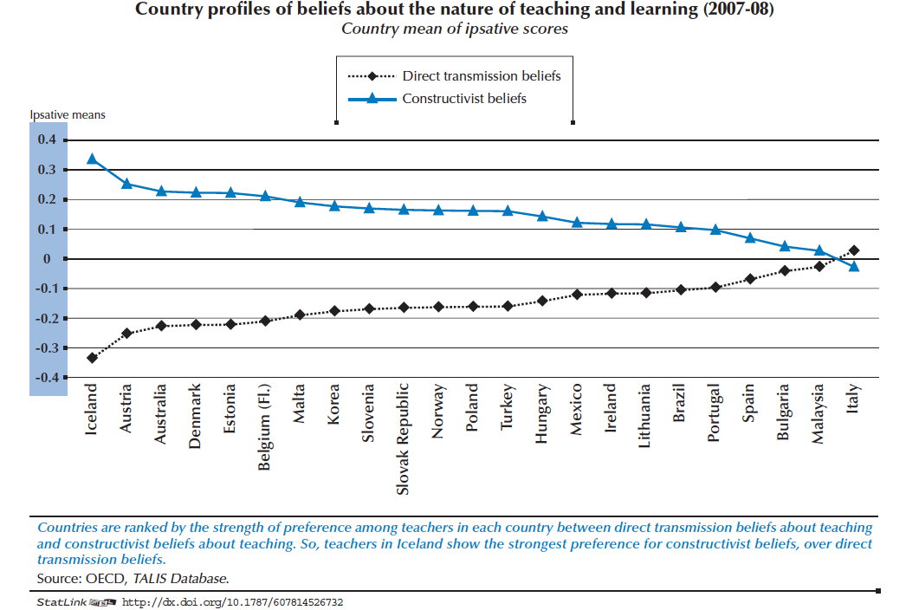
Notes:
Organization for Economic Co‑operation and Development – Teaching and Learning International Survey (TALIS)

Slide 16
What Do These Terms Describe?
Systematic skills building
Mastery learning
Component skills to composite
Behavioral cusp
Contingent praise
Errorless learning
Blooms taxonomy
The search for social justice
Authentic learning
Student centered
Learning occurs through discovery
Teaching students how to think, not what to think
Real world learning
Intrinsic motivation
Helping students become caring, responsible problem solvers
Notes:
The constructivist descriptors are warm, inviting, appealing to many of our human values. Explicit descriptors come off sounding cold and mechanistic
Video Next - Observe the video for your reaction. What do you observe, How do you feel about what you see
10 minutes

Slide 17


Slide 18

“The Culture Divide”
…Watch a group of children respond like trained seals to a teacher clapping. I'm amazed that this is supposed to pass for higher-level thinking. To me, it looks like the creation of little, semi-robotic creatures who will happily fold t-shirts at Walmart for 8 bucks an hour. ….
…the real problem is that this exercise isn't "developmentally" appropriate for these kids -- Having five year olds count to 15, with a clapping/snapping/goonily-smiling teacher, is neither rigorous nor effectively producing college-ready kindergartners.
They stopped the video before the kids get the food pellets!
I think she moonlights at Seaworld....we must have missed the minnow treats.
You should see when the teacher claps twice. All the kids roll over and fetch her the morning newspaper.
(NY Educator, 2013)
#1
Notes:
This video from the New York Educator. We are not successfully framing our practices in a way that educators are embracing. We are losing the culture war. They predominate. They are telling a better story while appealing to peoples emotions.

Slide 19
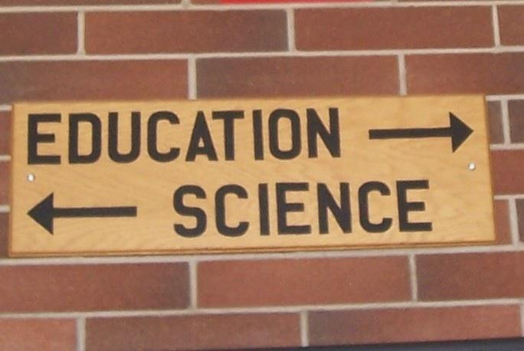
How Do Americans Feel About Science?
#2
This picture was taken at a well known American university
Notes:
the National Science Foundation - 90 % of Americans think scientists are "helping to solve challenging problems"
26% of respondents said the sun revolves around the earth (44% for EU) and only 48% percent knew that human beings developed from earlier species of animals.

Slide 20
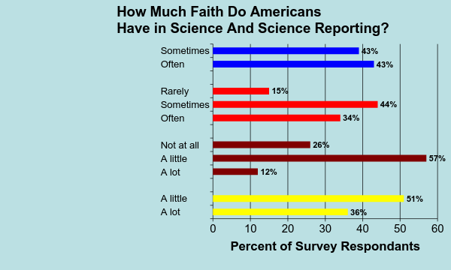
Findings influenced by
companies funding
Results influenced
by politics
Trust science journalists
Trust what scientists report
Huffington Post and YouGov, 2013
Notes:
Companies = 86% --- Politics = 78% ----- journalist 0ver 80% --------- what science reports = 51% #2 The American public is ill informed regarding science and are skeptical about what science is reporting

Slide 21
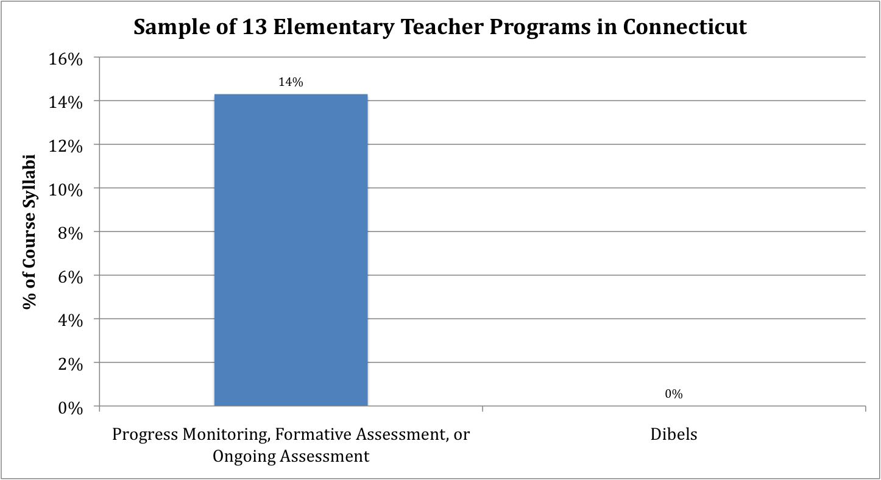
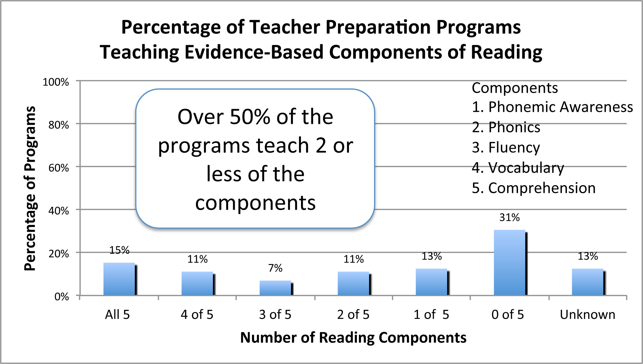
Impact of Teacher Preparation
#3
Spear-Swerling (2008)
Walsh, Glaser, and Wilcox. (2006)
Notes:
Steiner, 2004 - 16 mostly well-regarded colleges of education all emphasized constructivism
National Reading Panel
#3 Constructivism predominates Teacher preparation

Slide 22

Long Term Versus Short Term Contingencies
#4
Notes:
Art vs. Science – it is more akin to bing a craft. Classroom teacher will make more than 800 - 1,500 educational decisions every school day.
Explicit model teachers must master a set a skills – Trained and coached: This takes time, effort, and money – long term rewards
Constructivist payoff is immediate, can’t be evaluated, easy to implement because you select what you want vs what works
#4 – The contingencies maintaining Constructivism are winning the short term vs long term

Slide 23
Take Away Message?
We have a robust knowledge-base of practices supported by science that work and those that do not
Despite knowing what works, most teachers embrace constructivism
The constructivists are doing a better job of framing the debate
The foundation of explicit instruction, science, is misunderstood by the public
Constructivist control of a majority of teacher preparation programs
In a head to head match constructivism is winning the short term contingency vs the long term contingencies
Notes:
Take Away is Being right is not enough

