Slide 1
Manipulatives CPD
Session 1: Algebra Tiles

Slide 2
What wrong answer would you expect?
On your tables, look at the worksheet and discuss what wrong answers you would expect to see from your students

Slide 7
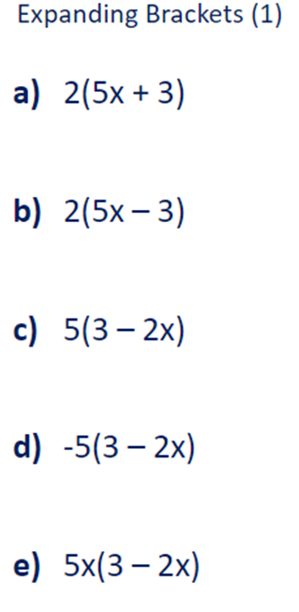
Notes:
During this section, I will bring the group together in a full group discussion, to see if we can find reasons why misconceptions occur

Slide 8
Notes:
Introduce the research that underpins today’s session

Slide 9
Notes:
Ask group to read this section of the evidence review, and ask if they recognise any of what is said in their own classrooms

Slide 10
Notes:
This is the EEF recommendation on use of manipulatives and representations

Slide 11
When I listen, I hear.
When I see, I remember.
But when I do, then I understand.

Slide 12
The purpose of this workshop is to help you help your students learn how to use algebra tiles effectively
Algebra tiles help to develop concepts related to integers, algebraic expressions, equations, and polynomials.
Notes:
In this workshop, I, as the Facilitator, will act as the teacher. I’ll use algebra tiles and Visual Aids to model the activities on the projector. You, the participants, will act as students and experience the benefits of hands-on activities in maths classrooms.

Slide 13
Let’s look at the algebra tiles!
Spread them out on your desk, look at them, turn them, flip them
What do you notice about each tile?
What might they be used to represent?

Slide 14
1
-1
x
-x
x²
-x²

Slide 15
Activity 1: Adding Integers
Small yellow tiles (+1 tiles) are used for positive integers
Small red tiles (–1 tiles) are used for negative integers

Slide 16
Show me +5 with your tiles
Show me +3 with your tiles
How can we model 5 + 3 with these tiles?
What number sentence describes the model?
5 + 3 = 8

Slide 17
The Zero Pair
Since the sum of a number and its opposite is zero, together, a positive tile and a negative tile represent zero and are called a zero pair.
What number sentence describes this zero pair?
1 + (-1) = 0

Slide 18
Show me 3 + (-3) with your tiles

Slide 19
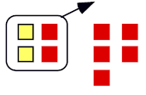
Show me 2 + (-7)
Zero pairs
2 + (-7) = -5

Slide 20
Use your tiles to model -6 + 4

Slide 21
Try these
a. 4 + (– 9)
b. – 3 + (– 8)
c. 9 + (– 3)

Slide 22
Activity 2: Subtracting Integers
We can model -6 - (-2)
What number sentence does this model describe?
-6 - (-2) = -4

Slide 23
We can model 4 - 7
Begin with 4
Now add zero pairs until you have 7 positive integer tiles
Now take away 7 positive integer tiles
We are left with -3

Slide 24
Try these
A. 2 – 6
B. 2 + (–6)
C. –3 – 8
D. –3 + (–8)

Slide 25
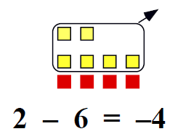
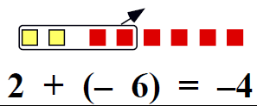
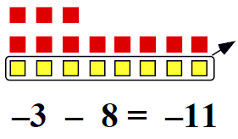
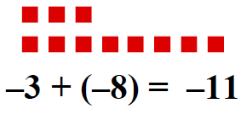

Slide 26
Can you complete the sentence?
To subtract an integer, you can add ___________________
This is called “The Additive Inverse”

Slide 27
Notes:
How can we remove the scaffold? What other representations may be required to bridge the gap to the abstract?

Slide 28
Activity 3: Simplifying Algebraic Expressions
1
-1
x
-x

Slide 29
How can we model the expression 5 + 4x?

Slide 30
3x + 2 - 4x - 5
How could we model this expression?
Remember that subtraction is the same as adding the opposite
This expression could be written as 3x + 2 + (-4x) + (-5)

Slide 31
How can we simplify this expression?
We collect “like terms”

Slide 32
-2x + 5 - 4x - 5

Slide 33
-2x + 5 - 4x - 5

Slide 34
Try these:
a. 4x + 8 – 3x
b. 5x – 9 – 2 – 3x
c. –3x + 7 + x – 6

Slide 35
Notes:
How can we remove the scaffold? What other representations may be required to bridge the gap to the abstract?

Slide 36
Activity 4: Solving Linear Equations
How could we model the equation x - 2 = 7?

Slide 37
Activity 4: Solving Linear Equations
How could we use algebra tiles to solve this equation?

Slide 38
2x + 3 = -9

Slide 39
2x + 3 = -9

Slide 40
Solve 3x – 2 = 4

Slide 41
5x + 6 = –4

Slide 42
Activity 5: Using algebra tiles to solve worded problems
A total of 38 students from two schools attended a mathematics tournament. Six students from Jefferson High School rode bicycles. The rest were transported in three cars. Seven students from Lincoln Middle School rode bicycles. The rest were transported in two cars. If all the cars transported the same number of students, how many students rode in each car?
5 minutes: Write an equation to model the situation
Model the problem with algebra tiles
Solve the Problem

Slide 44
Notes:
How can we remove the scaffold? What other representations may be required to bridge the gap to the abstract?

Slide 45
Activity 6: Adding and Subtracting Polynomials

Slide 46
1
-1
x
-x
x²
-x²

Slide 47
What expression does this model represent?

Slide 48
Build a model for 2x² + 4x - 5

Slide 49
How can we model the addition of 2x² + 3x + 5 and x² – 2x – 3?
3x² + x + 2

Slide 50
Find the sum: (3x² + 2x – 4) + (–2x² + x – 3)
x² + 3x - 7

Slide 51
How can we model this subtraction?
2x² + 4x – 5 – (x² + 2x – 3)
Remember: “Additive Inverse”

Slide 52
Find the difference: (2x² + 2x – 1) – (x² – x + 3)

Slide 53
Notes:
How can we remove the scaffold? What other representations may be required to bridge the gap to the abstract?

Slide 54
Activity 7: Expanding Brackets
In this section, we will use rectangular arrays to model multiplication
This can be associated with the grid method for multiplication of numbers, but also demonstrates how area can be used to allow different means of breaking up numbers other than hundreds, tens, units etc

Slide 55
How could we model 3(2x + 1)?

Slide 56
How could we model 4(2x - 2)?

Slide 57
How could we model -3(3x - 1)

Slide 58
How could we model 2(3x + 1) - 3(x - 2)?

Slide 59
Model x(2x + 3)

Slide 60
How could we model (x - 2)(x + 3)?

Slide 61
Show me (x - 4)(x - 1)

Slide 62
How about (2x + 1)(x - 3)?

Slide 63
Lastly, (-2x + 1)(2x - 3)

Slide 64
Notes:
How can we remove the scaffold? What other representations may be required to bridge the gap to the abstract?

Slide 65
Time to critique…
I am going to share with you examples of the work my Year 8s have done
What do you like? What would you change?
Can you think of a better way to introduce algebra tiles?
Any ideas for improved resources to support delivery of this?

Slide 66
Summary
How can the activities that we worked on today have an impact on students in your classroom from now on?
What will you be your main take away from this session?
Did anything surprise you today?
Have your attitudes changed towards the use of manipulatives?

Slide 67
When I listen, I hear.
When I see, I remember.
But when I do, then I understand.

Slide 68
Manipulatives CPD
Session2: Algebra Tiles

Slide 69
Activity 8: Factorising
We will again be using rectangular arrays
This can be used to show that division is the inverse of multiplication, and again that an area model can be used to break numbers down

Slide 70
What does this model represent?

Slide 71
How do we factorise the expression?
We need to work out the dimensions of each rectangular array
So this diagram represents 6x - 6 = 3(2x - 2)

Slide 72
What does this model represent?

Slide 73
How do we factorise the expression?

Slide 74
Create a model to factorise x² + 5x + 6

Slide 75
Create a model to factorise x² - 7x + 12

Slide 76
Activity 9: Completing the square
How could we model the expression x² + 6x + 12?

Slide 77
Can we make this into a square?
We can, but we have some tiles left over
So what does this diagram represent?
x² + 6x + 12 = (x + 3)² + 3

Slide 78
Let’s model x² - 4x + 2

Slide 79
Can we make this into a square?
We can, but we have too many tiles
So what does this diagram represent?
x² - 4x + 2 = (x - 2)² - 2

Slide 80
Show me x² - 2x - 2
We can, but we have +1 when it should be -2
So what does this diagram represent?
x² - 2x - 2 = (x - 1)² - 3

