Slide 1


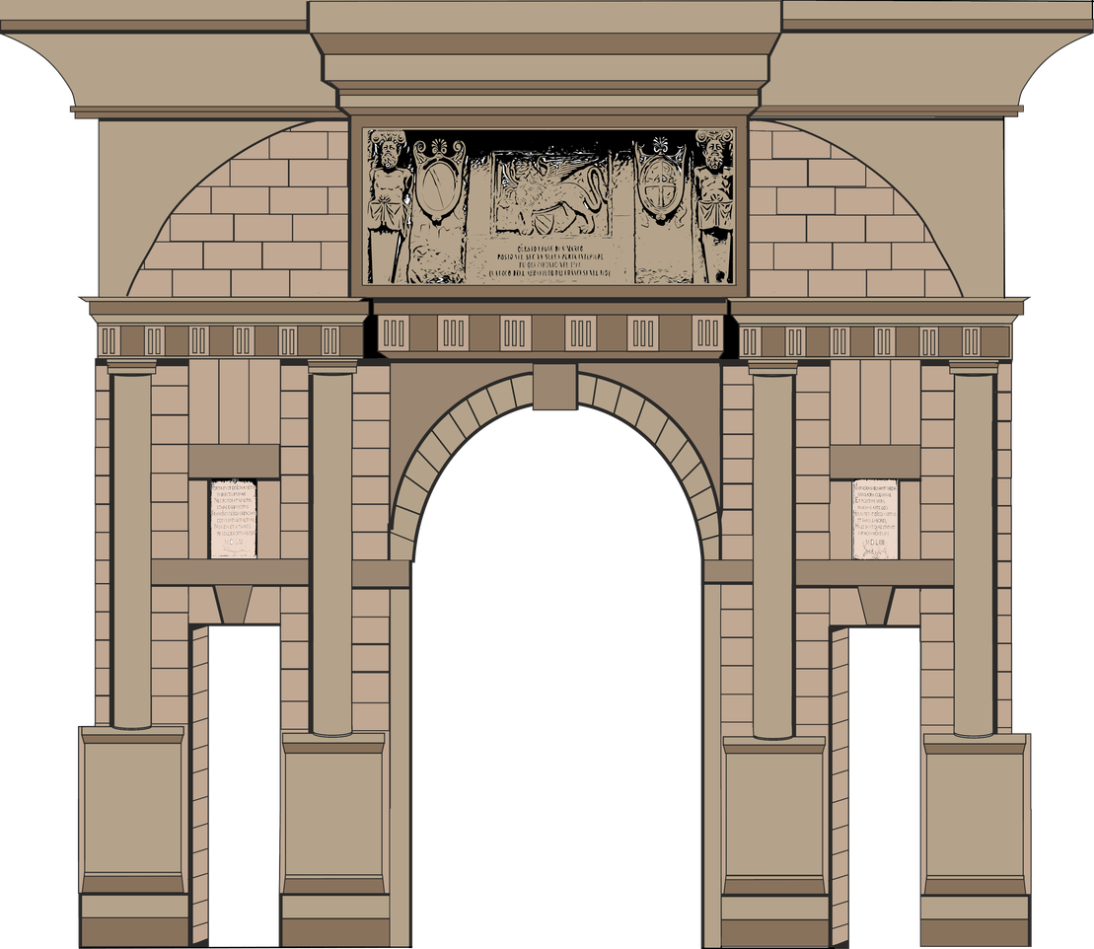


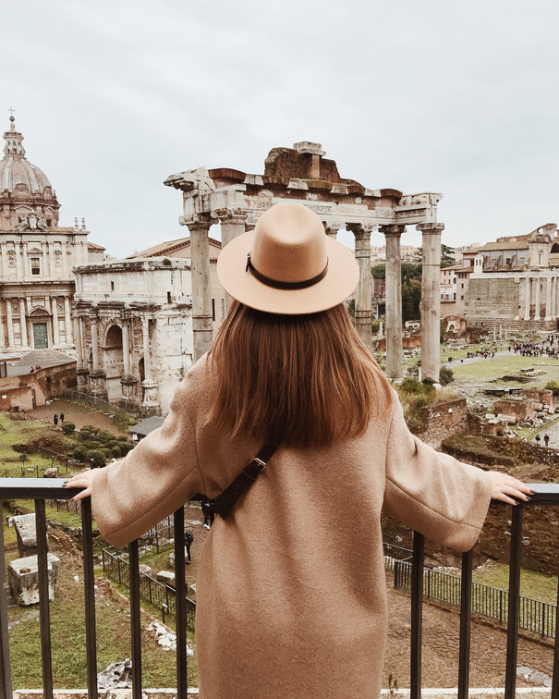
Ancient European
About
Architecture
Contact
Ancient European
ARCHITECTURE
HITECT
PRESENTATION
+
This presentation introduces ancient European architecture
Visit European Buildings with Us
START PRESENTATION

Slide 2


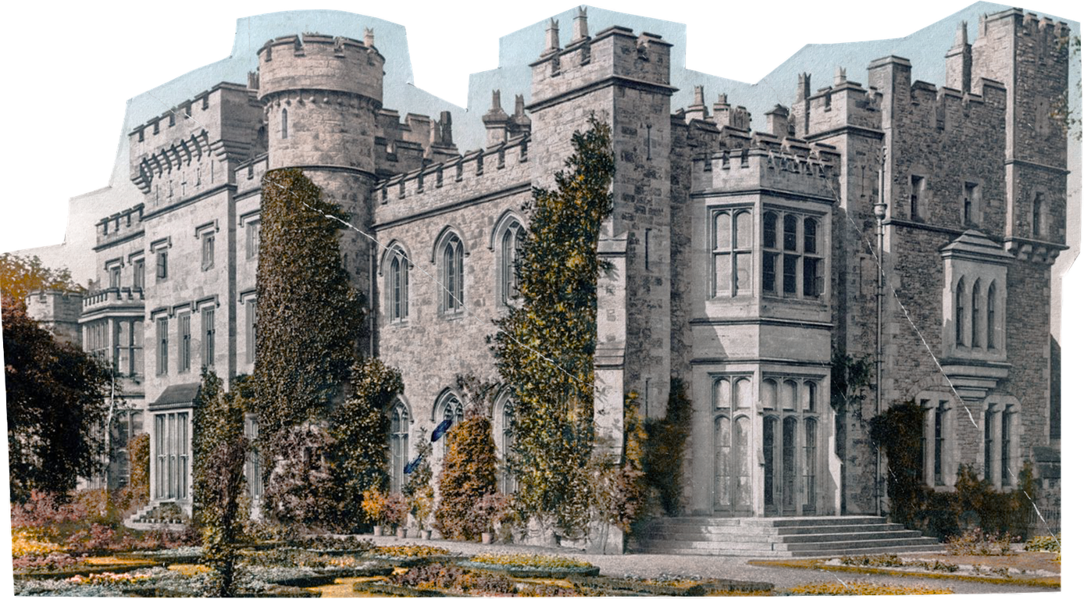
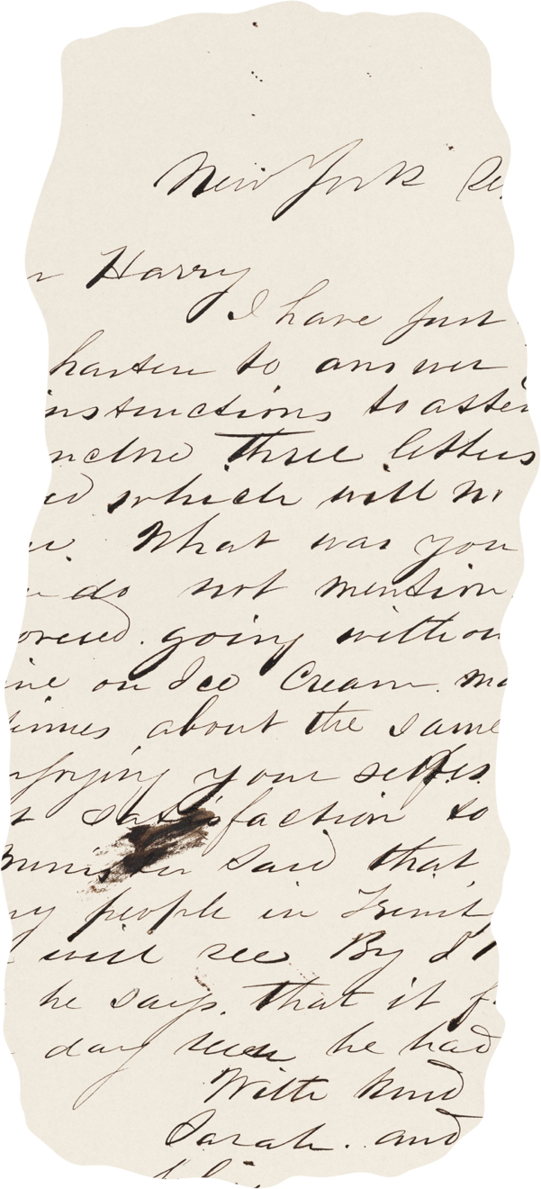


Ancient European
About
Architecture
Contact
Ancient European
01
Introduction purpose
Architecture Overview
This presentation introduces ancient European architecture as a cultural mirror reflecting religious beliefs political power aesthetic values
02
Geographic spread
European architecture spans diverse regions from Mediterranean temples and amphitheaters to Gothic cathedrals.

Slide 3
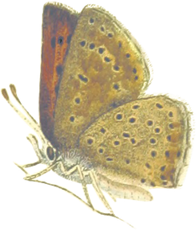
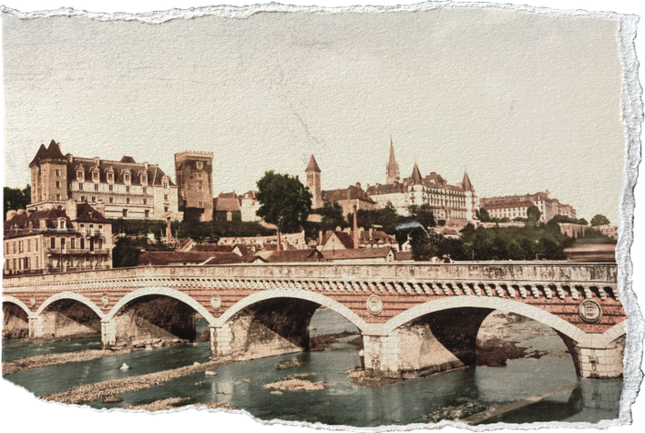
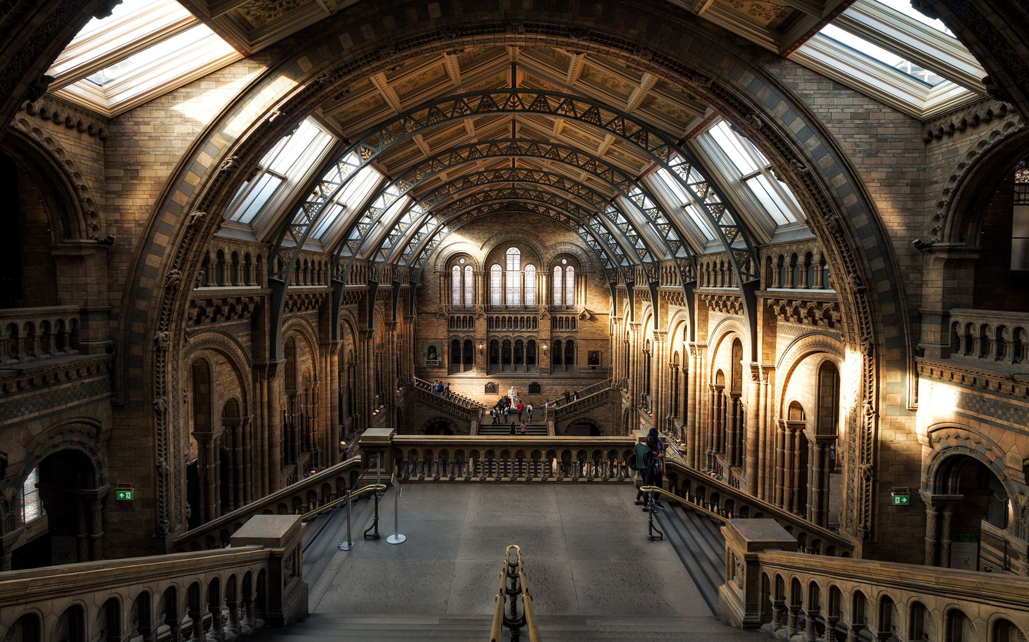
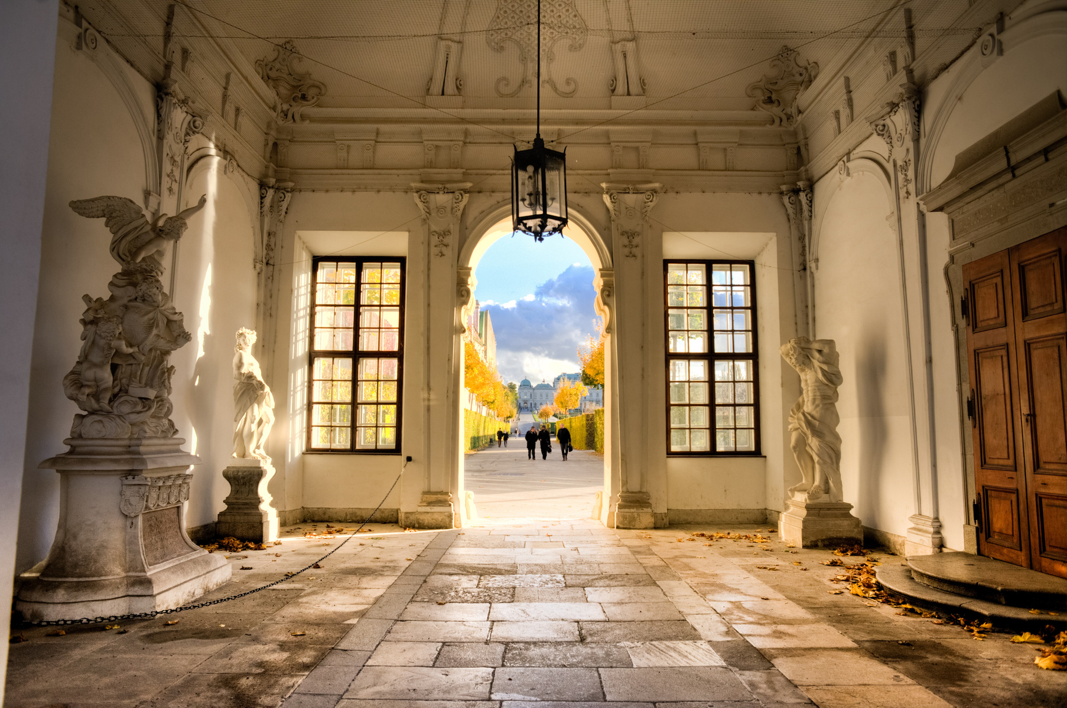
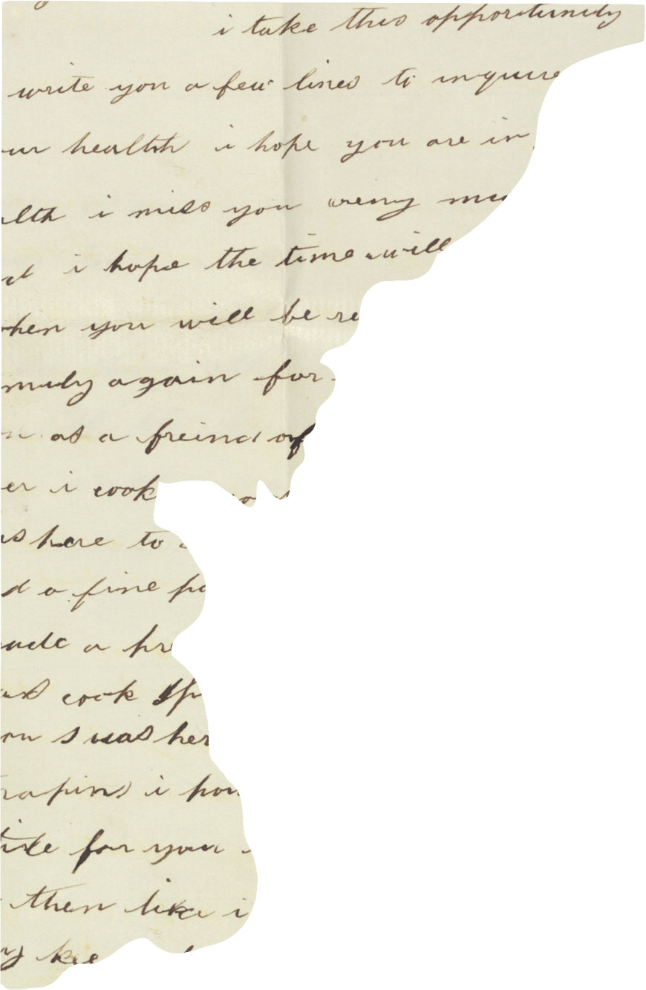
Ancient European
About
Architecture
Contact
Concrete innovation
Public infrastructure
Romans pioneered concrete construction enabling arches domes and aqueducts
Romans built baths amphitheaters roads and aqueducts that transformed.
Roman
Engineering And Architecture
Triumphal monuments
Triumphal arches and columns celebrated military victories and emperors; carved reliefs documented campaigns, offering historians visual records while inspiring European commemorative.

Slide 4



Ancient European
About
Architecture
Contact
Byzantine
Architectural Marvels
Sacred mosaics
Byzantine churches employed shimmering mosaics depicting Christ saints and biblical scenes
Iconic domes
Fusion of styles
Hagia Sophia’s massive dome epitomized Byzantine innovation and pendentives.
Byzantine architecture fused Roman engineering with Eastern aesthetics producing richly

Slide 5
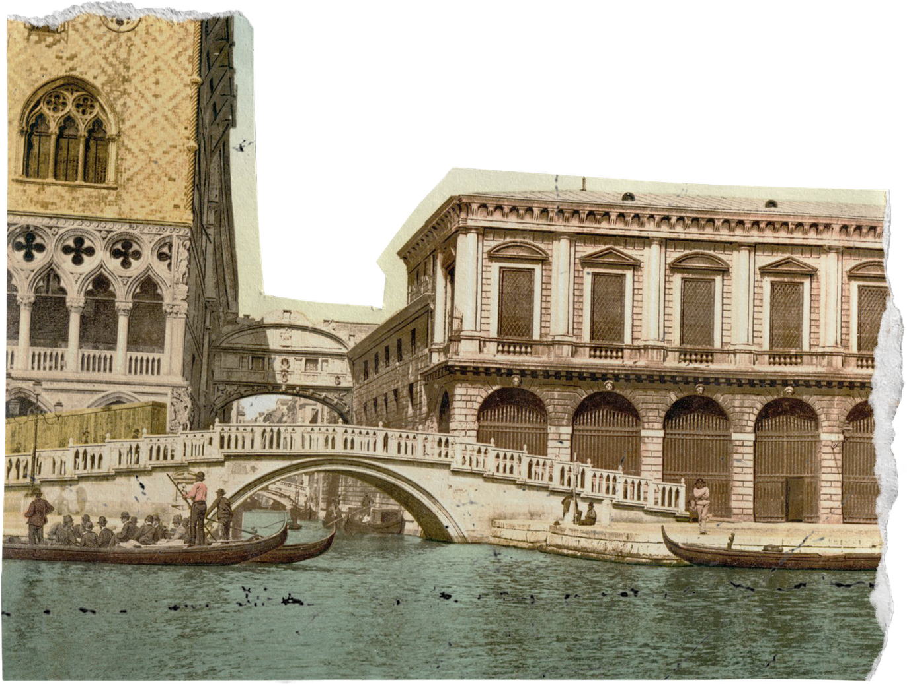


Ancient European
About
Architecture
Contact
Romanesque
Rounded arches
Architecture In Europe
Characteristic rounded arches spanned doorways and vaults, creating rhythmic interiors; their structural simplicity.
Thick stone walls
Romanesque buildings used massive stone walls and small windows creating fortress-like churches; these features provided stability fire resistance.
Membership Programs
Monastic communities spearheaded Romanesque construction, building abbeys that combined worship with self-sufficient living; these complexes embodied spiritual.

Slide 6

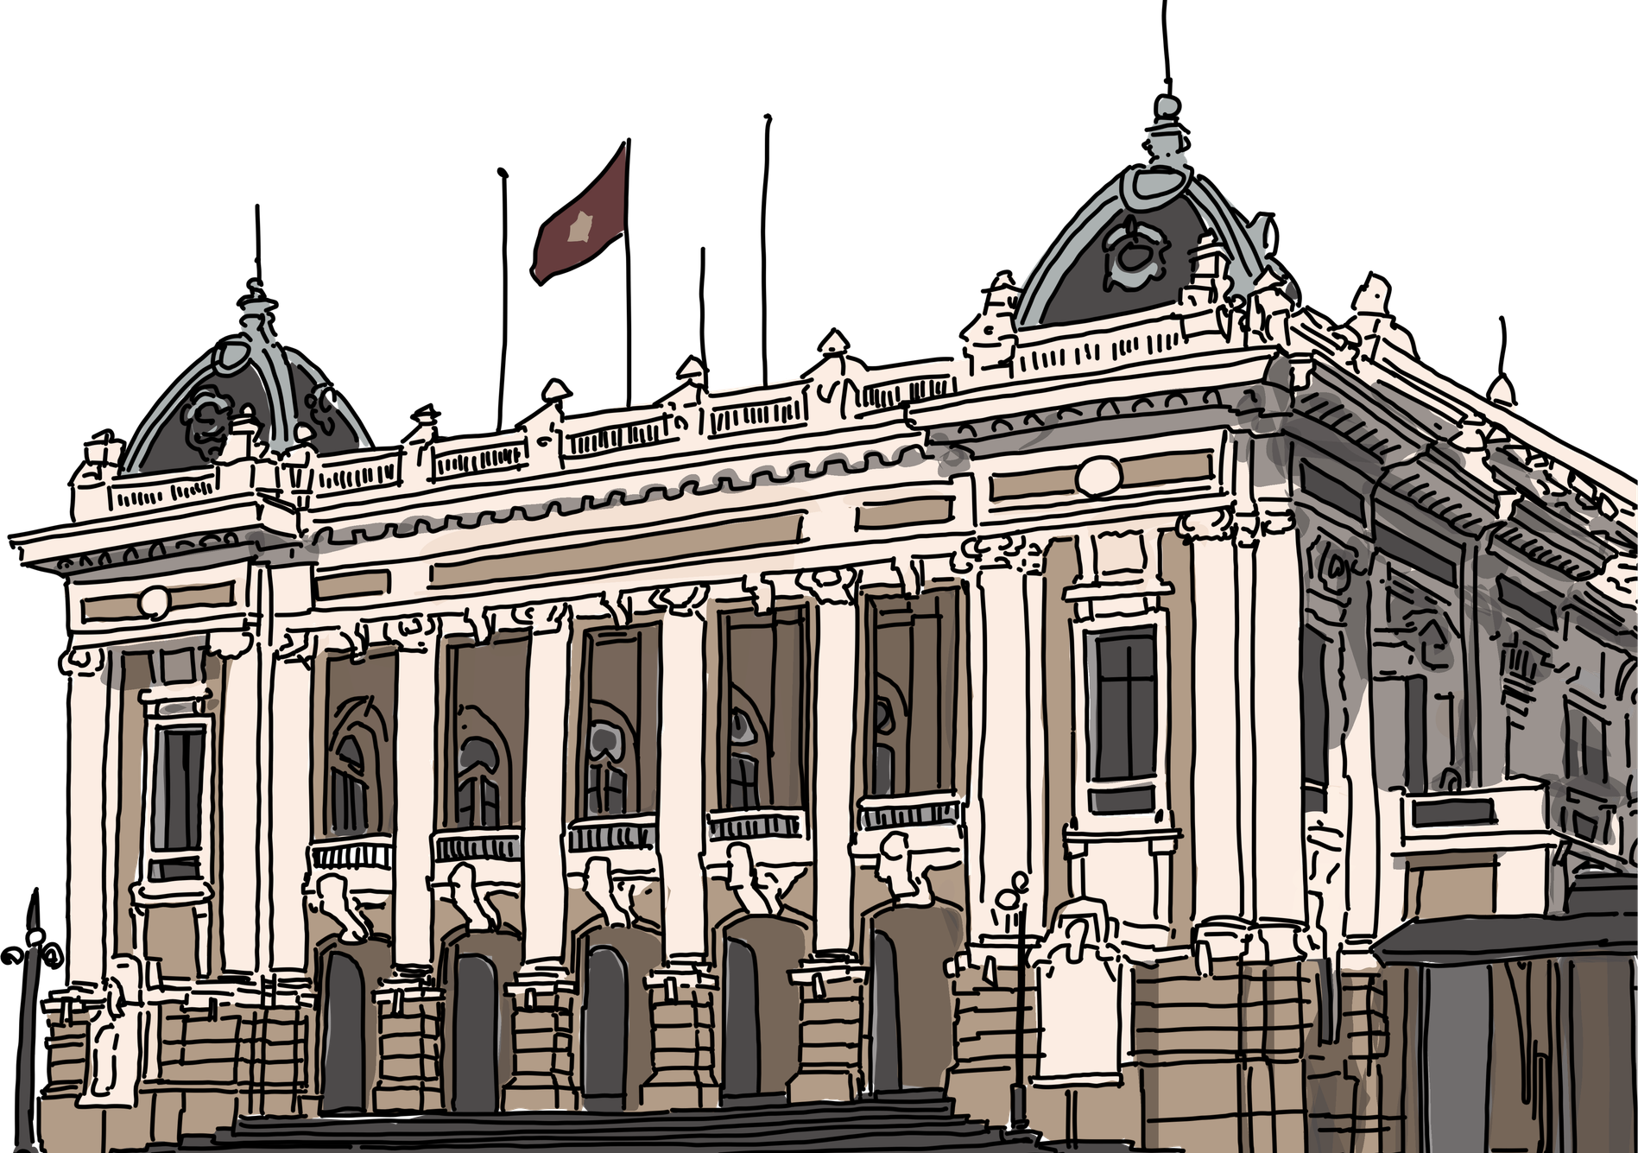
Ancient European
About
Architecture
Contact
Gothic
Cathedrals And Light
Cathedral communities
Cathedrals dominated medieval towns, serving as religious civic and economic hubs; construction spanned generations.
Stained glass windows
Expansive stained glass filled interiors with colored light narrating biblical stories; these windows taught scripture.

Slide 7
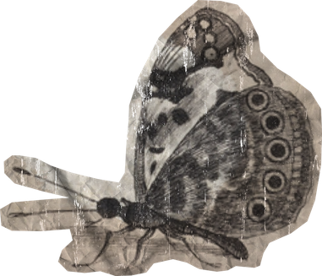
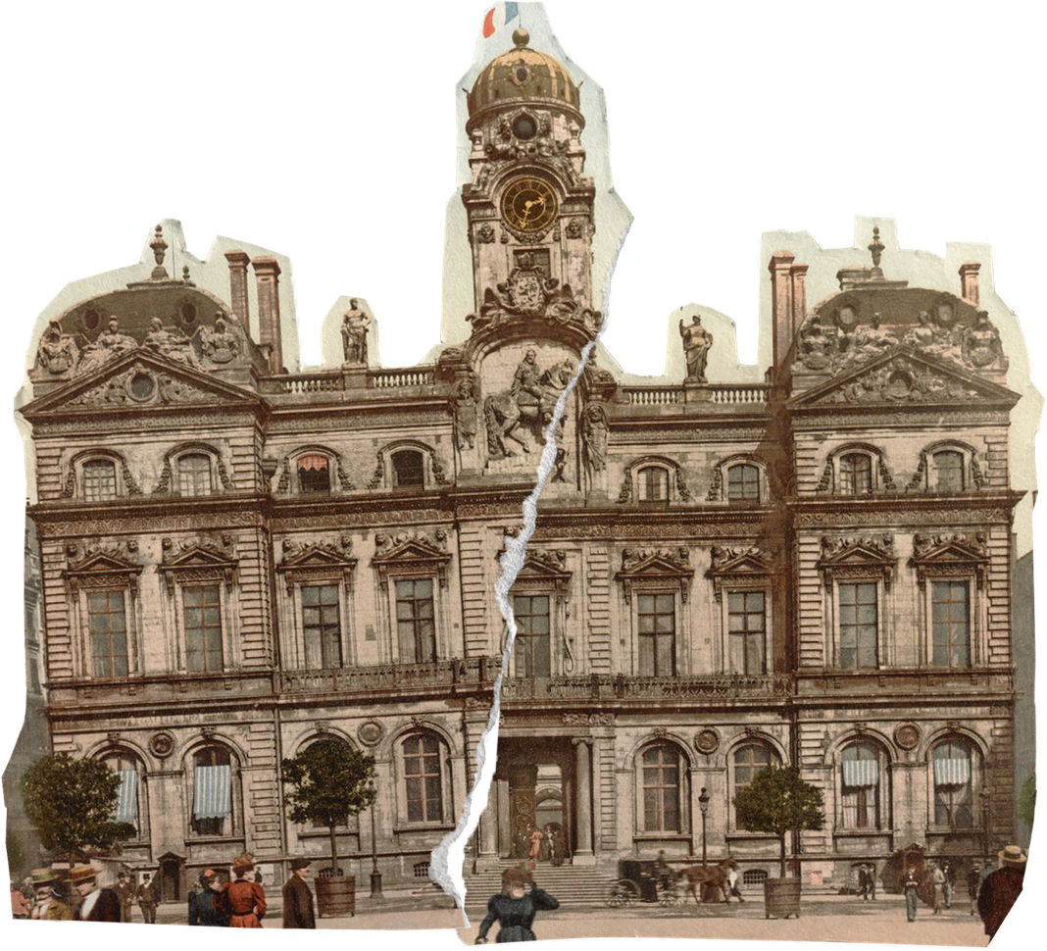

Ancient European
About
Architecture
Contact
Renaissance
Architectural Rebirth
Return to classics
Patronage system
Renaissance architects revived classical ideals symmetry columns and domes inspired by Greek and Roman ruins; their work emphasized harmony proportion rational.
Wealthy patrons including Medici families commissioned churches palaces and public buildings; patronage encouraged artistic experimentation fostering innovations in architecture.

Slide 8


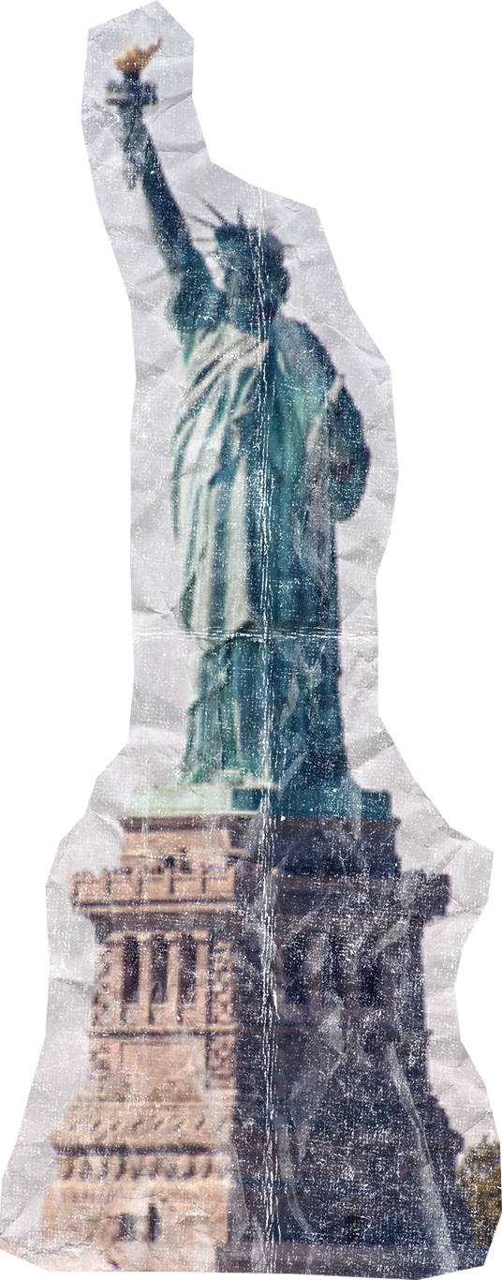
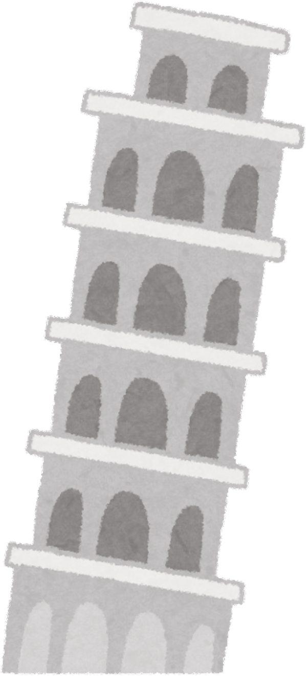

Ancient European
About
Architecture
Contact
Baroque
Splendor And Power
Illusion and light
Baroque architects used light shadow and illusionistic painting to expand spaces; ceilings depicted heavens.
European influence
Baroque style spread through Europe influencing churches palaces and urban planning; its theatricality shaped Spanish

Slide 9

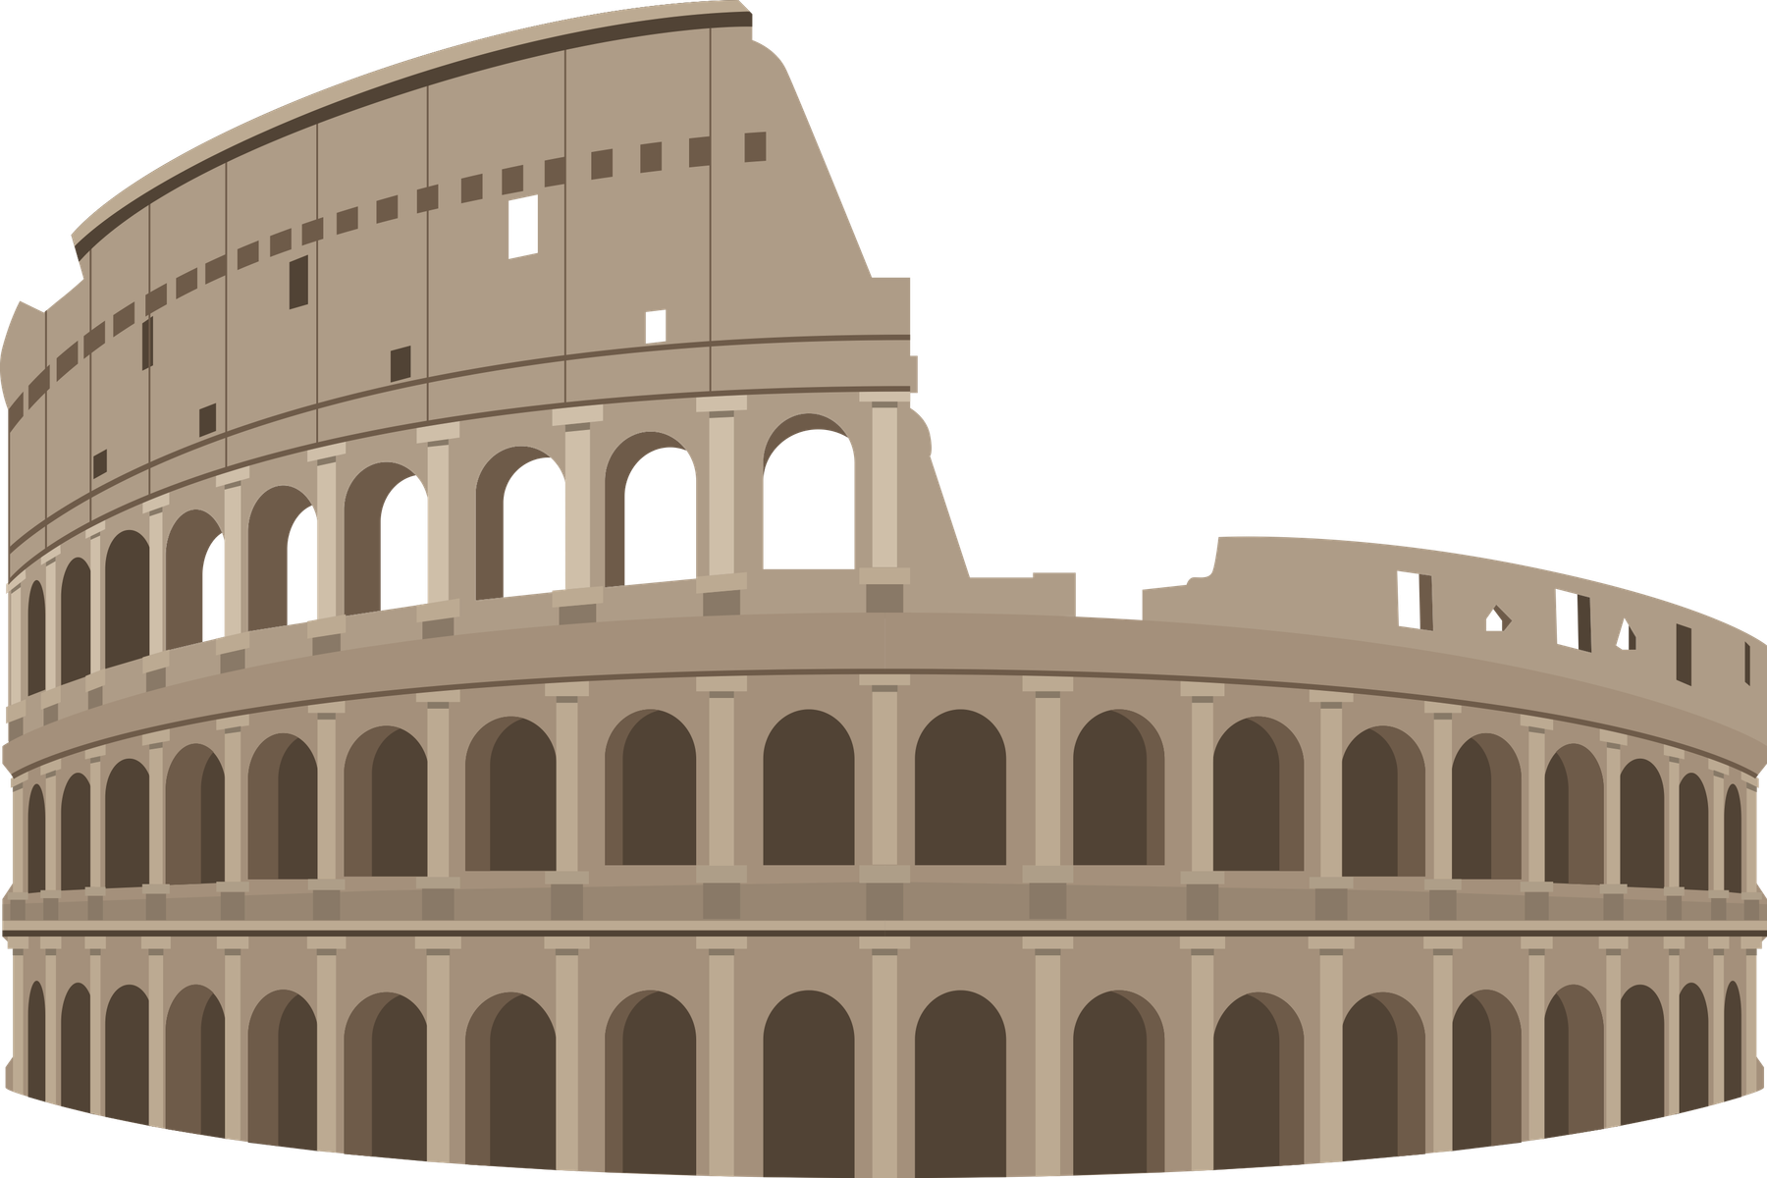
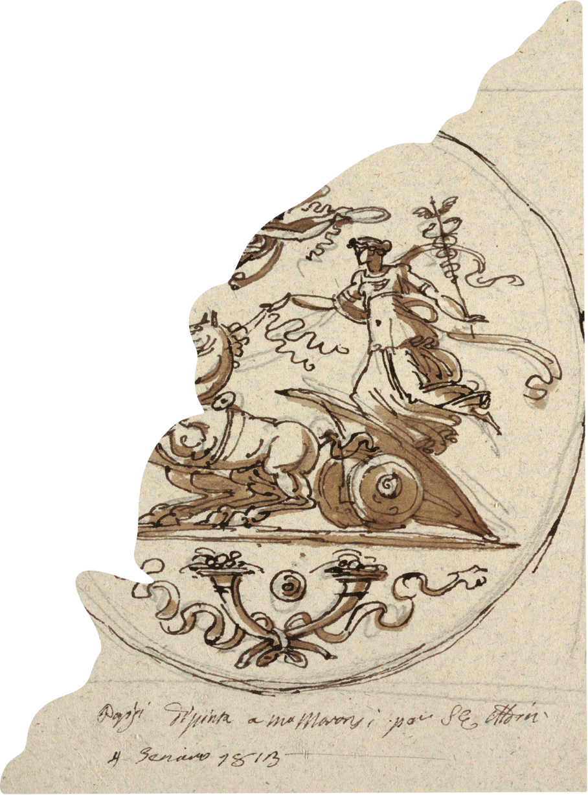

Ancient European
About
Architecture
Contact
Neoclassicism
And Enlightenment Architecture
Neoclassicism embraced rational design symmetry and simplicity inspired by Greek and Roman antiquity; it reflected Enlightenment ideals of reason civic virtue and universality contrasting ornate Baroque exuberance decisively.
Governments built neoclassical courthouses museums and parliaments; monumental facades.

Slide 10

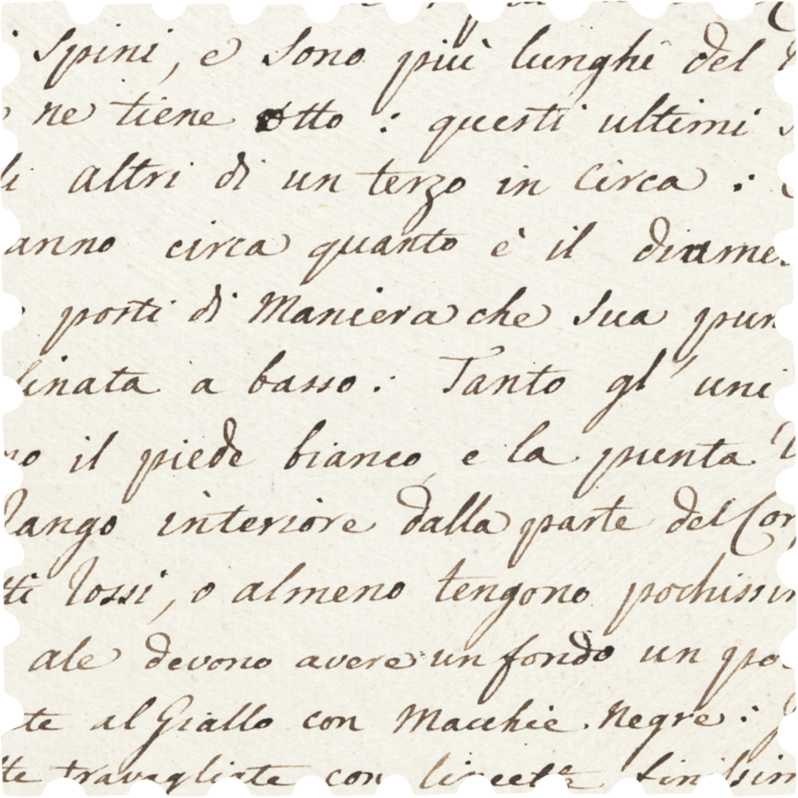




Ancient European
About
Architecture
Contact
Contact
Information
Website
www.reallygreatsite
Email
hello@reallygreatsite.com
Location
123 Anywhere St., Any City, ST 12345

Slide 11
Ancient European
About
Architecture
Contact
THANK YOU.
For Your Attention

