Slide 1


Culture Mapping:
A Cognitive Analysis of
The Education Culture Landscape in America
Randy Keyworth

Slide 2
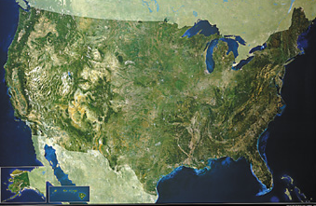
How cultural constructs influence education policy at the national level.

Slide 3

Culture Mapping
or
Going Down the
Rabbit Hole
(an adventure into the unknown)
cognitive concepts: attitudes, beliefs, philosophies, ideologies
qualitative research: surveys, interviews, focus groups, media analyses
social sciences: anthropology, linguistics, cognitive psychology, sociology, political science, communications theory

Slide 4
The scope of public thinking about American education.
Education policy has become a partisan issue.
Education policy is regularly covered by media at all levels.
Education policy generates widespread interest
Many adults work within the field of education,
or know people who do.
Most adults have dealt with education as parents.
All adults have dealt with education as students.

Slide 5
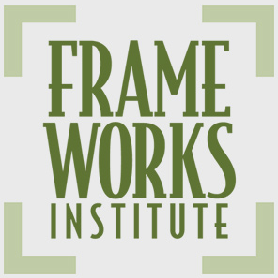
A systematic inquiry into patterns of public thinking about American education.
Research : systematic review of social science
and education literature
Methodology: surveys
review of national & local media
focus groups
in-depth interviews
Reports: “Framing Education Reform: A FrameWorks Message Memo” Nall Bales (2010)
“Magic Bullets Hanging By a Thread”
O’Neil & Haydon (2013)

Slide 6
Differing Views on the Influence of Evidence in Education
RATIONAL ACTOR MODEL:
Reason is conscious, literal, logical, universal, unemotional, disembodied, and serves self interest.
If people are made aware of the fact and figures, they should naturally come to the right conclusions.
2. FRAME MODEL:
People evaluate information and make decisions in the context of their deeply held constructs—worldviews, beliefs, and assumptions—called “frames”.
Frames are a small sets of internalized concepts and values that allow people to attach meaning to new information.
Once a frame is established, it will “trump” numbers. If the facts don’t fit the frame, it’s the facts that are rejected, not the frame.
Frameworks, Framing Public Issues, 2002

Slide 7
Culture Mapping: Patterns of Public Thinking
FRAMES REGARDING EDUCATION SOLUTIONS
1. Individual Frame
education “systems” are invisible, complex… focus goes to individual “actors”: parents, teachers, students
2. Blame Frame
assume problems are the result of motivation, character, discipline, effort and/or caring
“irresponsible parents”, “bad teachers”, “undisciplined students”
3. Visionary Leader Frame
tendency to reduce the complexity of a multi-actor system to the actions and characteristics of a single individual in a leadership role
Magic Bullets Hanging By a Thread”, O’Neil & Haydon, FrameWorks Institute, (2013)

Slide 8
Culture Mapping: Patterns of Public Thinking
FRAMES REGARDING EDUCATION SOLUTIONS
4. Magic Bullet Frame
belief there is one reform or policy initiative that will “magically” address the country’s educational woes
5. Local Solutions Frame
innovation, dynamism, and meaningful programmatic change can only occur at the local level; state and federal actors are inflexible, out of touch, and ineffective
6. Private Sector Frame
private sector is the only place capable of innovation and efficiency, public schools too mired in bureaucracy,
“Magic Bullets Hanging By a Thread”, O’Neil & Haydon, FrameWorks Institute, (2013)

Slide 9
Culture Mapping: Patterns of Public Thinking
FRAMES REGARDING EDUCATION SOLUTIONS
7. Back to Basics Frame
failure of education is due to reforms getting away from the basics: reading, writing and arithmetic
8. More Funding Frame
assumption that any reforms would require that much more money, and that more money will improve education
9. Computers Frame
belief that having more computers in the classroom is a universal panacea for improving education
“Magic Bullets Hanging By a Thread”, O’Neil & Haydon, FrameWorks Institute, (2013)

Slide 10
Culture Mapping: Impact of Cultural Beliefs
EDUCATION REFORM INITIATIVES
EVIDENCE vs. CULTURAL FRAMES
CHARTER SCHOOLS
SCHOOL IMPROVEMENT GRANTS
(additional funding and staff replacement)
ONE-TO-ONE COMPUTING

Slide 11
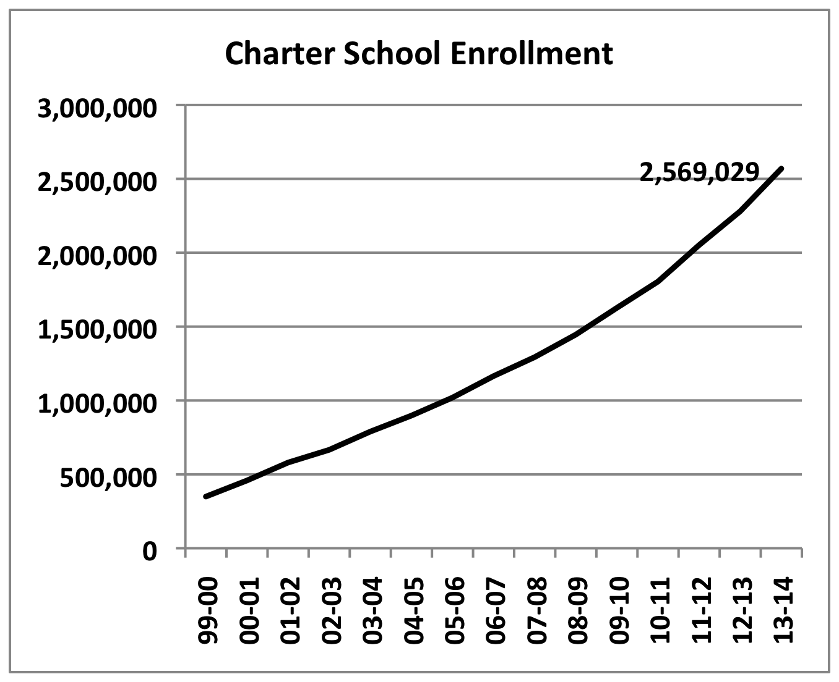
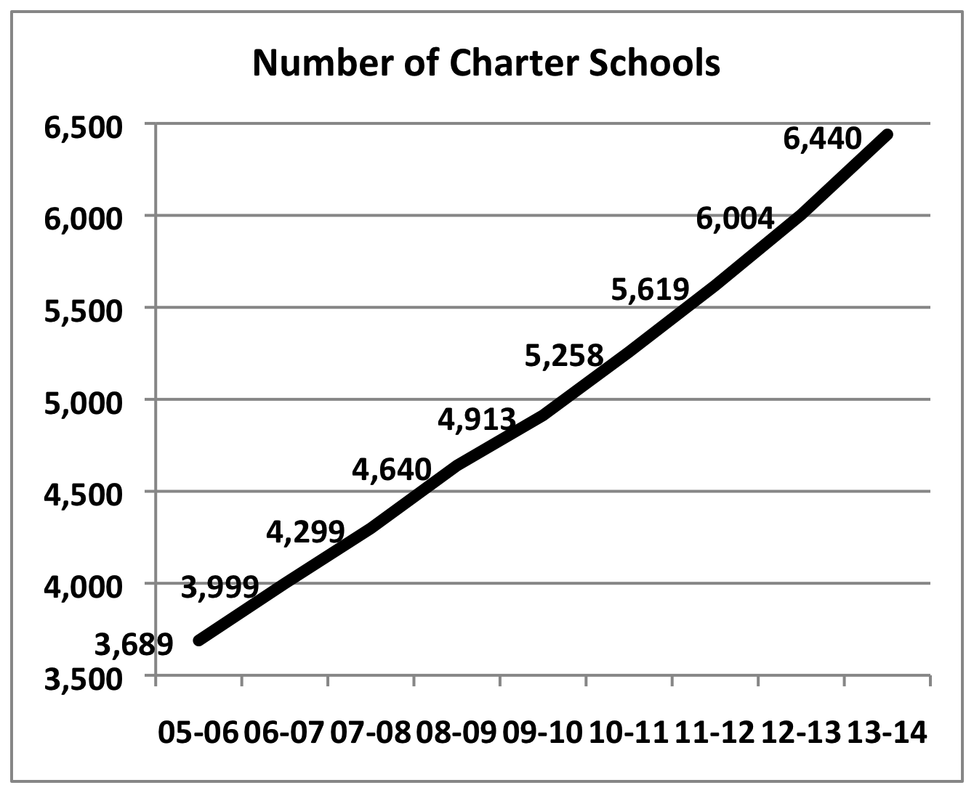
Culture Mapping: Impact of Cultural Beliefs
Charter Schools
Model: 1. independently contract with outside group to operate schools
2. no specific education model, curriculum, pedagogy
3. no unions
5.1% of K-12 students in charter schools
100% enrollment growth since 2007-08
Percentage of children in charter schools
New Orleans : 79% District of Columbia: 43%
Detroit: 51% Chicago: 19%
70% of Americans support charter schools

Slide 12
Culture Mapping: Impact of Cultural Beliefs
Charter Schools
EVIDENCE
CULTURAL FRAMES
Private Sector Frame
Visionary Leader Frame
Magic Bullet Frame
Local Solutions Frame
Charter School Performance in 16 States (2009), CREDO, Stanford
“On average, academic growth be somewhat lower than their traditional public school peers…”
“tremendous variation in academic quality among charter schools is the strongest result of the study…”
The Evaluation of Charter Schools Final Report (June 2010), IES
“On average, charter middle schools that hold lotteries are neither more nor less successful than traditional public schools in improving achievement, behavior, and school progress.”
“The impact of charter middle schools on student achievement varies significantly across schools”

Slide 13
Culture Mapping: Impact of Cultural Beliefs
School Improvement Grants
Model (funding and staff replacement)
1. funding over three years (2010-11, 2011-12, 2012-13 ) toward the goal of turning around the 1,200 of the nation’s lowest-performing schools
up to $ 2 million per school per year, $ 3.5 Billion total
3. must use one of the following four models for turnaround:
Turnaround model: replace the principal and no less than 50% of the staff; and introduce significant reforms (20% of schools)
Restart model: reopen the school under management of a charter school operator, or an ed. mgmt. organization (4% of schools)
School closure: close the school and reassign students to higher achieving schools (2% of schools)
Transformational model: replace the principal,
introduce significant reforms (74% of schools)
Hurlburt, et.al. 2011, Institute of Education Sciences

Slide 14
Culture Mapping: Impact of Cultural Beliefs
School Improvement Grants
EVIDENCE
FUNDING
Funding increased by 30% from 1995-2009
Disconnect between funding levels and performance at all levels
STAFF REPLACEMENT
5 years NCLB data implementing staff replacement model
80% no change
8% small improvement
1% successful turnaround
11% closed
CULTURAL FRAMES
More Funding Frame
Individual Frame
Blame Frame
Magic Bullet Frame
Local Solutions Frame
Private Sector Frame

Slide 15
Culture Mapping: Impact of Cultural Beliefs
One-to-One Computing
Model:
• Each student and teacher is given a computing device: computer, access to the internet and software. Computers include personal computer, laptop, netbook, handheld, or tablet.
• Untold billions of dollars being spent across many states and nations
• The vast majority of 1-1 computing initiatives drop computers into classrooms without consideration of pedagogy, curriculum, or teaching
• The focus on the technology, not the teaching
spray and pray: “spray” on the technology, and then “pray” that you get an increase in learning
belief that students can be left to their own devices

Slide 16
Culture Mapping: Impact of Cultural Beliefs
One-to-One Computing
LAUSD $ 1 Billion to get iPADS to 650,000 students
cost over-runs (support, maintenance, WiFi, replacement, electricity)
inadequate, untested curriculum
poor planning, implementation
inadequate training for teachers
lack of integration with district
36% teacher support

Slide 17
Culture Mapping: Impact of Cultural Beliefs
One-to-One Computing
EVIDENCE
“one-to-one computer programs are only as effective as their teachers”
Bebell & Key, The Journal of
Technology, Learning & Assessment, (2010)
“Factors related to successful implemented reported in the research include extensive teacher professional development, technical support, and positive teacher attitudes toward student technology use.”
Penuel, SRI International, Journal of Research on Technology in Education, (2006)
CULTURAL FRAMES
Computers Frame
Magic Bullet Frame
Local Solutions Frame
Private Sector Frame

Slide 18
How cultural constructs have influenced
education policy at the national level.
How to influence cultural constructs regarding
education policy at the national level.

Slide 19
Understand the complexity of effective communication
People are not blank slates
Communication is interactive
Communication resonates with people’s deeply held values and worldviews
Communication is frame based
When communication is inadequate, people default
to the “pictures in their heads”
When communication is effective, people can see an issue from a different perspective.

Slide 20
2. Recognize the limitations of evidence, numbers, data, research on influencing public opinion.
Being “right” is never enough.
3. Craft the message within the context of dominant frames
LEVEL ONE: Big ideas, like freedom, justice, community, success, prevention, responsibility
LEVEL TWO: Issue-types, like the environment or childcare
LEVEL THREE: Specific issues, like rainforests or earned tax credits

Slide 21
4. Use numbers as part of the story, not as the story.
Begin with the interpretation, then the numbers
Never provide numbers without telling them what they mean.
5. The choice of messenger is as important as the message itself.
6. Use tools to make extensive inferences beyond the words actually used
visuals
metaphors

Slide 22


Slide 23


Slide 24
How do you get rid of “bad” teachers?
Make them “good” teachers.

Slide 25
Thank you

