Slide 1

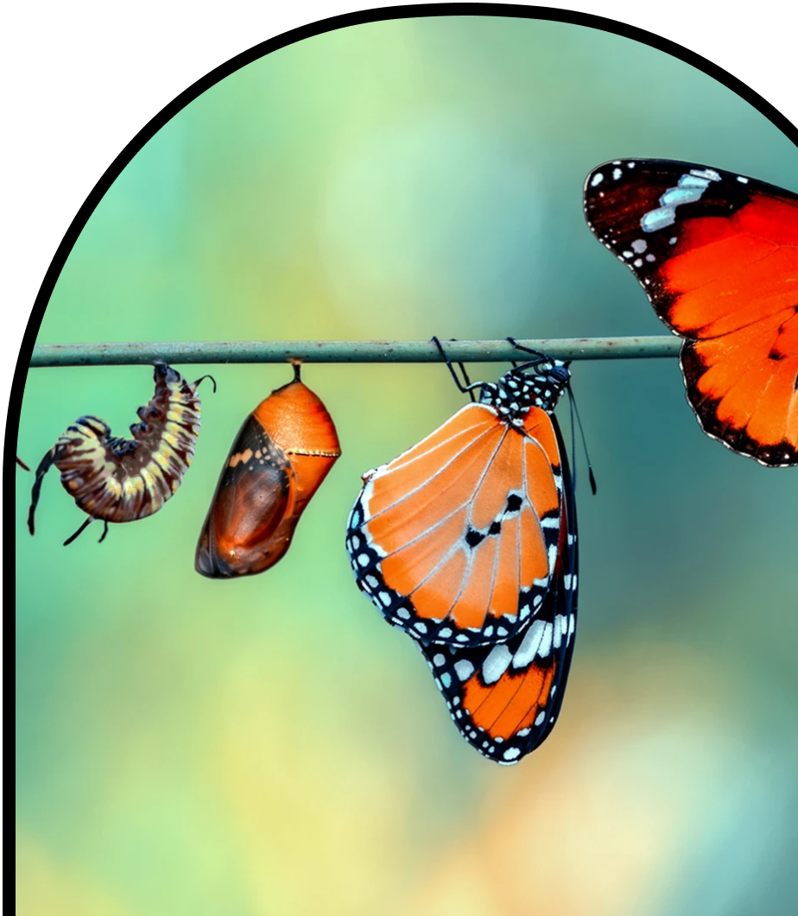
Anchor Layer Teacher Guide
A curriculum companion for Anchor Layer users
Grade 3
Life Cycles
Unit Web Link • Pacing Guide • Other Units

Slide 2
Life Cycles • Grade 3
Anchor Layer Teacher Guide
Unit Summary
In this unit, students compare and contrast the life cycles of both animals and plants. Students create models to build an understanding that all organisms share certain stages in their life cycles: birth, growth, reproduction, and death. Students also explore how an understanding of life cycles can aid in solving problems that occur when there are too many or too few organisms in a particular environment.
Assessments
Performance Expectations | Science & Engineering Practices | Disciplinary Core Ideas | Crosscutting Concepts
• 3-LS2-1. Construct an argument that some animals form groups that help members survive. • 3-LS3-1. Analyze and interpret data to provide evidence that plants and animals have traits inherited from parents and that variation of these traits exists in a group of similar organisms. • 3-LS3-2. Use evidence to support the explanation that traits can be influenced by the environment. • 3-LS4-2. Use evidence to construct an explanation for how the variations in characteristics among individuals of the same species may provide advantages in surviving, finding mates, and reproducing. • 3-LS4-3. Construct an argument with evidence that in a particular habitat some organisms can survive well, some survive less well, and some cannot survive at all. | • Analyzing and Interpreting Data • Constructing Explanations and Designing Solutions • Planning and Carrying Out Investigations • Engaging in Argument from Evidence • Obtaining, Evaluating, and Communicating Information | • LS3.A: Inheritance of Traits • LS3.B: Variation of Traits • LS4.B: Natural Selection • LS4.C: Adaptation • LS2.D: Social Interactions and Group Behavior | • Patterns • Cause and Effect • Systems and System Models • Stability and Change
Life Cycles Lesson Flow on Next Page
‹#›

Slide 3
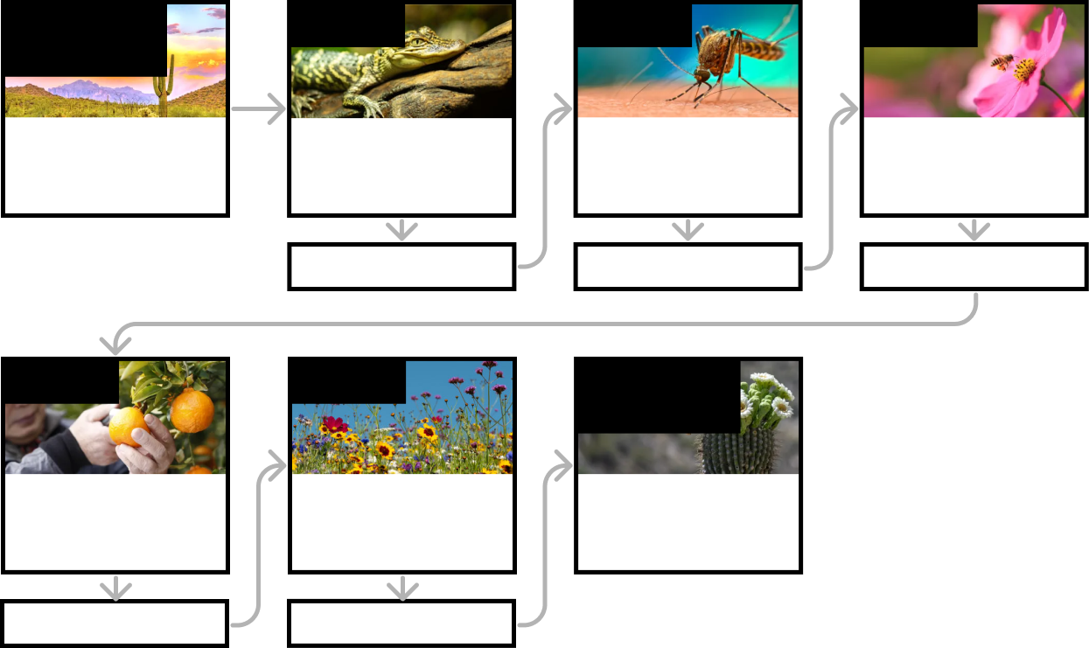
Life Cycles • Grade 3
Anchor Layer Teacher Guide
Life Cycles Lesson Flow
Anchor Phenomenon
Lesson 1
Lesson 2
Lesson 3
Life Cycles
Saguaro Cycles
Animal Life Cycles
How is your life like an alligator’s life?
Environmental Change & Engineering
What’s the best way to get rid of mosquitoes?
Pollination & Plant Reproduction
Why do plants grow flowers?
Anchor Connection
Anchor Connection
Anchor Connection
Lesson 4
Lesson 5
Performance Task
Fruit, Seeds, & Plant Reproduction
Why do plants give us fruit?
Plant Life Cycles
Why are there so many different kinds of flowers?
Life Cycles
Why are some saguaros so tiny?
Anchor Connection
Anchor Connection
‹#›

Slide 4
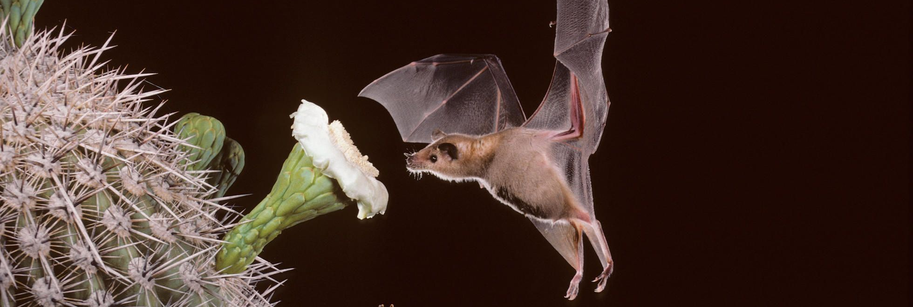
Life Cycles • Grade 3
Anchor Layer Teacher Guide
Anchor Phenomenon Background
Why do these bats fly around and stick their heads in flowers?
Animals all around the world engage in behaviors that, on the surface, seem quite strange. For instance, many bats can be found flying around at night, sticking their heads into cactus flowers. And from the perspective of the cactus, it is an equally strange situation. Why would a plant that is completely covered in large, protective spikes produce soft, unprotected flowers every spring that are easily accessible to animals?
The answers can be found in the life cycles of both living things.
Bats, like all animals, must eat in order to grow. Different types of bats eat a variety of foods, but many bats eat both nectar and pollen that can be found in flowers. In fact, some bats will migrate huge distances in order to follow the seasonal blooming patterns of various plants.
If they don’t follow this precious food source, they won’t be able to survive and reproduce.
Many plants, on the other hand, grow flowers that produce seeds that will eventually grow into the next generation of plants. Most flowers need pollinators to help make this happen. Pollinators can take many forms, from bees, to birds, to beetles, to bats. When these animals visit a flower for something to eat, they invariably get some pollen stuck to them. When they travel to a new flower for more food, they distribute that pollen, and help ensure that the plants are able to produce seeds.
This relationship between plants and animals is mutually beneficial.The life cycle of each living thing depends upon the interactions that take place between them.
‹#›

Slide 5
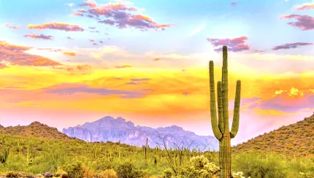
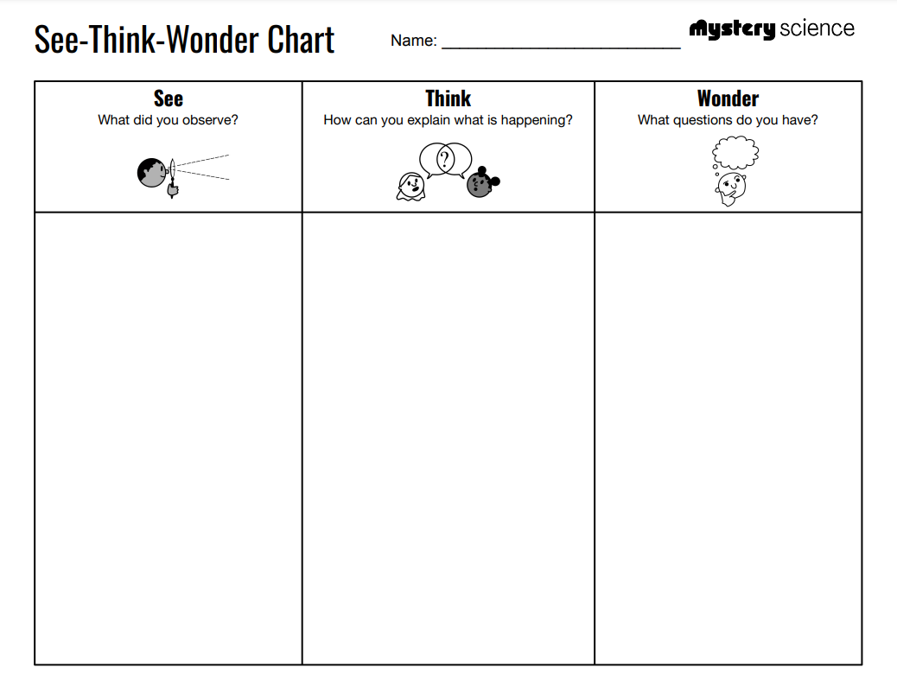
Life Cycles • Grade 3
Anchor Layer Teacher Guide
Anchor Phenomenon: Saguaro Cycles
Life Cycles
Anchor Phenomenon Lesson Overview
Note: This lesson is part of this unit’s Anchor Layer. If you have the Anchor Layer turned on, we recommend teaching all of the lessons in this unit in order.
The anchor phenomenon for this unit is based around bats that fly around at night, sticking their heads into cactus flowers. The unit is focused specifically on saguaro cacti; however, some of the images were selected due to their quality and clarity, despite the fact that they show flowers from other types of cacti.
During the introduction, students generate observations and questions about the phenomenon and create a list of possible explanations for the phenomenon. Students will use these initial ideas to track how their understanding grows throughout the unit.
Anchor Phenomenon 15 mins
Guided Inquiry 15 mins
Hands-On Activity 15 mins
Student Work Samples & Notes
Students will gather clues during and after each lesson in this unit to help them improve their understanding and explanations. It is important to encourage students to recognize that even if they don't know the perfect answer yet, they are going to learn a lot throughout the unit and will have an opportunity to revisit the phenomenon over time.
Bats sticking their heads in the flowers
Giant cacti
Cacti growing flowers
Bats flying around
The sky is dark
Maybe the bats are looking for bugs to eat
The flowers grow for people to look at them
The bats fly into the flowers because they smell good
Why do the bats go into the flowers?
Why can a cactus grow a flower?
‹#›

Slide 6
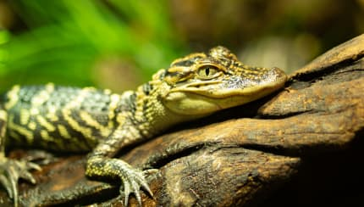
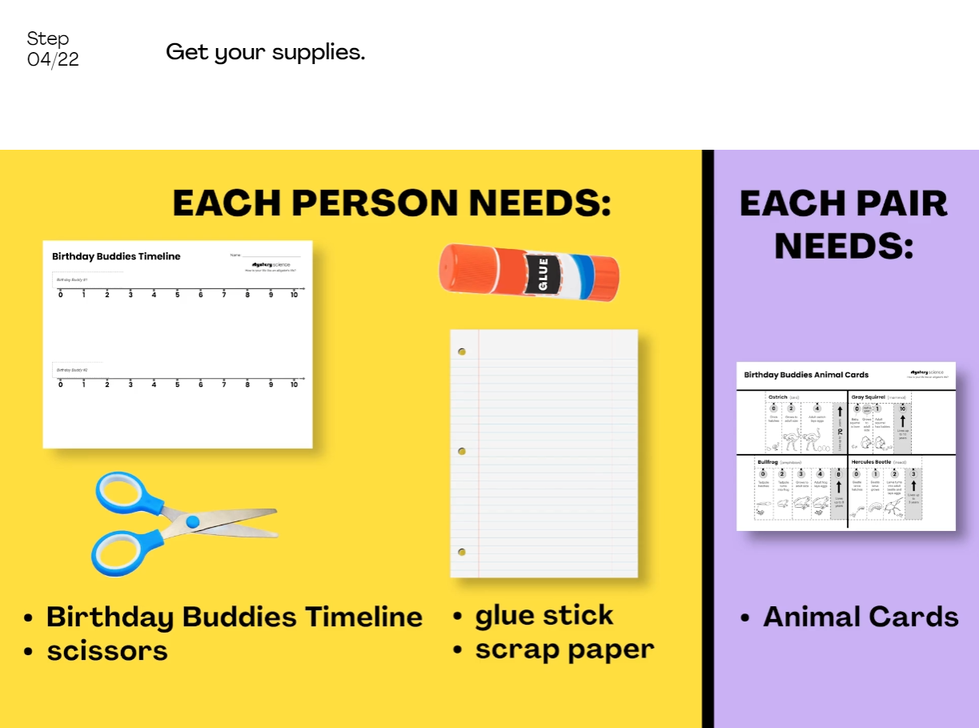
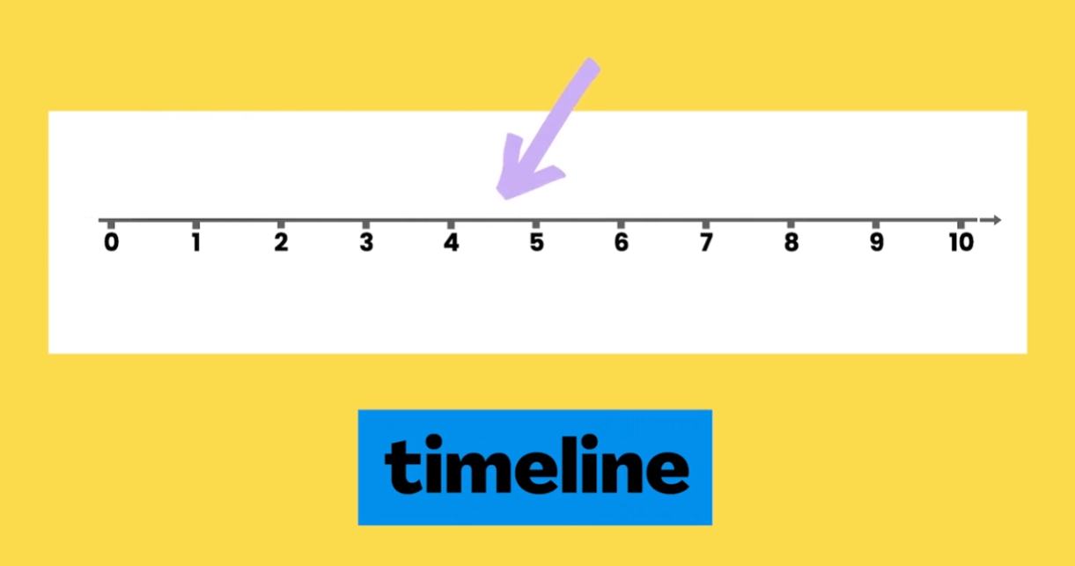
Life Cycles • Grade 3
Anchor Layer Teacher Guide
Lesson 1: How is your life like an alligator’s life? (pg 1 of 2)
Animal Life Cycles
Overview
In this lesson, students explore animal life cycles by thinking about their birthday buddies—all the animals that were born on the exact same day as they were born—and what happens to those birthday buddies over the course of their lives.
In the activity, Birthday Buddies Timeline, students develop a model to compare the life stories of different animals. Using this model, students discover that although the lives of animals can be very different, they all have in common birth, growth, reproduction, and death.
Anchor Connection on Next Page
Exploration 15 mins
Hands-On Activity 35 mins
Anchor Connection 10 mins
Assessment 20 mins
Activity Notes
We suggest students work in pairs.
Teachers may want to explain that for animals that give birth to live young, their birthday is straightforward. For those animals that lay eggs, we use the day that they hatch from their egg as their birthday. Many science standards state that all animals are born, equating hatching with birth.
‹#›

Slide 7
Life Cycles • Grade 3
Anchor Layer Teacher Guide
Lesson 1: How is your life like an alligator’s life? (pg 2 of 2)
Animal Life Cycles
Anchor Connection
All animals life cycles go through the stages of birth, growth, reproduction, and death. This is true for the bats, too.
For animals to grow, they need to eat. This explains why the bats are sticking their heads in the flowers: they are eating. The need to eat explains a great deal of behavior of all animals.
Students revisit the explanation and/or drawing that they worked on during the Anchor Phenomenon. They should understand that bats must eat in order to grow during their life cycle. The bats are eating when they stick their heads in the flowers.
Students can revise their thinking by explaining that the bats go through life
cycles. Even though we only saw the bats on one night, the bats were going
through their life cycle. Specifically, we saw the bats eating, which helps them in the growth phase of their life cycle.
Connecting Storyline Question
What other cycles do the bats go through?
Exploration 15 mins
Hands-On Activity 35 mins
Anchor Connection 10 mins
Assessment 20 mins
‹#›

Slide 8
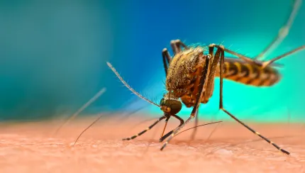
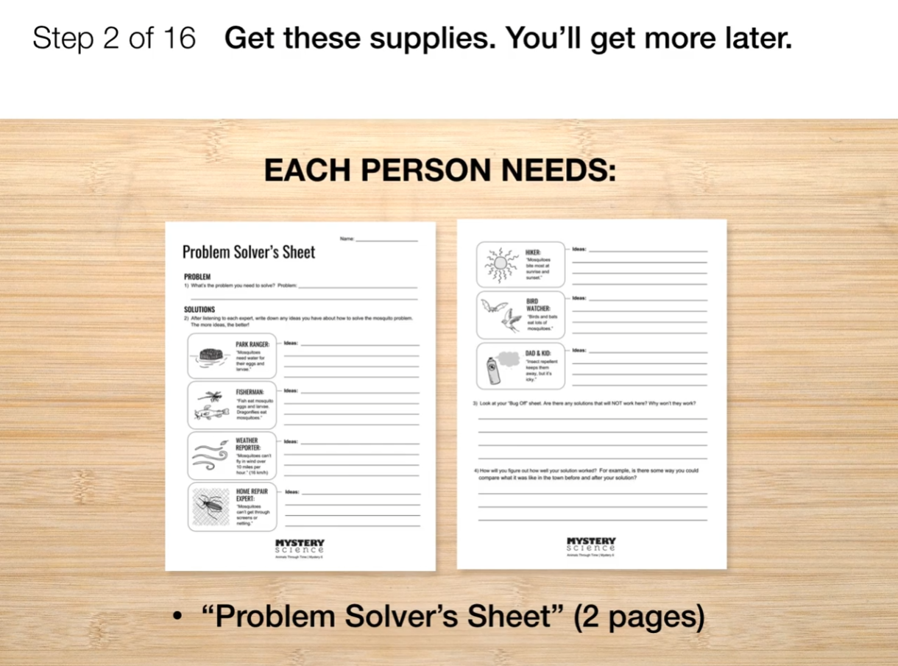
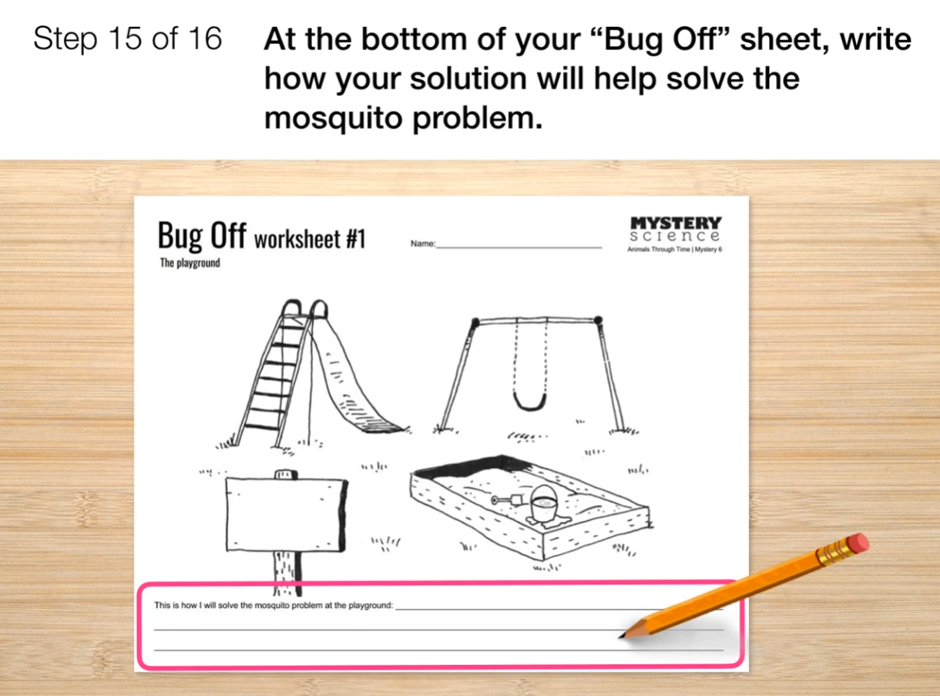
Life Cycles • Grade 3
Anchor Layer Teacher Guide
Lesson 2: What’s the best way to get rid of mosquitoes? Environmental Change & Engineering (pg 1 of 2)
Overview
In this lesson, students investigate mosquito life cycles and habitats and discover the role of mosquitoes in carrying diseases such as malaria.
In the activity, Bug Off!, students evaluate the merits of different solutions for getting rid of mosquitoes at various locations in a town. Students design a solution to help the town deal with an abundance of mosquitoes resulting from a very rainy summer.
Anchor Connection on Next Page
Exploration 21 mins
Hands-On Activity 35 mins
Wrap-Up 4 mins
Anchor Connection 15 mins
Assessment 20 mins
Activity Notes
We suggest students work in pairs so they can share their ideas with a partner.
We have provided three Bug Off! worksheets, each picturing a different location in town. In a class, we suggest giving students a choice of which site they’d like to work with.
You could also choose to have everyone come up with a solution for the same site. If students finish early, you can have them work on other sites so they can think of multiple solutions to the mosquito problem.
‹#›

Slide 9
Life Cycles • Grade 3
Anchor Layer Teacher Guide
Lesson 2: What’s the best way to get rid of mosquitoes? Environmental Change & Engineering (pg 2 of 2)
Anchor Connection
The mosquitos in this lesson go through cycles, too. They go through a short life cycle. They also go through a cycle of resting and wakefulness. This cycle lasts for only one day. The mosquitoes rest during the day, and are active at night. The same is true for the bats.
Students revisit the explanation and/or drawing that they worked on during the Anchor Phenomenon. They should understand that a bat’s life cycle may last many years, but they also go through daily cycles of resting and being awake. Bats are nocturnal.
Students can revise their thinking by explaining that the bats go through a sleep/wake cycle every day and night. The bats have a nocturnal sleep cycle.
Connecting Storyline Question
Do the cacti go through cycles?
Exploration 21 mins
Hands-On Activity 35 mins
Wrap-Up 4 mins
Anchor Connection 15 mins
Assessment 20 mins
‹#›

Slide 10
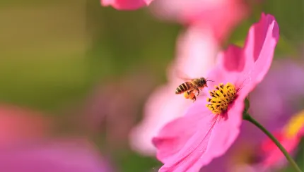
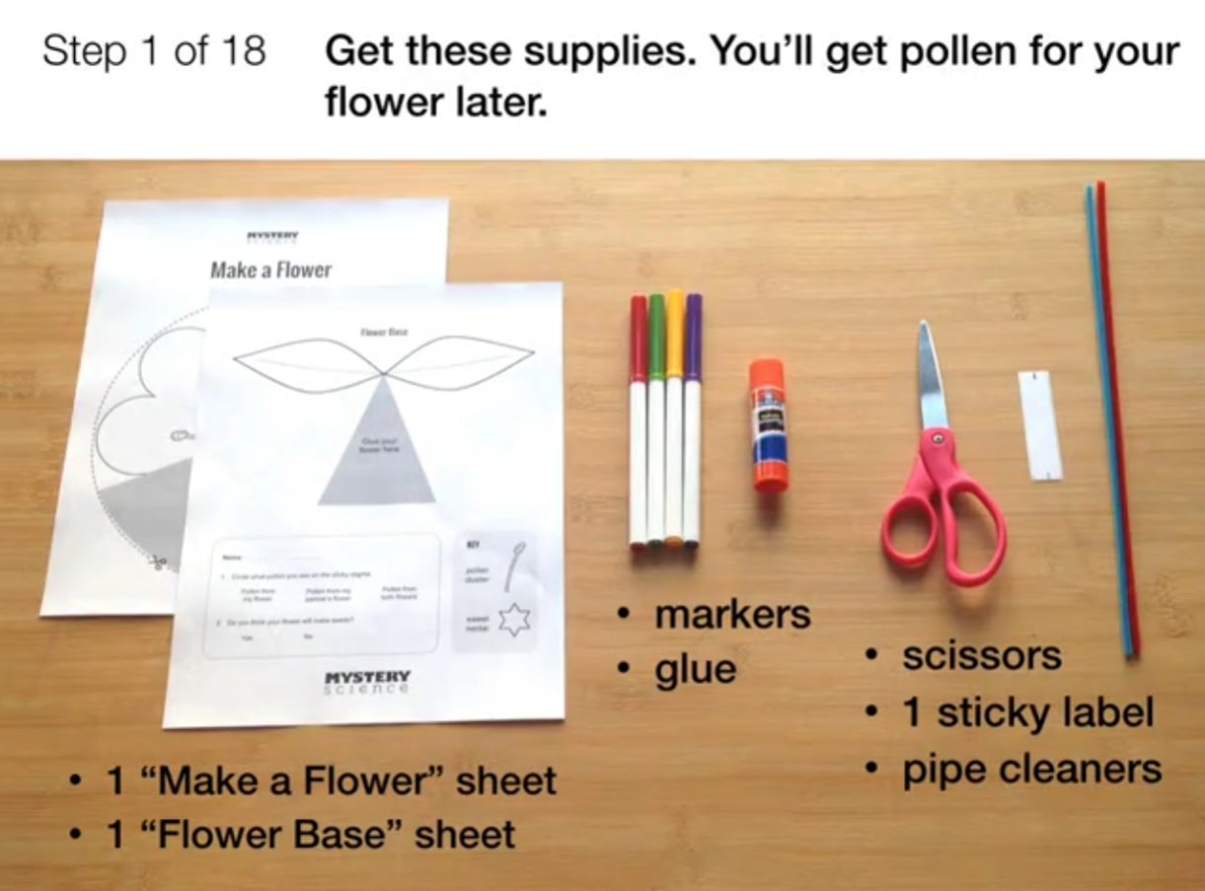
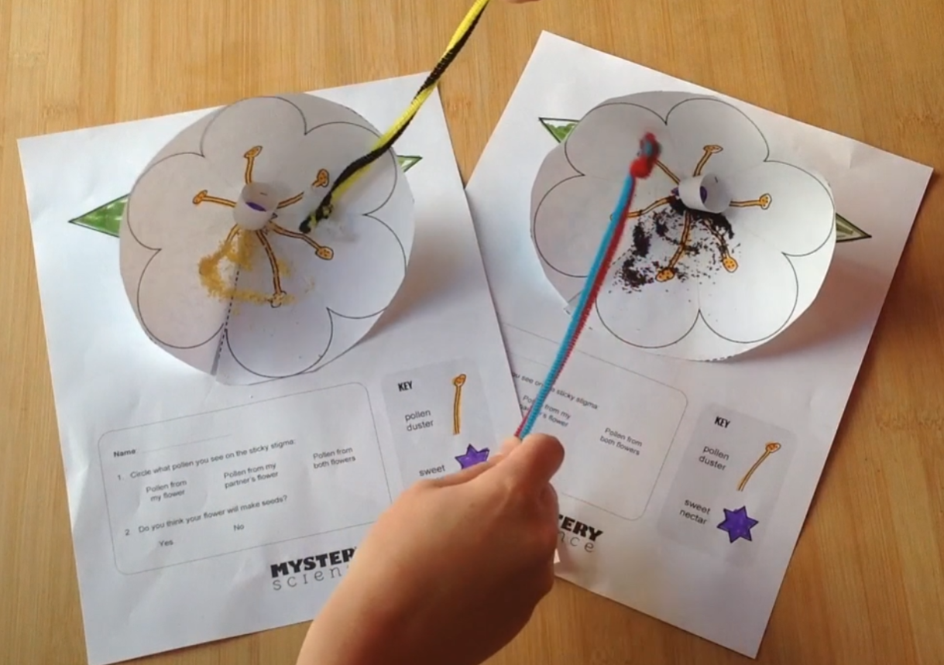
Life Cycles • Grade 3
Anchor Layer Teacher Guide
Lesson 3: Why do plants grow flowers? (pg 1 of 2)
Pollination & Plant Reproduction
Overview
In this lesson, students learn how and why flowers are pollinated.
In the activity, Make a Flower, students make flower models out of paper and bee models out of pipe cleaners. Students fly their bees from flower to flower and observe what happens to the flower’s pollen during this process.
Anchor Connection on Next Page
Exploration 31 mins
Hands-On Activity 30 mins
Anchor Connection 15 mins
Assessment 20 mins
Activity Notes
We suggest students work in pairs. Students can work on their own, but will need to make two flower models and may need a partner to help with a few steps of the activity.
So they can observe that pollen is transferred from one flower to another, you will need to provide students with two different kinds of pollen. Before class, in half the cups, spoon about a tablespoon of one of the “pollen” types (e.g. cinnamon). In the other half of the cups, spoon about a tablespoon of the other “pollen” type (e.g. ground coffee). Groups of four students will be sharing two cups of “pollen."
To avoid distractions, we suggest waiting to distribute the “pollen” cups to students until Step 9 of the activity.
‹#›

Slide 11
Life Cycles • Grade 3
Anchor Layer Teacher Guide
Lesson 3: Why do plants grow flowers? (pg 2 of 2)
Pollination & Plant Reproduction
Anchor Connection
Saguaro flowers have internal structures just like most other flowers. They grow new flowers in the spring of every year, in an annual cycle.
Students revisit the explanation and/or drawing that they worked on during the Anchor Phenomenon. They should understand that saguaros grow new flowers every spring. This cycle repeats every year.
Students can revise their thinking by explaining that the saguaros grow new
flowers in the spring of every year, year after year. They may also explain that the bats travel to the saguaro flowers every spring.
Connecting Storyline Question
What happens to the saguaros flowers after the spring?
Exploration 31 mins
Hands-On Activity 30 mins
Anchor Connection 15 mins
Assessment 20 mins
‹#›

Slide 12
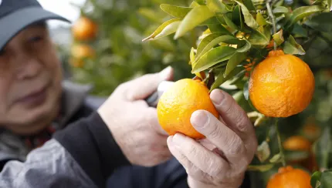
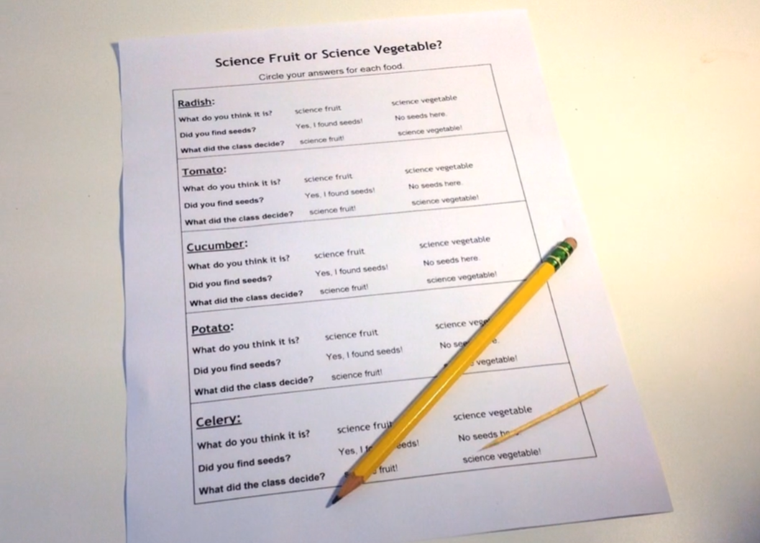
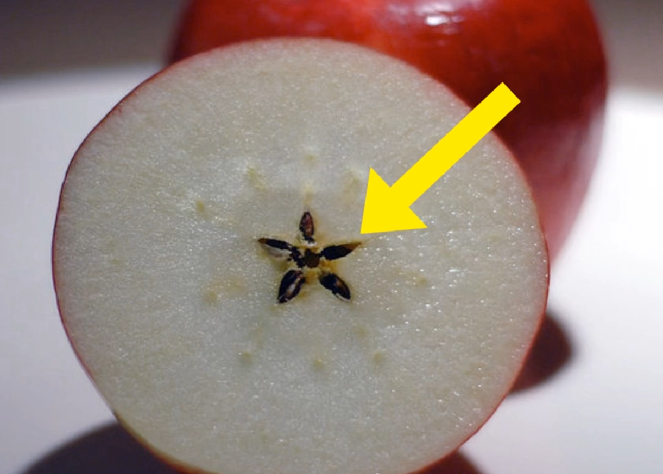
Life Cycles • Grade 3
Anchor Layer Teacher Guide
Lesson 4: Why do plants give us fruit? (pg 1 of 2)
Fruit, Seeds, & Plant Reproduction
Overview
In this lesson students learn about why plants grow fruit.
In the activity, Science Fruit or Vegetable, students examine common grocery produce and predict if each item is a science fruit or science vegetable. Then they take a closer look at slices of the produce and search for seeds.
Anchor Connection on Next Page
Exploration 20 mins
Hands-On Activity 25 mins
Anchor Connection 25 mins
Assessment 20 mins
Activity Notes
We suggest slicing foods before class. We used the foods listed above, but you can use other foods in place of these. Just be sure to include a mix of vegetables that have seeds, such as tomatoes and cucumbers (science fruits), and ones that don’t, such as celery, potatoes, and radishes (science vegetables). If you want to challenge your students, use less familiar produce, such as pineapples, eggplants, and kiwis (science fruits), as well as brussels sprouts (science vegetables).
Place one slice of each type of fruit or vegetable onto a paper plate for each student so that each student will have the opportunity to examine all the produce.
Before students examine the sliced fruit and vegetables and look for seeds, you will show them one whole fruit or vegetable so that they can first make a prediction. So be sure to reserve one of each grocery item to show students.
‹#›

Slide 13
Life Cycles • Grade 3
Anchor Layer Teacher Guide
Lesson 4: Why do plants give us fruit? (pg 2 of 2)
Fruit, Seeds, & Plant Reproduction
Anchor Connection
Saguaro flowers turn into saguaro fruit every summer. The fruit contain seeds. This is part of the saguaro’s life cycle.
Students revisit the explanation and/or drawing that they worked on during the Anchor Phenomenon. They should understand that Saguaro flowers turn into saguaro fruit. This cycle repeats every year.
Students can revise their thinking by explaining that explaining that the saguaro flowers turn into saguaro fruit in the summer of every year, year after year.
Connecting Storyline Question
What happens to the saguaro fruit after the summer?
Exploration 20 mins
Hands-On Activity 25 mins
Anchor Connection 25 mins
Assessment 20 mins
‹#›

Slide 14
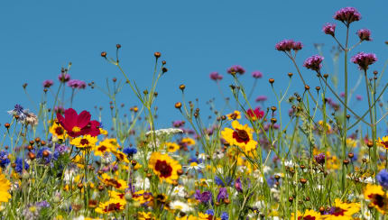
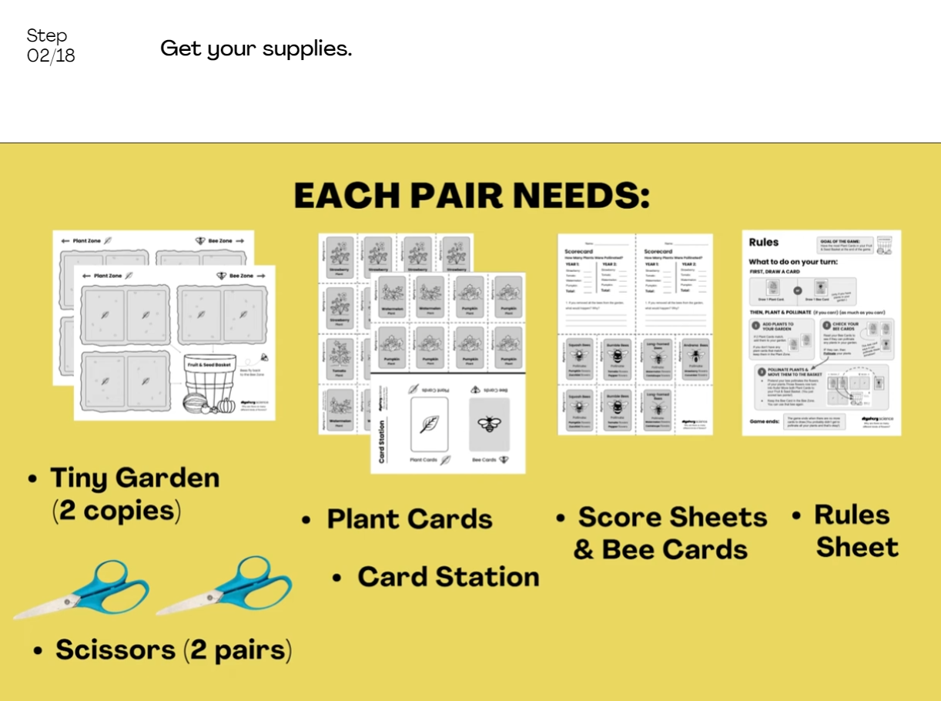
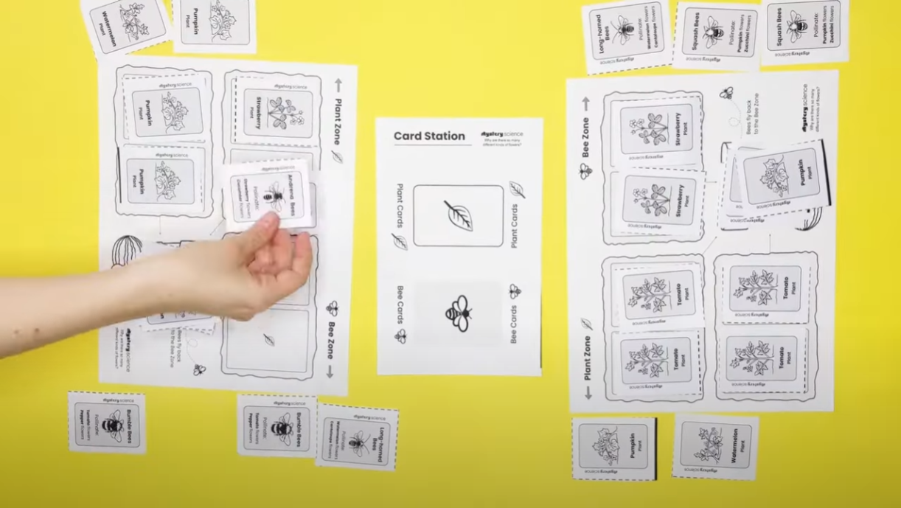
Life Cycles • Grade 3
Anchor Layer Teacher Guide
Lesson 5: Why are there so many different kinds of flowers?
Plant Life Cycles (pg 1 of 2)
Overview
In this lesson, students discover that while there is great diversity among flowering plants, they all share similar life cycles. They all start from seeds, grow, and eventually reproduce through the process of pollination.
In the activity, Future Flowers, students observe and predict how changes to the pollinators affect plant reproduction, which affects the life cycles of those plants.
Anchor Connection on Next Page
Exploration 17 mins
Hands-On Activity 35 mins
Wrap-Up 8 mins
Anchor Connection 15 mins
Assessment 20 mins
Activity Notes
We suggest students work in pairs.
All the plants in the activity game are annuals, which means they die every winter and must be replanted every year from seed. We do not discuss annual versus perennial plant life cycles in this particular lesson.
In the extensions, we have another set of Plant Cards with different annual garden plants. Check out the Extensions for further instructions.
‹#›

Slide 15
Life Cycles • Grade 3
Anchor Layer Teacher Guide
Lesson 5: Why are there so many different kinds of flowers?
Plant Life Cycles (pg 2 of 2)
Anchor Connection
Flowers are very important in the life cycles of many plants. Flowers are the primary structure involved in plant reproduction. Many flowers need pollinators to help develop seeds. In the case of saguaro flowers, bats are one of the primary pollinators. They pollinate the flowers when they stick their heads in to eat nectar.
Students revisit the explanation and/or drawing that they worked on during the Anchor Phenomenon. They should understand that the bats pollinate the cacti and help them progress through their life cycle.
Students can revise their thinking by explaining that the saguaros are going
through a life cycle as well. The saguaros need the bats to pollinate their flowers. Students may not have all of the details of the saguaro life cycle, but they should be able to explain that the flowers will eventually turn to fruit with seeds, and that the seeds can then grow into new saguaros.
Connecting Storyline Question
What does the entire saguaro life cycle look like?
Exploration 17 mins
Hands-On Activity 35 mins
Wrap-Up 8 mins
Anchor Connection 15 mins
Assessment 20 mins
‹#›

Slide 16
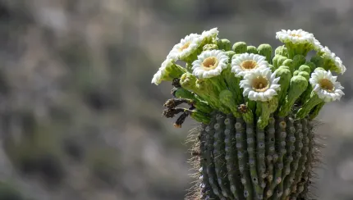
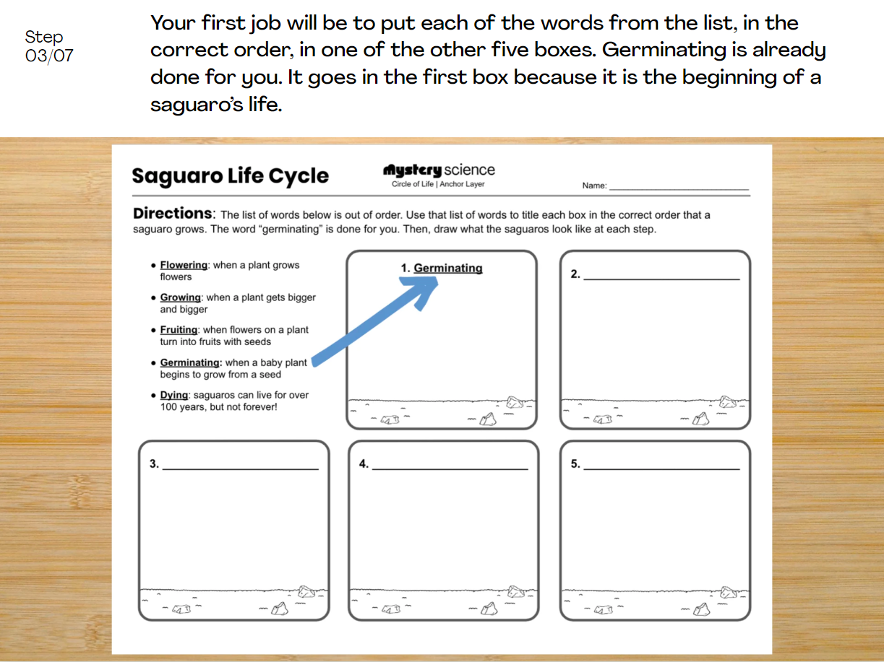
Life Cycles • Grade 3
Anchor Layer Teacher Guide
Performance Task: Why are some saguaros so tiny?
Life Cycles
Overview
In this performance task, students will observe and describe saguaros at various stages of their life cycles.
After a review of the unit, students will gather observations of saguaros from Saguaro National Park. They will use those observations, along with the observations they gathered over the course of the unit about the relationship between saguaros and bats, to predict how bats and saguaros interact with one another.
Unit Review 10 mins
Hands-On Activity 35 mins
Performance Task Notes
Students can work individually, in pairs, or you may choose to work with small groups. One copy of the saguaro life cycle worksheet will be needed for each individual, each pair, or each small group.
Crosscutting Concepts
Patterns: A pattern is something that repeats in multiple places or multiple times. The primary type of pattern that is seen in this unit is a cycle of events.
Cause & effect: The sequence of events in a cycle frequently have a cause & effect relationship with one another. Frequently, one event must take place before another event, and the prior event causes the subsequent one. If one event in a cycle doesn’t take place, it may cause the cycle to stop entirely
‹#›

