Slide 1


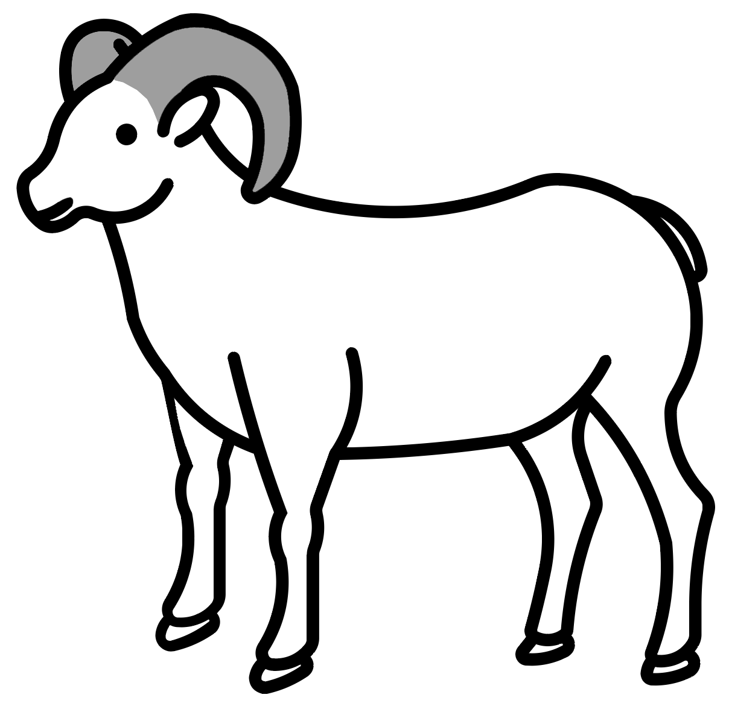







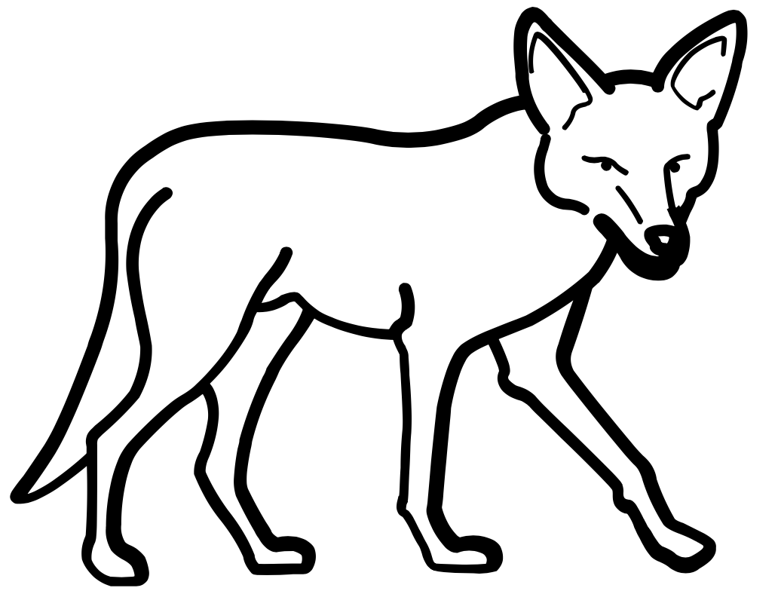
2. Where can the bighorn sheep find the
most food? (Circle your answer)
DESERT PARK
3. Where can the bighorn sheep hide from
predators? (Circle your answer)
DESERT PARK
4. Why do you think the bighorn sheep go
back to the desert habitat at night?
__________________________________
__________________________________
__________________________________
__________________________________
Why would a wild animal visit a playground?
Name: ____________________________
Date: ____________________________
The Mystery of
the Bighorn Sheep in the Park
Park Habitat
Desert Habitat
What was the total number of animals that you found in the PARK? _____________
What was the total number of animals that you found in the DESERT? _____________
1. Did you find some kinds of animals in both habitats? YES NO

