Slide 1

HOCKEY
Free Template
Do you have any questions?

Slide 2
Whoa!
Do you have any questions?
It could be the part of the presentation where you can introduce yourself. Keep it short and go straight to the point. Your audience will appreciate that

Slide 3
TABLE OF CONTENTS
01
After the Course Ends
Introduction
02
03
Best practices

Slide 4
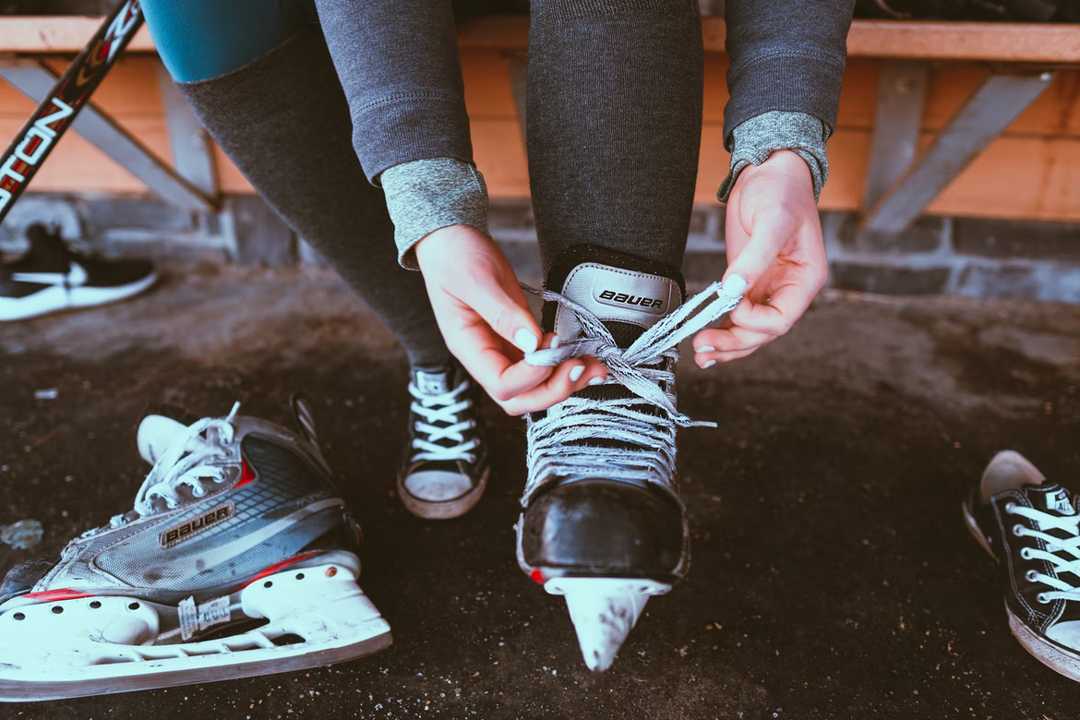
01
Introduction
Write a small intro about the chapter. Cras nec quam eu neque tempus bibendum. Vestibulum porta metus odio, convallis interdum magna pellentesque tincidunt. Vivamus pellentesque.

Slide 5
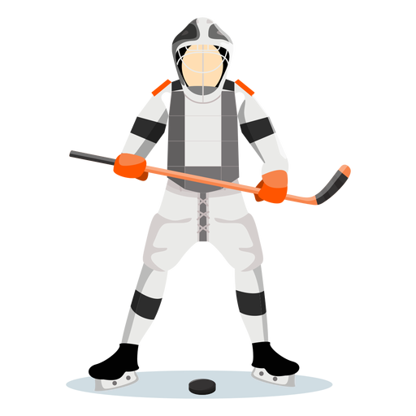
Define the roles of the teacher and students
COUCH
PLAYER
Designing the course
Teaching in the course
Modeling
Coaching
Scaffolding
Providing Feedback
Assessing Students progress
Contributing to conversation
Engaging in assignments and activities
Collaborating with peers
Asking questions of peers and the instructor
Reflecting
Sharing experiences

Slide 6
Key differences between classroom
and online learning
1
Students can directly share their views and clarify their own queries with the teacher
Interactions with good teachers help motivate students to achieve higher marks
Classroom learning helps students and teachers know each other in a better manner.
Online learning gives the learner more control over when they can learn
Online learning allows learners to progress at their own pace
Online learning doesn’t subject learners to distractions from others
1
2
2
3
3

Slide 7
Basketball Infographics
Jupiter
Mars
Mercury
Jupiter is a gas giant and the biggest planet in the Solar System
Despite being red, Mars is actually a cold place full of iron oxide dust
Mercury is the closest planet to the Sun and the smallest one

Slide 8
Tips To Start Designing Your Online Class
Be clear, concise, and comprehensive
Provide a manageable amount of content.
Provide a variety of learning activities
Avoid making last-minute changes
Provide resources to help students succeed
Test the course in different browsers and on different computers

Slide 9

02
Best Practices
Write a small intro about the chapter. Cras nec quam eu neque tempus bibendum. Vestibulum porta metus odio, convallis interdum magna pellentesque tincidunt. Vivamus pellentesque.

Slide 10
Instructor Presence
Post announcements, appear on video and participate in discussions.
Learning Objectives
Alignment matters! Be sure that the course content aligns with objectives and assessments
Best practices for teaching online
Real World Applications
Show students how they will apply what they are learning.
Prompt Feedback
Show students how they will apply what they are learning.
Teach for Online Students
Break learning into smaller chunks. Establish a pattern of activity and due dates.
Engage Students
Create educational experiences for students that are challenging, enriching, and that extend their academic abilities.

Slide 11
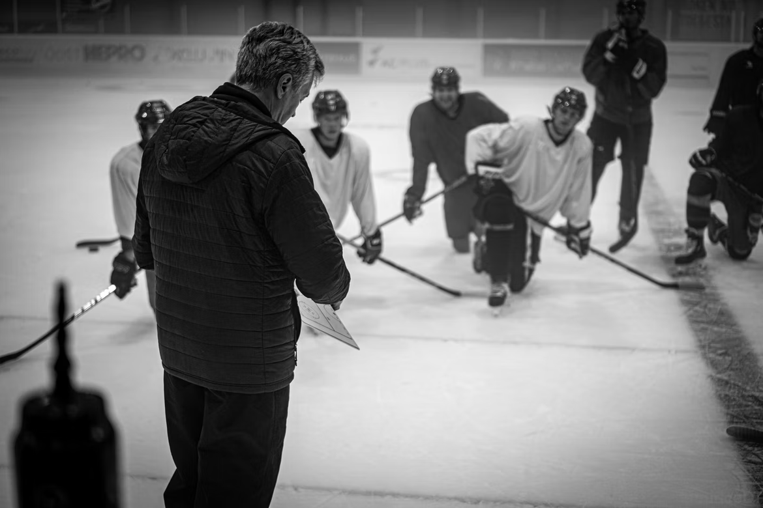
Make It a Group Effort
Faculty members need training in how to design and teach an online course.
'Chunk' the Lessons
Present information in 10-minute “chunks” and vary the format.
Keep Group Sizes Small
A cap of 20 to 30 students are recommended in online classes. If it is posible, break those students into groups of 10 for purposes of discussions or group activities.
Focus on 'Active' Learning
Instructors often rely on long lectures to fill the time in a traditional class meeting. But even the most dynamic lecturers cannot get away with that online.
Be Present
The importance of the faculty member being there and being mentally present with the students is the most important thing they can do.
Parse Your Time
Online courses can really consume you. Manage your time in a reasonable way. Don’t be available 24/7. Don’t turn your class into a one-on-one interaction with 30 students.

Slide 12
Design Your Custom Excercises and tasks
1
X
Answer A
Integer vel vehicula nisi, sed consectetur lorem..
EXCERCISE 1 / CHAPTER 1
Write here a small description of the task or small notes to give a context about the excersice.
Answer B
Integer vel vehicula nisi, sed consectetur lorem.
Question, how can you solve this problem?
Answer C
Integer vel vehicula nisi, sed consectetur lorem.
Add some caption for the context of the image here

Slide 13
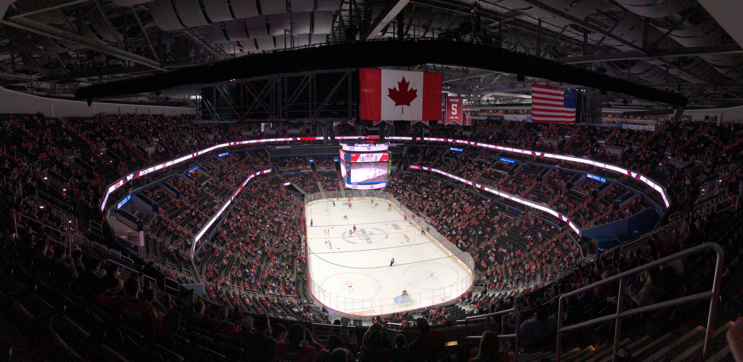
03
After the course ends
Write a small intro about the chapter. Cras nec quam eu neque tempus bibendum. Vestibulum porta metus odio, convallis interdum magna pellentesque tincidunt. Vivamus pellentesque.

Slide 14
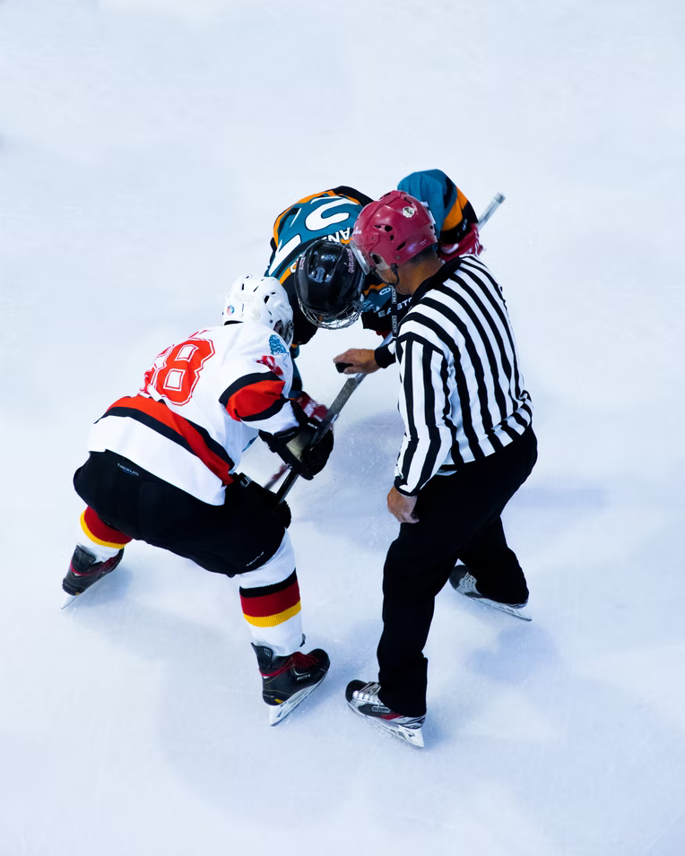
And Now What?
The end of a course can be busy but it is important to continue to engage with students, take care of administrative tasks and take time to reflect on your practice. Consider following these steps as the course comes to a close:
1
2
3
Provide students with assignment grades
Give prompt feedback to students on final papers and tests
Evaluate your own teachings

Slide 15
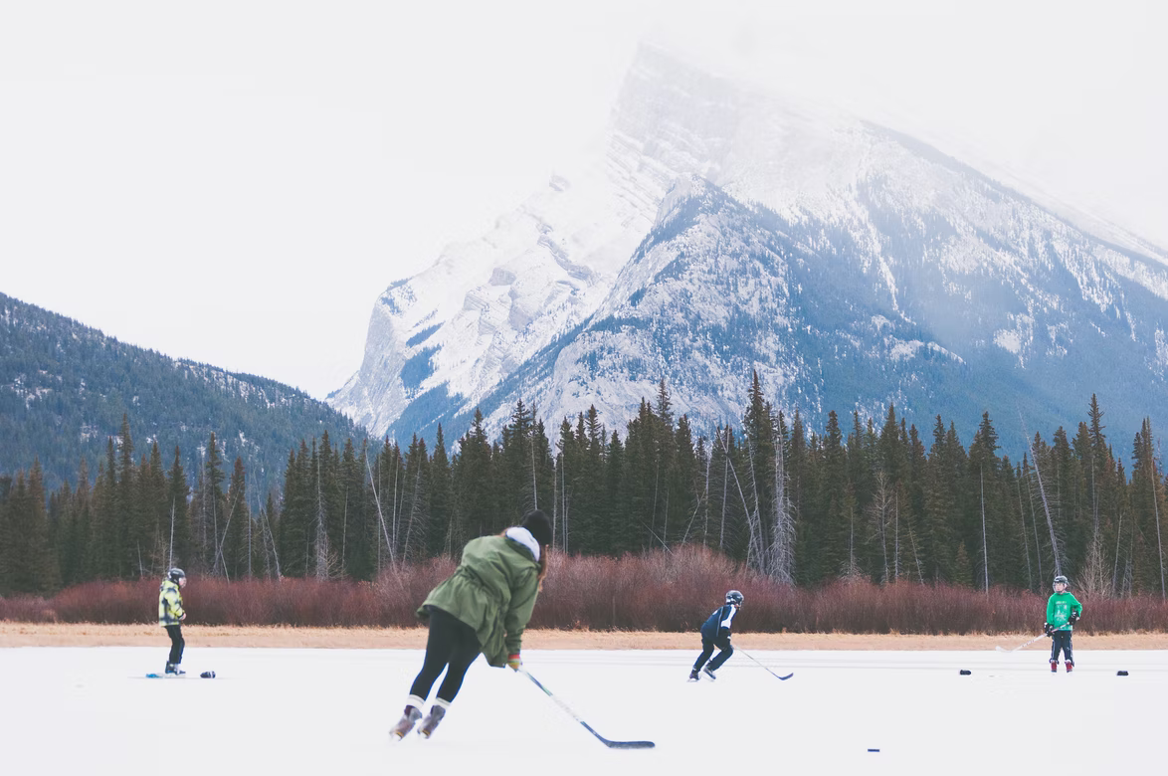
04
Additional Resources
Write a small intro about the chapter. Cras nec quam eu neque tempus bibendum. Vestibulum porta metus odio, convallis interdum magna pellentesque tincidunt. Vivamus pellentesque.

Slide 16
Basketball Infographics
Mercury
Venus
Mercury is the smallest planet in the Solar System
Venus is terribly hot, even hotter than Mercury
Saturn
Mars
Saturn is a gas giant and has several rings
Despite being red, Mars is actually a cold place
Jupiter
Earth
Jupiter is the biggest planet in the Solar System
The Earth is the beautiful planet where we all live

Slide 17
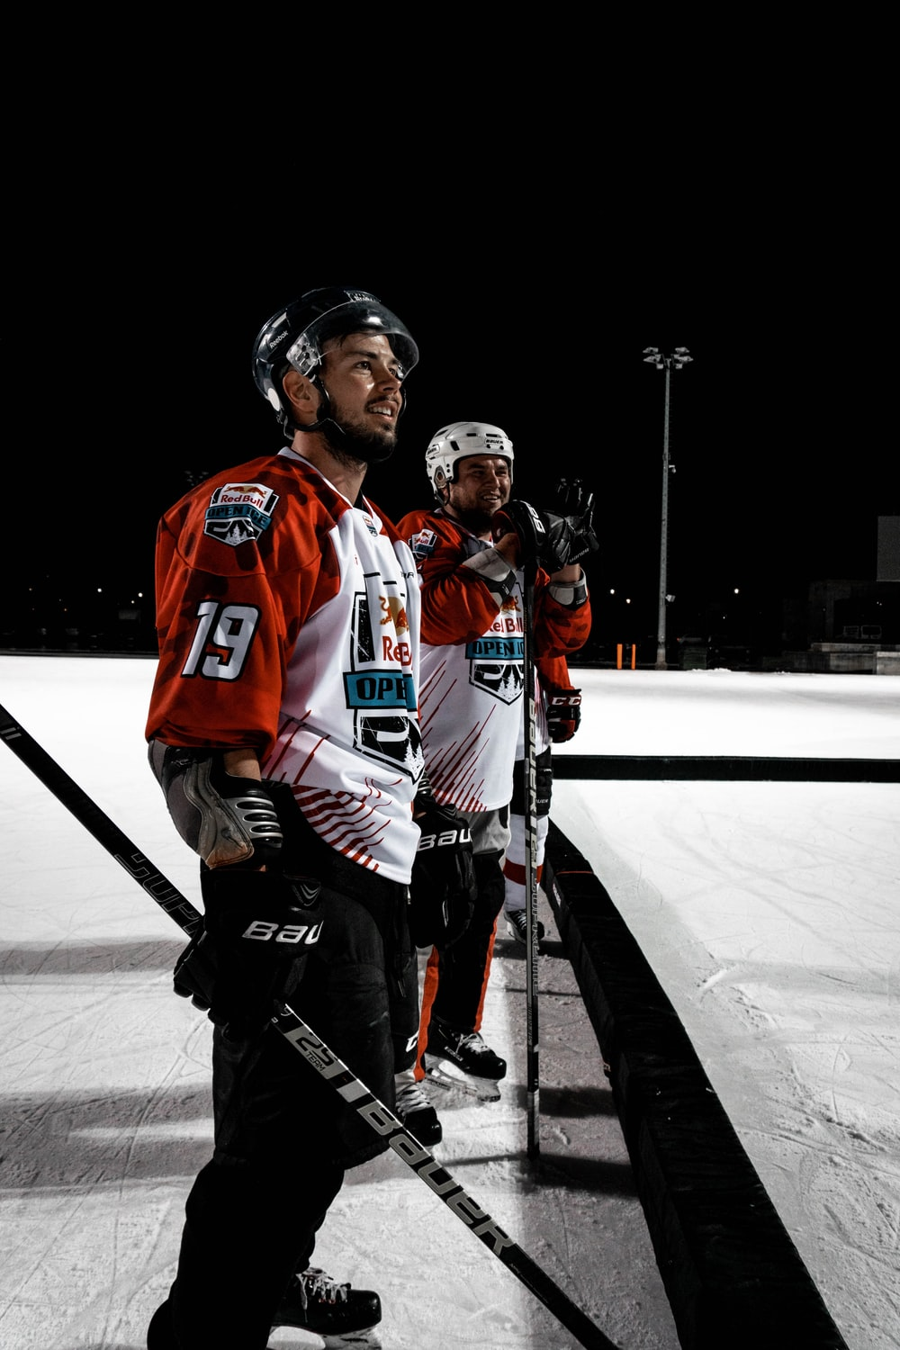
Task Template 1
A
X
Answer A
Integer vel vehicula nisi, sed consectetur lorem..
EXERCISE 1 / CHAPTER 1
Write here a small description of the task or small notes to give a context about the exercise.
Answer B
Integer vel vehicula nisi, sed consectetur lorem.
Question, how can you solve this problem?
Answer C
Integer vel vehicula nisi, sed consectetur lorem.
Add some caption for the context of the image here

Slide 18
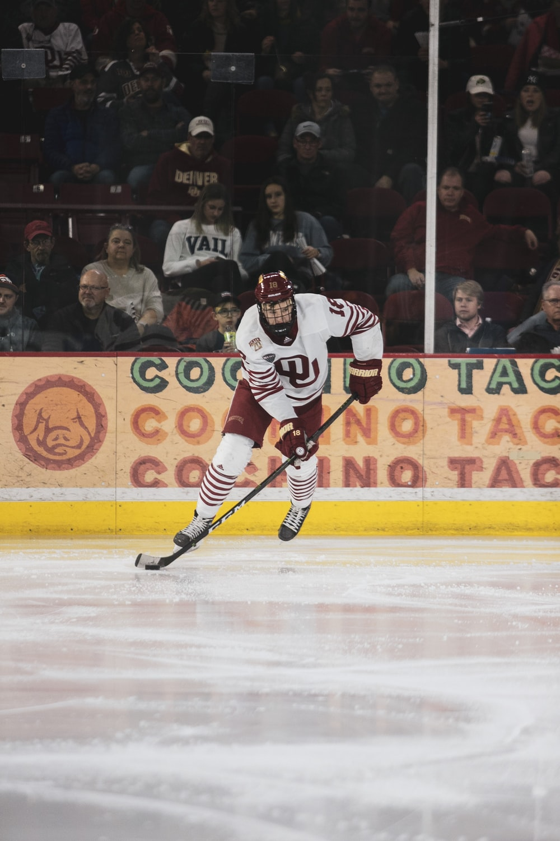
Task Template 2
ANSWER
B
WRITE HERE YOUR ANSWER
Start writing here…
EXERCISE 1 / CHAPTER 1
Write here a small description of the task or small notes to give a context about the exercise.
Question, how can you solve this problem?
Add some caption for the context of the image here

Slide 19
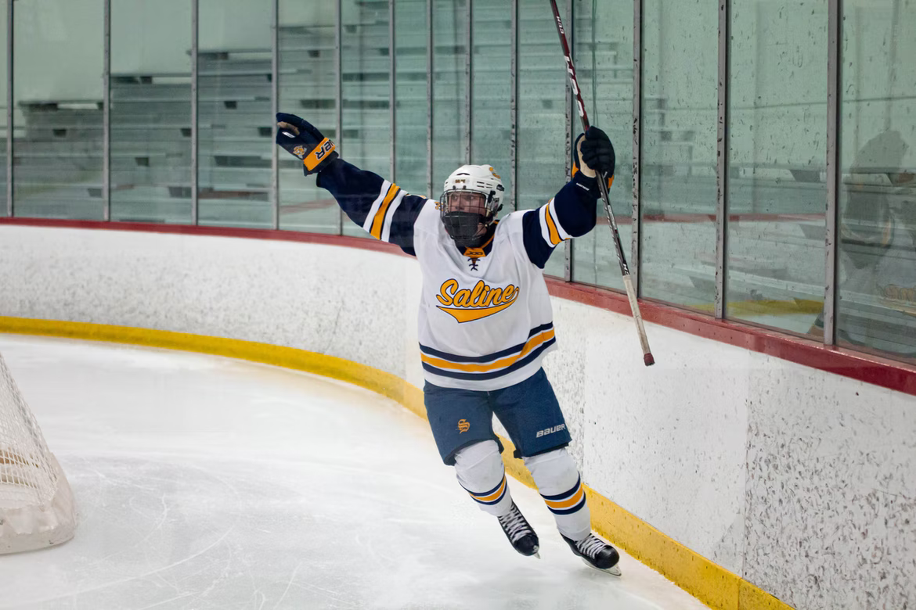
Task Template 3
C
EXERCISE 1 / CHAPTER 1
Write here a small description of the task or small notes to give a context about the exercise.
Question with big image, can you solve this?
X
Answer A
Integer vel vehicula nisi, sed consectetur lorem..
Answer B
Integer vel vehicula nisi, sed consectetur lorem.
Answer C
Integer vel vehicula nisi, sed consectetur lorem.
Add some caption for the context of the image here

Slide 20
Basketball Infographics
Saturn
1
2
Venus
Saturn is a gas giant and has several rings
It is terribly hot, even hotter than Mercury
Jupiter
3
4
Earth
It’s the biggest planet in the Solar System
The Earth is the planet where we all live
Mars
5
6
Mercury
Despite being red, Mars is actually a cold place
It’s the smallest planet in the Solar System

Slide 21
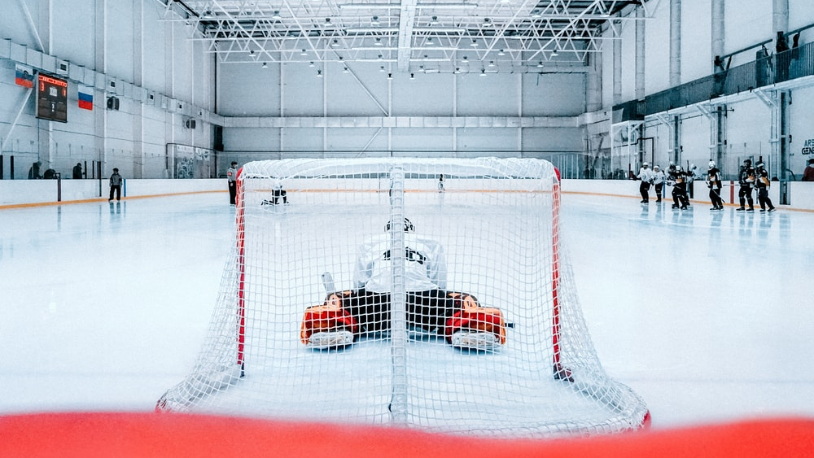
Big images for big ideas
Virtual classes best practices

Slide 22
You could use three columns, why not?
Mercury
Mercury is the smallest planet of them all
Venus
Venus has a beautiful name, but it’s very hot
Saturn
Yes, this is the ringed planet. It’s a gas giant

Slide 23
Basketball Infographics
Mercury
Venus
Mercury is the smallest planet in the Solar System
Venus is terribly hot, even hotter than Mercury
Saturn
Mars
Saturn is a gas giant and has several rings
Despite being red, Mars is actually a cold place
Jupiter
Earth
Jupiter is the biggest planet in the Solar System
The Earth is the beautiful planet where we all live

Slide 24
Our team
John James
Here you can talk a bit about this person
Jennifer Patterson
Here you can talk a bit about this person

Slide 25

4,498,300,000
Task Template 1
EXERCISE 1 / CHAPTER 1
Write here a small description of the task or small notes to give a context about the exercise.
Question, how can you solve this problem?
Big numbers catch your audience’s attention

Slide 26
Basketball Infographics
Venus
Mercury
Venus is terribly hot, even hotter than Mercury
Mercury is the smallest planet in the Solar System
Saturn
Earth
Saturn is a gas giant and has several rings
The Earth is the beautiful planet where we all live

Slide 27
How to prepare your bike
1
2
Saddle area
Mercury is the closest planet to the Sun
Wheels
Venus has a beautiful name, but it’s very hot

Slide 28
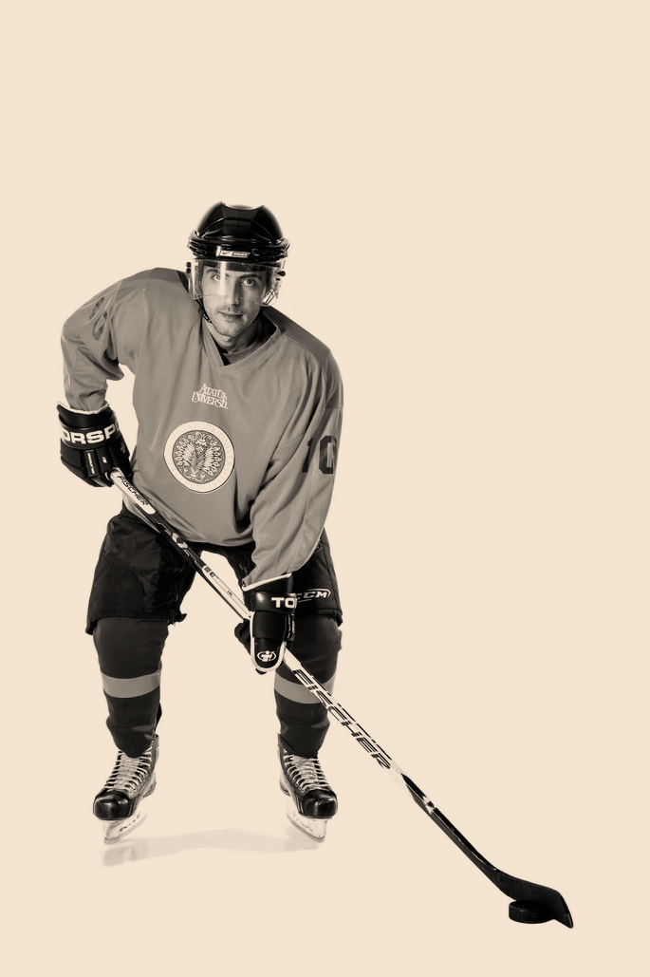
Important Quote Slide
“
We need to bring learning to people instead of people to learning.
”
Grym

Slide 29
Thanks
Do you have any questions?
addyouremail@example.com
+91 620 421 838
yourcompany.com
Free Template

Slide 30
FUENTE
ELABORADO POR :
plantillaspowerpoint.org
IMAGES :
unsplash.com
FONTS :
Rubik

Slide 31
RESOURCES

Slide 32
RESOURCES

Slide 33
RESOURCES

Slide 34
Fully Editable Icon Sets: A

Slide 35
Fully Editable Icon Sets: B

Slide 36
Fully Editable Icon Sets: C

