Slide 1

Doughboys!
The Mon Plaisir Assault
September 21st, 1918
From the staff of Gen. John J. Pershing, commander, American Expeditionary Force (AEF)Eastern France, near the Belgian border.
For four long years, the French and the British have fought trench warfare with the Germans. They call it “The Great War” or “The War to End All Wars.” We call it the First World War. Now, American troops have joined in the fight, and you are among them! Because the Americans are “soft” and inexperienced, the British and French jokingly refer to them as “Doughboys.”
The orders have come down from High Command: you must take out a German stronghold. The target: a machine-gun nest in an old farmhouse, on the Mon Plaisir Ferme. You must cross No Man’s Land, avoiding the patrols and gunfire from the German trenches. Be on special lookout for an experimental new device that the Germans are rumored to have; it will forever change the way wars are fought!
The mission is based on “Helicopter”. The Jr. Boathouse will be the American trench – the starting point. All camp will be grouped in this area when the game begins. Campers will be released into active game play in attack waves. Their goal is then to evade hostile patrol (certain counselors) and make it to the rallying point, which will be next to the Senior Volleyball Court.
The following pages have the latest intel on your mission. Read and destroy.
Good luck!

Slide 3

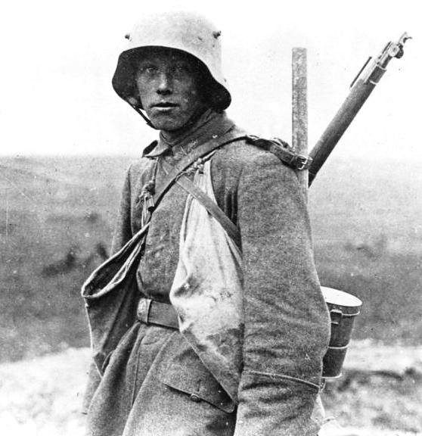
Doughboys!
The Mon Plaisir Assault
ORIGIN – Jr. Boathouse
The TRENCHES – Craig Village
1st WAYPOINT – Junior Village Bridge
NO MAN’S LAND – Tennis Courts
2nd WAYPOINT – Field above tennis courts
The BONEYARD – Maijgren Village
3rd WAYPOINT – Maijgren Picnic Table
The MAELSTROM - Senior Lower Athletic Field
The MON PLAISIR FARM – Senior Upper Athletic
BEWARE:
ENEMY!!!

Slide 4
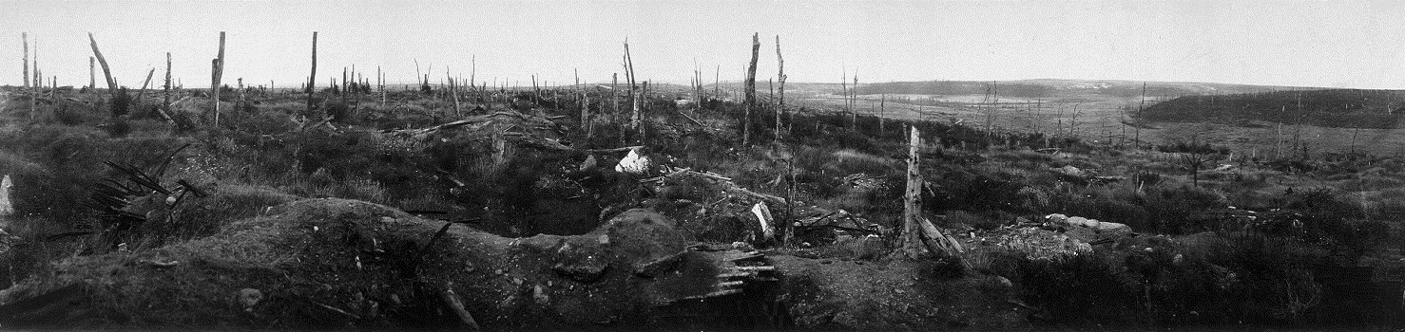

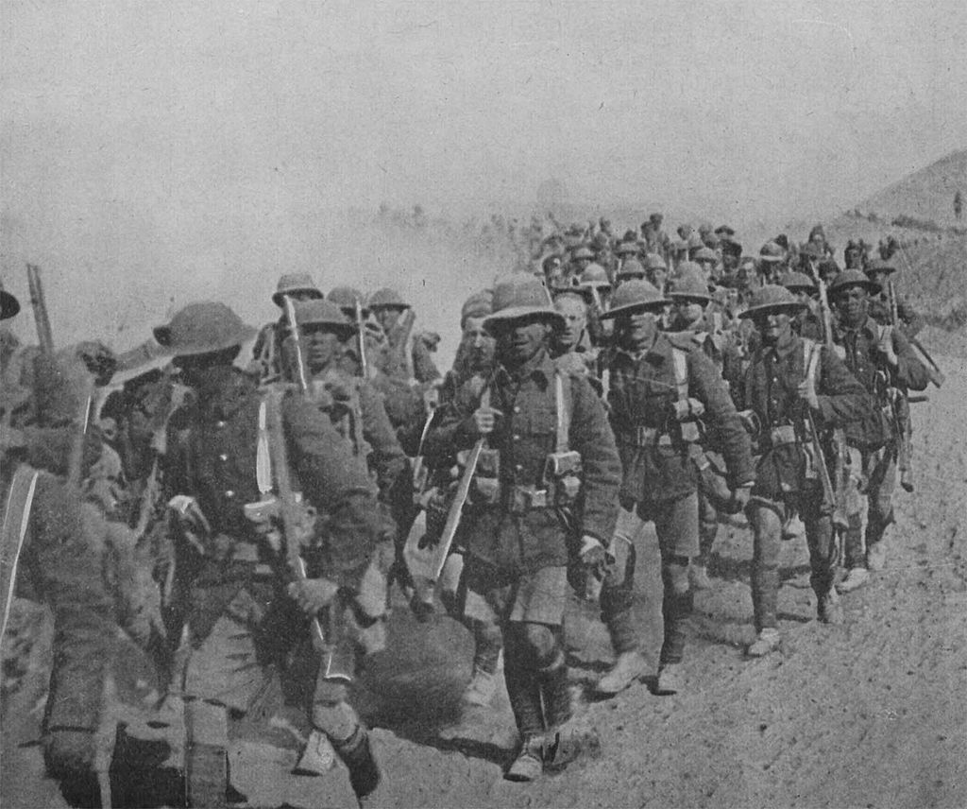
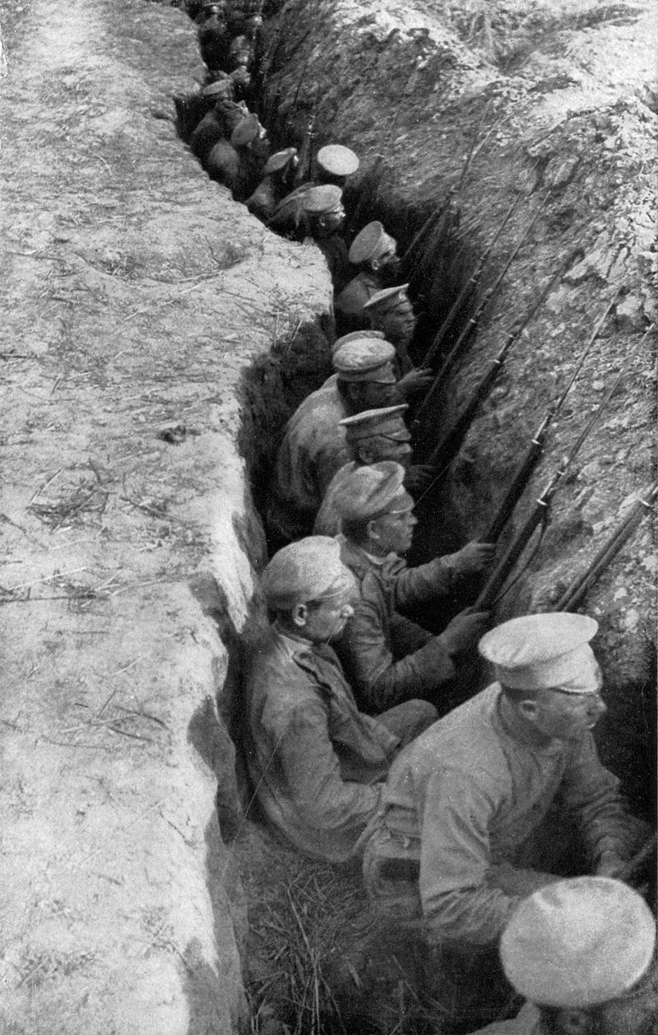

No Man’s Land
British Troops Marching
Mesopotamian Campaign
Troops
Russian

Slide 5
Waypoint Ticket # 1
Waypoint Ticket # 1
The bearer of this ticket has completed
The bearer of this ticket has completed
THE TRENCHES
THE TRENCHES
Waypoint Ticket # 1
Waypoint Ticket # 1
The bearer of this ticket has completed
The bearer of this ticket has completed
THE TRENCHES
THE TRENCHES
Waypoint Ticket # 1
Waypoint Ticket # 1
The bearer of this ticket has completed
The bearer of this ticket has completed
THE TRENCHES
THE TRENCHES
Waypoint Ticket # 1
Waypoint Ticket # 1
The bearer of this ticket has completed
The bearer of this ticket has completed
THE TRENCHES
THE TRENCHES

Slide 6
Waypoint Ticket # 2
Waypoint Ticket # 2
The bearer of this ticket has completed
The bearer of this ticket has completed
NO MAN’S LAND
NO MAN’S LAND
Waypoint Ticket # 2
Waypoint Ticket # 2
The bearer of this ticket has completed
The bearer of this ticket has completed
NO MAN’S LAND
NO MAN’S LAND
Waypoint Ticket # 2
Waypoint Ticket # 2
The bearer of this ticket has completed
The bearer of this ticket has completed
NO MAN’S LAND
NO MAN’S LAND
Waypoint Ticket # 2
Waypoint Ticket # 2
The bearer of this ticket has completed
The bearer of this ticket has completed
NO MAN’S LAND
NO MAN’S LAND

Slide 7
Waypoint Ticket # 3
Waypoint Ticket # 3
The bearer of this ticket has completed
The bearer of this ticket has completed
THE BONEYARD
THE BONEYARD
Waypoint Ticket # 3
Waypoint Ticket # 3
The bearer of this ticket has completed
The bearer of this ticket has completed
THE BONEYARD
THE BONEYARD
Waypoint Ticket # 3
Waypoint Ticket # 3
The bearer of this ticket has completed
The bearer of this ticket has completed
THE BONEYARD
THE BONEYARD
Waypoint Ticket # 3
Waypoint Ticket # 3
The bearer of this ticket has completed
The bearer of this ticket has completed
THE BONEYARD
THE BONEYARD

Slide 8
GAME FLOW
THE TRENCHES - (ORIGIN – JR. BOATHOUSE)
Campers start at the boathouse (American trenches) where every couple minutes the Allied Commanders will announce an “attack wave” and release about 20 people into play. Their first objective is to make it to the J-1 porch. A German guard will be posted at the porch and a US Reconnaissance Scout is nearby. When campers make it to the porch, the Scout will call them over, give them a 1st waypoint ticket and direct them to the nearby bridge where they will have to sneak past a German patrol.
1st Waypoint
A German guard will be patrolling from the central area side of the bridge to the infirmary and back. A US Scout stationed at the bridge will amass campers and instruct them to walk to the east porch of the dining hall when the guard is walking away. If the guard spots the campers, he will take their 1st waypoint ticket and send them back to the Jr. Boathouse. The campers will group up with a game official at the east porch of the dining hall
NO MAN’S LAND - (Tennis courts)
Campers start from the east porch of the dining hall and must play helicopter to get to the old archery range field. A German lookout is stationed at that field. A US Scout is nearby. When the campers make it to the field, the Scout will give them a 2nd waypoint ticket (only if they have a 1st waypoint ticket) and send them over to another scout. If campers are caught, they must return to the east porch of the dining hall.
2nd Waypoint
A German patrol guard is walking from the parking lot to the bridge-to-the-leadership lodge and back. The US Scout will instruct the campers to walk silently behind the guard and hide if he turns around. Another U.S. Scout will make sure campers don’t cross that bridge over to Senior Village. The campers must follow the guard, staying out of his field of vision and make it to the epo-depot where a US Scout will direct them to another scout at the yacht club. If campers are caught, the guard will confiscate their 2nd waypoint tickets and send them back to the E. porch of the dining hall.
THE BONEYARD
Helicopter from the yacht club to the Maijgren picnic table by M-3 and M-4. There is a German lookout at the table and a US Scout nearby. The Scout will award 3rd waypoint tickets (campers must show a 2nd waypoint ticket) and direct them to the US outpost by the Maijgren water fountain/big sign.

Slide 9
3rd Waypoint
The soldiers at the slope by S-8/Maijgren water fountain will group up campers and release them in groups of about 10. They will instruct the campers that the Sr. field is overrun with German troops (“It’s a bloodbath up there!”, “The Boche have taken the field!”). There will be a shootout with a German soldier, and when that soldier is killed the U.S. Troops will release the campers, “Over the Top! Over the Top!”
THE MAELSTROM
When the groups run across the field, guards will run after them. Some of the doughboys from the bottom of the hill will accompany each group of campers part of the way up the field. Other doughboys (KIA) will already be fighting in the field, from behind cover. They’ll join the campers, being killed along the way. If the Germans tag or (water-gun) shoot the campers, they will confiscate 3rd waypoint tickets and send them back to the yacht club. The field has a tank and a mortally wounded US soldier.
END GAME
When campers arrive safely at the BBall courts, they will stand behind a line and throw grenades (playground balls) at the machine gun. Once they hit close enough, the US Scout there will congratulate them. The Scout will take their name down, or give them a tally mark for completing the game again. They can rest for a couple minutes. A game official will take their tickets and send them back to the Jr. Boathouse to start over.
Tactical Escort
This elite squad of American commandos will escort campers who have finished the game back to the Jr. Boathouse to play again.
GLOSSARY:
“The Boche” – What the Americans call the Germans
“Brodie” – The helmet used by U.S. troops (e.g., “Don’t forget your Brodie!”)
“The Hun” – The Germans, collective (e.g., “The Hun is up to something!”)
“Yanks” – what the Germans call the Americans (“Doughboys” is also acceptable)
In general, german characters should dress in black, and american characters should dress in green/camo. Program will provide green helmets to important american soldiers, and guns to other characters.

Slide 10
STAFF PLACEMENT
The Trenches:
Uncle Sam (1) – Mayer
Lady Liberty (1) – Sypniewski
Bald Eagle of America (1) – Likly
German whistler (1) – Barrette
U.S. Scout @ porch (1) – Stockman
Enforcers (3) – CITs
1st Waypoint:
German patrol guard (2) – McLaud, Hassan
U.S. Scout (2) – Gagneir, Jones
No Man’s Land:
German lookout and help (2) – York & Rosette
Enforcers (2) – CITs
U.S. Scout @ ~dumpster (2) – Civiletti, Graham
2nd Waypoint:
German patrol guard (1) – Kealey, Mailloux Kux
U.S. Scouts [1 @ Boat planter, 1 @ epo depot] (2) – Anastasio & Nagy
The Boneyard:
German lookout (1) – Baum
U.S. Scout @ Maijgren picnic table (1) – Nikolayeva
Enforcers (2) – Casto & Gombert
3rd Waypoint / The Maelstrom:
U.S. Troops (4) – Lecomer, Scribner, Zahn, Landry
German Shooter (2) – Romell, Park
German Stormtroopers (8) – Treihafts, Jejelowo, Morrisey, Kuchera, Lopez, Rinaldo, Jaques, Caron, McLaud
Wounded Soldier (1) – Jagel
Endgame:
U.S. Scout (1) – Avino
Game Official (2) – Hill, Wolf
Tactical Escort (6) – Tynon, Ward, DeRusha, Martell, Wilder, Casto
Media:
Photo – Beckman
GoPro – Barrette

Slide 11
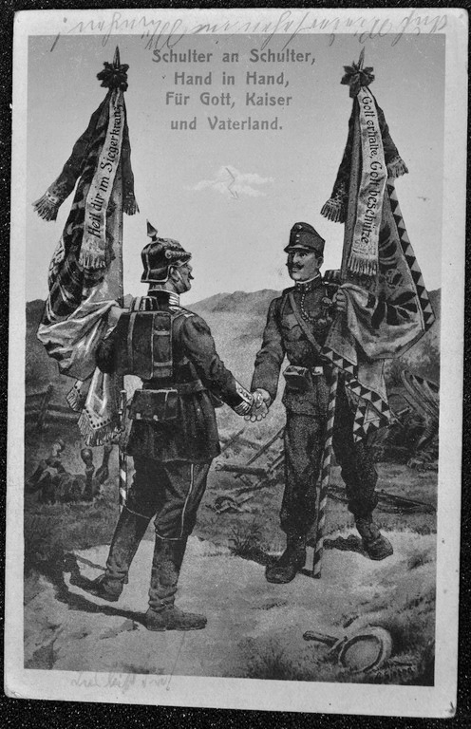
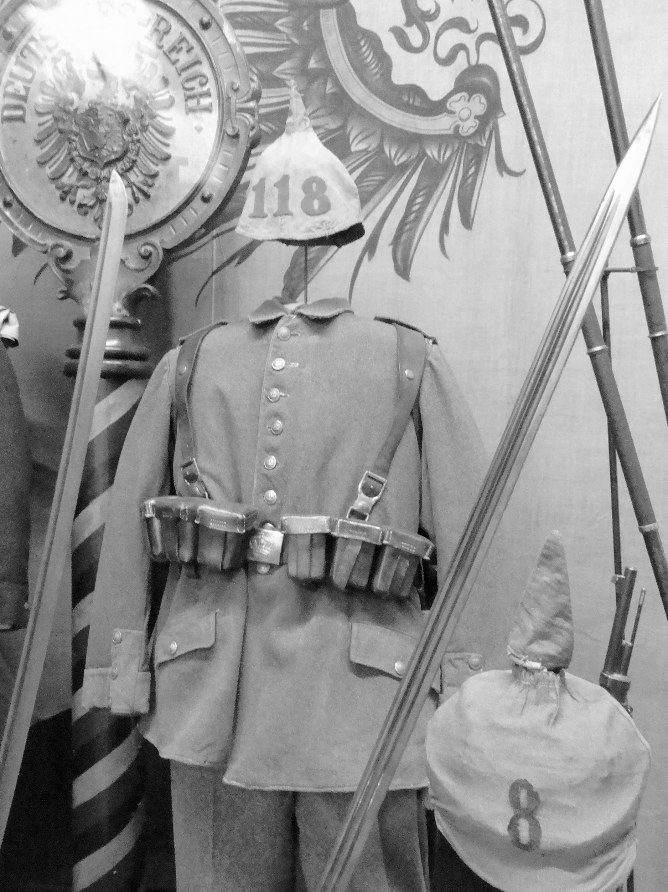

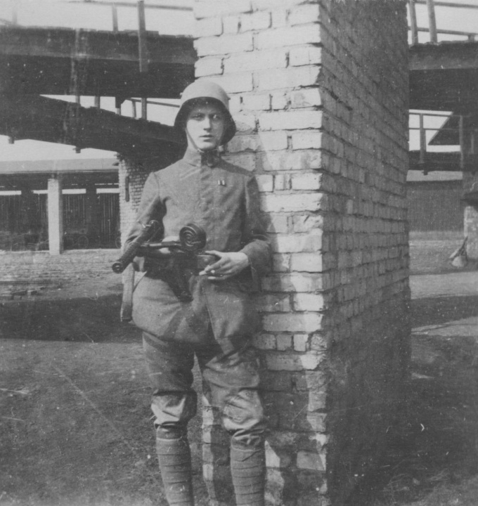
COSTUME INSPIRATION

Slide 12
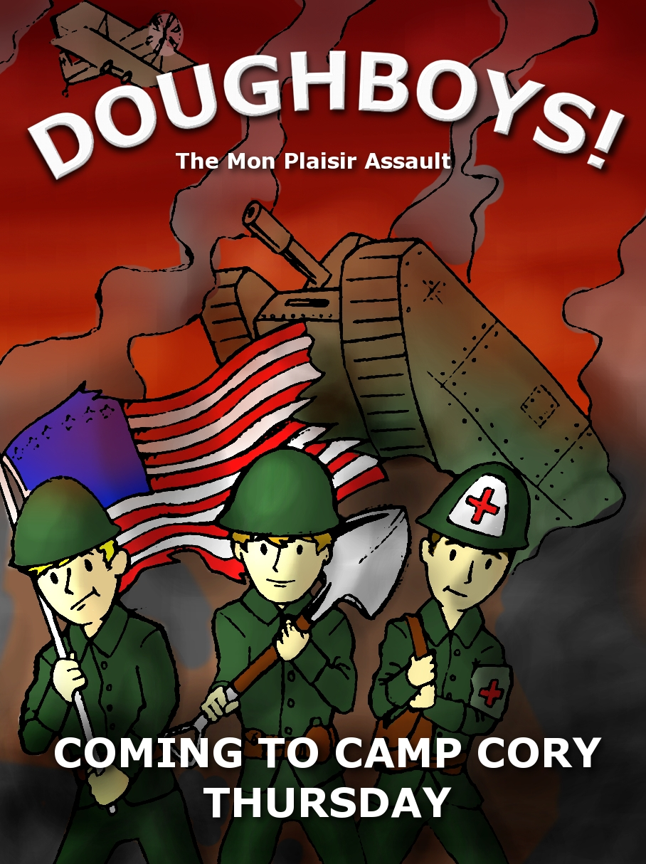

Slide 13
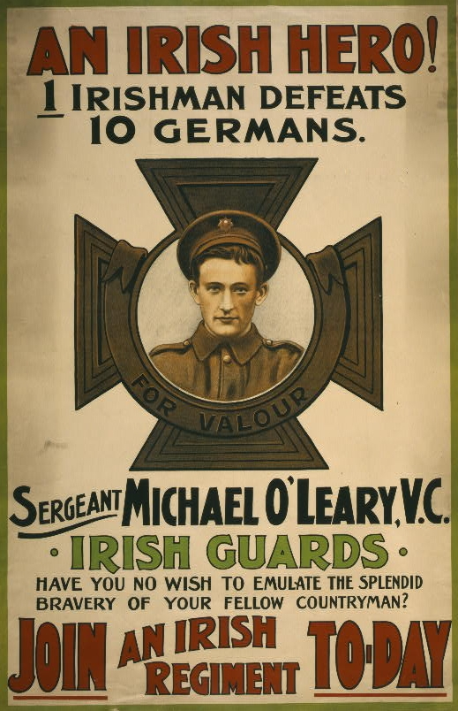

Slide 14
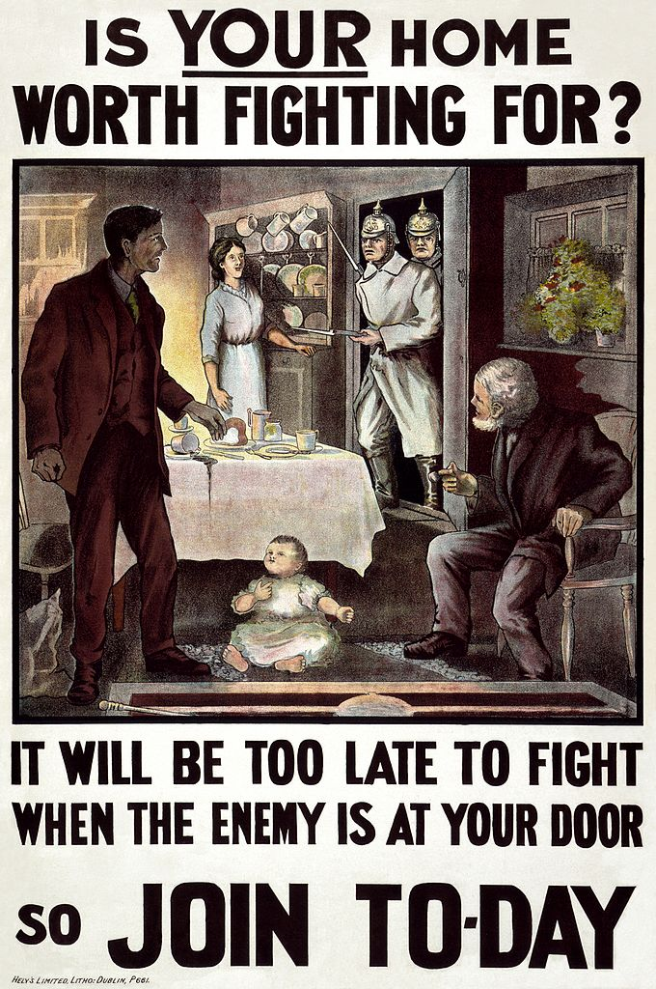

Slide 15
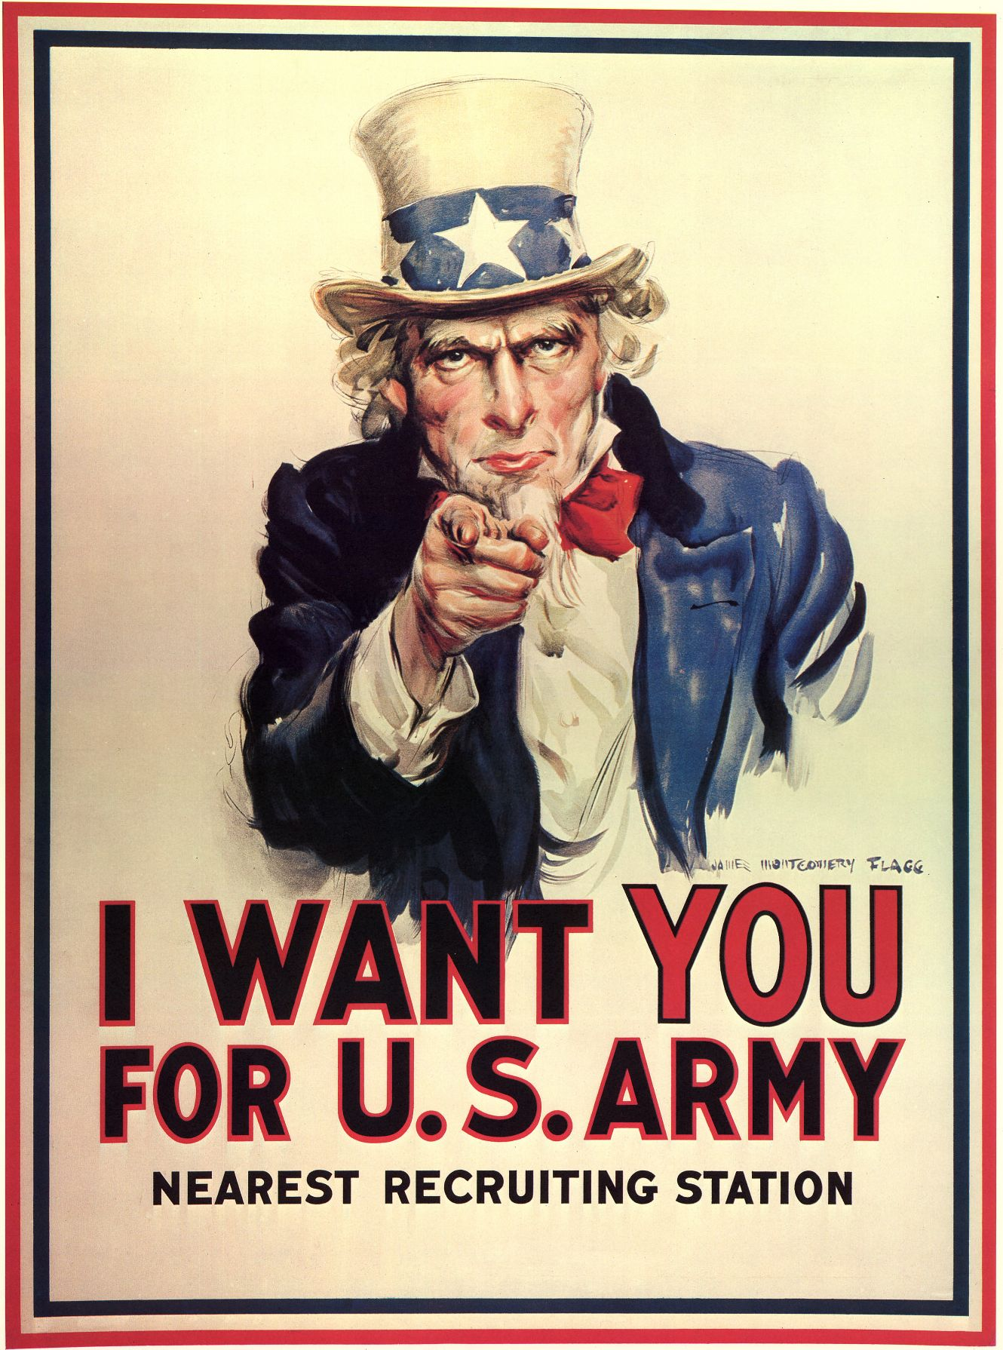

Slide 16


Slide 17
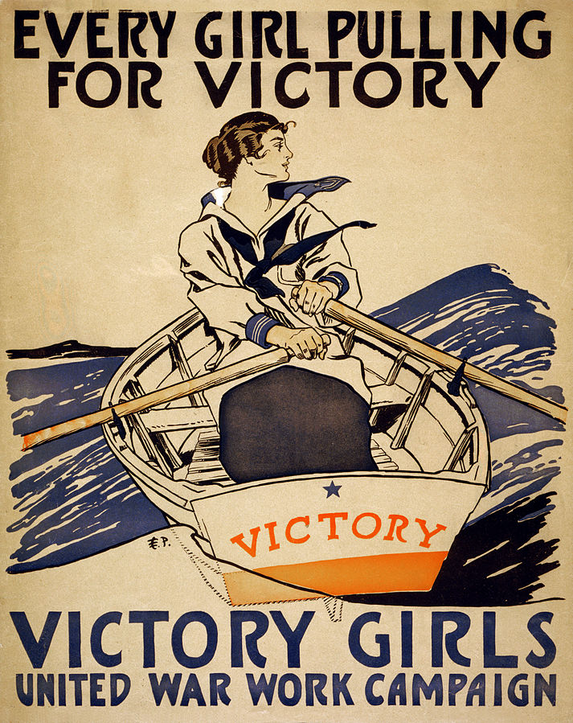

Slide 18
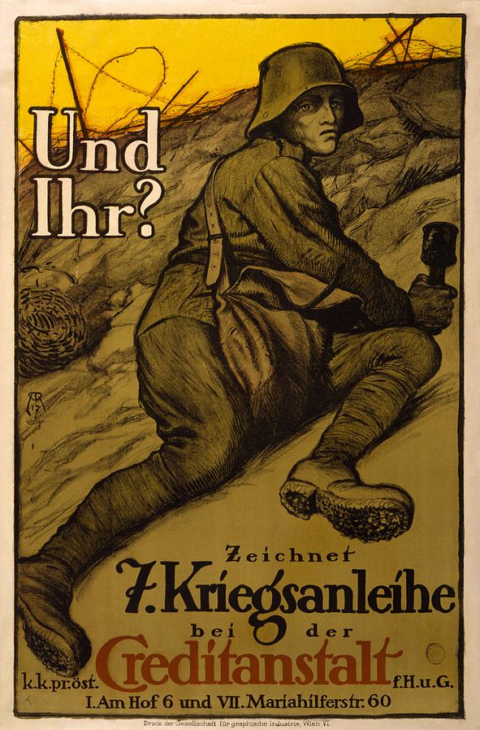

Slide 19


Slide 20
