Slide 1

Choose 5 cases to open! See if you are lucky enough to find the Million Dollars!

Slide 2
Goal-Pick the Case with the “Free Ride” inside!
Move the X over one case. Open the cases one at a time, by clicking on them and complete the activity inside.
If you open the “Free Ride” case, then you must go back and do the activity in your chosen case.
To go back to the main stage to spin again, click on the banker in the bottom left corner. You can play as a group or with a partner.
Play until you have opened all the cases to see if you chose wisely!
Most importantly have fun and work hard!

Slide 3


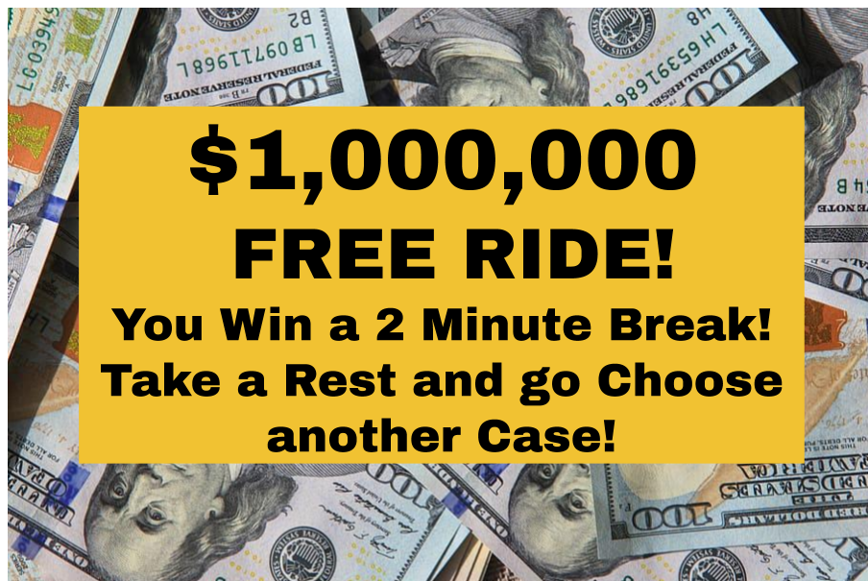

Million Dollar Case
Copy and Paste this image into the case on an activity slide that you want to be the $Million Dollar Case! Kids get a free ride on this one and don’t have an activity to do!
30 Second Timer 45 Second Timer
Dice

Slide 4
1
1

Slide 5
2
2

Slide 6
3
3

Slide 7
4
4

Slide 8
5
5

Slide 9
6
6

Slide 10
7
7

Slide 11
8
8

Slide 12
9
9

Slide 13
10
10

Slide 14
11
11

Slide 15
12
12

Slide 16
13
13

Slide 17
14
14

Slide 18
15
15

Slide 19
16
16

Slide 20
17
17

Slide 21
18
18

