Slide 1




Who we are
What we do
Why you should
work with us

Slide 2






Who we are
35+ Years of Market Experience
Founded in 1987, now built on almost four decades of trusted expertise.
ISO 9001:2015 Certified
Internationally recognized quality standards for reliable products and processes.
Product Management in Germany
Driven by German engineering principles ensuring precision and reliability.
In-House Quality Control
Our own QC team in Asia testing each product before it’s shipped.
Superior Warranty
3-year-warranty on active products and a lifetime warranty on passive products.
Global Presence, Local Mentality
With offices on four continents, we combine worldwide operations with regional knowledge.

Slide 3
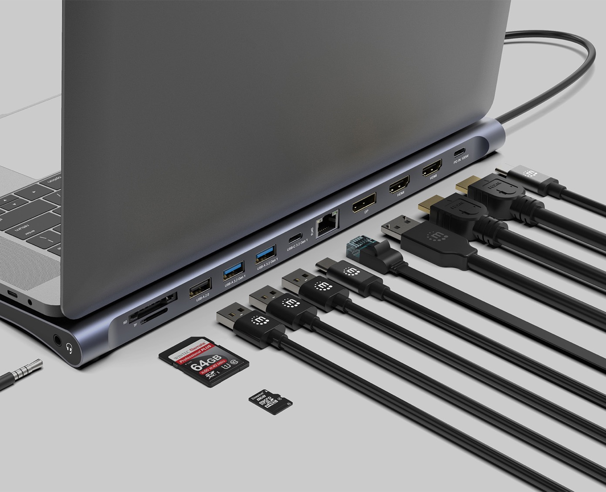

Our Brands
What does Manhattan Products stand for?
”
“Life just got easier” is more than our tagline – it defines how we design connectivity solutions that simplify digital experiences for consumers and businesses.

Slide 4
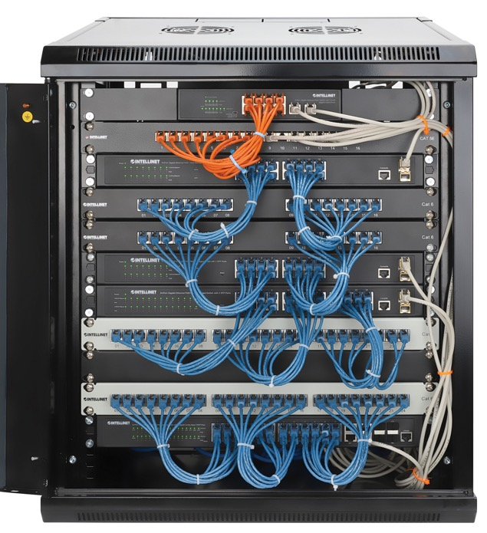

Our Brands
What does Intellinet Network Solutions stand for?
”
Delivering professional active and passive networking solutions for small and mid-sized businesses.

Slide 5



Milestones
1987 Founded IC INTRACOM Vertriebs GmbH in Germany
1988 Established IC INTRACOM Asia Co., Ltd in Taiwan
1991 Established IC INTRACOM US and Italia S.p.A
1996 IC INTRACOM Vertriebs GmbH Certified by ISO 9001
1997 IC INTRACOM USA, Inc. were selected on INC. 500 in USA
1999 Established IC INTRACOM MEXICO SAPI de CV
2002 Opening ICML office in Dongguan China
2018 Established UK Brand Rep Office
2012 IC INTRACOM Asia Co., Ltd. Certified by ISO 9001:2015
IC INTRACOM Asia obtains SEDEX - SMETA4P :
Environmental & Social Responsibility Certificates
2024 Re-Opening ICNB Office in Ningbo China
2025 Established IC INTRACOM Philippine Office
2015 Established Balkans Brand Rep Office
2023

Slide 6
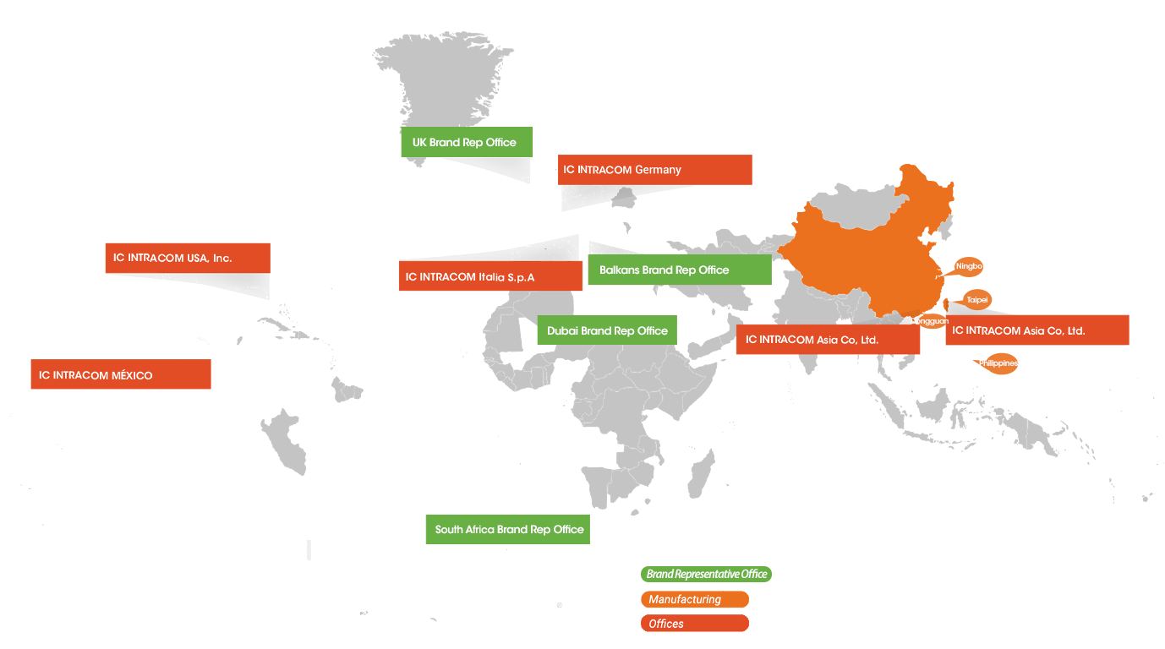
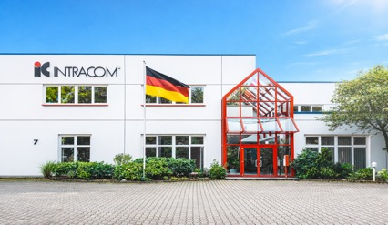




Business Worldwide
100+ Countries
Italy

Slide 7










Trusted partners
TD SYNNEX is a global IT distribution company with a workforce of 22,000 in over 100 countries. It was formed in 2021 by the merger of Synnex and Tech Data.
ALSO is one of the leading technology distributors, currently active in 143 countries worldwide. Net sales of the Swiss-based company, which employs around 4000 people, amounted to 12.4 billion euros.
Ingram Micro is a global distributor of information technology products and services in 61 countries. In 2022 they shipped 1.5 billion units and operated at 50.8 billion USD net.
Conrad Electronic is a multi-national retailer based in Germany with over 100 years of market experience.
Avtera is a leading IT distributor in the Adriatic region, specializing in IT, consumer electronics, mobility, and health products.
Softcat is a UK-based IT infrastructure provider that specializes in hardware, software licensing, security, and IT services. In 2022 they grossed over 1.14 billion euros.
SiS was established in June 1998 and registered as listed company on the stock exchange of Thailand in 2004. Distribution of world class brands in IT, computers, peripherals and office equipment business in Thailand.
Api Computerhandels GmbH is a German IT distributor with over 100,000 associated system integrators.

Slide 8


IC Intracom Sales By Region

Slide 9
IC Intracom Sales By Brand

Slide 10


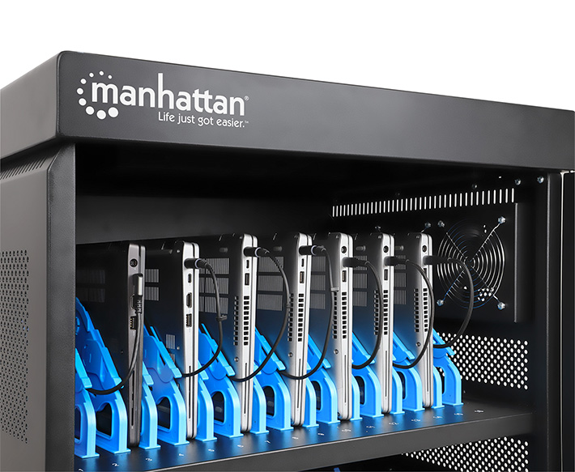

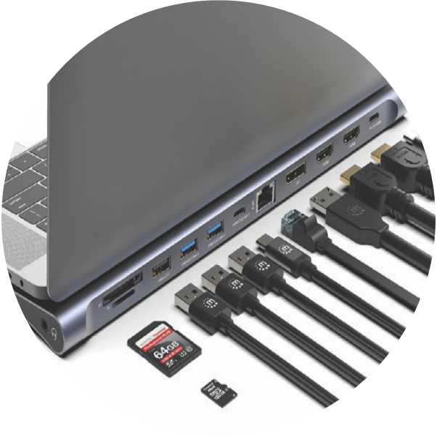



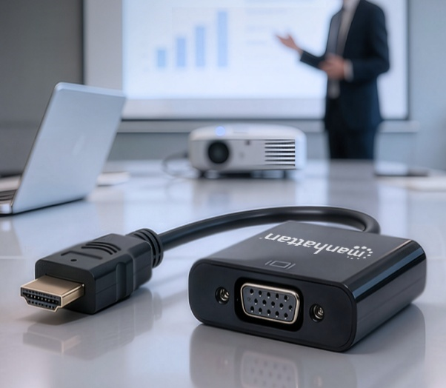
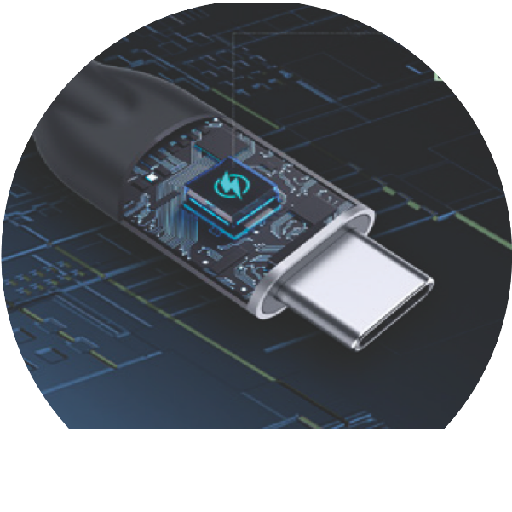
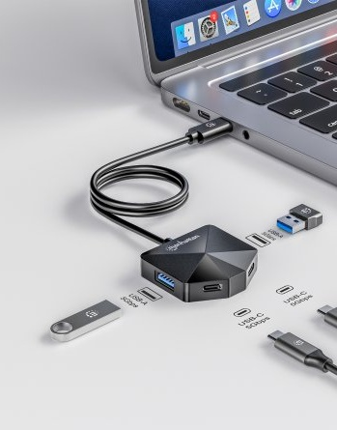


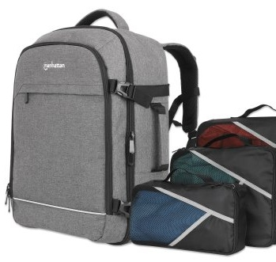
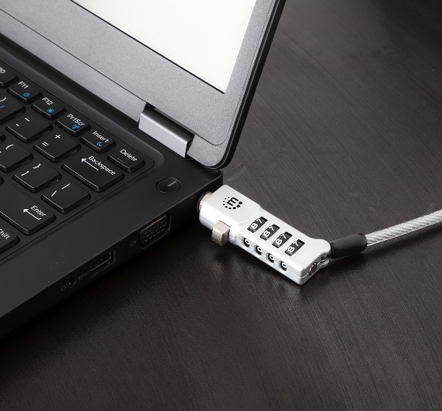
Product Highlights
√
Key Product Lines
Chargers & Charging Stations
Charging Cabinets
Docking Stations
Display Mounts
Video Solutions
Video
Cables
Adapters & Converters
USB
Cables
USB
Hubs
Barcode Scanners
Peripherals
Laptop
Bags
Other Accessories
More than 700 SKUs

Slide 11

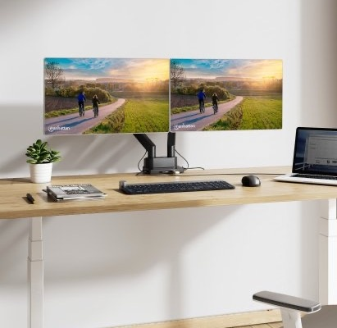

Product Highlights
OEM/Private Label Services
√
Display Mounts
SKUs: 60+
Options: Desk-, wall- and ceiling mounts, for TV, monitor, projector and tablet, full motion, steel, aluminum and much more
Great for home theater, office, conference rooms and digital signage
Discover Manhattan Display Mounts

Slide 12
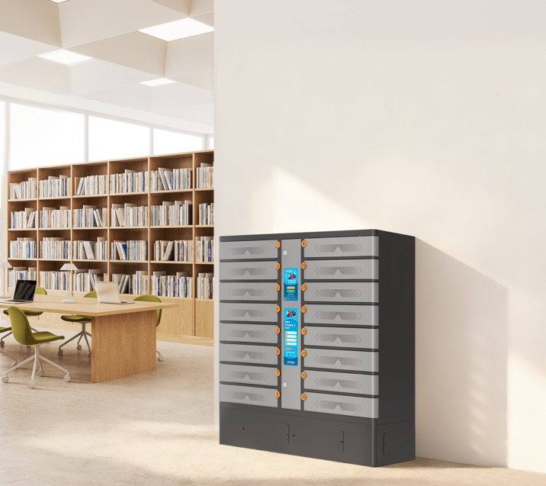
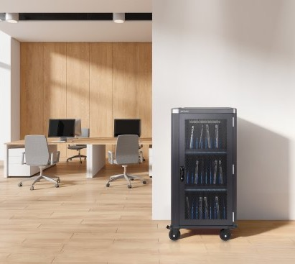
Product Highlights
OEM/Private Label Services
√
Charging Cabinets
SKUs: 17
Options: Charging Cabinets, Carts & Kiosks with USB-C PD or AC, 7-32 Outputs
Great for schools and hospitality markets
Discover Charging Cabinets

Slide 13
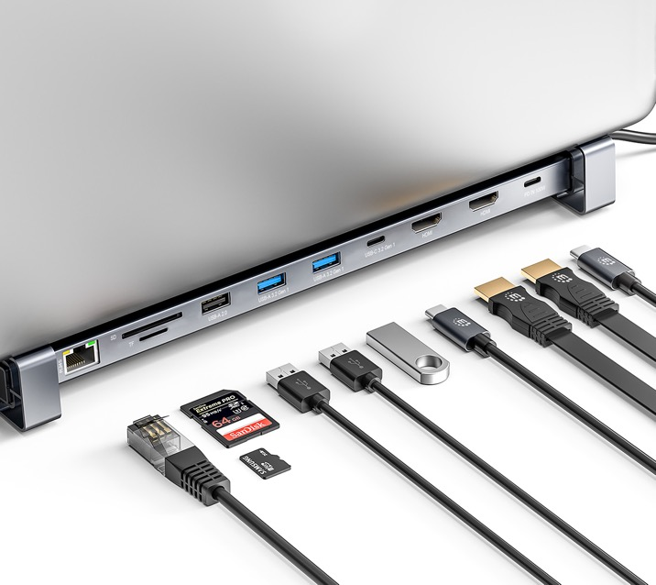
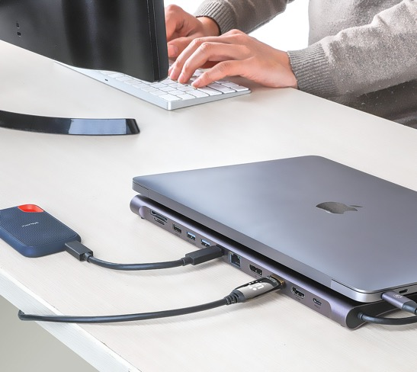
Product Highlights
OEM/Private Label Services
√
Docking Stations
Options: For one, two or three monitors, up to 4K@60Hz, HDMI or DP, up to 12 ports for Ethernet, card reader, audio, USB-A, and USB-C
Great for adding connectivity to mobile devices
Discover Docking Stations

Slide 14

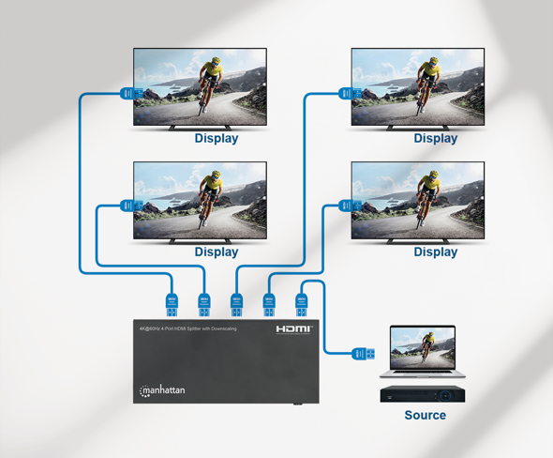
Product Highlights
OEM/Private Label Services
√
Video Solutions
With Video Cables, Adapters, Extenders, Switches, and Splitters, we deliver the whole package
Great for office or home theater setups
Discover Video Solutions

Slide 15
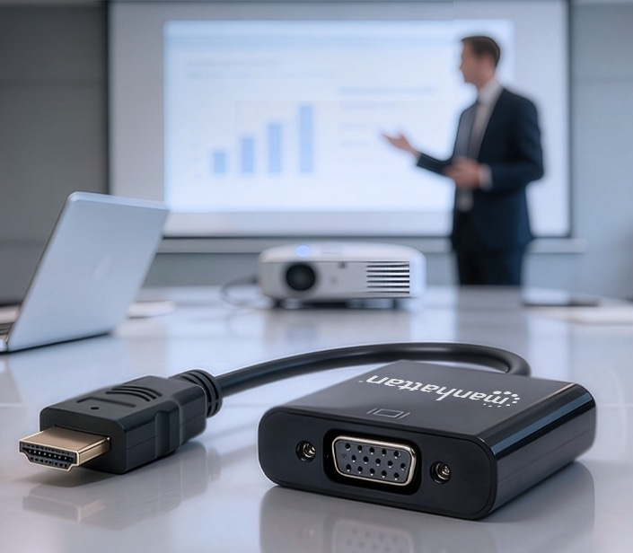
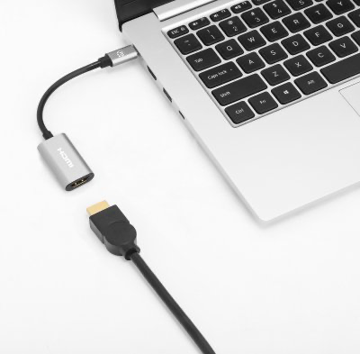
Product Highlights
OEM/Private Label Services
√
Adapters & Converters
Adapters are an important part of our DNA as connectivity brand, transmitting data, video, audio, and power to modern devices
Featuring all interfaces including legacy connections like Serial
Discover Adapters & Converters

Slide 16

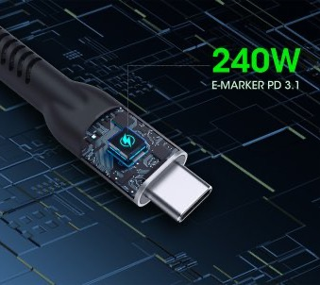
Product Highlights
OEM/Private Label Services
√
USB Cables
Similar to our long history of adapter expertise, we offer an extensive portfolio of USB cables for consumer, office and project installations
Featuring any standard from legacy Micro-USB to USB4
Discover USB Cables

Slide 17

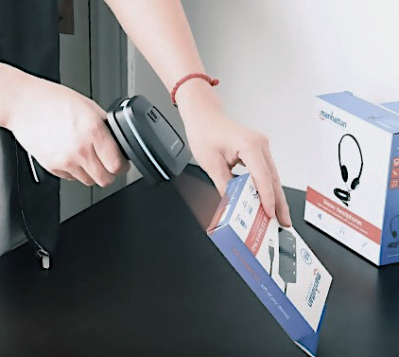
Product Highlights
OEM/Private Label Services
√
Barcode Scanners
Options: wired, wireless, laser, long range, 1D/2D, IP54-rated housing and more
Great for point-of-sale retail, shipping, warehousing, office and more
Discover Barcode Scanners

Slide 18


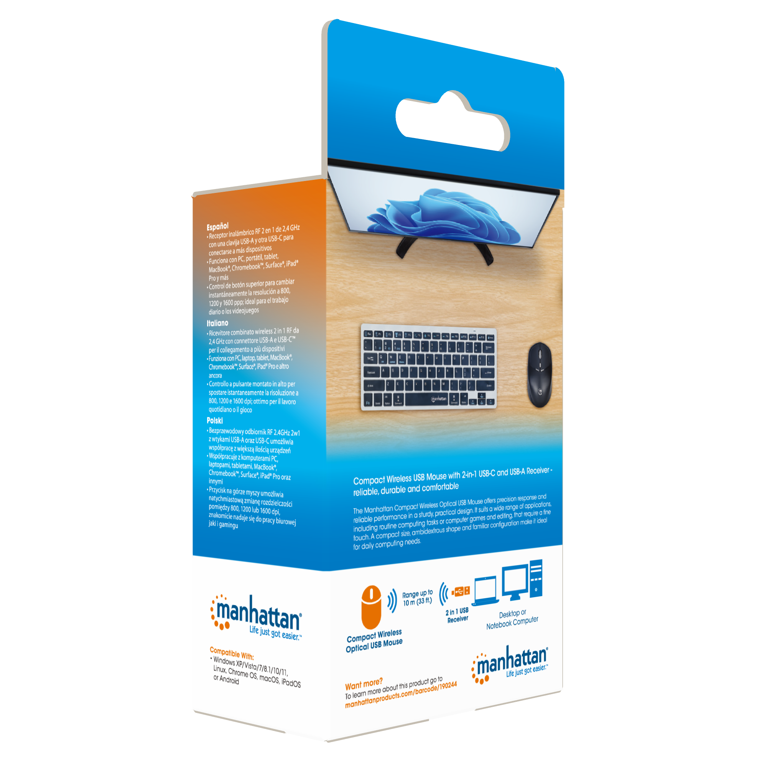


Professional Packaging for Unassisted Sales
Sustainable and eco-friendly cardboard
Retail-Ready
Colorful, eye-catching style draws consumers to the product every time
Multi-Language Features
Six common languages describe product features for a diverse customer base
Clear Diagrams
Illustrations show ease of setup and common applications
Smart Icons
Clear depictions of key features that users can expect, right out of the box

Slide 19
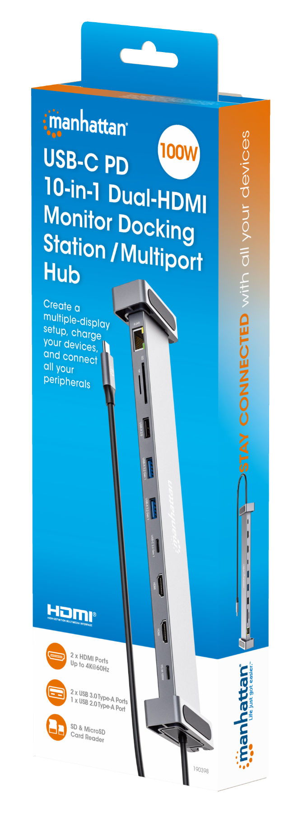
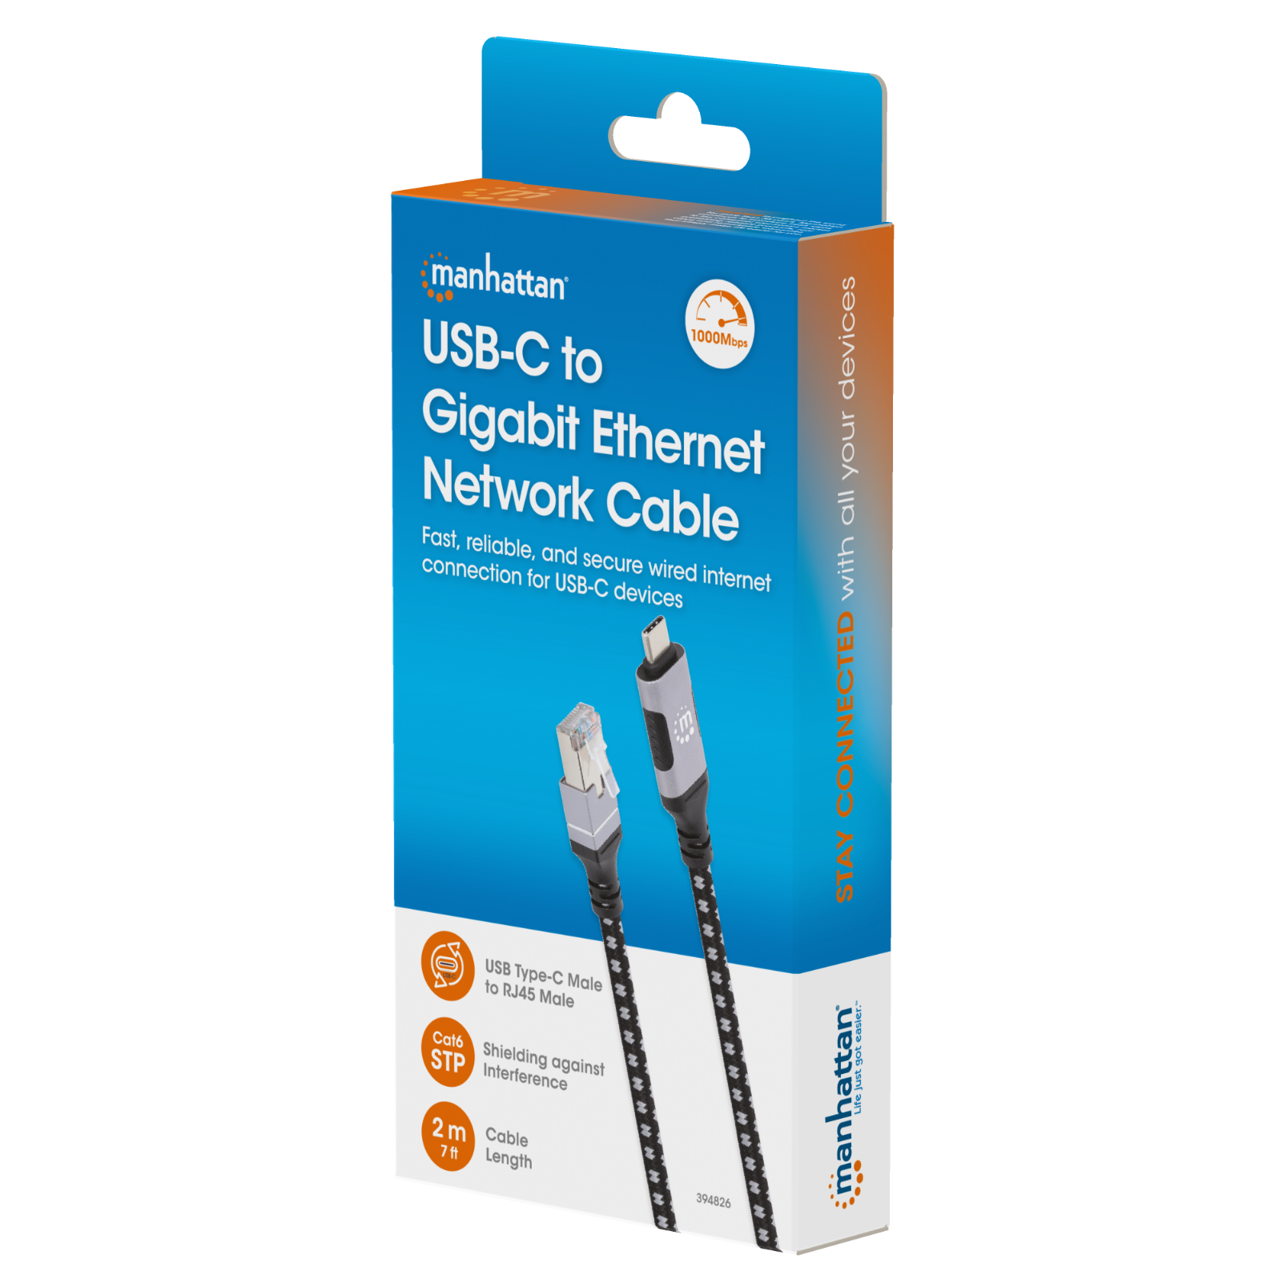

Hanging Box

Slide 20
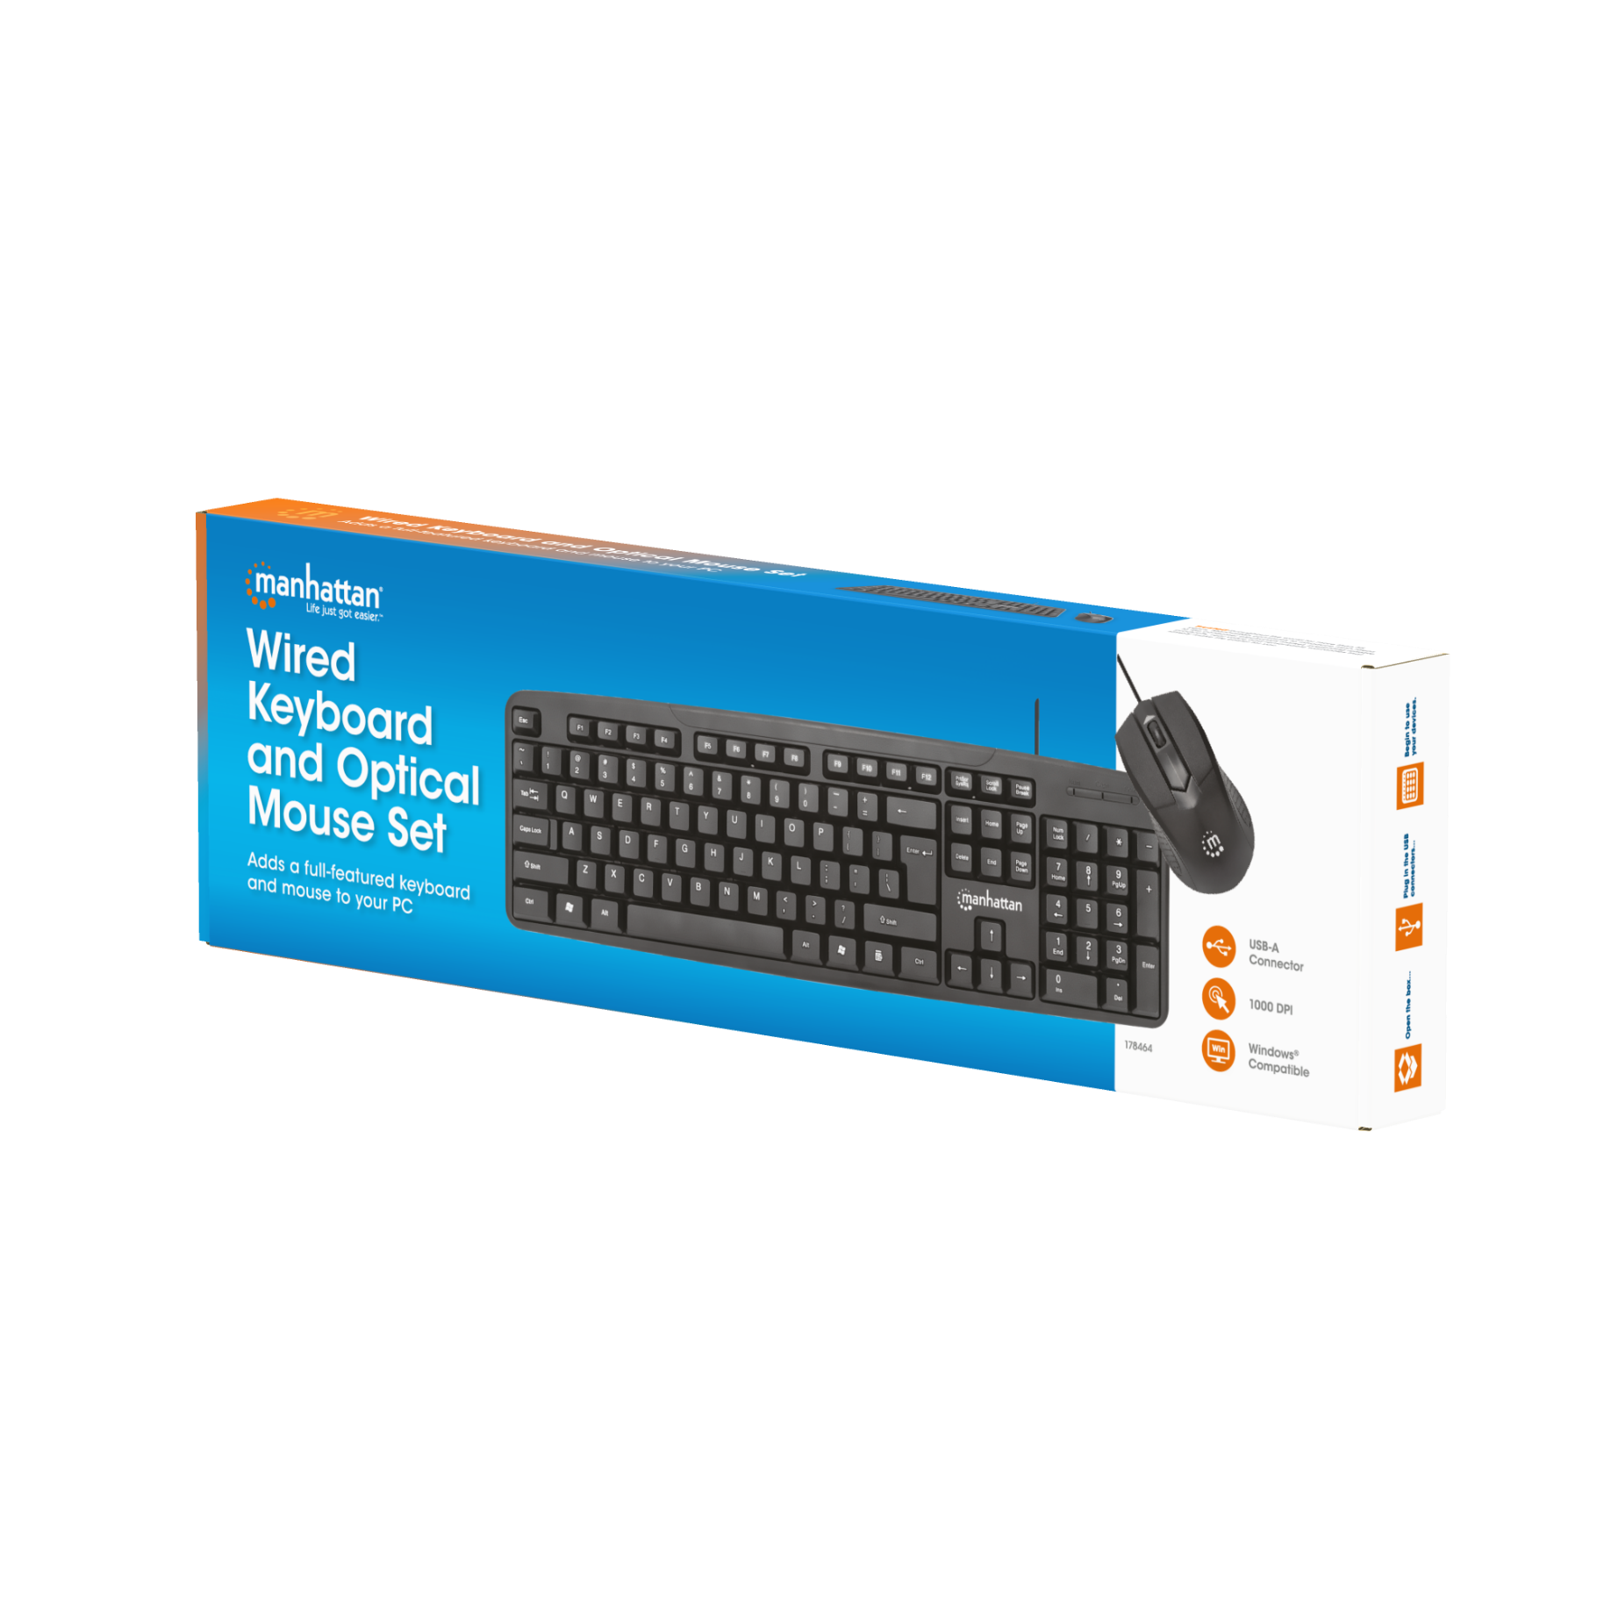
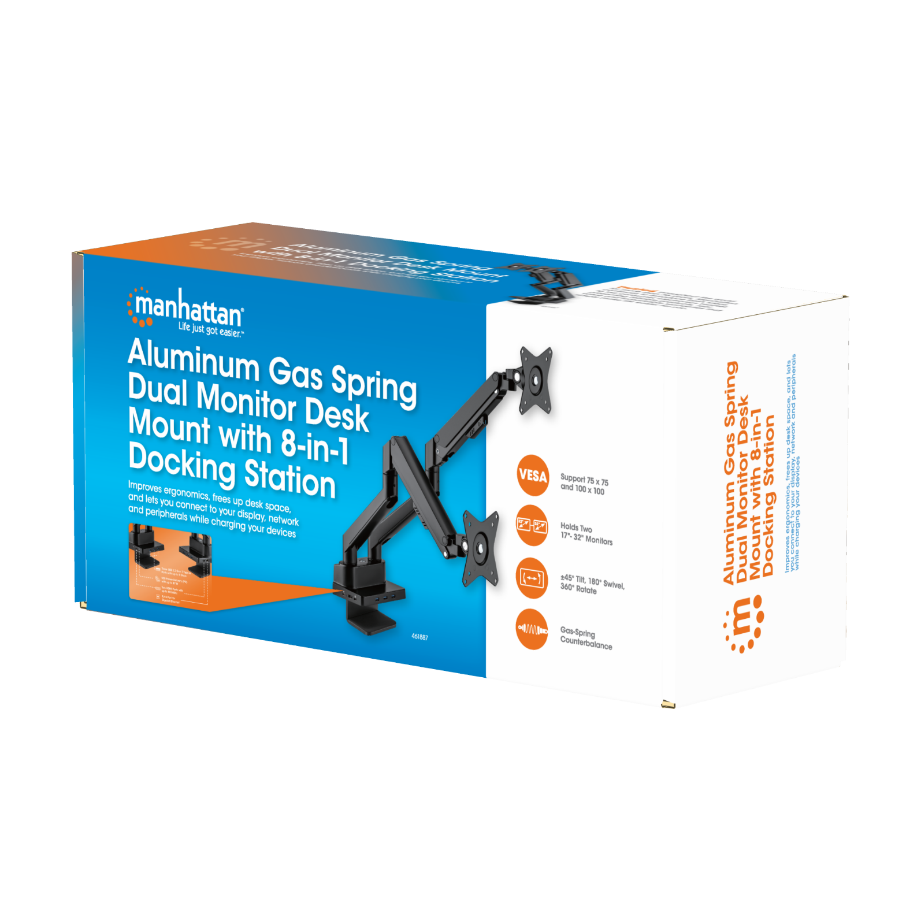
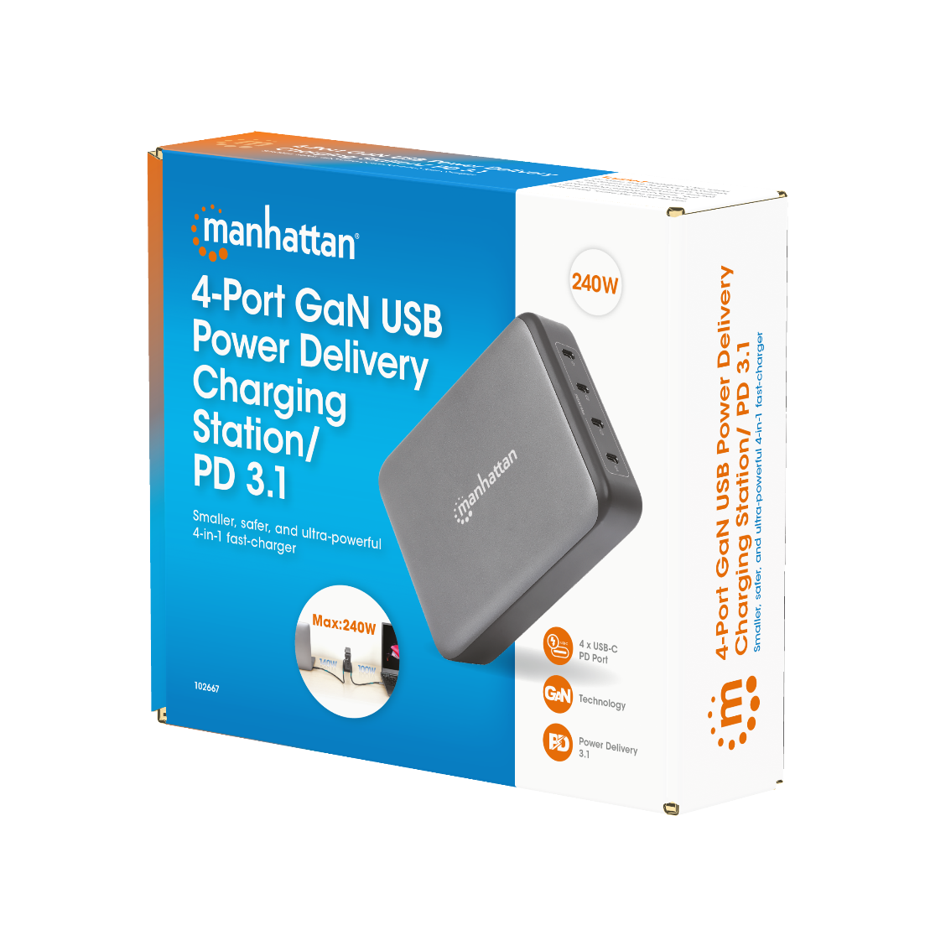
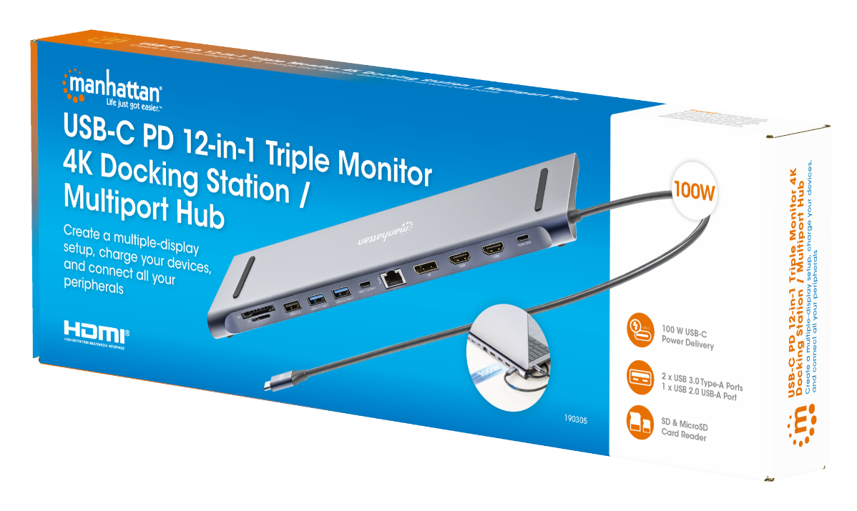
Standing Box

Slide 21
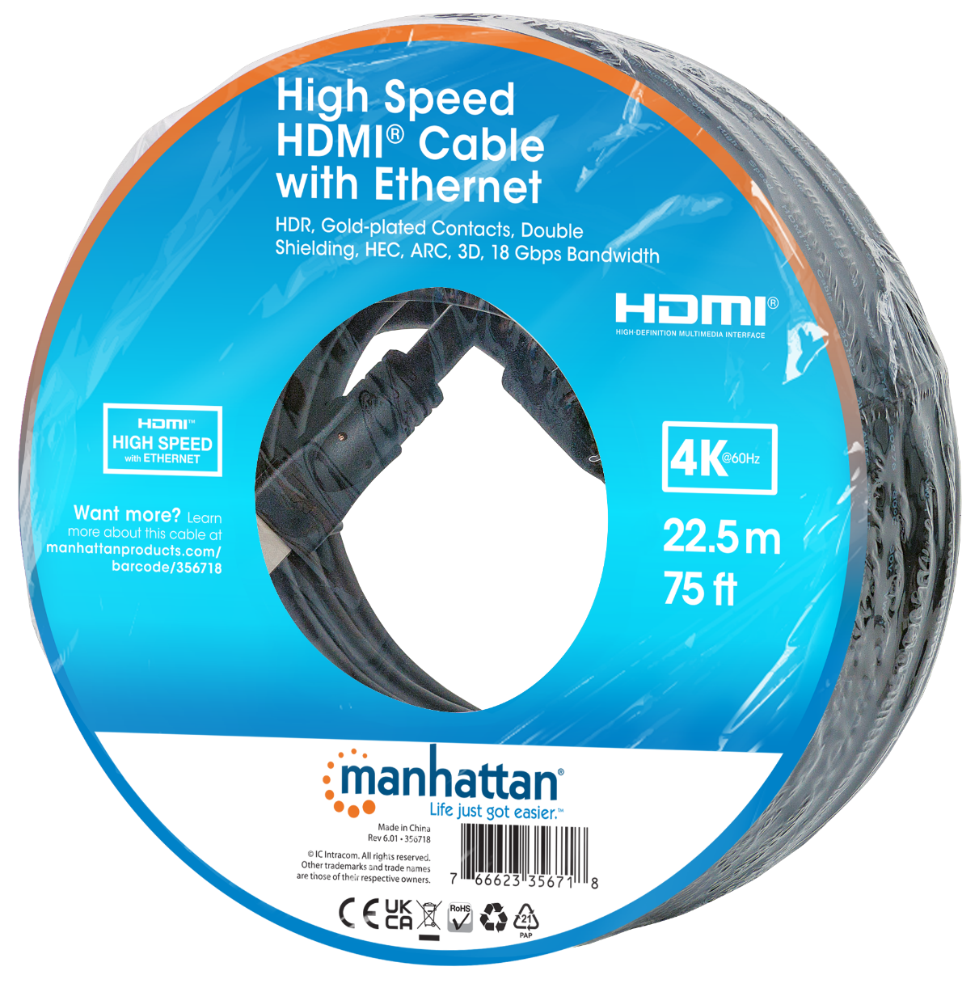

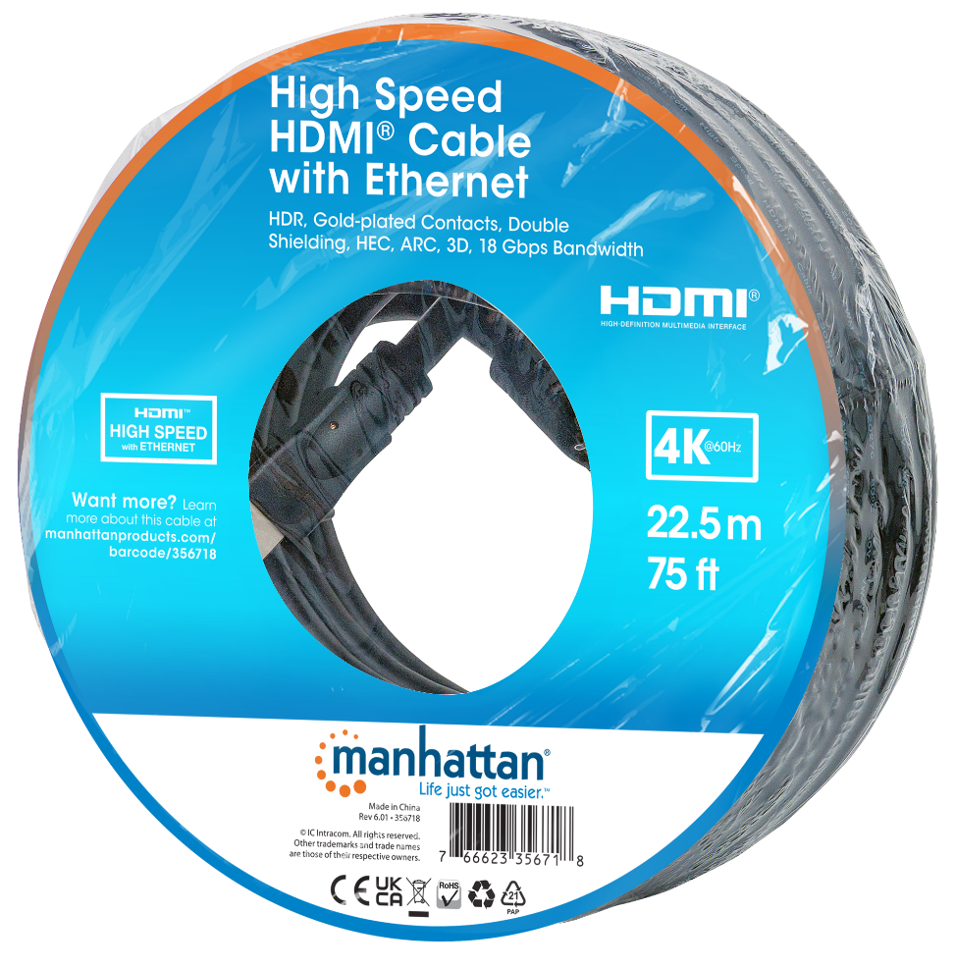
Donut

Slide 22

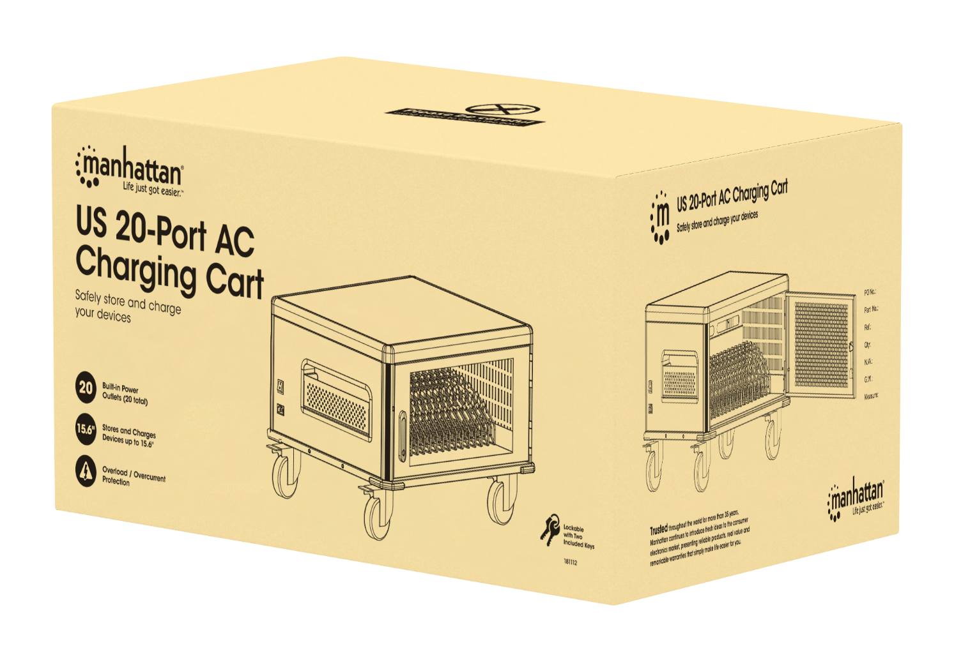
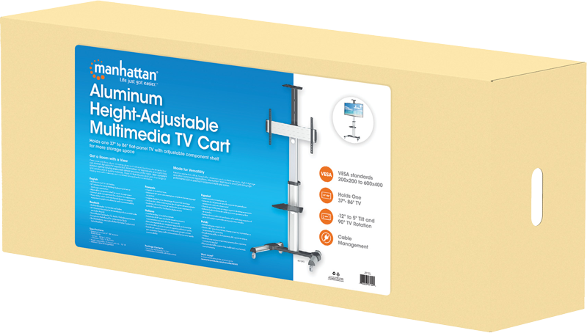
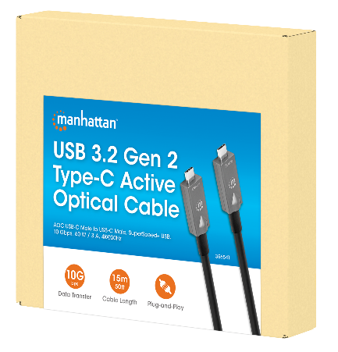
Brown Box

Slide 23
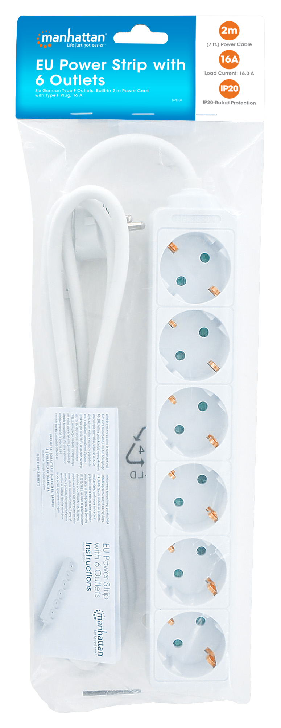
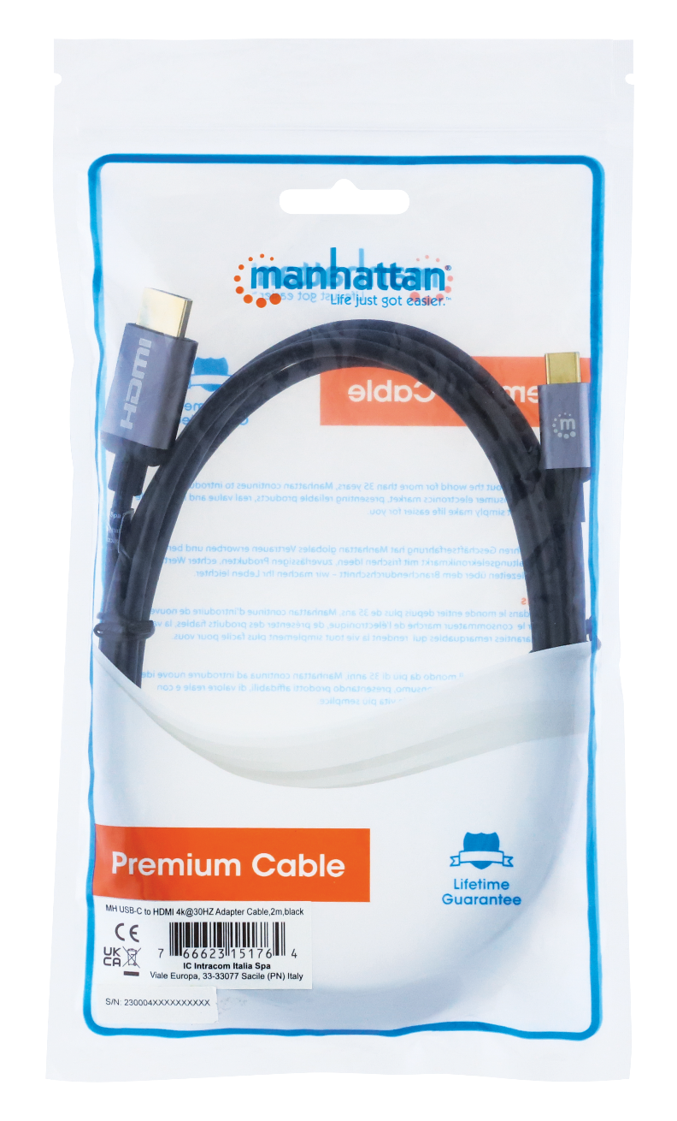
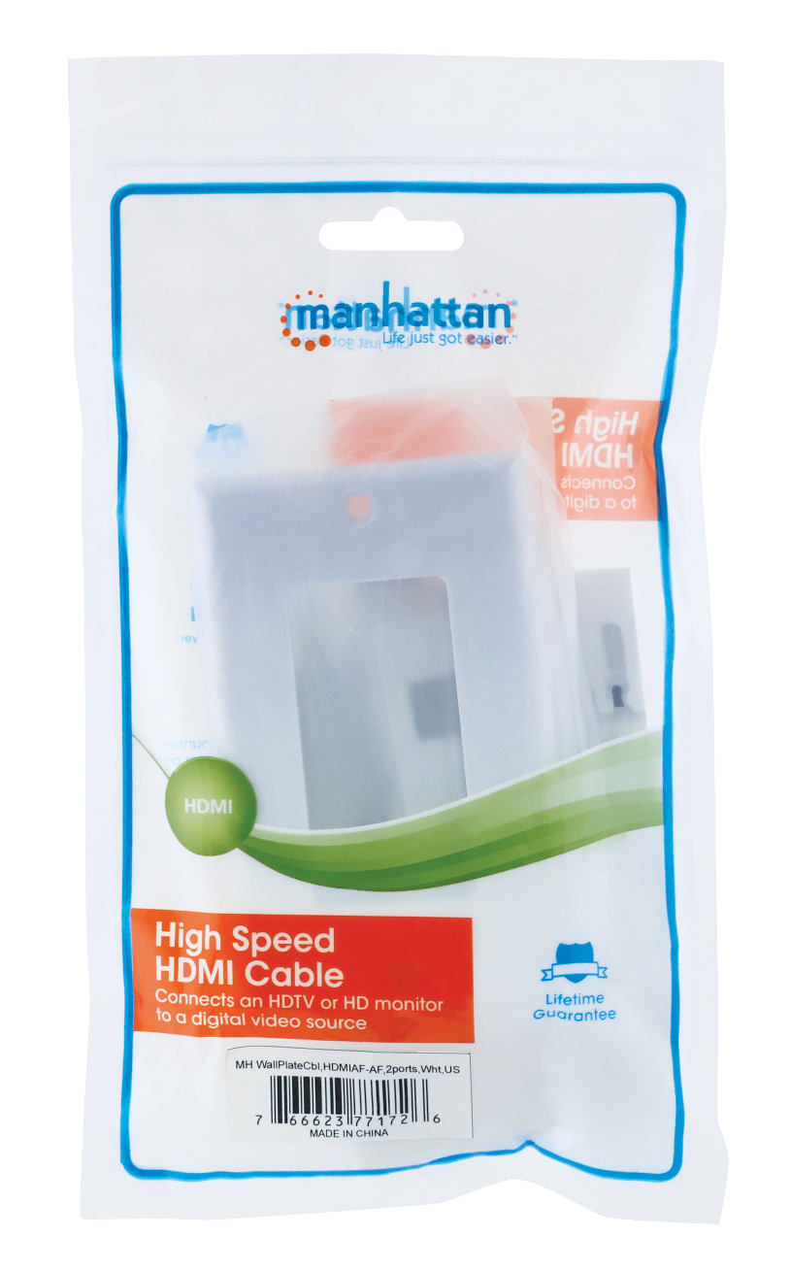
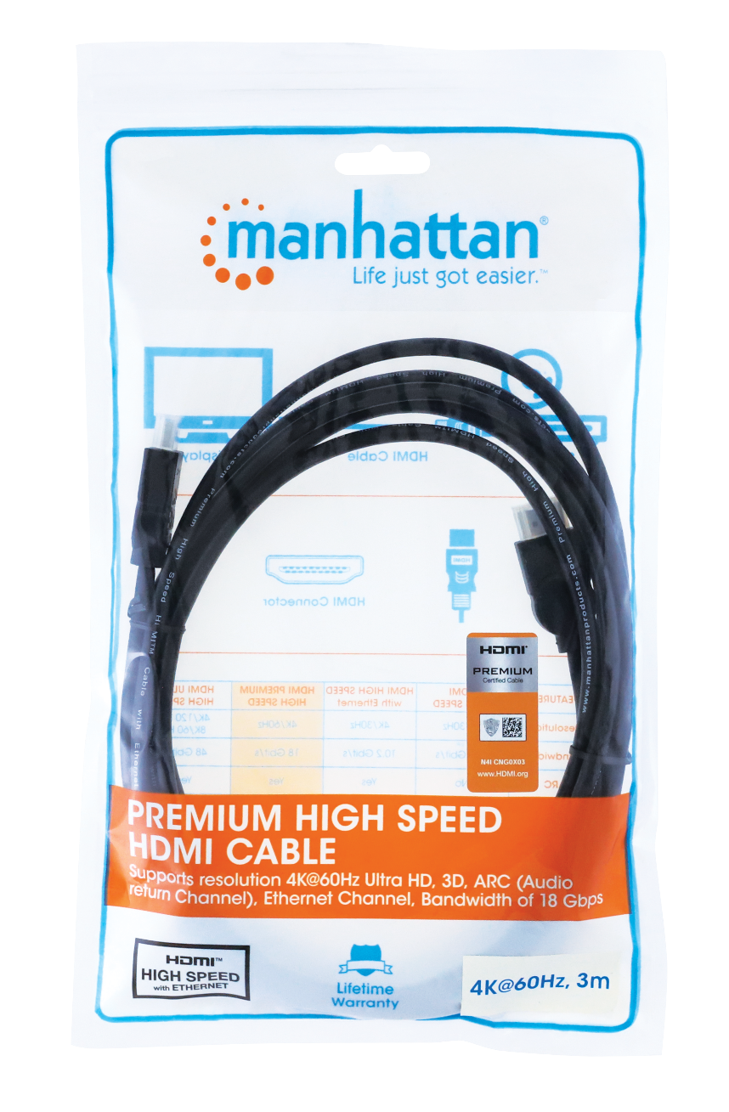
Polybag

Slide 24

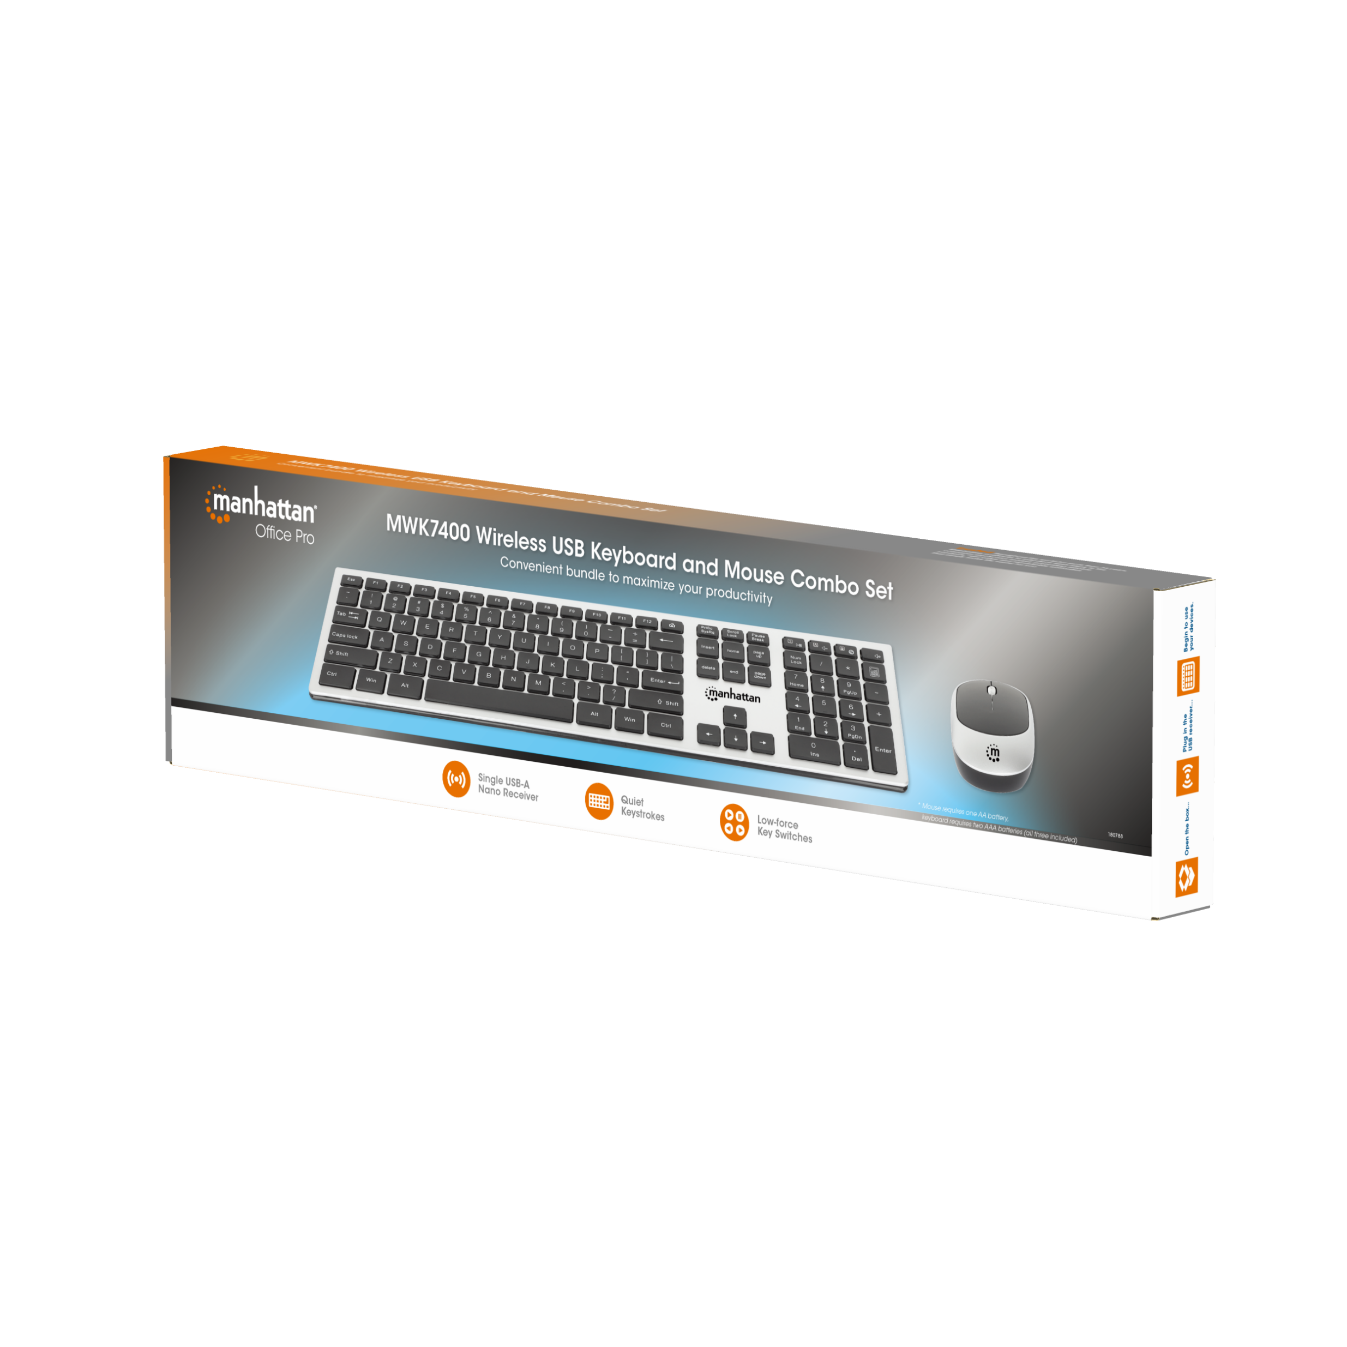
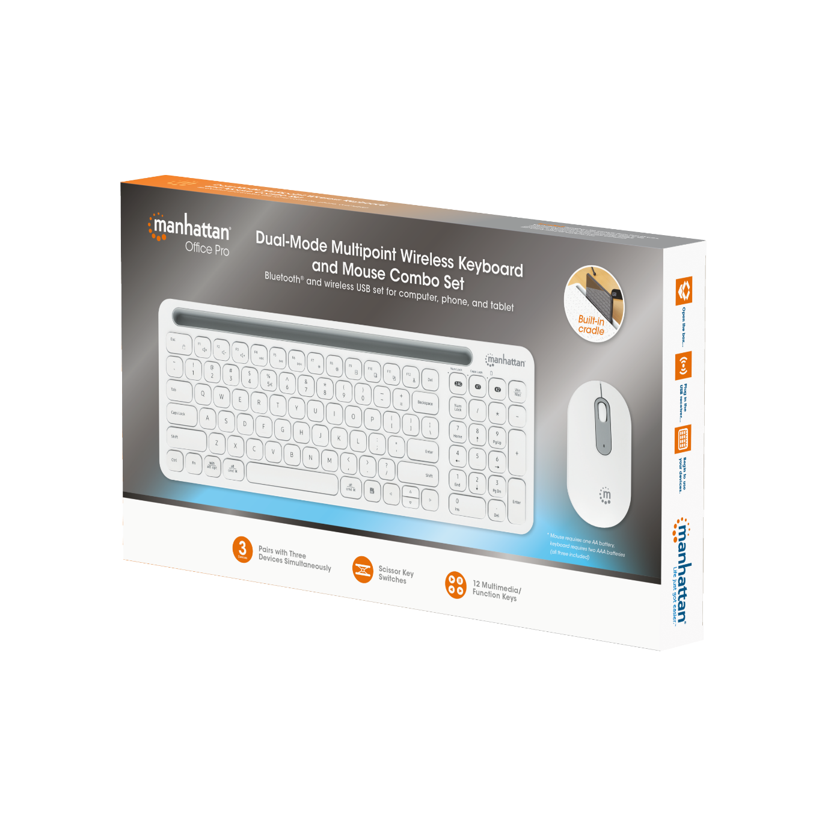
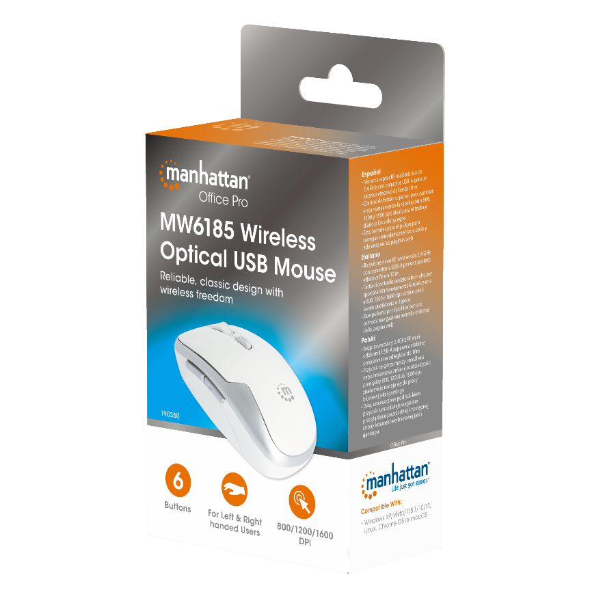

Office Pro Line

Slide 25


Sample
Planogram

Slide 26
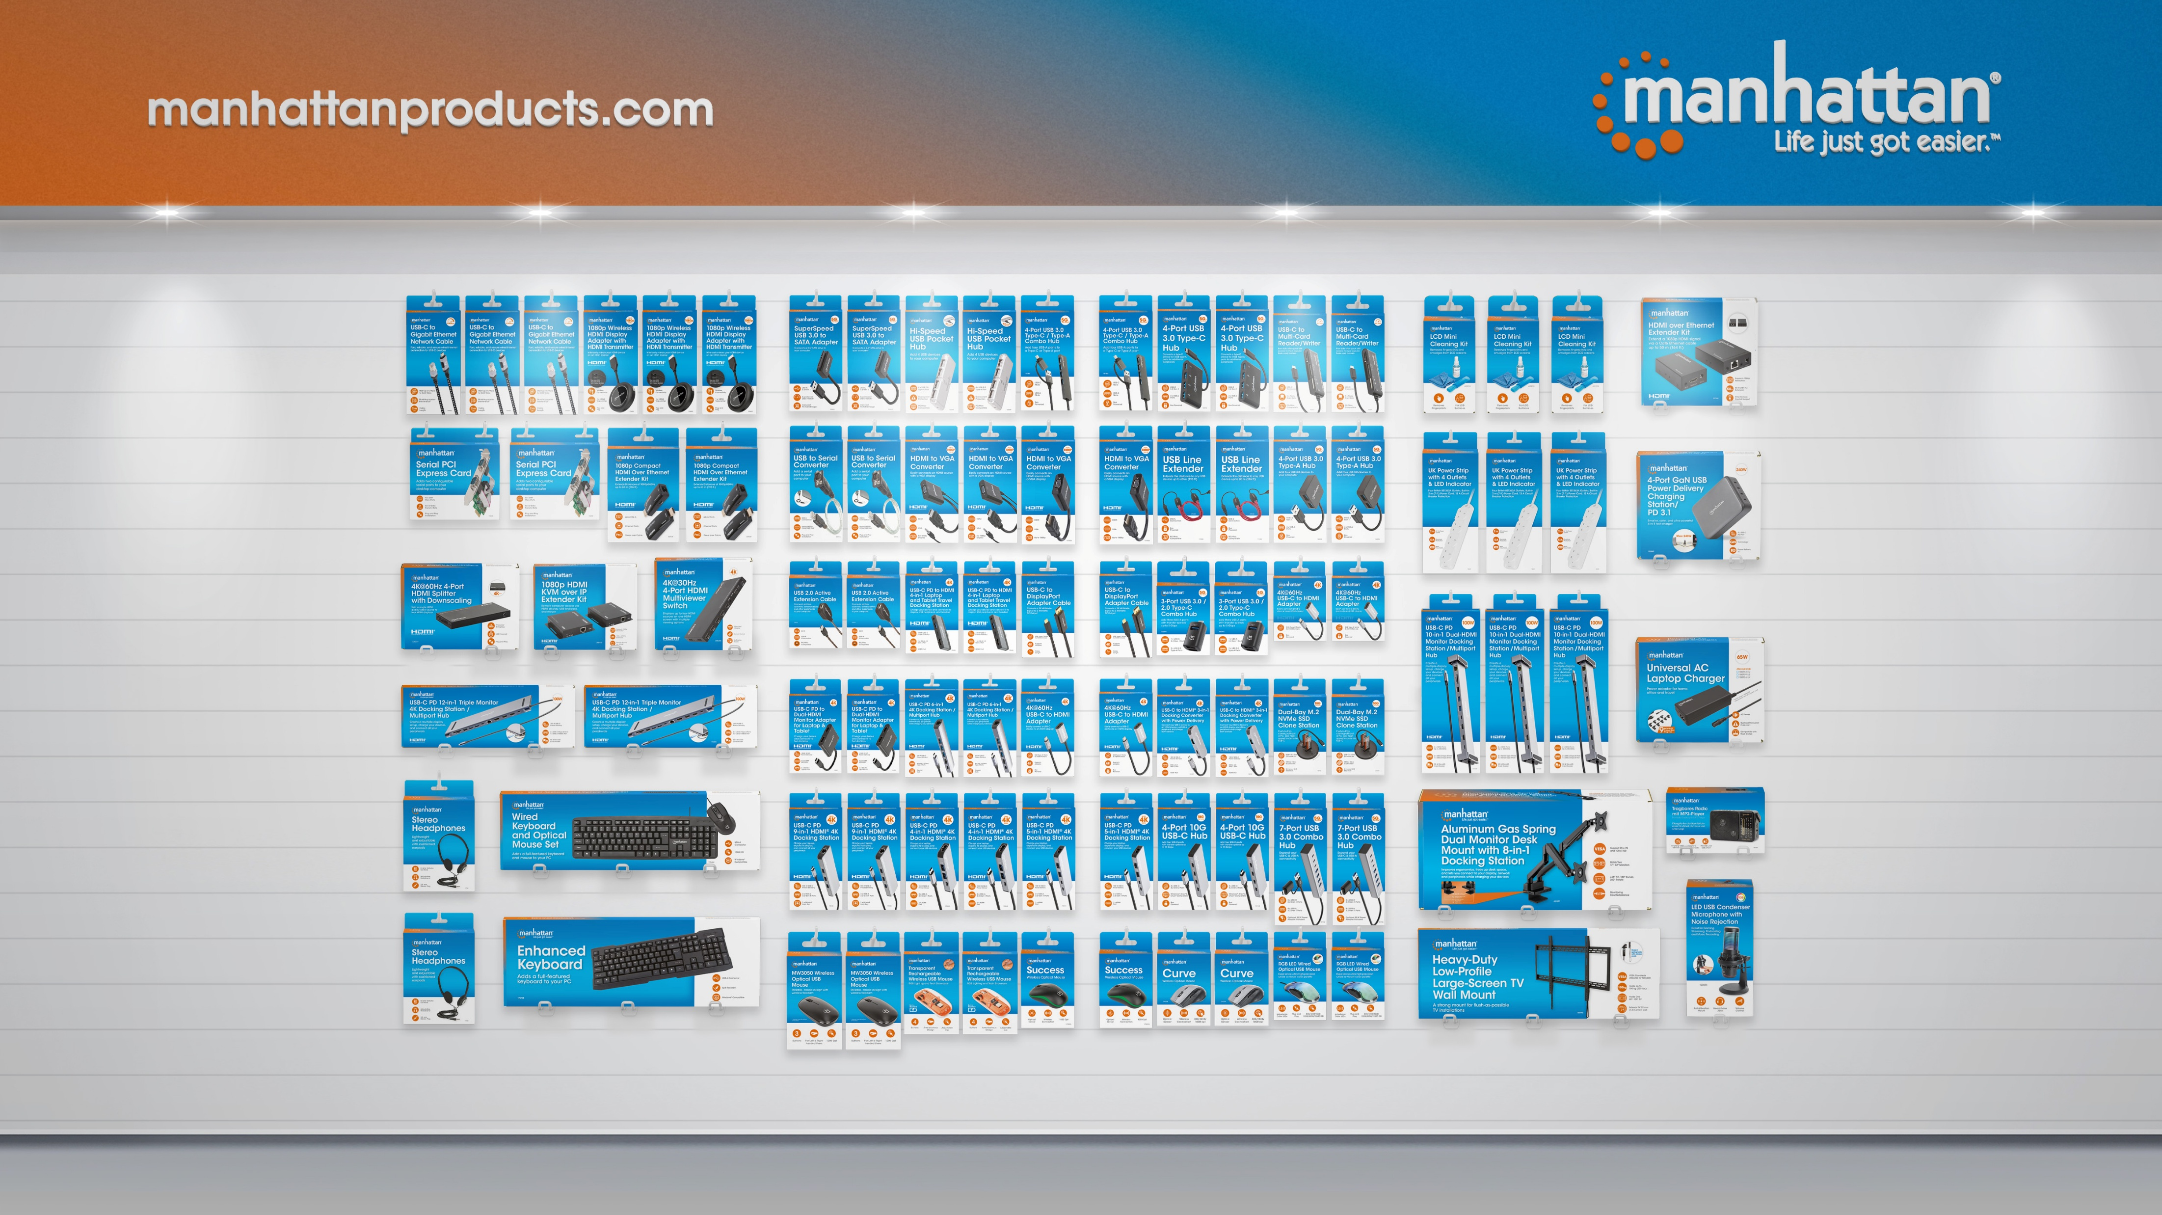
Sample Planogram

Slide 27
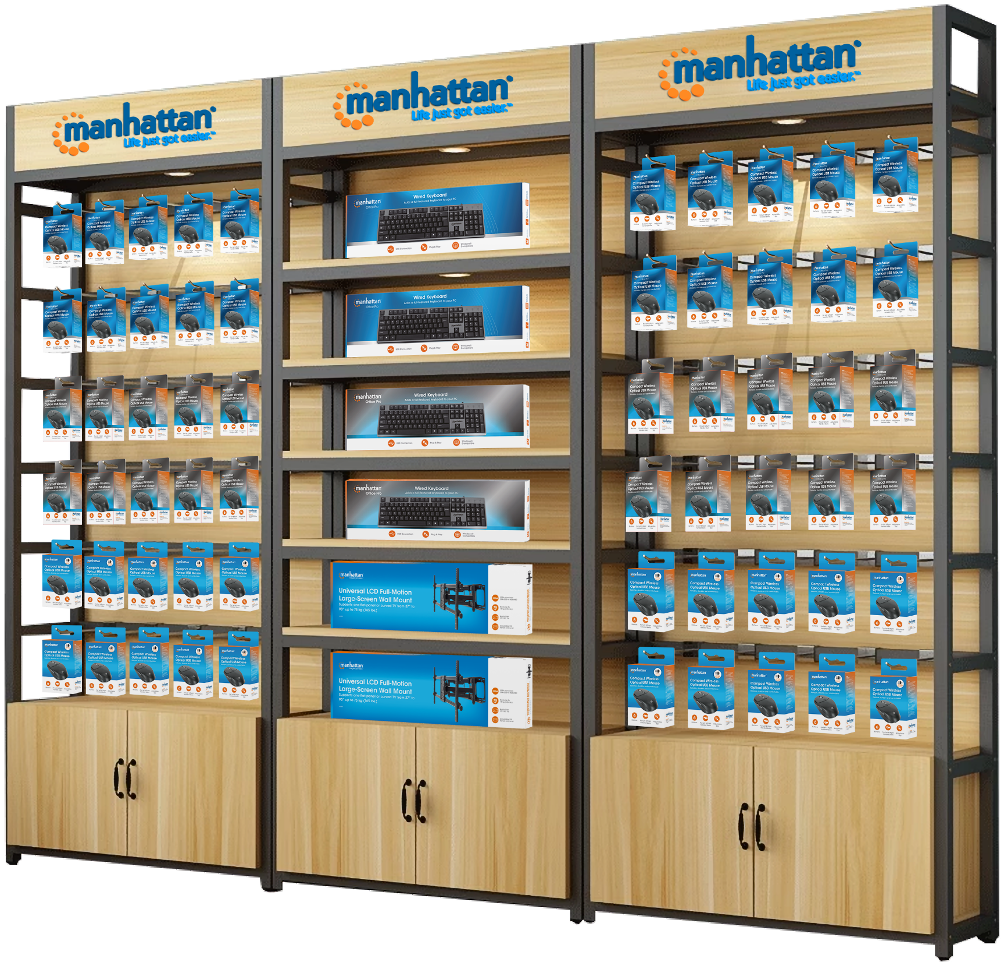
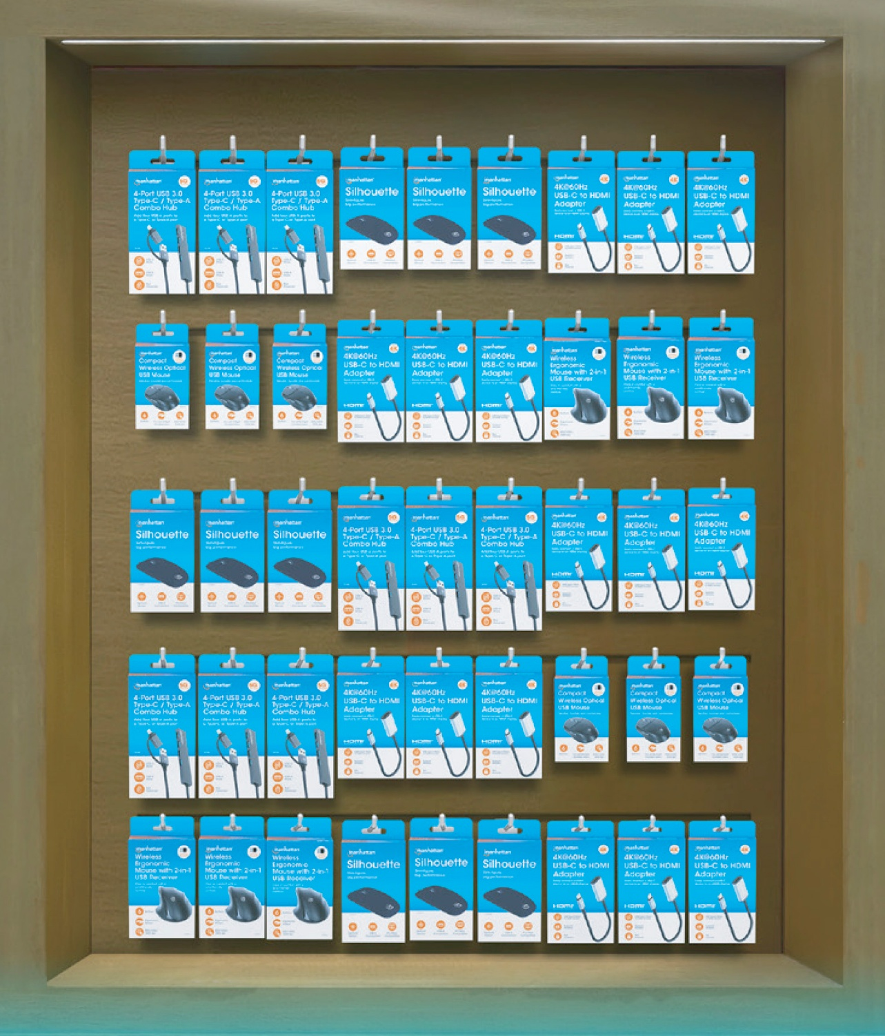
Sample Planogram

Slide 28

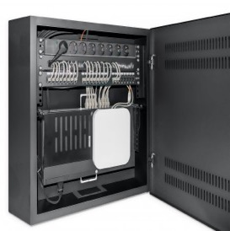
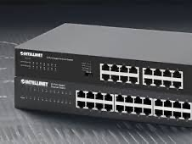

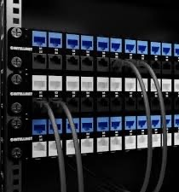
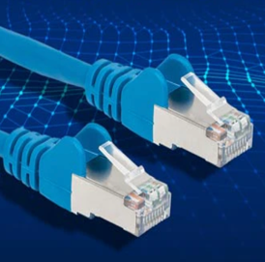
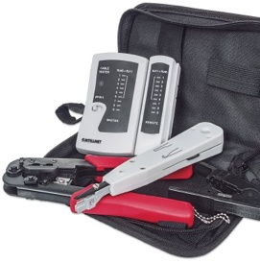
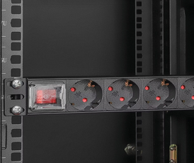
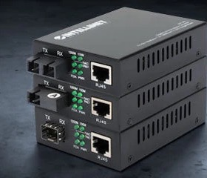

Product Highlights
√
Network Key Product Lines
Racks & Cabinets
Switches
Power over Ethernet
Patch
Panels
Network Cables
Cloud
Management
Installation Equipment
PDUs
Media Converters
Transceivers
Powered by
More than 1100 SKUs

Slide 29



Product Highlights
√
Racks & Cabinets
Options: Network and Server, floor-standing and wall-mount, 6U-48U, 450-1200 mm depth, IP20 and IP55, 10” and 19”, open and closed frame, assembled and flat pack, black and gray
Discover Racks & Cabinets

Slide 30




Product Highlights
√
Switches
Options: unmanaged, smart-managed, industrial, L2, L2+ & L3 Managed, Power over Ethernet (PoE), and PoE Passthrough, 5-48 ports, up to 2.5G and 10G
Discover Switches

Slide 31






Product Highlights
√
Power over Ethernet
SKUs: 50+
Options: PoE switches, injectors, extenders, splitters up to PoE++
Discover Power over Ethernet

Slide 32




Product Highlights
√
Patch Panels
Options: Cat5e/Cat6/Cat6a, shielded and unshielded, up to 48 ports, space-saving blank panels (24-port as 0.5U, 48-port as 1U), 10” and 19”, desktop, wall-mount and rack-mount, black and gray
Discover Patch Panels

Slide 33



Product Highlights
√
PDUs
Options: 10” and 19”, vertical and horizontal rack-mount, AC, C13 and C19, 4-15 outlets, different protection options, smart and non-smart
Discover PDUs

Slide 34



Product Highlights
√
Network Cables
Options: Patch and Bulk cable, all categories, CCA or 100% copper, snag-less connectors, multiple shieldings, special design like FlexiBoot, LSZH, and more
Discover PDUs

Slide 35




Product Highlights
√
Media Converters
Options: 1G and 10G, up to 120 km, WDM BiDi, different wavelengths, SC and ST, Singlemode and Multimode
Discover Media Converters

Slide 36





Product Highlights
√
Transceivers
Options: MSA- and HPE-compliant, 1G and 10G, up to 80 km, WDM BiDi, different wavelengths, LC and RJ45, Singlemode, Multimode, and Copper
Discover Transceivers

Slide 37





Cloud Management with Domotz
Cloud
Management
Powered by
Detailed device and network monitoring, remote cloud access, remote power management, alert settings and more.

Slide 38




OEM/Private Label Services
√
OEM Projects
OEM version of Intellinet Industrial PoE Switch
for a sensor manufacturer

Slide 39







OEM/Private Label Services
√
OEM Projects
We customize your exclusive products in a turn-key solution from production and direct shipment from Asia to your warehouse or distribution center
Complete support for packaging, product photos, instructions, and retail display artwork
Customizable in all languages
Discover Manhattan Display Mounts

Slide 40



Learn more
manhattanproducts.eu
intellinetnetwork.eu

