Slide 1
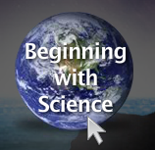
Part one

Slide 2
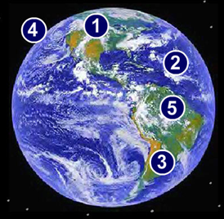

The spheres of the Earth are:
1.) Cryosphere – All the ice on Earth
2.) Hydrosphere – All the water in oceans, rivers, lakes, streams, and underground
3.) Biosphere – Every living thing on Earth
4.) Atmosphere – The thin layer of gases surrounding Earth
5.) Geosphere – The land surfaces and interior of Earth
6.) Exosphere – Everything located outside the Earth, in space; stars, galaxies, and the sun

Slide 3

Scientific Method:
Purpose/Question: What you’re trying to “find out”.
Research: Find out what other scientists have discovered.
Hypothesis: Make a prediction as to what you think will happen (or what the “answer” is).
Experiment: Design and carry out your experiment; use variables.
(Dependent Variables, Independent Variables, Control)
Analysis: Look over (review) the data from your experiment.
Conclusion: Was your hypothesis correct?
Independent variables – the variable that is chosen to change within an experiment in order to test the hypothesis
Dependent variables – The variable that is dependent on the changes of the independent variable
Controlled variables – the factors that a scientist chooses to keep constant over the course of the experiment.

Slide 4
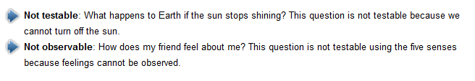


Pseudo Science vs. Good Science
Pseudo-science cannot be answered by the scientific method. The answers to these questions often involve opinion or beliefs. To be considered science, information must be testable and the results must be reproducible. The scientific method must be followed.
Ask yourself this…
Has it been tested and observed numerous times by more than one group of scientists?
Is the study or data documented completely, and does it follow the scientific method?
Does the information contain just the facts and avoid mixing in opinion and assumption?
Is the information presented purely for public knowledge, avoiding being connected with a new product that is for sale?
Does the information come from a third party that is not profiting from the results of the study?
Is this information supported by any other studies that have been conducted by other companies or agencies?
Example of pseudoscience: Astrology, which are predictions about the future with no
Scientific support.

Slide 5

What is a theory?
What is a scientific law?

Slide 6

Hmm… I wonder…
THEORY:
Once a hypothesis has been supported by many experiments, which have been performed by many different scientists, it can be presented as a theory.
When the majority of the scientific community agrees, or reaches a consensus around a problem and solution we call this a theory.
In science, the testing, revising, and occasional discarding of theories, new and old, never ends.
An example of a theory would be the Big Bang theory.

Slide 7

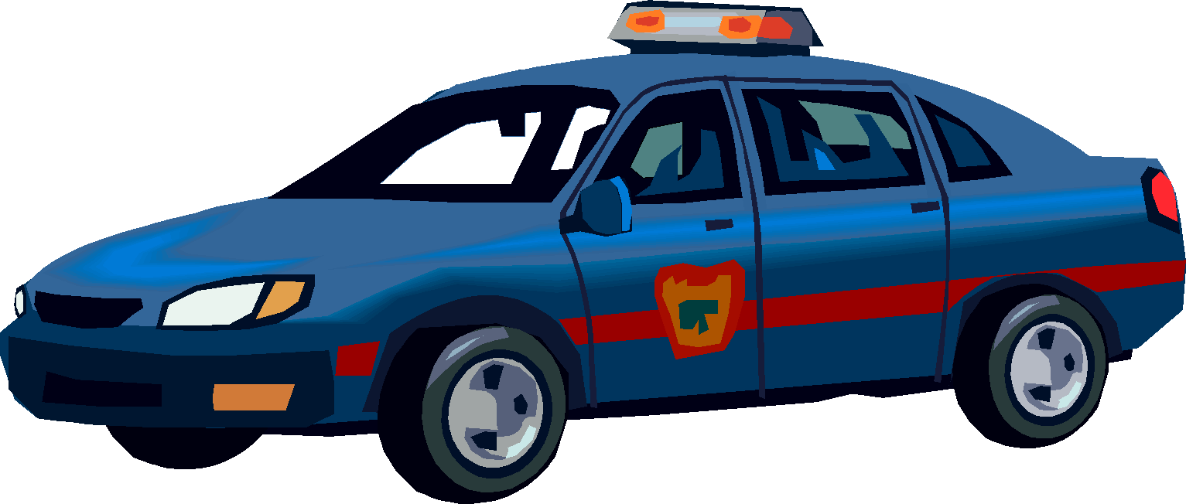
A scientific law is a conclusion that is made based on repeated scientific experimentation over many years and has become universally accepted by the scientific community.
An example of a law would be the law of gravity.
Laws are descriptions of specific relationships that occur in nature they do not attempt to tell us why these relationships exist just that they do. For instance, the law of gravity is universal: What goes up must come down.

Slide 8
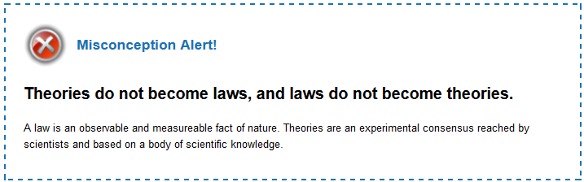

Slide 9
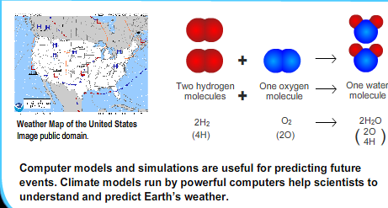
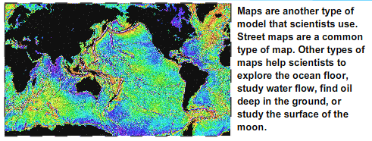
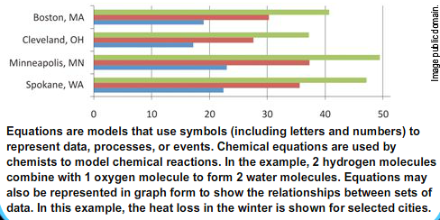
Models
Models are used to represent things that are very small or very large.

Slide 10
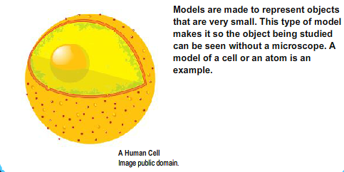
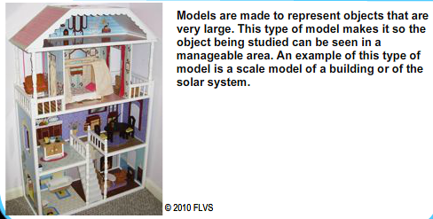
More Models
Small-scale Models
Large-scale Models

Slide 11
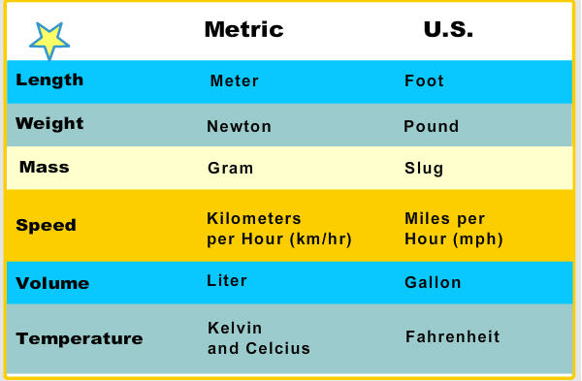
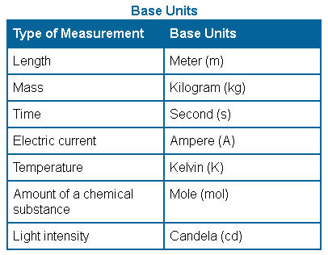
/SI
Metric vs. US system of Measurement
Metric system or SI (Standard International) system of measurement is accepted worldwide. We start with “base” units.
why do you think the metric system is used in science?

Slide 12
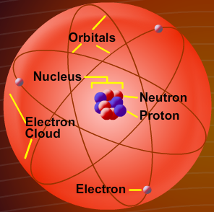
Review: Parts of an atom
What are the three sub atomic particles in an atom?
1. Protons
2. Neutrons
3. Electrons
What charge does each particle have? (positive, negative, or neutral)
1. Proton = Positive (+)
2. Neutron = Neutral (0)
3. Electron = Negative (-)
Where are they located?
1. Proton = Inside the nucleus
2. Neutron = Inside the nucleus
3. Electron = Outside the nucleus

Slide 13

Atomic Theory
Dalton was the first scientist to propose that all matter was made of atoms. He suggested that the atoms of the same element were identical and they could neither be created nor destroyed. They could only react with other atoms to form compounds. Dalton’s theory provided the foundation for the modern atomic theory.
J.J. Thompson was the first scientist to discover the electrons inside the atom. He proposed the “raisin pudding” model of the atom which showed that the negatively charged electrons were embedded in a positive mass of the atom. Although this theory was later proved inaccurate, it provided the foundation for the modern atomic theory.
Rutherford was the first scientist to discover the nucleus of the atom. He bombarded atoms with small particles which bounced off from the center of the atom. Based on this observation, Rutherford concluded that the atom had a positively charged nucleus in the center. This model provided the foundation for the modern atomic theory.

Slide 14
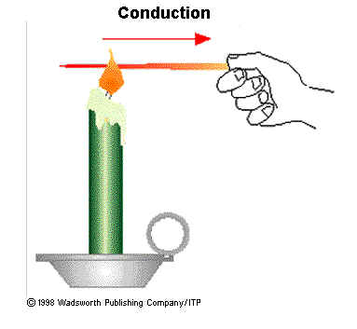
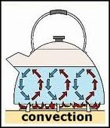

Heat is transferred to the environment in three basic ways:
Radiation
Conduction
convection
Radiation is the transfer of energy through waves. The process of radiation does not require a medium.
Conduction occurs when a material is in direct contact with another material with a different heat energy. When objects with different temperatures come in contact with each other, energy is transferred from the higher-temperature object to the lower-temperature object.
Convection occurs when warm fluids rise and cool fluids sink. The buoyancy of a fluid is the difference in density when that fluid is in contact with another fluid. Warm fluids are more buoyant and, therefore, they rise. Cool fluids are less buoyant and sink.

Slide 15
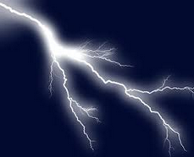

Part Two

Slide 16
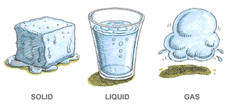
Law of Conservation of Matter
The law of conservation of matter means that matter is not lost during a change in the state of water. Therefore, mass is not lost during a change in the state of water.

Slide 17
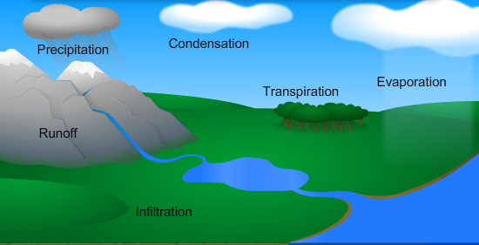
Where Can Water be Found?
Water Cycle: the movement and storage of water between Earth's atmosphere, hydrosphere, and geosphere
Evaporation - changes the state of water from a liquid to a gas, or water vapor.
Transpiration - is the release of water vapor from plants into the atmosphere.
Condensation - Water vapor in the atmosphere can condense to form clouds.
Precipitation - Any form of water that falls from the sky is called precipitation. Forms of precipitation include rain, snow, sleet, and hail.
Infiltration - occurs when water enters the soil. The water can be used by plants and animals, or it can sink deeper until it becomes part of the groundwater supply.
Runoff - occurs when water from precipitation moves over the surface of Earth.

Slide 18
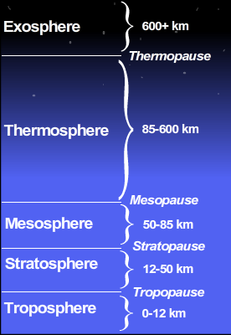
Structure of the Atmosphere
The effects of gravity, solar radiation, and the properties of the gases cause the atmosphere to be layered.
These layers are ordered
based on their temperature
and density

Slide 19
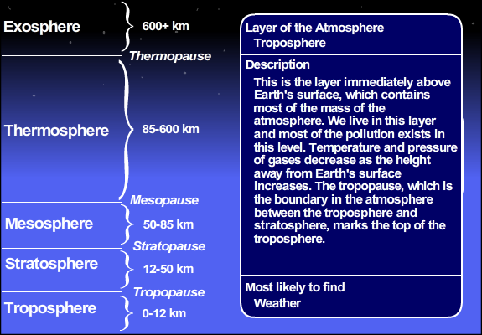
Troposphere

Slide 20
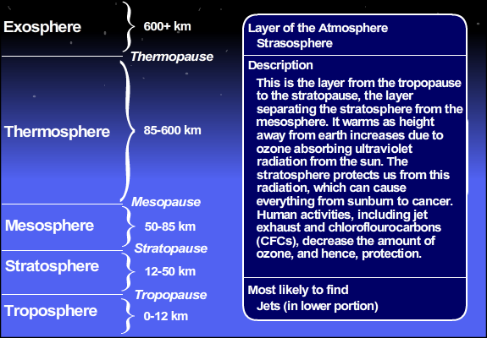
Stratosphere

Slide 21
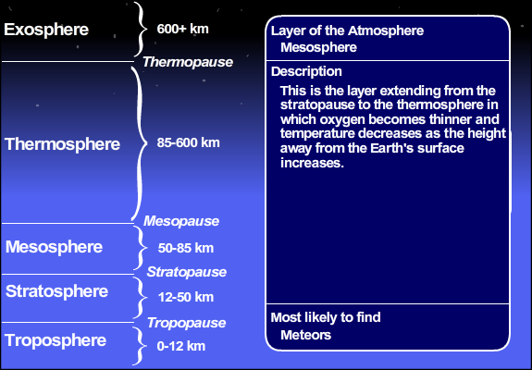
Mesosphere

Slide 22
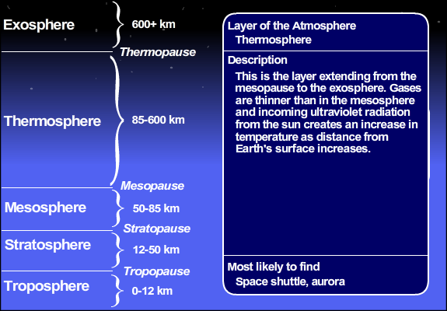
Thermosphere

Slide 23
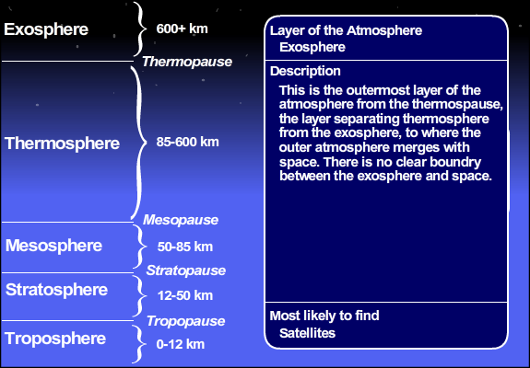
Exosphere

Slide 24
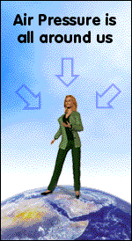
Atmospheric Pressure
Air pressure is the force exerted on you by the weight of tiny particles of air (air molecules).
As you go higher in the atmosphere, particles of atmospheric gases become more widely spaced apart. So, as altitude increases, atmospheric pressure decreases. The sudden decrease in pressure as you rise through the atmosphere causes your ears to "pop," as one part of your ear equalizes pressure with another part.

Slide 25

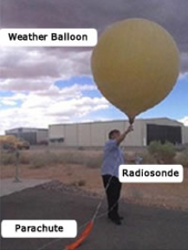
Tools for Measuring Air Pressure
Barometer - Liquid mercury inside a long glass tube moves up and down based on the force of the atmosphere on the liquid.
When the pressure rises, good weather is on its way, when the pressure drops, bad weather is on its way
A radiosonde is an instrument package that scientists use to gather data about the atmosphere, which, in turn, helps them forecast the weather. The weather reports you see on television or on web sites are created partly with data from radiosondes.

Slide 26
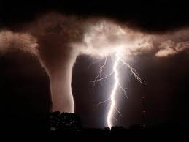
Types of Severe Weather
Thunderstorms
Tornadoes
Hurricanes
Other (Flood and Droughts)

Slide 27
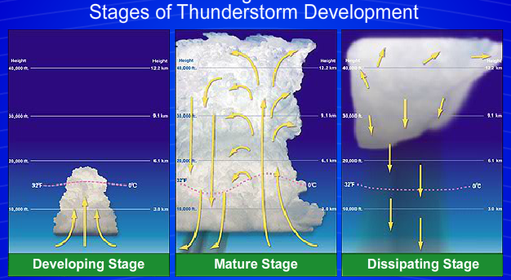
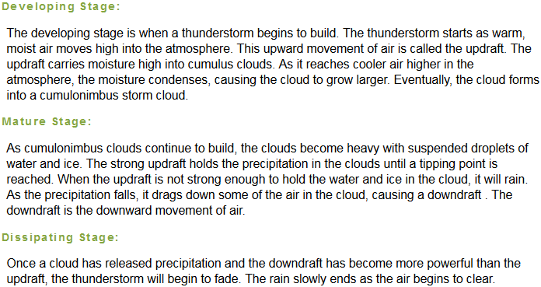

Slide 28
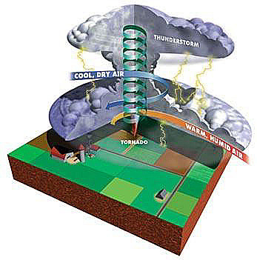
Formation of a Tornado
Cool, dry air meets warm, moist air.
This usually causes a severe thunderstorm
High winds in the upper atmosphere push against the thunderstorm cloud causing a rotation or funnel

Slide 29

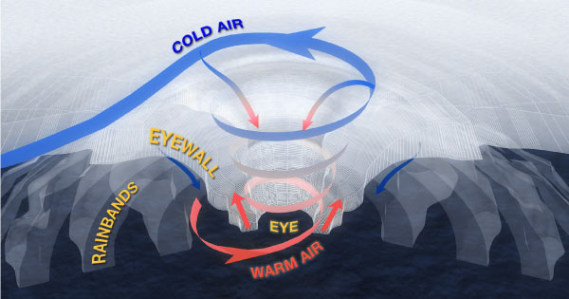
Formation of Hurricanes

Slide 30
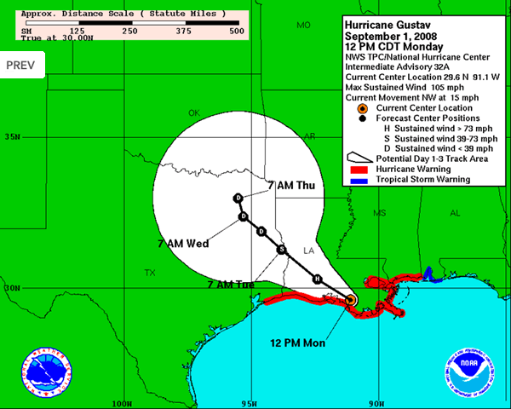
Tracking Hurricanes

Slide 31
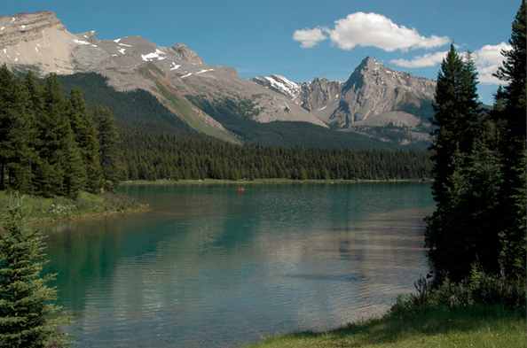

Part Three

Slide 32
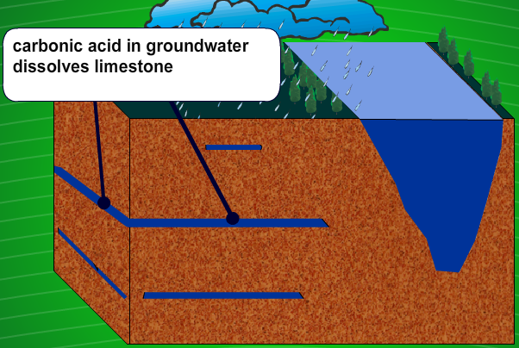
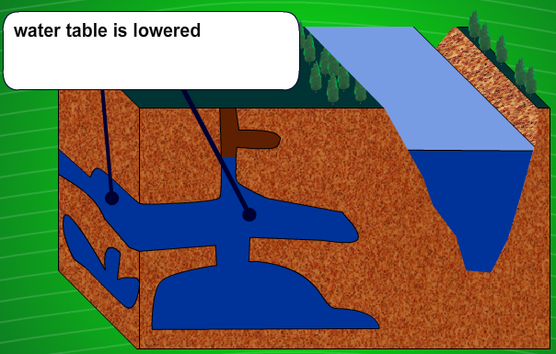
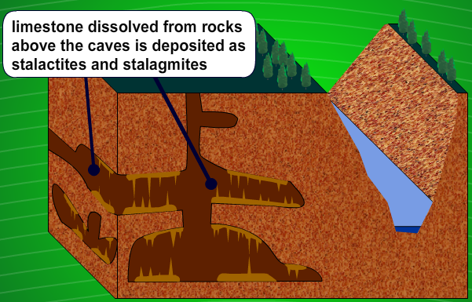
Effects of Groundwater
The movement of water underground can cause various surface and subsurface features to form. One dramatic effect is when groundwater creates vast systems of underground caves.
The foundation of Florida is made up of limestone. Rain water contains weak acids. When rain water seeps into the ground, these acids dissolve the limestone and form small caves. The chemical action of groundwater makes these caves larger in size. Over a period of time large cave systems are formed.

Slide 33
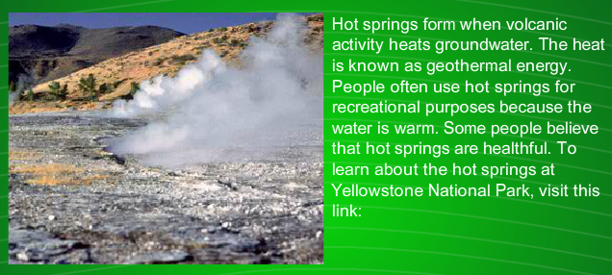
Effects of Groundwater
Groundwater is water found underground in the cracks and spaces in soil, sand and rock. These underground areas that are filled with water are called aquifers. Groundwater is stored in and slowly moves through aquifers

Slide 34
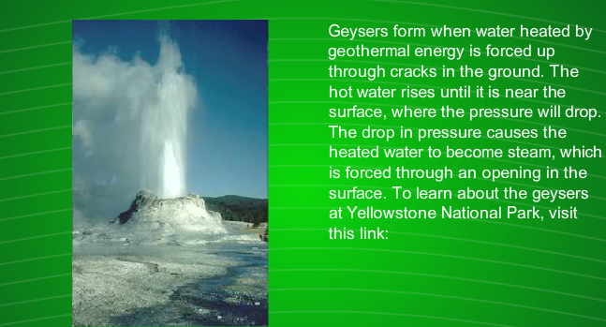
Effects of Groundwater

Slide 35
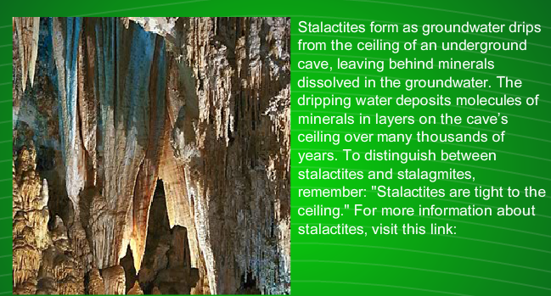
Effects of Groundwater

Slide 36
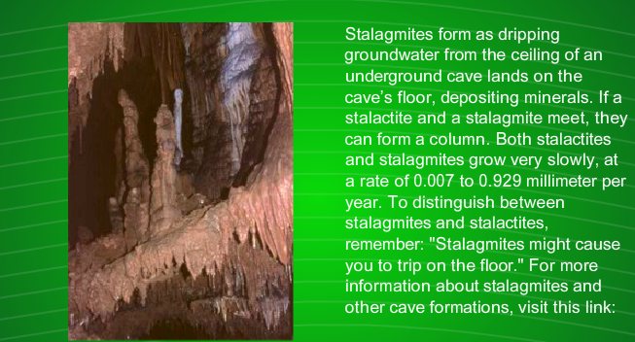
Effects of Groundwater

Slide 37
Water Conservation
Water conservation consists of the efforts of individuals, communities, industries, and governments to protect and conserve water resources. Conserving water means protecting the quality and quantity of water available for use.
What are some water conservation techniques you can do at your home?
(Type your idea on the white board below)

Slide 38
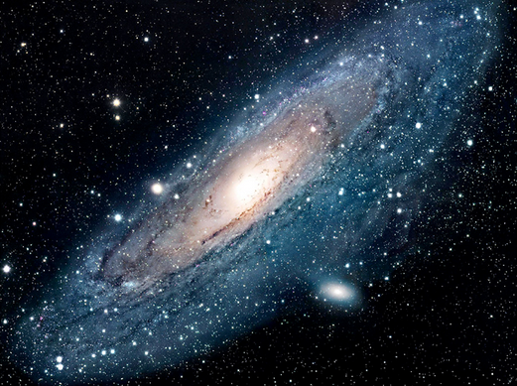

Part Four

Slide 39
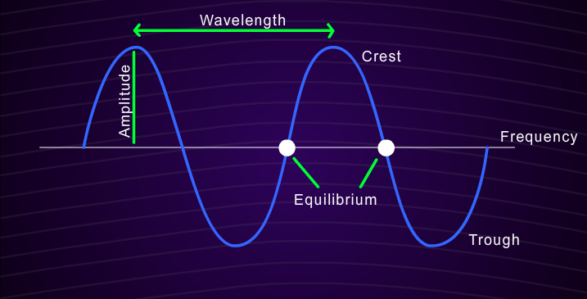
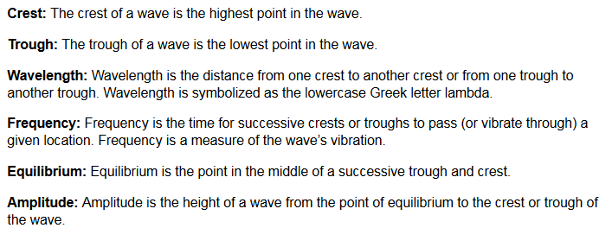
Features of a Wave

Slide 40
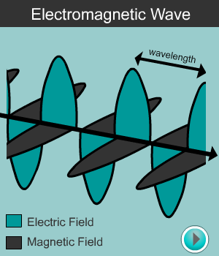
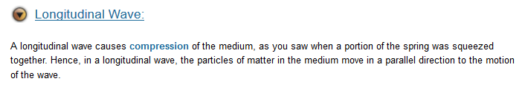
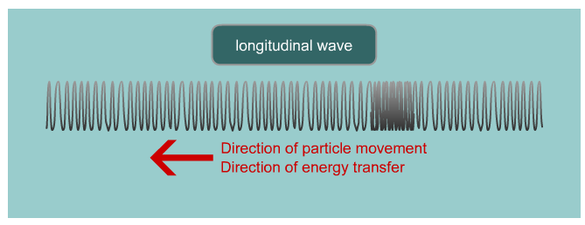
Electromagnetic Wave
An electromagnetic wave is a three-dimensional wave produced from an energy transfer of electrical charges. The wave includes both a magnetic field and an electrical field at right angles to each other.

Slide 41
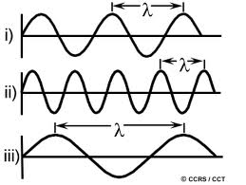
Frequency and Wavelength
Frequency is the time for successive crests or troughs to pass (or vibrate through) a given location. Frequency is a measure of the wave’s vibration.
Also has more energy
Also has less energy

Slide 42
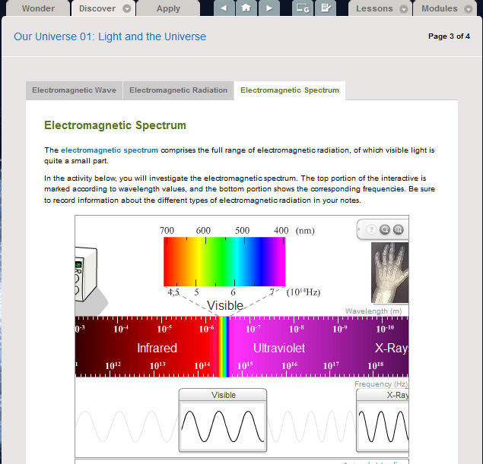

Slide 43
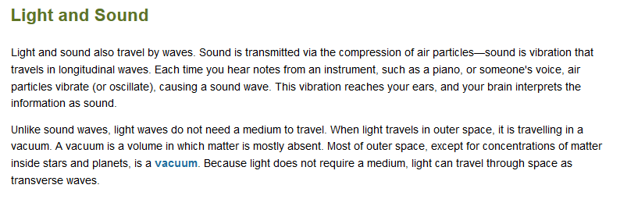
***Sounds need a medium to travel though, light does not***
***Light travels the fastest in a vacuum traveling at 300,000 km/sec***

Slide 44
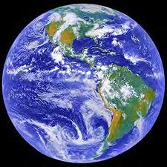

How far away is it
Light year - the distance light travels in one year. Although the term may sound like a measure of time, it is a measure of distance.
Since light can travel so far in a year, astronomers use that distance to define a unit of measurement called a light year. A light year is the distance light travels in one year. Although the term may sound like a measure of time, it is a measure of distance. If you were to complete the calculations, a light year is about 10 trillion kilometers. Proxima Centauri is about four light years away from Earth. Therefore, the electromagnetic energy released from this star takes four years to reach Earth.
Scientists use light to measure many properties of space and the universe. Light travels at about 300,000 kilometers per second. Because it moves so fast, light can be used to measure enormous distances.

Slide 45





Telescopes
Uses lenses to focus the light

Slide 46





Telescopes
Uses mirrors to focus the light, which reduces distortion

Slide 47

Hertzsprung-Russell Diagram
Comparing the brightness of a star to Earth’s sun provides scientists with the star’s absolute magnitude. Astronomers plot the brightness of stars on a chart called a Hertzsprung-Russell diagram, shortened to HR diagram.
Be sure to check out the presentation on the HR diagram in the Our Universe 03: Life Cycle of a Star lesson on page 1 under the Discover tab then click on the Brightness tab

Slide 48



Blue Star
18000 K
Intensity/Relative brightness
Yellow Star
6000 K
Red Star
4000 K

Slide 49




Types of Galaxies
Type | Shape | Description | Image
Spiral | Pinwheel | Revolve around a single point
Barred Spiral | Pinwheel with a bar in the center | Has an elongated center that looks like a bar
Elliptical | Circular or oval | Most of the objects are concentrated in the center. From far away look like one big star
Irregular | Undefined shape | Not Spiral or Elliptical
***All galaxies are held together by gravity (Newton’s Law of Universal Gravity***

Slide 50

Gravitational Forces

Slide 51

Hubble
Hubble is a real person and not just the name of a telescope?
Hubble found that the universe was expanding. Think of a chunk of raisin bread that is rising. The raisins represent galaxies and the dough represents time and space between the galaxies. As each raisin (galaxy) moves, it moves away from all the other raisins in the dough. The space between them is actually expanding. Hubble proposed that the more distant the galaxy, the faster it is moving away from Earth. This is known as Hubble's law. The more galaxies separated, the faster they accelerated.
an object moving away from Earth shifts to the red side (longer wavelength), an object moving towards Earth shifts to the blue side (shorter wavelength).
Doppler Effect
Hubble law

Slide 52


Arno Penzias and Robert Woodrow Wilson were awarded the 1978 Nobel Prize in Physics for their discovery. Today, scientists continue to study the universe and the physical principles that are a part of it. One mission, called the COBE (short for Cosmic Background Explorer), was launched in 1989 and took detailed measurements of the universe's temperature. The WMAP mission (Wilkinson Microwave Anisotropy Probe), launched in 2001, built on COBE's work, getting more detailed temperature measurements and helping scientists gather more evidence for the Big Bang theory. These probes have provided scientists with a complete and highly detailed map of the cosmic microwave radiation in the universe.
The COBE mission was able to measure accurately the temperature of the universe.
The WMAP mission was technically more advanced than the COBE mission. It was able to detect and map the microwave radiations in space more accurately than the COBE mission.
The temperature and radiations in space detected by the COBE and WMAP mission were the original heat from Big Bang and provided evidence for the theory.

Slide 53


Part Five

Slide 54

Igneous Rocks
Igneous rocks form when magma or lava cools and crystallizes (hardens).

Slide 55

Sedimentary Rocks
When water and other forces move sediments to new locations, the relocated material may be deposited as sedimentary rock. Most sedimentary rocks are made up of small or large pieces of other rocks that are cemented together.

Slide 56

Metamorphic Rocks
When rocks and minerals are subjected to extreme changes in temperature and pressure, they do not always melt. Instead, these extreme conditions can alter the rock's internal arrangement of atoms, causing the rock's chemical composition to change.

Slide 57

The Rock Cycle
A particular rock may not always remain the same type. Igneous, metamorphic, and sedimentary rocks are transformed as they pass through the rock cycle. The rock cycle is the continuous transformation of rocks from one type to another within the geosphere. All rocks on Earth started as igneous rocks, approximately 4.6 billion years ago. Over time, forces from wind, water, heat, and pressure transformed these early rocks into sedimentary and metamorphic rocks.

