Slide 1
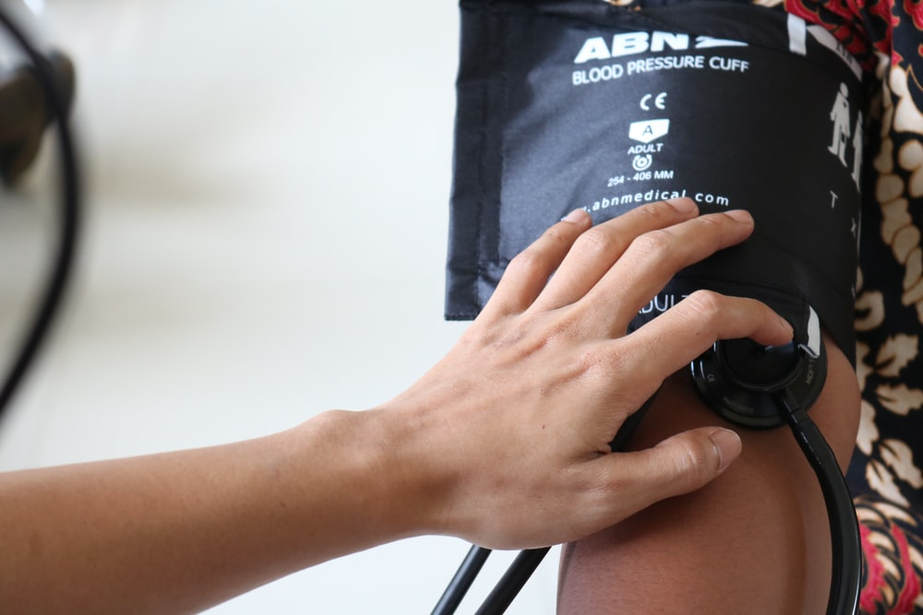
HYPER
TENSION
Free Template

Slide 2
Introduction
You can give a brief description of the topic you want to talk about here. For example, if you want to talk about Mercury, you can say that it’s the smallest planet in the entire Solar System

Slide 3
Table of contents
01
02
03
04
05
Disease
Diagnosis
Advices
You can describe the topic of the section here
You can describe the topic of the section here
You can describe the topic of the section here
Pathology
Treatment
You can describe the topic of the section here
You can describe the topic of the section here

Slide 4
01.
Introduction
You can enter a subtitle here if you need it

Slide 5
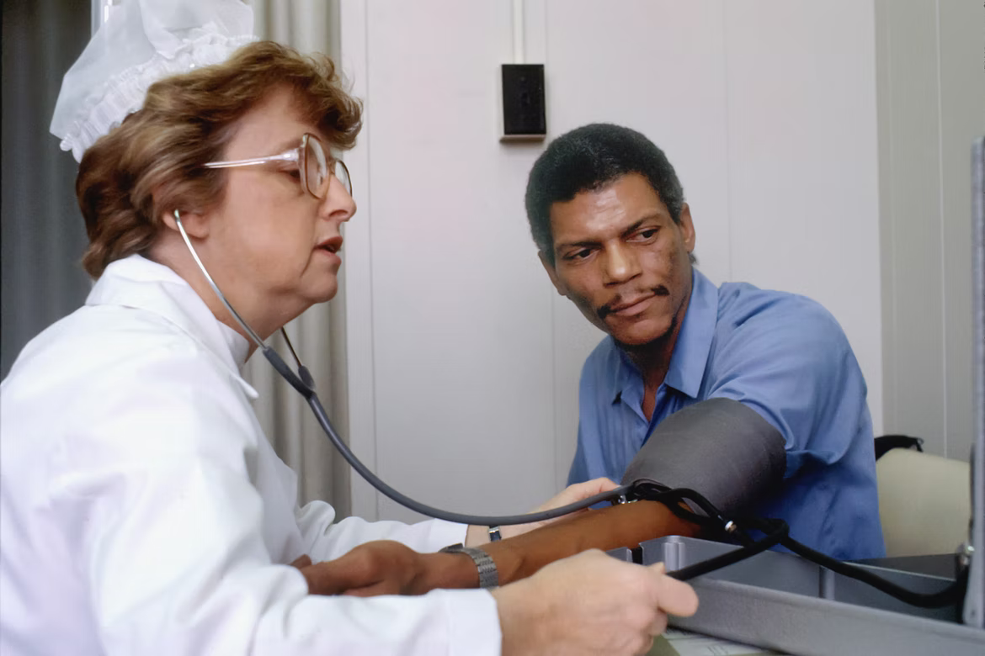
WHOA!
This could be the part of the presentation where you can introduce yourself, write your email...

Slide 6
About the disease
Mercury
Venus
Mars
Saturn
Mercury is the smallest planet of them all
Venus is the second planet from the Sun
Despite being red, Mars is a cold place
Saturn is a gas giant and has several rings

Slide 7
About the disease
Venus
Jupiter
Mars
Saturn
Venus is the second planet from the Sun
Jupiter is the biggest planet of them all
Despite being red, Mars is a cold place
Saturn is a gas giant and has several rings

Slide 8
Pathology
Venus
Mars
Venus has a beautiful name and is the second planet from the Sun. It’s terribly hot, even hotter than Mercury
Despite being red, Mars is actually a cold place. It's full of iron oxide dust, which gives the planet its reddish cast

Slide 9
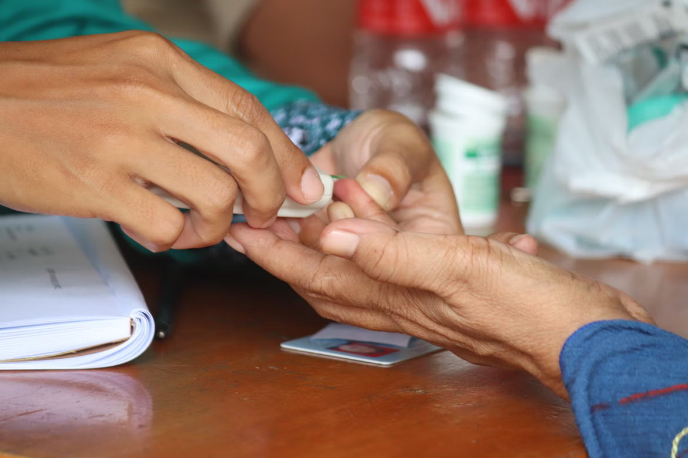
A PICTURE IS WORTH A
THOUSAND WORDS

Slide 10
Symptoms and disease
Mercury
Earth
Pluto
Mars
Ceres
Saturn
Venus
Jupiter
Mercury is a small planet
Earth is the planet that harbors life
Pluto is a dwarf planet
Mars is a very cold place
Ceres is in the asteroid belt
Saturn is the ringed planet
Venus has high temperatures
Jupiter is the biggest planet

Slide 11
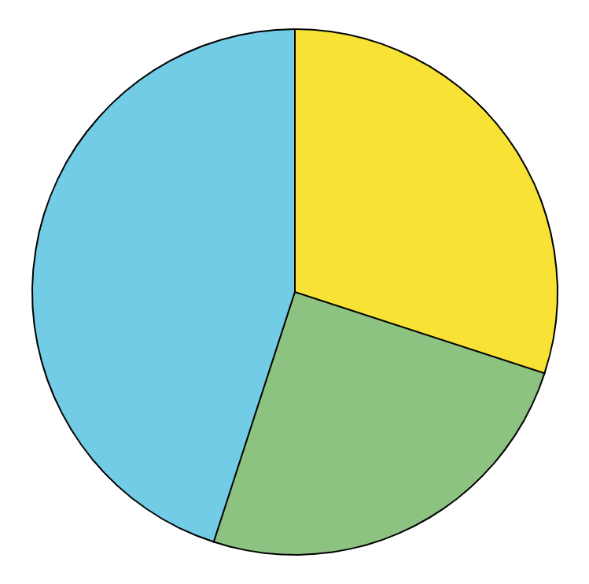
Risk factors
Mercury, 40%
Mercury is the smallest planet of them all
Mars, 30%
Despite being red, Mars is a cold place
Venus, 25%
Venus is the second planet from the Sun
Follow the link in the graph to modify its data and then paste the new one here. For more info, click here

Slide 12
150,000
Big numbers catch your audience’s attention

Slide 13
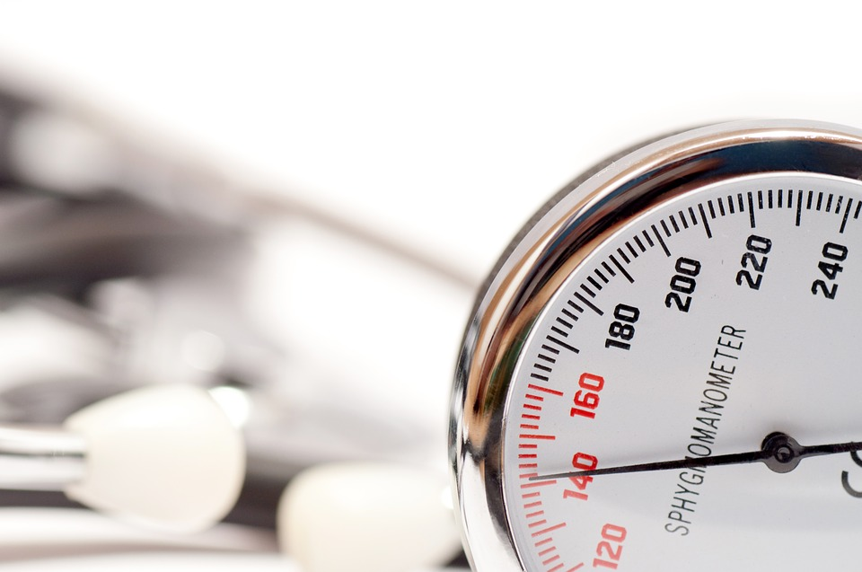
A PICTURE ALWAYS
REINFORCES THE
CONCEPT
Images reveal large amounts
of data, so remember: use an
image instead of long texts

Slide 14
INFOGRAPHICS MAKE YOUR
IDEA UNDERSTANDABLE...
Despite being red, Mars is a cold place
Jupiter is the biggest planet in the Solar System
Mercury is the closest planet to the Sun
Venus has a beautiful name, but it’s terribly hot

Slide 15
150,000
75,000
12,000
Mercury is the smallest planet of them all
Venus is the second planet from the Sun
Despite being red, Mars is a cold place

Slide 16
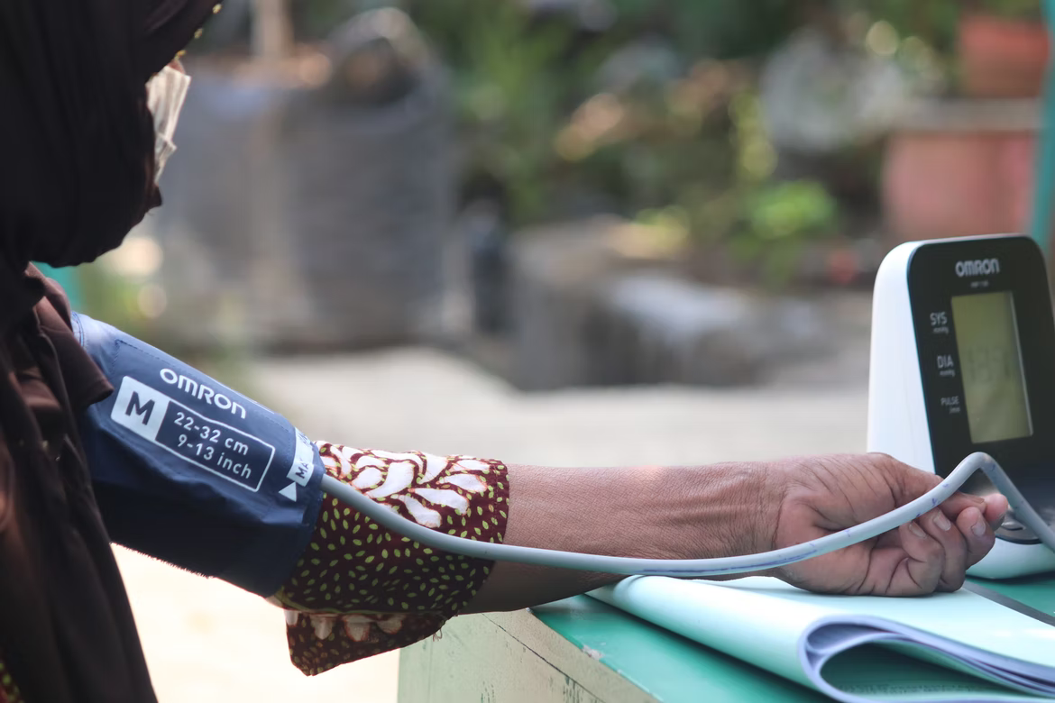
AWESOME WORDS

Slide 17
—Someone Famous
“This is a quote, words full of wisdom that someone important said and can make the reader get inspired.”

Slide 18
Diagnosis
Mercury
Neptune
Mars
Jupiter
Saturn
Venus
Mercury is the closest planet to the Sun
Neptune is the farthest planet from the Sun
Mars is actually a very cold place
Jupiter is the biggest planet of them all
Saturn is composed of hydrogen and helium
Venus has a beautiful name, but it’s hot

Slide 19
Prevention
Mercury
Venus
Mercury is the closest planet to the Sun. This planet's name has nothing to do with the liquid metal
Venus has a beautiful name and is the second planet from the Sun. It’s terribly hot, even hotter than Mercury

Slide 20
A picture always reinforces the concept
Images reveal large amounts of data, so remember: use an image instead of a long text. Your audience will appreciate it

Slide 21
Treatment
Psychopharmacological
Psychotherapeutic
Mercury is the closest planet to the Sun and the smallest one in the Solar System. This planet's name has nothing to do with the liquid metal
Venus has a beautiful name and is the second planet from the Sun. It’s terribly hot, even hotter than Mercury, and its atmosphere is extremely poisonous

Slide 22
Recommendations
To do
Not to do
You can describe here what the patient should do
You can describe here what the patient should do
You can describe here what the patient should do
You can describe here what the patient should do
You can describe here what the patient shouldn’t do
You can describe here what the patient shouldn’t do
You can describe here what the patient shouldn’t do
You can describe here what the patient shouldn’t do

Slide 23
This is a timeline
Mercury is the closest planet to the Sun
Earth is the third planet from the Sun
Step 1
Step 2
Step 3
Step 4
Saturn is the second-largest planet in the Solar System
Despite being red, Mars is very cold place

Slide 24
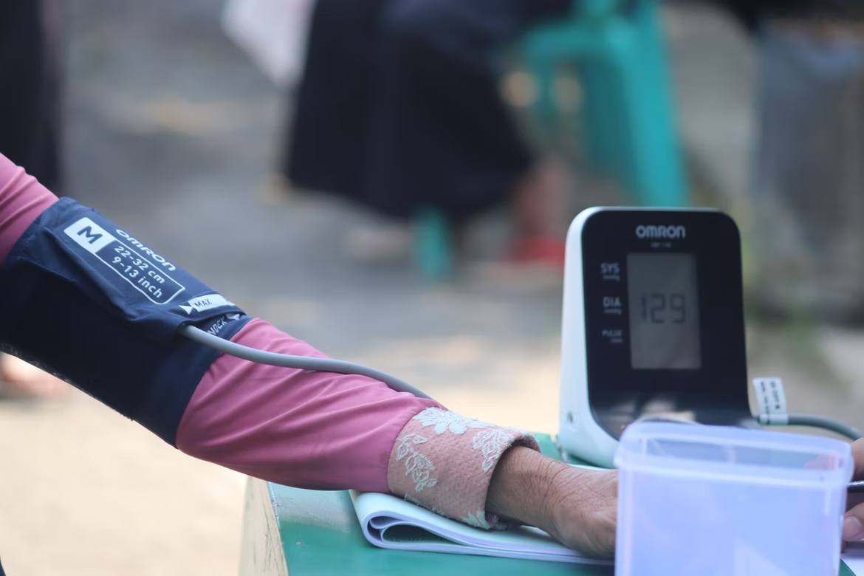
A picture is worth a thousand words

Slide 25
Prevalence
< 45
45-75
75-120
> 120

Slide 26
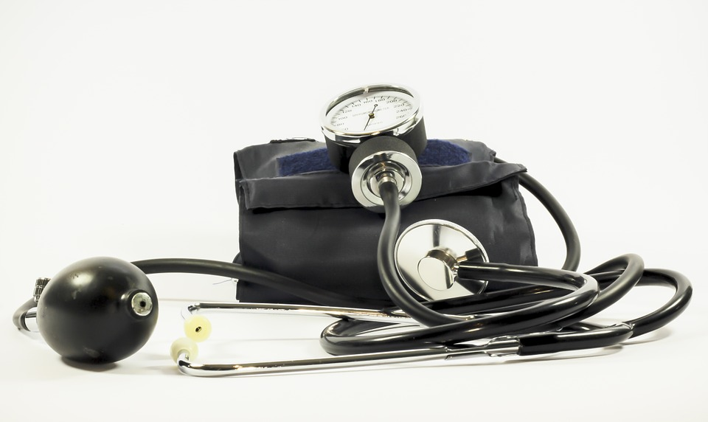
Awesome words
Mercury is the closest planet to the Sun. This planet's name has nothing to do with the liquid metal

Slide 27
Our team
Julia Doe
Steven Walls
You can speak a bit about this person here
You can speak a bit about this person here

Slide 28
Conclusion
Mercury is the closest planet to the Sun and the smallest one in the Solar System—it’s only a bit larger than the Moon
Hipertensión

Slide 29
Thanks!
Do you have any questions?
Mercury is the closest planet to the Sun and the smallest one in the Solar System—it’s only a bit larger than the Moon
Free Template

Slide 30
Fuentes
ELABORADO POR :
plantillaspowerpoint.org
IMAGES :
unsplash.com
pixabay.com
FONTS :
Prata
Catamaran

Slide 31
RESOURCES

Slide 32
RESOURCES

Slide 33
RESOURCES

Slide 34
Fully Editable Icon Sets: A

Slide 35
Fully Editable Icon Sets: B

Slide 36
Fully Editable Icon Sets: C

