Slide 1


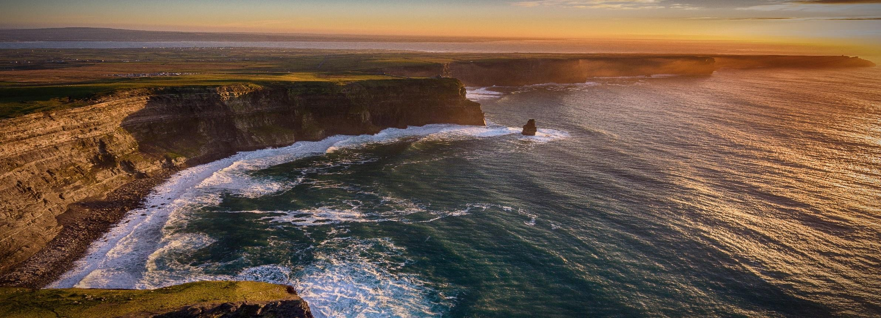

Smart decisions. Lasting value.
The Strategies for Growing Profits Aiden Murphy, Crowe Horwath
29 May 2017
Audit | Tax | Advisory
© 2017 Crowe Horwath 1

Slide 2

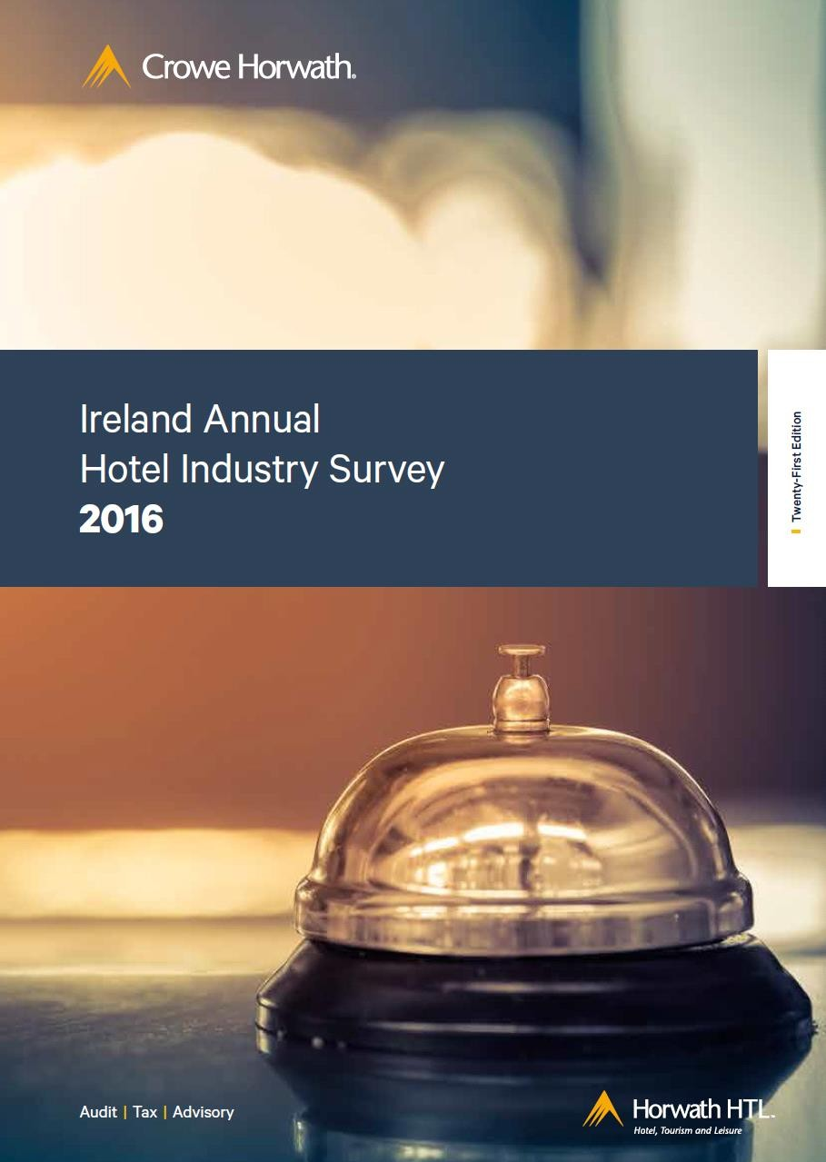
IHF Investment Conference
Agenda
Hotel Profitability
Momentum – Where are we now?
Current Hotel Supply
Rest of Ireland Hotel Performance
Dublin Hotel Performance
International Visitor Numbers
Conclusion

Slide 3
Overview of Hotel Performance & Profitability
Hotel Profitability Trends
20
18
16
14
12
10
8
6
Dublin
4
All
Hotels
2
Rest of Ireland
0
2011
2012
2013
2014
2015
2016

Slide 4




Momentum 2011-2016
Funding
How to take advantage of this new economy in the journey to 2021
Bank Funding Private Equity Mezzanine Funds
Equity PLC Pensions Sweat Equity
Sales per
Room
RevPAR
Profit
Capex
Hotel Restructuring

Slide 5

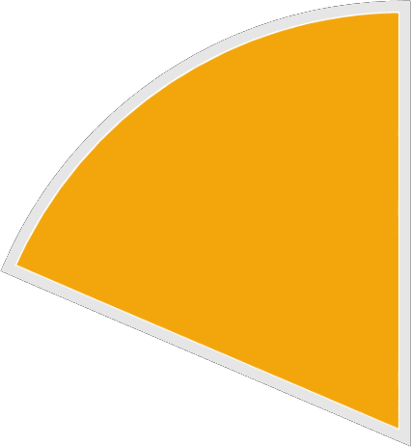



2016 Hotel Supply
Hotels
Rooms
Dublin
152
Dublin 18,875
Rest of Ireland 668
Rest of Ireland 38,721
820
57,596

Slide 6
Rest of Ireland – Sales Mix
100
 | 11.3 | Other Bev Food Rooms | 8.0
 |  |  | 19.0
 | 19.6
 |  |  | 38.0
 | 35.4
 |  |  | 35.0
 | 33.7
Rooms
Food
90
80
Beverage Other
70
60
50
40
Sales & RevPar
Dept Profit
+ 3%
30
20
10
0
2011
2016

Slide 7
Rest of Ireland Hotel Market
Sales | 2011 | 2016
Sales Per Room | €42K | €59K | +40%
 | 2011 (%) | 2016 (%) | Change
Sales | 100.0 | 100.0
Cost of Sales | 59.0 | 56.0
Dept Profit | 41.0 | 44.0 | 3.0
Undistributed Expenses
A&G | 10.3 | 9.8 | -0.5
S&M | 4.6 | 4.0 | -0.6
Utilities | 6.3 | 5.0 | -1.3
R&M | 4.0 | 3.8 | -0.2
Total | 25.2 | 22.6 | -2.6
Fixed Costs | 6.0 | 4.8 | -1.2
Net Profit % | 9.8 | 16.6 | 6.8
Sales
Net Profit

Slide 8
Rest of Ireland
 | 2011 | 2016 | Change
Sales Per Room | €42k | €59k
Occupancy | 57% | 67%
Rate | €68 | €82
RevPar | €39 | €55
Rooms Available | 40,944 | 38,721
Rooms Sold | 8.5m | 9.5m
67%
Current Growth
Requires 3,800 rooms

Slide 9
Source of Increased Room Sales
Rest of Ireland | 2011 | 2016 | Change
Market Mix
Domestic | 75% | 62%
 | 6.4m | 5.9m | - 500K
International | 25% | 38%
 | 2.1m | 3.6m | 1.5m
Total | 8.5m | 9.5m | 1.0m

Slide 10
Dublin – Sales Mix
100.0
 | 8.8 | Other Bev Food Rooms | 6
 |  |  | 14
 | 12.8
 |  |  | 24
 | 24
 |  |  | 56
 | 54.4
Rooms Beverage
90.0
80.0
Other
70.0
60.0
50.0
40.0
30.0
Sales & RevPar
Dep Profit
+ 4.9%
20.0
10.0
0.0
2011
2016

Slide 11
Dublin Hotel Market
Sales | 2011 | 2016
Sales Per Room | €39K | €65K | +66%
 | 2011 (%) | 2016 (%) | Change
Sales | 100.0 | 100.0
Cost of Sales | 49.9 | 45.0
Dept Profit | 50.1 | 55.0 | 4.9
Undistributed Expenses
A&G | 10.4 | 9.2 | -1.2
S&M | 5.5 | 4.0 | -1.5
Utilities | 4.8 | 4.0 | -0.8
R&M | 3.4 | 3.4 | -0.0
Total | 24.1 | 20.6 | -3.5
Fixed Costs | 6.4 | 4.9 | -1.5
Net Profit % | 19.6 | 29.5 | 9.9
Sales
Net Profit

Slide 12
Dublin
 | 2011 | 2016 | Change
Sales Per Room | €39k | €65k
Occupancy | 70.5% | 83%
Rate | €81 | €125
RevPar | €57 | €104
Rooms Available | 19,427 | 18,875
Rooms Sold | 5.0m | 5.7m
80%
Current Growth
Requires 3,200 rooms

Slide 13
Source of Increased Room Sales
Dublin | 2011 | 2016 | Change
Market Mix
Domestic | 54% | 47%
 | 2.7m | 2.7m | -
International | 46% | 53%
 | 2.3m | 3.0m | 700k
Total | 5.0m | 5.7m | 700k

Slide 14

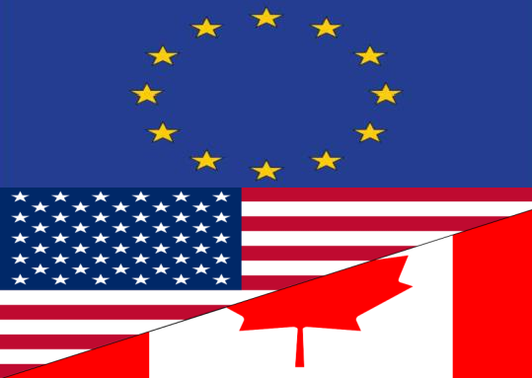

International Tourism Demand
Visitor s to Ireland (‘000s) | 2007 (Peak) | Change | 2011 (Trough) | Change | 2016 | 2021 (F)
 | 4,032k | -29% | 2,878k | +36% | 3,924k | ?
 | 2,590k | -12% | 2,283k | +45% | 3,301k
 | 1,073k | -8% | 987k | +83% | 1,808k
 | 317k | +13% | 357k | +54% | 550k
Total | 8,012k | -19% | 6,505k | +46% | 9,583k

Slide 15
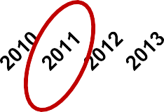











International Tourism Demand
International Visitor Growth 1985 to 2016 by Source Market
12.0m
2016
+15.7%
10.0m
8.0m
6.0m
4.0m
2.0m
0.0m
GB Other Europe
US/Canada ROW

Slide 16
Visitor Numbers
2011
ROW 6%
US/Canada
15%
GB
44%
2016
ROW 6%
Other Europe 35%
US/Canada 19%
GB
41%
Other Europe 34%

Slide 17
Visitor Expenditure
ROW 7%
2011
USA and Canada 30%
Great Britain 37%
2016
ROW 9%
Other Europe 26%
Great Britain 30%
USA and Canada 38%
Other Europe 23%

Slide 18
Summary
Revenue
Cost Base
Staff Retention
Investment
Continued Success
Customer Care
Affiliations

Slide 19



Aiden Murphy
Partner |Corporate Finance
Crowe Horwath 01 4482200
aiden.murphy@crowehorwath.ie
Crowe Horwath Bastow Charleton Member Crowe Horwath International Marine House
Clanwilliam Place
Dublin 2
Ireland
Tel + 353 1 448 2200
www.crowehorwath.ie
Crowe Horwath Bastow Charleton is a member of Crowe Horwath International, a Swiss verein (Crowe Horwath). Each member firm of Crowe Horwath is a separate and independent legal entity. Crowe Horwath Bastow Charleton and its affiliates are not responsible or liable for any acts or omissions of Crowe Horwath or any other member of Crowe Horwath and specifically disclaim any and all responsibility or liability for acts or omissions of Crowe Horwath or any other Crowe Horwath member.
© 2017 Crowe Horwath 19

